Slide 1
Shooting the trouble down to the Wireshark Lua Plugin
June 2019
Shakthi Kannan
Version 0.9
shakthi@aerospike.com

Slide 2
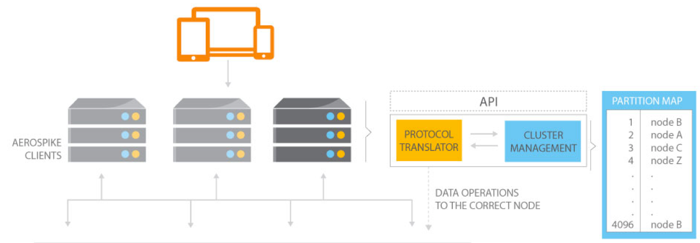
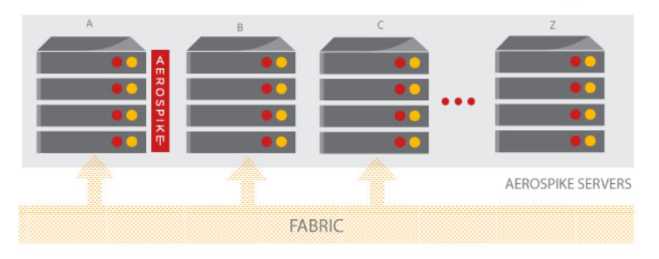

Motivation
Hello Production Support Engineer,
We are seeing client timeouts in our cluster,
Can you analyze the logs on the server,
And let us know how to proceed further?
”input from client unsupported proto version”
Is the message that we see for our operation,
What in the client can cause this assertion?
We need your help to provide us with a solution.
We are making batch read queries in production,
And receiving the values in a timely fashion,
Aerospike uses RIPEMD160 hash function,
But, can we also read the digests in conjunction?

Slide 3
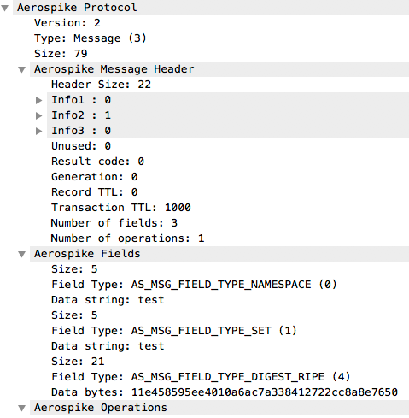
Wireshark Lua
Dissectors
Decode packet data.
Chained Dissectors
Access to one dissector’s data.
Post-dissectors
Called after every other dissector
has been called.
Listeners
Called for every packet that
matches a filter or tap.
Source: https://wiki.wireshark.org/Lua/Dissectors

Slide 4
Tap Listener
-- simple_http.lua
-- implements a very simple tap in Lua
-- this is going to be our counter
http_packets = 0
-- this is going to be our tap
tap_http = nil
-- first we declare the tap called “http tap” with the filter it is going to use
tap_http = Listener.new(nil, “http”)
-- this function will get called at the end(3) of the capture to print the summary
function tap_http.draw()
debug(“http packets:” .. http_packets)
end
-- this function is going to be called once each time the filter of the tap matches
function tap_http.packet()
http_packets = http_packets + 1
end
-- this function will be called at the end of the capture run
function tap_http.reset()
http_packets = 0
end

Slide 5
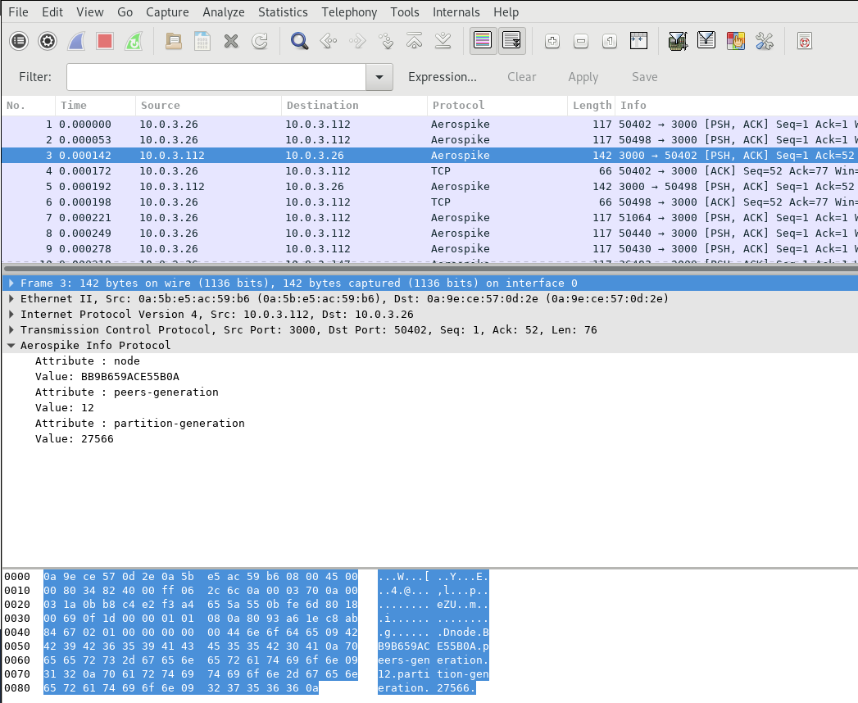
Wireshark User Interface
Main Menu
Main Toolbar
Filter Toolbar
Packet List
Packet Details
Protocol
Dissection
Packet Bytes

Slide 6
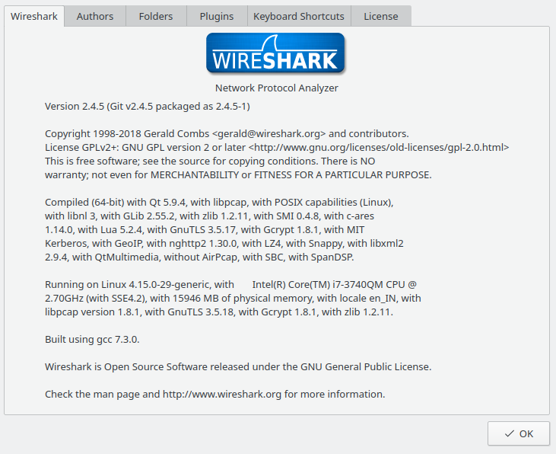
Usage
Help -> About Wireshark
Free (Libre) Open Source
$ wireshark -X lua_script:aerospike.lua capture.pcapng
$ tshark -X lua_script:aerospike.lua capture.pcapng
You can also place plugins in ~/.wireshark/plugins folder.

Slide 7

Hello World Lua!
$ lua -v
Lua 5.3.4 Copyright (C) 1994-2017 Lua.org, PUC-Rio
$ lua
Lua 5.3.4 Copyright (C) 1994-2017 Lua.org, PUC-Rio
> print(“Hello, World!”)
Hello World
$ cat hello_world.lua
#!/usr/bin/lua
print(“Hello, World!”)
$ lua hello_world.lua
Hello, World!

Slide 8
Lua: Assignment and Operations
$ lua
Lua 5.3.4 Copyright (C) 1994-2017 Lua.org, PUC-Rio
> i, j = 1, 2
> -3
-3
> k = i + j
> k
3
> j ^ k
8.0
> k % j
1
> not i
false
Category | Operator | Associativity
Unary | not # - | Right to left
Concatenation | .. | Right to left
Multiplicative | * / % | Left to right
Additive | + - | Left to right
Relational | < > <= >= == ~= | Left to right
Equality | == ~= | Left to right
Logical AND | and | Left to right
Logical OR | or | Left to right

Slide 9
Lua: Strings
> name = “Lua”
> type(name)
string
> print(name .. “ Language”)
Lua Language
> print(“99” + 1)
100.0
> print(“Value of k”, k)
Value of k 3
> [[ This is also a string ]]
This is also a string
> print(“Lua’s \”syntax\” is simple!”)
Lua’s “syntax” is simple!
Escape Sequence | Use
\a | Bell
\b | Backspace
\f | Form feed
\n | New line
\r | Carriage return
\t | Tab
\v | Vertical tab
\\ | Backslash
\” | Double quotes
\[ | Left square bracket
\] | Right square bracket

Slide 10
Lua: Tables
> work_days = {“Mon”, “Tue”, “Wed”, “Thu”, “Fri”}
> work_days
table: 0x9f10b0
> work_days[0]
nil
> work_days[1]
Mon
> work_days[6] = “Sat”
> table.insert(work_days, “Sun”)
> work_days[7]
Sun
table: 0x9f10b0
1 | Mon
2 | Tue
3 | Wed
4 | Thu
5 | Fri
6 | Sat
7 | Sun

Slide 11

Lua: Functions
-- fact.lua
function fact (n)
local f = 1
for i = 2, n do
f = f * i
end
return f
end
print(fact(5))
$ lua fact.lua
120
module clock
module http
module yaml
module string

Slide 12

Lua: Conditions and Loops
if number < 10 then
print(“Less than 10”)
else
print(“Greater than 10”)
end
while number < 10 do
print(number)
number = number + 1
end
repeat
print(number)
number = number + 1
until number >= 10
for number = 0, 9, 1 do
print(number)
end

Slide 13

Literate Programming
"I believe that the time is ripe for significantly better documentation of programs, and that we can best achieve this by considering programs to be works of literature. Hence, my title: “Literate Programming.”
Let us change our traditional attitude to the construction of
programs: Instead of imagining that our main task is to instruct a computer what to do, let us concentrate rather on explaining to human beings what we want a computer to do."
~ Prof. Donald E. Knuth, 1984

Slide 14
Markdown Structure
# Requires...
# Configuration...
## Common...
# Helper Functions...
# Statistics...
## Hot Key...
# GUI...
# Protocols...
## Info...
## Batch...
## Message...
### Aerospike Message: Header Section...
### Aerospike Message: Fields...
### Aerospike Message: Operations...
### Functions...
## Heartbeat...
# The Main...

Slide 15
lit2lua
## Heartbeat
Heartbeat protocol
> +--------------------------+----------------------------+
> | Message Header | Message Fields |
> +--------------------------+----------------------------+
Message Header
> +------------+-------------+
> | size | type |
> +------------+-------------+
> 0 4 6
Constants
local HB_HEADER_SZ_START = 0
local HB_HEADER_SZ_LENGTH = 4
local HB_HEADER_TYPE_START = 4
local HB_HEADER_TYPE_LENGTH = 2

Slide 16
lit2lua ...
Op
| Value | Name | Description |
|------:|:---------------------|:------------------------------------------------------------|
| 1 | AS_MSG_OP_READ | Read the value |
| 2 | AS_MSG_OP_WRITE | Write the value |
| 3 | AS_MSG_OP_CDT_READ | Prospective CDT top-level ops |
| 4 | AS_MSG_OP_CDT_MODIFY | Prospective CDT top-level ops |
| 5 | AS_MSG_OP_INCR | Add a value to an existing value (only on integers) |
| 6 | Unused | Reserved |
| 7 | Unused | Reserved |
| 8 | Unused | Reserved |
| 9 | AS_MSG_OP_APPEND | Append a value to an existing value (on strings and blobs ) |
| 10 | AS_MSG_OP_PREPEND | Prepend a value to an existing value (on strings and blobs) |
| 11 | AS_MSG_OP_TOUCH | Touch a value (will only increment the generation) |
| 129 | AS_MSG_OP_MC_INCR | Memcache-compatible version of the increment command |
| 130 | AS_MSG_OP_MC_APPEND | Append value to existing value (only on strings) |
| 131 | AS_MSG_OP_MC_PREPEND | Prepend a value to an existing value (only on strings) |
| 132 | AS_MSG_OP_MC_TOUCH | Memcache-compatible touch (does not change generation) |
To generate the Wireshark Lua plugin from documentation, use:
$ less -f “docs/aerospike.lua.md” | lit2lua > lua/aerospike.lua

Slide 17
lit2lua ...
Table Definition
local TYPES_OPS = {
[1] = “AS_MSG_OP_READ”,
[2] = “AS_MSG_OP_WRITE”,
[3] = “AS_MSG_AP_CDT_READ”,
[4] = “AS_MSG_OP_CDT_MODIFY”,
[5] = “AS_MSG_OP_INCR”,
[6] = “Unused”,
[7] = “Unused”,
[8] = “Unused”,
[9] = “AS_MSG_OP_APPEND”,
[10] = “AS_MSG_OP_PREPEND”,
[11] = “AS_MSG_OP_TOUCH”,
[129] = “AS_MSG_OP_MC_INCR”,
[130] = “AS_MSG_OP_MC_APPEND”,
[131] = “AS_MSG_OP_MC_PREPEND”,
[132] = “AS_MSG_OP_MC_TOUCH”,
}

Slide 18
Protocol Dissection Pattern
Constants
local PROTO_VERSION_START = 0
local PROTO_VERSION_LENGTH = 1
local PROTO_TYPE_START = 1
local PROTO_TYPE_LENGTH = 1
local PROTO_TYPE_INFO = 1
local PROTO_TYPE_MSG = 3
local INFO_SIZE_START = 2
local INFO_SIZE_LENGTH = 6
local INFO_DATA_START = 8
> +---------+-------------+----------------------------------+
> | version | type | size |
> +---------+-------------+----------------------------------+
> 0 1 2 8

Slide 19
Protocol Dissection Pattern ...
Create Proto objects
local aerospike_info_proto = Proto(“Aerospike”, “Aerospike Info Protocol”)
local aerospike_attribute = Proto(“AerospikeAttribute”, “Aerospike Attributes”)
local aerospike_attribute_value = Proto(“AerospikeAttributeValue”, “Aerospike Attribute Value pairs”)
Proto header fields
local header_fields = {
version = ProtoField.uint8 (“header.version”, “Version”, base.DEC),
type = ProtoField.uint8 (“header.type”, “Type”, base.DEC, TYPES_PROTO),
size = ProtoField.uint64 (“header.size”, “Size”, base.DEC),
}
local header_attributes = {
attribute = ProtoField.string(“header.attribute”, “Attribute”),
}
local header_attribute_values = {
attribute = ProtoField.string(“header_attribute_values.attribute”, “Attribute “),
value = ProtoField.string(“header_attribute_values.value”, “Value”),
}
Register the protocol fields
aeropike_info_proto.fields = header_fields
aerospike_attribute.fields = header_attributes
aerospike_attribute_value.fields = header_attribute_values

Slide 20
Protocol Dissection Pattern ...
Functions
local function dissect_aerospike_info (tvbuf, tree, size)
-- Separate the data by newline
local data_tvbr = tvbuf:range(INFO_DATA_START, tonumber(size))
local data_string = data_tvbr:string()
local data_start = INFO_DATA_START
for line in string.gmatch(data_string, "[^\n]+") do
local d = tvbuf:range(data_start, string.len(line))
local d_string = d:string()
-- if contains attribute-values
if string.find(d_string, "\t") then
local parts = split_tab(d_string)
...
end
data_start = data_start + string.len(line) + 1 -- for \n
end
end

Slide 21
Dissector Table
# Configuration
local default_settings = {
aerospike_port = 3000,
heartbeat_multicast_port = 9918,
heartbeat_mesh_port = 3002,
}
# Create Proto objects
local aerospike_proto = Proto(“AerospikeProtocol”, “Aerospike Protocol”)
local heartbeat_proto = Proto(“AerospikeHeartbeat”, “Aerospike Heartbeat”)
# The Main
local function enable_dissector()
DissectorTable.get(“tcp.port”):add(
default_settings.aerospike_port, aerospike_proto)
DissectorTable.get(“tcp.port”):add(
default_settings.heartbeat_mesh_port, heartbeat_proto)
DissectorTable.get(“udp.port”):add(
default_settings.heartbeat_multicast_port, heartbeat_proto)
end
enable_dissector()

Slide 22
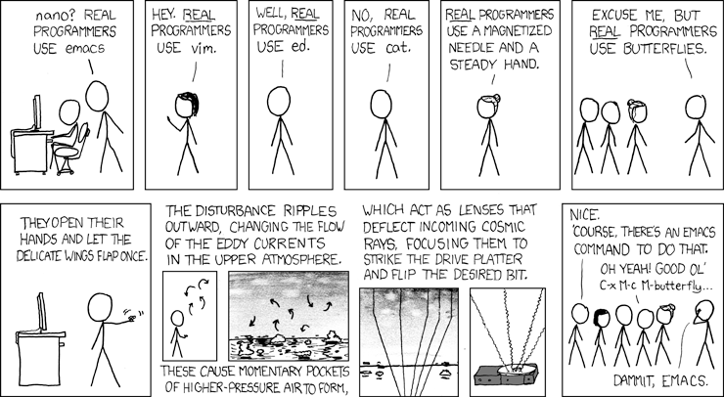
Live Coding!
Source: https://www.xkcd.com/378/

Slide 23
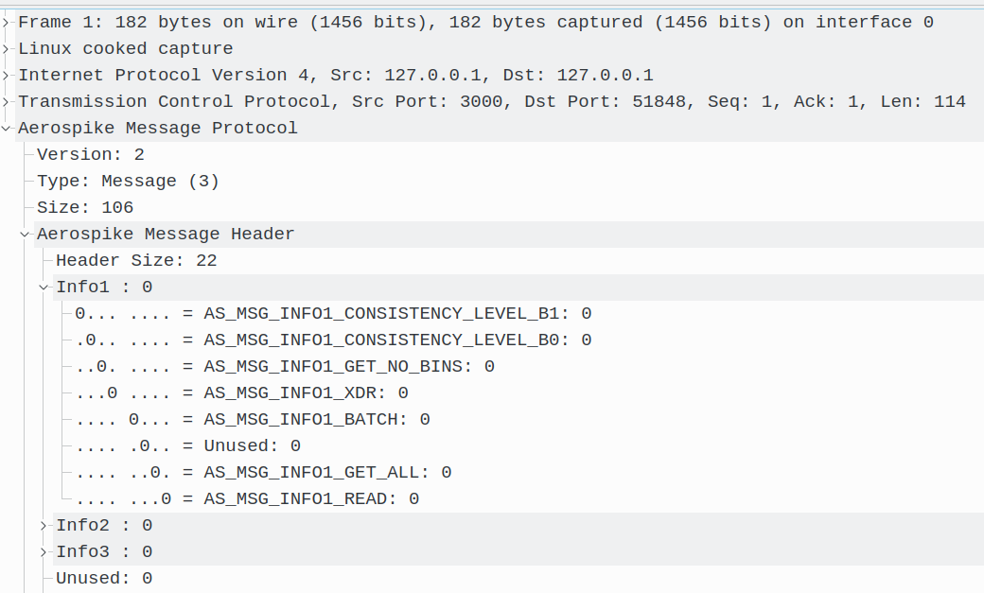
Message Protocol
Production Support
Bit-level Dissection
| Value | Name | Description |
|------:|:----------------------------------|---------------------------------|
| 1 | AS_MSG_INFO1_READ | Contains a read operation |
| 2 | AS_MSG_INFO1_GET_ALL | Get all bins data |
| 4 | Unused | Unused |
| 8 | AS_MSG_INFO1_BATCH | New batch protocol |
| 16 | AS_MSG_INFO1_XDR | Operation is performed by XDR |
| 32 | AS_MSG_INFO1_GET_NO_BINS | Do not read the bin information |
| 64 | AS_MSG_INFO1_CONSISTENCY_LEVEL_B0 | Read consistency level – bit 0 |
| 128 | AS_MSG_INFO1_CONSISTENCY_LEVEL_B1 | Read consistency level – bit 1 |

Slide 24
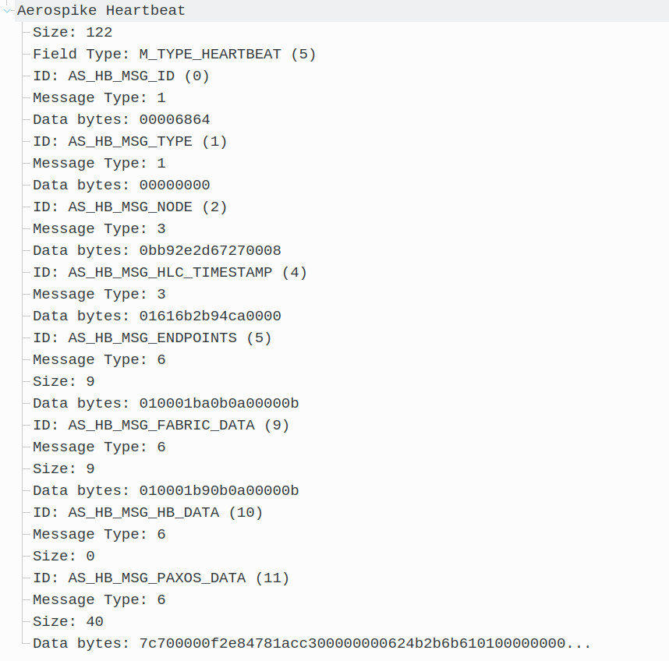
Heartbeat Protocol
Heartbeat protocol
> +------------------+----------------+
> | Message Header | Message Fields |
> +------------------+----------------+
Message Header
> +------------+-------------+
> | size | type |
> +------------+-------------+
> 0 4 6
Header Type
| Value | Name |
|------:|:--------------------|
| 0 | M_TYPE_FABRIC |
| 1 | M_TYPE_HEARTBEAT_V2 |
| 2 | M_TYPE_PAXOS |
| 3 | M_TYPE_MIGRATE |
| 4 | M_TYPE_PROXY |
| 5 | M_TYPE_HEARTBEAT |
| 6 | M_TYPE_CLUSTERING |
| 7 | M_TYPE_RW |
| 8 | M_TYPE_INFO |
| 9 | M_TYPE_EXCHANGE |
| 11 | M_TYPE_XDR |
| 15 | M_TYPE_SMD |
Network Analysis

Slide 25
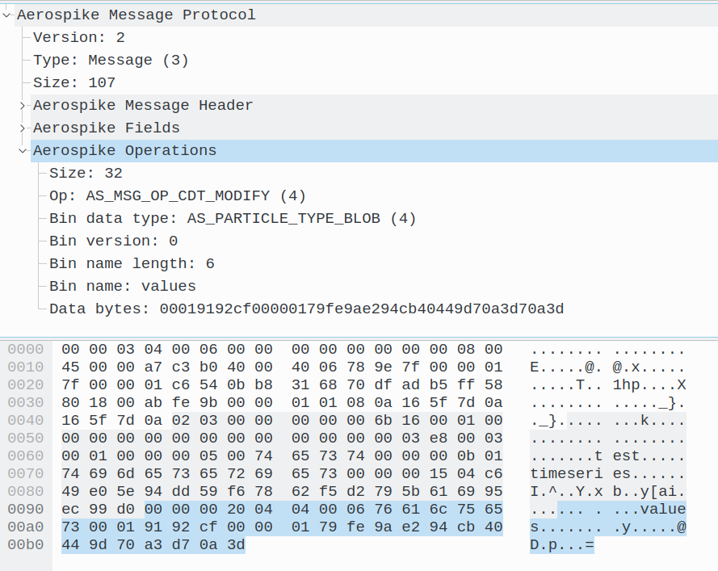
CDT List Operations
Modifying list of lists
‘values’ bin:
[[1523474230000, 39.04],[1523474231001, 39.78],[1523474236006, 40.07],[1523474235005, 41.18],[1523474233003, 40.89],[1523474234004, 40.93]]
client.list_append(
key,
‘values’,
[1623474234004, 41.23])
'values' bin:
[[1523474230000, 39.04],
[1523474231001, 39.78],
[1523474236006, 40.07],
[1523474235005, 41.18],
[1523474233003, 40.89],
[1523474234004, 40.93],
[1623474234004, 41.23]]
Source: https://www.aerospike.com/docs/guide/cdt-list-ops.html

Slide 26
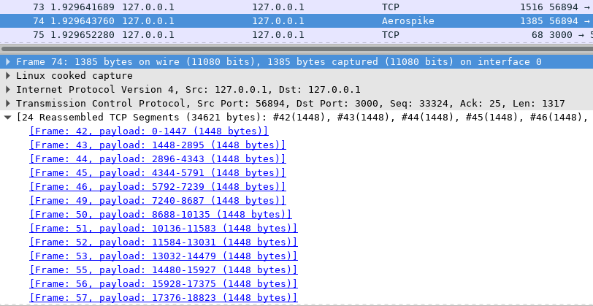
Reassembled TCP Segments
Anomaly Detection
dissect_tcp_pdus(tvb, tree, min_header_size, get_len_func, dissect_func)
Source: https://www.wireshark.org/docs/wsdg_html_chunked/lua_module_Proto.html

Slide 27
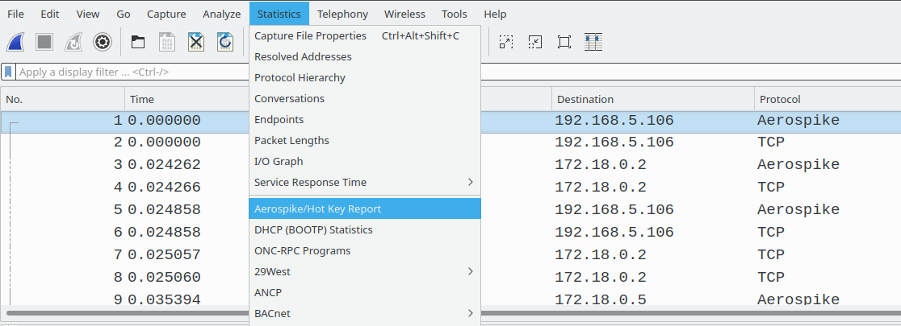
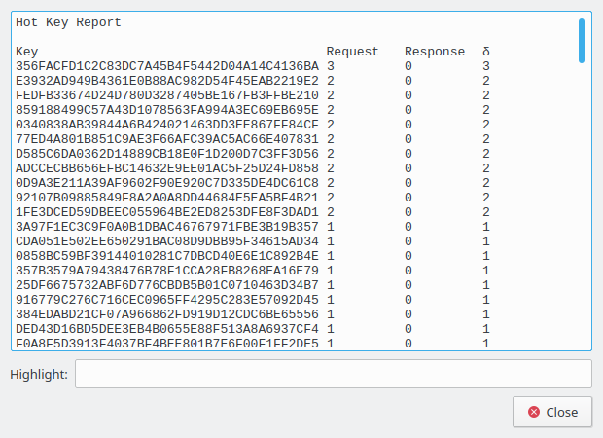
Hot Key Report
Report Generation

Slide 28
Tests: Execution
aeropike-wireshark-plugin/tests $ make clean; make
Testing test-msg-write-response.pcapng.pdml ... [OK]
Testing test-msg-write-request.pcapng.pdml ... [OK]
Testing test-batch.pcapng.pdml ... [OK]
Testing test-payload-response-greater-than-1500.pcapng.pdml ... [OK]
Testing test-heartbeat-mesh.pcapng.pdml ... [OK]
Testing test-payload-request-greater-than-1500.pcapng.pdml ... [OK]
Testing test-msg-read-response.pcapng.pdml ... [OK]
Testing test-msg-read-request.pcapng.pdml ... [OK]
Testing test-heartbeat-multicast.pcapng.pdml ... [OK]
Testing test-info-response.pcapng.pdml ... [OK]
Testing test-info-request.pcapng.pdml ... [OK]
Generate report using luacov-console ...
luacov-console ../lua
luacov-console -s # --no-colored
==============================================================================
Summary
==============================================================================
File Hits Missed Coverage
-----------------------------------------
../lua/aerospike.lua 634 48 92.96%
-----------------------------------------
Total 634 48 92.96%

Slide 29
Debugging
Function | Description
critical(text) | Critical severity
warn(text) | Warning
message(text) | Normal
info(text) | Informational
debug(text) | Debugging
report_failure(text) | Message box with error icon
local d = require ‘debug’
print (d.traceback())
d.debug()
Utility Functionshttps://wiki.wireshark.org/LuaAPI/Utils
Development Tips
https://wiki.wireshark.org/Development/Tips

Slide 30

Luacheck
Accessing undefined variable
Line contains only whitespace
Setting non-standard global variable
Unused variable
Unused argument
Unused loop variable i
Unused function
Line is too long
Trailing whitespace in a comment
$ luarocks install luacheck
$ luacheck lua/aerospike.lua
Total: 0 warnings / 0 errors in 1 file

Slide 31
Performance
Lua performs slower than implementing a plugin in C
Wireshark becomes slow for capture files greater than 100 MB
Display filter and save filtered results
Use TCP/Allow sub-dissectors to reassemble TCP streams
Use faster CPU and more physical RAM
Stop other programs on machine to reduce system load
Split/merge packet captures to analyze critical time intervals
$ editcap -r source.pcap target.pcap 0-15000 # 0-15000 packets
$ editcap -i 20 source.pcap 20starget.pcap # 20s
$ editcap -c 10000 source.pcap 10000target.pcap # 10000 packets
$ editcap -s 128 source.pcap 128btarget.pcap # 128 bytes of packet
$ mergecap -w output.pcap client.pcap server.pcap
Source: https://www.wireshark.org/docs/man-pages/editcap.html
https://www.wireshark.org/docs/man-pages/mergecap.html

Slide 32
Summary
Define Constants
Create Protocol Objects
Write Protocol Fields
Implement Functions
Wire up to Wireshark Lua

Slide 33
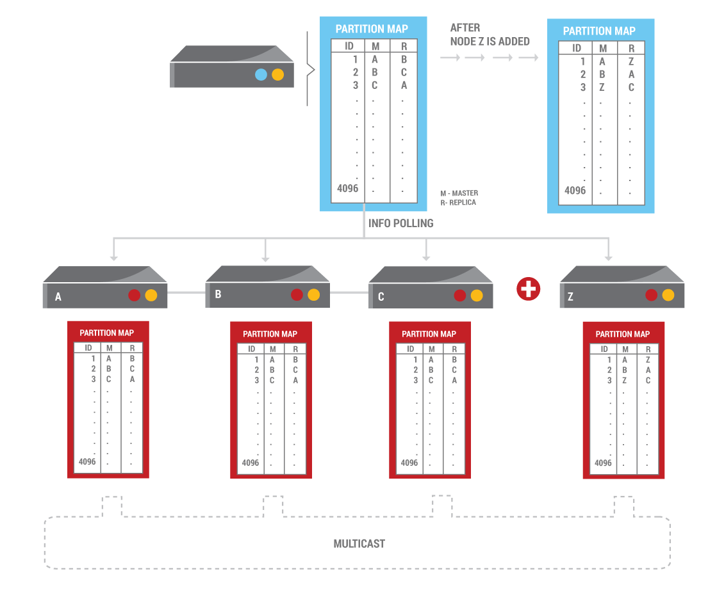
Future Work
Migration
Clustering
Proxy
RW (Replication)
Fabric
Info
Exchange
System Metadata
Security
Cross Datacentre Replication (XDR)

Slide 34
References
Lua: https://www.lua.org
Wireshark Lua API: https://wiki.wireshark.org/LuaAPI
Aerospike Wireshark Lua Plugin: https://github.com/aerospike/aerospike-wireshark-plugin
Lua Examples: https://www.wireshark.org/Lua/Examples
“Changing Wireshark with Lua: Writing a Lua Plug-in to Create a Custom Decoder” (~ 1h 20m)
https://www.youtube.com/watch?v=HTtVHxIh6ww
Lua style guide: http://lua-users.org/wiki/LuaStyleGuide
Lua Performance: https://wiki.wireshark.org/Performance
Peter Wu (“Lekensteyn” at #wireshark irc.freenode.net) Wireshark notes: https://git.lekensteyn.nl/peter/wireshark-notes
Lua scripting in Wireshark:
https://sharkfestus.wireshark.org/sharkfest.09/DT06_Bjorlykke_Lua%20Scripting%20in%20Wireshark.pdf

Slide 35
Thank You
@shakthimaan

