Slide 1
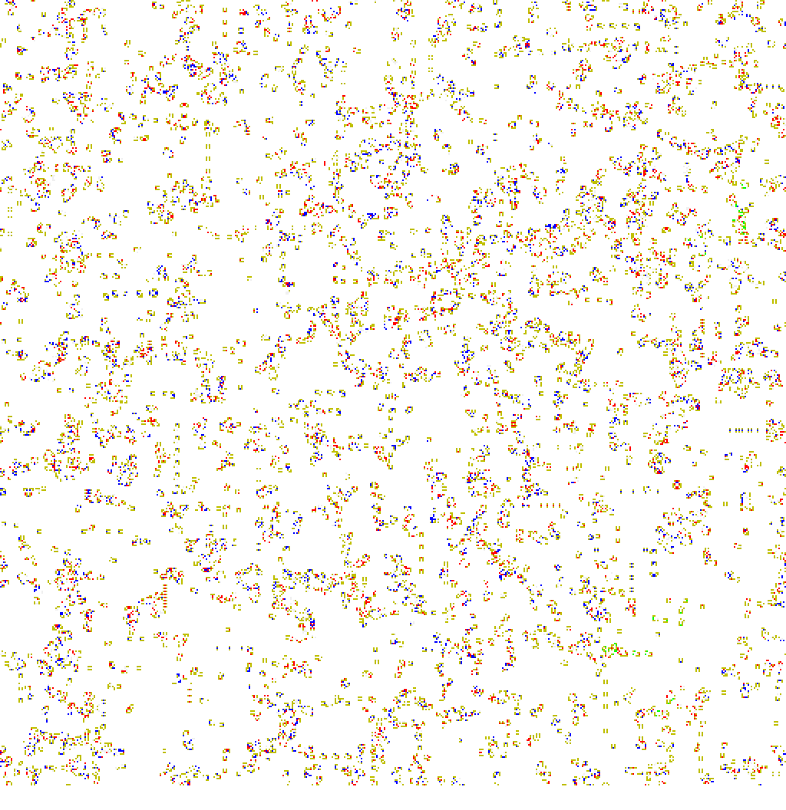
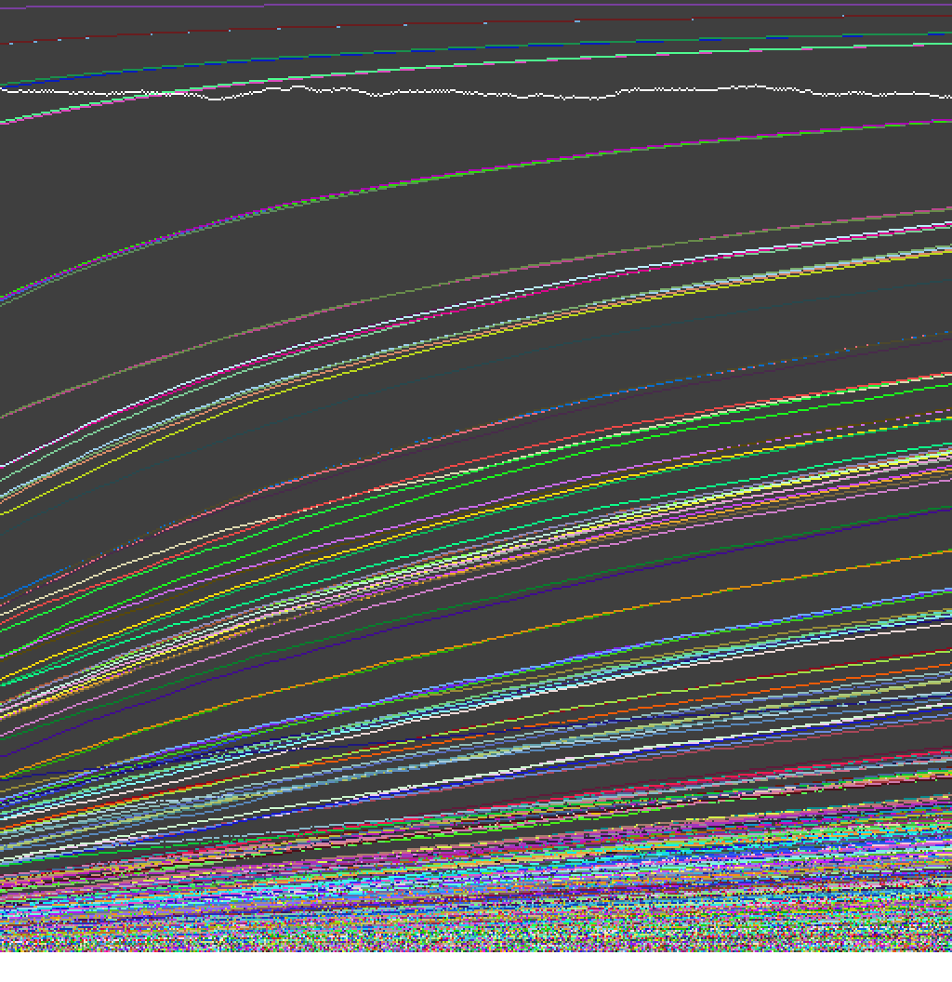
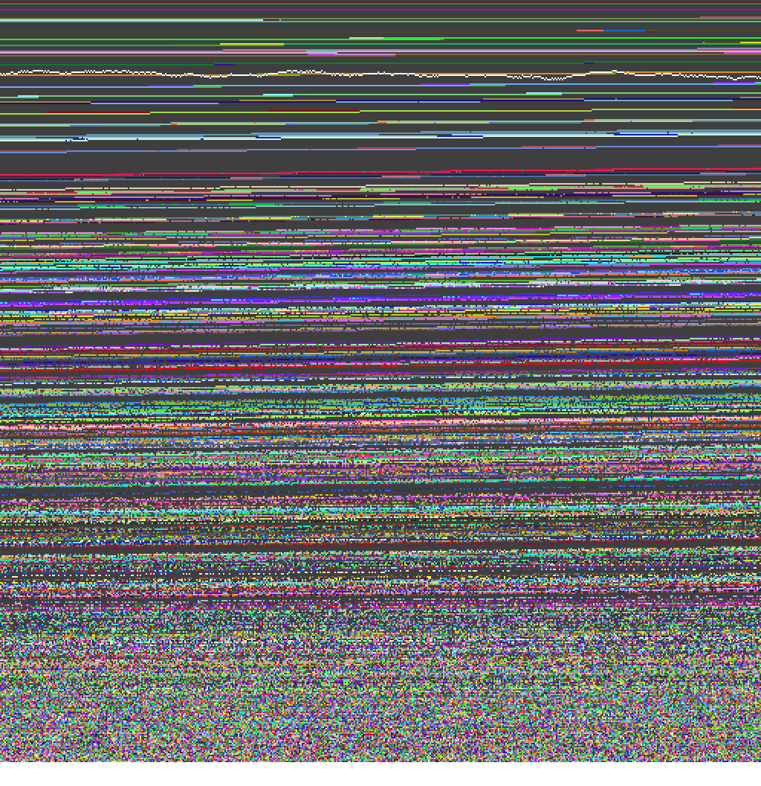
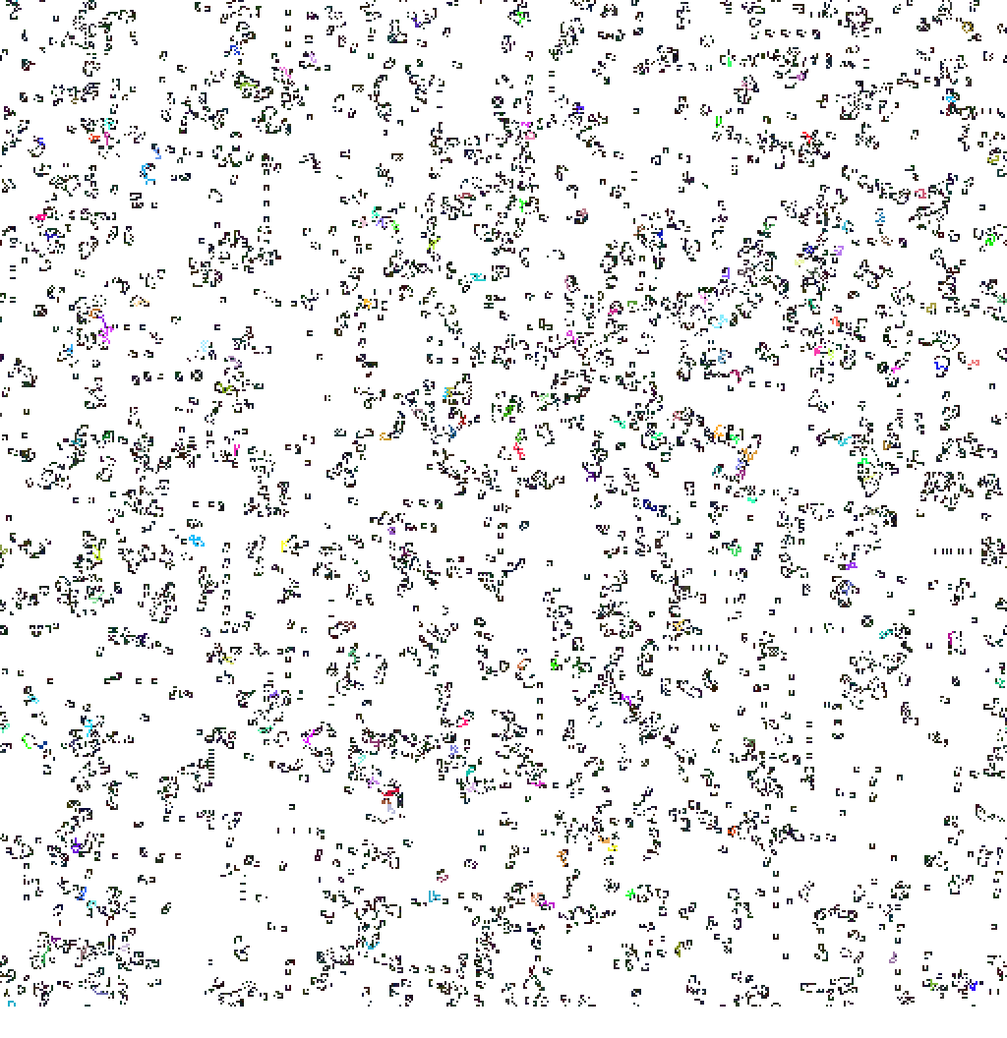
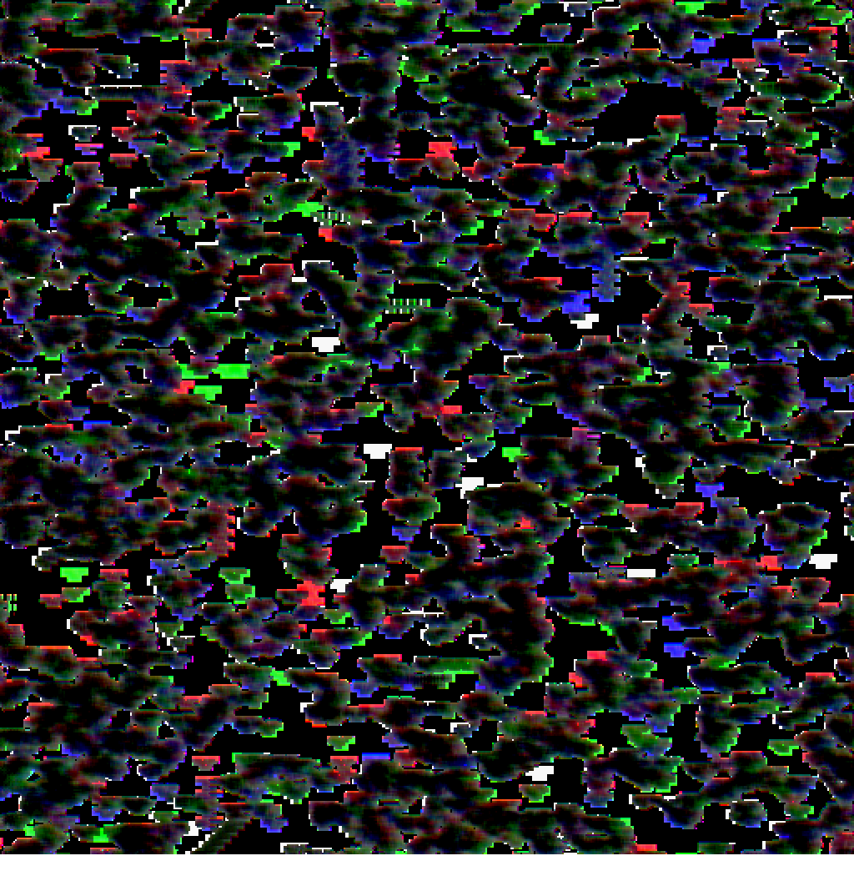
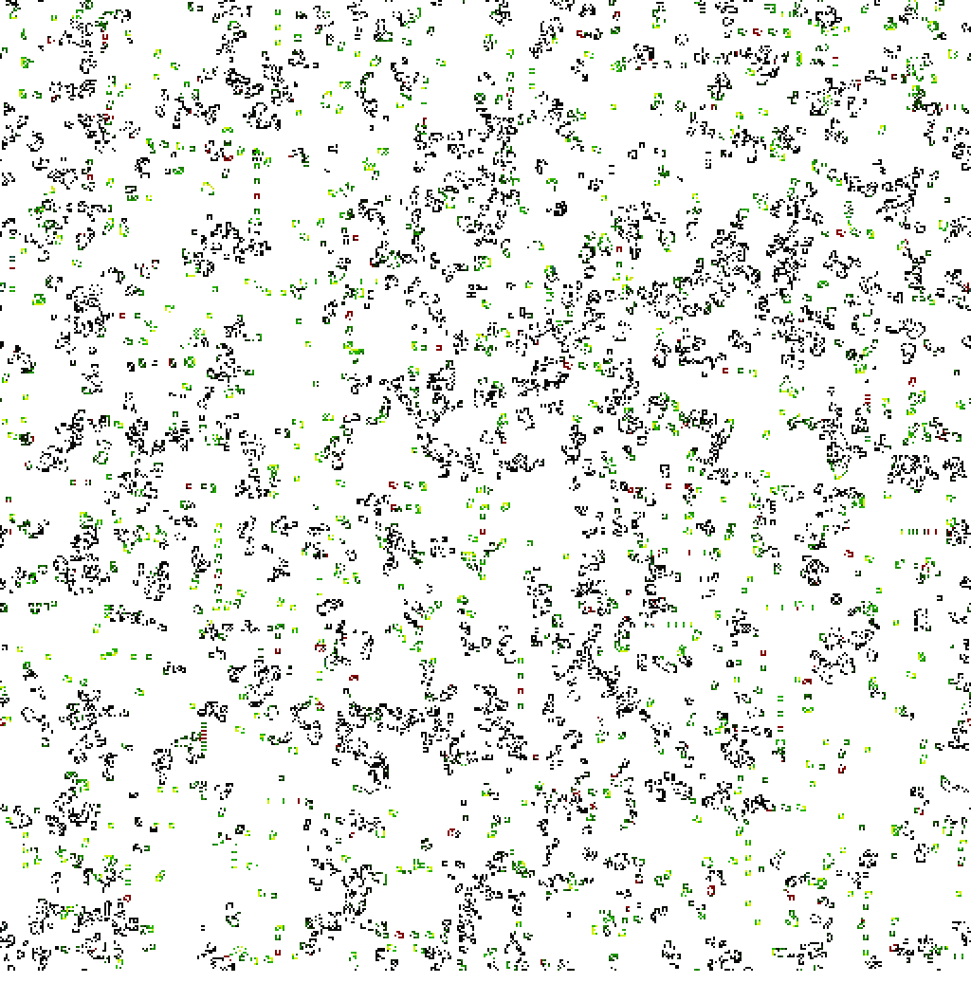
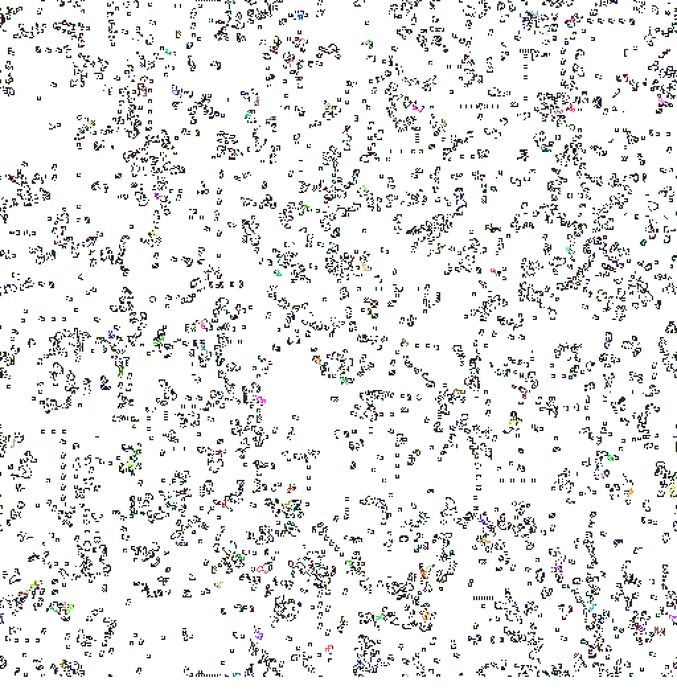
a
b
c
d
e
f

Slide 2
a
b
c
d
e
f

Slide 3
a)
c)
1111
1111
1
1111
1110
1101
1011
1100
0111
0110
0011
0101
0
1001
1010
b)
d)
111111
111111
111111
111
111
111
110000
110000
111
111110
111100
110111
111000
110011
011111
110001
100000
110
011
101
110000
001
010
100
001111
010000
010000
000000

Slide 4
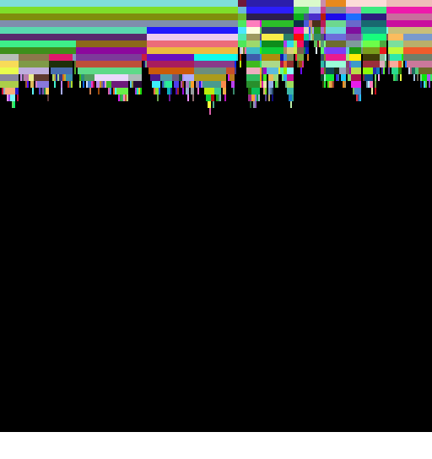
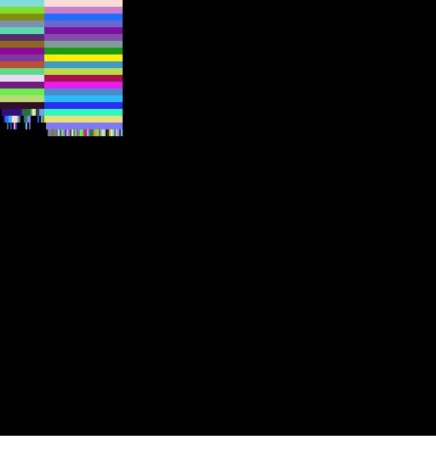
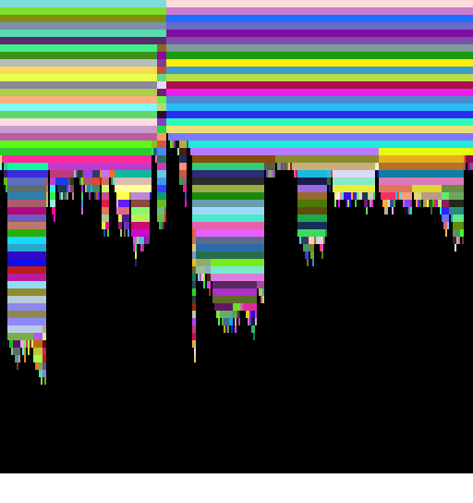

Slide 5
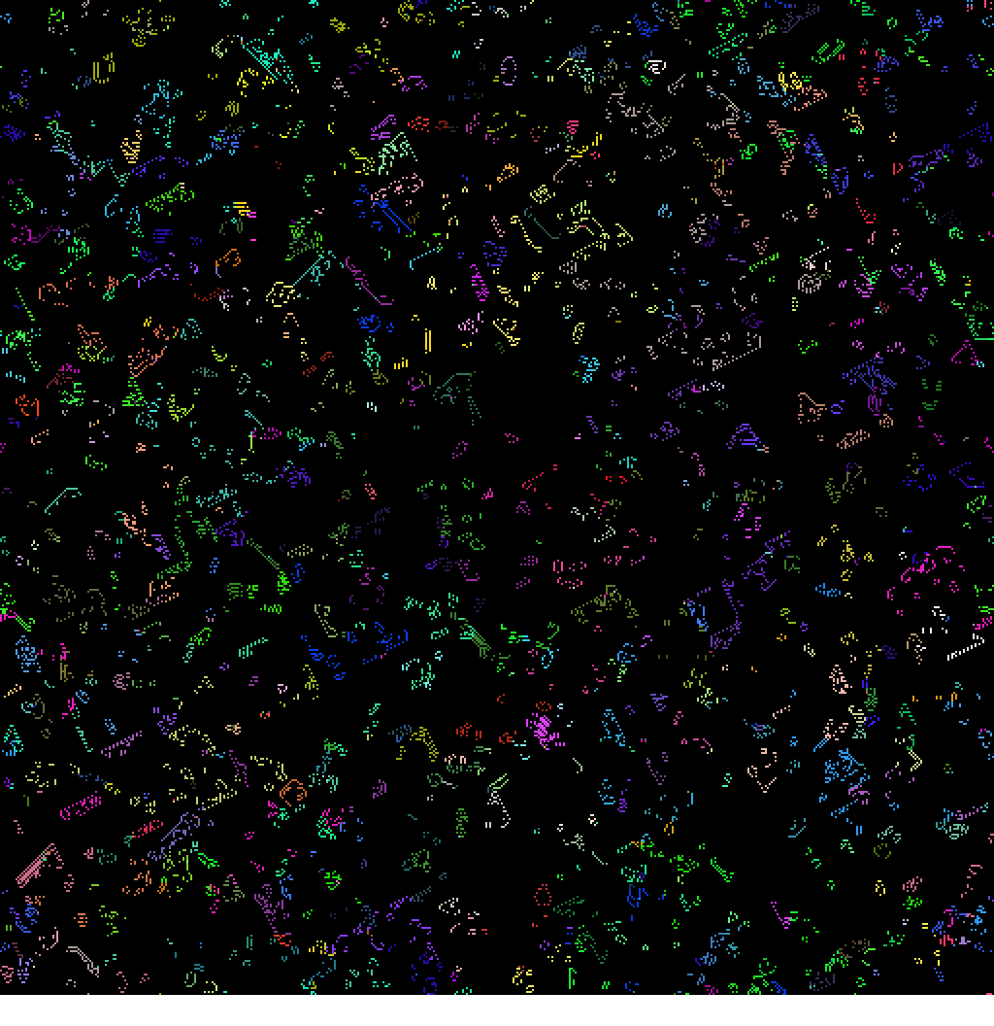
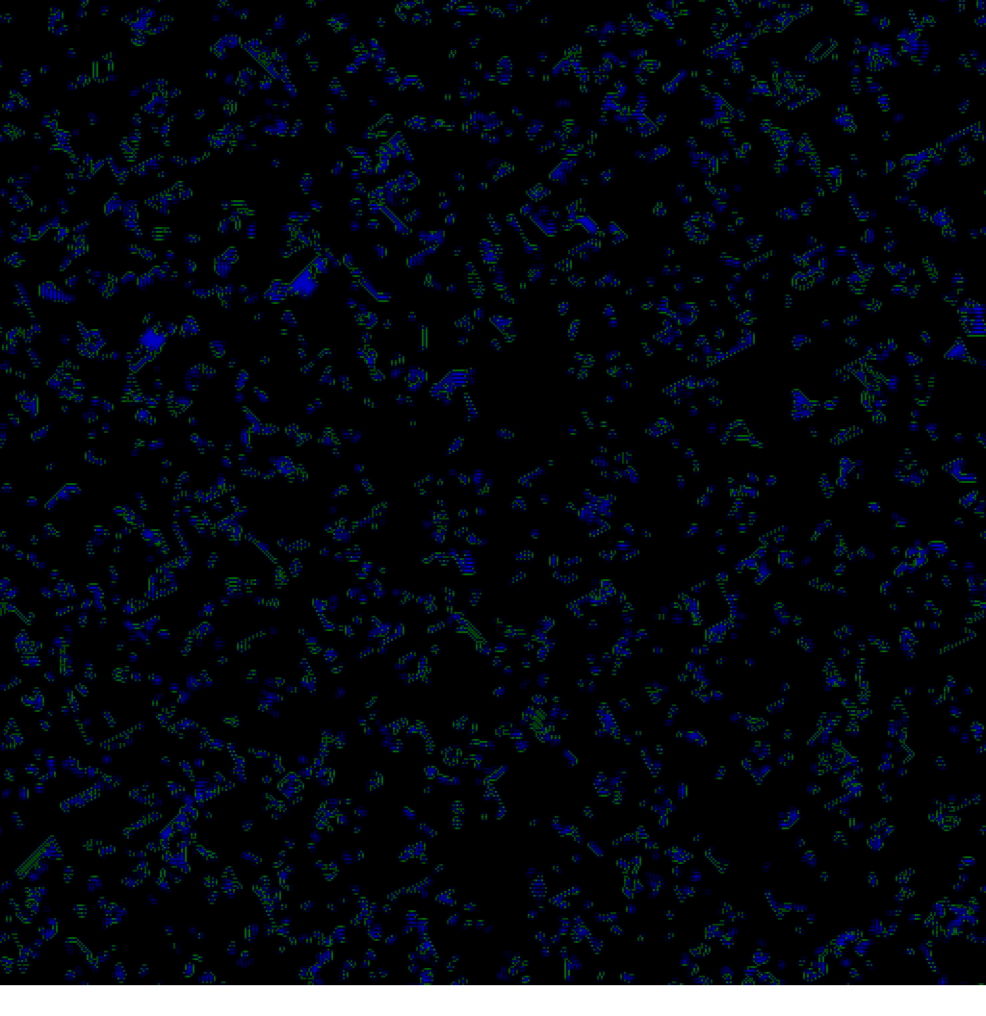
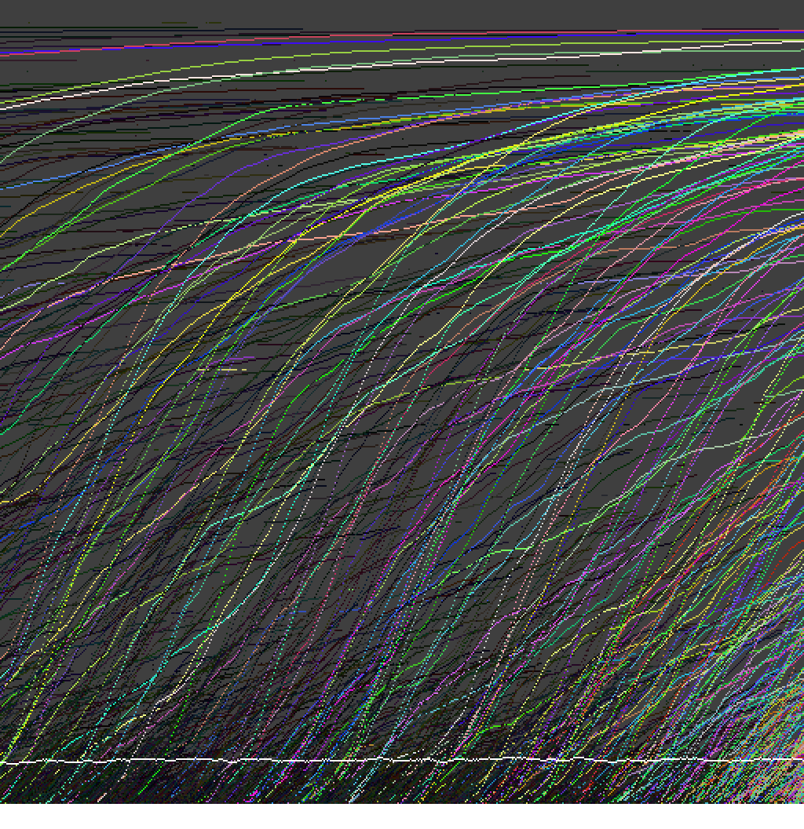
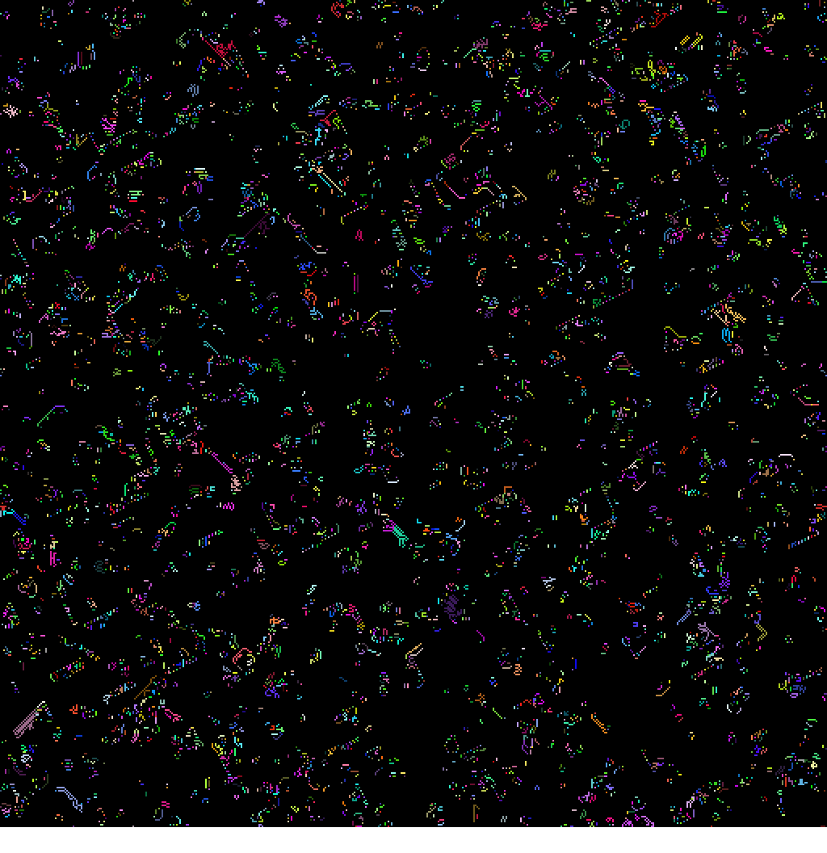
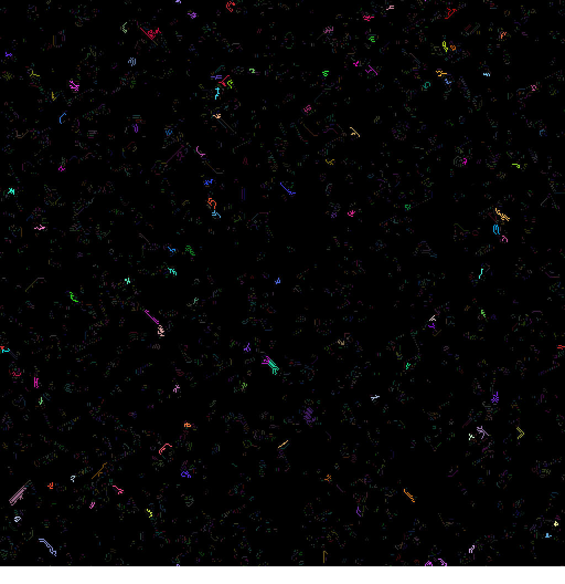
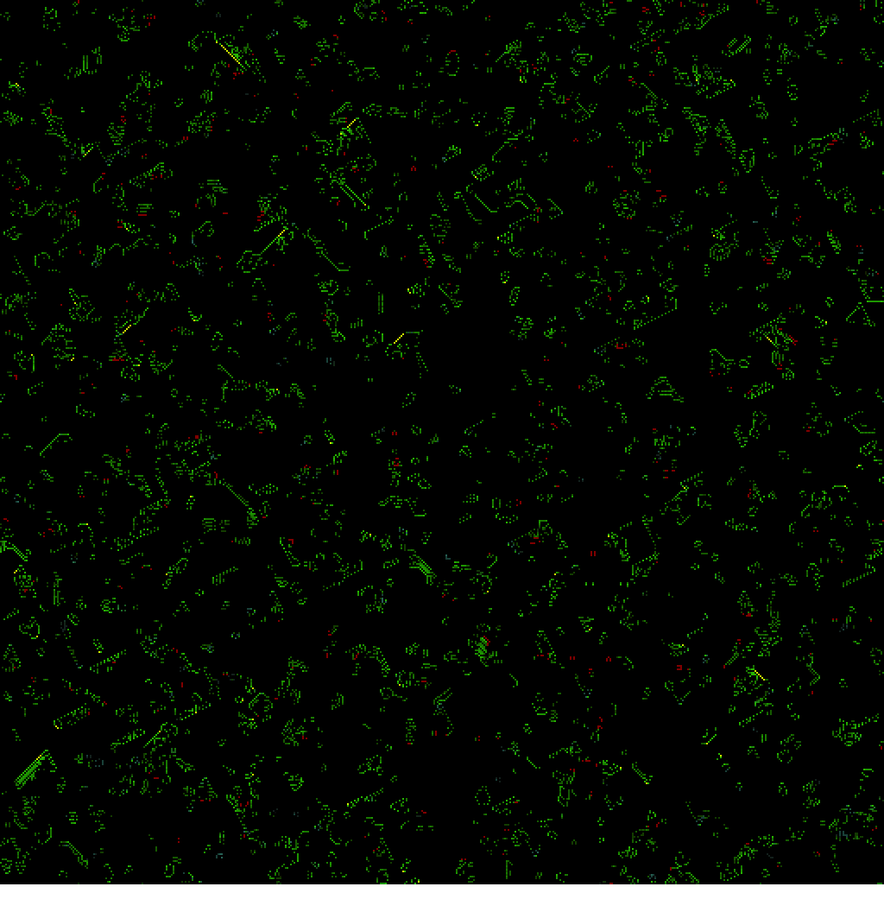
a
b
c
d
d
e
f
Notes:
g.rulemod = g.runparams[0] = 0x1 g.repscheme = g.runparams[1] = 0x1f2
g.selection = g.runparams[2] = 13
g.overwritemask = g.runparams[3] = 0xfc
g.birthmask = g.runparams[7] = 0x03f
g.survivalmask = g.runparams[4] = 0x0
g.ancestormask = g.runparams[8] = 0xff
g.colorfunction = g.runparams[5] = 0
g.initfield = g.runparams[6] = 0
g.nlog2pmut = g.simparams[0] = 8
g.initial1density = g.simparams[1] = 8192
g.initialrdensity = g.simparams[2] = 16384
g.ncoding = g.simparams[3] = 0
g.startgenechoice = g.simparams[4] = 8
genelife_sel13_t12772_r000001f2_s001_c09.jpeg and other colorfunctions
Values above switched interactively during prior period

