Slide 1
graphs
John S. McCaskill and Norman H. Packard

Slide 2
The rule
g.repscheme = g.runparams[1] = 0x110
g.selection = g.runparams[2] = 11
g.overwritemask = g.runparams[3] = 0xff
g.birthmask = g.runparams[7] = 0x000000fe
g.survivalmask = g.runparams[4] = 0x00000000
g.colorfunction = g.runparams[5] = 0
g.initfield = g.runparams[6] = 256
g.nlog2pmut = g.simparams[0] = 8
g.initial1density = g.simparams[1] = 10000
g.initialrdensity = g.simparams[2] = 10000
g.ncoding = g.simparams[3] = 0
g.startgenechoice = g.simparams[4] = 7

Slide 3
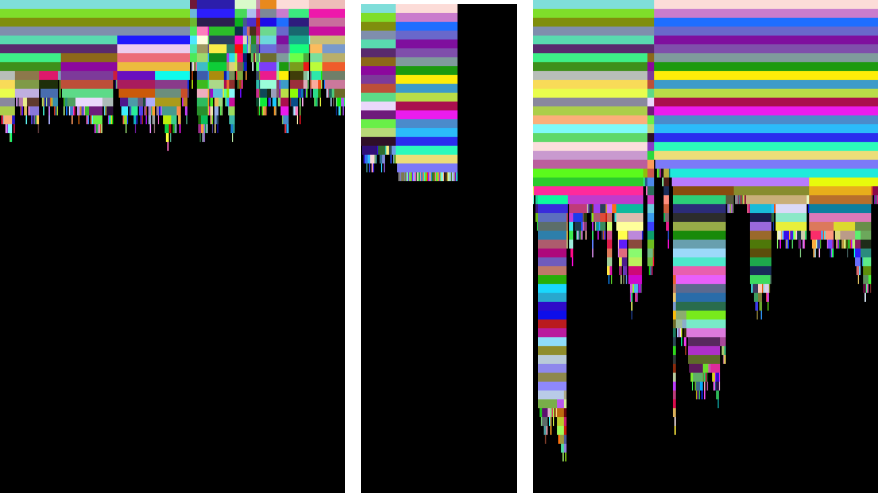
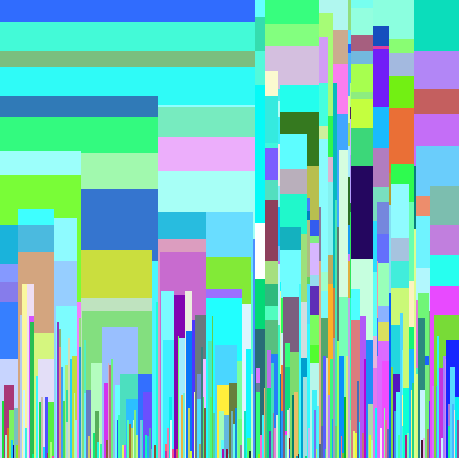
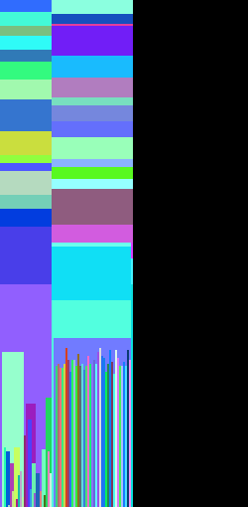
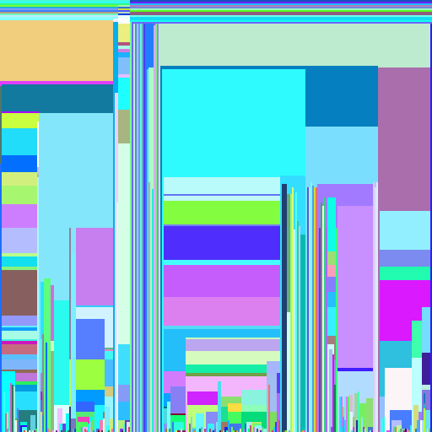
a
b
c
d
e
f

