Slide 1
graphs
John S. McCaskill and Norman H. Packard

Slide 2
The rule
g.repscheme = g.runparams[1] = 0x0002 # bits 0 to 20 code for mostly independent binary options
g.selection = g.runparams[2] = 2 # fitness for 2 live neighbor rule : 0-6 see subgenelife.c code
g.overwritemask = g.runparams[3] = 3 # mask of 2 bits to overwrite instead of survival for 3(bit0) or 2(bit1) live nbs
g.survivalmask = g.runparams[4] = 0 # survive mask for two (bit 1) and three (bit 0) live neighbours : GoL = 3
g.colorfunction = g.runparams[5] = 0 # color function 0(hash), ≥1(fnal), 2 nongolchg yellow, 3 notgolrul yellow
g.initfield = g.runparams[6] = 0 # 1 init via 32x32 genepat.dat, n>1 init via nxn rand array
g.nlog2pmut = g.simparams[0] = 8 # log2 gene mutation probability (0 or >56 means no mutation)
g.initial1density = g.simparams[1] = 8192 # initial 1 density in GOL state
g.initialrdensity = g.simparams[2] = 0 # initial density of random genes
g.ncoding = g.simparams[3] = 0 # no of bits used to encode valid connection functions 1-16
g.startgenechoice = g.simparams[4] = 8 # initialize genes to startgene number 0-8 : 8 is random choice of 0-7

Slide 3
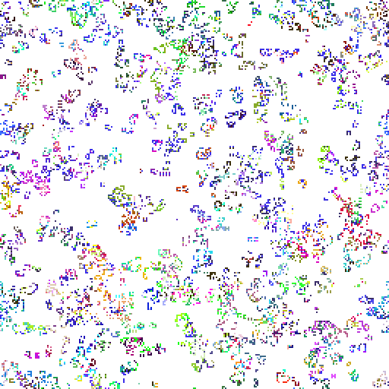
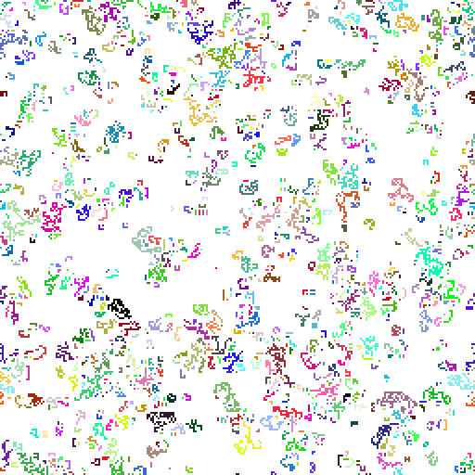
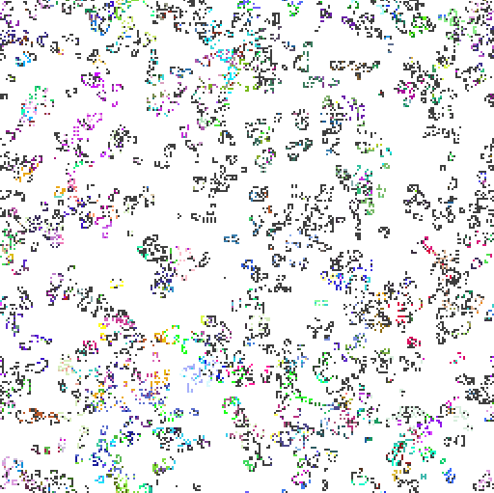
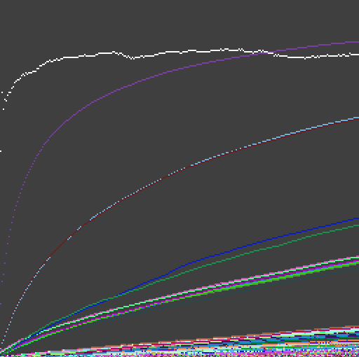
a
b
c
c)
d

