Slide 1
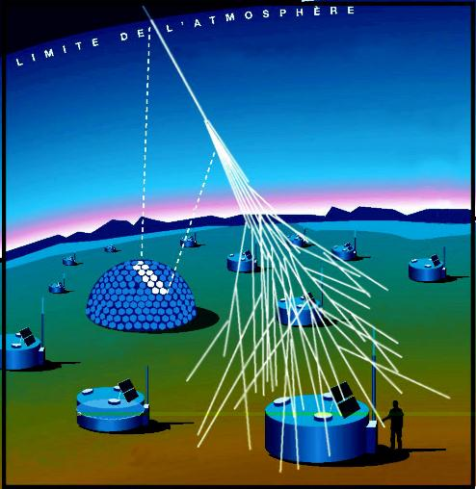
Pierre Auger Observatory
www.auger.org

Slide 2
Pierre Auger Observatory
Pampa Amarilla in western Argentina (east of the Andes Mountains in Mendoza Province)
The detection area is 3000 square kilometers, an area about ten times the size of Paris.
Hybrid detector
  water tanks
  optical detectors (“fluorescence detectors”)

Slide 3
Pierre Auger Observatory
Able to determine the direction and energy of the original incoming cosmic ray particle.
Above 10¹⁹ eV the arrival rate is only 1 particle per square kilometer per year.
Energies above 10²⁰ eV have an estimated arrival rate of 1 particle per square kilometer per century.

Slide 4
Pierre Auger Observatory
An “extensive air shower” arrives at ground level with billions of energetic particles that can be detected over approximately 10 to 15 square kilometer.

Slide 5
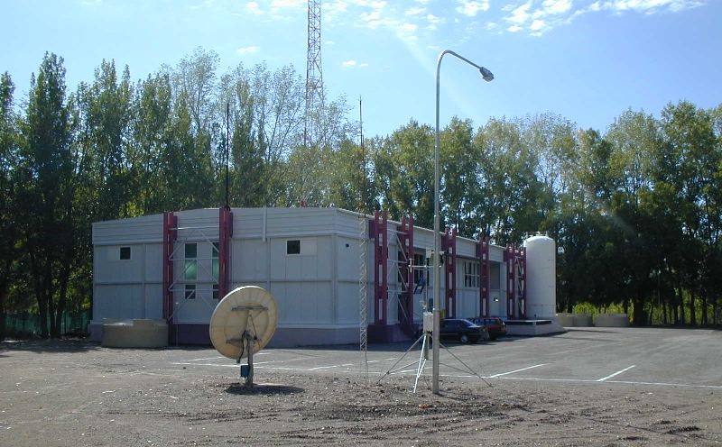
Pierre Auger Observatory
The assembly building at the Auger Campus. The purified water storage tank can be seen at the back corner of the building. The tall communications mast behind the building collects data from the full array and fluorescence detectors via microwaves.

Slide 6
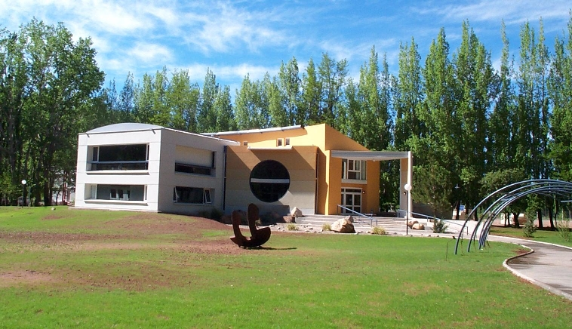
Pierre Auger Observatory
This office building includes a visitor center and the Central Data Acquisition System as well as offices for the various project tasks.

Slide 7
Pierre Auger Observatory water tanks
1600 water tanks with a separation of 1.5 km, each one an 11,000 liter tank filled with pure water.
Energetic charged shower particles, traveling faster than light travels in water, produce Cherenkov light by a shock front of light that spreads out in a cone around the particle.
3 large photomultiplier tubes with flash ADC electronic placed in the water measured the amount of produced light.

Slide 8
Pierre Auger Observatory water tanks
An extensive air shower causes nearly simultaneous bursts of light in 5 or more separated tanks.
The amount of detected light reveal the energy of the primery cosmic ray.
Slight differences in the detection times at the various tank positions determine the cosmic ray arrival direction.

Slide 9
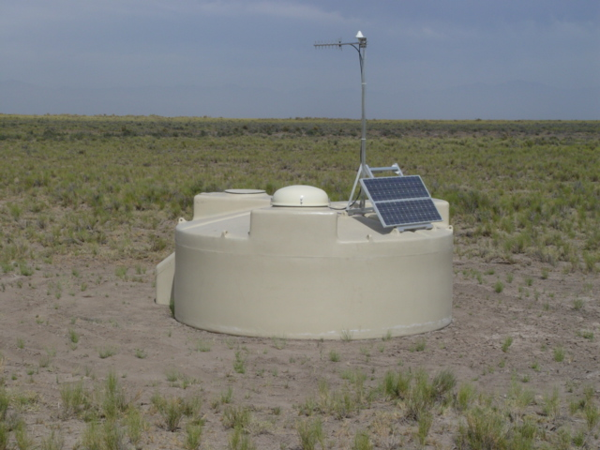
Pierre Auger Observatory water tanks

Slide 10
Pierre Auger Observatory optical detectors (“fluorescence detectors”)
24 Hi-Res Fluorescence detectors with a typical distance of 15 km.
A charged particle passes close to molecules in the atmosphere, it transfers some energy to the molecules. The molecules respond by emitting light (fluorescence).
Measured by photomultipliers

Slide 11
Pierre Auger Observatory optical detectors (“fluorescence detectors”)
The light is so faint that it can only be seen on moonless nights without clouds.
Total amount of light depends on the number of particles in the shower and, in turn, on the energy.
The shape and direction of the light trace determine the cosmic ray’s direction and indicate what kind of particle the original cosmic ray might have been.

Slide 12
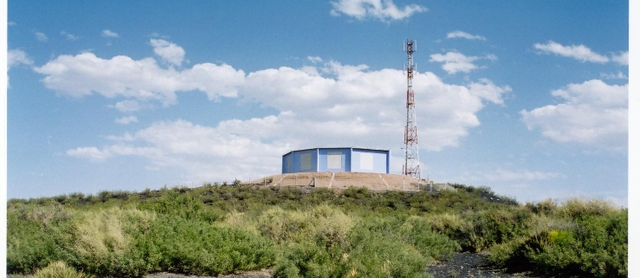
Pierre Auger Observatory optical detectors (“fluorescence detectors”)
There are 6 bays, each containing a fluorescence telescope with a 30x30 degree field of view.

Slide 13
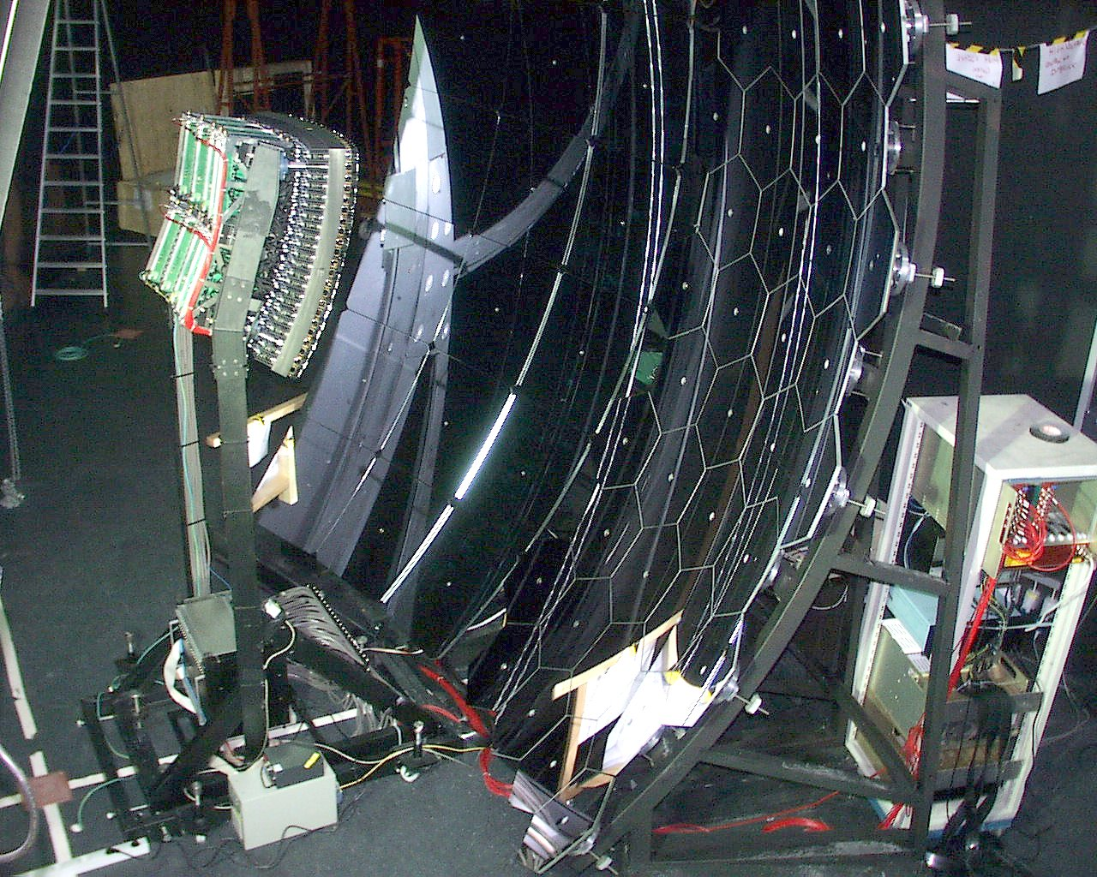
Pierre Auger Observatory optical detectors (“fluorescence detectors”)
Prototype Fluorescence telescope showing mirror and camera

Slide 14
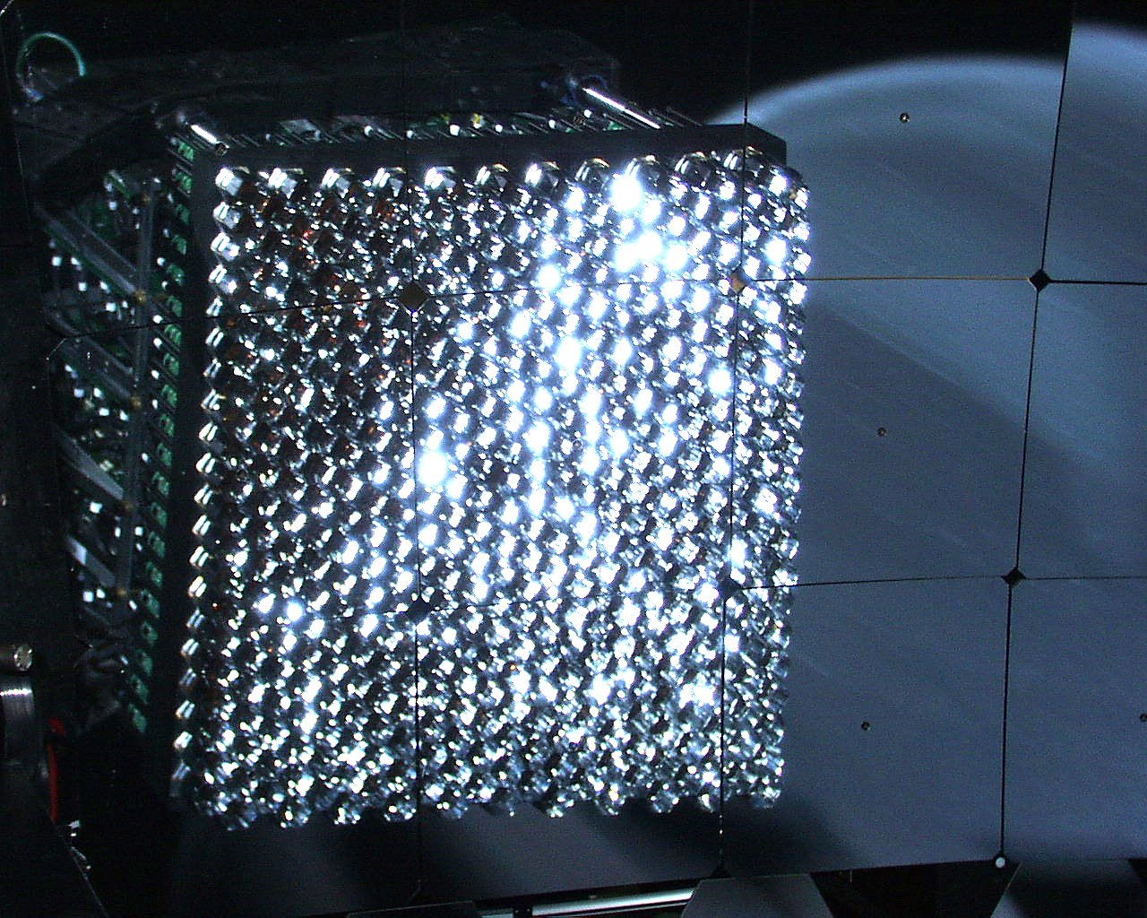
Pierre Auger Observatory optical detectors (“fluorescence detectors”)
Prototype Fluorescence telescope camera (440 photomultiplier tubes)

Slide 15
Pierre Auger Observatory
Fluorescence detectors can measure cosmic ray showers in more detail than the giant array but can only observe fluorescence on dark nights.
The large surface array is active all the time, so it measures 10 times more events.
A very powerful instrument for capturing the rarest, most interesting, and most puzzling high-energy cosmic rays.

Slide 16
Pierre Auger Observatory
Animation unter
http://www.auger.org/photos/AnimGif.html

