Slide 1


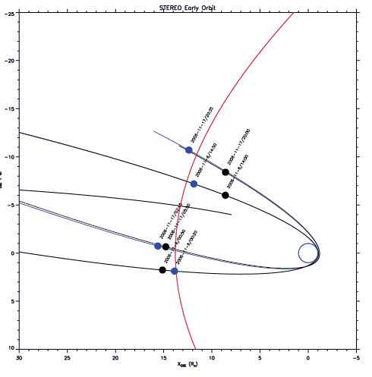
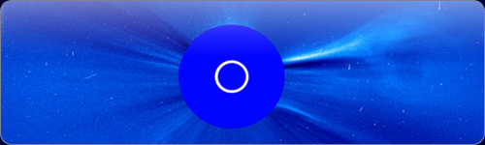
The STEREO/WAVES antenna calibration

Slide 2

The STEREO/WAVES antenna calibration
The goal: correct data interpretation
Effective length vectors, impedance/ admittance matrices, field patterns
Numerical and experimental analysis:
  Wire/Patchgrid modeling
  Rheometry
  Anechoic chamber
  Inflight calibration
Overview

Slide 3
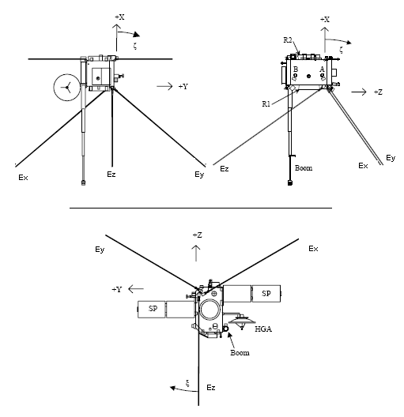
The STEREO/WAVES antenna calibration
The coordinate system

Slide 4
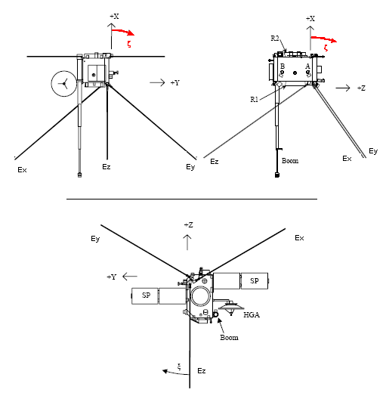
The STEREO/WAVES antenna calibration
The coordinate system

Slide 5
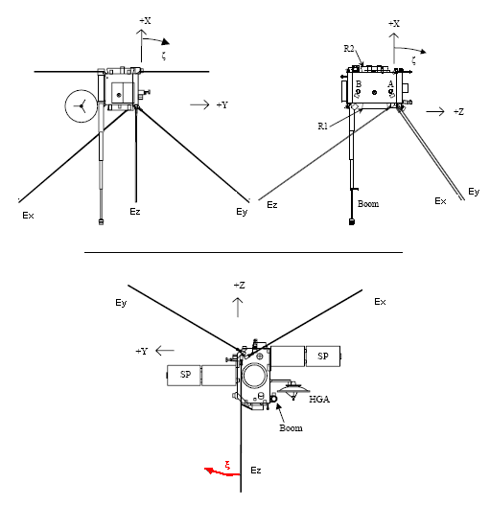
The STEREO/WAVES antenna calibration
The coordinate system

Slide 6

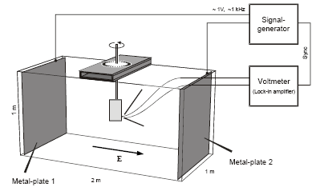
The STEREO/WAVES antenna calibration
A gold-plated model of the spacecraft is submerged into a water tank
A low-frequency electric field is applied
The response (induced voltage) of the antennas is measured as a function of spacecraft orientation
The effective length vectors and the antenna impedances can be computed from the data
Rheometry is only applicable to the quasi-static limit
Rheometry

Slide 7
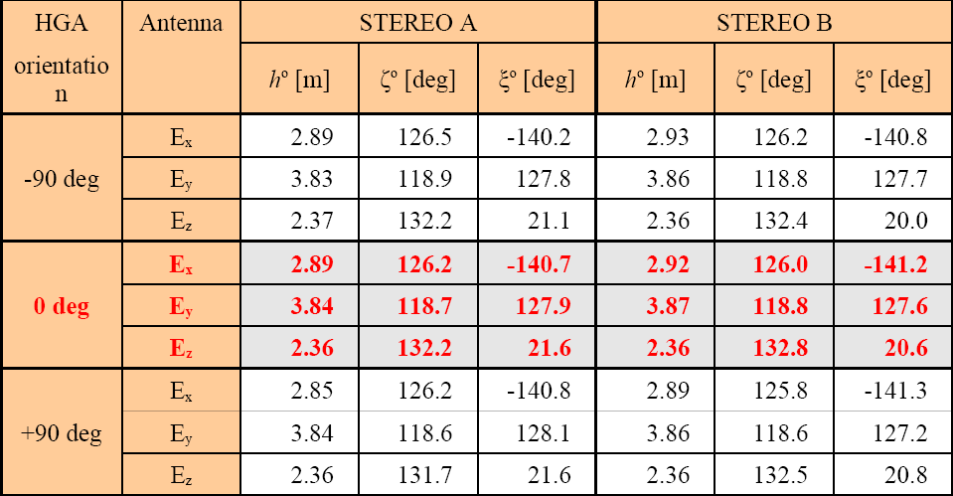
The STEREO/WAVES antenna calibration
Rheometry results

Slide 8
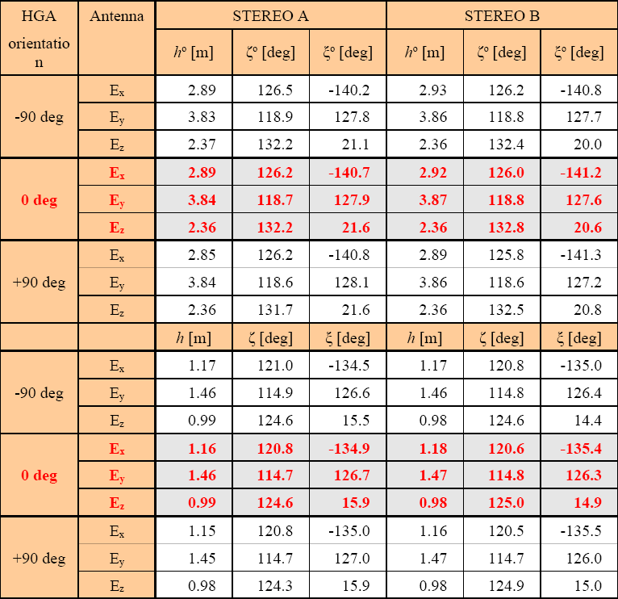
The STEREO/WAVES antenna calibration
open feeds
Rheometry results
loaded feeds

Slide 9


The STEREO/WAVES antenna calibration
The spacecraft is modeled as a grid of wires or patches
Then the currents along these wires/patches are computed
This calculation is done with ASAP (wires) and CONCEPT II (wires and patches)
On base of the current distribution, all other antenna properties (effective length vectors, impedances) can be calculated with MATLAB routines
The numerical method

Slide 10

The STEREO/WAVES antenna calibration
The equation governing the current distribution is the electric field integral equation (EFIE. CONCEPT), or the reaction integral equation (RIE, ASAP)
For patches, the magnetic field integral equation (MFIE, CONCEPT) is used
The antenna is excited at the feed
Due to reciprocity, the receiving antenna results in the same current distribution as the transmitting
The numerical method

Slide 11
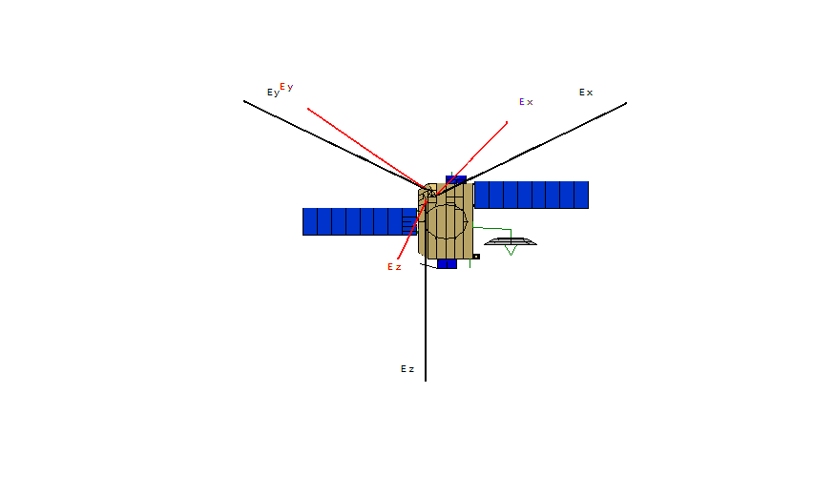
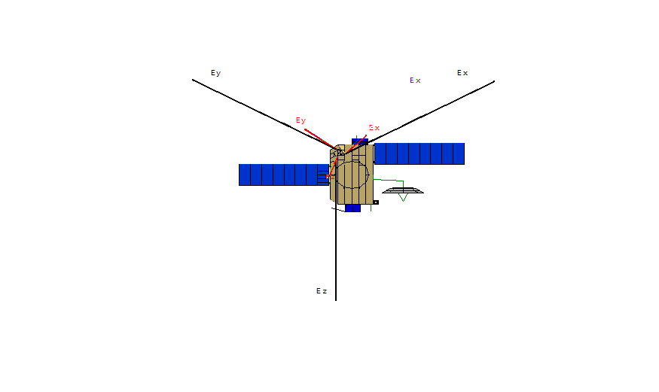
The STEREO/WAVES antenna calibration
Calculations were performed for open feeds and base capacitances of 90pF.
A correction for the real antenna diameters has to be applied on the ASAP results. CONCEPT can deal with real antenna diameters.
The numerical method

Slide 12
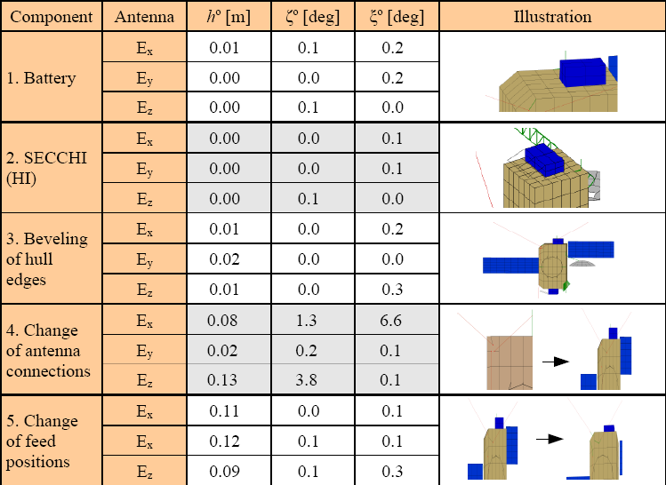
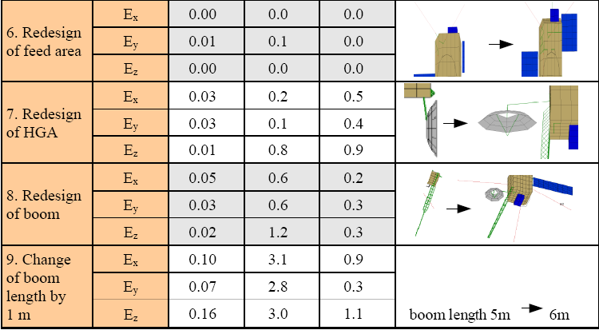
The STEREO/WAVES antenna calibration
The effect of changing the model

Slide 13
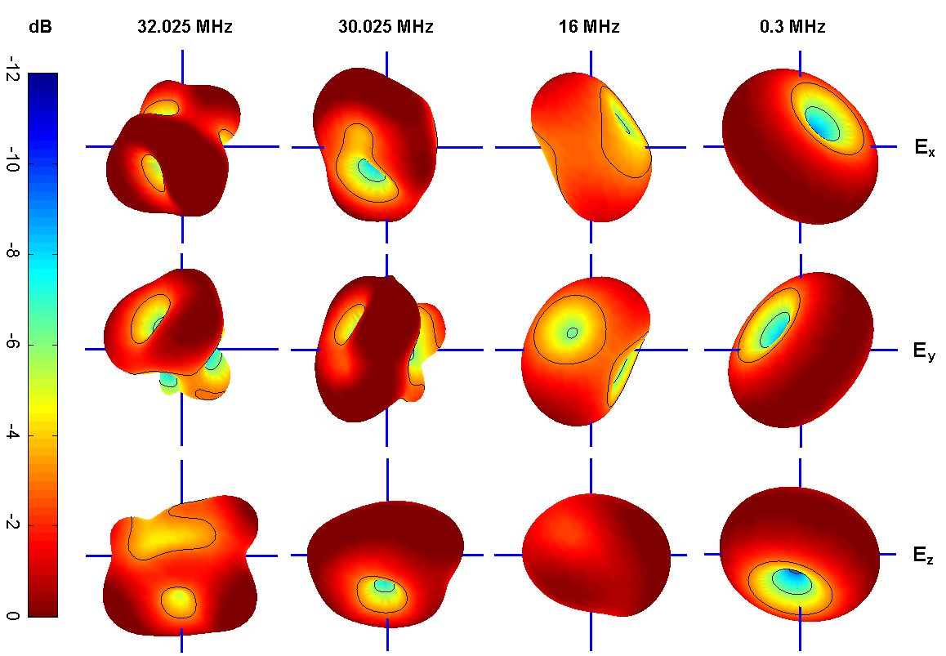
The STEREO/WAVES antenna calibration
Relative gain Pattern

Slide 14

The STEREO/WAVES antenna calibration
Spacecraft antennas are usually coupled to the surrounding space plasma.
The electromagnetic coupling can be modeled by a system of a resistance and a capacitance.
In rarefied plasma the coupling can not take place without photoelectrons.
The sheath thickness must not be larger than the antennas.
Including the plasma sheath
[Bale et. al. 2007]

Slide 15


The STEREO/WAVES antenna calibration
STEREO operates in solar wind conditions at 1AU.
The photo-electron production rate is higher than the thermal electron impact rate. --> positive charge.
i_{ph}...10⁻⁴Am⁻² [Fahrleson 1967]
A_{rel}...0.5
l=6m
d=1in (0.0254m) on average
Mean energy of photo-electrons=1.5eV [Grard 1973]
Mean energy of thermal electrons=10eV
Application
-->V=5.5V
n_{e}=10⁶m⁻³
-->n_{ph}(0)=2x10⁸m⁻³
-->2.5% of the photo-electrons reach the plasma.
-->λ_{sh} =0.6m or 0.4m, depending on the method.

Slide 16

The STEREO/WAVES antenna calibration
Using the appropriate equations, one finds:
  R_{s}=0.2MΩ
  C_{s}=87pF
Via these parameters the sheath can be included into the numerical antenna calibration (wire-grid).
Computation of the impedances show that the inclusion of the sheath has an effect.
Application

Slide 17

The STEREO/WAVES antenna calibration
Comparing the location of the second resonance of antenna E_{z} with measured data shows that the inclusion of the sheath capacitance has a corrective effect.
Further and more accurate data is needed to verify the model.
Application

Slide 18
The STEREO/WAVES antenna calibration
The End
Thank You for Your attention !

