Slide 1


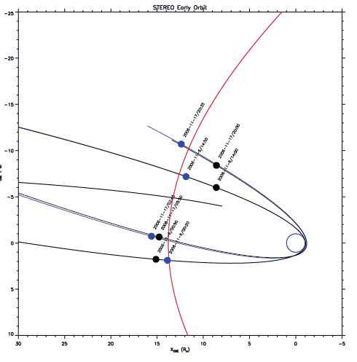
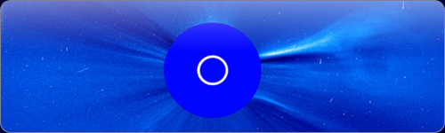
The Physics of the plasma sheath

Slide 2
The Physics of the plasma sheath
The space is filled with space plasma.
The plasma interacts with an object made of conducting material (spacecraft) which is immersed in the plasma.
A boundary zone forms around the body.
This boundary zone is called plasma sheath.
Basics

Slide 3
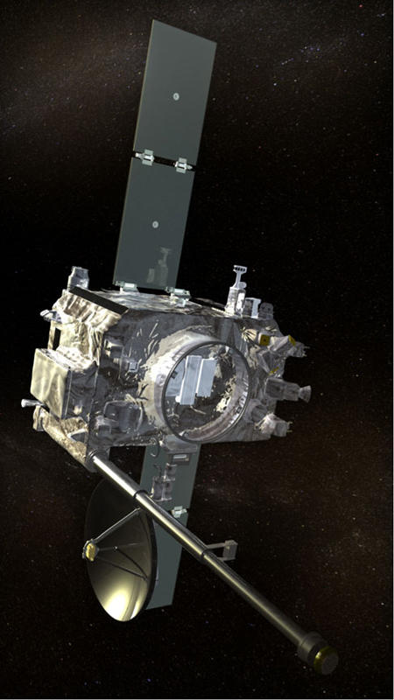
The Physics of the plasma sheath
2 or 3 different currents flow to the spacecraft, depending on the environment.
In a steady state condition the, sum of the currents must be zero.
Depending on the magnitude of the photo-electron current, the spacecraft can be charged positively or negatively.
Depending on the charging, there are two different forms of the sheath possible.
Basics
+
-
-
Ion current
Photoelectron
current
Electron
current

Slide 4
The Physics of the plasma sheath
No illumination --> only thermal electron- and ion-current.
At comparable temperatures the mean speed of the electrons will be higher.
--> more electrons hit the surface in a given time interval.
--> the S/C will be charged negatively.
--> the negative charge of the S/C pushes away the mobile electrons and attracts the ions.
--> an electron depletion zone forms around the S/C
--> the sheath thickness and S/C potential will adjust such that the currents have the same magnitude
Negatively charged spacecraft

Slide 5
The Physics of the plasma sheath
The number of photo-electrons exceeds the number of thermal electrons.
-->The body builds a positive charge such that the number of photoelectrons reaching the plasma is roughly equal to the number of thermal electrons impacting on the surface.
All other photo-electrons are unable to cross the potential difference and fall back to the surface.
These photoelectrons form an electron sheath.
They do not contribute to the photo-electron current.
Positively charged spacecraft

Slide 6



The Physics of the plasma sheath
The currents can be estimated.
All thermal electrons reach the surface, while only photoelectrons with a certain minimum energy.
The photoelectrons are roughly Maxwell distributed.[Grard 1973]
i_{ph} ...current density at the surface.
A_{rel}...relative illuminated area cross section.
The potential of the spacecraft can be deduced by equating thermal and photo-electron current.
The currents

Slide 7



The Physics of the plasma sheath
The photo-electron density at the surface can be found by using .
Equilibrium: Produced electrons=impacting electrons (ignoring ions)
A possible way to estimate the sheath thickness.
The densities

Slide 8


The Physics of the plasma sheath
The distribution of the photo-electron density.
The density of the thermal electrons can be derived as before.
The heavy ions are assumed not to be influenced by the potential gradient.
The densities

Slide 9



The Physics of the plasma sheath
Boundary Conditions
1D flat surface approximation.
Substitution of the densities results in a Poisson equation.
The governing differential equation

Slide 10
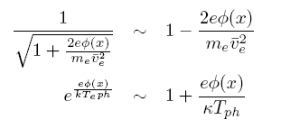


The Physics of the plasma sheath
Taylor expansion.
Assuming quasi-neutrality.
Only valid for small potential energies.
The solution is the sum of an exponential function and a constant.
Does not fulfill the boundary conditions.
One can define the shielding length.
The linearized equation

Slide 11

The Physics of the plasma sheath
Spacecraft antennas are usually coupled to the surrounding space plasma.
The electromagnetic coupling can be modeled by a system of a resistance and a capacitance.
In rarefied plasma the coupling can not take place without photoelectrons.
The sheath thickness must not be larger than the antennas.
Spacecraft antennas
[Bale et. al. 2007]

Slide 12



The Physics of the plasma sheath
The expressions for the positively charged spacecraft.
ε_{r} is the relative impedance tensor which depends on the model used.
Changes continuously along the sheath.
As a first approximation the mean value could be used.
Positively charged spacecraft

Slide 13


The Physics of the plasma sheath
STEREO operates in solar wind conditions at 1AU.
The photo-electron production rate is higher than the thermal electron impact rate. --> positive charge.
i_{ph}...10⁻⁴Am⁻² [Fahrleson 1967]
A_{rel}...0.5
l=6m
d=1in (0.0254m) on average
Mean energy of photo-electrons=1.5eV [Grard 1973]
Mean energy of thermal electrons=10eV
Application
-->V=5.5V
n_{e}=10⁶m⁻³
-->n_{ph}(0)=2x10⁸m⁻³
-->2.5% of the photo-electrons reach the plasma.
-->λ_{sh} =0.6m or 0.4m, depending on the method.

Slide 14

The Physics of the plasma sheath
Using the appropriate equations, one finds:
  R_{s}=0.2MΩ
  C_{s}=87pF
Via these parameters the sheath can be included into the numerical antenna calibration (wire-grid).
Computation of the impedances show that the inclusion of the sheath has an effect.
Application

Slide 15

The Physics of the plasma sheath
Comparing the location of the second resonance of antenna E_{z} with measured data shows that the inclusion of the sheath capacitance has a corrective effect.
Further and more accurate data is needed to verify the model.
Application

Slide 16
The Physics of the plasma sheath
The surface of a body immersed in space plasma interacts in a complicated way with the plasma.
The body is charged negatively or positively and a sheath is formed.
Models approximating the physics of the electron sheaths were derived and partly solved.
Representing the sheath by a combination of resistivity and capacitance, the coupling of the antenna to the space plasma can be incorporated into the numerical antenna calibration.
As an example, the STEREO/WAVES antennas were used.
The results are promising, but we have to validate the models used.
Many estimations have to be used in the models.
A uniform sheath around the spacecraft has been assumed.
The velocity of the spacecraft has been neglected.
Final Remarks

Slide 17
The Physics of the plasma sheath
The End
Thank You for Your attention !

