Slide 1
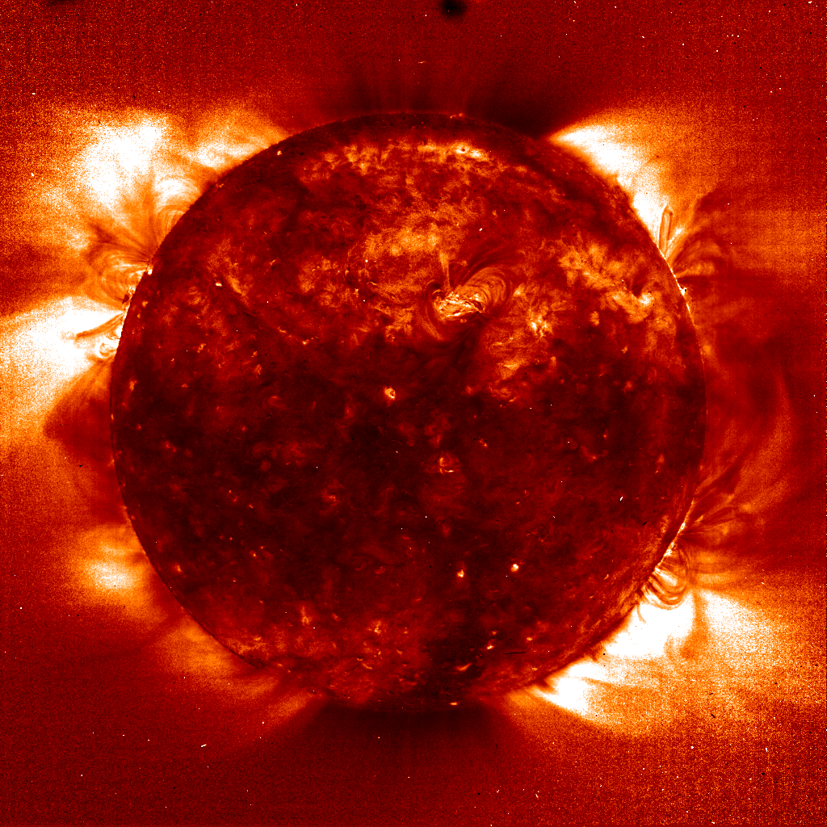
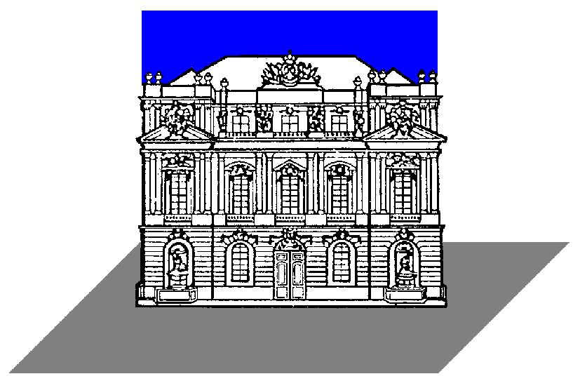

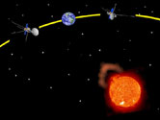
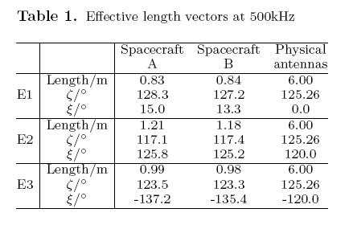
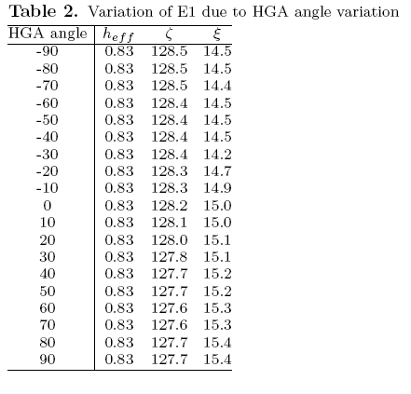
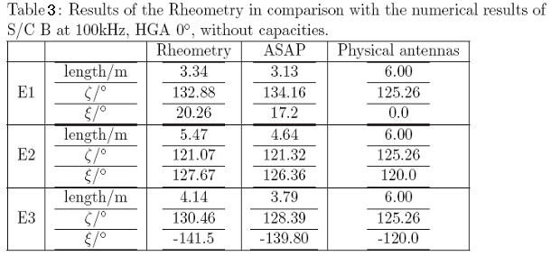
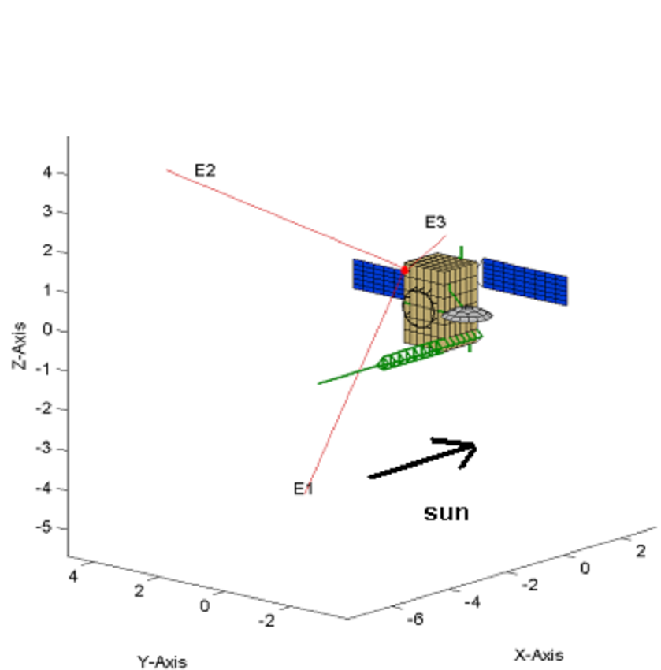
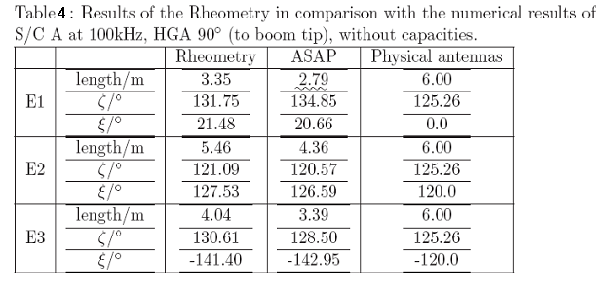
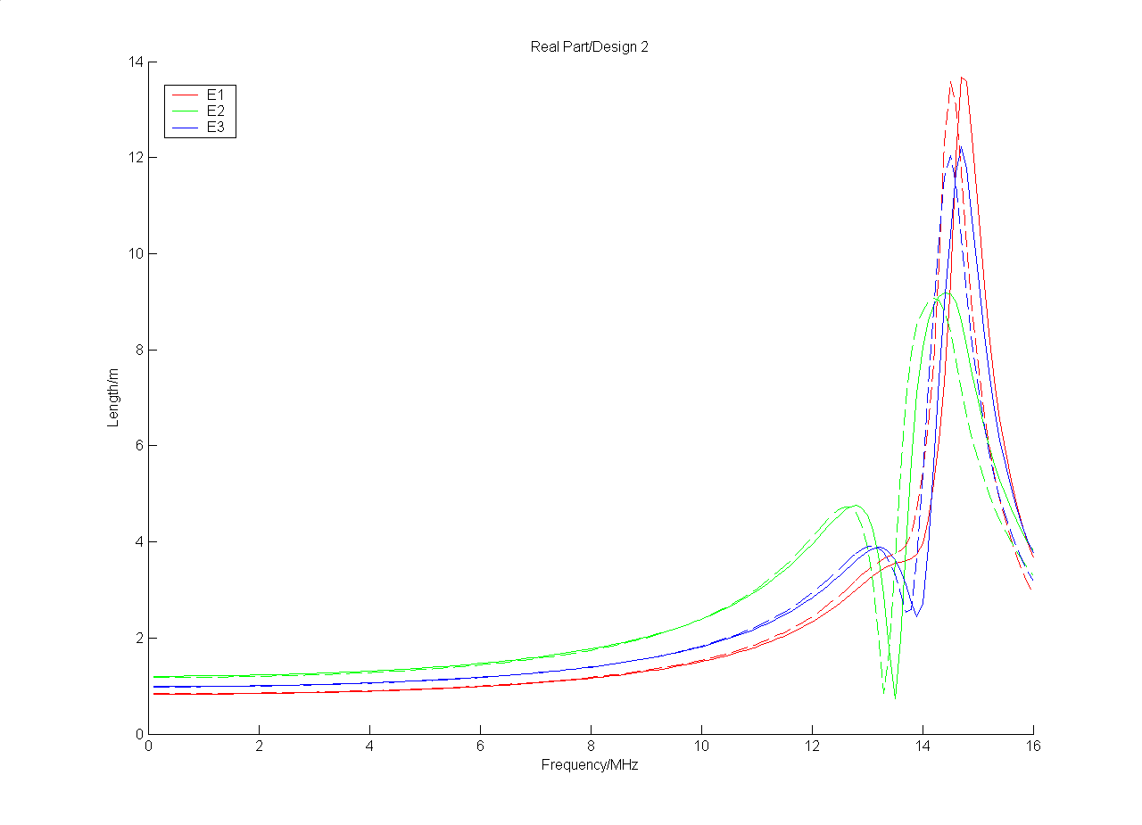
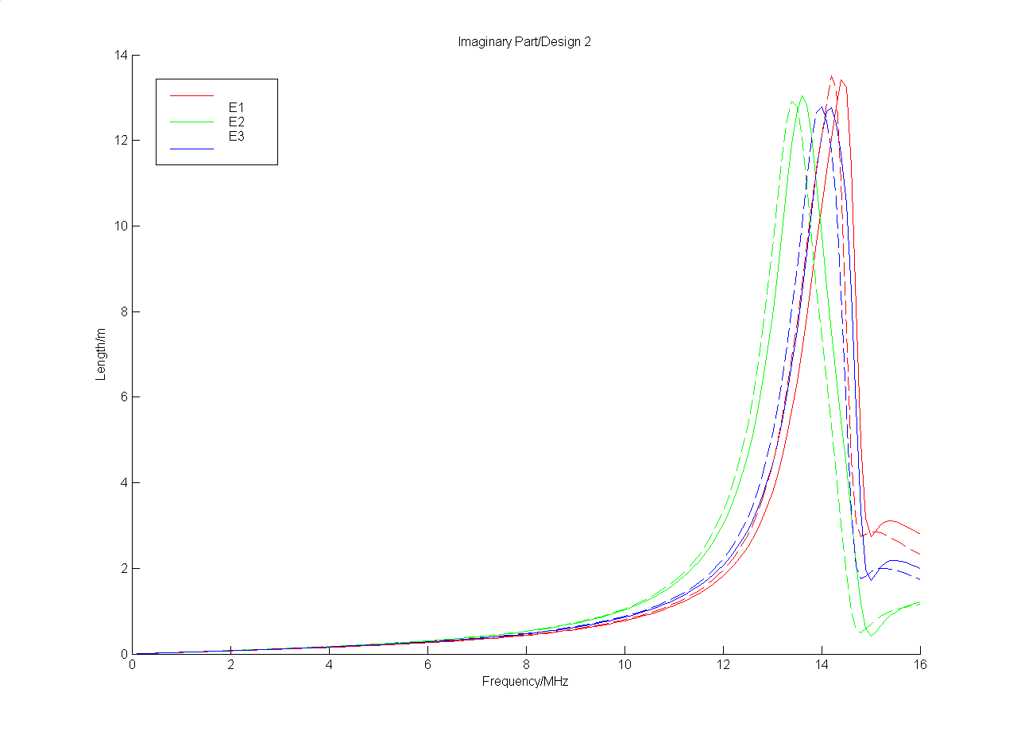
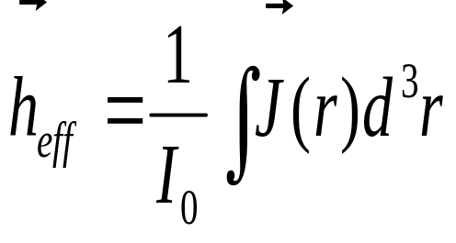
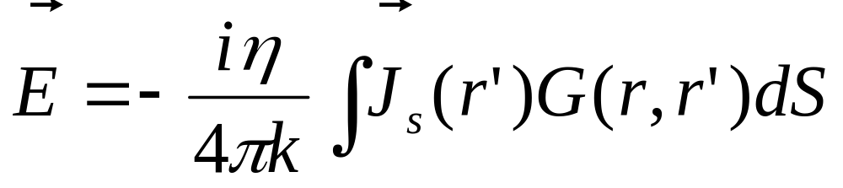
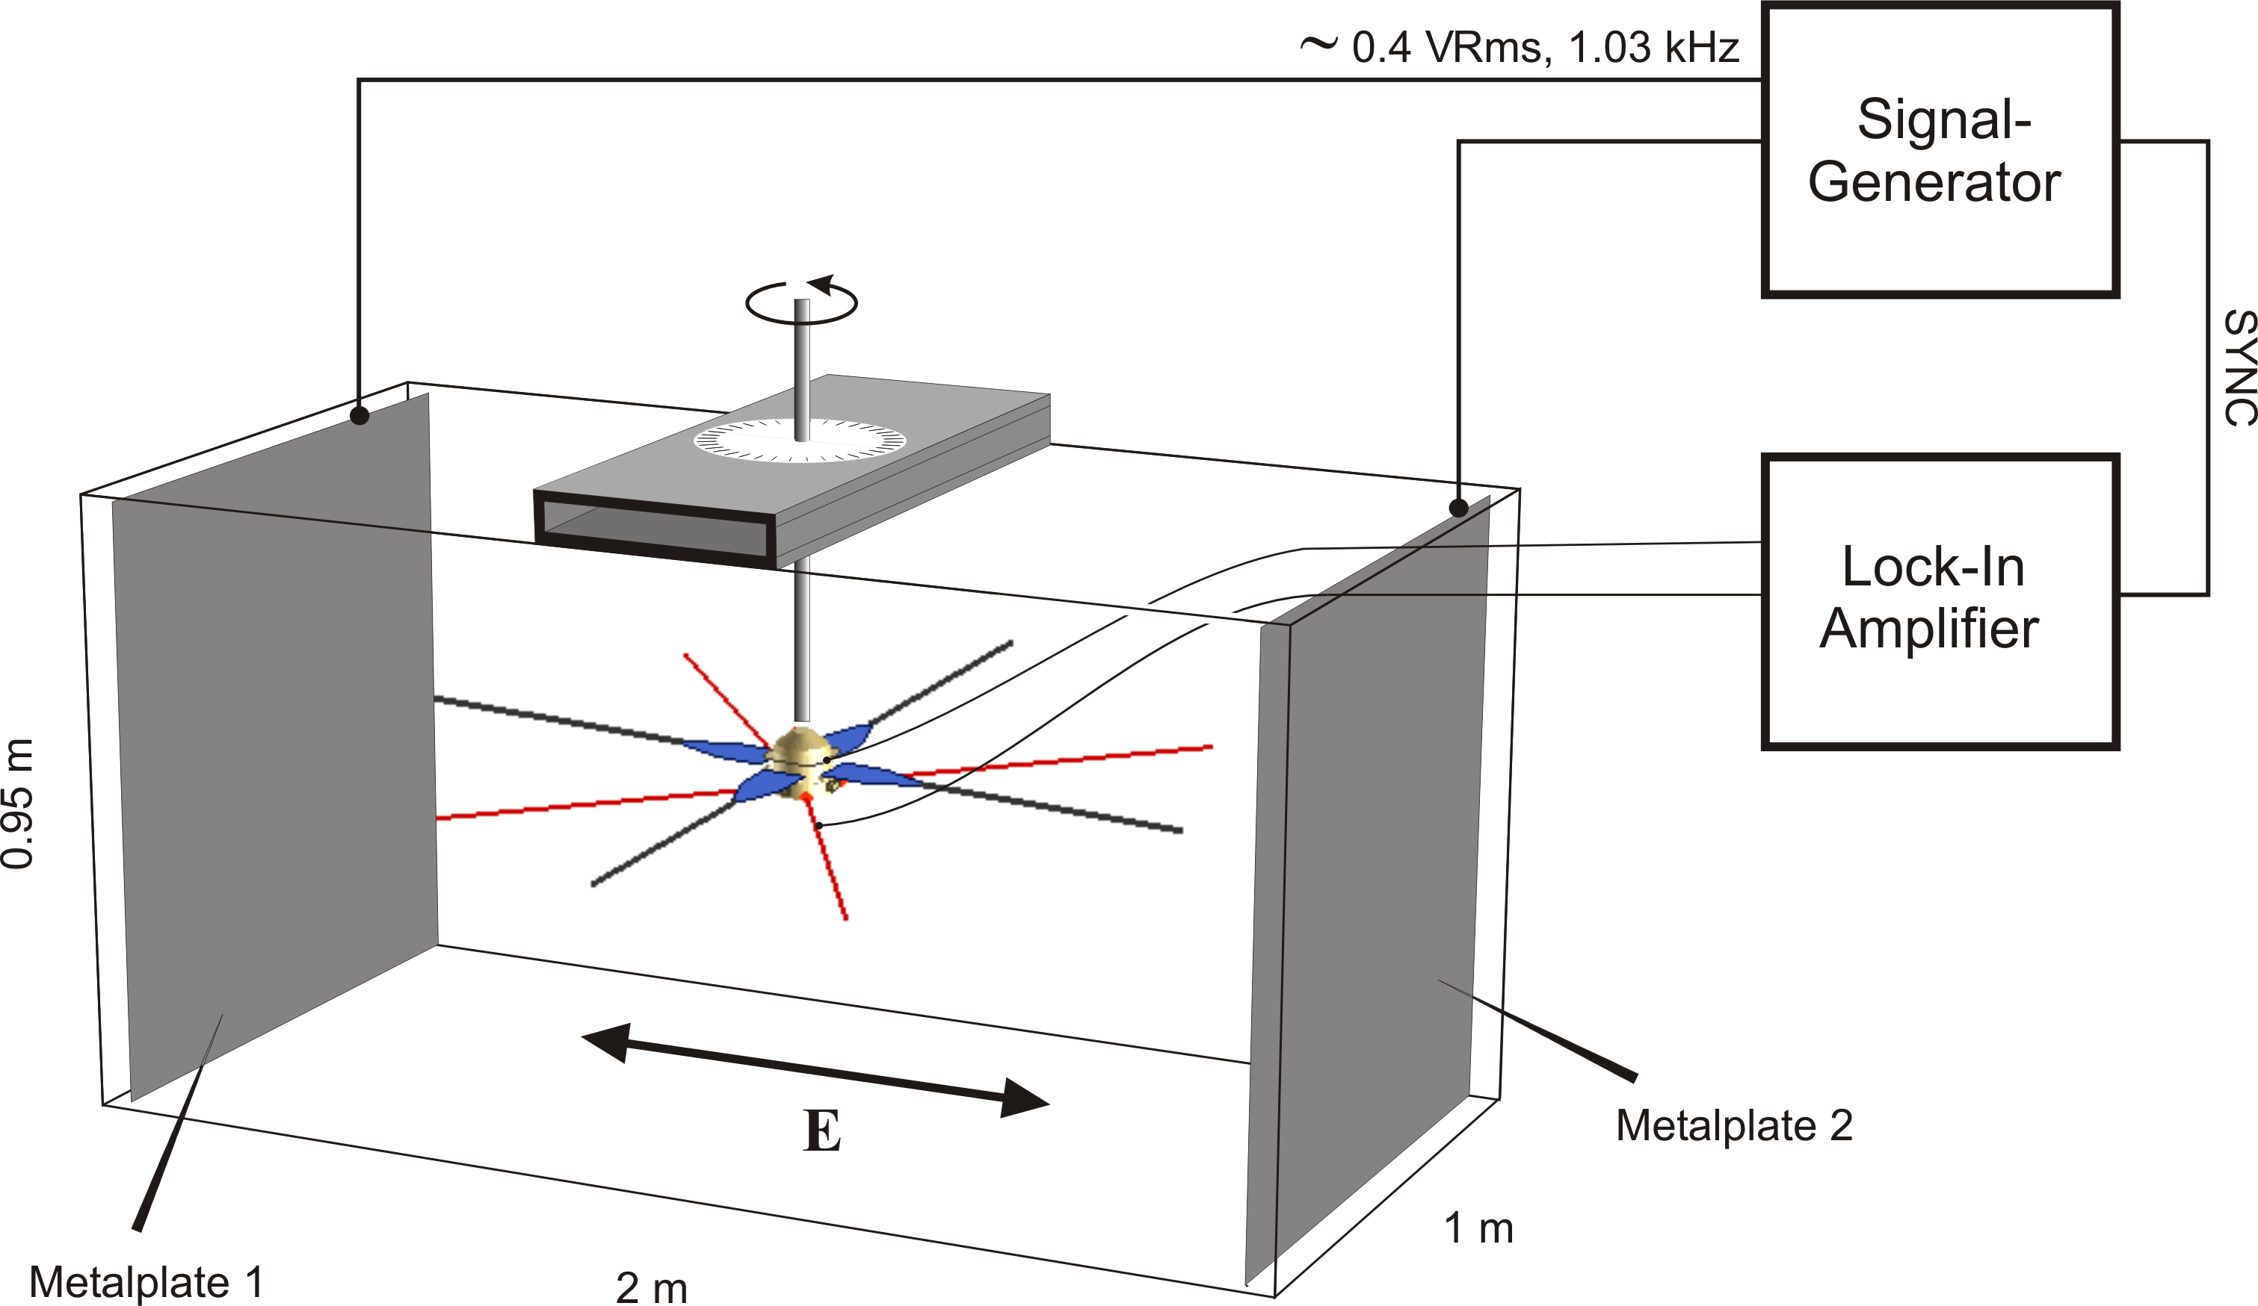
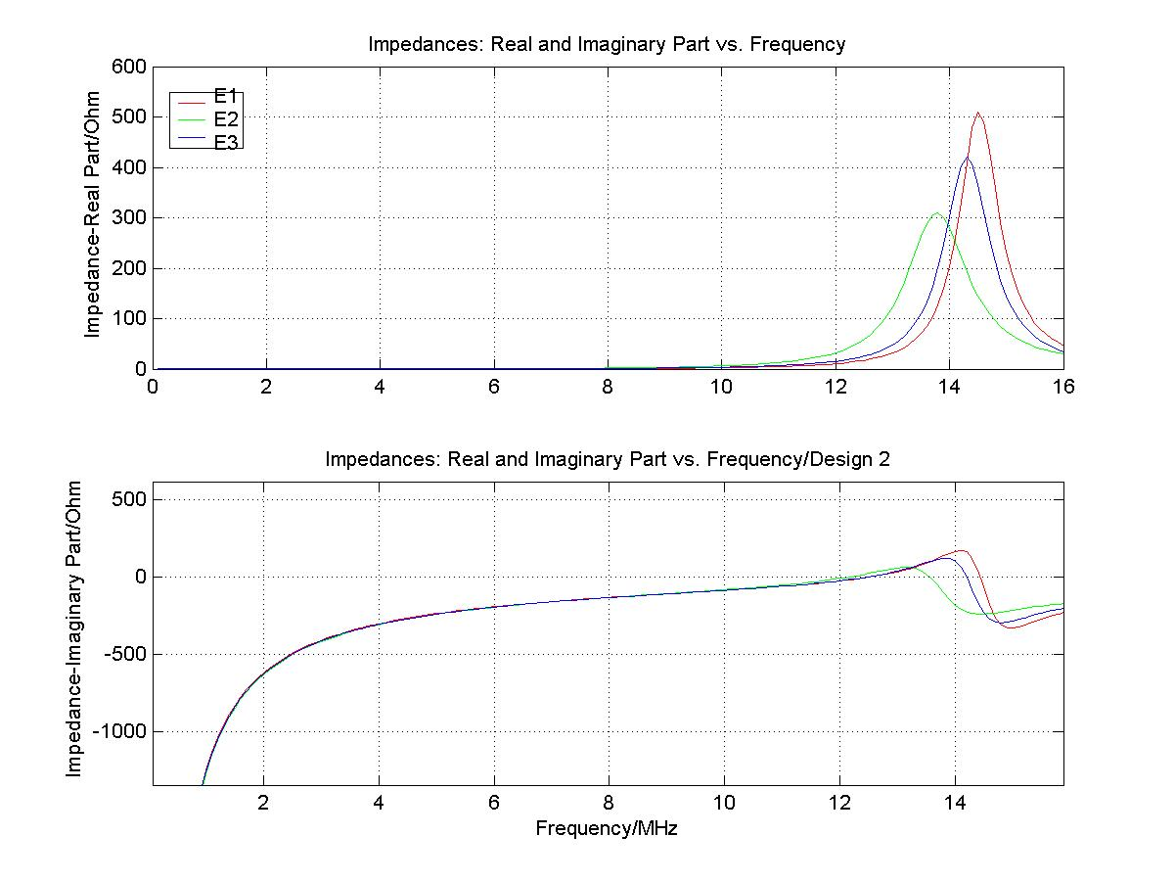
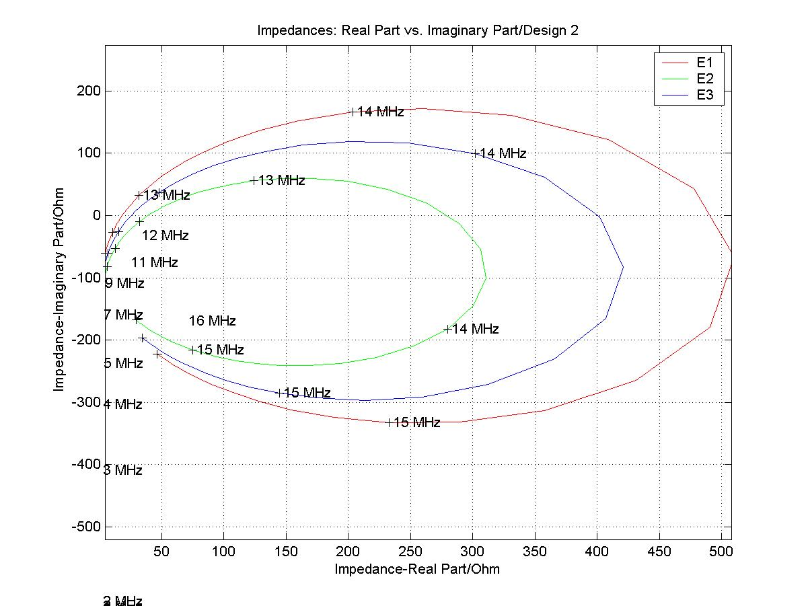
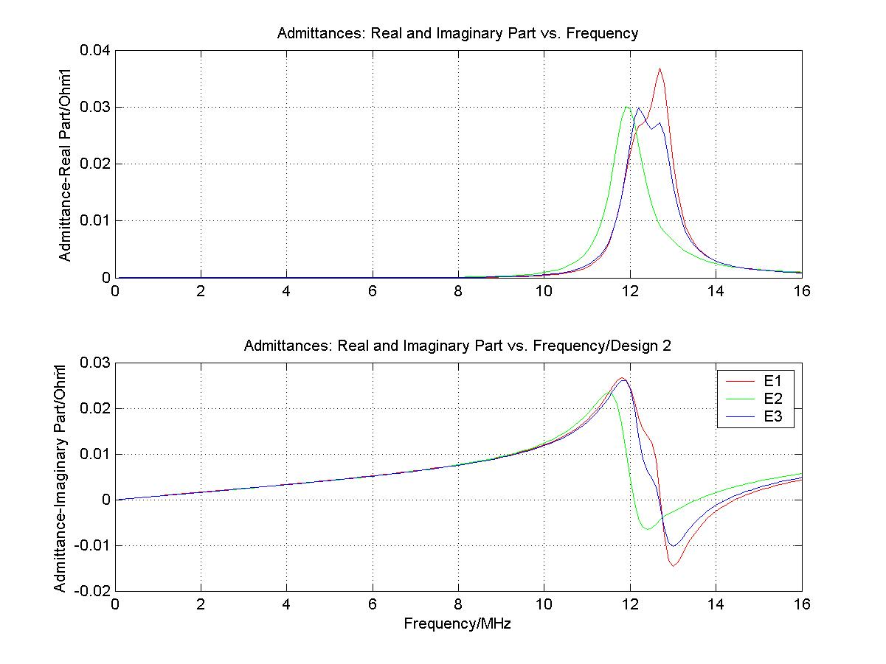
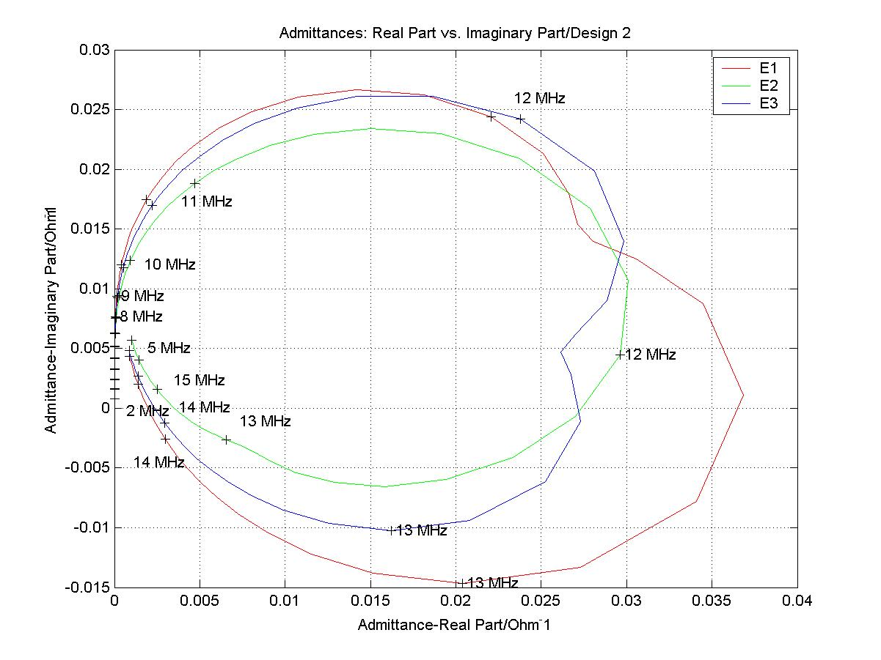
STEREO/WAVES antennas calibration: Implications for radio source triangulation
AGU05-SH-SH01_6199
T.H. Oswald (1), W. Macher (1), G. Fischer (1), H.O. Rucker (1), U. Taubenschuss(1) , J.L. Bougeret (2), A. Lecacheux (2), M.L Kaiser (3), K. Goetz (4)
Space Research Institute, Austrian Academy of Sciences, A-8042 Graz, Austria
Observatoire de Paris-Meudon, France
NASA/GSFC, Greenbelt, MD, USA,
University ofMinnesota, USA
ABSTRACT
THE RESULTS
NASA will launch in April 2006 the two STEREO spacecraft with the radio experiment, called SWAVES, which is designed to observe solar radio emissions by using direction finding capabilities. This method enables the triangulation of radio sources. The present paper provides the latest results on the determination of the effective antenna vectors and the methodology of direction finding. Further it gives some thoughts on the implications of the data interpretation, since higher frequency observations have direction of incidence dependent effective antenna vectors.
THE NUMERICAL METHOD
The numerical method for determining the effective length vectors is based on electromagnetic codes for the determination of antenna properties in a wide frequency range. At first, a wire grid model of the spacecraft is constructed (see figure 2). Then, numerical codes are used to get the current distribution on the surface of the antenna-spacecraft system.
Calculation of the current distribution on the surface of the spacecraft was done by using a modified version of the Antenna Scatterers Analysis Program (ASAP) which is a very popular open source electromagnetic code. The surface of the spacecraft and the antennas were modelled as a wire grid which is excited by an electromotive force of 1V at the feeds of the antennas. So the electric field integral equations (EFIE) can be used to calculate the currents along the wires, which is a good approximation to the actual current distribution on the real spacecraft if the modelling is done properly.
On the figure at the right the wire grid model of one of the STEREO spacecraft is shown. One can clearly see the larger boom, the solar panels and the high gain antenna. These features influence the antenna reception properties.
Figure 2: The wiregrid model
In this section there are four tables and two figures showing some results of the numerical and experimental antenna calibration. Since there is not enough space on this poster, only a small fraction of the available results can be shown here. For further results, please contact one of the authors.
As one can see on the diagrams, showing the real and imaginary parts of the effective vectors as function of the frequency, the resonances at ~12MHz change drastically the effective lengths of the antennas. The imaginary part vanishes as the frequency approaches zero, while the real part converges to the quasi-static limit. The direction of the incident wave was chosen to be the positive x-axis (direction of the sun).
THE SWAVES EXPERIMENT
The STEREO-WAVES (SWAVES) experiment is designed to track solar and interplanetary radio bursts and trace the generation and evolution of radio disturbances from the Sun to the Earth orbit and beyond. Each spacecraft has three, nearly orthogonal, antennas, capable of receiving electromagnetic waves in a frequency range between 30kHz and 16MHz. With this configuration, it is possible to perform direction finding at the lower end of the frequency range to determine the direction of incidence and the polarization of the received radiation. When both spacecraft receive radiation from the same source, the actual location of the source can be pinpointed by the method of triangulation.
Direction finding is the procedure of finding the direction of the incident wave and, in this context, also the procedure of finding the Stokes parameters. To successfully perform direction finding, it is of vital importance to know the antenna properties with great accuracy.
The antenna properties of a receiving antenna can be described in a very concise manner by use of the effective length vector.
J is the current density and I₀ is the current at the gap.h_{eff} is the effective length vector.
METHODS OF ANTENNA CALIBRATION
J is the surface current density, G is the retarded Green function, η is the impedance of free space and k is the wave number. The surface integral can be used because the whole spacecraft surface is made of conducting material. This integral equation has to be solved in conjunction with the well known boundary conditions. The integral can be reduced to a scalar integral for the case of a cylindrical wire. Additionally the transverse currents on the wire are ignored and the currents are represented by single filaments along the wire axes. So the boundary conditions have to be satisfied only in axial direction. This equation can be solved by the Method of Moments (MOM) which was developed in this form by Roger Harrington. The integral equation is converted into a matrix equation which can be solved numerically. Hereby the current along each wire is represented as the sum of a set of two weighed sinusoidal base functions.
There are 3 methods to determine the effective length vectors spacecraft antennas.
Rheometry Setup
IMPEDANCES AND ADMITTANCES
Figure 1:
Numerical computation
Rheometry (see figure 1)
Inflight calibration
The following plots show the diagonal elements of the Impedance and Admittance matrix of spacecraft A as a function of frequency. The total base capacitance (receiver, cable and antenna mounting) was estimated to be 90 pF. The first resonance occurs at the frequency when the imaginary part is zero.
Each of the three methods has its advantages so they complement each other. For the STEREO antennas we have performed the numerical determination and the rheometry up to now.
From these currents, the effective length vectors, the fields and the impedances can be computed. This was done by using our Matlab toolbox. The main advantage of this method is flexibility with regard to the representation of spacecraft parts, which can easily be altered to test their influence on antenna properties. Furthermore it enables an estimation of an upper frequency limit below which the quasi-static results are valid.
Except near the plasma resonance frequencies, all electric antennas have a length which is shorter than the length of the physical antennas, as expected by theory for monopole antennas that are small in relation to the wavelength. It can clearly be seen that the solar panels push the electric antennas towards the negative x-axis with a counteracting influence of the boom. The total base capacitance (receiver, cable and antenna mounting) was estimated to be 90 pF.
References
Cecconi, B., P. Zarka, and D. Vogl, Direction finding and antenna calibration through analytical inversion of radio measurements performed using a system of 2 or 3 electric dipole wire antennas, EGU 1st General Assembly, April 2004.
Fischer, G., W. Macher, H.O. Rucker, H.P. Ladreiter, D.F. Vogl and the Cassini/RPWS Team: Wire-grid modeling of Cassini spacecraft for the determination of effective antenna length vectors of the RPWS antennas. In: Planetary Radio Emissions V,
Fischer, G., W. Macher, H.O. Rucker and the Cassini/RPWS team: Reception properties of the Cassini/RPWS antennas from 1 to 16 MHz, EGS-AGU-EUG Joint Assembly, Nice, April 2003.
Ladreiter, H.P., P. Zarka, A. Lecacheux, W. Macher, H.O. Rucker, R. Manning, D.A. Gurnett, W.S. Kurth: Analysis of electromagnetic wave direction finding performed by spaceborne antennas using singular value decomposition techniques, Radio Sci., 30, 1699-1712, 1995.
Macher, W., and T. Vejda, Design of antenna grid structures. Manual to the MATLAB toolbox. Austrian Academy of Sciences, IWF-144, January 2003.
Oswald, T.H., W. Macher, G. Fischer, H.O. Rucker: First results of STEREO/WAVES antenna calibration, Austrian Academy of Sciences, IWF-160 (2004)
Oswald, T.H., W. Macher, G. Fischer, H.O. Rucker: Results of STEREO/WAVES antenna calibration using a refined spacecraft model, Austrian Academy of Sciences, IWF-167 (2005)
Oswald, T.H., Electromagnetic waves in space and the STEREO/SWAVES experiment, Master Thesis, University Graz and Technical University Graz (2005)
Rucker, H.O., W. Macher, and S. Albrecht, Experimental and theoretical investigations on the Cassini RPWS antennas. In: Planetary Radio Emissions IV, H. O. Rucker, S. J. Bauer, and A. Lecacheux (Eds.), Austrian Academy of Sciences Press, Vienna, 327-337, 1997.
Rucker, H.O., W. Macher, R. Manning, and H. P. Ladreiter, Cassini model rheometry, Radio Sci., 31, 1299-1311, 1996.
Rucker H.O., M.L. Kaiser, Y. Leblanc (Eds.), Austrian Academy of Sciences Press, Vienna, 347-356, 2001.
Rucker H.O., W. Macher G. Fischer, T.H. Oswald, J.-L. Bougeret, M.L. Kaiser, K. Goetz, Analysis of spacecraft antenna systems: Implications for STEREO/WAVES, Adv. Space Res, in press, 2005.
´Vogl, D.F., B. Cecconi, W. Macher, P. Zarka, H.P. Ladreiter, P. Fedou, A. Lecacheux, T. Averkamp, G. Fischer, H.O. Rucker, D.A. Gurnett, W.S. Kurth, G.B. Hospodarsky, In-flight calibration of the Cassini-RPWS antenna system for direction finding and polarization measurements, J. Geophys. Res., 109,A09S17, DOI: 10.1029/2003JA010261, 2004.
Conclusion: The calibration of the STEREO/WAVWS antennas was performed by using a numerical and an experimental method. The results are consistent, as far as we can judge today. Nevertheless much work has to be done to refine the numerical method and further analyze the data of the rheometry. Inflight calibration, which is planned for the early phase of the mission, when the spacecraft are located near earth, will be a valuable complement to check and verify the results of the methods presented on this poster.

