Slide 1
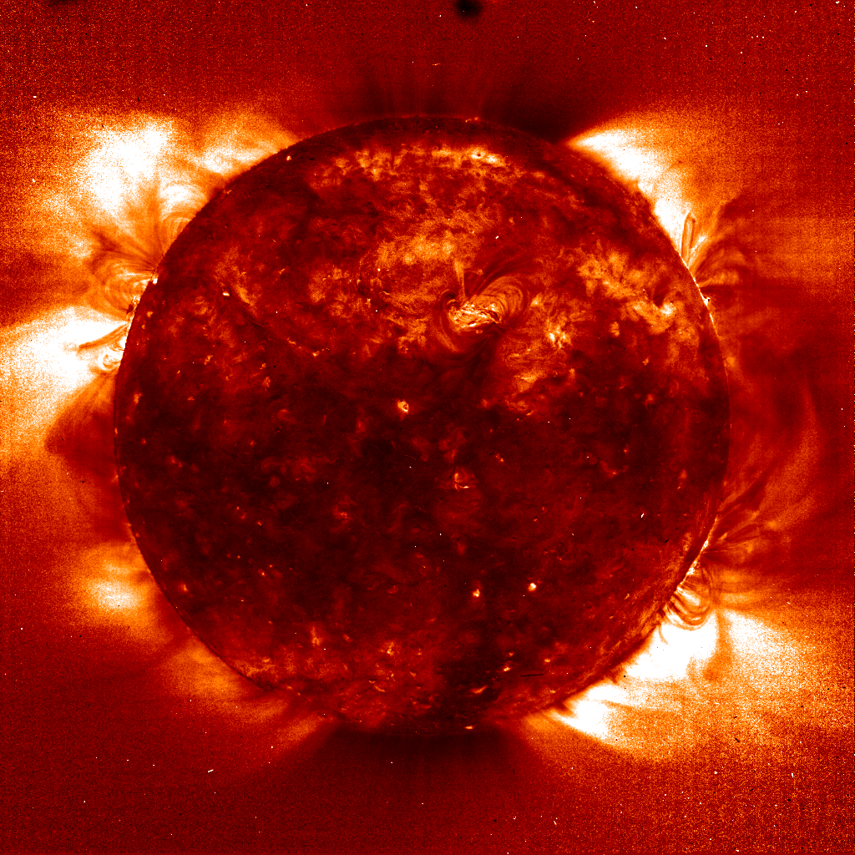
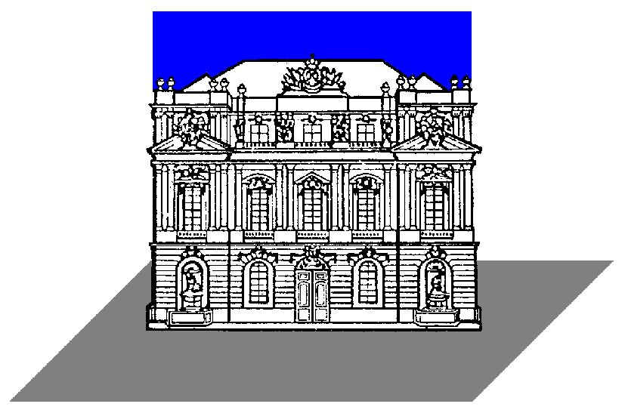

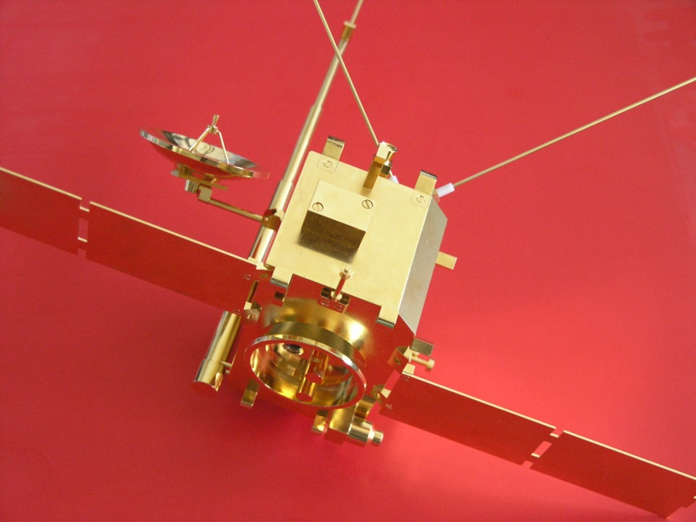
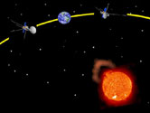
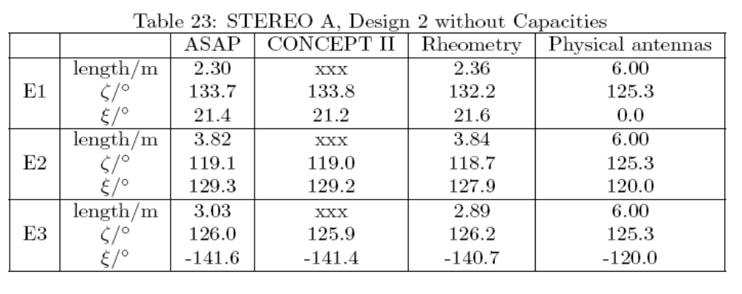
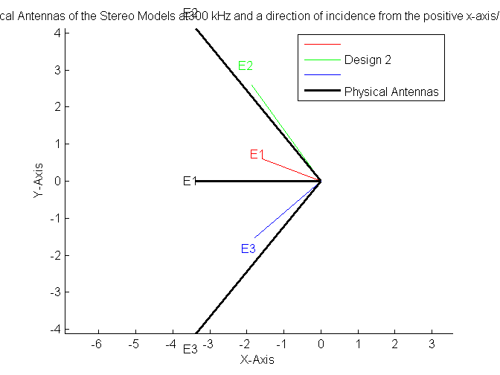
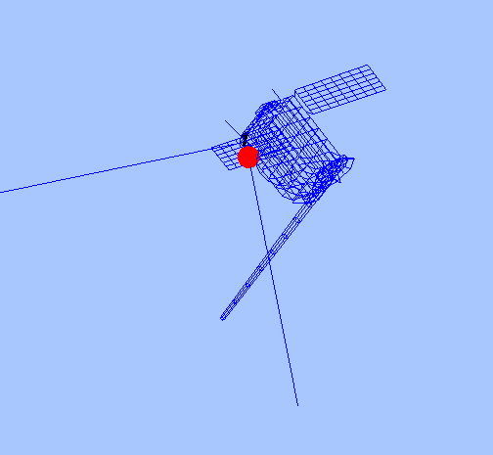
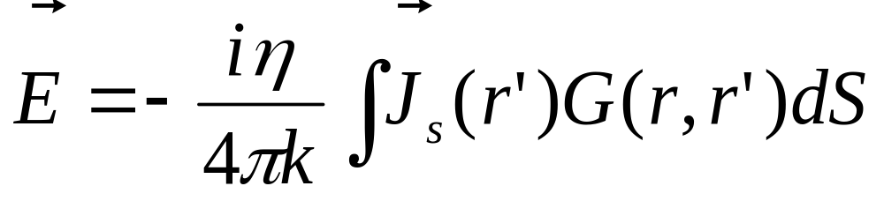
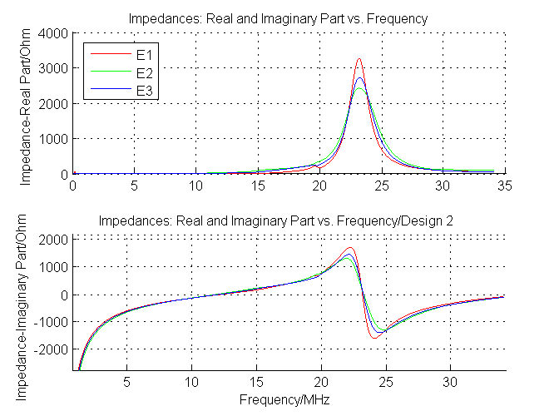
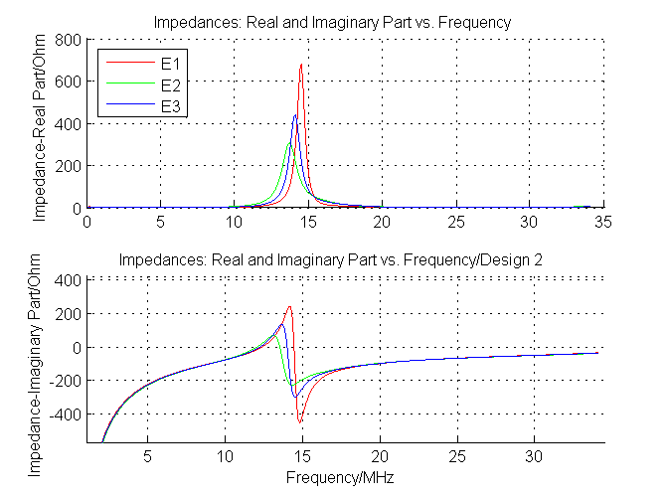
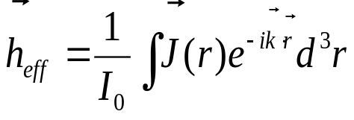
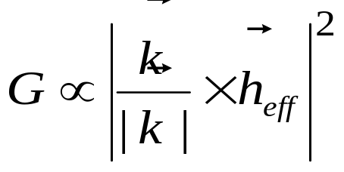

Various methods of calibration of the STEREO/SWAVES antennas
T.H. Oswald (1), W. Macher (1), H.O. Rucker (1), G. Fischer (2), U. Taubenschuss(1),
^{JL. Bougeret (3),} A. Lecacheux(3), M.L Kaiser (4), K. Goetz (5)
COSPAR2006
E2.1-0057-06
Space Research Institute, Austrian Academy of Sciences, A-8042 Graz, Austria; (2) University of Iowa, USA
(3) Observatoire de Paris-Meudon, France; (4) NASA/GSFC, Greenbelt, MD, USA; (5) University of Minnesota, USA;
ABSTRACT
THE EXPERIMENTAL METHOD
In 2006, NASA’s two STEREO spacecraft will be launched. On board, they carry a sophisticated radio experiment, called SWAVES, which is designed to increase our knowledge of the physics of the solar system. The key technology, used by SWAVES is the direction finding capability in addition to the use of two spacecraft. This new method makes it possible to triangulate radio sources. Direction finding requires the reception properties of the antennas to be known very accurately. We performed several different methods to calibrate the SWAVES antennas. In this paper, the methods are described and compared and the results are presented and discussed with respect to advantages and disadvantages of the different methods.
Rheometry is an experimental technique to determine the effective length vectors of antennas in the quasi-static frequency range, where the wave length is much greater than the dimension of the antenna system. Its advantages are that the antenna system (antennas as well as spacecraft) can be modelled in great detail and that the used measurement set-up is pretty much disturbance-free, contrary to the standard high-frequency measurements.
THE SWAVES EXPERIMENT
Merits. Either method has its own advantages. Rheometry can be far more detailed than it would be possible for the wire-grid simulations, so the influence of the fine structure of the spacecraft can be estimated by comparison of the two methods. Rheometry is therefore a good basis to decide about improvements of wire-grids, it further yields a purely quasi-static result, which must agree with the asymptotic limit of the numeric calculations as the frequency converges to zero. The advantage of the computer simulation is the flexibility regarding the model structure, so it can be used to study the perturbation of antenna properties provoked by single spacecraft parts. Of course, the decisive advantage is that electromagnetic codes are devised for high-frequency analysis up to frequencies far above the resonance, thereby enabling the estimation of the validity range of the quasi-static results.
NASA will launch the two STEREO spacecraft with the radio experiment, called SWAVES, in 2006 which is designed to observe solar radio emissions by using direction finding capabilities.
The STEREO-WAVES (SWAVES) experiment is designed to track solar and interplanetary radio bursts and trace the generation and evolution of radio disturbances from the Sun to the Earth orbit and beyond. Each spacecraft has three, nearly orthogonal, antennas, capable of receiving electromagnetic waves in several frequency ranges. The main operation range of the receivers is between 30kHz and 16MHz. With this configuration, it is possible to perform direction finding at the lower end of the frequency range to determine the direction of incidence and the polarization of the received radiation. When both spacecraft receive radiation from the same source, the actual location of the source can be pinpointed by the method of triangulation.
THE RESULTS
Since the calibration of spacecraft antennas produces a large amount of data, we can present only some examples on this poster. In the corresponding paper more data will be published. Table 1 showss A comparison between the experimental and the two numerical methods. The spacecraft coordinate axes are defined as follows: The X-axis is directed opposite to the boom, the Y-axis parallel to the axes of the solar panels, the Z-axis completes the right-handed triad. The antenna axes are given in spherical coordinates with regard to the reference frame (-Z,Y,X), i.e. colatitudes ζ from +X and azimuth ξ from -Z towards Y. Results are given for open antenna ports at 300 kHz, which is well below the quasi-static limit. The results for the loaded ports will be presented in the article. One can clearly see that the three methods give very consistent results. A further way of verifying the computation will be the in-flight calibration.
For the correct interpretation of the produced data it is of vital importance to know the antenna properties with great accuracy. We performed the antenna calibration using two numerical and one experimental method. Each method has its own merits. The results are very consistent.
Table 1:
THE NUMERICAL METHOD
The numerical method for determining the relevant antenna properties is based on electromagnetic codes. At first, a wire-grid model of the spacecraft is constructed (see adjacent figure). Then, numerical codes are used to get the current distribution on the surface of the antenna-spacecraft system.
Calculation of the current distribution on the surface of the spacecraft was done by using two programs, a modified version of the Antenna Scatterers Analysis Program (ASAP) which is a very popular open source program based on a well proved electromagnetic code and CONCEPT II, a proprietary software written at the University of Hamburg-Harburg. Each program uses its own representation of the currents along the wires which result in slightly different results. The consistency of the two results is a good indication for the validity of the method and the modelling process. In both cases the surface of the spacecraft and the antennas were modelled as a wire grid which is excited by an electromotive force of 1V at the feeds of the antennas. So the electric field integral equations (EFIE) can be solved for the currents along the wires, which is a good approximation to the actual current distribution on the real spacecraft if the modelling is done properly.
E is the electric field of the incident wave, J is the surface current density, G is the retarded Green function, η is the impedance of free space and k is the wave number. Surface currents can be used because the whole spacecraft surface is made of conducting material.
This integral equation has to be solved in conjunction with the well known boundary conditions. The integral can be reduced to a scalar integral for the case of a cylindrical wire. Additionally the transverse currents on the wire are ignored and the currents are represented by single filaments along the wire axes. So the boundary conditions have to be satisfied only in axial direction. This equation can be solved by the Method of Moments (MOM) which was developed in this form by Roger Harrington [Harrington, 1968]. The integral equation is converted into a matrix equation which can be solved numerically. Hereby the current along each wire is represented as the sum of a set of two weighed sinusoidal base functions.
Above, the capacitance matrix for STEREO A is shown, which comprises the self and mutual capacitances of the antennas, as determined by means of numerical calculation. They have to be corrected for the actual radius of the antennas. The experimental method gives similar values.
This figure shows the physical and electrical antennas as computed with the help of the ASAP program. The calculation was done for 300 kHz and open feed for spacecraft A.
Sun
THE IMPEDANCES
The following figures show the diagonal elements of the Impedance Matrix of spacecraft A as a function of frequency with and without consideration of the base capacitances which were estimated to be 90 pF. The calculation was performed by using ASAP.
Based on these currents, the effective length vectors, the fields, the radiation pattern and the impedances can be computed. This was done by using Matlab functions. The main advantage of this method is flexibility with regard to the representation of spacecraft parts, which can easily be altered to test their influence on antenna properties. The total base capacitance (receiver, cable and antenna mounting) was estimated to be 90 pF.
The effective length vector h_{eff} is a very useful representation of the receiving property of an antenna. It
can be computed using the formula:
Using the effective length vector, the response of an antenna to an incident wave can be formulated as
The effective length vector can be used to compute the
Gain:
Except near the plasma resonance frequencies the effective length vectors are always shorter than the physical antenna rods.
Without Capacitances
With Capacitances
The magnitude of the real and imaginary parts of the impedances of the three antennas is generally smaller when the base capacitances are included. In both cases there is a resonance, which is slightly shifted due to the included capacitances. Near the resonances the behavior of the antenna can vary considerably. Hence is of vital importance that the calibration of the antennas is done with great care near these frequencies.
References
Acknowledgement: The research leading to this poster was made possible by a project within the framework of the Austrian Space Applications Programme (ASAP-CO-001-05) of the Austrian Research Promotion Agency.
Cecconi, B., P. Zarka, and D. Vogl, Direction finding and antenna calibration through analytical inversion of radio measurements performed using a system of 2 or 3 electric dipole wire antennas, EGU 1st General Assembly, April 2004.
Fischer, G., W. Macher, H.O. Rucker, H.P. Ladreiter, D.F. Vogl, Cassini/RPWS Team: Wire-grid modeling of Cassini spacecraft for the determination of effective antenna length vectors of the RPWS antennas. In: Planetary Radio Emissions V, H.O. Rucker, M.L. Kaiser, Y. Leblanc (Eds.), Austrian Academy of Sciences Press, Vienna, 347-356, 2001.
Fischer, G., W. Macher, H.O. Rucker and the Cassini/RPWS team: Reception properties of the Cassini/RPWS antennas from 1 to 16 MHz, EGS-AGU-EUG Joint Assembly, Nice, April 2003.
Harrington, R., Field Computation by Moment Methods, Robert E. Krieger Publishing Company, 1968.
Ladreiter, H.P., P. Zarka, A. Lecacheux, W. Macher, H.O. Rucker, R. Manning, D.A. Gurnett, W.S. Kurth: Analysis of electromagnetic wave direction finding performed by space-borne antennas using singular value decomposition techniques, Radio Sci., 30, 1699-1712, 1995.
Macher, W., and T. Vejda, Design of antenna grid structures. Manual to the MATLAB toolbox. Austrian Academy of Sciences, IWF-144, 2003.
Oswald, T.H., W. Macher, G. Fischer, H.O. Rucker: First results of STEREO/WAVES antenna calibration, Austrian Academy of Sciences, IWF-160, 2004.
Oswald, T.H., W. Macher, G. Fischer, H.O. Rucker: Results of STEREO/WAVES antenna calibration using a refined spacecraft model, Austrian Academy of Sciences, IWF-167, 2005.
Oswald, T.H., Electromagnetic waves in space and the STEREO/SWAVES experiment, Master Thesis, University Graz and Technical University Graz, 2005.
Rucker, H.O., W. Macher, and S. Albrecht, Experimental and theoretical investigations on the Cassini RPWS antennas. In: Planetary Radio Emissions IV, H. O. Rucker, S. J. Bauer, and A. Lecacheux (Eds.) Austrian Academy of Sciences Press, Vienna, 327-337, 1997
Rucker, H.O., W. Macher, R. Manning, and H. P. Ladreiter, Cassini model rheometry, Radio Sci., 31, 1299-1311, 1996.
Rucker, H., W. Macher, G. Fischer, T.H. Oswald, J.-L. Bougeret, M. Kaiser, and K. Goetz, Analysis of spacecraft antenna systems: Implications for stereo/waves, Adv. Space Res.,36,1530-1533, doi: 10.1016/j.asr.2005.07.060, 2005.
Vogl, D.F., B. Cecconi, W. Macher, P. Zarka, H.P. Ladreiter, P. Fedou, A. Lecacheux, T. Averkamp, G. Fischer, H.O. Rucker, D.A. Gurnett, W.S. Kurth, G.B. Hospodarsky, In-flight calibration of the Cassini-RPWS antenna system for direction finding and polarization measurements, J. Geophys. Res., 109, doi:10.1029/2003JA010261, 2004.

