Slide 1
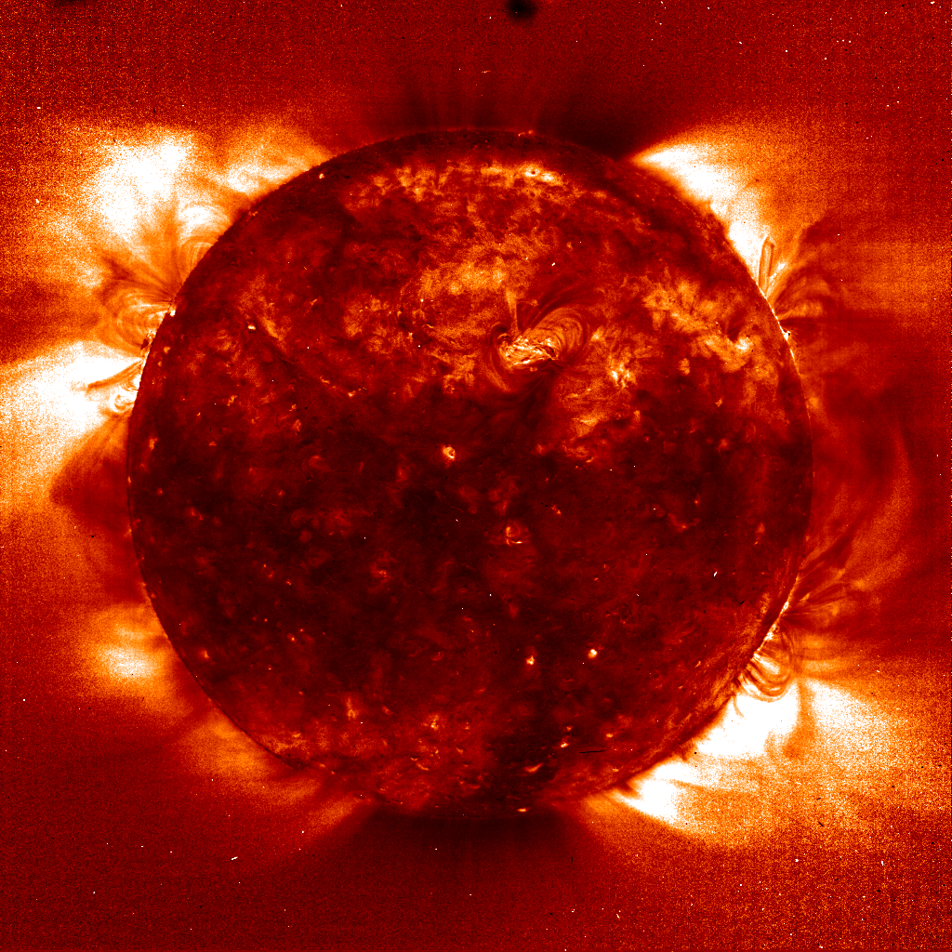
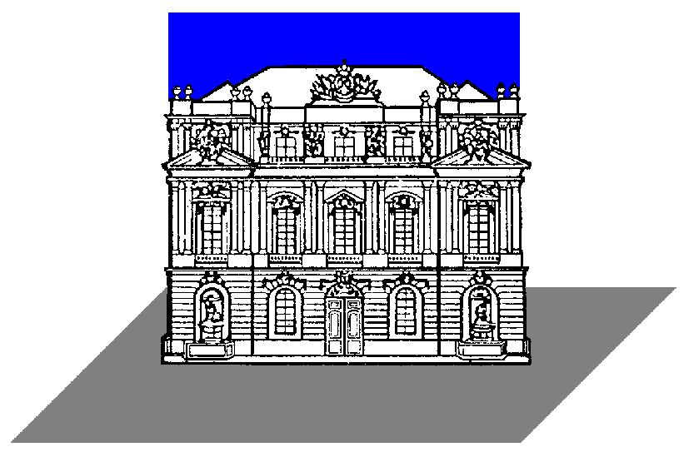

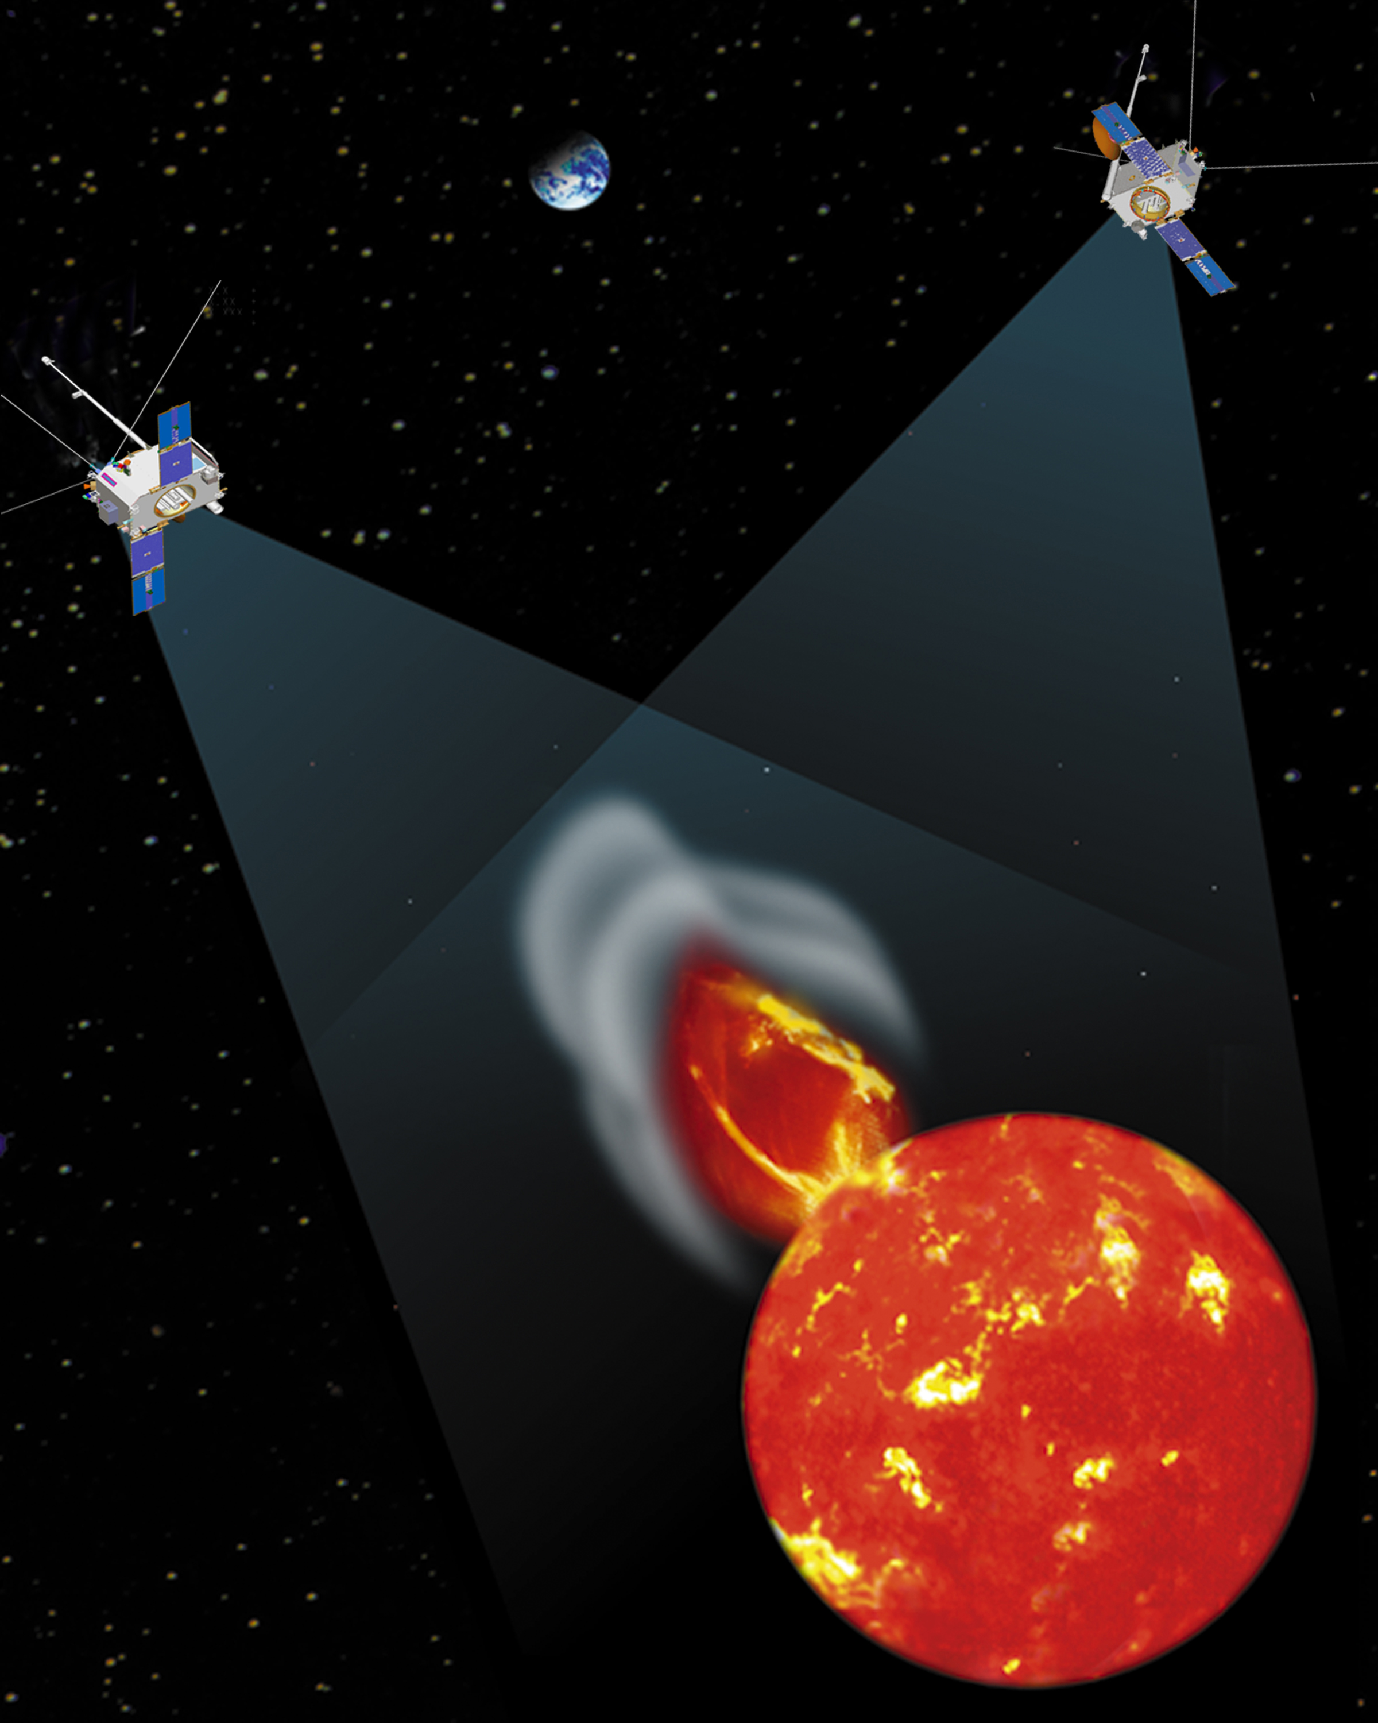
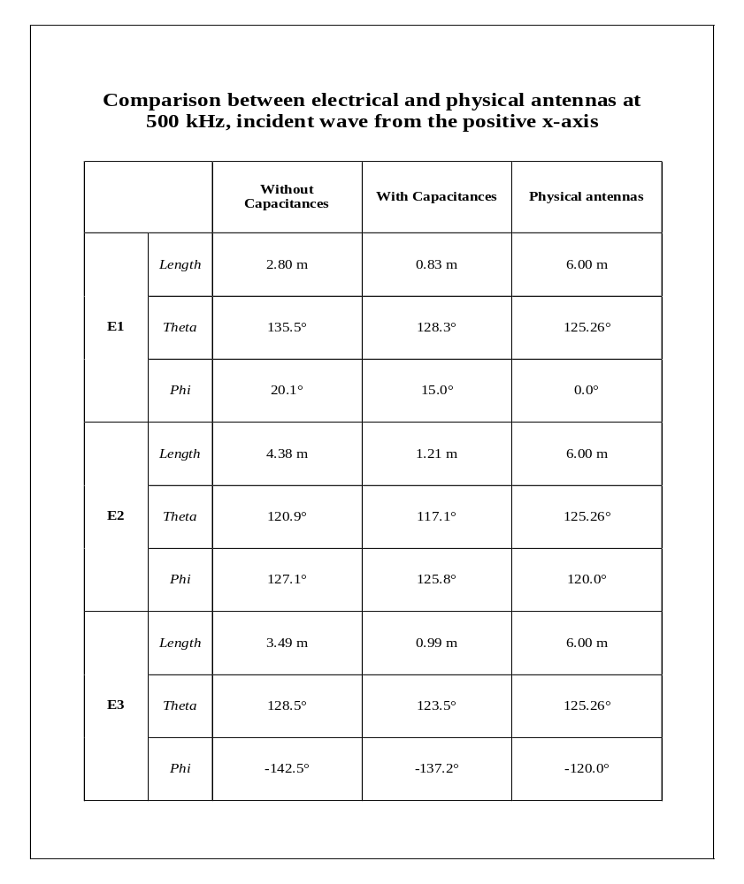
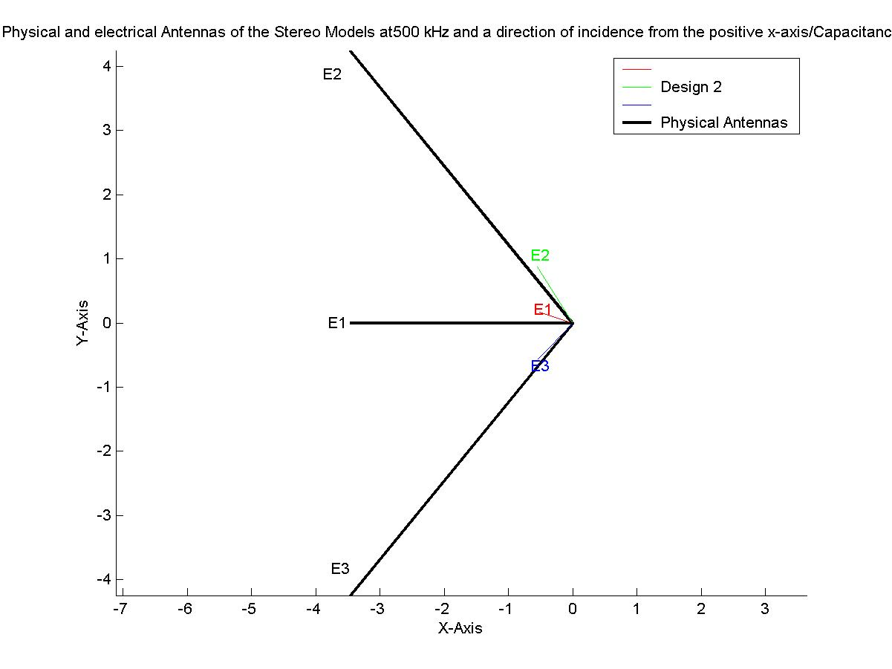
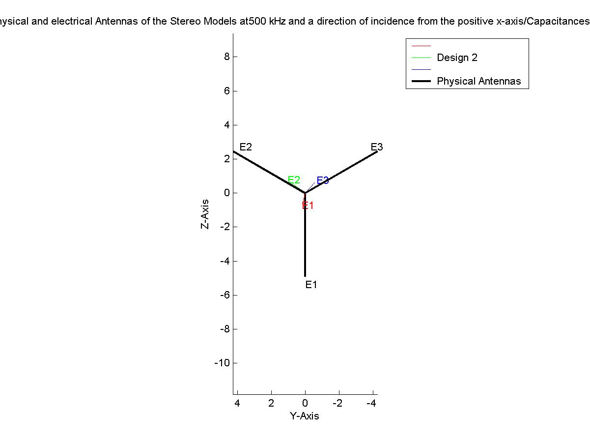
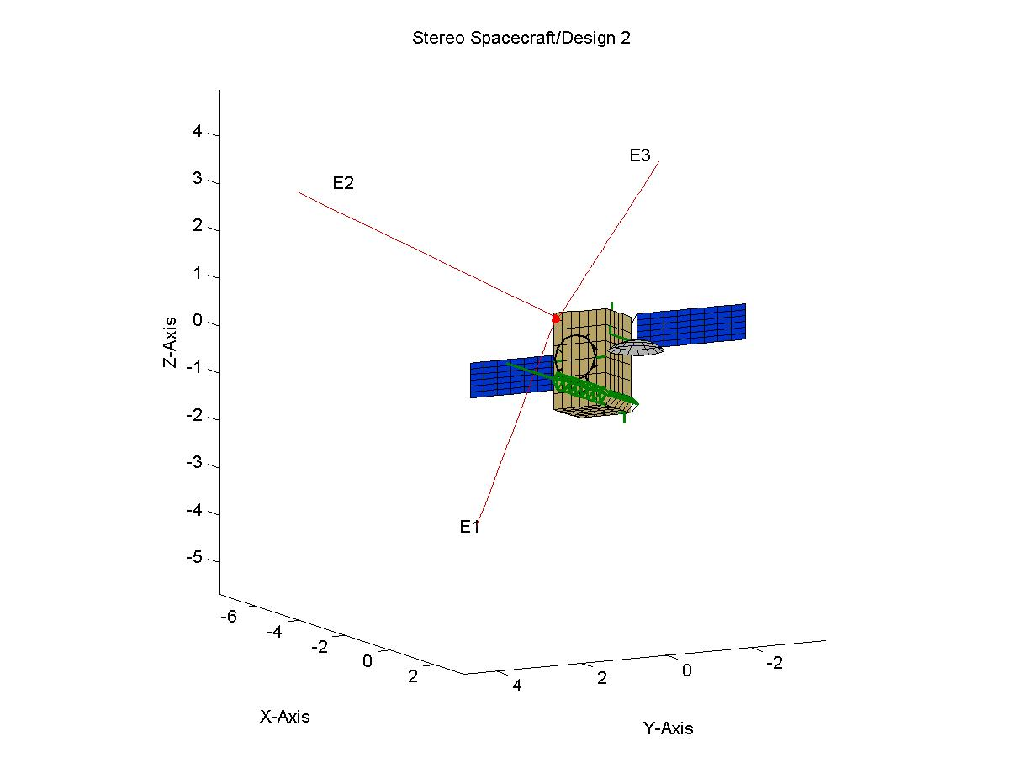
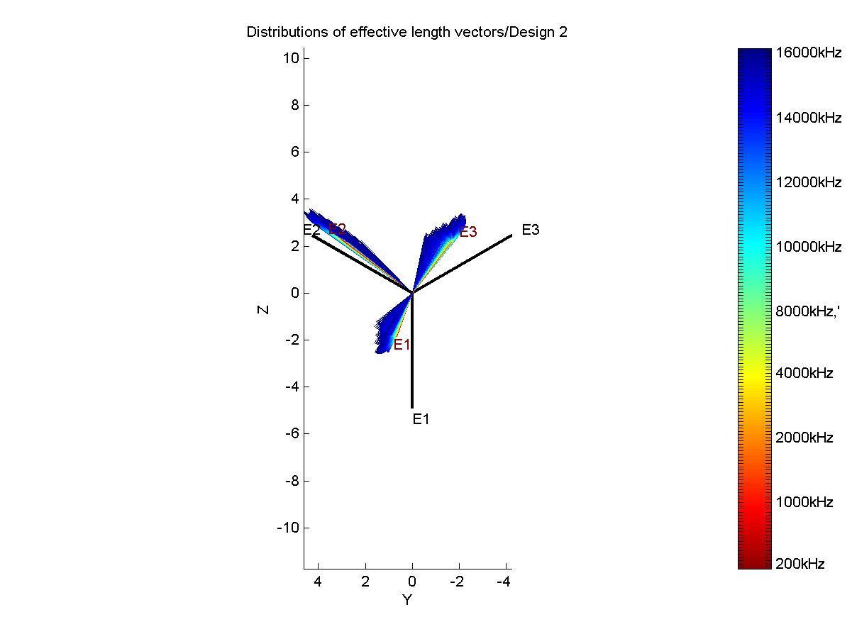
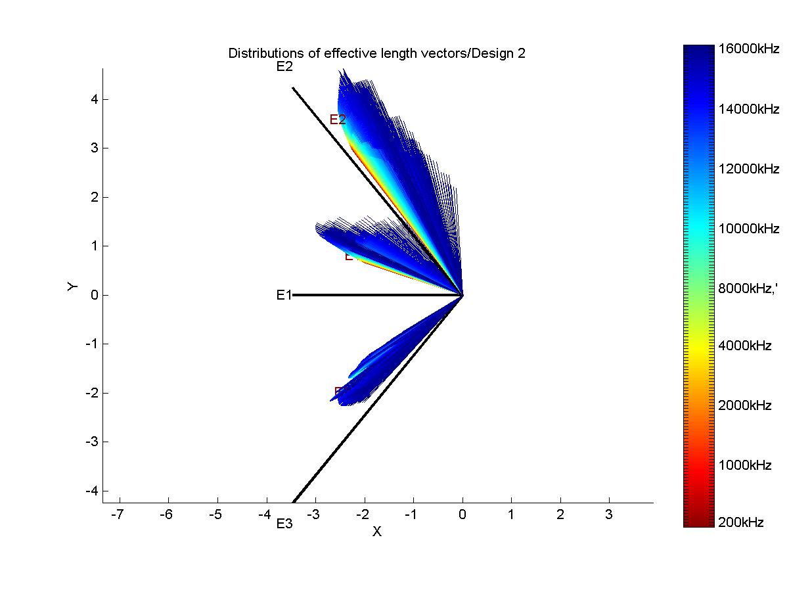
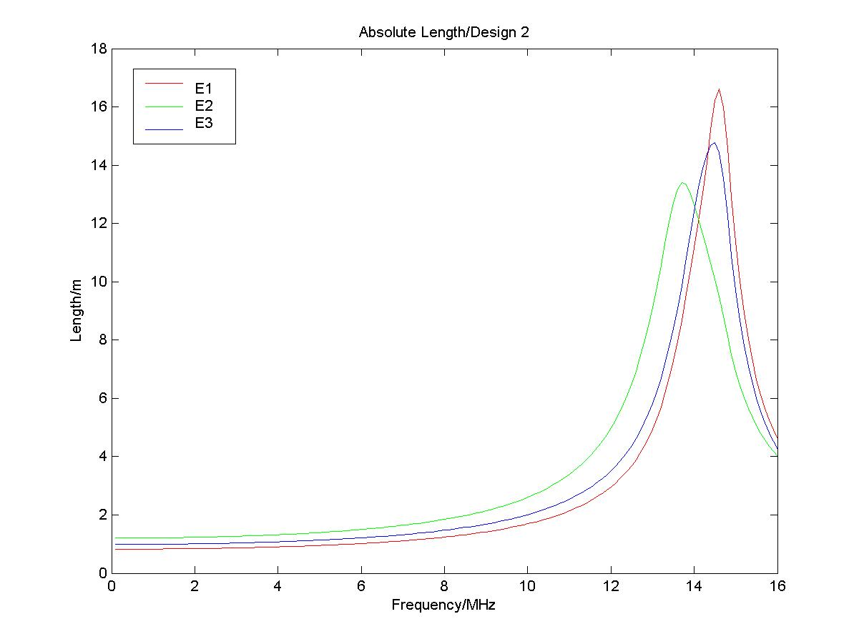
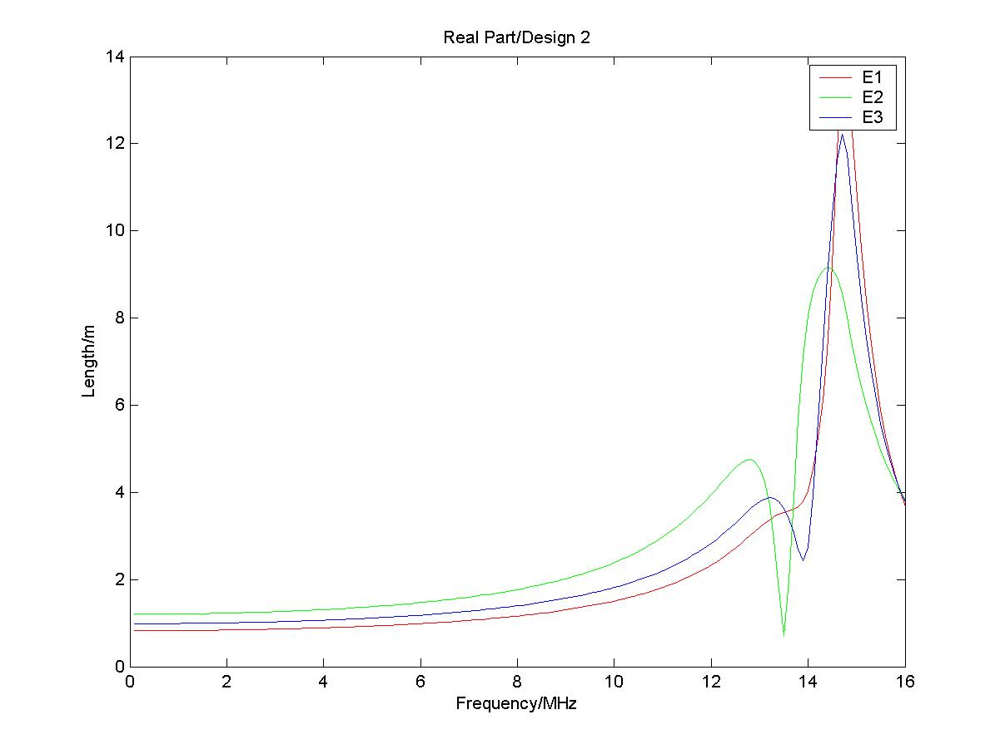
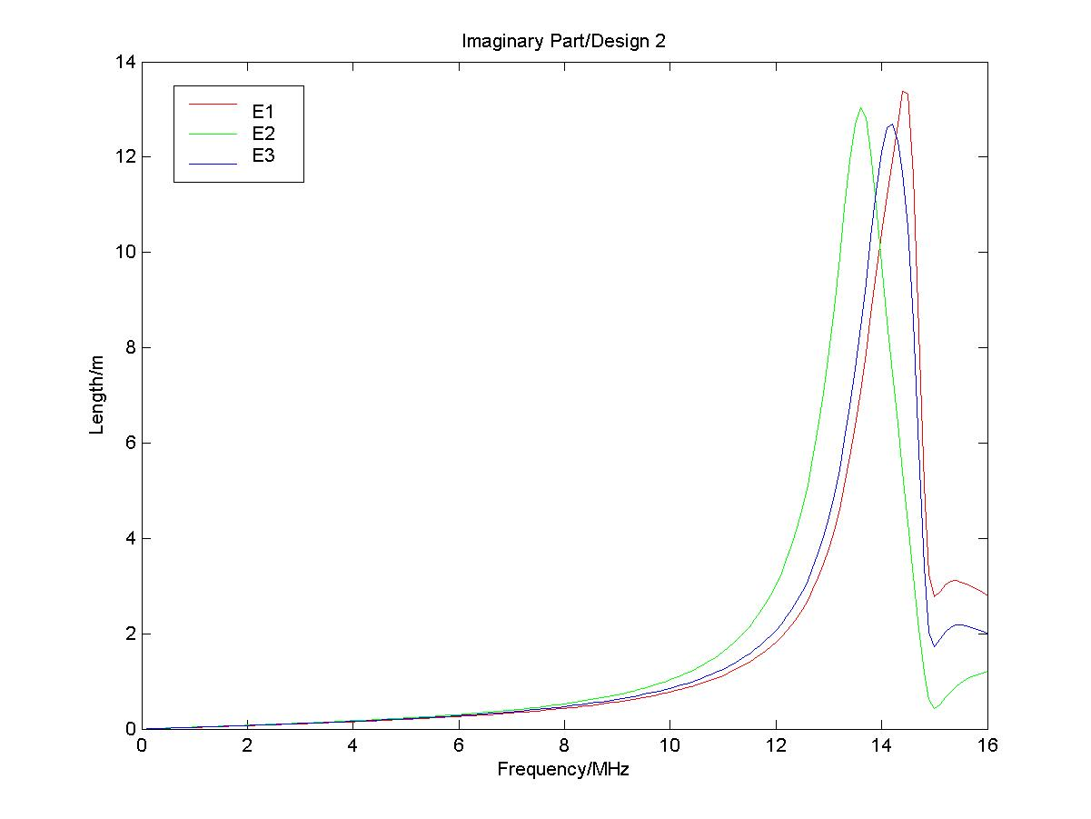
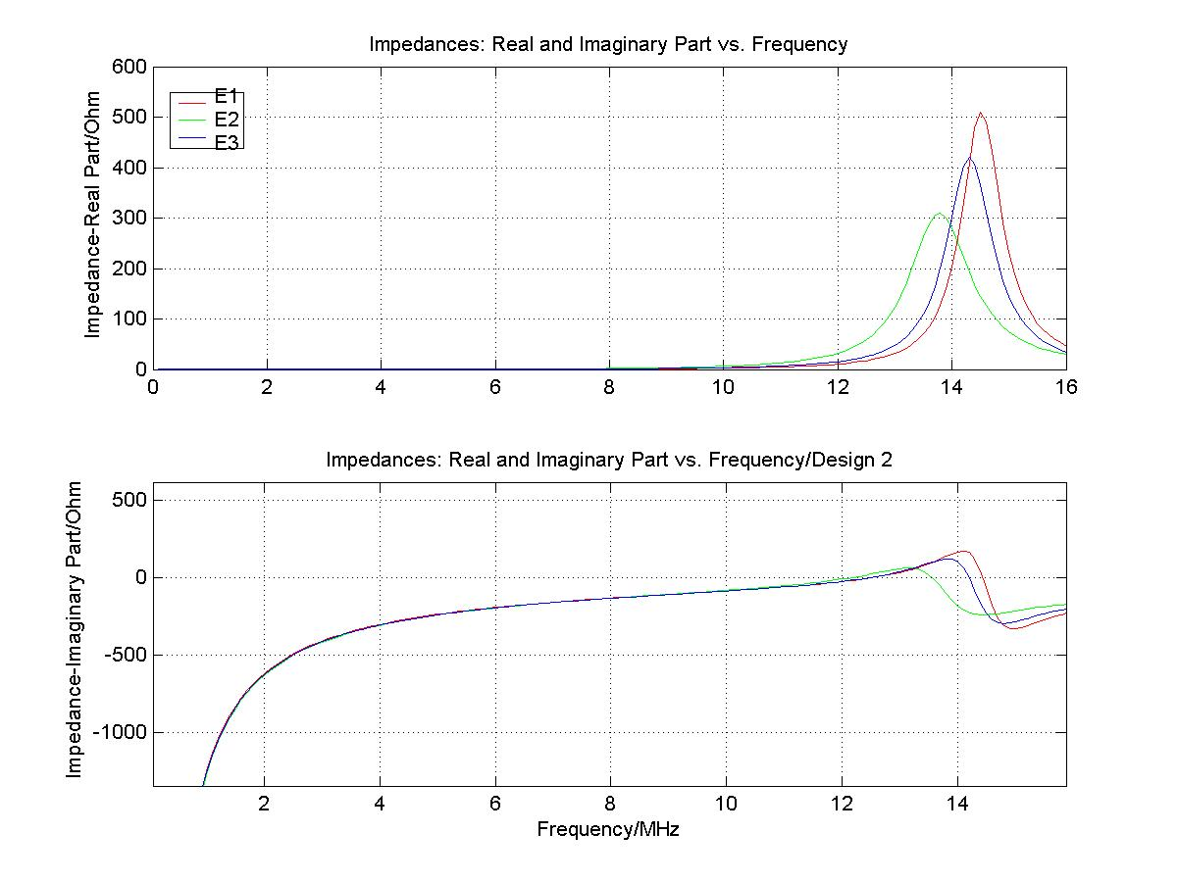
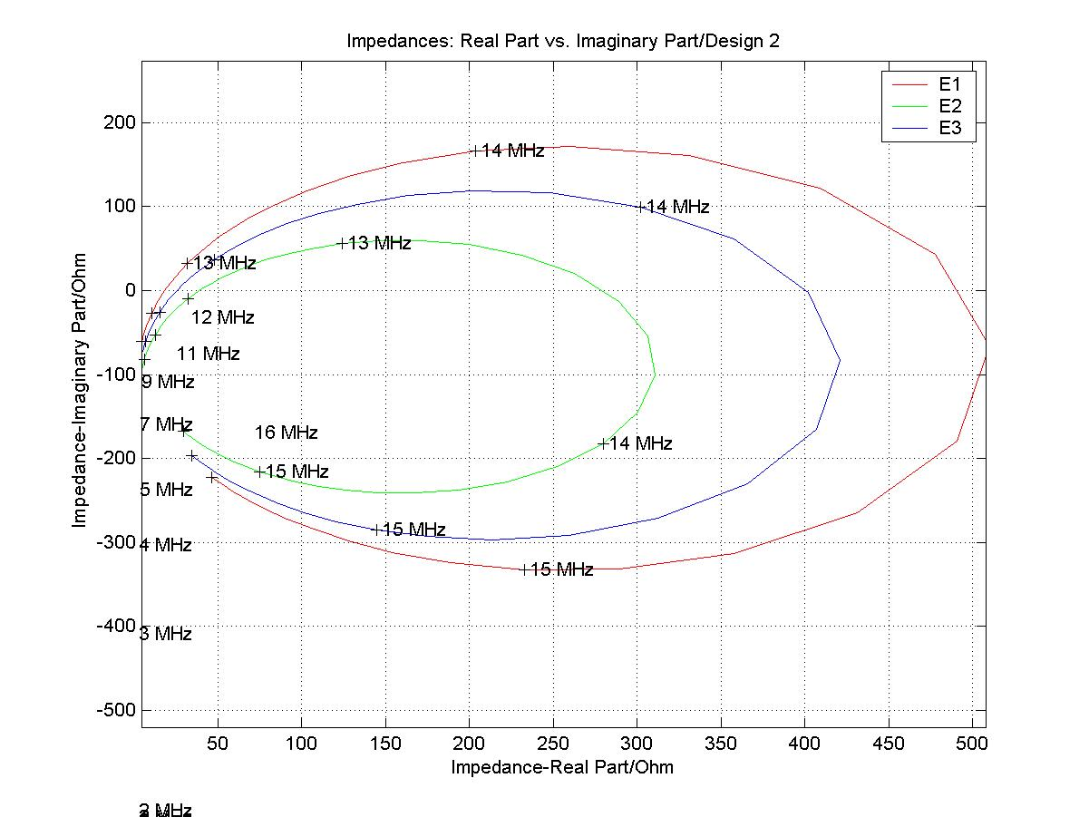
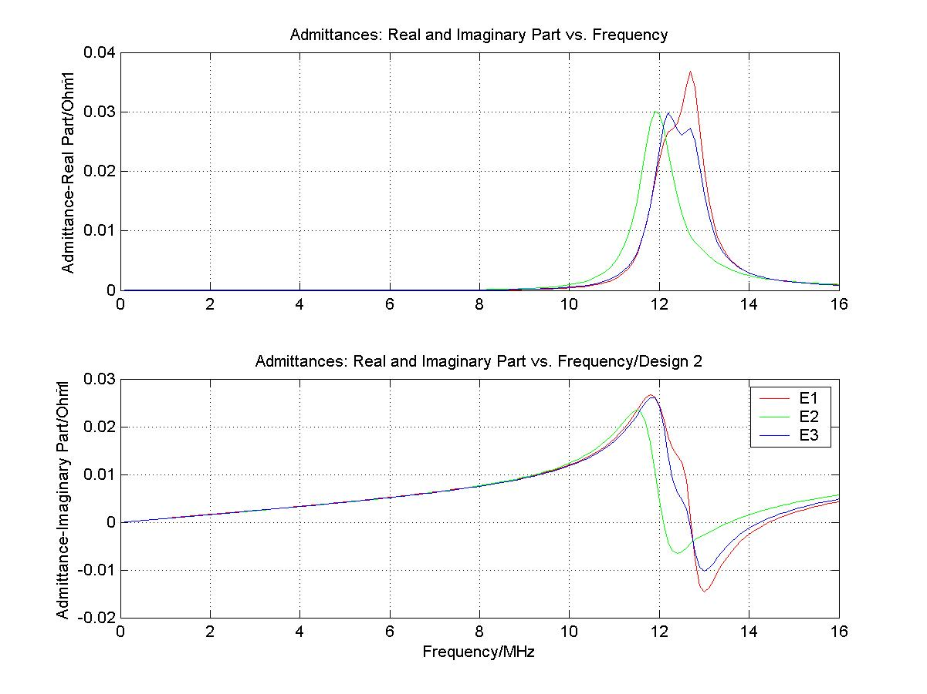
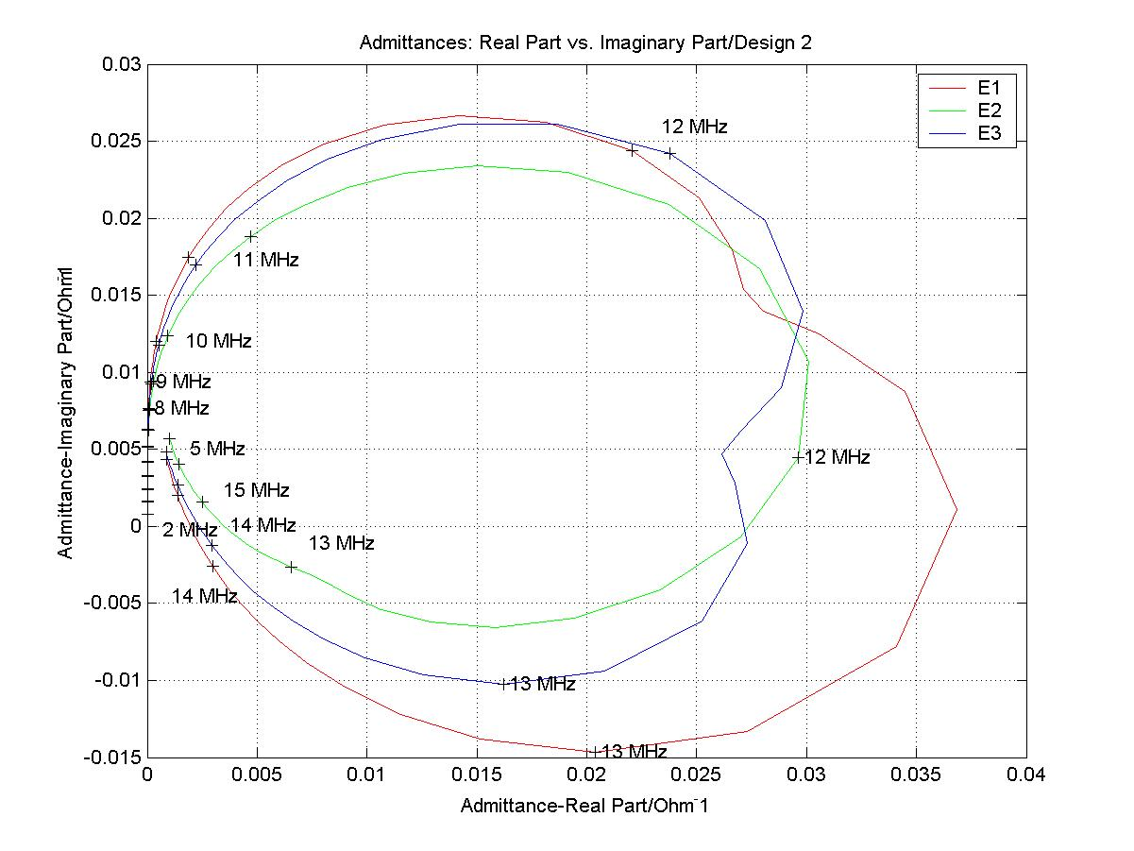
First results of the antenna calibration of the STEREO/SWAVES experiment
Th. Oswald (1), W. Macher (1), G. Fischer (1), H.O. Rucker (1)
DGG05-A-00988
(1) Space Research Institute, Austrian Academy of Sciences, A-8042 Graz, Austria
ABSTRACT
FIRST RESULTS
STEREO consists of two spacecraft, which will fly in a heliocentric orbit, leading and trailing earth. Purpose of this mission is to extend our knowledge about space weather and solar terrestrial relations. On board of the spacecraft is the SWAVES experiment, which will receive radio waves in the low frequency range by means of three antennas. Due to the use of two spacecraft, it is possible to measure the spatial evolution of dynamic phenomena by triangulation, if one knows the direction of the incident wave. This direction is calculated with the method of direction finding. To be able to perform direction finding, it is imperative to know the antenna properties to a high degree of accuracy, especially the size and directions of the effective length vectors, how they vary with frequency and how they are influenced by the configuration of the spacecraft and the direction of the incident wave. The first results of the numerical computation of the antenna properties are presented on this poster.
THE QUASISTATIC REGIME
All electric antennas have a length that is near the half length of the physical antennas, as expected by theory for monopole antennas that are small in relation to the wavelength. It can clearly be seen that the solar panels push the electric antennas towards the negative x-axis with a counteracting influence of the boom.
NUMERICAL METHOD FOR ANTENNA CALIBRATION
The numerical method for determining the effective length vectors is based on electromagnetic codes for the determination of antenna properties in a wide frequency range. At first, a wire grid model of the spacecraft is constructed. Then, numerical codes are used to get the current distribution on the surface of the antenna-spacecraft system. From these currents, the effective length vectors can be computed. The main advantage of this method is flexibility with regard to the representation of spacecraft parts, which can easily be altered to test their influence on antenna properties. Furthermore it enables an estimation of an upper frequency limit below which the quasi-static results are valid.
THE VARIATON WITH FREQUENCY
With the currently available methods, direction finding is only possible in the lower frequency regions. At higher frequencies, the effective length vectors become complex and dependent of frequency and direction of incidence. The variability of the real part of the effective length vectors can be easily seen on the plot. The plot was constructed by choosing 26 different directions and computing the real part of the effective length vectors for each frequency and each direction. The frequency is color coded.
THE SPACECRAFT AND THE SWAVES EXPERIMENT
A characteristic of the spacecraft is a certain degree of asymmetry. In contrast to many other spacecraft, the solar panels are positioned at different longitudinal distances at the spacecraft hull. Additionally the spacecraft consist of an, about 6 meters long, boom, and a high gain antenna, which are also two prominent features that we expected to influence the antenna characteristics. The boom is divided into 4 sections with different diameters. The direction of the boom defines the negative x-axis in the spacecraft reference frame. There are 3 orthogonal monopole antennas, E1, E2 and E3, each 6 meters long. They are all directed about 125.26° from the x axis. The boom was expected to push the 3 electrical antennas away, which was shown tu be true by calculation. This effect is increased by the high gain antenna, which is located near the boom and can be turned in a range of 180°. The solar panels push the effective length vectors towards the negative x-axis. The two space craft, A and B are almost identical, apart from some small differences concerning their instrumentation.
The STEREO-WAVES (SWAVES) Experiment is designed to track solar and interplanetary radio bursts and trace the generation and evolution of radio disturbances from the Sun to the Earth orbit and beyond. Each spacecraft has three, nearly orthogonal, antennas, capable of rerceiving electromagnetic waves in a frequency range between 30kHz and 16MHz. With this configuration, it is possible to perform 'direction finding' at the lower end of the frequency range to determine the direction of incidence and the polarization of the received radiation. When both spacecraft receive radiation from the same source, the actual location of the source can be pinpointed by the method of triangulation.
The antennas will be directed away from the sun, so that they remain out of view of the sunward looking instruments on the spacecraft. Thus, the most interesting direction of incident waves is the positive x-axis.
As one can see on the diagrams, showing the length of the effective vectors as function of the frequency, the resonances at ~14MHz change drastically the effective lengths of the antennas. The imaginary part vanishes as the frequency approaches zero, while the real part converges to the quasistatic limit. The direction of the incident wave was chosen to be the positive x-axis (direction of the sun).
IMPEDANCES AND ADMITTANCES
The following plots show the diagonal elements of the Impedance and Admittance matrix as a function of frequency. The total base capacitance (receiver, cable and antenna mounting) was estimated to be 90 pF.
References
Oswald, T.H., W. Macher, G. Fischer, H.O. Rucker: First results of STEREO/WAVES antenna calibration, Austrian Academy of Sciences, IWF-160 (2004)
Oswald, T.H., W. Macher, G. Fischer, H.O. Rucker: Results of STEREO/WAVES antenna calibration using a refined spacecraft model, Austrian Academy of Sciences, IWF-167 (2005)
Oswald, T.H., Electromagnetic waves in space and the STEREO/SWAVES experiment, Master Thesis, University Graz and Technical University Graz (2005)
Cecconi, B., P. Zarka, and D. Vogl, Direction finding and antenna calibration through analytical inversion of radio measurements performed using a system of 2 or 3 electric dipole wire antennas, EGU 1st General Assembly, April 2004.
Fischer, G., W. Macher, H.O. Rucker, H.P. Ladreiter, D.F. Vogl and the Cassini/RPWS Team: Wire-grid modeling of Cassini spacecraft for the determination of effective antenna length vectors of the RPWS antennas. In: Planetary Radio Emissions V, H.O. Rucker, M.L. Kaiser, Y. Leblanc (Eds.), Austrian Academy of Sciences Press, Vienna, 347-356, 2001.
Fischer, G., W. Macher, H.O. Rucker and the Cassini/RPWS team: Reception properties of the Cassini/RPWS antennas from 1 to 16 MHz, EGS-AGU-EUG Joint Assembly, Nice, April 2003.
Ladreiter, H.P., P. Zarka, A. Lecacheux, W. Macher, H.O. Rucker, R. Manning, D.A. Gurnett, W.S. Kurth: Analysis of electromagnetic wave direction finding performed by spaceborne antennas using singular value decomposition techniques, Radio Sci., 30, 1699-1712, 1995.
Macher, W., and T. Vejda, Design of antenna grid structures. Manual to the MATLAB toolbox. Austrian Academy of Sciences, IWF-144, January 2003.
Rucker, H.O., W. Macher, and S. Albrecht, Experimental and theoretical investigations on the Cassini RPWS antennas. In: Planetary Radio Emissions IV, H. O. Rucker, S. J. Bauer, and A. Lecacheux (Eds.), Austrian Academy of Sciences Press, Vienna, 327-337, 1997.
Rucker, H.O., W. Macher, R. Manning, and H. P. Ladreiter, Cassini model rheometry, Radio Sci., 31, 1299-1311, 1996.
Vogl, D.F., B. Cecconi, W. Macher, P. Zarka, H.P. Ladreiter, P. Fedou, A. Lecacheux, T. Averkamp, G. Fischer, H.O. Rucker, D.A. Gurnett, W.S. Kurth, G.B. Hospodarsky, In-flight calibration of the Cassini-RPWS antenna system for direction finding and polarization measurements, J. Geophys. Res., in press 2004.

