Slide 1


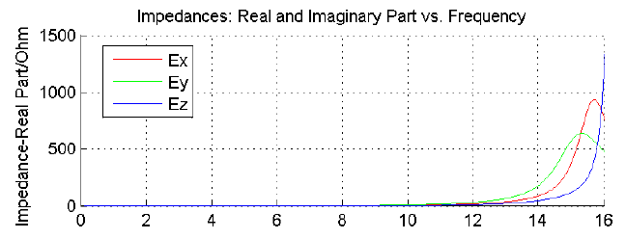
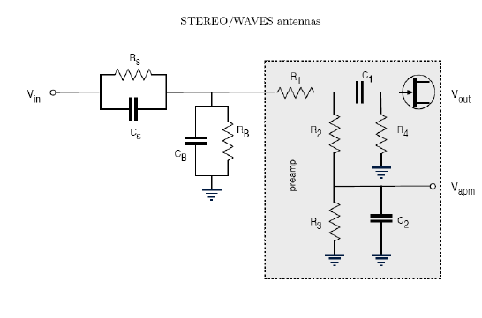









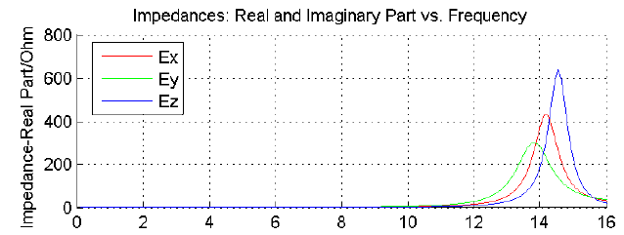

Determination of the base and sheath capacitances for the STEREO/WAVES antenna calibration
T.H. Oswald (1), W. Macher (1), H.O. Rucker (1), and the STEREO WAVES team
EGU2007-A-03260
Space Research Institute, Austrian Academy of Sciences, A-8042 Graz, Austria
ABSTRACT
VARYING THE BASE CAPACITANCE
INCLUDING THE PLASMA SHEATH IN THE NUMERICAL ANTENNA CALIBRATION
The STEREO/WAVES experiment uses 3 monopole stacer antennas to measure electric fields from the quasi-static limit to 16MHz and beyond. Numerical and experimental calibration has been completed, using an estimation of the base capacitances (i.e. the capacitances of antenna mounting, receiver and cable) of 90pF. As the first measurement data became available, however, it became clear that this estimation must have been too high. By matching the measured and calculated auto correlation, we tried to compute a more realistic value to be used in future calibration processes.
Additionally we included the effects of the plasma sheath in our calculations, which resulted in a theoretically determined antenna resistance which matches the measured data.
The first try was to vary the capacitances in a way such that the rise of the curve of the real part of the impedance of the E_{z} antenna is just at the right end of the frequency range. It turned out that the best fit can be achieved by using 40pF (see. Fig. 3). The computation was done with CONCEPT II using patches at 300kHz. 40pF, however, seem to be far too low to be realistic.
An other factor seems to have an important effect on the reception properties of the antenna. One possible solution could be the plasma sheath.
Antenna resistance with 40pF base capacitance
The plasma sheath can be modeled as a combination of resistivity and capacitance which is parallel to the base impedance, as shown in Figure 4 [Bale (2007)]. The Plasma resistance is the gradient of the voltage-current curve of the antenna and can be derived from equation (1).
(6)
The capacitance of a cylindrically shaped antenna can be calculated by using the textbook equation
(7)
Where l_{a} is the length of the antenna, δ is the thickness
the relative permittivity due to the photoelectron densit
THE DISCREBANCY OF THE RESONANCE
Figure 3
Figure 4
THE PHYSICS OF THE PLASMA SHEATH
of the sheath, r_{a} is the radius of the antenna, and є_{r} is y, which may vary according to the model used.
Based partly on measurements results of the STEREO/WAVES team and partly on estimation derived from our experience with the CASSINI antennas, the base capacitances of the SWAVES antennas, which include the capacitances of the receiver, the coax cable and the antenna mounting, were to be 90pF.
Figure 1 shows received data. When comparing the plot with the graph of the calculated radio resistance shown in Figure 2, it becomes clear that some parameter can not be correct. Figure 1 shows the autocorrelation of the E_{z} monopole and the E_{x}-E_{y} dipole as a function of frequency. Provided the background noise was of comparable level during the reception, the curve should have a shape, representing the sensitivity of the antenna-receiver system.
The same shape can be expected when plotting the radiation resistance, which is a measure of how much of the power which is fed to the antennas is actually converted into electromagnetic energy, when looking at a transmitting antenna system. Using the reciprocity theorem, it means that the radiation resistance is a measure for the sensitivity of the antenna. Therefore the peak of the second resonance is expected to be at the same frequency in both cases.
Comparing the two mentioned Figures it becomes clear that the calculations do not fit the measured results. At the Figure showing the measurements of antenna E_{z,} the peak is at the right end of the scale or slightly beyond, whereas
the calculation results in a resonance at approximately 14,5MHz, which is well within the frequency range of the receiver.
Unfortunately only this data of the E_{z} antenna was present at this time. The other antennas have, according to our calculation, peaks which are at a lower frequency and therefore probably within the frequency range of the receiver.
Varying the base capacitance has the effect to move the resonance frequency. A lower base capacitance results in a higher resonance frequency. So a possible way to match the two curves is to perform the calculation with a lower base capacitance. The level of the curve at any point is irrelevant for this purpose, because it depends on the intensity of the background noise which is not known to us. For the purpose of capacitance matching only the frequency of the rise
or peak of the resonance is relevant.
An other possible way to match the sensitivity curves of the calculated and measured data is the inclusion of the plasma sheath in the numerical calculation. This will be described in the right part of the poster.
The antenna of a spacecraft is coupled to the space plasma. The coupling can often be described by a combination of a resistivity R_{s} and a capacity C_{s}, where the resistive coupling dominates at frequencies below the typical plasma frequencies and the capacitive coupling dominates at high frequencies [Gurnett(2000)]. During the operation of a spacecraft, two or three different currents are acting on the antenna, the current of positively charged ions and thermal electrons are flowing towards the surface, and, if parts of the spacecraft are exposed to sunlight, a current of photoelectrons is flowing away from the surface. Because the velocity of the thermal electrons is higher than the velocity of the ions, the spacecraft potential of a spacecraft which is not illuminated from sunlight, or is moving through a dense plasma where the current of the photoelectrons is negligible in comparison to the current due to the thermal electrons, is negative. If the photoelectron current dominates, which is usually the case in rarified plasma, the spacecraft, and the spacecraft antennas, will be charged positively.
The equations modeling the two currents for cylindrically shaped antennas:
(1)
l and d are the length and diameter of the antenna, while A_{r} is the illuminated fraction of the surface. i_{ph} is the saturated photoelectron current density, which can be estimated as 1e⁻⁴ Am⁻² [Fahleson(1967)]. V is the potential of the spacecraft in relation to the environmental plasma. By postulating a steady state condition, the equations can be equated to yield the potential of the antenna.
(2)
The thickness of the sheath can be approximated by the Debye length of the photoelectrons
(3)
where the density of the photoelectrons at the surface can be used. It has to be taken into account that most photoelectrons do not have enough kinetic energy to leave the sheath and fall back to the surface. Hence
(4) using
For determining the potential or density profile across the sheath, Poisson's equation has to be solved, i.e.
(5)
For a flat surface. is the mean ion density of the surrounding plasma. This equation is non-linear and has to be solved numerically. Else it can be approximated by using a Taylor polynomial This approximation can be used to describe the behavior in a region where the potential energy of the particles is small in relation to the mean thermal energy, i.e. near the sheath edge.
STEREO operates in solar wind conditions at 1AU. Under this condition, the photoelectron current exceeds the thermal electron current, so the spacecraft is charged positively, producing a negatively charged sheath consisting mainly of photoelectrons. The number of photoelectrons with an energy high enough to cross the sheath and enter the space plasma must be in balance to the thermal electrons, if the system is in a steady state condition. The thermal electrons are attracted to the surface so all of them reach the surface, while most of the photoelectrons will not be able to leave the sheath and fall back to the surface. They do not contribute to the photoelectron current. Hence, the
distribution of the photoelectrons, which can be well approximated as Maxwellian, has to be considered in connection with the photoelectrons.
Figure 1
Antenna resistance with 90pF base capacitance
References
Figure 2
DISCUSSION
S.D. Bale, R. Ullrich, K. Goetz, B. Cecconi, M. Dekkali, W. Macher, R. E. Manning, T. H. Oswald, and M. Pulupa : The electric antennas for the stereo/waves experiment. Advances in Space Research, submitted, 2007.
Cecconi, B., P. Zarka, and D. Vogl, Direction finding and antenna calibration through analytical inversion of radio measurements performed using a system of 2 or 3 electric dipole wire antennas, EGU 1st General Assembly, April 2004.
Fischer, G., W. Macher, H.O. Rucker, H.P. Ladreiter, D.F. Vogl and the Cassini/RPWS Team: Wire-grid modeling of Cassini spacecraft for the determination of effective antenna length vectors of the RPWS antennas. In: Planetary Radio Emissions V, H.O. Rucker, M.L. Kaiser, Y. Leblanc (Eds.), Austrian Academy of Sciences Press, Vienna, 347-356, 2001.
Fahleson, U. , Theory of electric field measurements conducted in the magnetosphere with electric probes, Space Science Reviews, 7, 238-262, 1967.
Fischer, G., W. Macher, H.O. Rucker and the Cassini/RPWS team: Reception properties of the Cassini/RPWS antennas from 1 to 16 MHz, EGS-AGU-EUG Joint Assembly, Nice, April 2003.
Gurnett, D., Principles of space plasma wave instrument design, in Measurement Techniques in Space Plasmas, Fields, edited by R. Pfaff, E. Borovsky, and D. Young, pp. 121-137, American Geophysical Union, Washington, DC, 2000.
Ladreiter, H.P., P. Zarka, A. Lecacheux, W. Macher, H.O. Rucker, R. Manning, D.A. Gurnett, W.S. Kurth: Analysis of electromagnetic wave direction finding performed by space-borne antennas using singular value decomposition techniques, Radio Sci., 30, 1699-1712, 1995.
Macher, W., and T. Vejda, Design of antenna grid structures. Manual to the MATLAB toolbox. Austrian Academy of Sciences, IWF-144, January 2003.
Oswald, T.H., W. Macher, G. Fischer, H.O. Rucker: First results of STEREO/WAVES antenna calibration, Austrian Academy of Sciences, IWF-160 (2004)
Oswald, T.H., W. Macher, G. Fischer, H.O. Rucker: Results of STEREO/WAVES antenna calibration using a refined spacecraft model, Austrian Academy of Sciences, IWF-167 (2005)
Oswald, T.H., Electromagnetic waves in space and the STEREO/SWAVES experiment, Master Thesis, University Graz and Technical University Graz (2005)
Oswald, T.H., H.O. Rucker, W. Macher, G. Fischer, U. Taubenschuss, M.L.Kaiser, K. Goetz, J.L. Bougeret, and A. Lecacheux:The numerical calibration of the STEREO/SWAVES monopole antennas, Radio Sci., under review
Rucker, H.O., W. Macher, and S. Albrecht, Experimental and theoretical investigations on the Cassini RPWS antennas. In: Planetary Radio Emissions IV, H. O. Rucker, S. J. Bauer, and A. Lecacheux
Rucker, H.O., W. Macher, R. Manning, and H. P. Ladreiter, Cassini model rheometry, Radio Sci., 31, 1299-1311, 1996.
Rucker, H., W. Macher, G. Fischer, T.H. Oswald, J.-L. Bougeret, M. Kaiser, and K. Goetz (2005), Analysis of spacecraft antenna systems: Implications for stereo/waves, Adv. Space Res.,36,1530-1533, doi: 10.1016/j.asr.2005.07.060.
Vogl, D.F., B. Cecconi, W. Macher, P. Zarka, H.P. Ladreiter, P. Fedou, A. Lecacheux, T. Averkamp, G. Fischer, H.O. Rucker, D.A. Gurnett, W.S. Kurth, G.B. Hospodarsky, In-flight calibration of the Cassini-RPWS antenna system for direction finding and polarization measurements, J. Geophys. Res., 109 (2004).
The calibration of the STEREO/WAVES antennas at the frequencies of the fixed-frequency receiver (FFR) was performed by using a numerical method. The results show that the influence of the spacecraft-body results in a significant deviation of the antenna properties at these frequencies from the quasi-static case. Caution has to be used when interpreting the data of the FFR. The antenna properties which were calculated for these specific frequencies have to be used for the calibration of the data, in contrast to using the general antenna properties computed for the case of the quasi-static limit, which is appropriate at lower frequencies.

