Slide 1


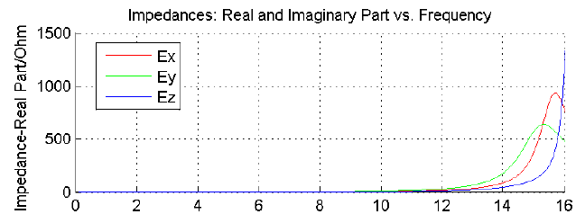
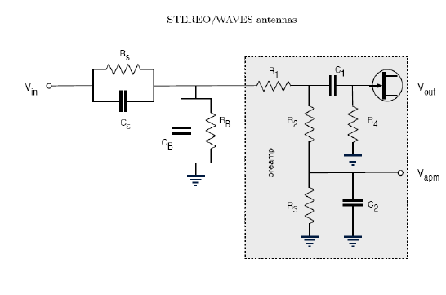









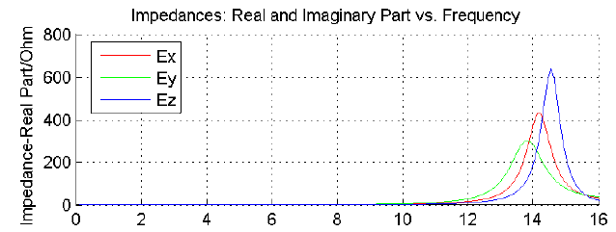

Determination of the base and sheath capacitances for the STEREO/WAVES antenna calibration
T.H. Oswald (1), W. Macher (1), H.O. Rucker (1), and the STEREO WAVES team
EGU2007-A-03260
Space Research Institute, Austrian Academy of Sciences, A-8042 Graz, Austria
ABSTRACT
VARYING THE BASE CAPACITANCE
INCLUDING THE PLASMA SHEATH IN THE NUMERICAL ANTENNA CALIBRATION
The STEREO/WAVES experiment uses 3 monopole stacer antennas to measure electric fields from the quasi-static limit to 16MHz and beyond. Numerical and experimental calibration has been completed, using an estimation of the base capacitances (i.e. the capacitances of antenna mounting, receiver and cable) of 90pF. As the first measurement data became available, however, it became clear that this estimation must have been too high. By matching the measured and calculated auto correlation, we tried to compute a more realistic value to be used in future calibration processes.
Additionally we included the effects of the plasma sheath in our calculations, which resulted in a theoretically determined antenna resistance which matches the measured data to a first approximation.
First try: altering the base capacitances.
CONCEPT II was used for the computation.
Patches were used.
300kHz (quasistatic)
A qualitative fit was achieved at 40pF (Figure 3).
This value is far to low to be realistic.
Other parameters seem to be responsible for the discrepancy
Antenna resistance with 40pF base capacitance
The plasma sheath can be modeled as a combination of resistivity and capacitance which is parallel to the base impedance, as shown in Figure 4 [Bale (2007)]. The plasma resistance is the gradient of the voltage-current curve of the antenna and can be derived from equation (1).
(6)
The capacitance of a cylindrically shaped antenna can be calculated by using the textbook equation
(7)
Where l_{a} is the length of the antenna, δ is the thickness
the relative permittivity due to the photoelectron densit
THE DISCREPANCY OF THE RESONANCE
Figure 3
Figure 4
THE PHYSICS OF THE PLASMA SHEATH
of the sheath, r_{a} is the radius of the antenna, and є_{r} is y, which may vary according to the model used.
For the calibration of the STEREO WAVES antennas, a base capacitance of 90pF was used.
The second antenna resonance seen on the first received data does not match the calculated value (Figures 1 and 2).
We tried to find a way to match the data, using the antenna resistance of antenna E_{z}.
Only a qualitative matching of the peak, corresponding to the second resonance, was performed, i.e. the peak should be at or just above 16MHz.
The level was not taken into account. It depends on the level of the background noise.
The resonance can be shifted by altering the base capacitance.
Another approach was to include the effect of the plasma sheath into the numerical calculation.
The antenna of a spacecraft is coupled to the space plasma. The coupling can often be described by a combination of a resistivity R_{s} and a capacity C_{s}, where the resistive coupling dominates at frequencies below the typical plasma frequencies and the capacitive coupling dominates at high frequencies [Gurnett(2000)]. During the operation of a spacecraft, two or three different currents are acting on the antenna, the current of positively charged ions and thermal electrons are flowing towards the surface, and, if parts of the spacecraft are exposed to sunlight, a current of photoelectrons is flowing away from the surface. Because the velocity of the thermal electrons is higher than the velocity of the ions, the spacecraft potential of a spacecraft which is not illuminated from sunlight, or is moving through a dense plasma where the current of the photoelectrons is negligible in comparison to the current due to the thermal electrons, is negative. If the photoelectron current dominates, which is usually the case in rarified plasma, the spacecraft, and the spacecraft antennas, will be charged positively.
The equations modeling the two currents for cylindrically shaped antennas:
(1)
l and d are the length and diameter of the antenna, while A_{r} is the illuminated fraction of the surface. i_{ph} is the saturated photoelectron current density, which can be estimated as 1e⁻⁴ Am⁻² [Fahleson(1967)]. V is the potential of the spacecraft in relation to the environmental plasma. By postulating a steady state condition, the equations can be equated to yield the potential of the antenna.
(2)
The thickness of the sheath can be approximated by the Debye length of the photoelectrons
(3)
where the density of the photoelectrons at the surface can be used. It has to be taken into account that most photoelectrons do not have enough kinetic energy to leave the sheath and fall back to the surface. Hence
(4) using
For determining the potential or density profile across the sheath, Poisson's equation has to be solved, i.e.
(5)
For a flat surface. is the mean ion density of the surrounding plasma. This equation is non-linear and has to be solved numerically. Else it can be approximated by using a Taylor expansion. This approximation can be used to describe the behavior in a region where the potential energy of the particles is small in relation to the mean thermal energy, i.e. near the edge of the sheath.
RESULTS AND DISCUSSION
Antenna resistance with sheaths effect
Antenna resistance with sheaths effect
Figure 5
Figure 6
Using the equations given above, the following values can be calculated:
I_{ph}=7.6•10⁻⁶A
I_{e}=2•10⁻⁷A
n_{ph}=2•10⁸m⁻³
V=5.5V
δ=0.6m
R_{s}=0.2MΩ
C_{s}=87pF
Figure 5 shows the antenna resistance, when these values are incorporated into the numerical calculation. The following parameters were used for the calculation:
i_{ph}=10⁻⁴Am⁻²
Mean energy of photoelectrons at creation : 1.5eV
Mean energy of thermal electrons : 10eV
n_{e}=n_{i}=5•10⁶
l=6m
d=0.0254m
A_{rel}=0.5
In the submitted article [Bale (2007)], the following values are given :
R_{s}=0.75MΩ
C_{s}=40pF
This corresponds to Figure 6. Both results look correct on a qualitative level. Hence, we believe that the inclusion of the plasma sheath effect in the numerical calculation of the STEREO WAVES antennas could be the key to match computed and measured data. We expect to find that the inclusion of the plasma sheath is generally an important factor in antenna calibration of spacecraft antennas which should not be neglected in future studies of spacecraft antenna systems. Which model produces the most realistic values in case of the STEREO antennas, remains to be determined. A detailed study, including more and more detailed measurement data, being conducted on basis of matching the actual level of the correlation parameters should be performed.
Antenna resistance with 90pF base capacitance
STEREO operates in solar wind conditions at 1AU. Under this condition, the photoelectron current exceeds the thermal electron current, so the spacecraft is charged positively, producing a negatively charged sheath consisting mainly of photoelectrons. The number of photoelectrons with an energy high enough to cross the sheath and enter the space plasma must be in balance to the thermal electrons, if the system is in a steady state condition. The thermal electrons are attracted to the surface so all of them reach the surface, while most of the photoelectrons will not be able to leave the sheath and fall back to the surface. They do not contribute to the photoelectron current. Hence, the
distribution of the photoelectrons, which can be well approximated as Maxwellian, has to be considered in connection with the photoelectrons.
Figure 2
Figure 1
References
Bale,S.D., R. Ullrich, K. Goetz, B. Cecconi, M. Dekkali, W. Macher, R. E. Manning, T. H. Oswald, and M. Pulupa : The electric antennas for the stereo/waves experiment. Advances in Space Research, submitted, 2007.
Cecconi, B., P. Zarka, and D. Vogl, Direction finding and antenna calibration through analytical inversion of radio measurements performed using a system of 2 or 3 electric dipole wire antennas, EGU 1st General Assembly, April 2004.
Fahleson, U. , Theory of electric field measurements conducted in the magnetosphere with electric probes, Space Science Reviews, 7, 238-262, 1967.
Fischer, G., W. Macher, H.O. Rucker, H.P. Ladreiter, D.F. Vogl and the Cassini/RPWS Team: Wire-grid modeling of Cassini spacecraft for the determination of effective antenna length vectors of the RPWS antennas. In: Planetary Radio Emissions V, H.O. Rucker, M.L. Kaiser, Y. Leblanc (Eds.), Austrian Academy of Sciences Press, Vienna, 347-356, 2001.
Fischer, G., W. Macher, H.O. Rucker and the Cassini/RPWS team: Reception properties of the Cassini/RPWS antennas from 1 to 16 MHz, EGS-AGU-EUG Joint Assembly, Nice, April 2003.
Gurnett, D., Principles of space plasma wave instrument design, in Measurement Techniques in Space Plasmas, Fields, edited by R. Pfaff, E. Borovsky, and D. Young, pp. 121-137, American Geophysical Union, Washington, DC, 2000.
Langmuir, I. , The interaction of electron and positive ion space charges in cathode sheaths, Phys. Rev., 33 (6), 954{989, doi: 10.1103/PhysRev.33.954(1929).
Oswald, T.H., W. Macher, G. Fischer, H.O. Rucker: First results of STEREO/WAVES antenna calibration, Austrian Academy of Sciences, IWF-160 (2004)
Oswald, T.H., W. Macher, G. Fischer, H.O. Rucker: Results of STEREO/WAVES antenna calibration using a refined spacecraft model, Austrian Academy of Sciences, IWF-167 (2005)
Oswald, T.H., Electromagnetic waves in space and the STEREO/SWAVES experiment, Master Thesis, University Graz and Technical University Graz (2005)
Rucker, H.O., W. Macher, and S. Albrecht, Experimental and theoretical investigations on the Cassini RPWS antennas. In: Planetary Radio Emissions IV, H. O. Rucker, S. J. Bauer, and A. Lecacheux
Rucker, H., W. Macher, G. Fischer, T.H. Oswald, J.-L. Bougeret, M. Kaiser, and K. Goetz (2005), Analysis of spacecraft antenna systems: Implications for stereo/waves, Adv. Space Res.,36,1530-1533, doi: 10.1016/j.asr.2005.07.060.

