Slide 1



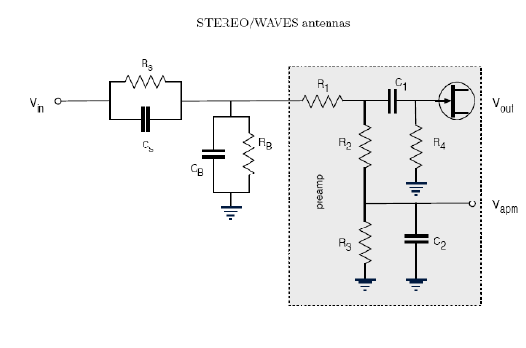





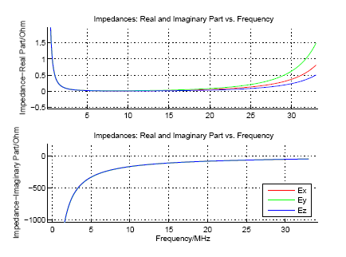






Numerical calibration of spacecraft antennas including 2 simple models of space plasma
T.H. Oswald (1), W. Macher (1), H.O. Rucker (1), and the STEREO WAVES team
EGU2007-A-03260
Space Research Institute, Austrian Academy of Sciences, A-8042 Graz, Austria
ABSTRACT
For determining the potential or density profile across the sheath, Poisson's equation has to be solved, i.e.
(4)
for a flat surface. This equation is non-linear and has to be solved numerically. Else it can be approximated by using a Taylor expansion. This approximation can be used to describe the behavior in a region where the potential energy of the particles is small in relation to the mean thermal energy, i.e. near the edge of the sheath.
RESULTS AND DISCUSSION
Many spacecraft carry sophisticated radio experiments which are designed to increase our understanding of the physics of the waves and plasmas of the solar environment. A key technology of modern radio science is the capability of performing goniopolarimetry, i.e. the reconstruction of the state of polarization and the direction of the radio source from the received data. Goniopolarimetry requires the reception properties of the antennas to be known very accurately. We performed several different methods to calibrate the scientific antennas of various spacecraft. While the traditional technique is to ignore the space plasma which surrounds the spacecraft and the antennas, we are now in a position to use two simple models to consider some effects which can be attributed to the plasma. In the paper, the methods are described and discussed and some results are presented using the recently launched STEREO spacecraft as example.
SHEATH EFFECT
Results
I_{ph}=7.6•10⁻⁶A I_{e}=2•10⁻⁷A
n_{ph}=2•10⁸m⁻³ V=5.5V
δ₁=0.6m δ₂=0.2m
R_{s}=0.2MΩ C_{s}=87pF
Parameters
i_{ph}=10⁻⁴Am⁻² n_{e}=n_{i}=5•10⁶ l=6m
d=0.0254m A_{rel}=0.5Mean
ε_{ph}= 1.5eV ε_{e}=10eV
INCLUDING THE PLASMA SHEATH IN THE NUMERICAL ANTENNA CALIBRATION
THE PHYSICS OF THE PLASMA SHEATH
The plasma sheath can be modeled as a combination of resistivity and capacitance which is parallel to the base impedance, as shown in Figure 1 [Bale (2007)]. The plasma resistance is the gradient of the voltage-current curve of the antenna and can be derived from equation (1).
(5)
The capacitance of a cylindrically shaped antenna can be calculated by using the textbook equation
(6)
Where l_{a} is the length of the antenna, δ is the thickness of the
the relative permittivity due to the photo-electron density which
Antenna impedance in vacuum
Antenna impedance with sheaths effect
The coupling of the spacecraft antennas to the space plasma can often be described by a combination of a resistivity R_{s} and a capacity C_{s}, where the resistive coupling dominates at frequencies below the typical plasma frequencies and the capacitive coupling dominates at high frequencies [Gurnett(2000)]. During the operation of a spacecraft, two or three different currents are acting on the antenna, the current of positively charged ions and thermal electrons are flowing towards the surface, and, if parts of the spacecraft are exposed to sunlight, a current of photoelectrons is flowing away from the surface. Because the velocity of the thermal electrons is higher than the velocity of the ions, the spacecraft potential of a spacecraft which is not illuminated from sunlight, or is moving through a dense plasma where the current of the photoelectrons is negligible in comparison to the current due to the thermal electrons, is negative. If the photo-electron current dominates, which is usually the case in rarefied plasma, the spacecraft, and the spacecraft antennas, will be charged positively.
This electron stream must be in balance with the thermal electrons when the system is in a steady state condition. The photoelectrons not able to cross the sheath fall back to the surface. They do not contribute to the photo-electron current. Hence, the energy distribution of the photo-electrons, which can be well approximated as Maxwellian, has to be considered in connection with the photoelectrons.
The equations modeling the two currents for cylindrically shaped antennas:
(1)
l, d ...length and diameter of the antenna
A_{r} ... illuminated fraction of the surface
i_{ph} ... saturated photo-electron current density
i_{ph} ~1e⁻⁴ Am⁻² [Fahleson(1967)]
V ... potential of the spacecraft in relation to the environmental plasma.
By postulating a steady state condition, the equations can be equated to yield the potential of the antenna.
(2)
The wideness of the sheath can be approximated by the Debye length of the photoelectrons or using a more complicated mode.
(3)
Figure 1
sheath, r_{a} is the radius of the antenna, and є_{r} is may vary according to the model used.
Figure 2
Figure 3
COLD PLASMA
A simple isotropic cold plasma model
Constant ε_{r}=0.1
When dealing with radiation problems, especially in the frequency domain, it is sometimes practical to use the model of a dielectric medium to describe plasma. Then the dielectric tensor contains all information of the plasma and Maxwell's equations in combination with the constitutive equations can be used directly. In its most general version, the dielectric tensor has the form
(7)
which can describe an isotropic as well as an anisotropic system. It is, however, very difficult to use an anisotropic dielectric tensor in a calculation, because the Green's function containing the tensor needs to be Fourier transformed from k into r space. The corresponding integral is not solvable analytically.
It is easy to include a relative permittivity constant different from unity into the algorithms used in computational electromagnetics. To be able to include an arbitrary complex permittivity is enough to model an isotropic plasma. Using the most simple case of the cold plasma approximation, the permittivity is even real. The equation is well known:
(8)
ω_{p,s} is the plasma frequency of particle species s. Since the contribution of the heavy ions is rather small, they often can be neglected.
STEREO operates in solar wind conditions at 1AU. Under this condition, the photo-electron current exceeds the thermal electron current, so the spacecraft is charged positively, producing a negatively charged sheath consisting of photoelectrons. Only 2.5% of the photoelectrons have an energy high enough to cross the sheath and enter the space plasma.
Figure 4
or
References
Bale,S.D., R. Ullrich, K. Goetz, B. Cecconi, M. Dekkali, W. Macher, R. E. Manning, T. H. Oswald, and M. Pulupa : The electric antennas for the stereo/waves experiment. Advances in Space Research, in press, 2007.
Cecconi, B., P. Zarka, and D. Vogl, Direction finding and antenna calibration through analytical inversion of radio measurements performed using a system of 2 or 3 electric dipole wire antennas, EGU 1st General Assembly, April 2004.
Fahleson, U. , Theory of electric field measurements conducted in the magnetosphere with electric probes, Space Science Reviews, 7, 238-262, 1967.
Fischer, G., W. Macher, H.O. Rucker, H.P. Ladreiter, D.F. Vogl and the Cassini/RPWS Team: Wire-grid modeling of Cassini spacecraft for the determination of effective antenna length vectors of the RPWS antennas. In: Planetary Radio Emissions V, H.O. Rucker, M.L. Kaiser, Y. Leblanc (Eds.), Austrian Academy of Sciences Press, Vienna, 347-356, 2001.
Fischer, G., W. Macher, H.O. Rucker and the Cassini/RPWS team: Reception properties of the Cassini/RPWS antennas from 1 to 16 MHz, EGS-AGU-EUG Joint Assembly, Nice, April 2003.
Gurnett, D., Principles of space plasma wave instrument design, in Measurement Techniques in Space Plasmas, Fields, edited by R. Pfaff, E. Borovsky, and D. Young, pp. 121-137, American Geophysical Union, Washington, DC, 2000.
Langmuir, I. , The interaction of electron and positive ion space charges in cathode sheaths, Phys. Rev., 33 (6), 954{989, doi: 10.1103/PhysRev.33.954(1929).
Oswald, T.H., W. Macher, G. Fischer, H.O. Rucker: First results of STEREO/WAVES antenna calibration, Austrian Academy of Sciences, IWF-160 (2004)
Oswald, T.H., W. Macher, G. Fischer, H.O. Rucker: Results of STEREO/WAVES antenna calibration using a refined spacecraft model, Austrian Academy of Sciences, IWF-167 (2005)
Oswald, T.H., Electromagnetic waves in space and the STEREO/SWAVES experiment, Master Thesis, University Graz and Technical University Graz (2005)
Rucker, H.O., W. Macher, and S. Albrecht, Experimental and theoretical investigations on the Cassini RPWS antennas. In: Planetary Radio Emissions IV, H. O. Rucker, S. J. Bauer, and A. Lecacheux
Rucker, H., W. Macher, G. Fischer, T.H. Oswald, J.-L. Bougeret, M. Kaiser, and K. Goetz (2005), Analysis of spacecraft antenna systems: Implications for stereo/waves, Adv. Space Res.,36,1530-1533, doi: 10.1016/j.asr.2005.07.060.
Even though the models used for the calculations in this paper are very simple, it can clearly be seen that the inclusion of space plasma, even in the high frequency range, has an appreciable effect on the results of computations as part of a spacecraft antenna calibration process. Therefore we think that the space-plasma should be included in such calculations and further research should be performed on this subject.
The models and methods we used up to now have to be validated, preferably by using measured data produced from spacecraft instrument systems.

