Slide 1
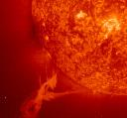
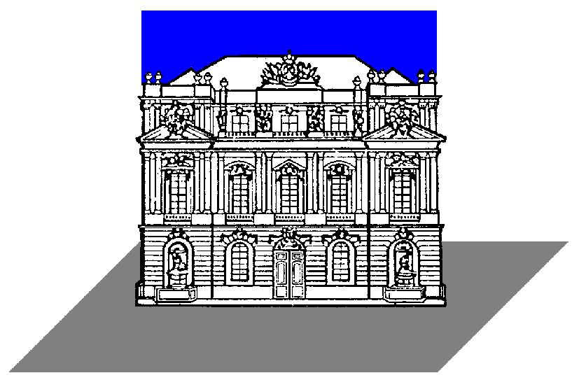

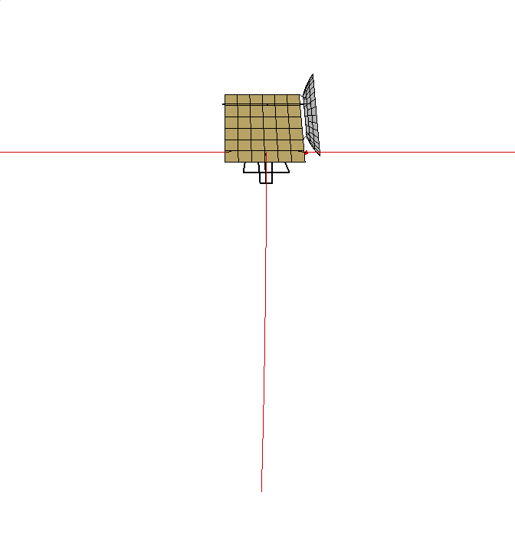
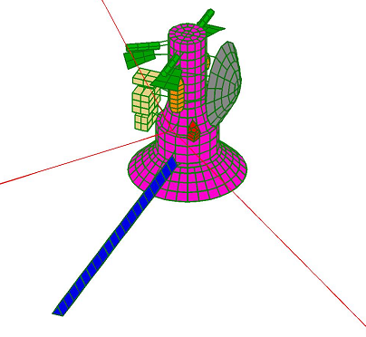
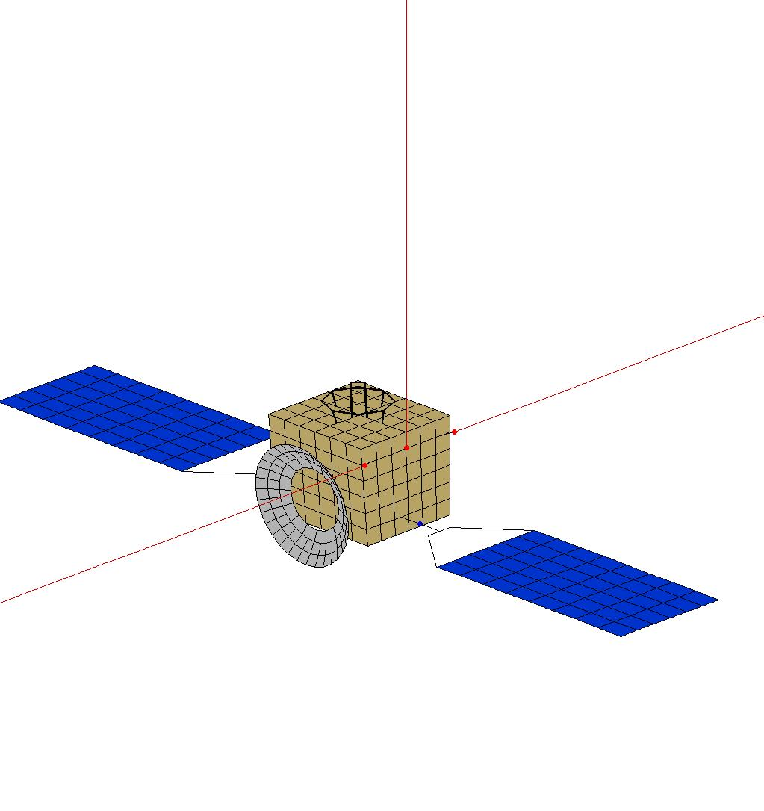
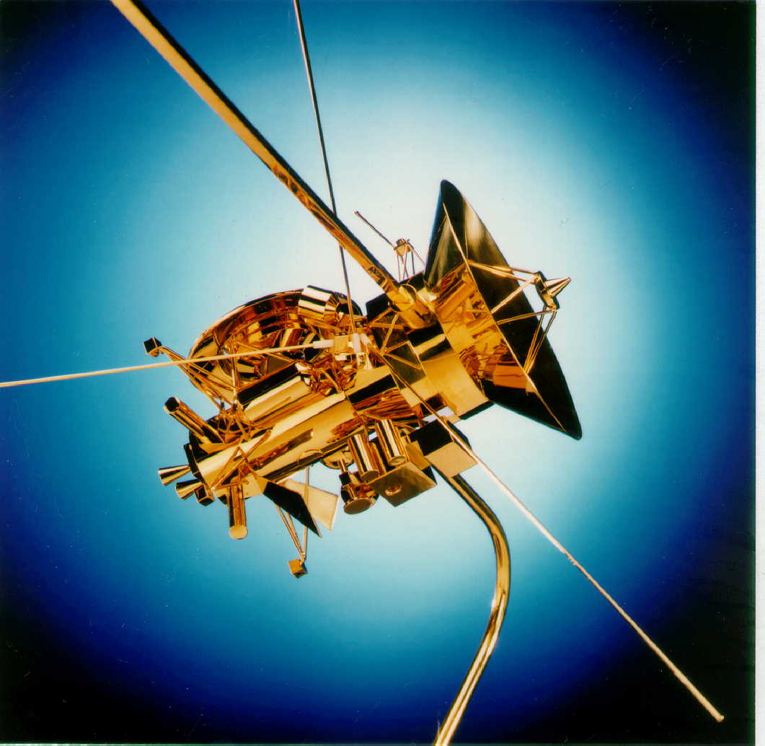
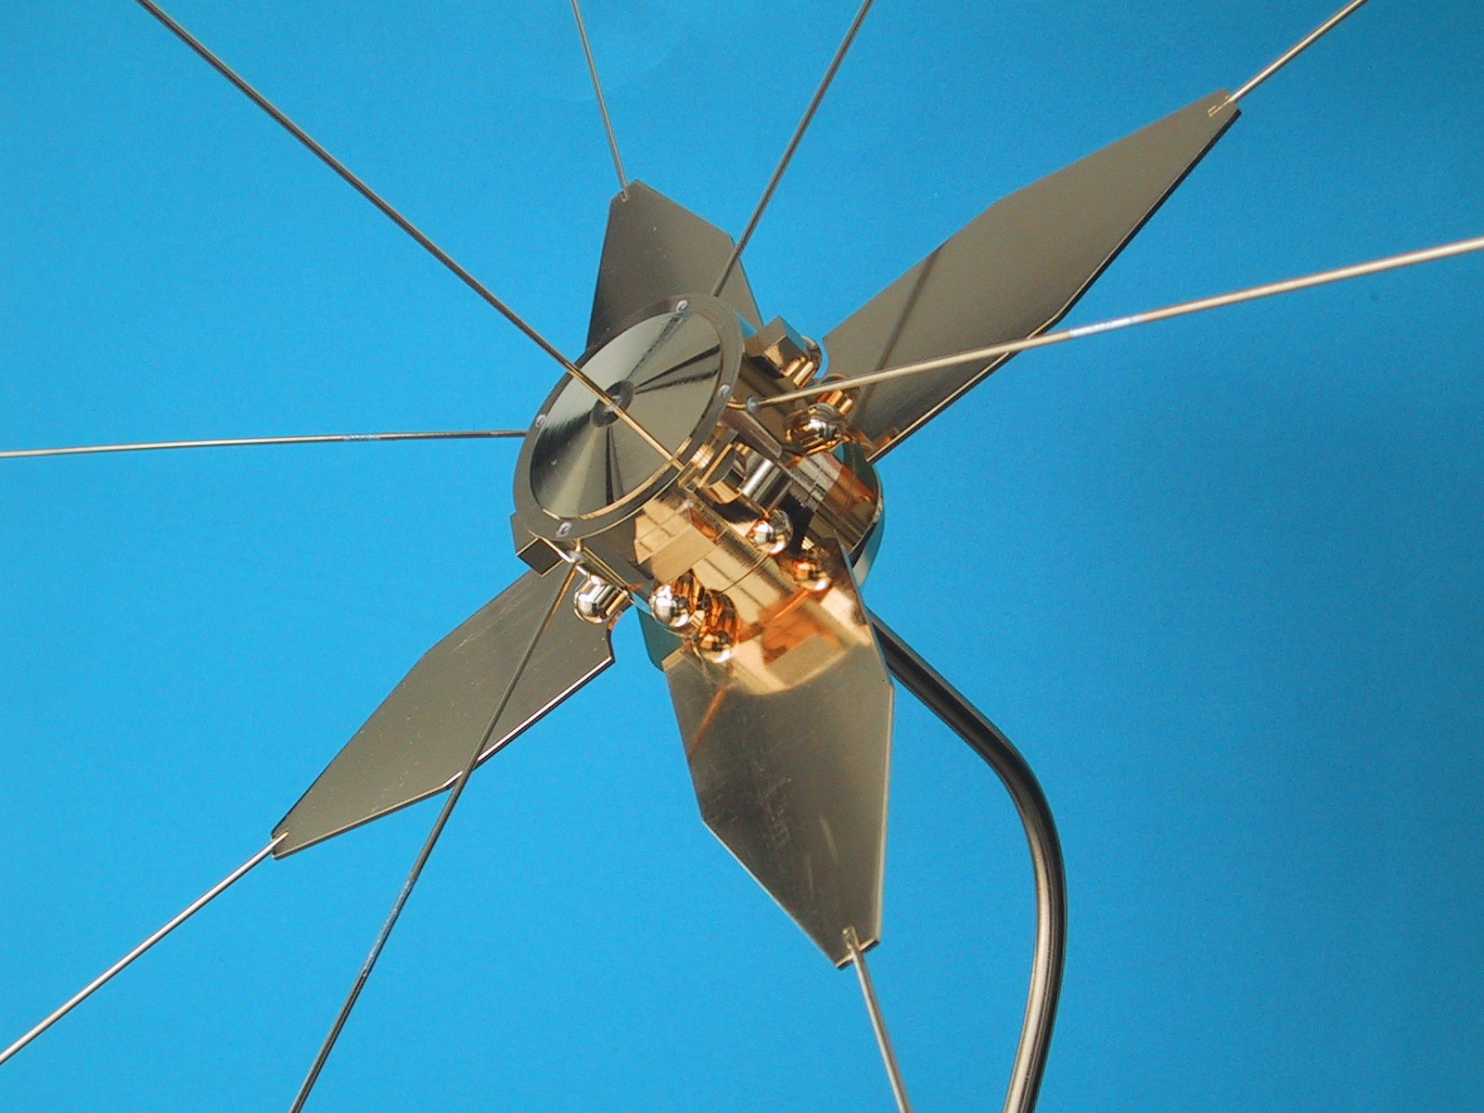
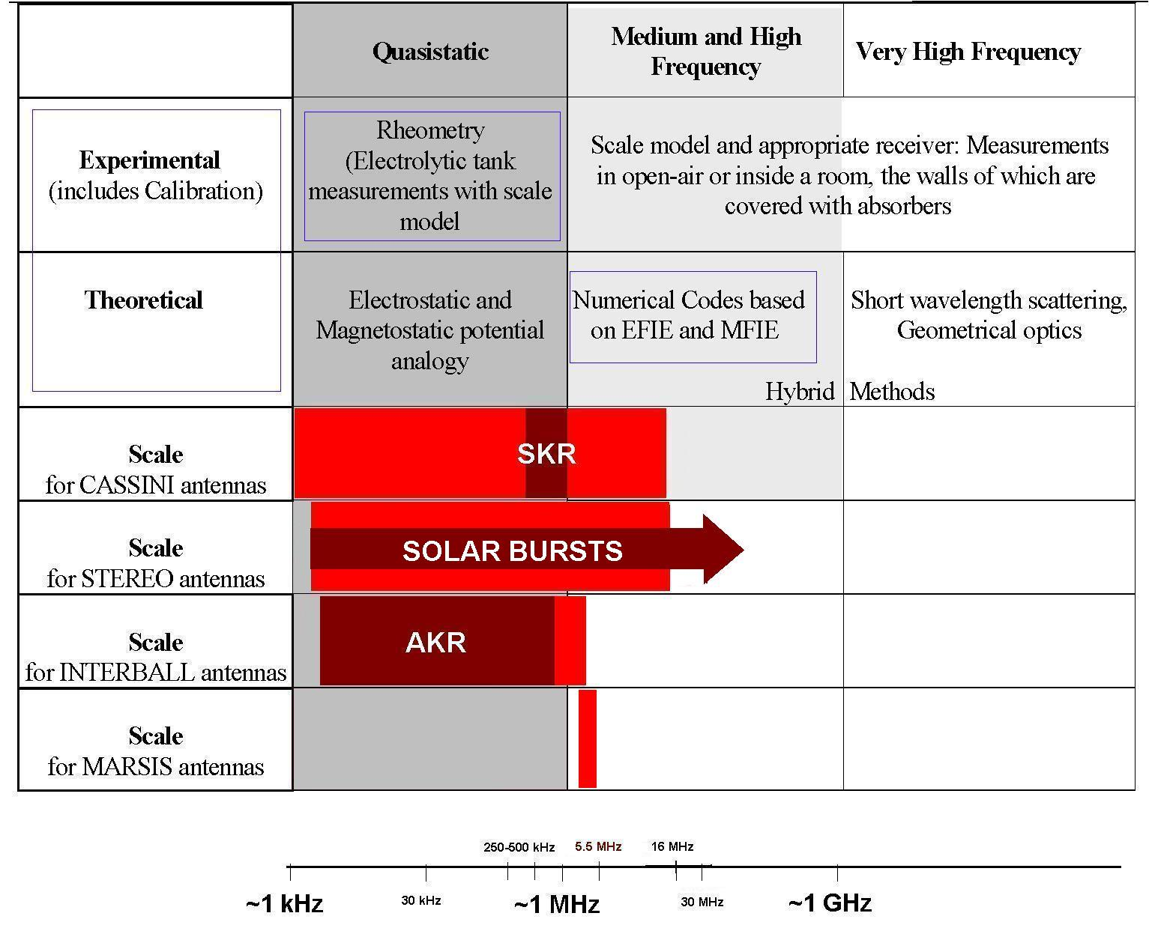
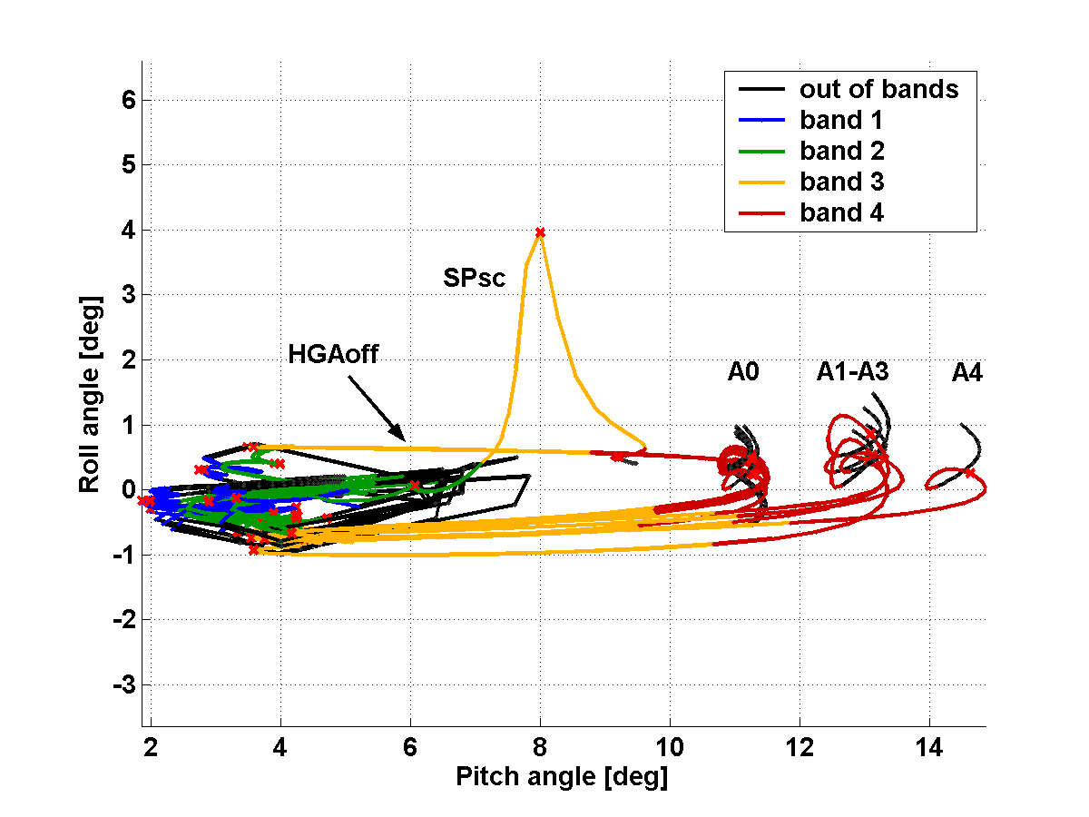
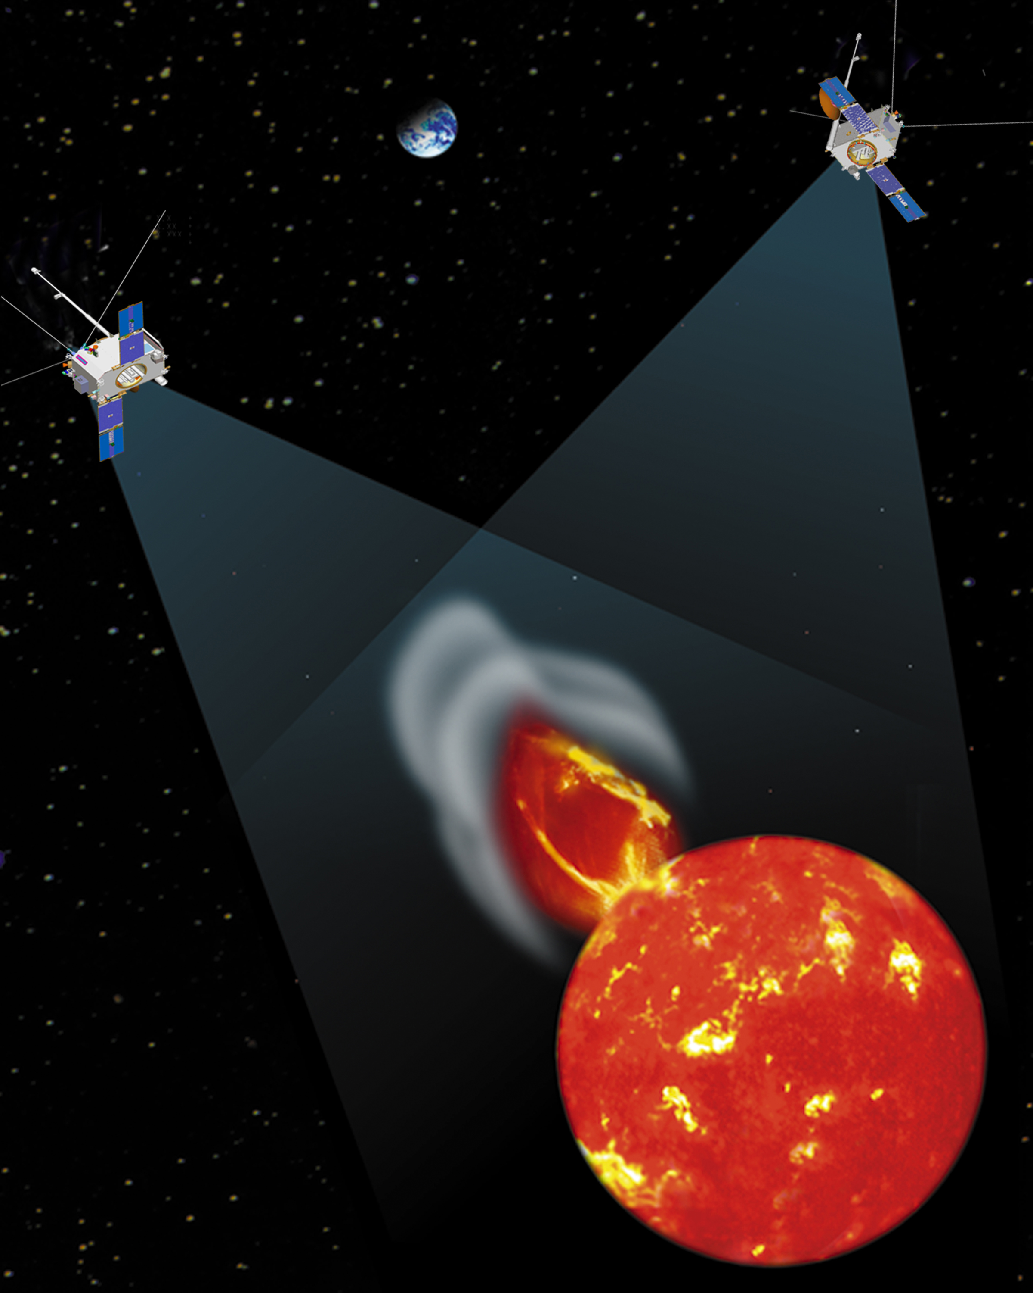
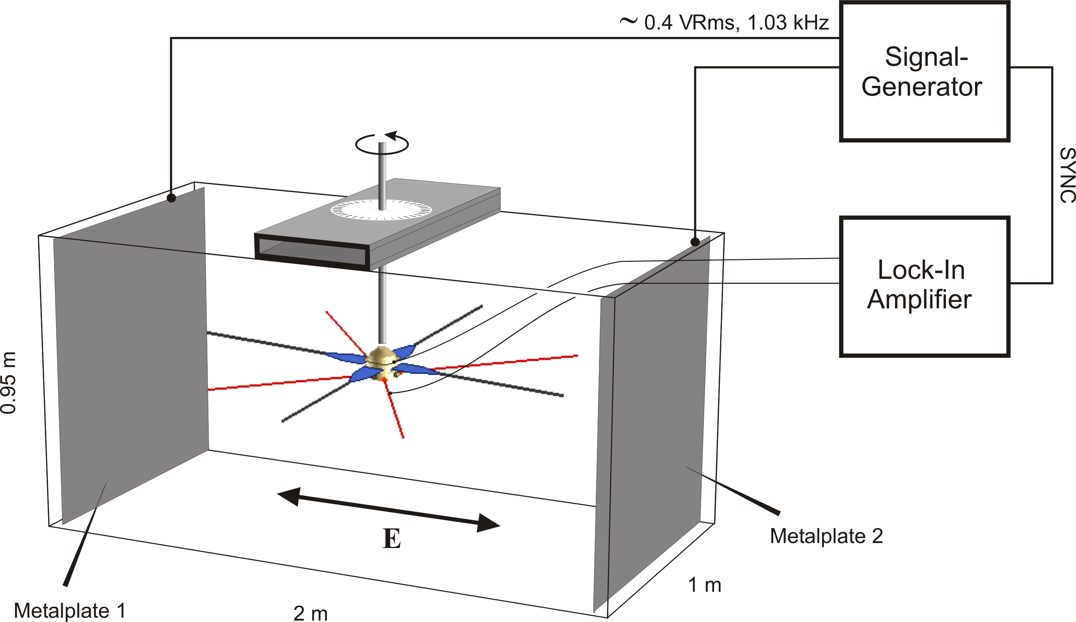
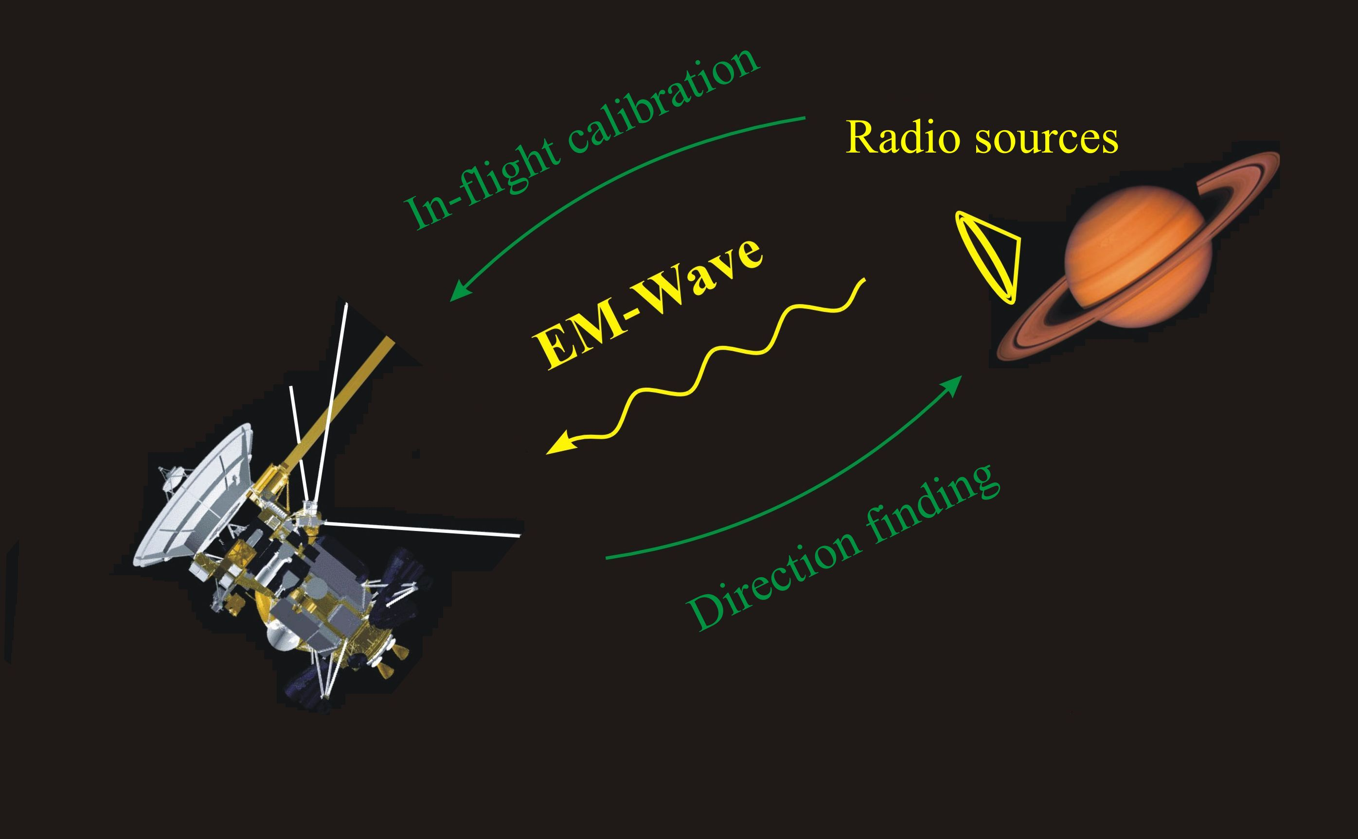
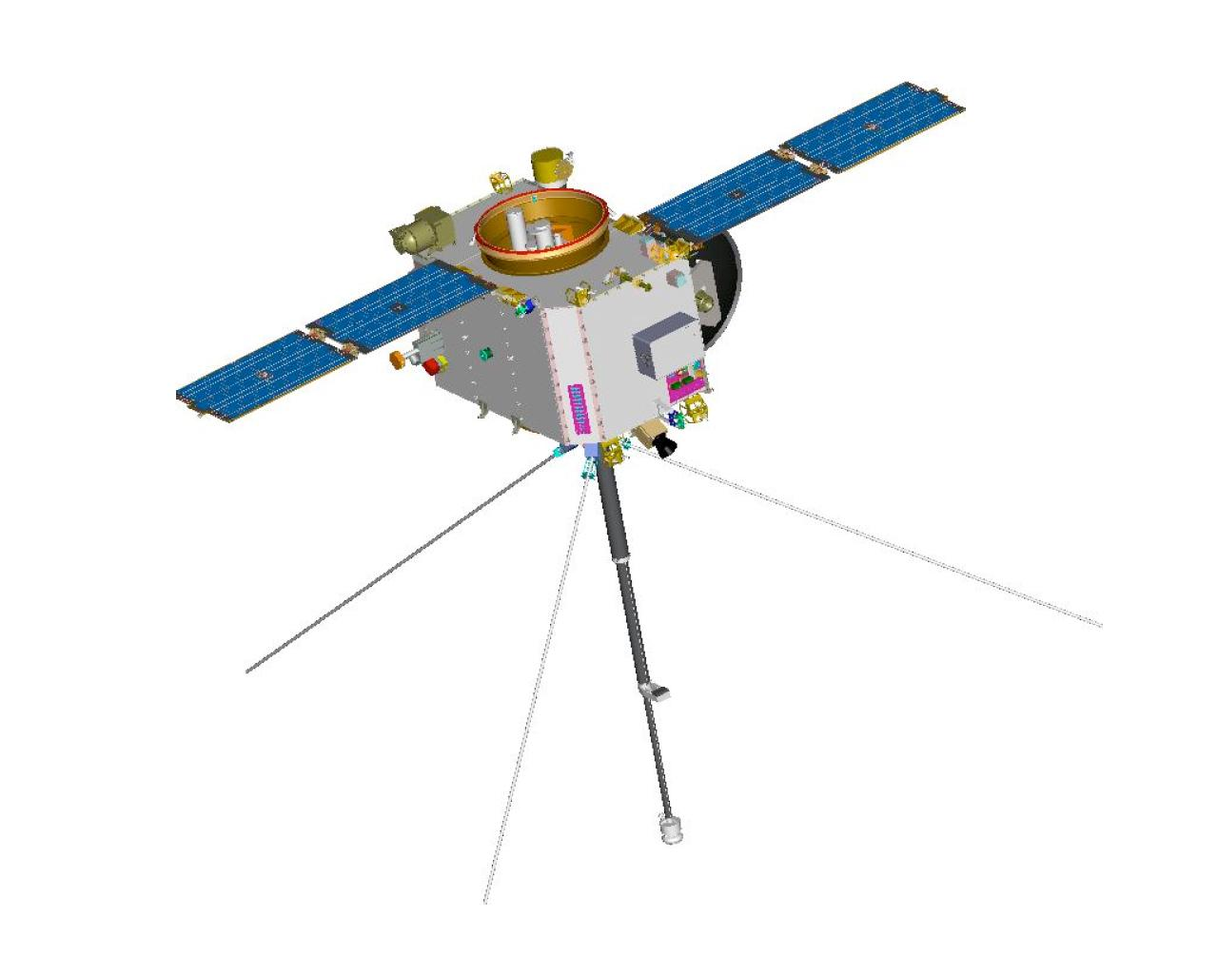
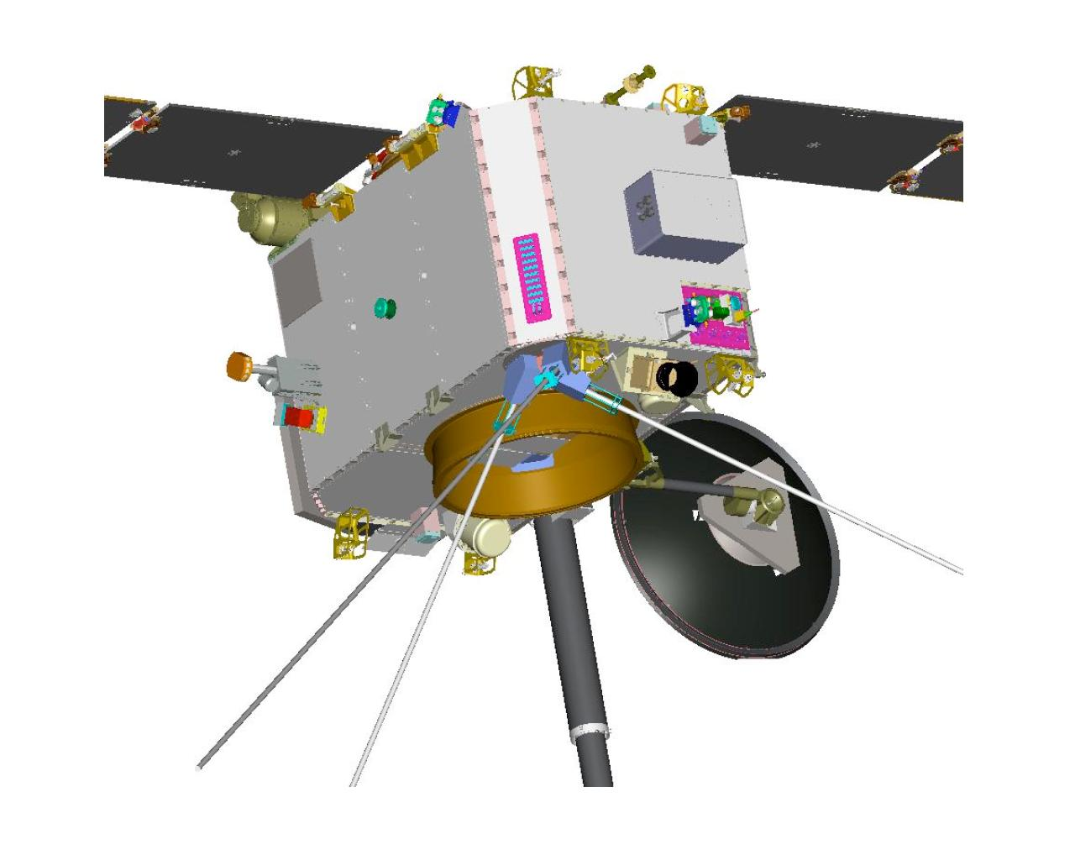
ANALYSIS OF SPACECRAFT ANTENNA SYSTEMS: IMPLICATIONS FOR STEREO/WAVES
H.O. Rucker (1), W. Macher (1), G. Fischer (1), Th. Oswald (1), J.L. Bougeret (2), M.L. Kaiser (3), K. Goetz (4)
COSPAR04-A-00988
(1) Space Research Institute, Austrian Academy of Sciences, Graz, Austria,
(2) Observatoire de Paris-Meudon, France,
(3) NASA/GSFC, Greenbelt, MD, USA,
(4) University of Minnesota, USA
ABSTRACT
APPLICATION TO VARIOUS SPACECRAFT
The STEREO/SWAVES experiment is considered to provide measurements of the non-thermal radio spectrum from a few kHz up to about 16 MHz, performed by 3 six meter orthogonal monopole antennas and a set of receivers (fixed-, high-, low frequency receiver). This system enables direction finding, i.e. the determination of direction of arrival and polarization state of the respective radio waves.
Analysis of such kind of antenna system is necessary in order to define the reception properties which crucially depend on the overall spacecraft configuration. The concept of effective antenna vector (h-eff) determination is applied to yield corresponding information on the deviation of h-eff from the physical rods, in dependence of frequency. Various methods are evaluated (rheometry for frequencies up to 1 MHz), wire grid modelling and in-flight calibration (e.g. probable use of earth-orbiting IMAGE/RPI) and their implications to the SWAVES experiment are discussed.
The following pictures show the most important spacecraft missions carrying experiments, the antennas of which have been analyzed at the Space Research Institute, Graz.
Cassini
METHODS FOR ANTENNA ANALYSIS
Mars Express
Interball
Numerical computer simulations are based on electromagnetic codes for the determination of antenna properties in a wide frequency range. Highly sophisticated electromagnetic code is used to get the current distribution on the surface of the antenna-spacecraft system. From these currents, the effective length vectors can be computed. The main advantage of this method is flexibility with regard to the representation of spacecraft parts, which can easily be altered to test their influence on antenna properties. Furthermore it enables an estimation of an upper frequency limit below which the quasi-static results are valid.
Frequency dependence of null axis of the MARSIS monopole for various s/c configurations. The axis is defined by pitch angle (offset from nadir along track) and roll angle (offset from nadir in cross-track direction). The shown frequency range is 0.5-6.0 MHz, containing the MARSIS operation bands 1-4. The main variation of the null axis with frequency is along-track. Configurations A0-A4 differ in the antenna feed position, which the axis proves to be fairly sensitive to. Considerable deviations from the most realistic configuration (A4) are obtained if the solar panels (SP) are short-circuited (sc) to the s/c (SPsc, in contrast to the nominal connection via 2kOhms).
STEREO/SWAVES
The STEREO-WAVES (SWAVES) Experiment is designed to track solar and interplanetary radio bursts and trace the generation and evolution of radio disturbances from the Sun to the Earth orbit and beyond. Each spacecraft has three, nearly orthogonal, antennas. With this configuration, it is possible to perform 'direction finding' to determine the direction of incidence and the polarization of the received radiation. When both spacecraft receive radiation from the same source, the actual location of the source can be pinpointed by the method of triangulation.
The technique of direction finding relies heavily upon the precise knowledge of the direction and the length of the three antennas (Ladreiter et al., 1995). Unfortunately, the real behaviour of the antennas is different than one would expect from the geometric configuration of the antennas. The reason is the perturbation due to radiation coupling with the body of the spacecraft. The surface of the spacecraft body is made of conducting material, so it can, in principle, be regarded as part of the antenna system. As a result, each antenna behaves as if it would point into a slightly different direction, with a slightly different length. The vector that describes the direction and length of this virtual antenna is called effective length vector, which has to be determined for each antenna, before any direction finding can be conducted.
Rheometry is an experimental technique to determine the effective length vectors of antennas in the quasi-static frequency range, where the wave length is much greater than the dimension of the antenna system. Its advantages are that the antenna system (antennas as well as spacecraft) can be modelled in great detail and that the used measurement set-up is pretty much disturbance-free, contrary to the standard high-frequency measurements.
Inflight Calibration is a method which uses emitted waves of a radio source of known location to measure the gain pattern of the antenna. For this purpose, the spacecraft has to be rotated with respect to the direction of the incident wave. From the change of the intensity of the received wave during the rotation, one can determine the direction of the effective length vector.
The difficulty, when trying to predict the behavior of STEREO’s antennas is the asymmetry of the spacecraft. One can expect the effective length vectors to be pushed away by the boom (b), which will have a large effect upon the gain pattern. Also, the solar panels will influence the situation by pushing the effective length vectors back towards the boom. So there is a highly unpredictable configuration, which makes the use of the methods, described above, absolutely necessary. The two spacecraft (STEREO A/ STEREO B) differ in shape, so the determination of the effective length vectors has to be performed twice.
At high frequencies, however, the direction of the effective length vector depends on the direction and frequency of the incident wave. This makes it impossible to describe the antenna properties by a constant vector.
Merits. Either method has its own advantages. Rheometry can be far more detailed than it would be possible for the wire-grid simulations, so the influence of the fine structure of the spacecraft can be estimated by comparison of the two methods. Rheometry is therefore a good basis to decide about improvements of wire-grids, it further yields a purely quasi-static result, which must agree with the asymptotic limit of the numeric calculations as the frequency converges to zero. The advantage of the computer simulation is the flexibility regarding the model structure, so it can be used to study the perturbation of antenna properties provoked by single spacecraft parts. Of course, the decisive advantage is that electromagnetic codes are devised for high-frequency analysis up to frequencies far above the resonance, thereby enabling the estimation of the validity range of the quasi-static results.
b
References
b
Cecconi, B., P. Zarka, and D. Vogl, Direction finding and antenna calibration through analytical inversion of radio measurements performed using a system of 2 or 3 electric dipole wire antennas, EGU 1st General Assembly, April 2004.
Fischer, G., W. Macher, and H.O. Rucker, A MATLAB toolbox for calculating ASAP-wire-grid-models of antennas, Austrian Academy of Sciences, IWF-121, September 2000.
Fischer, G., W. Macher, H.O. Rucker, H.P. Ladreiter, D.F. Vogl and the Cassini/RPWS Team: Wire-grid modeling of Cassini spacecraft for the determination of effective antenna length vectors of the RPWS antennas. In: Planetary Radio Emissions V, H.O. Rucker, M.L. Kaiser, Y. Leblanc (Eds.), Austrian Academy of Sciences Press, Vienna, 347-356, 2001.
Fischer, G., W. Macher, H.O. Rucker and the Cassini/RPWS team: Reception properties of the Cassini/RPWS antennas from 1 to 16 MHz, EGS-AGU-EUG Joint Assembly, Nice, April 2003.
Ladreiter, H.P., P. Zarka, A. Lecacheux, W. Macher, H.O. Rucker, R. Manning, D.A. Gurnett, W.S. Kurth: Analysis of electromagnetic wave direction finding performed by spaceborne antennas using singular value decomposition techniques, Radio Sci., 30, 1699-1712, 1995.
Macher, W., and T. Vejda, Design of antenna grid structures. Manual to the MATLAB toolbox. Austrian Academy of Sciences, IWF-144, January 2003.
Macher, W., B. Schraußer, G. Fischer, H.O. Rucker, H. Lammer, C. Kolb, G. Kargl, Analysis of sounding antennas of the Mars-Express MARSIS experiment, In: Proc. 2nd European Workshop on Exo/Astrobiology, Ed. H. Sawaya-Lacoste, ESA Publications Division, Noordwijk, ESA SP-518, 539-540, 2002.
Macher, W., H.O. Rucker, G. Fischer and the MARSIS Team, Analysis of the MARSIS antenna system onboard Mars Express, EGU 1st General Assembly, Nice, April 2004.
Rucker, H.O., W. Macher, and S. Albrecht, Experimental and theoretical investigations on the Cassini RPWS antennas. In: Planetary Radio Emissions IV, H. O. Rucker, S. J. Bauer, and A. Lecacheux (Eds.), Austrian Academy of Sciences Press, Vienna, 327-337, 1997.
Rucker, H.O., W. Macher, R. Manning, and H. P. Ladreiter, Cassini model rheometry, Radio Sci., 31, 1299-1311, 1996.
Vogl, D. F., H. P. Ladreiter, P. Zarka, H. O. Rucker, W. Macher, W. S. Kurth, D. A. Gurnett, G. Fischer: First results on the calibration of the Cassini RPWS antenna system. In: Planetary Radio Emissions V, H. O. Rucker, M. L. Kaiser, Y. Leblanc (Eds.), Austrian Academy of Sciences Press, Vienna, 357-366, 2001.
Vogl, D.F., B. Cecconi, W. Macher, P. Zarka, H.P. Ladreiter, P. Fedou, A. Lecacheux, T. Averkamp, G. Fischer, H.O. Rucker, D.A. Gurnett, W.S. Kurth, G.B. Hospodarsky, In-flight calibration of the Cassini-RPWS antenna system for direction finding and polarization measurements, J. Geophys. Res., in press 2004.

