Slide 1
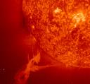
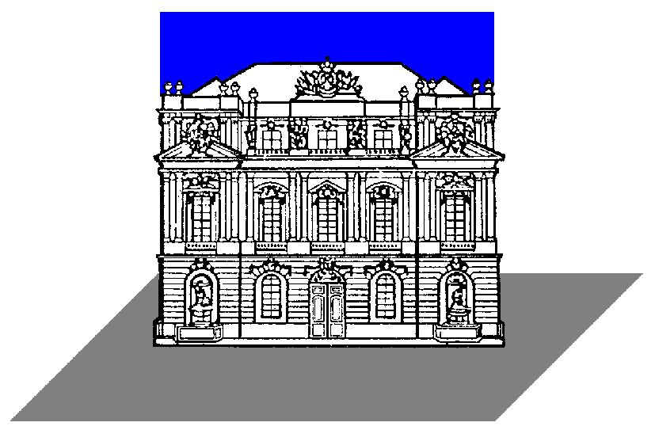

ANALYSIS OF SPACECRAFT ANTENNA SYSTEMS: IMPLICATIONS FOR STEREO/WAVES
H.O. Rucker (1), W. Macher (1), G. Fischer (1), Th. Oswald (1), J.L. Bougeret (2), M.L. Kaiser (3), K. Goetz (4)
(1) Space Research Institute, Austrian Academy of Sciences, Graz, Austria,
(2) Observatoire de Paris-Meudon, France,
(3) NASA/GSFC, Greenbelt, MD, USA,
(4) University of Minnesota, USA
The STEREO/SWAVES experiment is considered to provide measurements of the non-thermal radio spectrum from a few kHz up to about 16 MHz, performed by 3 six meter orthogonal monopole antennas and a set of receivers (fixed-, high-, low frequency receiver). This system enables direction finding, i.e. the determination of direction of arrival and polarization state of the respective radio waves.
Analysis of such kind of antenna system is necessary in order to define the reception properties which crucially depend on the overall spacecraft configuration. The concept of effective antenna vector (h-eff) determination is applied to yield corresponding information on the deviation of h-eff from the physical rods, in dependence of frequency. Various methods are evaluated (rheometry for frequencies up to 1 MHz), wire grid modelling and in-flight calibration (e.g. probable use of earth-orbiting IMAGE/RPI) and their implications to the SWAVES experiment are discussed.

Slide 2
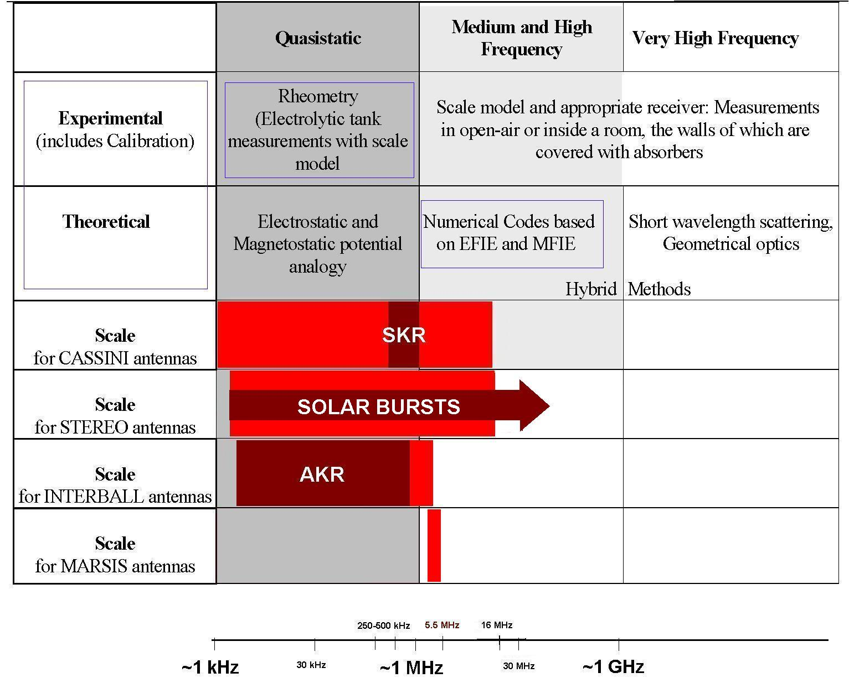
ANALYSIS OF SPACECRAFT ANTENNA SYSTEMS: IMPLICATIONS FOR STEREO/WAVES

Slide 3
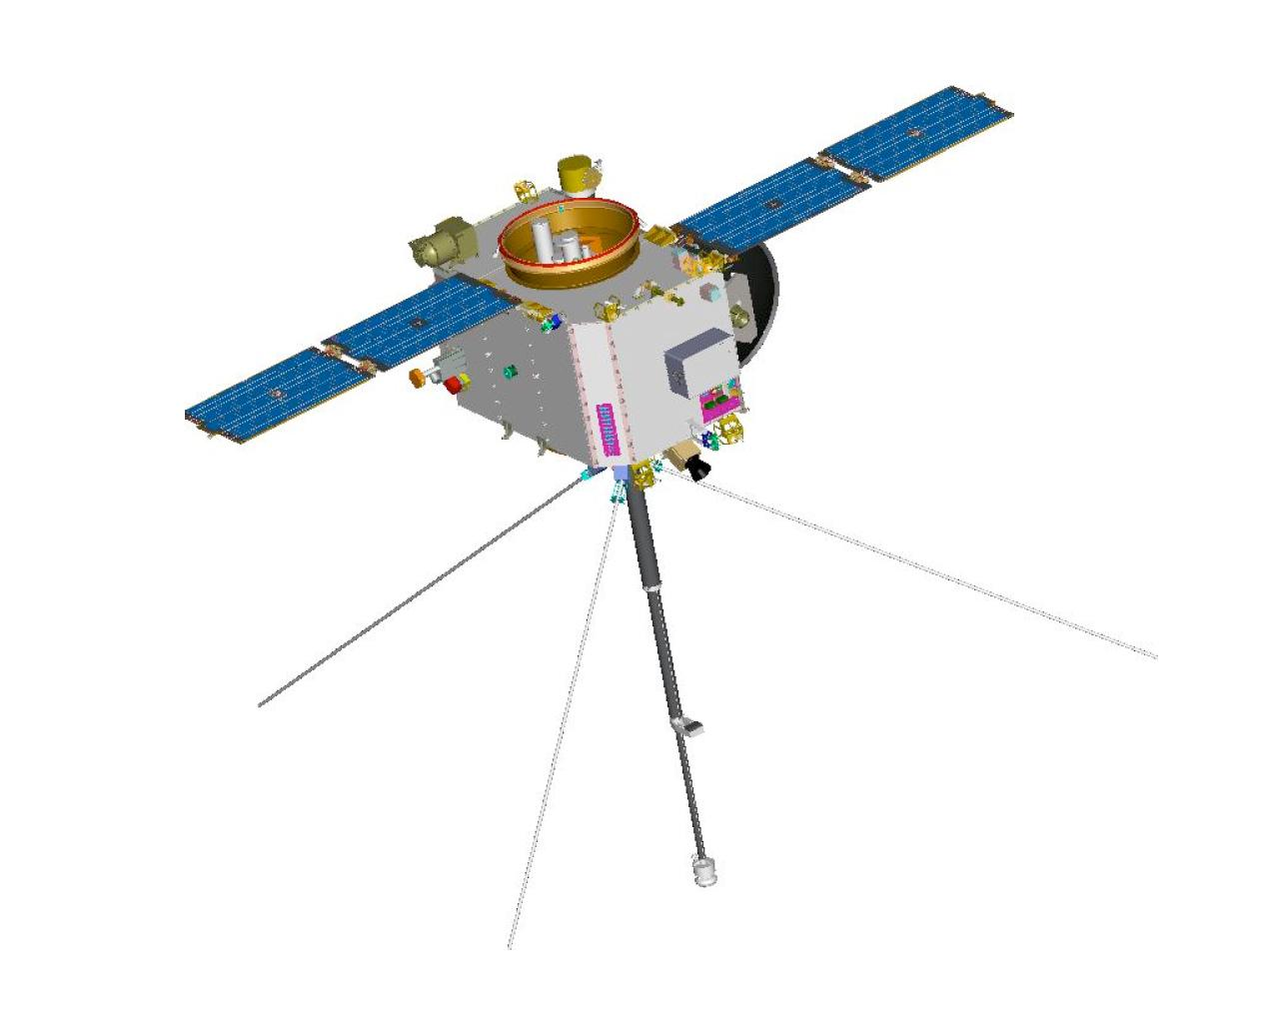
ANALYSIS OF SPACECRAFT ANTENNA SYSTEMS: IMPLICATIONS FOR STEREO/WAVES
The difficulty, when trying to predict the behavior of STEREO’s antennas is the asymmetry of the spacecraft. One can expect the effective length vectors to be pushed away by the boom (b), which will have a large effect upon the gain pattern. Also, the solar panels will influence the situation by pushing the effective length vectors back towards the boom. So there is a highly unpredictable configuration, which makes the use of the methods, described above, absolutely necessary. The two spacecraft (STEREO A/ STEREO B) differ in shape, so the determination of the effective length vectors has to be performed twice.
At high frequencies, however, the direction of the effective length vector depends on the direction and frequency of the incident wave. This makes it impossible to describe the antenna properties by a constant vector.

