Slide 1
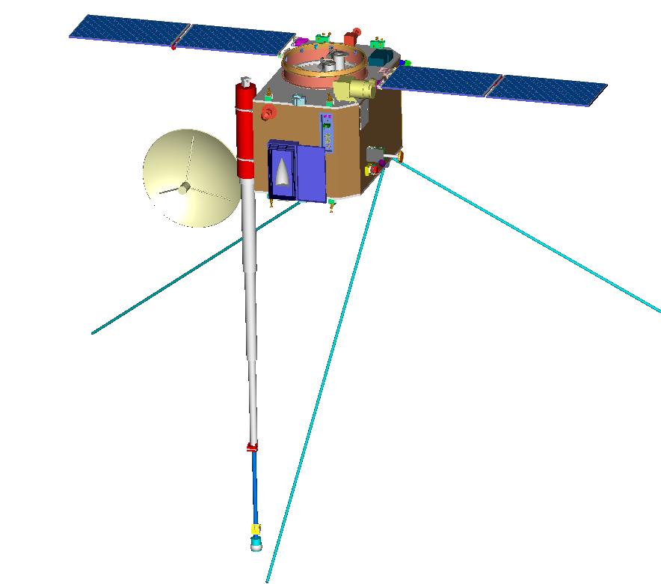
STEREO-B (BEHIND) OBSERVATORY
1.1m X 2.0 m X 1.2 m
610 kg
600 W (EOL)
SECCHI
Sun-Centered Imaging
Package (SCIP) Assy
(COR-1, COR-2, EUVI, GT)
PLASTIC Instrument
IMPACT SEP
Deployed SWAVES
Electric Field Antenna
(3 places)
SECCHI
Heliospheric Imager
(HI)
Deployed
IMPACT Boom
IMPACT
Magnetometer
(MAG)
IMPACT
Suprathermal Electron Detector
(STE)
IMPACT
Solar Wind Electron Analyzer (SWEA)

