Slide 1


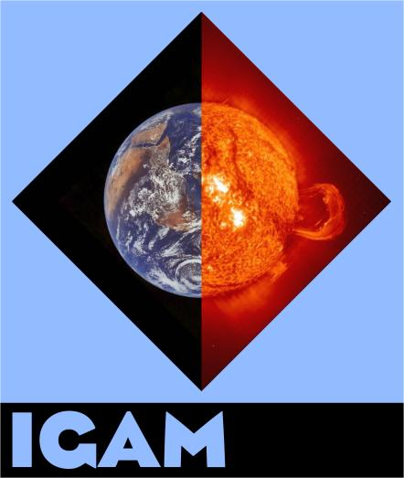

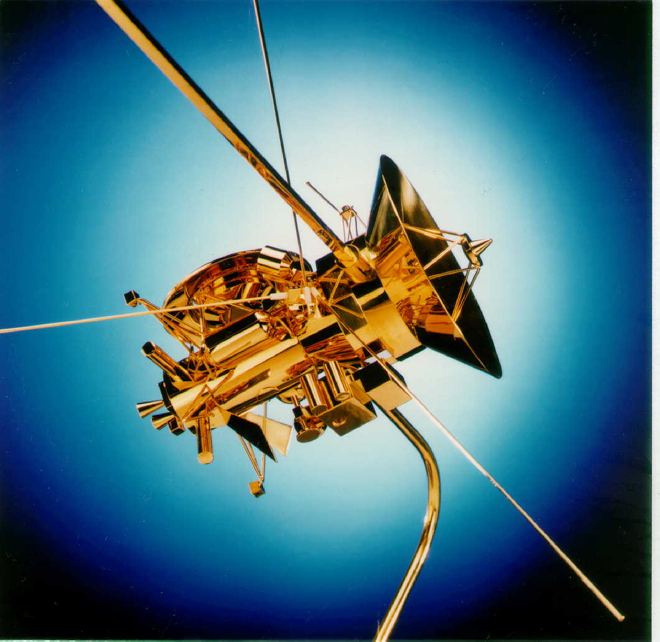
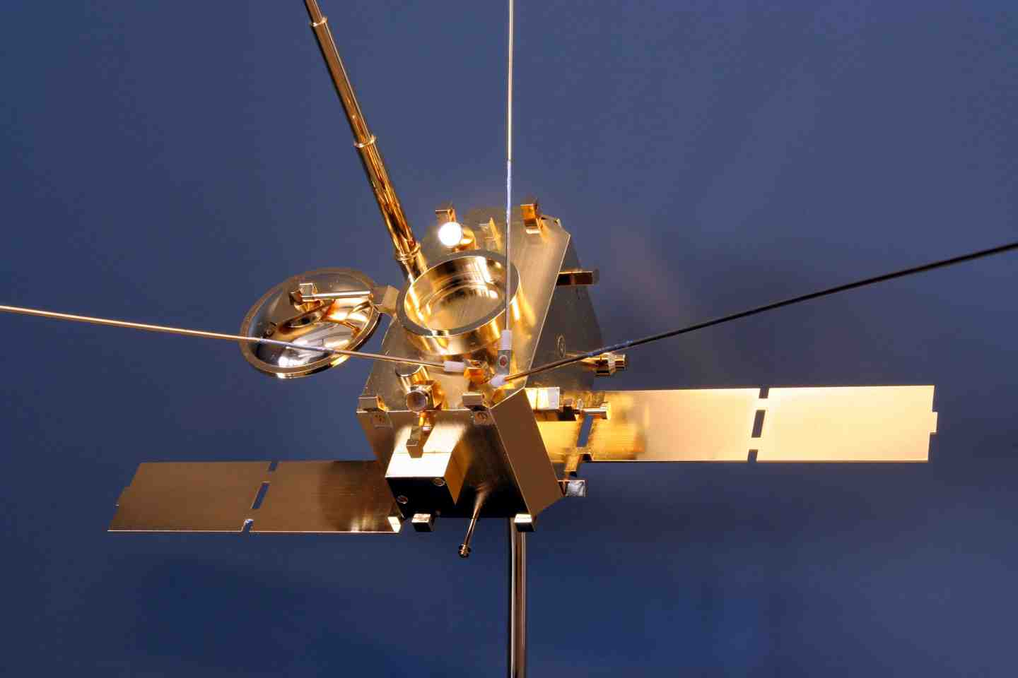
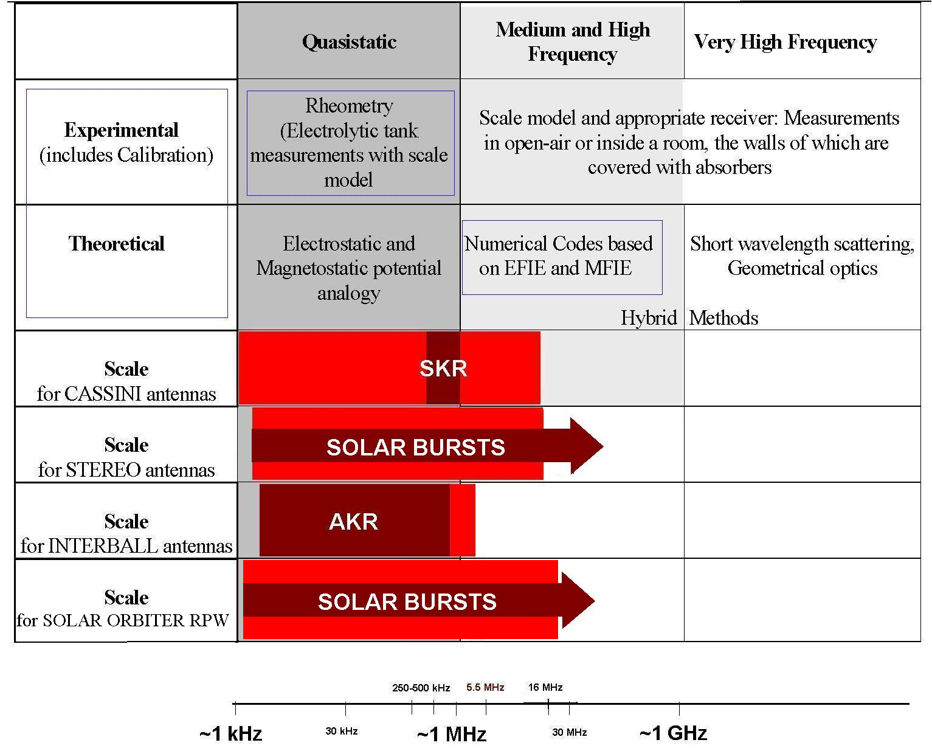
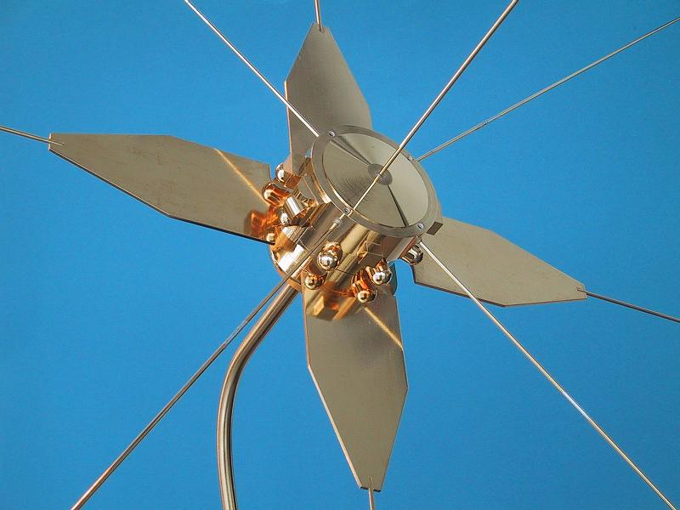
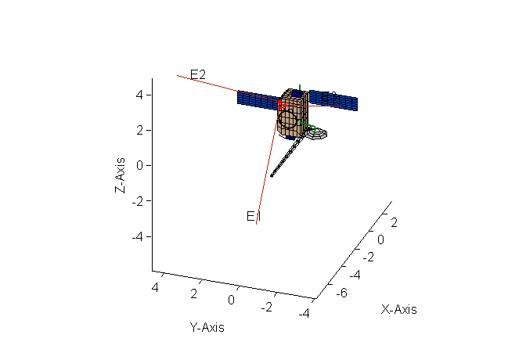
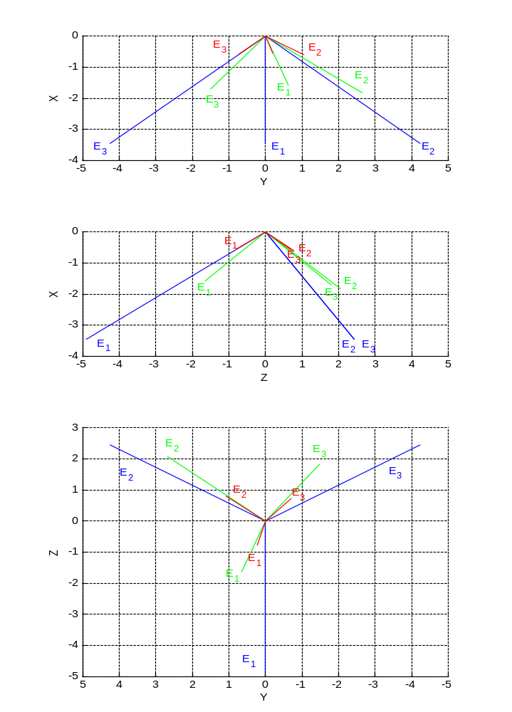
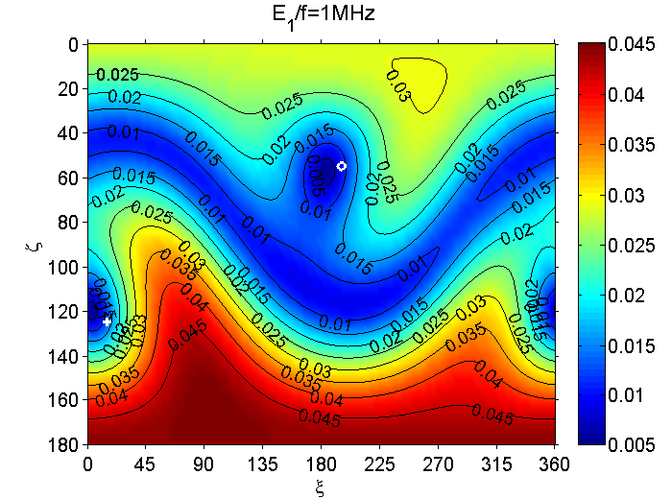
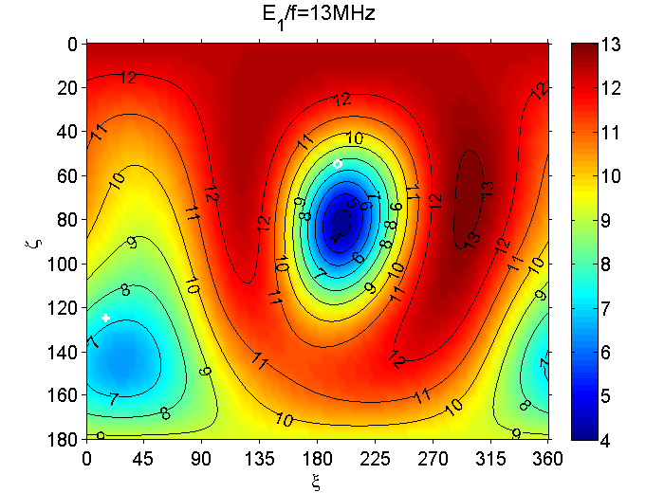
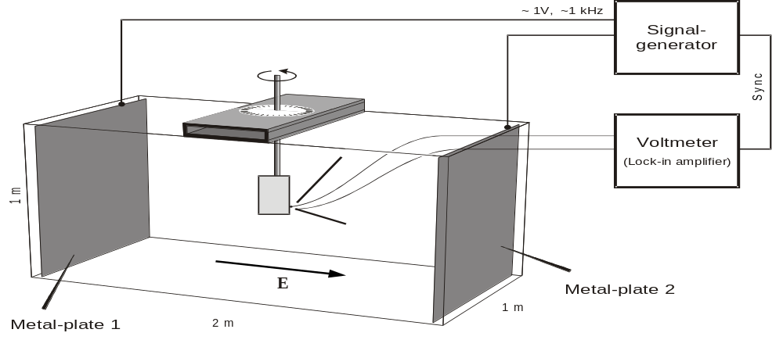
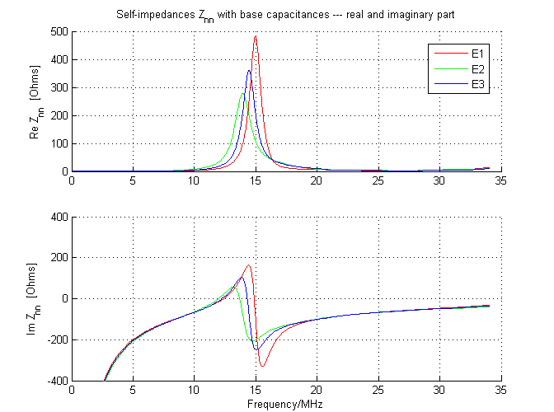
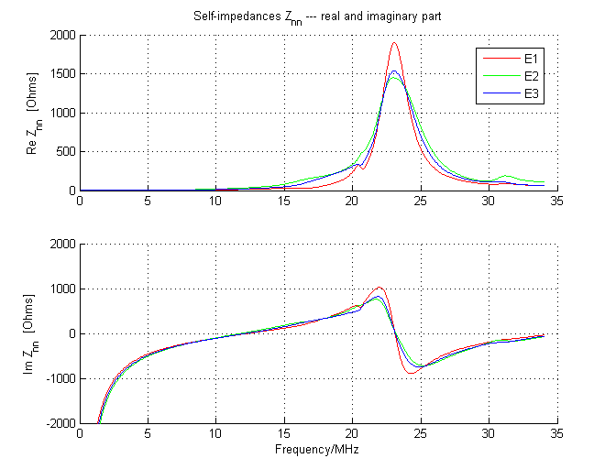
Calibration of the NASA/STEREO/WAVES antenna system
Oswald, T.H.(1,2), W. Macher (1), H.O. Rucker (1,2)
Space Research Institute, Austrian Academy of Sciences, A-8042 Graz, Austria
Institute of Physics, Karl Franzens Universität Graz, Austria
thomas.oswald@oeaw.ac.at
NASA’s two STEREO spacecraft have been launched on October, 25th, 2006. On board, they carry a sophisticated radio experiment, called SWAVES, which is designed to increase our knowledge of the physics of the solar system. The key technology, used by SWAVES is the direction finding capability in addition to the use of two spacecraft. This new method makes it possible to triangulate radio sources. Direction finding requires the reception properties of the antennas to be known very accurately. We performed several different methods to calibrate the SWAVES antennas. In this paper, the methods are described and compared and the results are presented and discussed with respect to advantages and disadvantages of the different methods.
Figure 1a
INTRODUCTION
The calibration of spacecraft antennas is of vital importance for the successful interpretation of the scientific data. Several methods exist:
Numerical method (wire-grid modeling)
Experimental method (rheometry)
In-flight calibration
Each method has it advantages and has successfully been applied for the calibration of several spacecraft (Figure 1). For a realistic picture of the overall situation it is necessary to perform all available methods in combination.
Figure 1b
1a
1b
1c
THE NUMERICAL METHOD
Figure 1
Figure 1c
The numerical method for determining the relevant antenna properties is based on electromagnetic codes. At first, a wire-grid model of the spacecraft is constructed (see Figure 2). Then, numerical codes are used to get the current distribution on the surface of the antenna-spacecraft system.
Calculation of the current distribution on the surface of the spacecraft is done by application of two programs:
The Antenna Scatterers Analysis Program (ASAP) is an open source program, using the method of moments (MOM) to solve the reaction integral equation. As representation of the currents, a piecewise sinusoidal expansion is used.
CONCEPT II is a proprietary software written at the University of Hamburg-Harburg. It uses the MOM to solve the electric field integral equation (EFIE) and uses triangular base functions to represent the currents.
In the regime of the spacecraft antennas both methods are equally valid, so the consistency of the two results is a good indication for the validity of the method and the modelling process. In both cases the antennas are excited by an electromotive force of 1V at the feed points. One of the feeds is marked by the red dot in Figure 2. Only currents along the wires are considered, all transverse currents are ignored. Another simplification made is that the currents are infinitely thin and flowing along the center of each wire.
THE RESULTS
We have determined the properties of the SWAVES antennas with a high degree of accuracy. The results will be used in the evaluation of the data recorded by the SWAVES instrument., in particular for direction finding of electromagnetic waves and subsequent triangulation of their sources. But they can also be employed as start values for the planned in-flight calibration of the whole antenna-receiver system.
Figure 4 shows the mechanical antennas (blue) of SWAVES antenna elements and their effective length vectors for open ports (green) and with base capacitances included (red). The configuration is STEREO A with the high gain antenna at its neutral orientation. Views are from –Z (top), from +Y (middle) and from –X (bottom).
Antenna impedances are an important factor in the determination of this upper quasi-static bound as their influence depends substantially on the frequency. In consequence, this holds for the base capacitances as well. Figure 6 depicts the antenna self-impedances (real and imaginary parts) as found by CONCEPT wire-grid simulations. These plots show the direct results of the wire-grid calculation, the capacitances of cables and mounting structures are not implemented. The implementation is done for Figure 7 which represents the antenna impedances with the complete base capacitances taken into account (cables, mounting, receiver input capacitances).
Figure 2
The integral equations have to be solved in conjunction with the boundary conditions. Both programs use the MOM which was developed in this form by Roger Harrington [Harrington, 1968]. The integral equation is transformed into a matrix equation which can be solved by means of linear algebra.
Based on the currents along the wires, the effective length vectors, the fields, the radiation pattern and the impedances can be computed. This is done by using Matlab functions. The main advantage of this method is flexibility with regard to the representation of spacecraft parts, which can easily be altered to test their influence on antenna properties.
Figure 4
The effective length vector represents the antenna as it behaves electrically in contrast to how it is built geometrically. It depends, in general on frequency and direction of incidence of the incoming wave and it is complex. Only at very low frequencies, the so-called quasi-static limit, the effective length vector is nearly real and constant. Figures 5 demonstrate this behavior. They show the deviation of the effective length vectors from quasi-static limit as a function of direction of the incident wave. The left Figure is calculated at 1 MHz well within the quasi-static regime. The right figure is computed at 13MHz. One can clearly see the higher deviation on the right plot.
THE EXPERIMENTAL METHOD
Rheometry is an experimental technique to determine the effective length vectors of antennas in the quasi-static frequency range, where the wavelength is much greater than the dimension of the antenna system. Its advantages are that the antenna system (antennas as well as spacecraft) can be modelled in great detail and that the used measurement set-up is pretty much disturbance-free, contrary to the standard high-frequency measurements.
A gold plated model of the antennas-spacecraft system has to be built (Figure 1). This model is immersed in an electrolytic tank (see Figure 3). Metal plates are attached to two opposite sides of the tank to form a large capacitor. A signal generator is connected to the plates to sustain a homogeneous electric field in the tank.
Figure 5
Figure 3
The voltages at the model antennas are measured as a function of the model orientation. For that purpose the model can be rotated around a vertical axis, and different suspensions of the model at this axis are used. So the induced voltages for a variety of orientations of the model with regard to the electric field direction are recorded, from which the effective length vectors can be inferred.
Literature:
Acknowledgement: These studies are supported by the Austrian Space Applications Programme (ASAP).
Figure 6
Figure 7
Num. Method: Fischer, G., W. Macher, H.O. Rucker, H.P. Ladreiter, D.F. Vogl and the Cassini/RPWS Team: Wire-grid modeling of Cassini spacecraft for the determination of effective antenna length vectors of the RPWS antennas. In: Planetary Radio Emissions V, H.O. Rucker, M.L. Kaiser, Y. Leblanc (Eds.), Austrian Academy of Sciences Press, Vienna, 347-356, 2001.
Num. Method: Fischer, G., W. Macher, H.O. Rucker and the Cassini/RPWS team: Reception properties of the Cassini/RPWS antennas from 1 to 16 MHz, EGS-AGU-EUG Joint Assembly, Nice, April 2003.
Num. Method: Harrington, R., Field Computation by Moment Methods, Robert E. Krieger Publishing Company, 1968.
Num. Method: Macher, W., and T. Vejda, Design of antenna grid structures. Manual to the MATLAB toolbox. Austrian Academy of Sciences, IWF-144, 2003.
Num. Method: Oswald, T.H., W. Macher, G. Fischer, H.O. Rucker: First results of STEREO/WAVES antenna calibration, Austrian Academy of Sciences, IWF-160, 2004.
Num. Method: Oswald, T.H., W. Macher, G. Fischer, H.O. Rucker: Results of STEREO/WAVES antenna calibration using a refined spacecraft model, Austrian Academy of Sciences, IWF-167, 2005.
Num. Method: Oswald, T.H. and W. Macher and G. Fischer and H.O. Rucker and J.L. Bougeret and M.L. Kaiser and K. Goetz, Numerical analysis of the stereo waves antennas: first results. In: Planetary Radio Emissions VI, H. O. Rucker, W.S. Kurth, and G.Mann (Eds.) Austrian Academy of Sciences Press, Vienna, 475-482, 2006
Num. Method: Oswald, T.H., Electromagnetic waves in space and the STEREO/SWAVES experiment, Master Thesis, University Graz and Technical University Graz, 2005.
Num. and Exp. Method: Rucker, H.O., W. Macher, and S. Albrecht, Experimental and theoretical investigations on the Cassini RPWS antennas. In: Planetary Radio Emissions IV, H. O. Rucker, S. J. Bauer, and A. Lecacheux (Eds.) Austrian Academy of Sciences Press, Vienna, 327-337, 1997
Exp. Method: Rucker, H.O., W. Macher, R. Manning, and H. P. Ladreiter, Cassini model rheometry, Radio Sci., 31, 1299-1311, 1996.
Num. and Exp. Method: Rucker, H., W. Macher, G. Fischer, T.H. Oswald, J.-L. Bougeret, M. Kaiser, and K. Goetz, Analysis of spacecraft antenna systems: Implications for STEREO/WAVES, Adv. Space Res.,36,1530-1533, doi: 10.1016/j.asr.2005.07.060, 2005.

