Slide 1







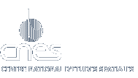







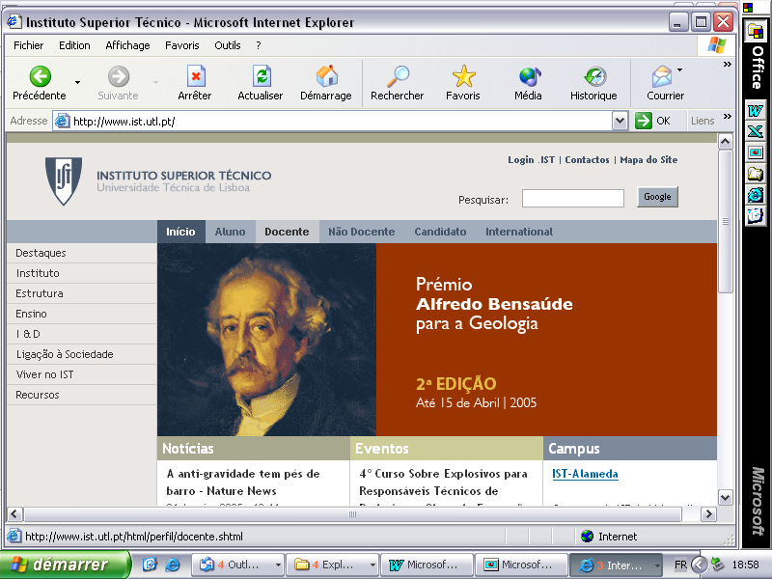
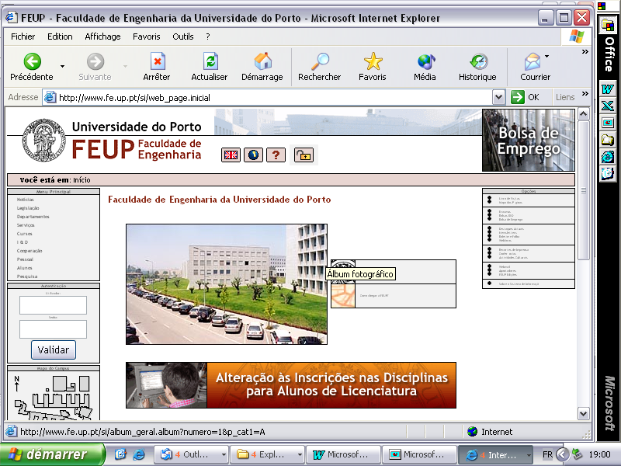
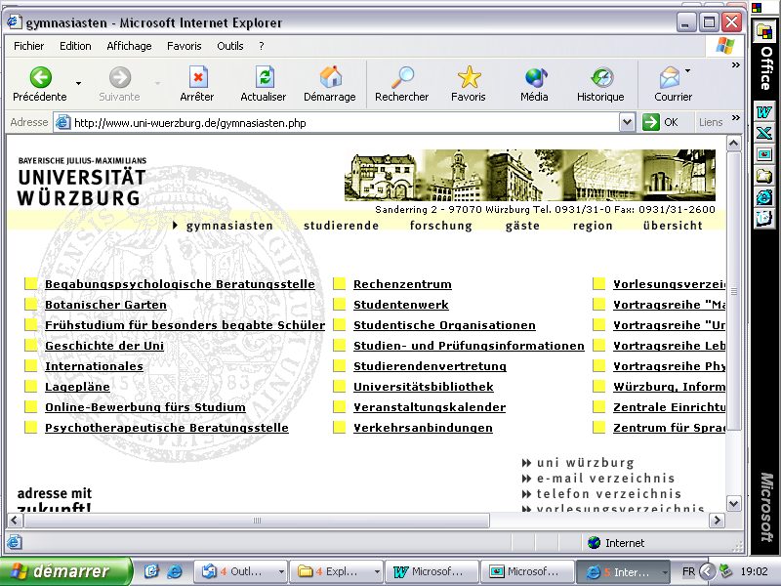
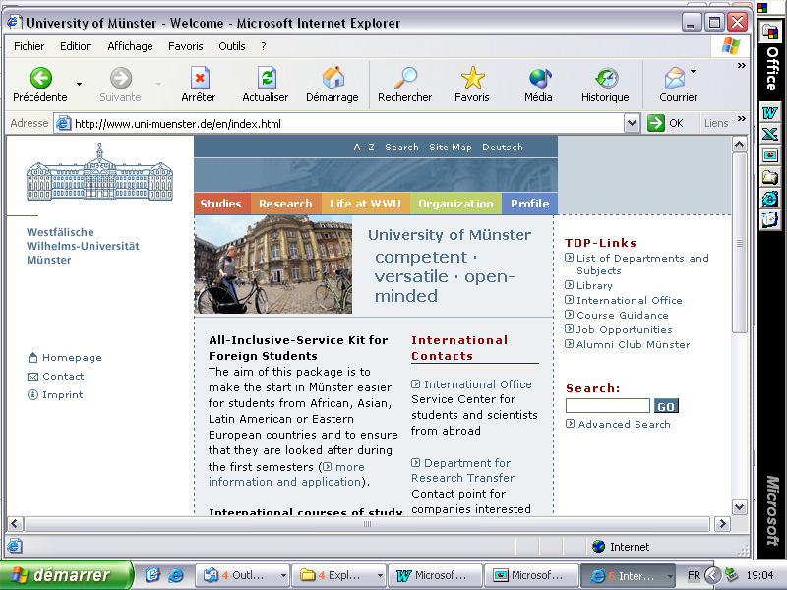





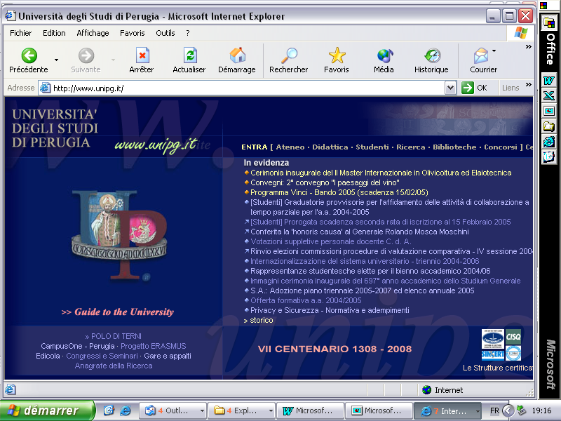


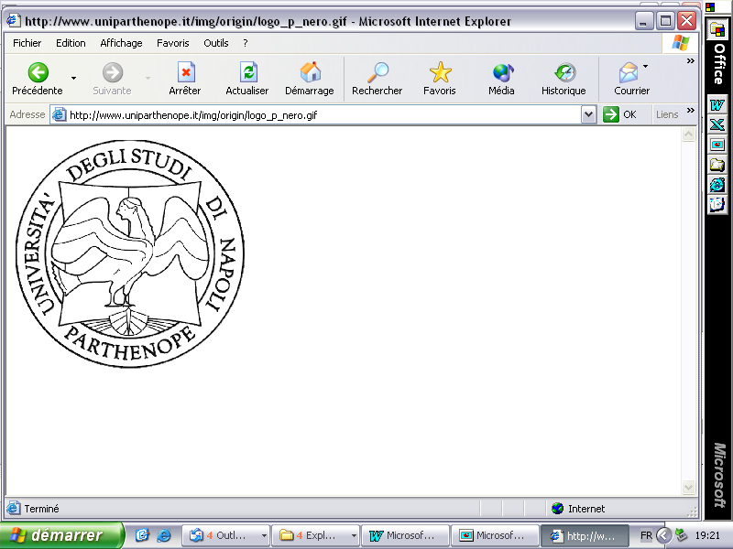


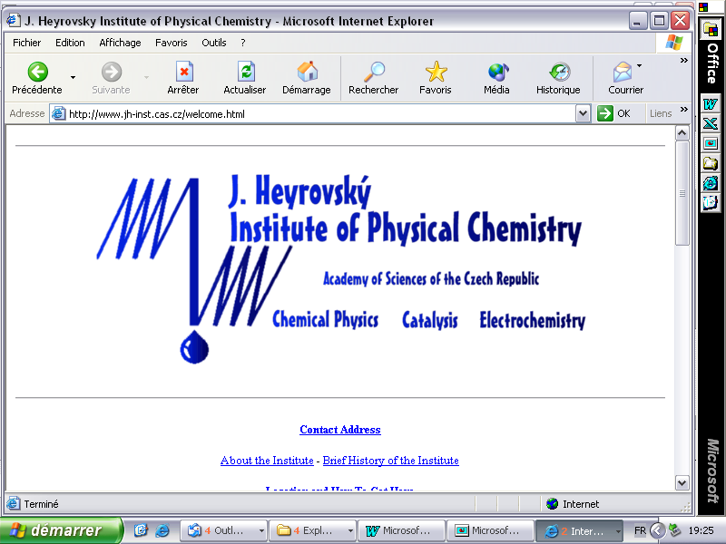

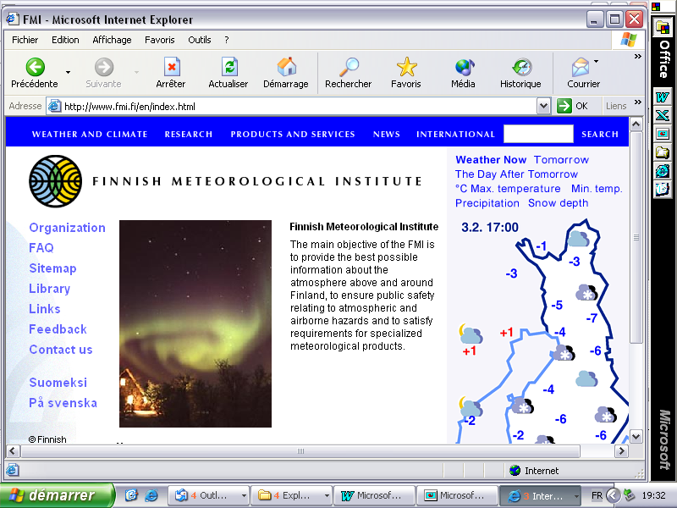

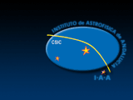



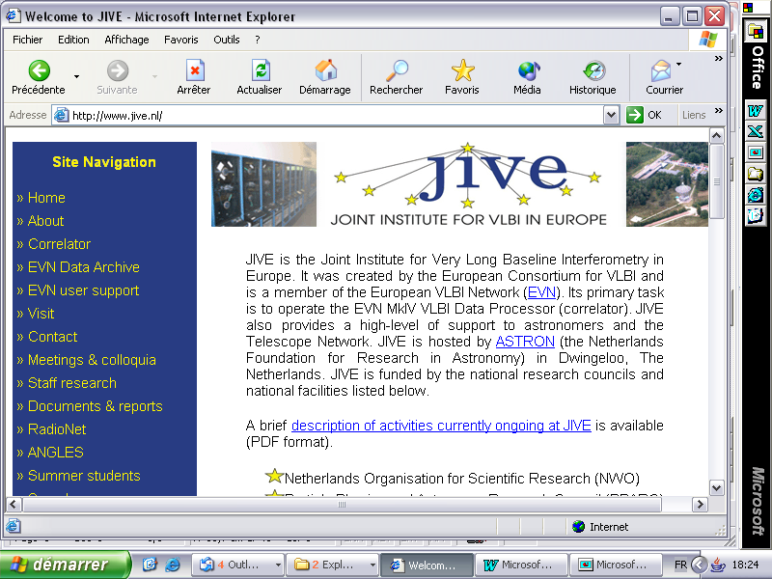
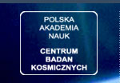


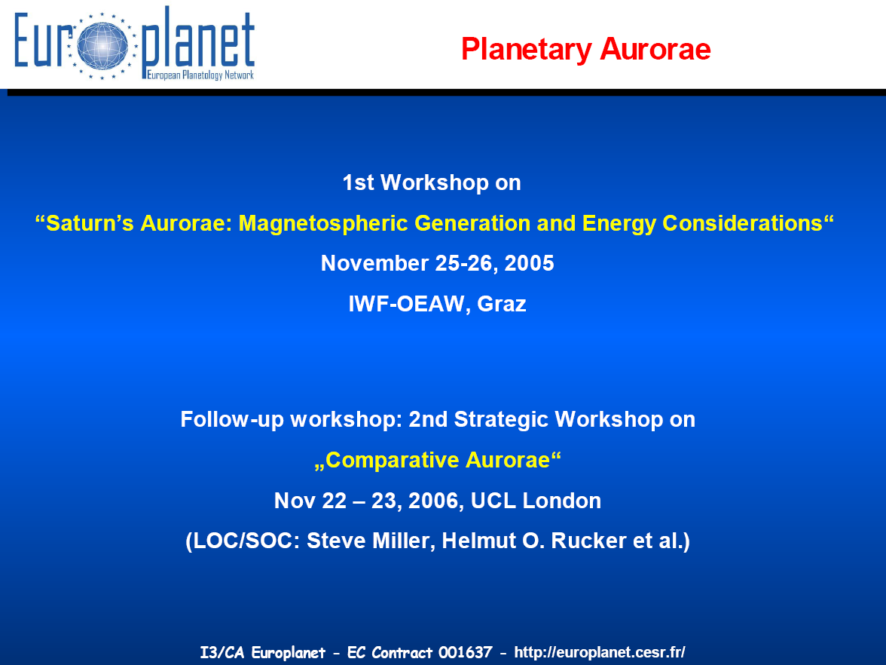
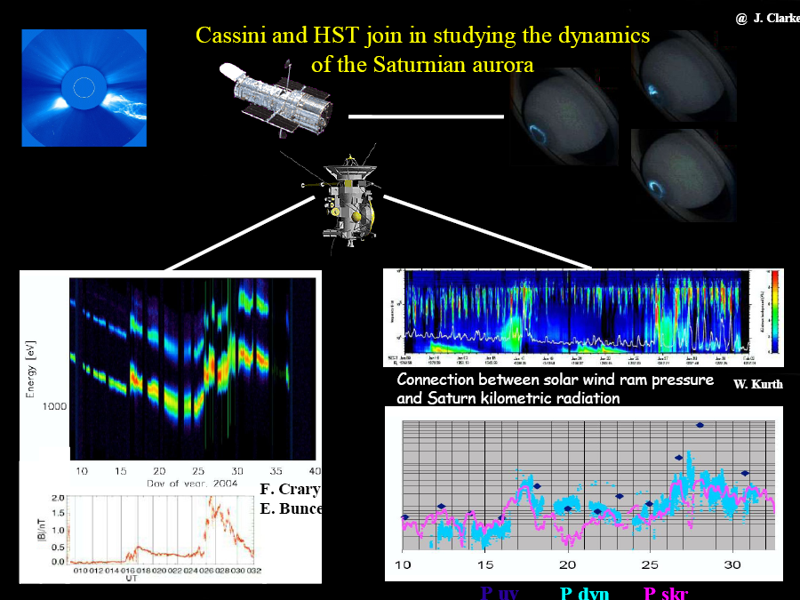
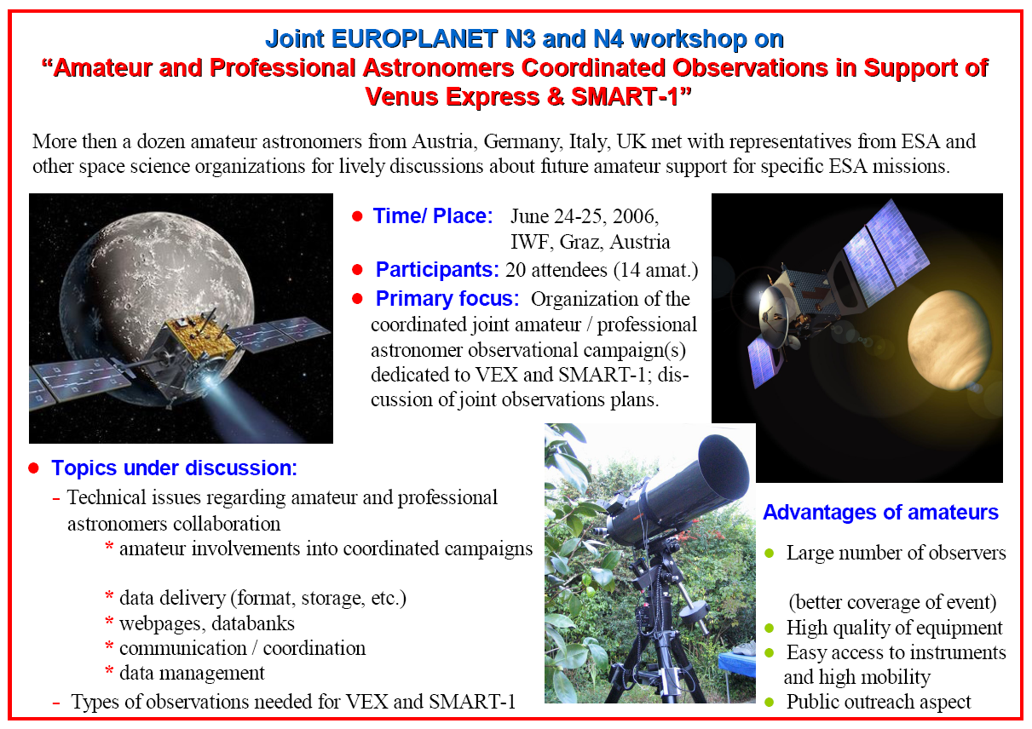
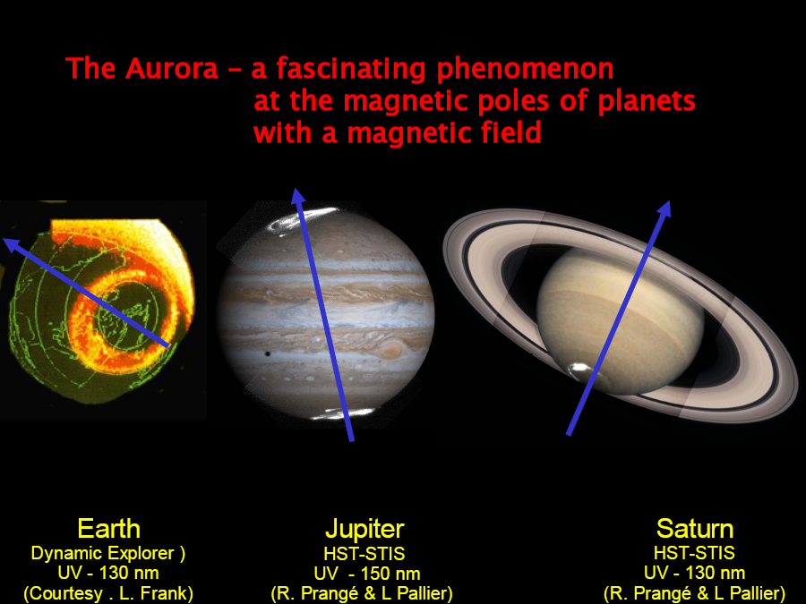
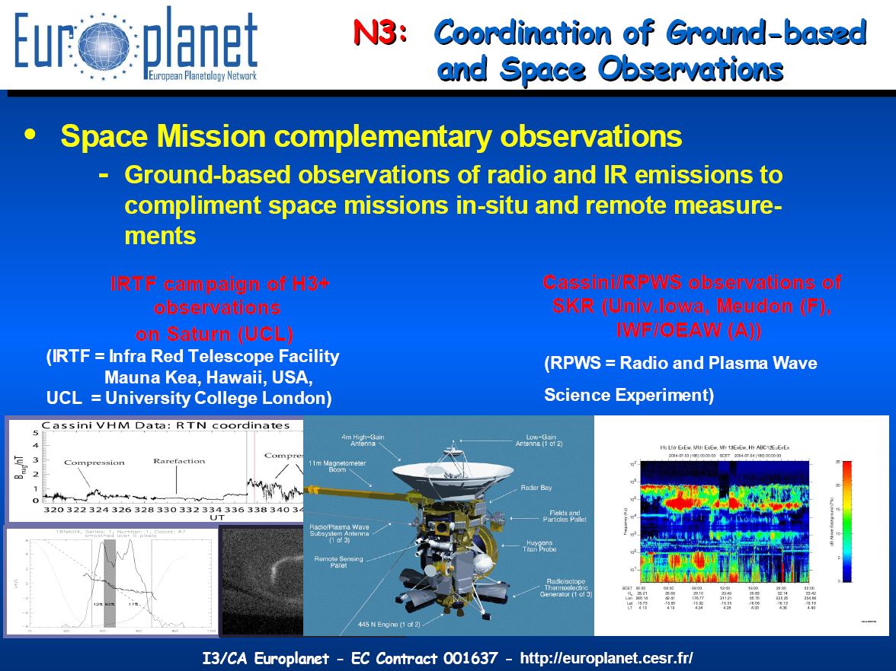
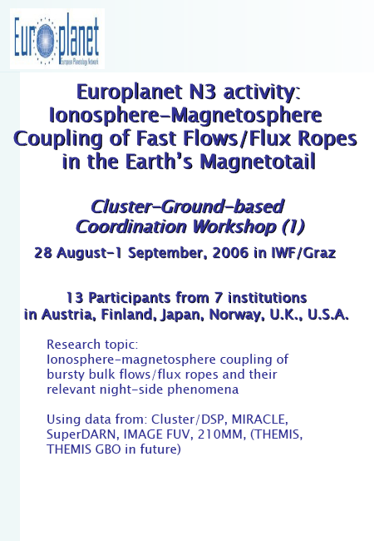
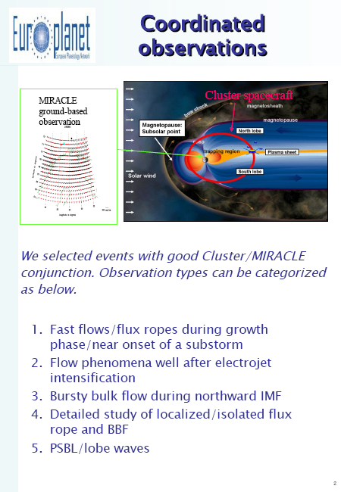
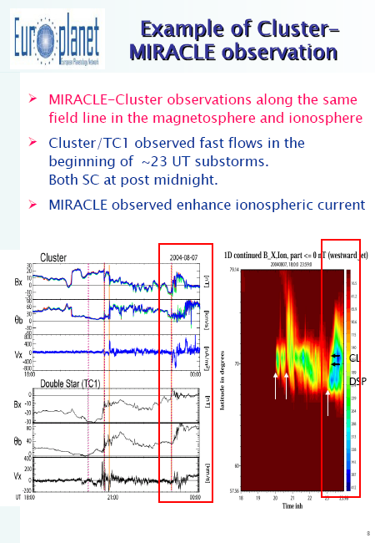
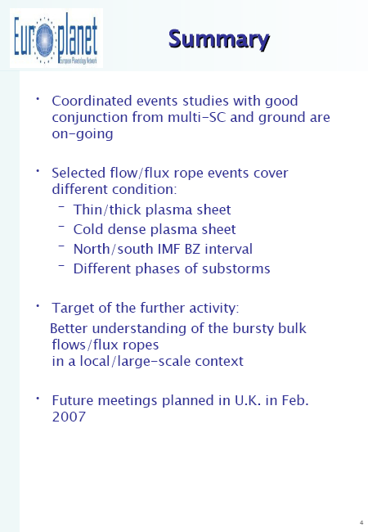
EUROPLANET-The European Planetology Network
Rucker, H.O. (1,2), M. Khodachenko (2), R. Nakamura (1,2), H.Lammer (2)
(1) Institute of Physics, Karl Franzens Universität Graz, Austria
(2) Space Research Institute, Austrian Academy of Sciences, A-8042 Graz, Austria
rucker@oeaw.ac.at
STRUCTURE OF THE EU-PROJECT EUROPLANET
Launched on January 1st 2005, The European Union-funded project “European Planetology Network” (EuroPlaNet) will provide an important added value to the European Planetology Community and the science produced by the international planetary missions. During four years, EuroPlaNet will strengthen
the networking of the European Planetary Sciences community by promoting the exchanges between its different partners and providing a support to the planetary exploration missions. The primary objective of the network will be to support the Cassini-Huygens mission. In the meantime, this project will take a particular attention to associate through specific outreach activities the European citizens to the planetary exploration programme in Europe.
EUROPLANET project scientist: Michel Blanc (CNRS France)
Web sites
40 laboratories
(i.e. 60 institutes)
17 EU countries
13 associate participants
worldwide
EuroPlaNet Structure and Activities
EuroPlaNet and modern
Planetary Science
Participants
N1: EuroPlaNet Management
Blanc, Dougherty, Guidice, Witasse
SPACE-BASED observations
N6
Data
processing
(scientific
Inference)
data
bases,
algorithms
Scientific
results
Theoretical interpretats
Outreach
products
N2
N3
N4
N3
Krupp, Matti Rucker, Miller Zarnecki,
Lebreton
N2
N6
N2
Discipline Working Groups
Ground-based Observation Coordination
Outreach Strategy
EARTH-BASED observations
N6
N3
N2
N6
Dutuit
Szego
N5: Personal Exchange
N2
N6
N5
Personnel Exchange
Lab Measurements
N6
N2
Technische Univ. München
Institüt für Weltraumforschung
Austrian Academy of Sciences
Srama
Serote
N2
N6
N2
IRSP
N6
Meetings
Numerical simulation
N6
N7: IDIS
N4
International Research School
of Planetary Sciences
Chanteur
Flamini
N2
N5: Personal Exchange
Prague Observatory
N7
IDIS
Royal Observatory Blegium
Activity N4: Developing an outreach strategy
Developing a pan-European outreach plan that will help to associate the European Citizens to the Planetary Exploration program activities in Europe (incl. space agencies, research institutes, Universities and science museums).
Activity N2: Discipline working groups Establishment of “discipline working groups” in the different science areas of planetary sciences with the aim to cover all major fields of planetary sciences.
Astronomical
Institute of the Romanian Academy
http://europlanet.cesr.fr/
http://europlanet.oeaw.ac.at
Activity N3: Coordinated space/earth-based observations
Developing synergies between in-situ exploration of the planetary systems and telescope observations from the ground or Earth orbit.
Activity N7: Design and development of the IDIS
Creation of an Integrated and Distributed Information Service (IDIS) and its further evolution into a European Virtual Planetary Observatory.
Activity N6: Meetings, conferences
Organisation of EuroPlaNet meetings during the project.
Activity N5: Personnel exchange
Supporting key exchanges of personnel between research groups with the aim to establish a long-term working relation between the groups.
Examples of Strategic Workshops
Planetary Aurorae
Joint EUROPLANET N3 and N4 Workshop
Workshop on “Ionosphere-Magnetosphere Coupling”

