Slide 1
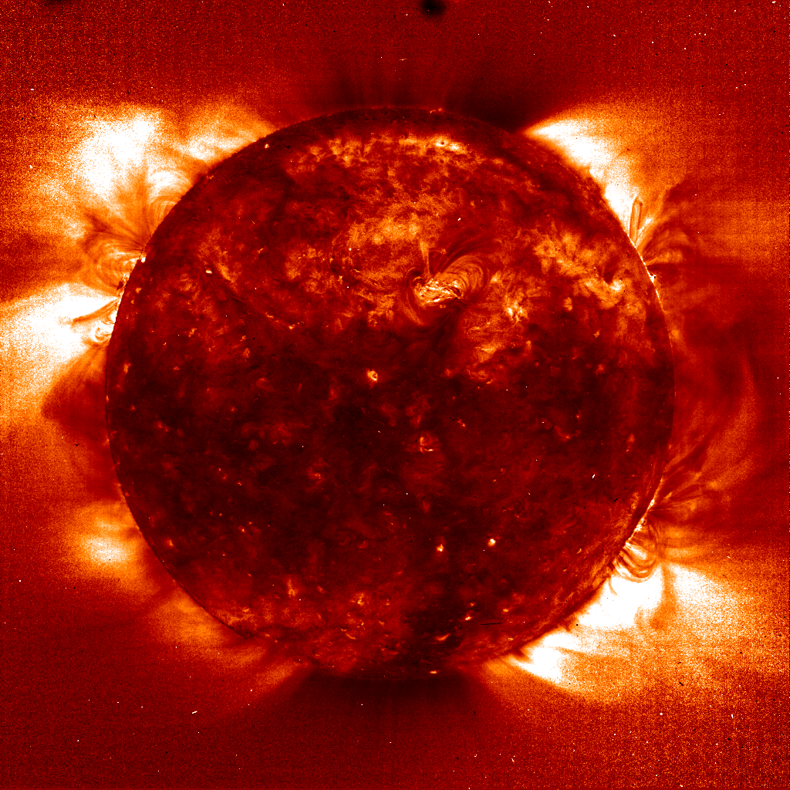
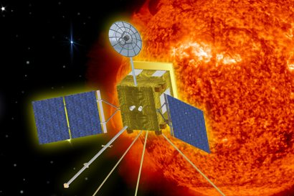
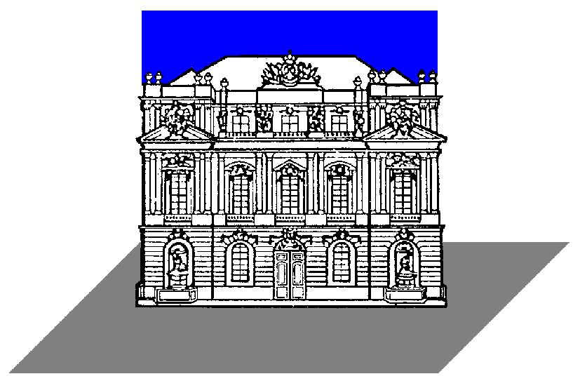

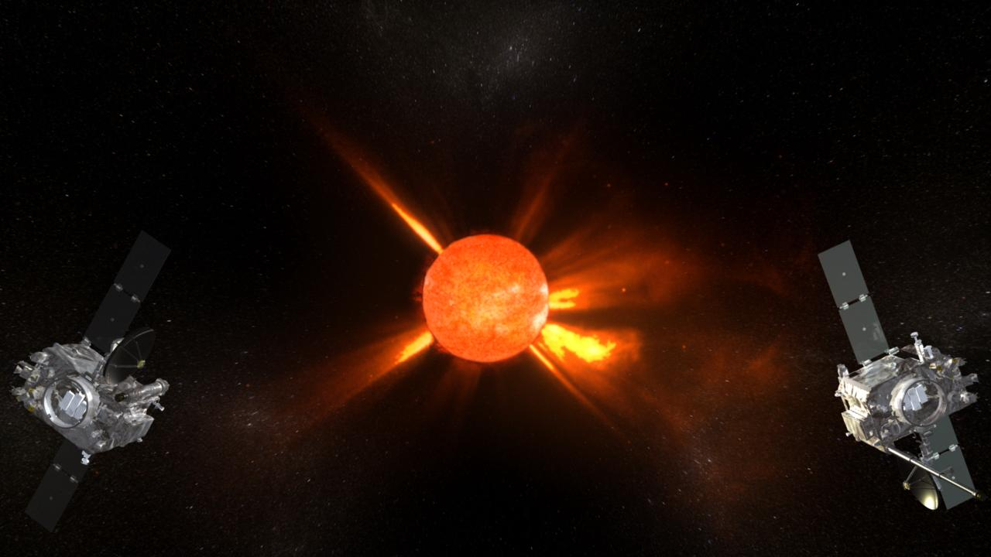
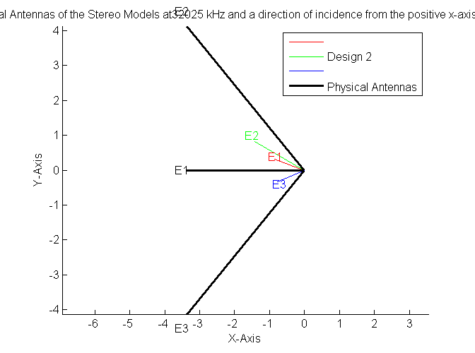
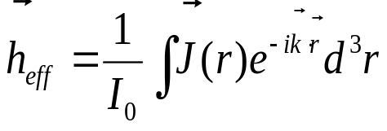
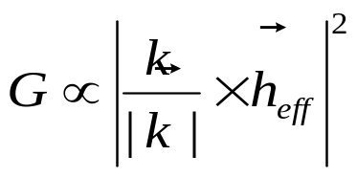

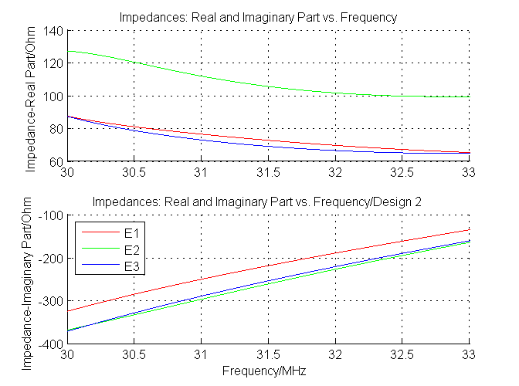
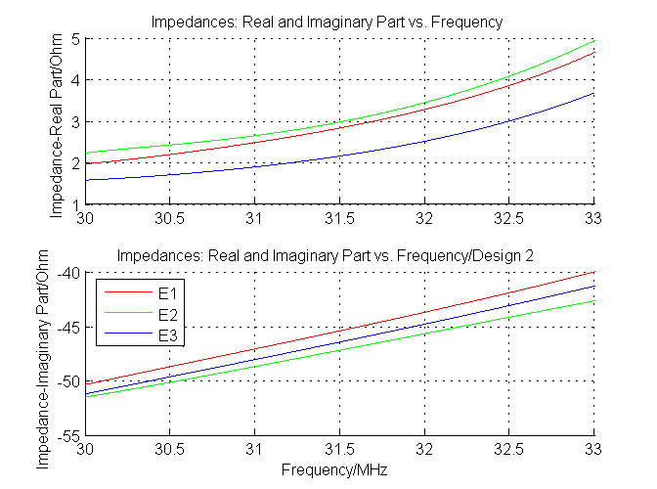
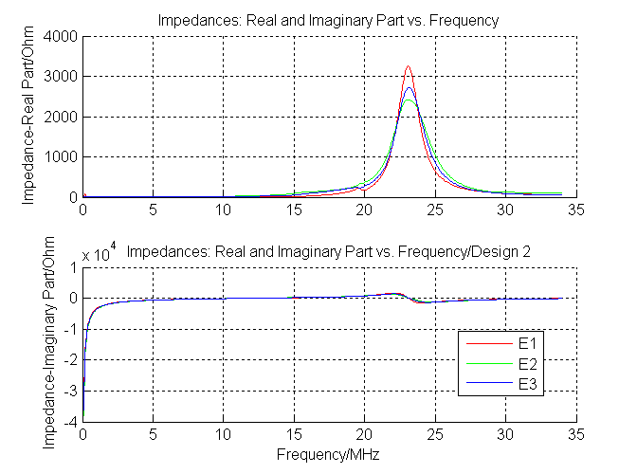
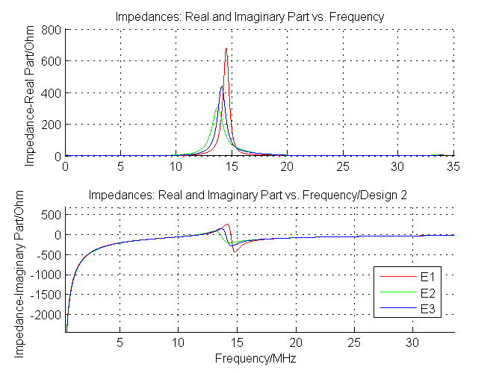
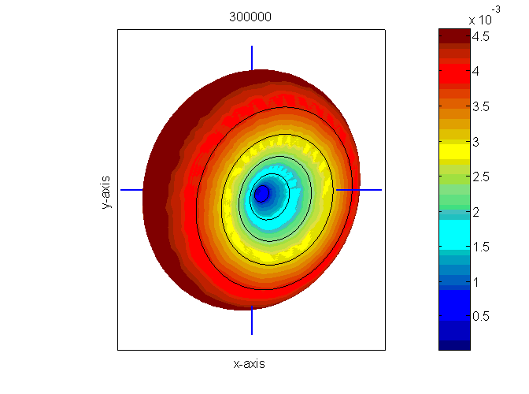
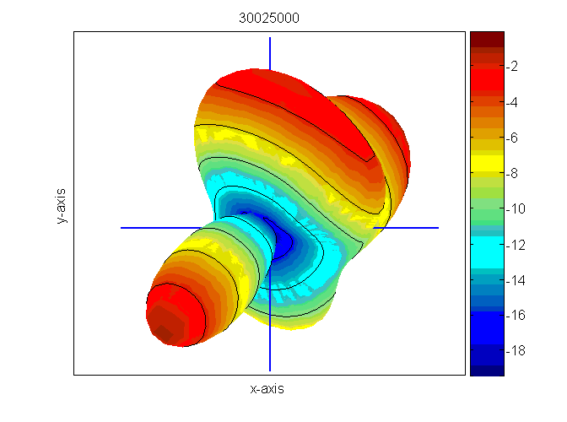
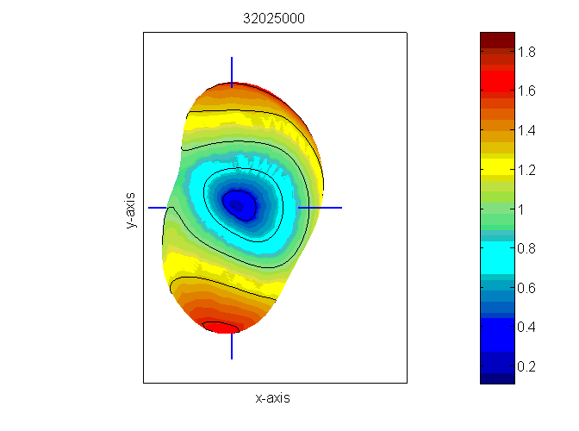
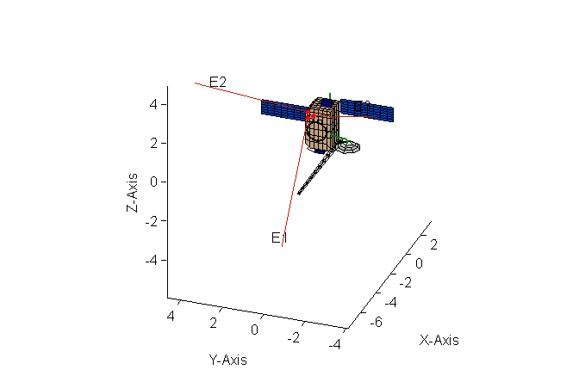
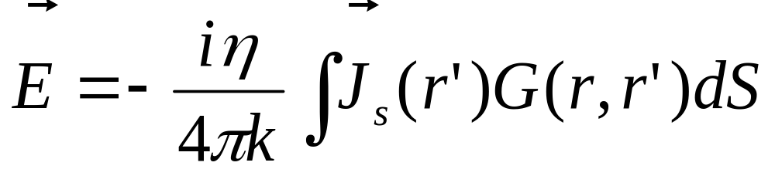
Antenna calibration of the STEREO/WAVES antennas in the frequency range of the fixed frequency receiver
T.H. Oswald (1), W. Macher (1), H.O. Rucker (1), G. Fischer (2), U. Taubenschuss(1),
^{JL. Bougeret (3),} A. Lecacheux(3), M.L Kaiser (4), K. Goetz (5)
COSPAR2006
E2.1-0058-06
Space Research Institute, Austrian Academy of Sciences, A-8042 Graz, Austria; (2) University of Iowa, USA
(3) Observatoire de Paris-Meudon, France; (4) NASA/GSFC, Greenbelt, MD, USA; (5) University of Minnesota, USA;
ABSTRACT
Based on these currents, the effective length vectors, the fields, the radiation pattern and the impedances can be computed. This was done with Matlab functions. The main advantage of this method is flexibility with regard to the representation of spacecraft parts, which can easily be altered to test their influence on antenna properties. The total base capacitance (receiver, cable and antenna mounting) was estimated to be 90 pF.
The STEREO/WAVES experiment includes a fixed frequency receiver (FFR) which operates at the frequencies of 30.025 MHz and 32.025 MHz, which is well outside the quasi-static range. For this reason, the antenna calibration has to be performed separately at these frequencies and the results have to be treated with special care with regard to the sensitivity on changes of frequency and direction of incidence. The results of these calibrations will be presented on this poster.
The effective length vector h_{eff} is a very useful representation of the receiving property of an antenna. It
can be computed using the formula:
Using the effective length vector, the response of an antenna to an incident wave can be formulated as
The effective length vector can be used to compute the
Gain:
THE SWAVES EXPERIMENT
THE IMPEDANCES
NASA will launch in September 2006 the two STEREO spacecraft with the radio experiment, called SWAVES, which is designed to observe solar radio emissions by using direction finding capabilities.
The STEREO-WAVES (SWAVES) experiment is designed to track solar and interplanetary radio bursts and trace the generation and evolution of radio disturbances from the Sun to the Earth orbit and beyond. Each spacecraft has three, nearly orthogonal, antennas, capable of receiving electromagnetic waves in several frequency ranges. The main operation range of the receivers is between 30kHz and 16MHz. With this configuration, it is possible to perform direction finding at the lower end of the frequency range to determine the direction of incidence and the polarization of the received radiation. When both spacecraft receive radiation from the same source, the actual location of the source can be pinpointed by the method of triangulation.
Additionally the SWAVES experiment comprises a fixed frequency receiver (FFR), which measures the incident radiation on one of the antennas at frequencies of 30.025 MHz and 32.025 MHz. These higher frequencies enable a comparison between space-based and earth-based observations.
For the correct interpretation of the produced data it is of vital importance to know the antenna properties with great accuracy. The antenna properties of a receiving antenna can be described in a very concise manner by use of the effective length vector, or by computing the radiation pattern. Additionally the antenna impedance, which is closely related to the length of the effective length vector, is a very useful quantity to know.
The antennas will be directed away from the sun, so that they remain out of view of the sunward looking instruments on the spacecraft. Since the surface spacecraft hull and the solar panels are made of conducting material it has an appreciable effect on the antenna properties.
The following plots show the diagonal elements of the Impedance Matrix of STEREO A as a function of frequency with and without consideration of the base capacitances which were estimated to be 90 pF.
The magnitude of the real and imaginary parts of the impedances of the three antennas is generally smaller when the base capacitances are included. In both cases there is a resonance near the frequencies of the FFR. This behavior is not unusual at higher frequencies and is the result of the complicated spacecraft structure. It shows that it is of vital importance that all details of the hull geometry have to be included when calculating the antenna properties.
3 methods to determine the effective length vectors spacecraft antennas are:
Each of the three methods has its advantages so they complement each other. For the STEREO antennas we have performed the numerical determination and the rheometry. Rheometry, however, yields only the results for the quasi-static case, so it is not relevant for the frequencies of the FFR.
Numerical computation
Rheometry
In-flight calibration
THE ANTENNA GAIN
THE NUMERICAL METHOD
The following figures show the gain of the first antenna (E1) of spacecraft A as a function of direction of the incident wave at three different frequencies. The left plot is in the quasi-static range, while the other two figures show the antenna response at the two FFR frequencies. The viewing position is the negative x axis.
The numerical method for determining the relevant antenna properties is based on electromagnetic codes. At first, a wire-grid model of the spacecraft is constructed as shown in the figure below. Then, numerical codes are used to get the current distribution on the surface of the antenna-spacecraft system.
Calculation of the current distribution on the surface of the spacecraft was done by using a modified version of the Antenna Scatterers Analysis Program (ASAP) which is a very popular open source program based on a well proved electromagnetic code. The surface of the spacecraft and the antennas were modelled as a wire grid which is excited by an electromotive force of 1V at the feeds of the antennas. So the electric field integral equations (EFIE) can be solved for the currents along the wires, which is a good approximation to the actual current distribution on the real spacecraft if the modelling is done properly.
E is the electric field of the incident wave, J is the surface current density, G is the retarded Green function, η is the impedance of free space and k is the wave number. Surface currents can be assumed because the whole spacecraft is made of conducting material.
This integral equation has to be solved in conjunction with the well known boundary conditions. The integral can be reduced to a scalar integral for the case of a cylindrical wire. Additionally the transverse currents on the wire are ignored and the currents are represented by single filaments along the wire axes. A numerical solution is achieved by the Method of Moments (MOM) which was developed in this form by Roger Harrington [Harrington, 1968]. The integral equation is converted into a matrix equation by expansion of the surface currents in linear or sinusoidal base functions.
Sun
While the gain plot of the frequency in the quasi-static range has the form of a torus, as antenna theory predicts, the gain at 30.025 MHz and 32.025 clearly depart from this case. Great care has to be taken when interpreting the data which the FFR records.
DISCUSSION
The analysis of the STEREO/WAVES antennas at the frequencies of the fixed-frequency receiver (FFR) was performed by using a numerical method. The results show that the influence of the spacecraft-body results in a significant deviation of the antenna properties at these frequencies from the quasi-static case. Caution has to be used when interpreting the data of the FFR. The antenna properties which were calculated for these specific frequencies have to be used for the calibration of the data, in contrast to using the general antenna properties computed for the case of the quasi-static limit, which is appropriate below approximately 2 MHz.
References
Acknowledgement: The research leading to this poster was made possible by a project within the framework of the Austrian Space Applications Programme (ASAP).
Cecconi, B., P. Zarka, and D. Vogl, Direction finding and antenna calibration through analytical inversion of radio measurements performed using a system of 2 or 3 electric dipole wire antennas, EGU 1st General Assembly, April 2004.
Fischer, G., W. Macher, H.O. Rucker, H.P. Ladreiter, D.F. Vogl and the Cassini/RPWS Team: Wire-grid modeling of Cassini spacecraft for the determination of effective antenna length vectors of the RPWS antennas. In: Planetary Radio Emissions V, H.O. Rucker, M.L. Kaiser, Y. Leblanc (Eds.), Austrian Academy of Sciences Press, Vienna, 347-356, 2001.
Fischer, G., W. Macher, H.O. Rucker and the Cassini/RPWS team: Reception properties of the Cassini/RPWS antennas from 1 to 16 MHz, EGS-AGU-EUG Joint Assembly, Nice, April 2003.
Harrington, R., Field Computation by Moment Methods, Robert E. Krieger Publishing Company, 1968.
Ladreiter, H.P., P. Zarka, A. Lecacheux, W. Macher, H.O. Rucker, R. Manning, D.A. Gurnett, W.S. Kurth: Analysis of electromagnetic wave direction finding performed by space-borne antennas using singular value decomposition techniques, Radio Sci., 30, 1699-1712, 1995.
Macher, W., and T. Vejda, Design of antenna grid structures. Manual to the MATLAB toolbox. Austrian Academy of Sciences, IWF-144, 2003.
Oswald, T.H., W. Macher, G. Fischer, H.O. Rucker: First results of STEREO/WAVES antenna calibration, Austrian Academy of Sciences, IWF-160, 2004.
Oswald, T.H., W. Macher, G. Fischer, H.O. Rucker: Results of STEREO/WAVES antenna calibration using a refined spacecraft model, Austrian Academy of Sciences, IWF-167, 2005.
Oswald, T.H., Electromagnetic waves in space and the STEREO/SWAVES experiment, Master Thesis, University Graz and Technical University Graz, 2005.
Rucker, H.O., W. Macher, and S. Albrecht, Experimental and theoretical investigations on the Cassini RPWS antennas. In: Planetary Radio Emissions IV, H. O. Rucker, S. J. Bauer, and A. Lecacheux (Eds.) Austrian Academy of Sciences Press, Vienna, 327-337, 1997
Rucker, H.O., W. Macher, R. Manning, and H. P. Ladreiter, Cassini model rheometry, Radio Sci., 31, 1299-1311, 1996.
Rucker, H., W. Macher, G. Fischer, T.H. Oswald, J.-L. Bougeret, M. Kaiser, and K. Goetz, Analysis of spacecraft antenna systems: Implications for stereo/waves, Adv. Space Res.,36,1530-1533, doi: 10.1016/j.asr.2005.07.060, 2005.
Vogl, D.F., B. Cecconi, W. Macher, P. Zarka, H.P. Ladreiter, P. Fedou, A. Lecacheux, T. Averkamp, G. Fischer, H.O. Rucker, D.A. Gurnett, W.S. Kurth, G.B. Hospodarsky, In-flight calibration of the Cassini-RPWS antenna system for direction finding and polarization measurements, J. Geophys. Res., 109, doi:10.1029/2003JA010261, 2004.

