Slide 1
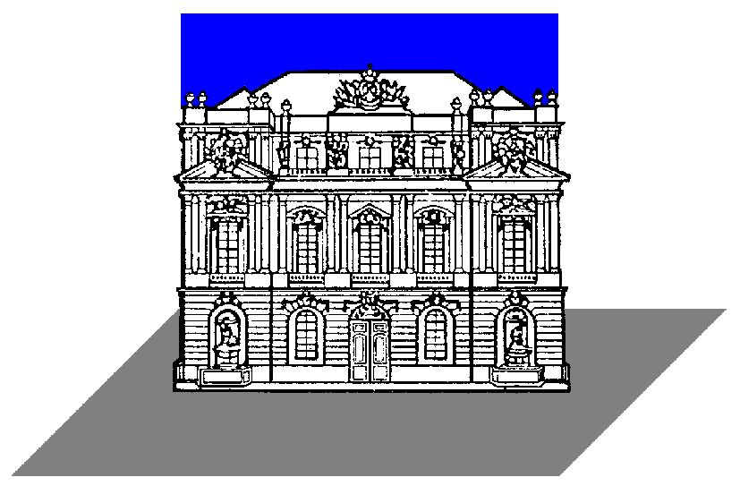

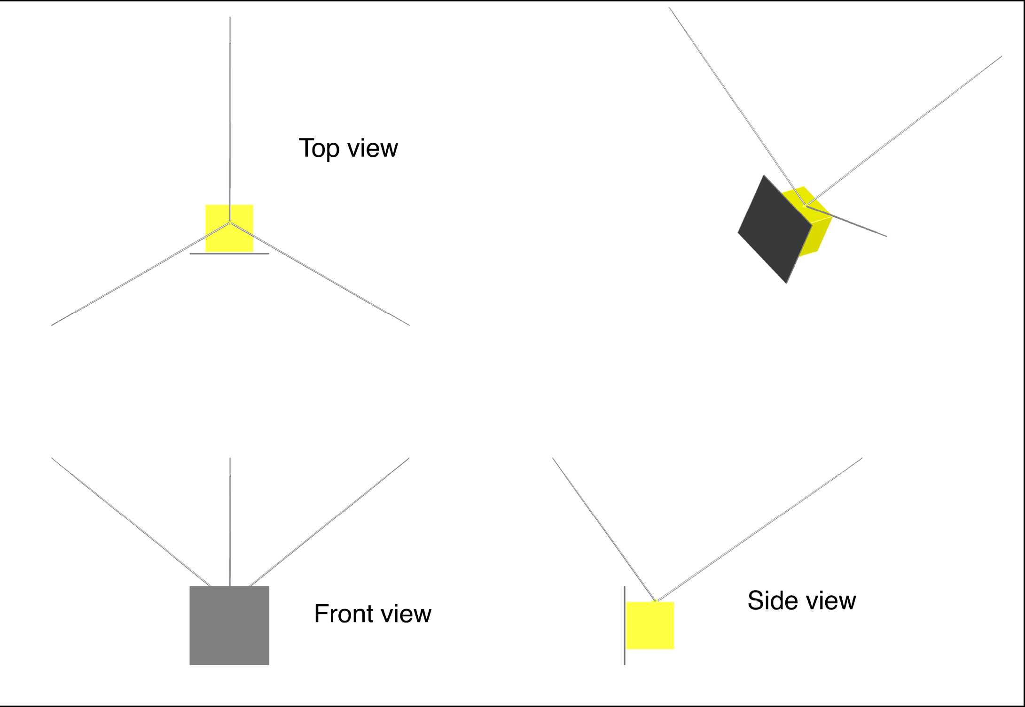
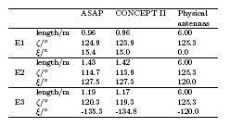
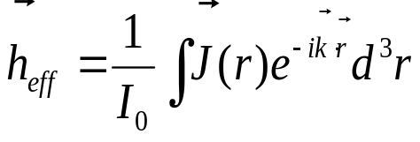
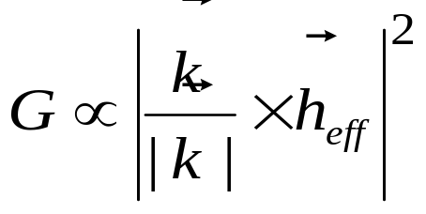

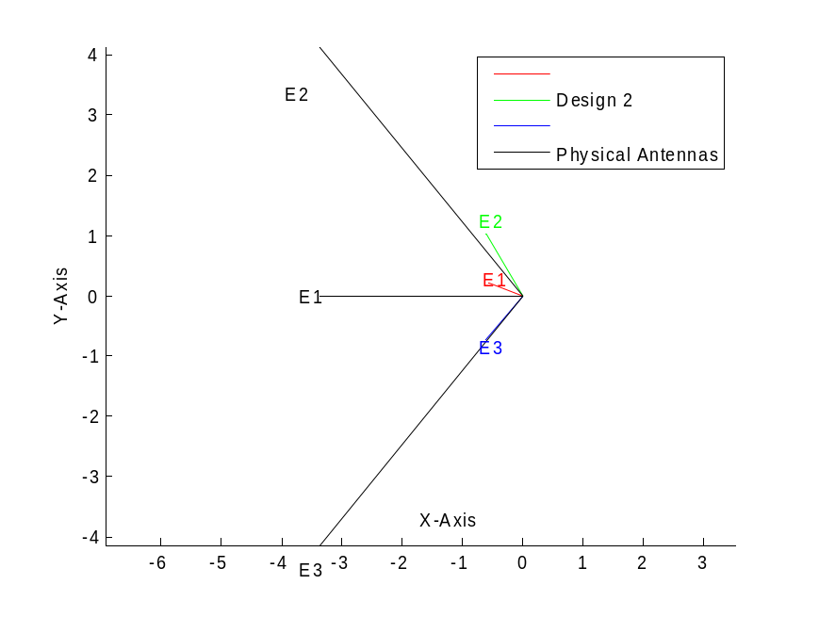
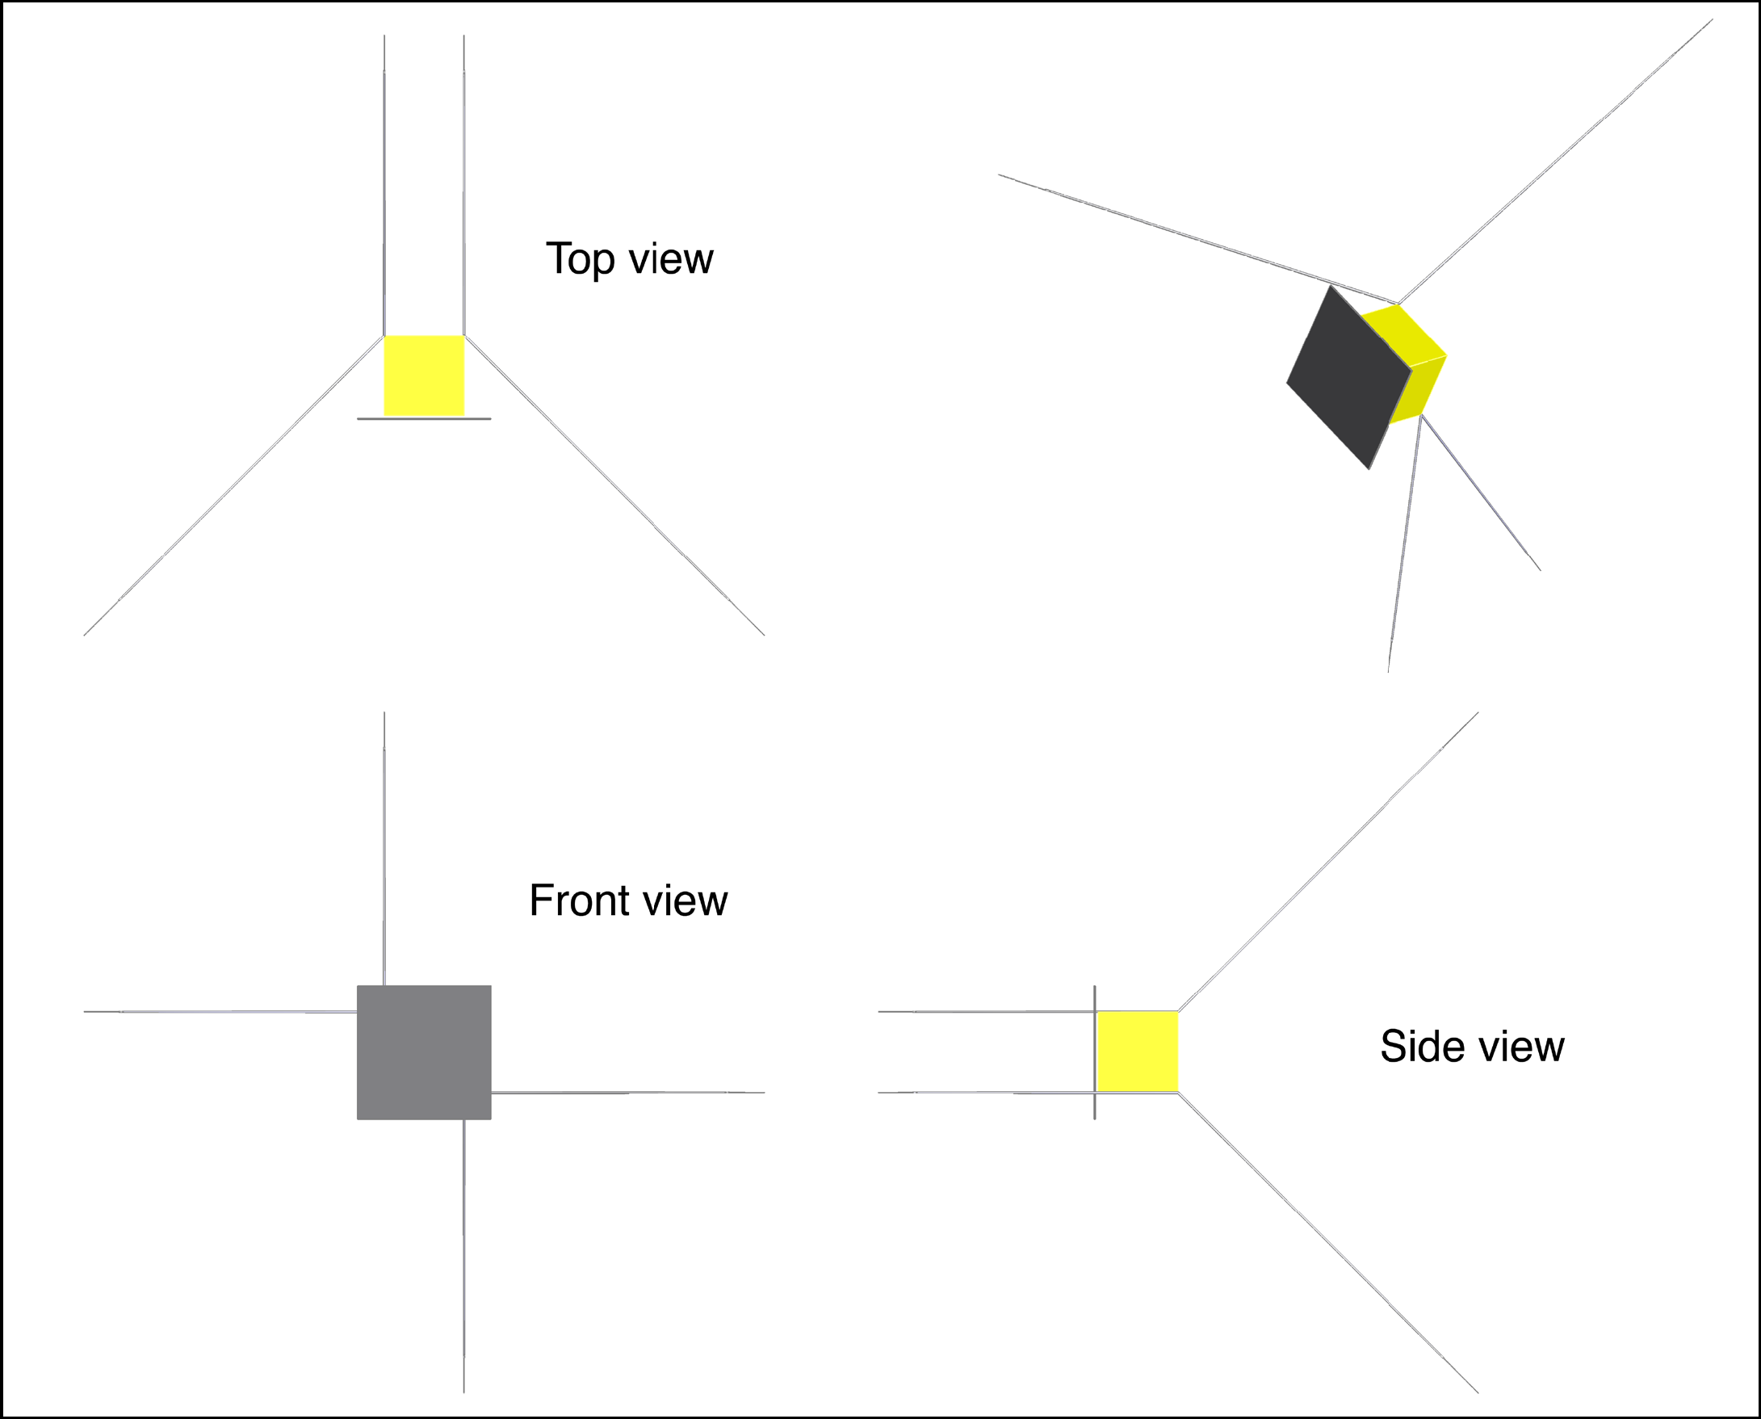
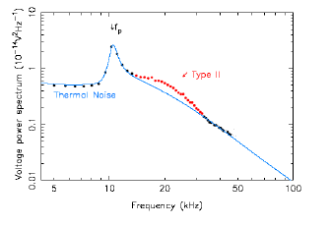
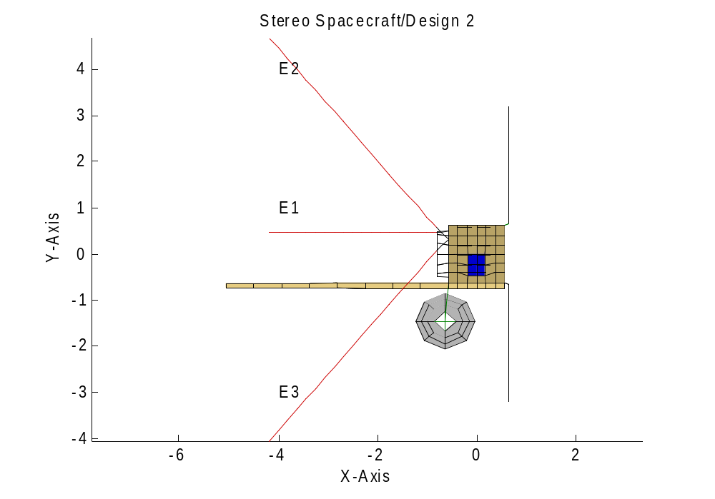
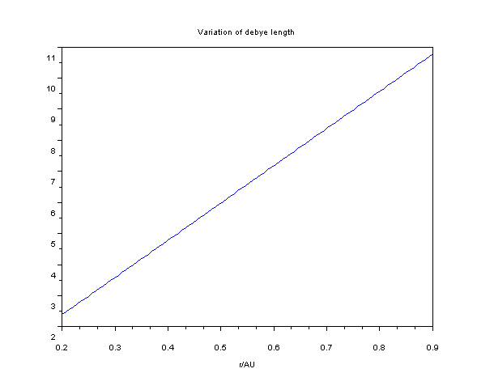
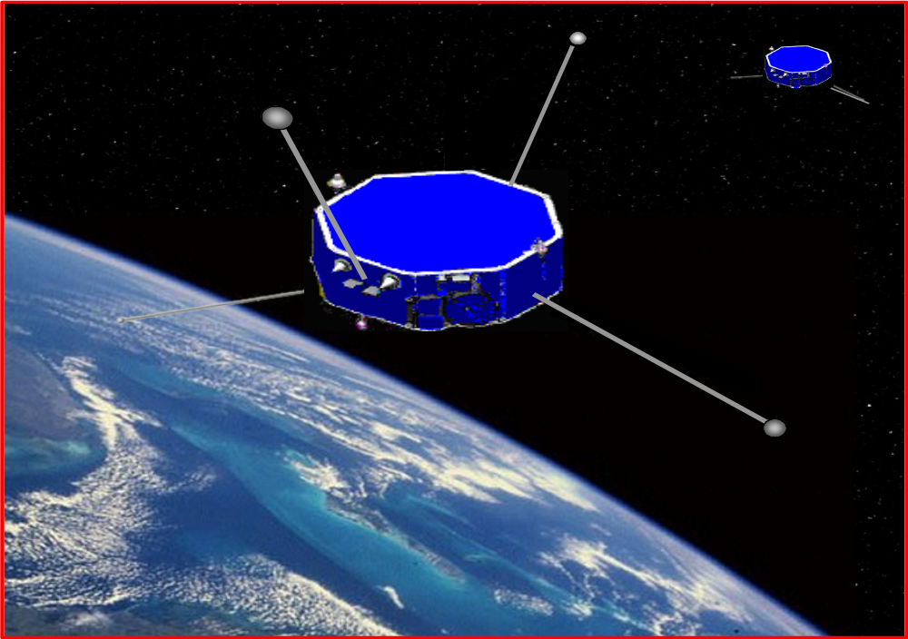
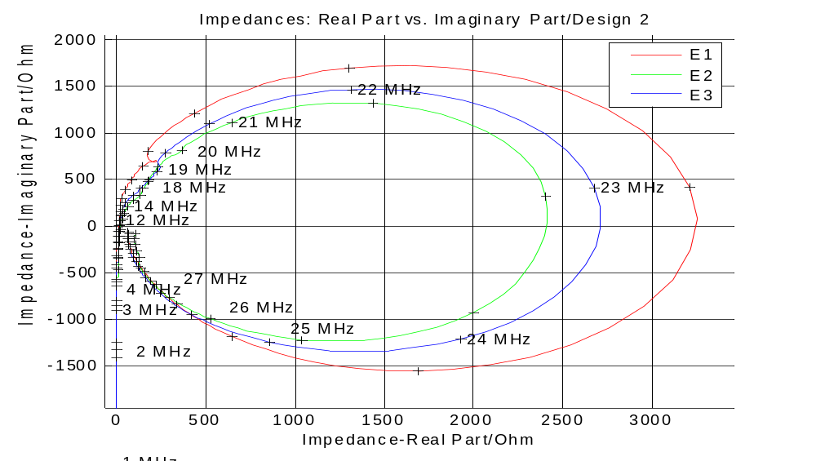
Aspects of the RPW antennas of SOLAR ORBITER
T.H. Oswald (1), H.O. Rucker (1), W. Macher (1)
^{and the SOLAR ORBITER RPW team}
Space Research Institute, Austrian Academy of Sciences, A-8042 Graz, Austria
thomas.oswald@oeaw.ac.at
The radio plasma and waves analyzer (RPW) of SOLAR ORBITER will be designed to receive electrostatic as well as electromagnetic waves, therefore enabling in-situ as well as remote sensing measurements. The Plasma Waves Analyser (PWA) will cover the in-situ measurements while the Radio Spectrum Analyzer (RAS) will be responsible for the remote sensing. Both subsystems will share the same sensors, especially the electric field antennas (RPW-antennas).
Quasi-thermal Noise Spectroscopy and Direction Finding, i.e. the technique to determine the direction of incidence and the state of polarization from the measured data, will play an important part in the science done in the course of this mission. Certain requirements have to be fulfilled such that these techniques can be successfully applied.
The RPW experiment is very similar to the SWAVES experiment on the STEREO spacecraft. In this paper we use our experience with the SWAVES antennas to discuss the mentioned requirements and limitations to be expected on SOLAR ORBITER.
Solar Orbiter
The concept of the effective length vector
The Solar Orbiter mission will provide the next major step forward in the exploration of the Sun and the heliosphere to solve many of the fundamental problems remaining in solar and heliospheric science. It incorporates both a near-Sun and a high-latitude phase. The near-Sun phase of the mission enables the Orbiter spacecraft to approach the Sun as close as 48 solar radii (~0.22 AU) during part of its orbit, thereby permitting observations from a quasi-heliosynchronous vantage point (so-called co-rotation.).
The main objectives are :
  Determine the properties, dynamics and interactions of plasma, fields and particles in the near-Sun heliosphere;
  Investigate the links between the solar surface, corona and inner heliosphere;
  Explore the energetics, dynamics and fine-scale structure of the magnetized atmosphere at all latitudes;
  Probe the solar dynamo by observing the Sun's high-latitude field, flows and seismic waves.
The effective length vector h_{eff} is a very useful representation of the receiving property of an antenna. It
can be computed using the formula:
Using the effective length vector, the response of an antenna to an incident wave can be formulated as
The effective length vector can be used to compute the
Gain:
Except near the plasma resonance frequencies the effective length vectors are always shorter than the physical antenna rods. Table 1 and Figure 3 show examples for SWAVES.
Table 1
Figure 1a
Figure 4
Quasithermal noise spectroscopy
Thermal noise spectroscopy (QTNS) is a technique for finding the basic parameters of plasma by analyzing the electrostatic field spectrum measured by antennas. When the plasma frequency is higher than the cyclotron frequency, thermal motion excites Langmuir waves which are dependent of the velocity distribution function. The spectrum is cut off at the plasma frequency and has a peak just above. The cutoff bears information about the plasma density, the spectrum level about the temperature. The shape of the peak reveals information about the supra thermal electrons. Figure 4 shows an example and also one of the problems with thermal noise. Its intensity is normally higher than the intensity of many received radio emissions (a Type II burst in this example).
Figures 1a and 1b show the two different antenna configurations which could be used for SOLAR ORBITER. The design consisting of 3 antennas shown in Figure 1a is very similar to the configuration used for the SWAVES experiment (see Figure 2). The second possible design comprises 4 antennas which are set up in a way to give a very good nearly isotropic power pattern. It is similar to the system used for the RESONANCE mission (see Figure 3).
It can be expected that the effective length vectors of configuration in Figure 1a would behave similar to the behavior of the electric antennas of the STEREO mission. The order of magnitude of the length of the effective length vectors of configuration in Figure 1b will also be similar to STEREO, while the directions will deviate considerably due to the different influence of the spacecraft hull.
Figure 1b
Figure 2
Figure 5
One of the requirements necessary for QTNS works is that the length of the antennas must be at least of the order of magnitude of the Debye length. The spacecraft will operate at a distance from the sun of 0.2-0.9AU which corresponds to a Debye length of 2.5-11.5 meters (see Figure 6). It must be understood that the effective length vectors have to fulfill this requirement, not the geometrical antennas. The theory of an ideal dipole shows that its effective length vector is half its physical length. Calibration of similar spacecraft like STEREO has shown that the effective length vectors can be substantially shorter than without considering the base capacitances. Hence we recommend that this shortening of the effective length vectors is taken into account when planning the exact length of the antennas.
Figure 2
In-flight Calibration
Inflight Calibration is a method which uses emitted waves of a radio source of known location to measure the gain pattern of the antenna. For this purpose, the spacecraft has to be rotated with respect to the direction of the incident wave. From the change of the intensity of the received wave during the rotation, one can determine the direction of the effective length vector.
Figure 6
Antenna impedances
Figure 3
The antenna impedance is an important property to describe an antenna. It describes the way an antenna is seen as part of the circuit and it determines how much the base capacitances influence the receipt ion behavior.
Figure 7 shows the antenna impedance of the STEREO antennas as function of frequency.
Acknowledgement: These studies were supported by the Austrian Space Applications Programme (ASAP).
Literature:
Figure 7
Cecconi, B., P. Zarka, and D. Vogl, Direction finding and antenna calibration through analytical inversion of radio measurements performed using a system of 2 or 3 electric dipole wire antennas, EGU 1st General Assembly, April 2004.
Fischer, G., W. Macher, H.O. Rucker, H.P. Ladreiter, D.F. Vogl and the Cassini/RPWS Team: Wire-grid modeling of Cassini spacecraft for the determination of effective antenna length vectors of the RPWS antennas. In: Planetary Radio Emissions V, H.O. Rucker, M.L. Kaiser, Y. Leblanc (Eds.), Austrian Academy of Sciences Press, Vienna, 347-356, 2001.
Fischer, G., W. Macher, H.O. Rucker and the Cassini/RPWS team: Reception properties of the Cassini/RPWS antennas from 1 to 16 MHz, EGS-AGU-EUG Joint Assembly, Nice, April 2003.
Harrington, R., Field Computation by Moment Methods, Robert E. Krieger Publishing Company, 1968
Macher, W., and T. Vejda, Design of antenna grid structures. Manual to the MATLAB toolbox. Austrian Academy of Sciences, IWF-144, 2003.
Oswald, T.H., W. Macher, G. Fischer, H.O. Rucker: First results of STEREO/WAVES antenna calibration, Austrian Academy of Sciences, IWF-160, 2004.
Oswald, T.H., W. Macher, G. Fischer, H.O. Rucker: Results of STEREO/WAVES antenna calibration using a refined spacecraft model, Austrian Academy of Sciences, IWF-167, 2005.
Oswald, T.H., Electromagnetic waves in space and the STEREO/SWAVES experiment, Master Thesis, University Graz and Technical University Graz, 2005.
Rucker, H.O., W. Macher, and S. Albrecht, Experimental and theoretical investigations on the Cassini RPWS antennas. In: Planetary Radio Emissions IV, H. O. Rucker, S. J. Bauer, and A. Lecacheux (Eds.) Austrian Academy of Sciences Press, Vienna, 327-337, 1997
Rucker, H., W. Macher, G. Fischer, T.H. Oswald, J.-L. Bougeret, M. Kaiser, and K. Goetz, Analysis of spacecraft antenna systems: Implications for stereo/waves, Adv. Space Res.,36,1530-1533, doi: 10.1016/j.asr.2005.07.060, 2005.
Vogl, D.F., B. Cecconi, W. Macher, P. Zarka, H.P. Ladreiter, P. Fedou, A. Lecacheux, T. Averkamp, G. Fischer, H.O. Rucker, D.A. Gurnett, W.S. Kurth, G.B. Hospodarsky, In-flight calibration of the Cassini-RPWS antenna system for direction finding and polarization measurements, J. Geophys. Res., 109, doi:10.1029/2003JA010261, 2004.

