Slide 1
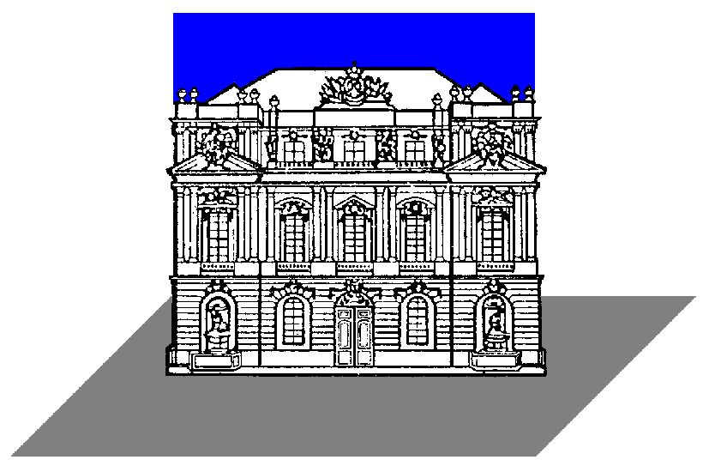

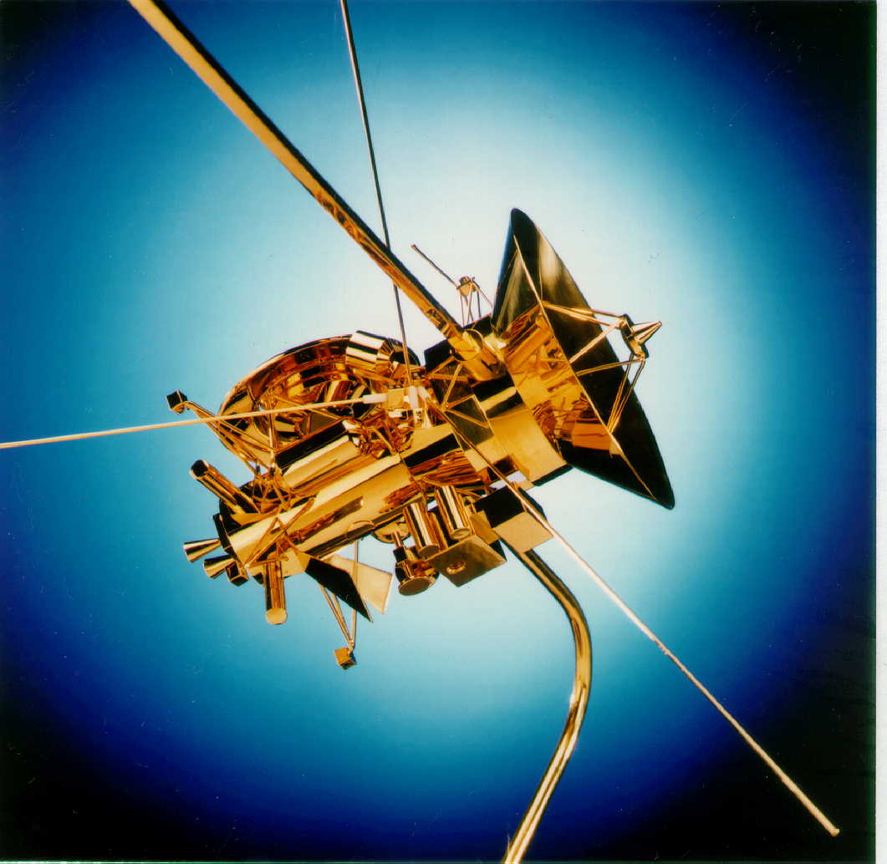
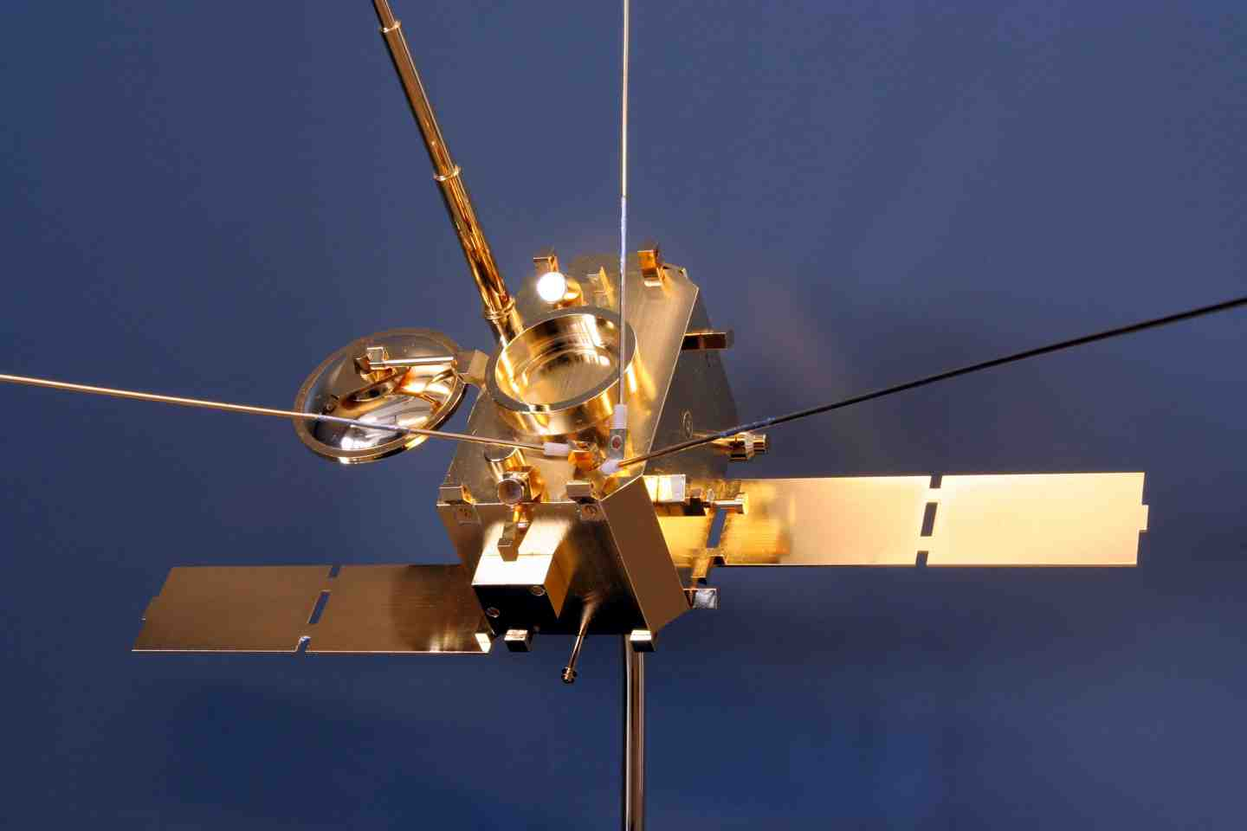
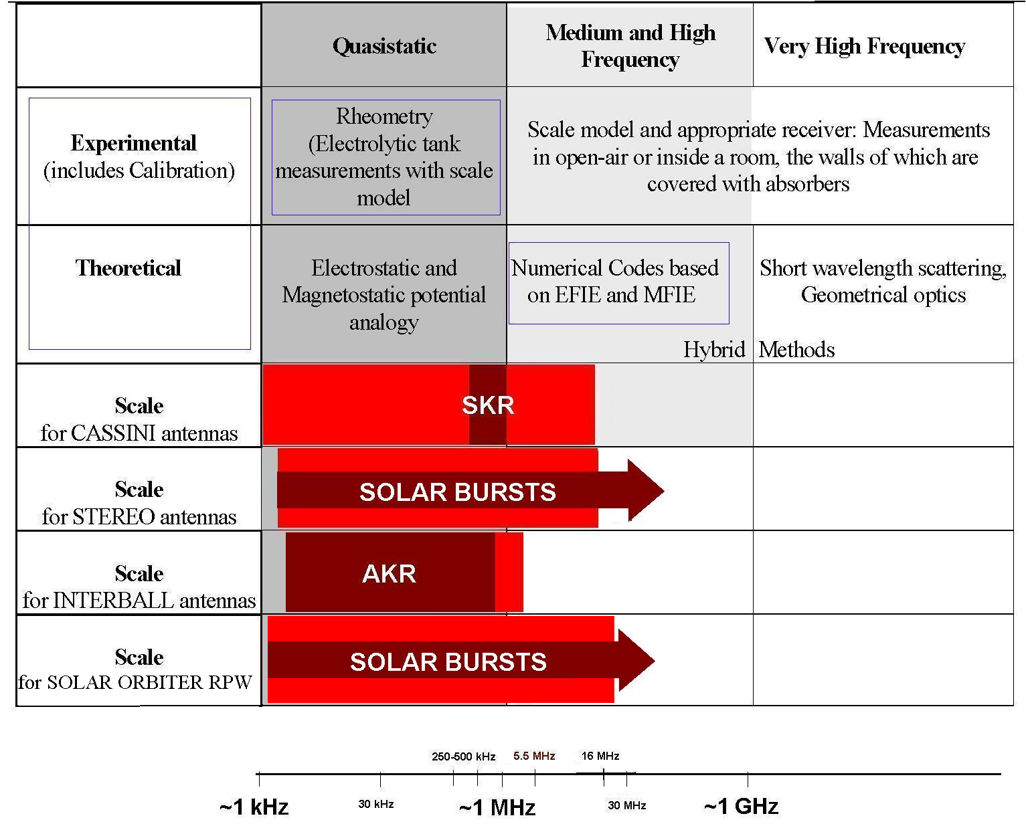
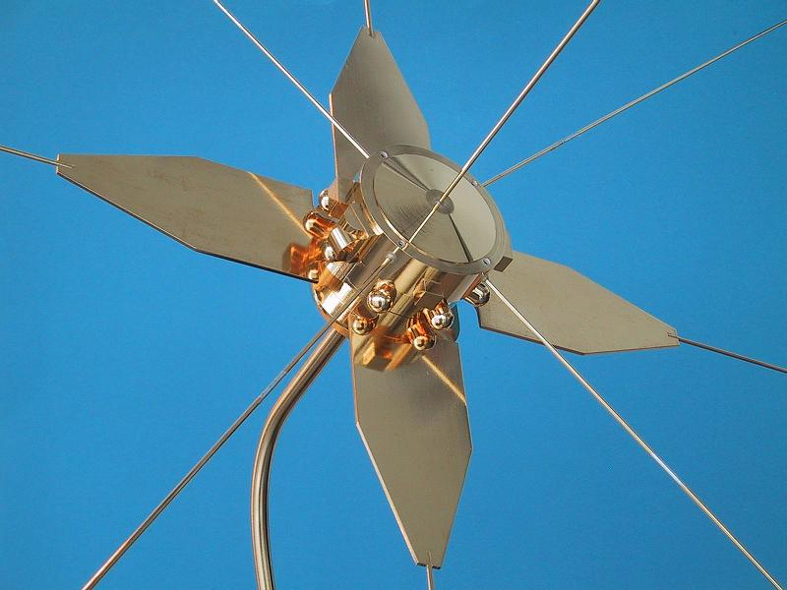
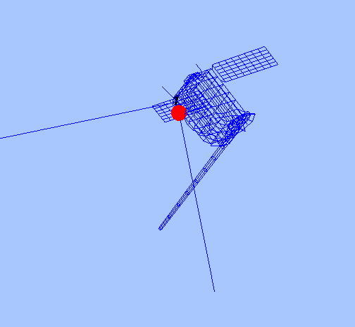
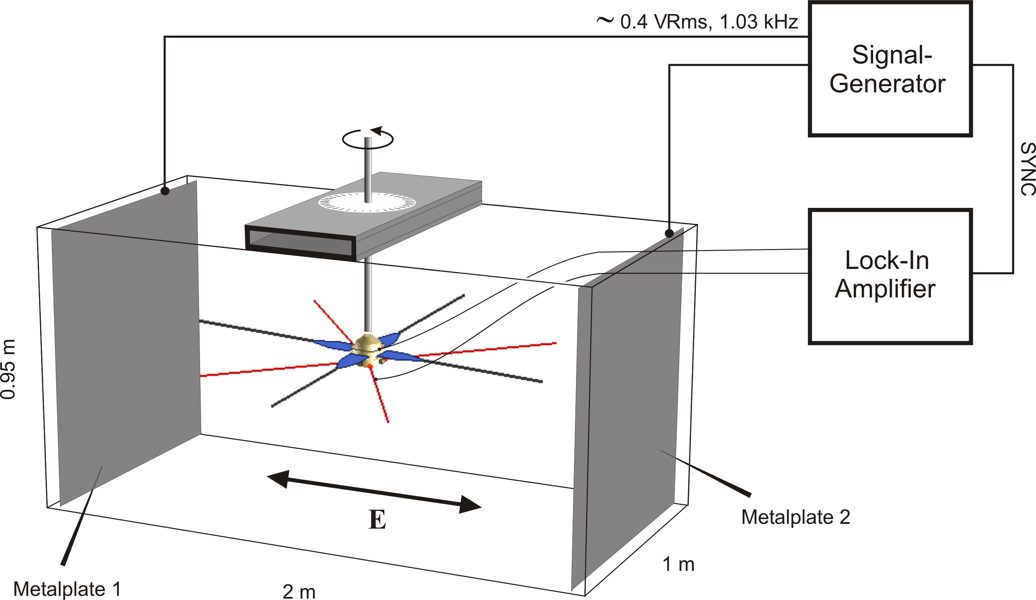
Considerations of Solar Orbiter electric antenna modelling
H.O. Rucker (1), T.H. Oswald (1), W. Macher (1)
^{and the SOLAR ORBITER RPW team}
Space Research Institute, Austrian Academy of Sciences, A-8042 Graz, Austria
rucker@oeaw.ac.at
On board of the Solar Orbiter the Radio and Plasma Wave (RPW) experiment comprises an important part by the measurement of electromagnetic radiation of solar and coronal origin. The RPW mag coils and electric antennas are connected to spectrometers comprising various frequency ranges. Of particular interest is the configuration of the RPW antennas attached to the spacecraft body, since both the mutual orientation of the antenna rods as well as the attitude of the overall antenna system with regard to the spacecraft configuration plays an important role for the reception properties of the RPW experiment.
Antenna model configurations can be analysed by means of calibration methods as there are wire grid modelling and rheometry, with specific pros and cons in the parameter space of antenna definition. Details will be given on the areas of application of both methods, their frequency ranges and accuracy limits.
Figure 1a
INTRODUCTION
The calibration of spacecraft antennas is of vital importance for the successful interpretation of the scientific data. Several methods exist:
Numerical method (wire-grid modeling)
Experimental method (rheometry)
In-flight calibration [see Poster Oswald et. al.:Aspects of the RPW antennas of SOLAR ORBITER]
Each method has it advantages and has successfully been applied for the calibration of several spacecraft (Figure 1). For a realistic picture of the overall situation it is necessary to perform all available methods in combination.
Figure 1b
1a
1b
1c
Figure 1
Figure 1c
THE NUMERICAL METHOD
THE EXPERIMENTAL METHOD
The numerical method for determining the relevant antenna properties is based on electromagnetic codes. At first, a wire-grid model of the spacecraft is constructed (see Figure 2). Then, numerical codes are used to get the current distribution on the surface of the antenna-spacecraft system.
Calculation of the current distribution on the surface of the spacecraft is done by application of two programs:
The Antenna Scatterers Analysis Program (ASAP) is an open source program, using the method of moments (MOM) to solve the reaction integral equation. As representation of the currents, a piecewise sinusoidal expansion is used.
CONCEPT II is a proprietary software written at the University of Hamburg-Harburg. It uses the MOM to solve the electric field integral equation (EFIE) and uses triangular base functions to represent the currents.
In the regime of the spacecraft antennas both methods are equally valid, so the consistency of the two results is a good indication for the validity of the method and the modelling process. In both cases the antennas are excited by an electromotive force of 1V at the feed points. One of the feeds is marked by the red dot in Figure 2. Only currents along the wires are considered, all transverse currents are ignored. Another simplification made is that the currents are infinity thin and flowing along the center of each wire.
Rheometry is an experimental technique to determine the effective length vectors of antennas in the quasi-static frequency range, where the wavelength is much greater than the dimension of the antenna system. Its advantages are that the antenna system (antennas as well as spacecraft) can be modelled in great detail and that the used measurement set-up is pretty much disturbance-free, contrary to the standard high-frequency measurements.
A gold plated model of the antennas-spacecraft system has to be built. This model is immersed in an electrolytic tank (see Figure 3). Metal plates are attached to two opposite sides of the tank to form a large capacitor. A signal generator is connected to the plates to sustain a homogeneous electric field in the tank. The voltages at the model antennas are measured as a function of the model orientation. For that purpose the model can be rotated around a vertical axis, and different suspensions of the model at this axis are used. So the induced voltages for a variety of orientations of the model with regard to the electric field direction are recorded, from which the effective length vectors can be inferred.
Figure 2
Figure 3
The integral equations have to be solved in conjunction with the boundary conditions. Both programs use the MOM which was developed in this form by Roger Harrington [Harrington, 1968]. The integral equation is transformed into a matrix equation which can be solved by means of linear algebra.
Based on the currents along the wires, the effective length vectors, the fields, the radiation pattern and the impedances [Poster Oswald et. al.:Aspects of the RPW antennas of SOLAR ORBITER]can be computed. This is done by using Matlab functions. The main advantage of this method is flexibility with regard to the representation of spacecraft parts, which can easily be altered to test their influence on antenna properties.
CONSTRAINTS/ PROS
Rheometry is suitable for consideration from the quasi-static limit up to a frequency where the effective length vectors are still constant and real. This limit is approximately 1.5MHz in case of the STEREO spacecraft. At these low frequencies there may be problems with the numerical method due to the ill conditioning of the resulting matrices. An advantage of this method is that very fine details of the spacecraft body can be modelled, whereas numerical methods soon reach their limit when small parts near the antenna feed zone have to be modelled.
CONSTRAINTS
CONCLUSION
The numerical method is suitable for a frequency from approximately 300kHz up to a frequency where one of the following conditions are no longer fulfilled:
  The wavelength must be considerably longer than the longest wire-segment.
  The mesh size must be considerably smaller than the wavelength.
Below this frequency range numerical instabilities may occur due to the ill conditioning of the resulting matrix, above this range the wire-grid model is not suitable to model the spacecraft accurately enough.
Another limitation regards the relation of the segment length to the segment diameter. It has to be large enough in a way that it represents a wire rather than a cylinder.
The limitation on the number of segments is given in form of the computation time. At the moment we work with a number of segments of 1000-1500, which can easily be handled by common PCs.
Either method has its own advantages. Rheometry can be far more detailed compared with wire-grid simulations, so the influence of the fine structure of the spacecraft can be estimated by comparison of the two methods. Rheometry is therefore a good basis to decide about improvements of wire-grids, it further yields a purely quasi-static result, which must agree with the asymptotic limit of the numerical calculations as the frequency converges to zero. The advantage of the computer simulation is the flexibility regarding the model structure, so it can be used to study the perturbation of antenna properties provoked by single spacecraft parts. Of course, the decisive advantage is that electromagnetic codes are devised for high-frequency analysis up to frequencies far above the resonance, thereby enabling the estimation of the validity range of the quasi-static results.
Acknowledgement: These studies are supported by the Austrian Space Applications Programme (ASAP).
Literature:
Num. Method: Fischer, G., W. Macher, H.O. Rucker, H.P. Ladreiter, D.F. Vogl and the Cassini/RPWS Team: Wire-grid modeling of Cassini spacecraft for the determination of effective antenna length vectors of the RPWS antennas. In: Planetary Radio Emissions V, H.O. Rucker, M.L. Kaiser, Y. Leblanc (Eds.), Austrian Academy of Sciences Press, Vienna, 347-356, 2001.
Num. Method: Fischer, G., W. Macher, H.O. Rucker and the Cassini/RPWS team: Reception properties of the Cassini/RPWS antennas from 1 to 16 MHz, EGS-AGU-EUG Joint Assembly, Nice, April 2003.
Num. Method: Harrington, R., Field Computation by Moment Methods, Robert E. Krieger Publishing Company, 1968.
Num. Method: Macher, W., and T. Vejda, Design of antenna grid structures. Manual to the MATLAB toolbox. Austrian Academy of Sciences, IWF-144, 2003.
Num. Method: Oswald, T.H., W. Macher, G. Fischer, H.O. Rucker: First results of STEREO/WAVES antenna calibration, Austrian Academy of Sciences, IWF-160, 2004.
Num. Method: Oswald, T.H., W. Macher, G. Fischer, H.O. Rucker: Results of STEREO/WAVES antenna calibration using a refined spacecraft model, Austrian Academy of Sciences, IWF-167, 2005.
Num. Method: Oswald, T.H. and W. Macher and G. Fischer and H.O. Rucker and J.L. Bougeret and M.L. Kaiser and K. Goetz, Numerical analysis of the stereo waves antennas: first results. In: Planetary Radio Emissions VI, H. O. Rucker, W.S. Kurth, and G.Mann (Eds.) Austrian Academy of Sciences Press, Vienna, 475-482, 2006
Num. Method: Oswald, T.H., Electromagnetic waves in space and the STEREO/SWAVES experiment, Master Thesis, University Graz and Technical University Graz, 2005.
Num. and Exp. Method: Rucker, H.O., W. Macher, and S. Albrecht, Experimental and theoretical investigations on the Cassini RPWS antennas. In: Planetary Radio Emissions IV, H. O. Rucker, S. J. Bauer, and A. Lecacheux (Eds.) Austrian Academy of Sciences Press, Vienna, 327-337, 1997
Exp. Method: Rucker, H.O., W. Macher, R. Manning, and H. P. Ladreiter, Cassini model rheometry, Radio Sci., 31, 1299-1311, 1996.
Num. And Exp. Method: Rucker, H., W. Macher, G. Fischer, T.H. Oswald, J.-L. Bougeret, M. Kaiser, and K. Goetz, Analysis of spacecraft antenna systems: Implications for STEREO/WAVES, Adv. Space Res.,36,1530-1533, doi: 10.1016/j.asr.2005.07.060, 2005.

