Slide 1
The STEREO/WAVES antenna calibration
SOLAR ORBITER RPW Antenna System Analysis, Science and Calibration
Oswald, T.H, H.O. Rucker, G. Mann, W. Macher

Slide 2

SOLAR ORBITER RPW antennas
The goal: correct data interpretation
Effective length vectors, impedance/ admittance matrices, field patterns
Numerical and experimental analysis:
  Wire/Patchgrid modeling
  Rheometry
  Anechoic chamber
  Inflight calibration
Overview

Slide 3

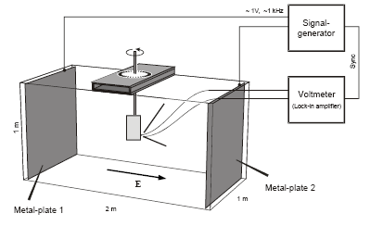
SOLAR ORBITER RPW antennas
A gold-plated model of the spacecraft is submerged into a water tank
A low-frequency electric field is applied
The response (induced voltage) of the antennas is measured as a function of spacecraft orientation
The effective length vectors and the antenna impedances can be computed from the data
Rheometry is only applicable to the quasi-static limit
Rheometry
Example: STEREO spacecraft

Slide 4


SOLAR ORBITER RPW antennas
The spacecraft is modeled as a grid of wires or patches
Then the currents as a response of a 1V excitation along these wires/patches are computed
This calculation is done with ASAP (wires), CONCEPT II (wires and patches) and NEC 4 in preparation
On basis of the current distribution, all other antenna properties (effective length vectors, impedances) can be calculated with MATLAB routines
The numerical method

Slide 5

SOLAR ORBITER RPW antennas
The equation governing the current distribution is the electric field integral equation (EFIE. CONCEPT, NEC), or the reaction integral equation (RIE, ASAP)
For patches, the magnetic field integral equation (MFIE, CONCEPT) is used
The antenna is excited at the feed
Due to reciprocity, the receiving antenna results in the same current distribution as the transmitting (postulating vacuum)
The numerical method

Slide 6


SOLAR ORBITER RPW antennas
Antenna behavior is influenced by the surrounding space plasma.
The influence is highest near the plasma resonance frequencies but also noticeable at the higher parts of the typical radio experiment frequency range.
Due to the trajectory it could be important for the SOLAR ORBITER RPW antenna calibration.
A dielectric model of the space plasma can be incorporated in the numerical antenna calibration.
The effect of plasma is encapsulated in the Green's tensor, which shape depends on the plasma model used.
The general form of the response tensor is
The resulting tensor can be incorporated into the electric field integral equation.
Including the effect of space plasma

Slide 7

SOLAR ORBITER RPW antennas
Spacecraft antennas are usually coupled to the surrounding space plasma.
The electromagnetic coupling can be modeled by a system of a resistance and a capacitance.
In rarefied plasma the coupling can not take place without photoelectrons.
The sheath thickness must not be larger than the antennas.
Including the plasma sheath
[Bale et. al. 2007]

Slide 8
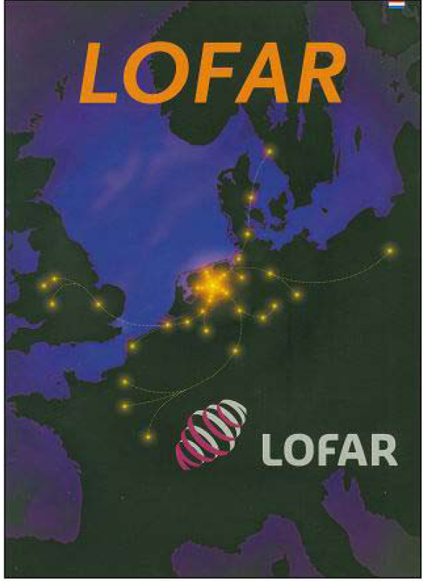
SOLAR ORBITER and LOFAR
The LOw Frequency ARray Project consists of a network of a large number of radio stations in the Netherlands, as well as remote stations in other European countries.
The main objective is research on extragalactic radio sources.
A possible use for solar physics is obvious and planned.
It is planned to use LOFAR in combination with solar observing spacecraft...like SOLAR ORBITER
LOFAR

Slide 9
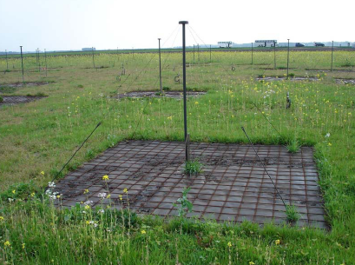
SOLAR ORBITER and LOFAR
Each station consists of two types of antennas:
  LBA = low-band-high antennas 30-80 MHz
  HBA = high-band antennas 120-240 MHz.
The receivers also have an input channel for a third antenna family which is not yet implemented:
  VLBL = low-band-low antennas 10-30 MHz
If VLBA would be implemented combined ground-based and space-based observations would be possible.
LOFAR

Slide 10
SOLAR ORBITER and LOFAR
At the Space Research Institute, Graz we are in the planning stage to build a new LOFAR radio station.
We also propose to implement the very-low-band functionality to make combined SOLAR ORBITER and LOFAR observations possible.
LOFAR

Slide 11
Conclusion:
We are ready for the SOLAR ORBITER RPW antenna calibration.
We propose the preparation of very-low-band antennas at the LOFAR radio stations.
Conclusion

Slide 12
The End
Thank You for Your attention !

