Slide 1
4 Items
Direction finding easier when antennas orthogonal
...not like on STEREO...
Direction finding never worked with Cassini, STEREO....
Cygnus ... for in-flight calibration

Slide 2


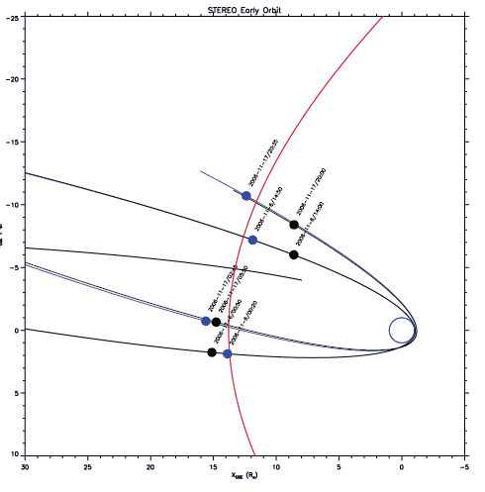
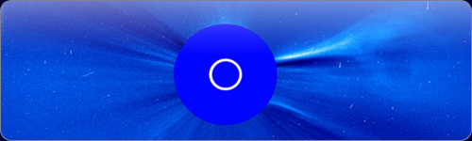
The Physics of the plasma sheath

Slide 3


SOLAR ORBITER RPW antennas
Antenna behavior is influenced by the surrounding space plasma.
The influence is highest near the plasma resonance frequencies but also noticeable at the higher parts of the typical radio experiment frequency range.
Due to the trajectory it could be important for the SOLAR ORBITER RPW antenna calibration.
A dielectric model of the space plasma can be incorporated in the numerical antenna calibration.
The effect of plasma is encapsulated in the Green's tensor, which shape depends on the plasma model used.
The general form of the response tensor is
The resulting tensor can be incorporated into the electric field integral equation.
Including the effect of space plasma

Slide 4

SOLAR ORBITER RPW antennas
Spacecraft antennas are usually coupled to the surrounding space plasma.
The electromagnetic coupling can be modeled by a system of a resistance and a capacitance.
In rarefied plasma the coupling can not take place without photoelectrons.
The sheath thickness must not be larger than the antennas.
Including the plasma sheath
[Bale et. al. 2007]

Slide 5


The Physics of the plasma sheath
STEREO operates in solar wind conditions at 1AU.
The photo-electron production rate is higher than the thermal electron impact rate. --> positive charge.
i_{ph}...10⁻⁴Am⁻²
A_{rel}...0.5
l=6m
d=1in (0.0254m) on average
Mean energy of photo-electrons=1.5eV
Mean energy of thermal electrons=10eV
Application
-->V=5.5V
n_{e}=10⁶m⁻³
-->n_{ph}(0)=2x10⁸m⁻³
-->2.5% of the photo-electrons reach the plasma.
-->λ_{sh} =85cm, using the photo-electron Debye length at the surface.

Slide 6
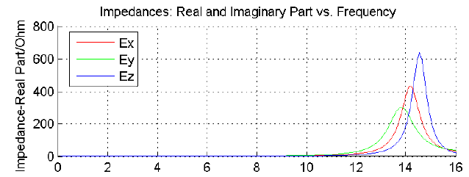

The Physics of the plasma sheath
Using the appropriate equations, one finds:
  R_{s}=0.2MΩ
  C_{s}=87pF
Via these parameters the sheath can be included into the numerical antenna calibration (wire-grid).
No calculations for the effective length vectors where done so far.
Computation of the impedances show that the inclusion of the sheath has an effect.
Application

Slide 7
The Physics of the plasma sheath
Stuart Bale estimates
  R_{s}=0.75MΩ
  C_{s}=40pF
The figures show the impedances using Bale's values in relation to the results using our theoretical model.
Application

Slide 8

The Physics of the plasma sheath
Comparing the location of the second resonance of antenna E_{z} with measured data shows that the inclusion of the sheath capacitance has a corrective effect.
Further and more accurate data is needed to verify the model.
Application

