Slide 1
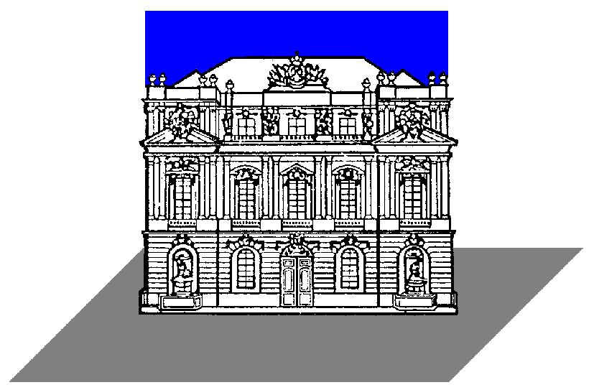

On the calibration of spacecraft antennas
Comparison and discussion of different methods
Oswald, T.H. (1), Rucker (1), W. Macher (1),, A. Lecacheux (2), J.L. Bougeret (2), M.L. Kaiser (3), K. Goetz (4)
(1) IWF/OEAW thomas.oswald@oeaw.ac.at
(2) Observatoire de Paris-Meudon, France
(3) NASA/GSFC Greenbelt, MD, USA
(4) University of Minnesota, USA

Slide 2
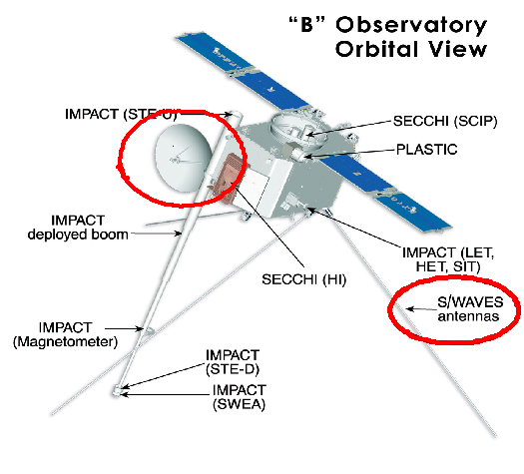
Antennas on spacecraft
Two kinds of antenas:
  For communication
  For scientific experiments
Scientific antennas often used to receive natural radiation
Sometimes direction finding is performed

Slide 3
Why is antenna calibration necessary ?
To perform “Direction Finding”(DF), antenna properties must be known to a high degree of accuracy
The receiving properties can be quantified by the effective length vector
The effective length vector represents the antenna as it behaves electrically
It is influenced by the geometry of the spacecraft
Depends, in general, upon frequency and direction of incidence and is a complex vector, but at low frequency it can be treated as a constant real vector
In this quasistatic range, DF is possible

Slide 4
Methods to determine the effective length vector
Numerical electromagnetic code
Rheometry
The EMC chamber
In-flight Calibration

Slide 5
The numerical method 1
The spacecraft is modelled as a grid of wires
Then the currents along these wires are computed
On base of the current distribution, all other antenna properties (effective length vectors, impedances, power patterns) can be calculated

Slide 6
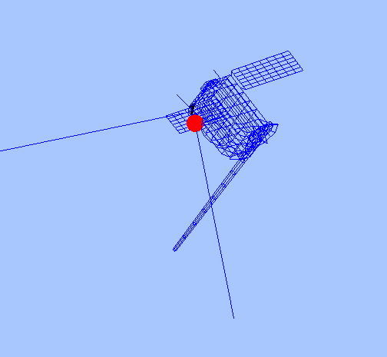
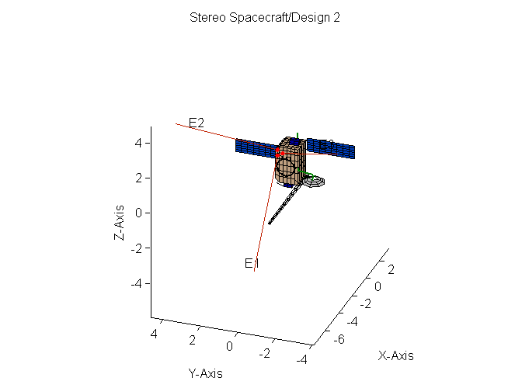
The numerical method 1

Slide 7
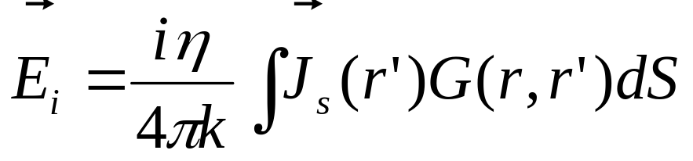
Computation of the current distribution 1
The equation governing the current distribution is the electric field integral equation (EFIE), or the reaction integral equation
Simplifications:
  Thin currents along the center of the wires
  No transverse currents

Slide 8
The numerical method 2
The spacecraft is modelled of patches
Then the surface currents on each patch are computed
On base of the current distribution, all other antenna properties (effective length vectors, impedances, power patterns) can be calculated

Slide 9
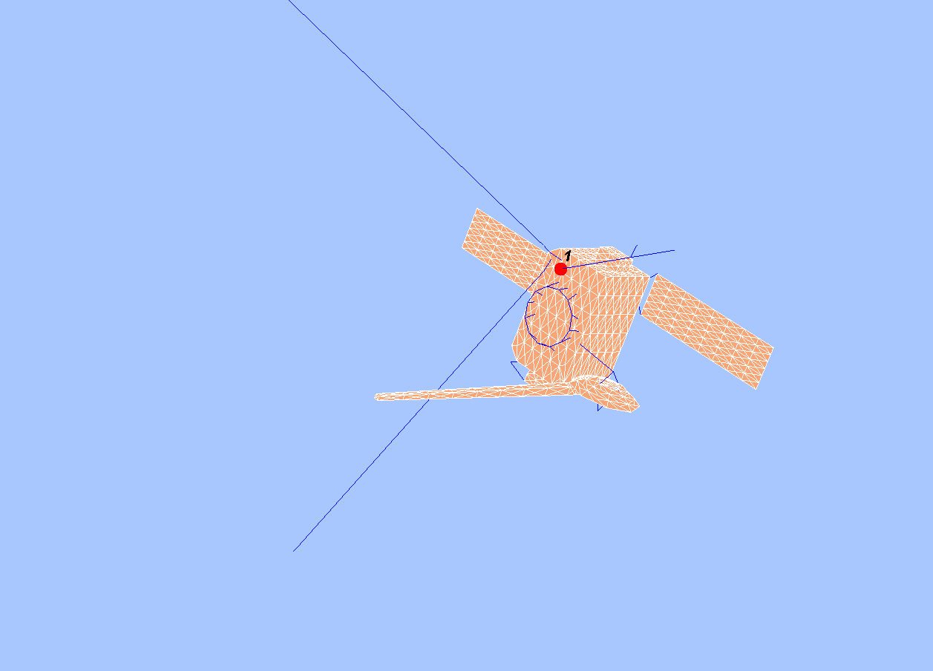
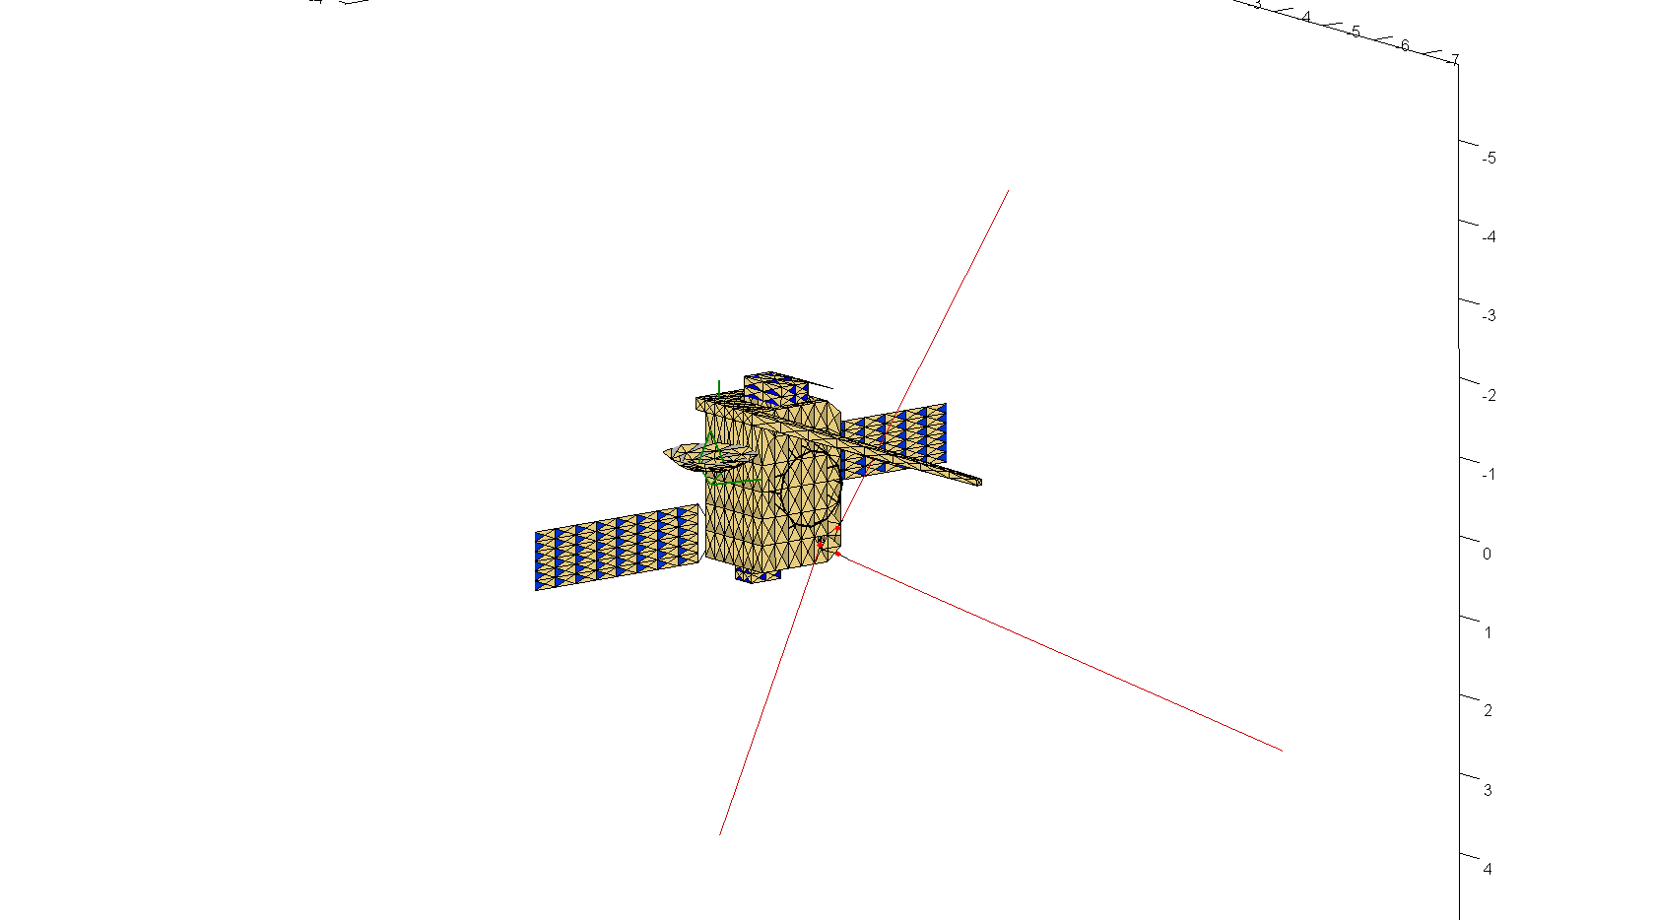
The numerical method 2

Slide 10
Computation of the current distribution 2
The equation governing the current distribution is the magnetic field integral equation (MFIE)
Disadvantage: Longer computing time
Advantage: Better results in the high frequency range

Slide 11
The Method of Moments
The Method of Moments (MoM) can be used to solve integral equations
A modified version of the antenna scatterers analysis program (ASAP) and CONCEPT II are used to calculate the currents
Only CONCEPT II can deal with patches

Slide 12
Further calculations
The effective length vectors, impedances and power patterns are calculated by Matlab routines created in the space research institute
Calculations were performed for open feeds and base capacitances of 90pF

Slide 13
Rheometry
A gold-plated model of the spacecraft is submerged into a water tank
A low-frequency electric field is applied
The response (induced voltage) of the antennas is measured as a function of spacecraft orientation
The effective length vectors and the antenna impedances can be computed from the data
Open feeds are intrinsically included in the method
Rheometry is only applicable for the quasi-static limit

Slide 14
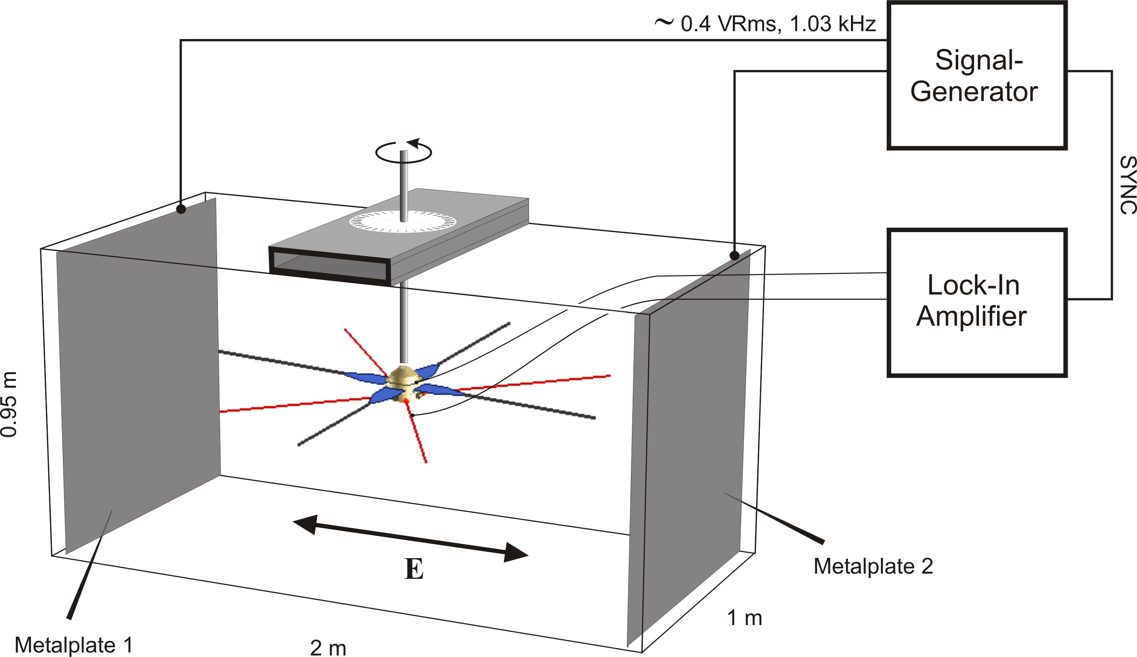
Rheometry

Slide 15
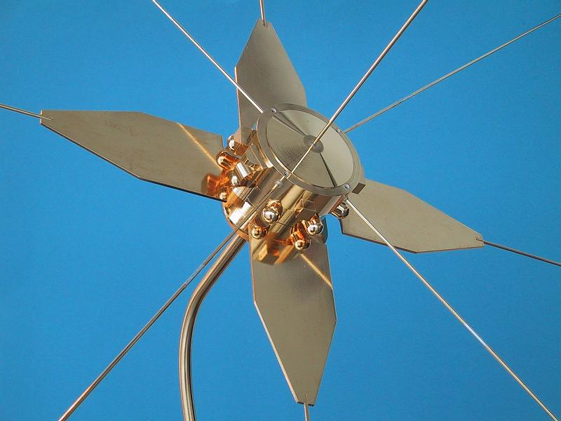
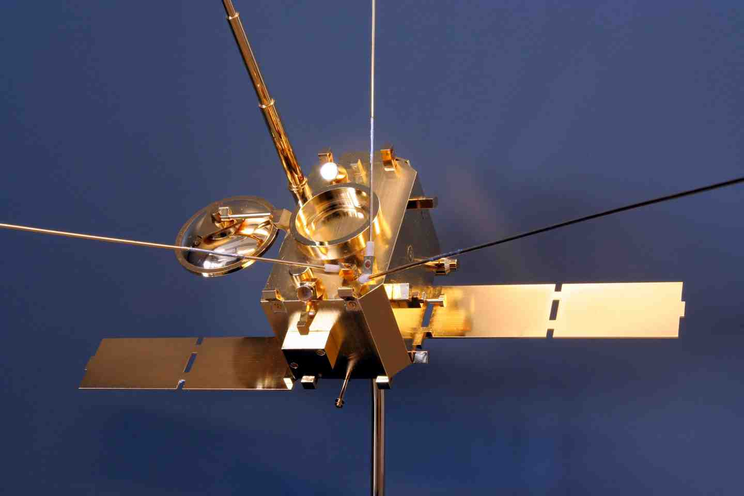
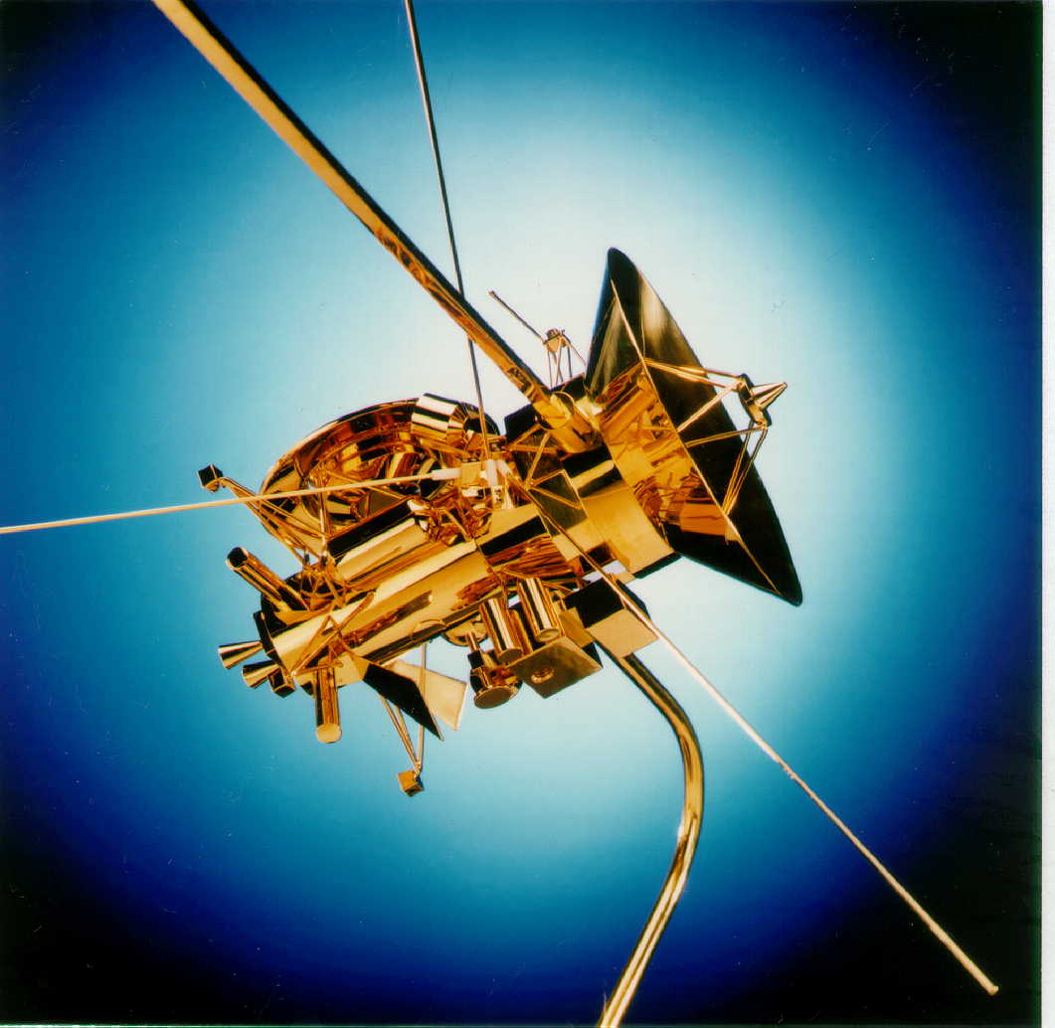
Some models

Slide 16
The EMC chamber
In the EMC (electromagnetic cleanliness) chamber a scale model is illuminated by coherent electromagnetic radiation.
The respons of the antennas is measured.
Different frequencies can be dealt with.

Slide 17
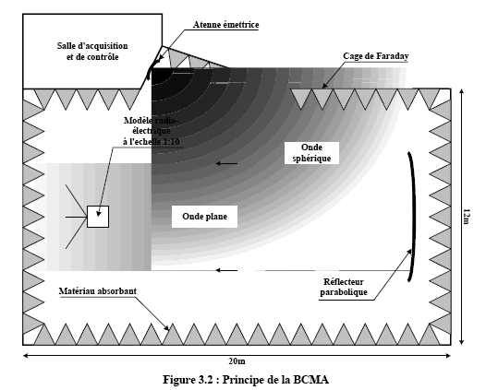
The EMC chamber

Slide 18
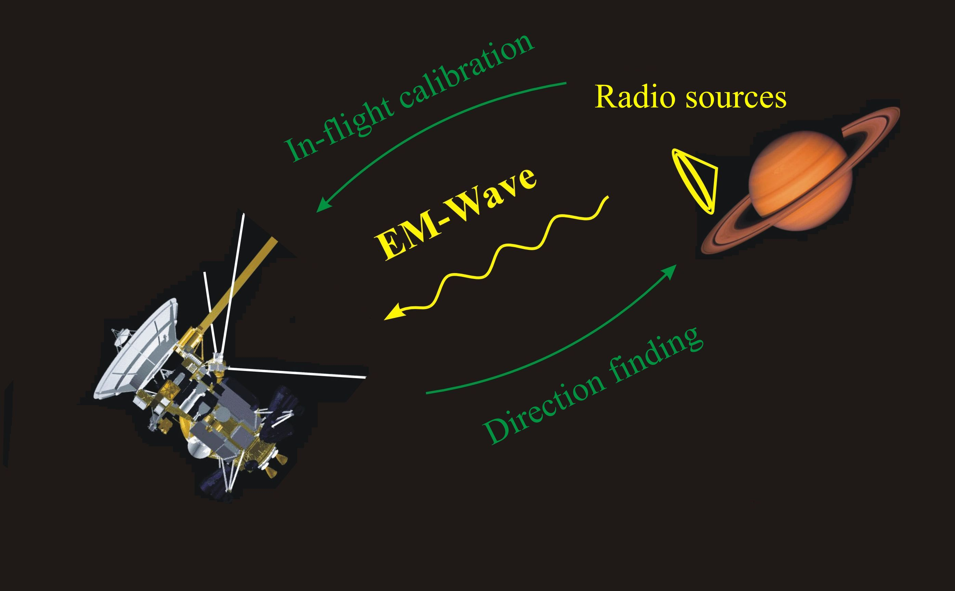
Inflight calibration
A known radio source, natural or manmade, is used to calibrate the antennas after launch
The spacecraft should make an appropriate roll manoeuvre to measure the dependence of the respons as a function of orientation

Slide 19
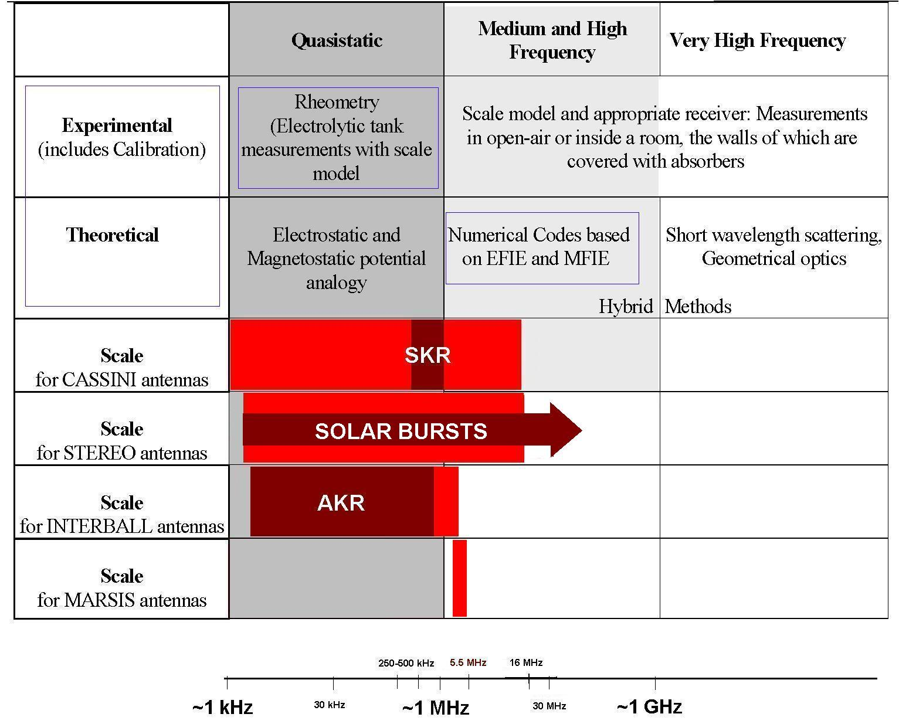
Overview

Slide 20
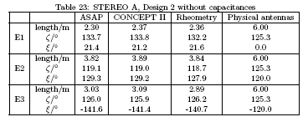
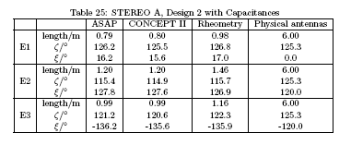
The results in case of the stereo spacecraft

Slide 21
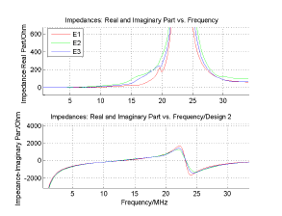
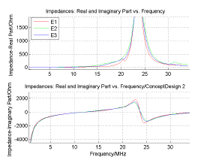
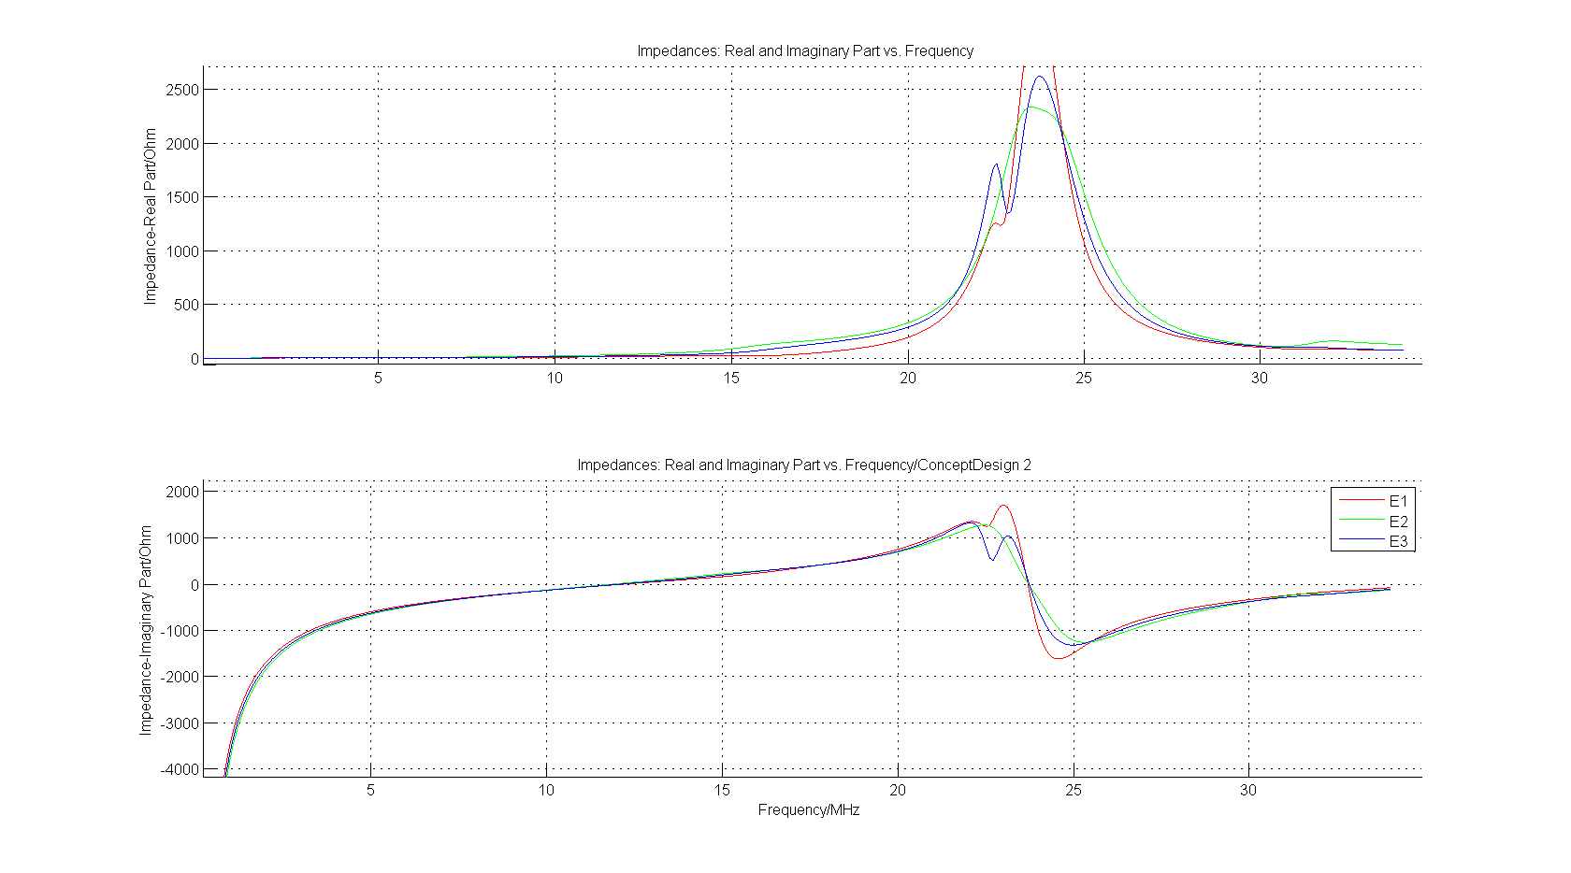
The impedances

Slide 22
Thank You for Your attention !

