Slide 1


Antennas in plasma
Antenna behavior is influenced by the surrounding space plasma.
The influence is highest near the plasma resonance frequencies but also noticeable at the higher parts of the typical radio experiment frequency range.
A dielectric model of the space plasma can be incorporated in the numerical antenna calibration.
The effect of plasma is encapsulated in the Green's tensor, which shape depends on the plasma model used.
The general form of the response tensor is
The resulting tensor can be incorporated into the electric field integral equation.
Including the effect of space plasma

Slide 2
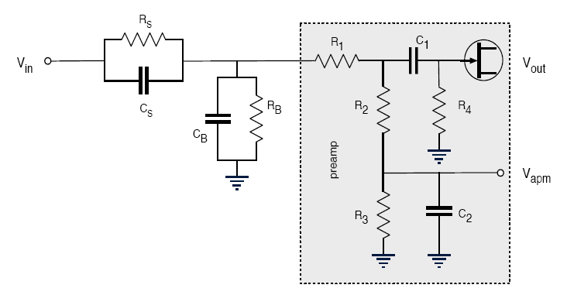
Plasma sheath effects
Spacecraft antennas are usually coupled to the surrounding space plasma.
The electromagnetic coupling can be modeled by a system of a resistance and a capacitance.
In rarefied plasma the coupling can not take place without photoelectrons.
The sheath thickness must not be larger than the antennas.
Including the plasma sheath
[Bale et. al. 2007]

Slide 3
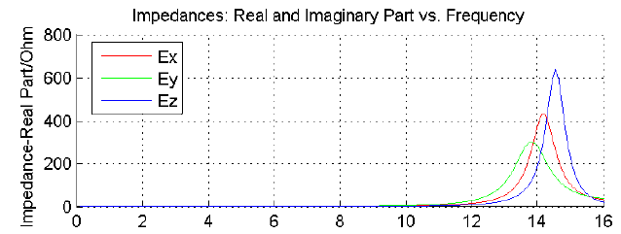
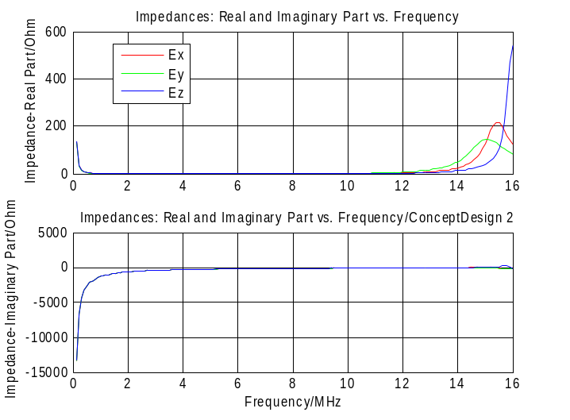

Plasma sheath effects
Using the appropriate equations, one finds:
  R_{s}=0.2MΩ
  C_{s}=87pF
Via these parameters the sheath can be included into the numerical antenna calibration (wire-grid).
No calculations for the effective length vectors where done so far.
Computation of the impedances show that the inclusion of the sheath has an effect.
Application

Slide 4
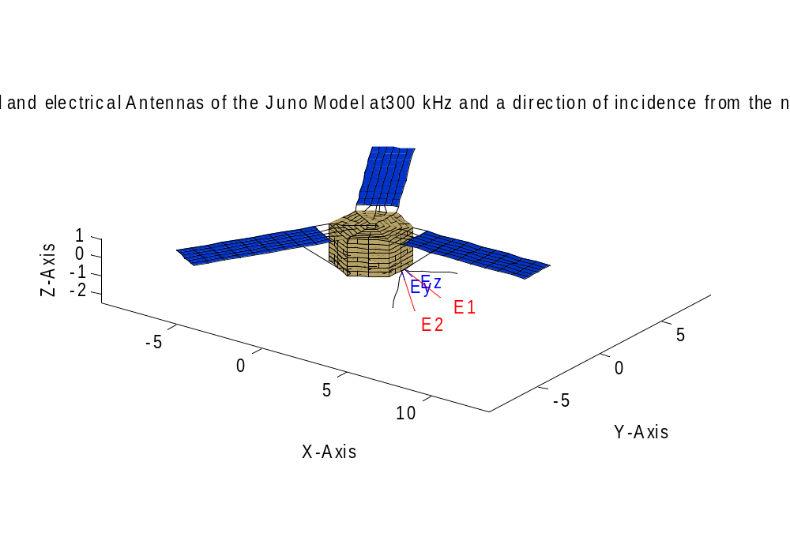
Juno Wire-grid modeling
Juno was modeled according to preliminary information concerning the spacecraft geometry.
Different antenna configurations and geometries were simulated and presented to the Juno team.
Juno

Slide 5
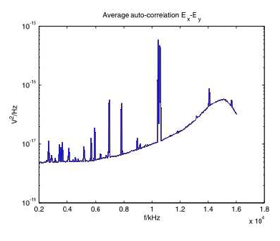
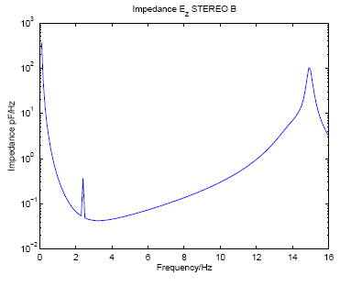
In-flight calibration
It could be important to verify the calibration results by reproducing them by means of inflight-calibration.
The base- and sheath capacitances could be calibrated by matching the second antenna resonance which is visible on STEREO/WAVES data plots.
AKR could be used to calibrate the length and direction of the effective length vectors.
STEREO

