Slide 1
Solar Corona propagation (f ≤ 1MHz)
Effects detected on Type III bursts, well summarized by Dulk (1999, AGU monogr. on LF radioastronomy), and based on works, namely by Fainberg et al (1972), Lin et al. (1981), Steinberg et al. (1984,1985), Dulk et al. (1985), Lecacheux et al. (1989), Bastian (1995a, 1995b), Hoang et al. (1997,1998):
  apparent source radial distances much larger than plasma altitudes
  F and H sources abnormally coincident, at a given frequency.
  apparent source sizes impossibly large.
  anomalous time delay up to 500 sec. (1 AU !) when observations of several S/C are compared.
  F and H radiation reception depends on S/C position wrt the e⁻ beam; F and H radiation are differently beamed.
  sources, located behind the Sun, are only weakly attenuated.

Slide 2
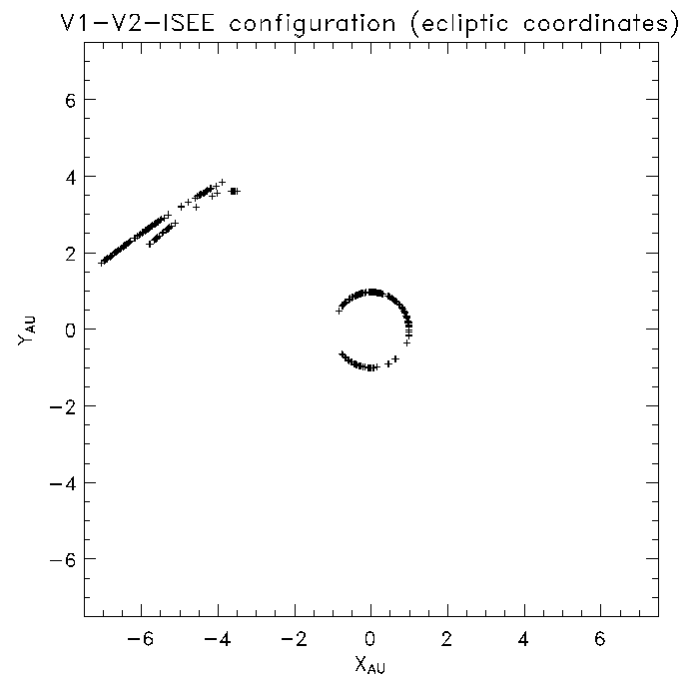
Re-visiting Voyager-ISEE 3 comparison
Analysis of 216 type III bursts over 18 frequencies (47-1000 kHz)
Voyager at distance > 4AU
Voyager provided intensity time profiles.
ISEE-3, in addition, measured direction of arrival and source size.

Slide 3
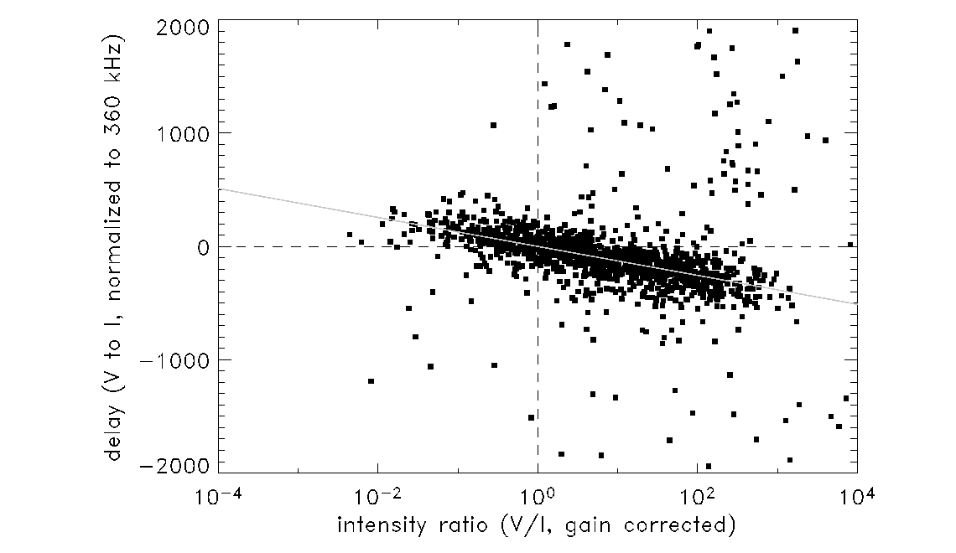
Voyager-ISEE : solar type III’s time delay excess vs. intensity ratio
(unpublished)

Slide 4
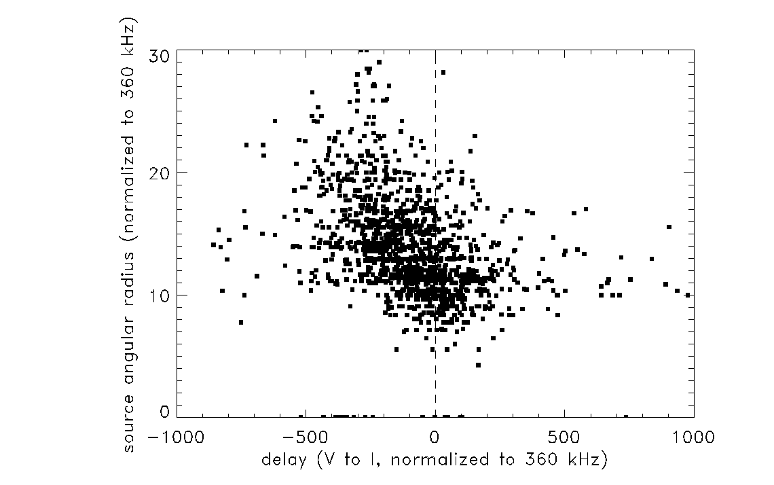
(unpublished)

Slide 5
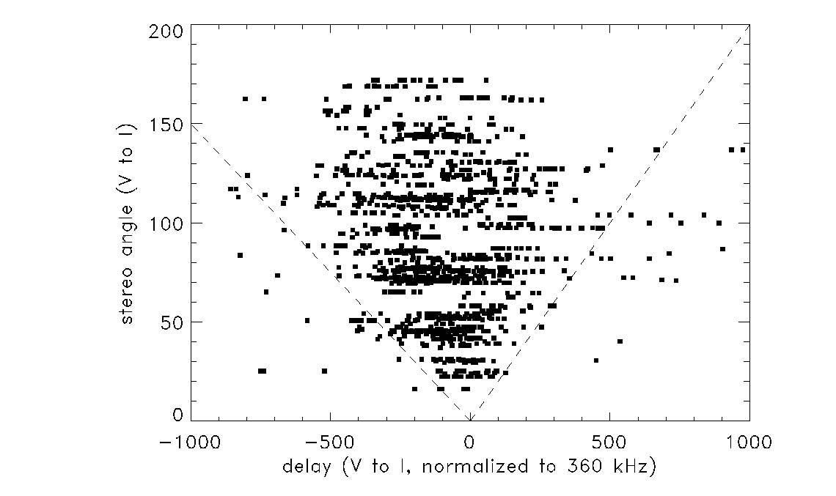

Slide 6
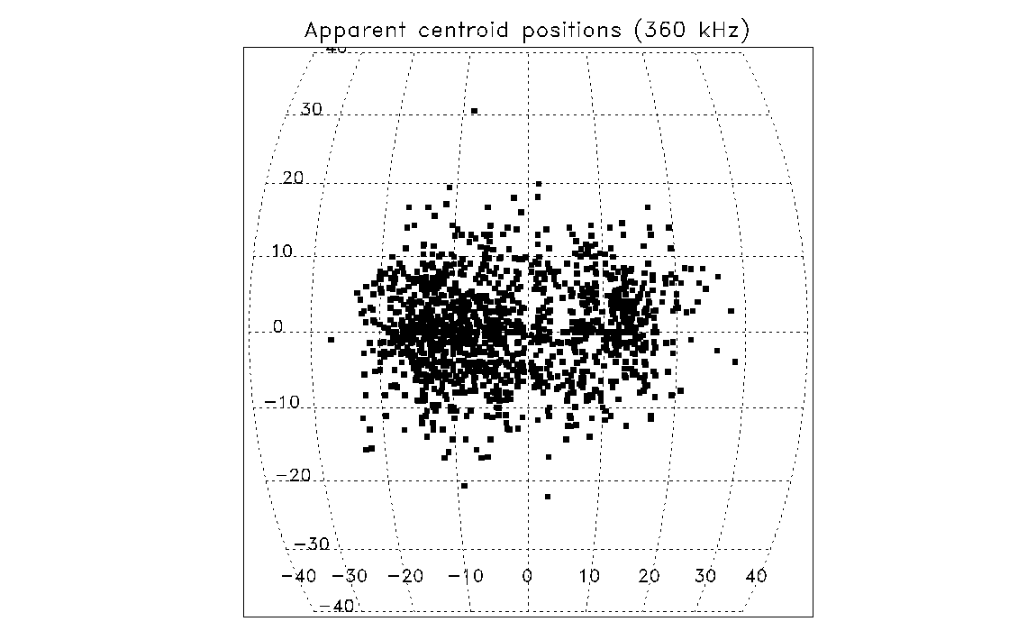

Slide 7
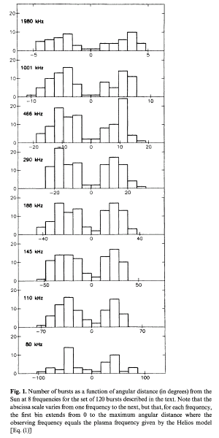
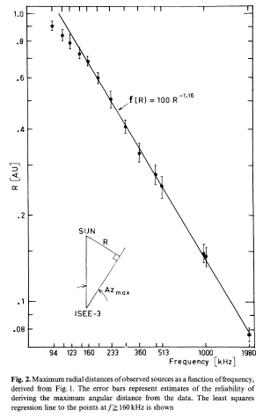

To be compared to the Helios density model:

Slide 8
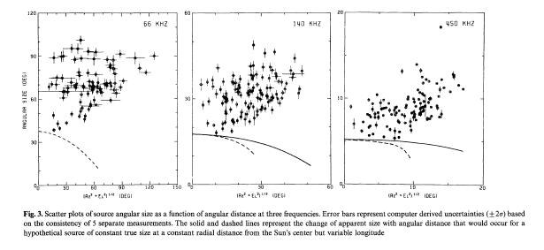

Slide 9
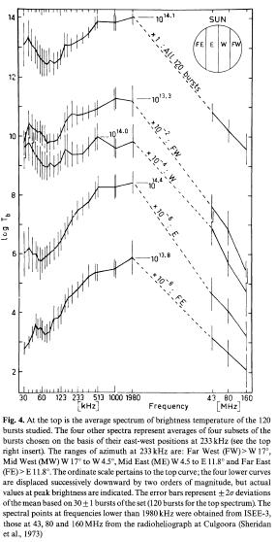
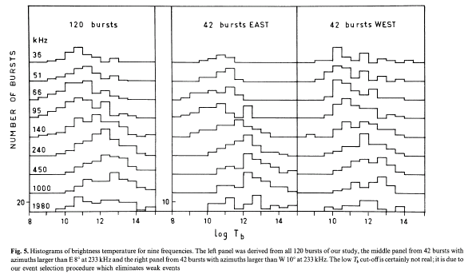

Slide 10
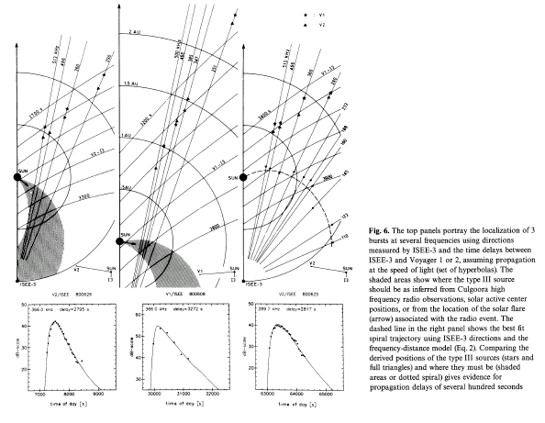

Slide 11
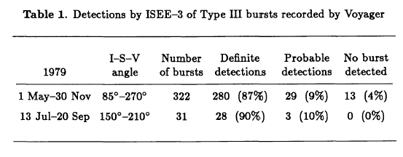
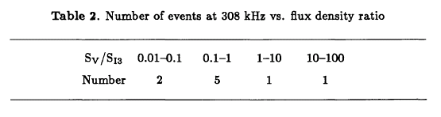

Slide 12

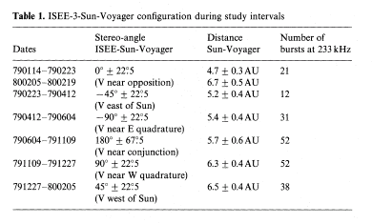
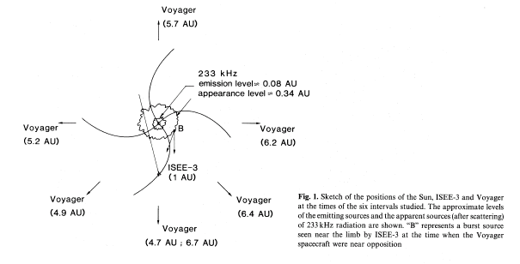

Slide 13
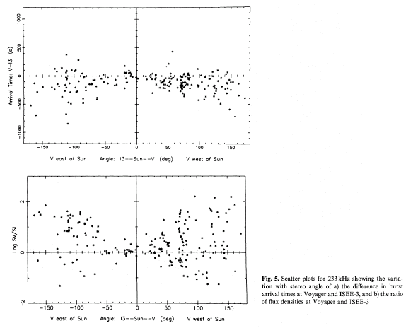
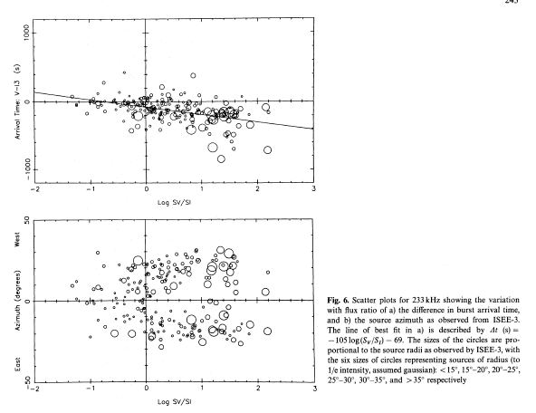

Slide 14
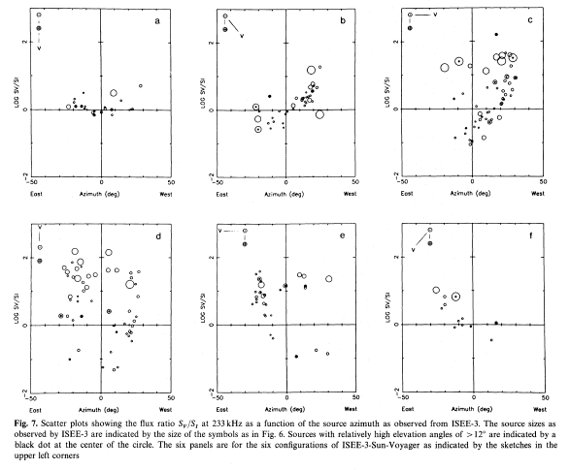

Slide 15
