Slide 1
Antenna effective heights and capacitances
W. Macher, G. Fischer + RPWS team
Cassini/RPWS Team Meeting, Iowa 2004
HP on
Inflight-calibration
Vogl et al. (2003)
Rheometry
Rucker et al. (1996)
Wire Grid
Fischer et al. (2001)
u
v
w
u
v
w
u
v
w
h/h_{w}
1.21
1.19
1.0
0.91
0.91
1.0
-
-
1.0
θ
108.3°
107.8°
29.3°
107.9°
107.3°
31.4°
106.4°
106.6°
29.6°
ϕ
17.0°
163.8°
90.6°
16.5°
162.7°
91.2°
16.0°
164.2°
89.5°
Rheometry: h_{u}=h_{v}=4.0, h_{w}=4.4; Wire-grid: h_{u}=4.36, h_{v}=4.24, h_{w}=4.08 (all in m) leading to h_{u}/h_{w}=1.07 and h_{v}/h_{w}=1.04

Slide 2
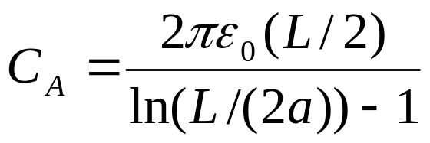
Antenna capacitances
Antenna capacitance of cylindrical dipole with L/2=10 m as element length and radius a=0.014 m: C_{A}=100 pF for antenna capacitance (Gurnett et al., 2004). a=0.002 m  C_{A}=74 pF a=0.025 m  C_{A}=111.4 pF
Wire-grid (no base included): C_{Au}=70 pF, C_{Av}=72 pF (CDA), C_{Aw}=72 pF (RTG) for a=0.002 m for a low freq. (500 kHz). Scaled to a=0.014 m: C_{Au}=94.6 pF, C_{Av}=97.3 pF, C_{Aw}=97.3 pF.
Rheometry capacitance measurement (not published): C_{Au}=C_{Av}=106.8 pF and C_{Aw}=102.6 pF for a radius a=30*0.83mm=0.025 m. Scaled to a=0.014 m: C_{Au}=C_{Av}=95.7 pF and C_{Aw}=91.9 pF.

Slide 3
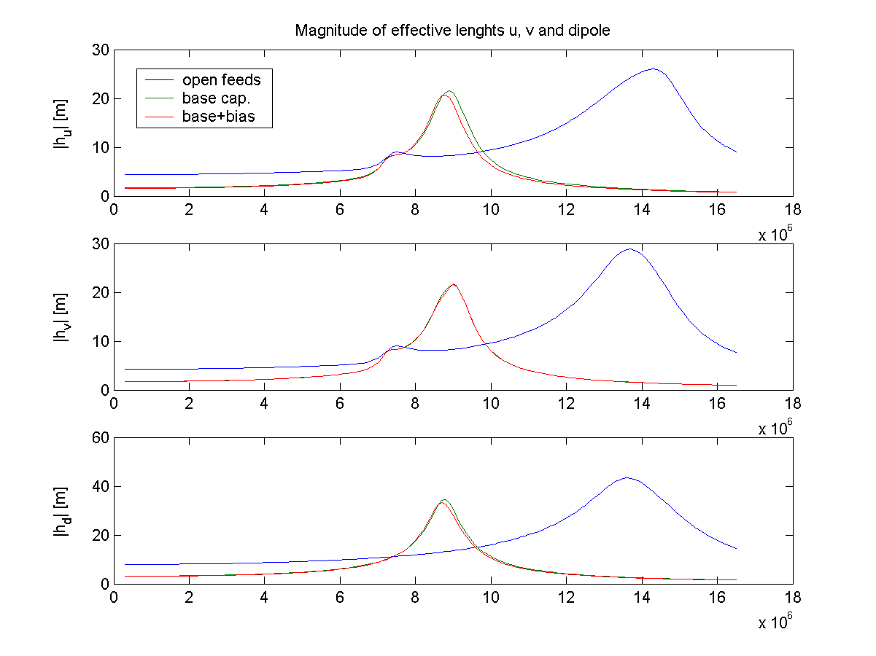
Wire-grid calculations with base capacitances included
For base capacitances (mounting, cables, HFR input): C_{Bu}=119 pF (+10% for base+bias), C_{Bv}=113 pF, C_{Bw}=106 pF mounted parallel to the antenna (capacitive divider; Gurnett et al., 2004)
h_{u}=4.36 m (open feeds) to h_{u}=1.67 m (base cap.)
h_{v}=4.24 m to h_{v}=1.70 m
h_{w}=4.08 m to h_{w}=1.66 m
Dipole!

Slide 4
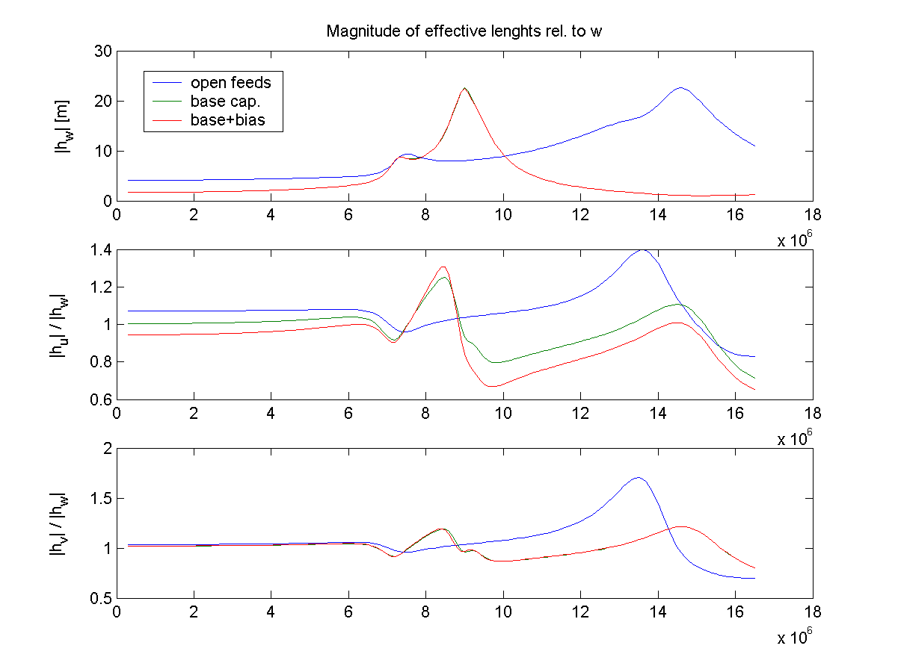
Effective height length ratios h_{u}/h_{w} and h_{v}/h_{w}
For low frequency:
h_{u}/h_{w}=1.004 h_{v}/h_{w}=1.021

Slide 5
Summary
Antenna capacitance of C_{A}=100 pF is a good approximation
Effective heights get a maximum at antenna resonance frequency (measurements of background) when base capacitances are introduced
A greater deviation of C_{Bw} (approx. 140 pF base capacitance of w-antenna) would lead to a h_{v}/h_{w}=h_{u}/h_{w}=1.2
Future calculations will be performed with patches and realistic wire radii: replace ASAP by CONCEPT

Slide 6
Direction Finding(DF)-Level 3 data on calypso.obspm.fr (PZ):
DF 3a (Powell, 3 antennas, JGR 2003, DV)
DF 3b (analytical inversion, 3 ant., BC, PZ)
DF 3c, 3d (analytical inversion, 2 ant., BC, PZ)
FINAL LEVEL 3 DATA FOR TEAM AFTER SELECTION
Austrian part: Dieter has provided the IDL DF 3a routines to French colleagues
Work to do: Error progression analysis of Powell‘s method DF 3a to calculate ΔS, ΔQ, ΔU, ΔV, Δθ, Δϕ
Work will be done mainly by successor of Dieter Vogl (should start working in May/June) with support of Wolfgang Macher and Georg Fischer

