Slide 1


On the intensity of Saturn lightning
Fischer, G., Macher, W., Desch, M.D., Kaiser, M.L., Zarka, P., Kurth, W.S., Farrell, W., Lecacheux, A., Cecconi, B., Gurnett, D.A.

Slide 2
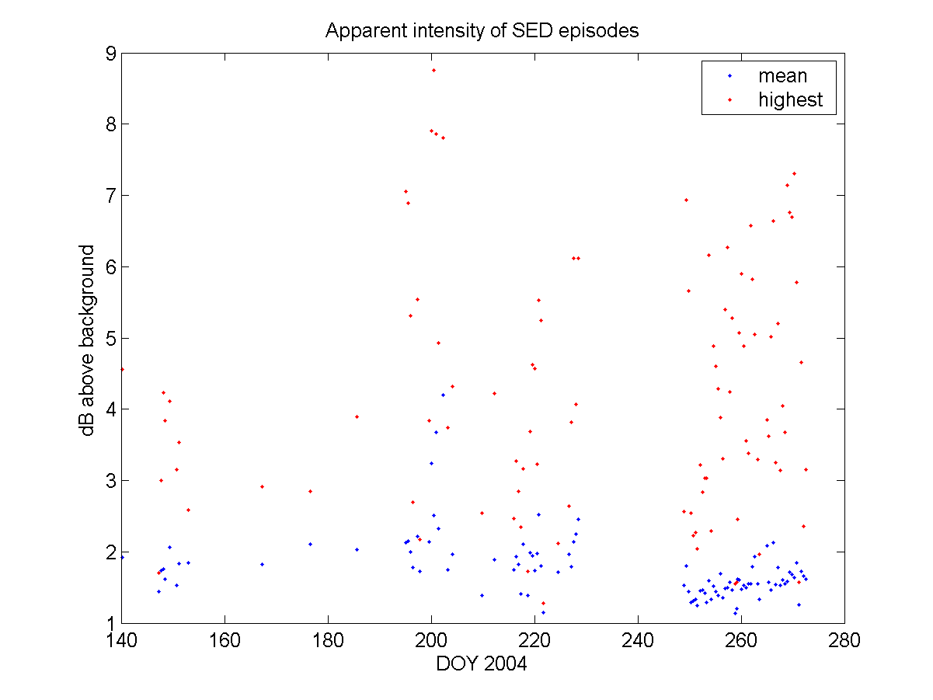
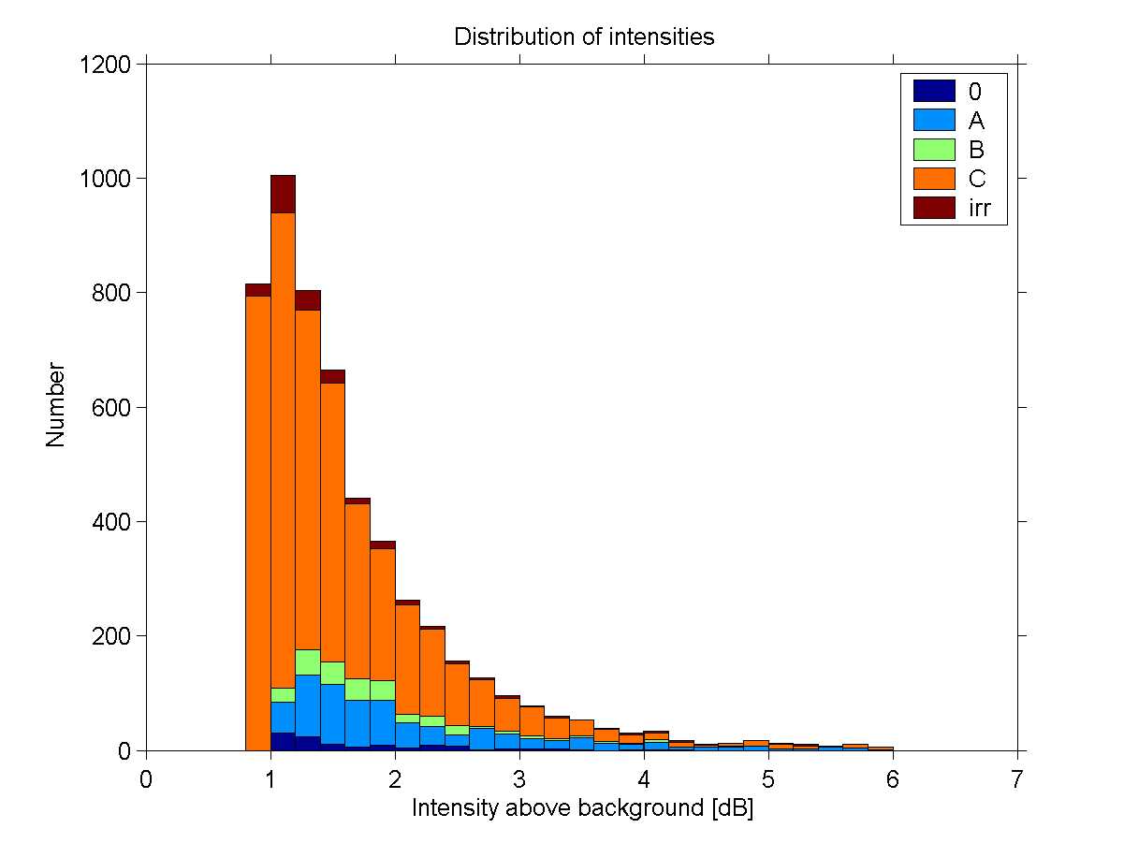
Intensities of SED signals related to the background
Distribution of intensities (threshold 0.8 dB)
Mean and highest intensity of all episodes in 2004

Slide 3
How to get absolute intensities
Calculation of a “reception area” by squaring the projection of the effective length vector into the wave plane
Antenna signal [V²/Hz] is divided by this area [m²] to get the incident flux [V²/(m²Hz)] (or in [W/(m²Hz)] using Z₀=120π Ω)
Effective length vector itself depends on frequency and direction of the incoming wave (no quasistatic regime!) and has to be calculated for every freq. and s/c position
Assumptions: SEDs are unpolarized and stem from Saturn, hence we know the direction of the incoming wave in s/c frame from Cassini attitude data

Slide 4
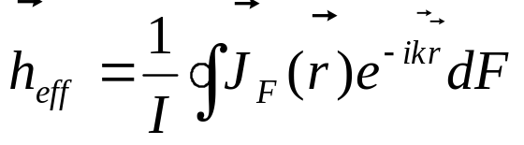
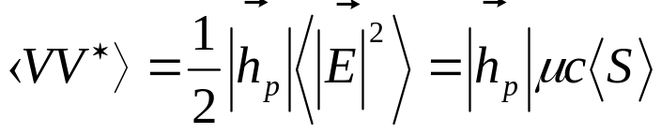
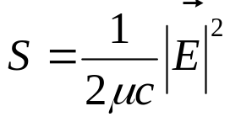

Some formulas
Effective length vector h_{eff} is calculated by integrating the surface current density J_{F} over the s/c surface F (it is important to include the base capacitances in the model):
with k as wave vector, r as the position, and I as the current at the feed point
By assuming unpolarized waves (Q=U=V=0) one can write:
With <VV*> as the measured signal, h_{p} as the projection of the effective length vector on the wave plane, E as the wave electric field, μ as the permeability of vacuum, c as the speed of light, Z₀ as the impedance of free space and S as the incident flux

Slide 5
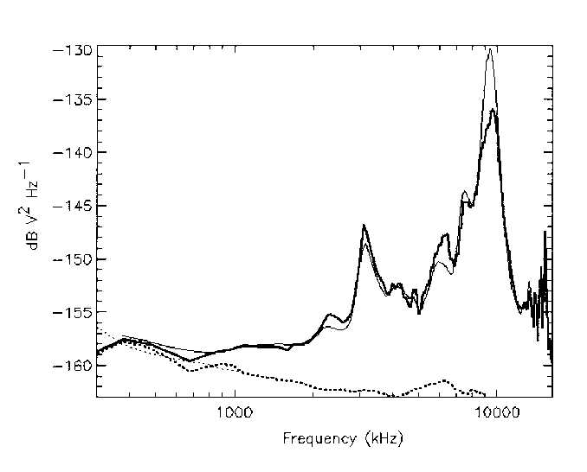
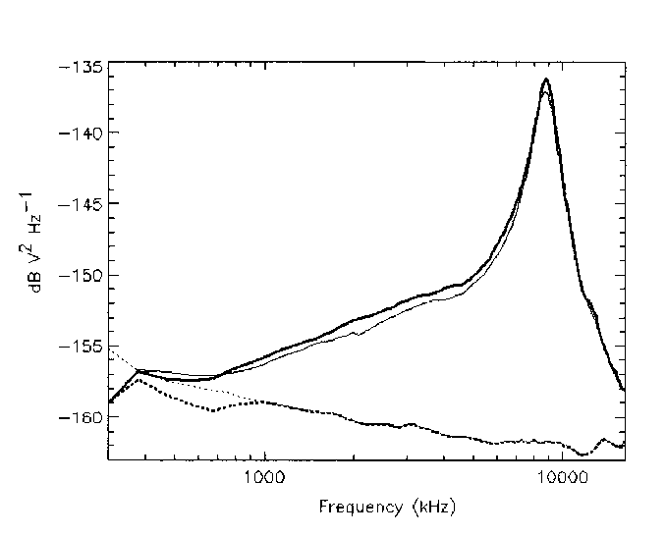
Galactic background noise spectra
Galactic background and receiver noise spectra recorded by the HFR with ±X monopole antennas (left) and by the dipole (right). From Zarka et al., JGR 109, 2004.

Slide 6
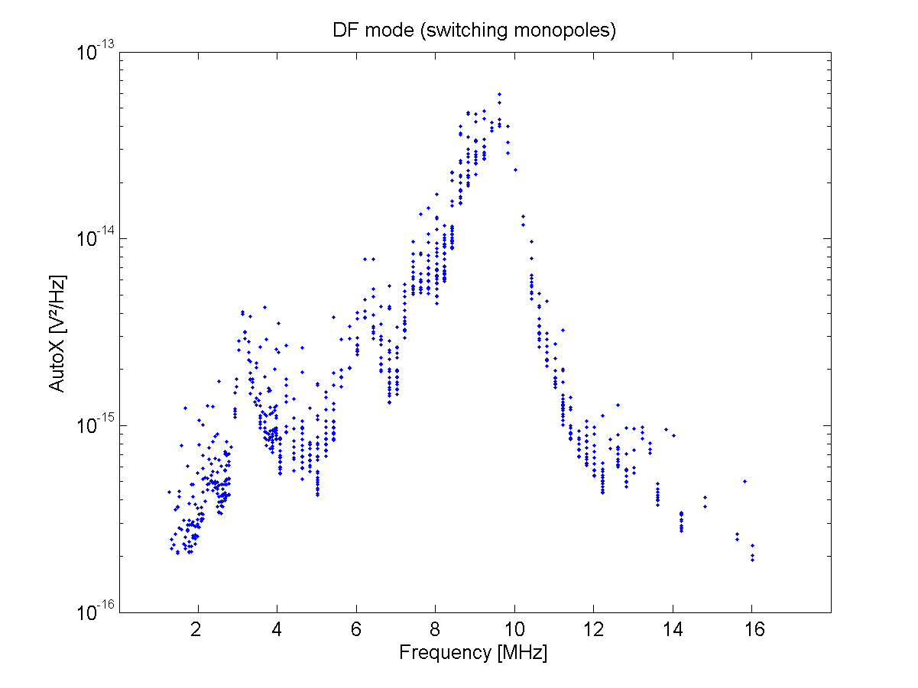
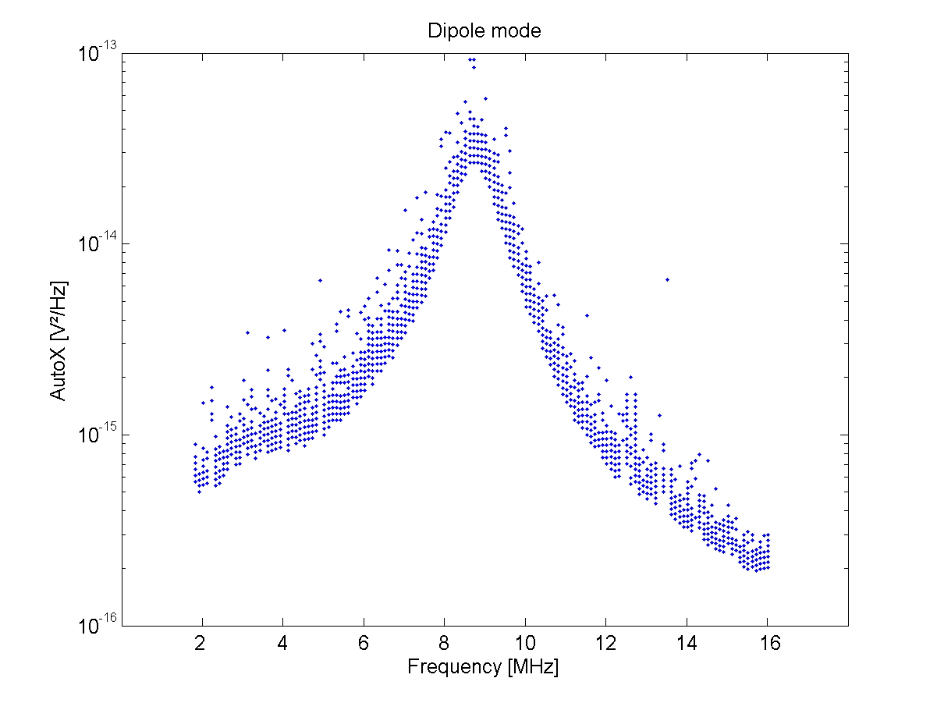
Measured antenna signals from SEDs in monopole and dipole mode
SED antenna signals as function of frequency (monopole mode for storms A, B; dipole mode for storms 0, C)

Slide 7
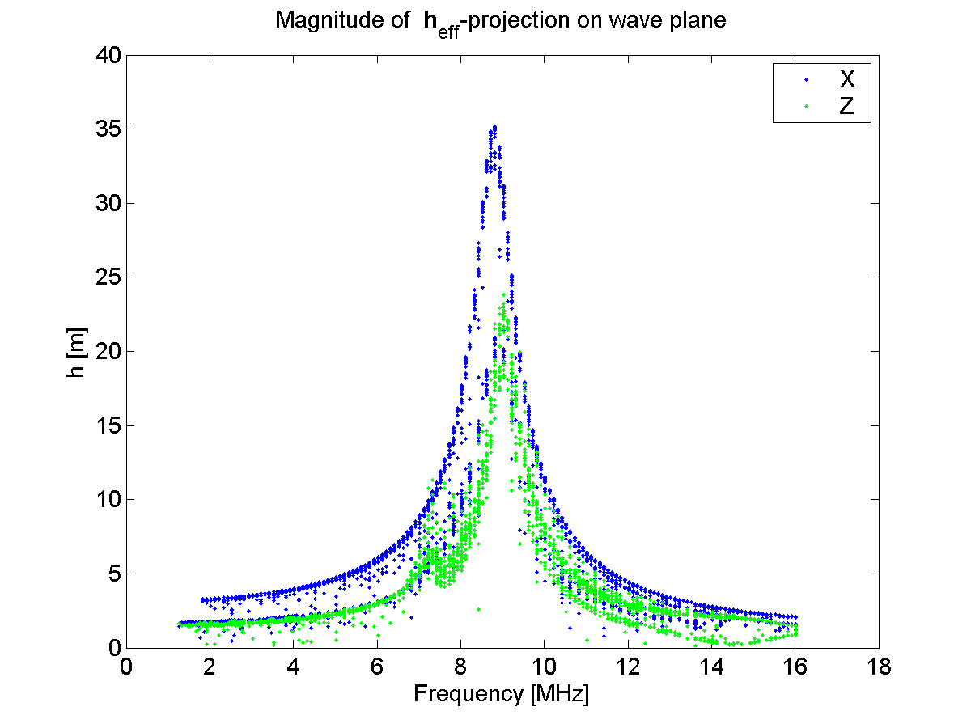
Projection of effective length vectors on wave plane
For quasistatic case there is h_{monopole}≈1.6 m, h_{dipole} ≈3.1 m from modelling in accordance with Zarka et al. (2004)

Slide 8
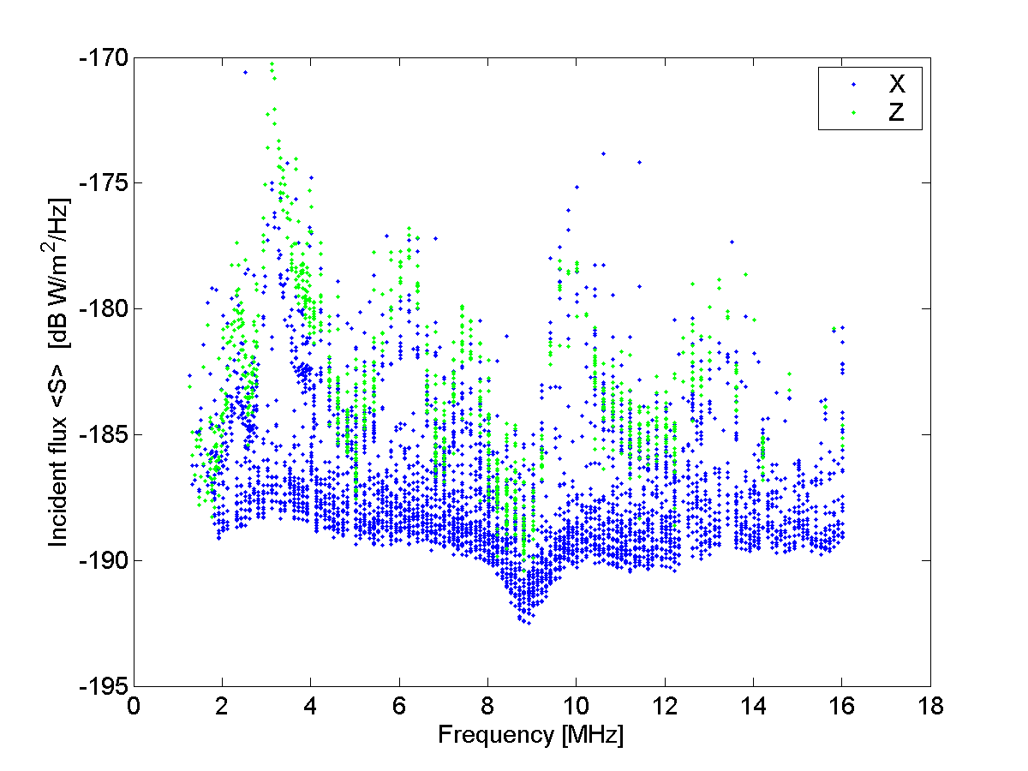
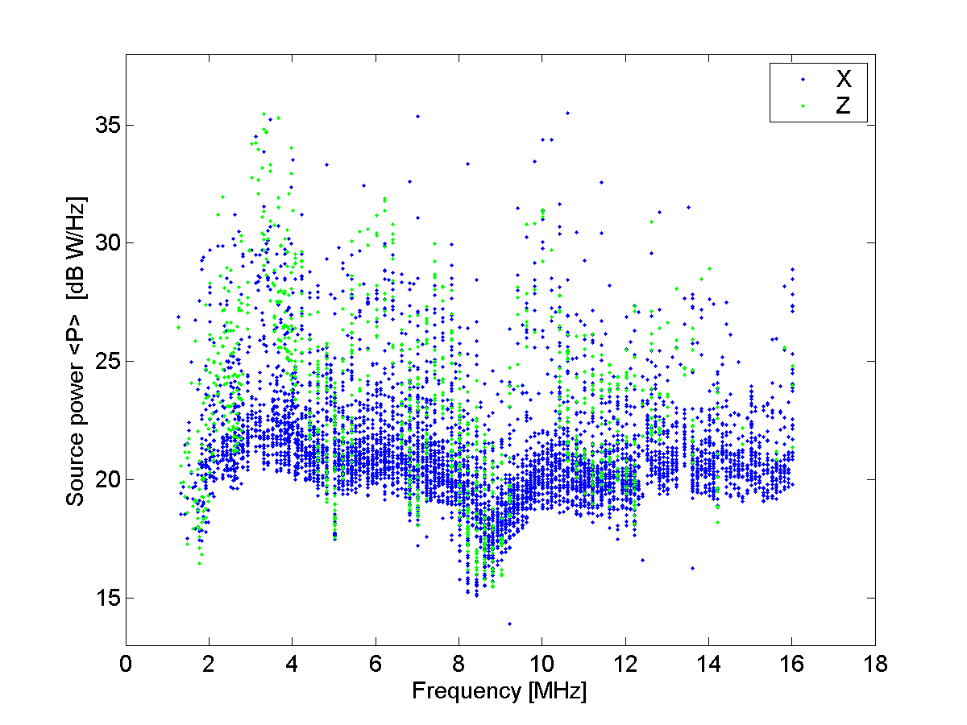
Incident flux and source power
Incident flux for all flashes and source power in W/Hz assuming an isotropically radiating source (taking into account the s/c-source distance)

Slide 9
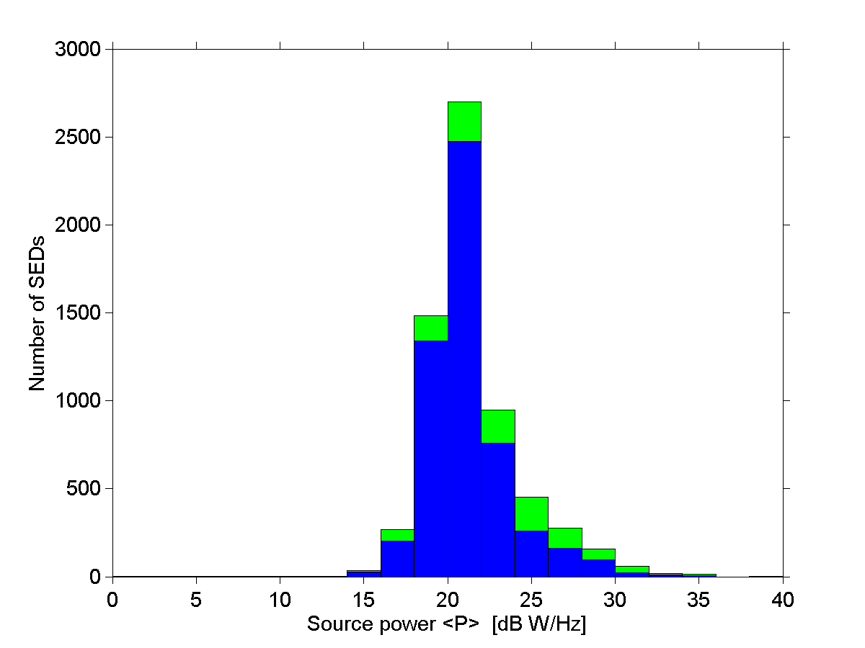
Distribution of source powers
Cassini:
Most SEDs have source powers greater 100 W/Hz.
Voyagers:
Range of 0.1-100 W/Hz, with mean of 60 W/Hz (V1), 6 W/Hz (V2).

Slide 10
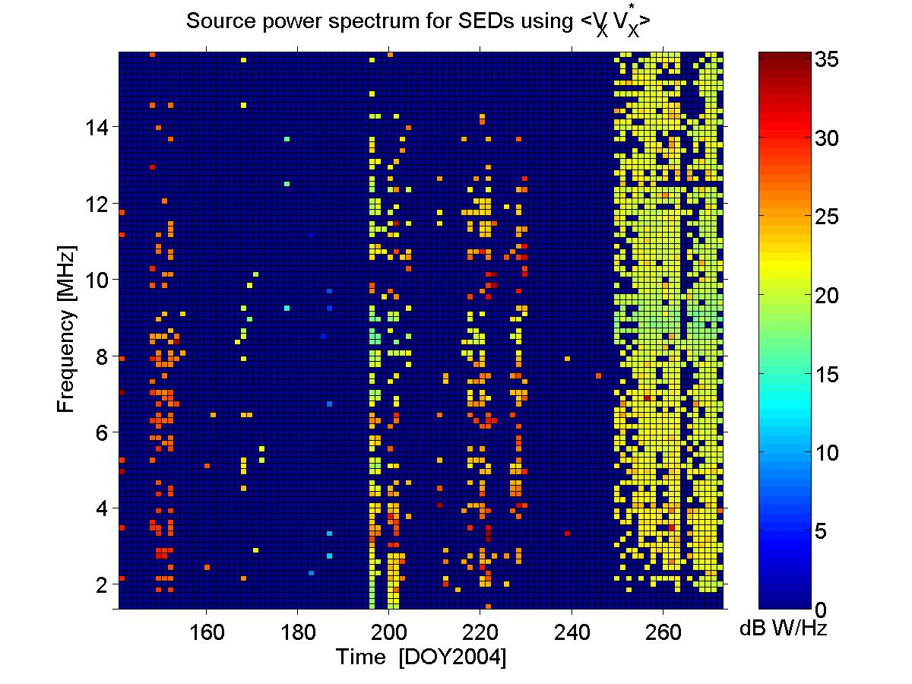
Source power spectrum for all
100 SED episodes of 2004

Slide 11
Summary
Complex effective antenna vectors calculated by a wire-grid modelling were used for the first time in the HF range to calculate absolute fluxes of SED signals
Result shows a nearly flat spectrum (just a slight fall-off with frequency) and a reduced flux from 1.5-3 MHz due to ionospheric damping
Only close to the antenna resonance the flux is underestimated by 2-3 dB due to imperfect modelling
It works better for the dipole than for monopoles as dipoles are less influenced by conducting s/c structure
Mean source powers of SED storms (plus background): 0: 650 W/Hz,A: 200 W/Hz,B: 470 W/Hz,C: 130 W/Hz

