Slide 1
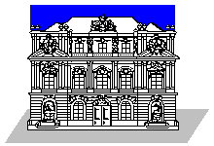

Study of Type III solar burst drift rates in the decametric wavelength
M.Y. Boudjada, H.O. Rucker, A. Lecacheux
Space Research Institute, Austrian Academy of Sciences, Graz, Austria

Slide 2
Solar Type III decametric bursts
Bursts are directly combined to the basic parameters of the
coronal plasma and the beams of fast particles
They result from the interaction of a disturbing agent, like
a beam of energetic electrons with the ambient plasma
The electrons are typically in the range 3 – 100 keV, and
occurring in bunches of up to ten bursts, with 1030 electrons
per bunch

Slide 3
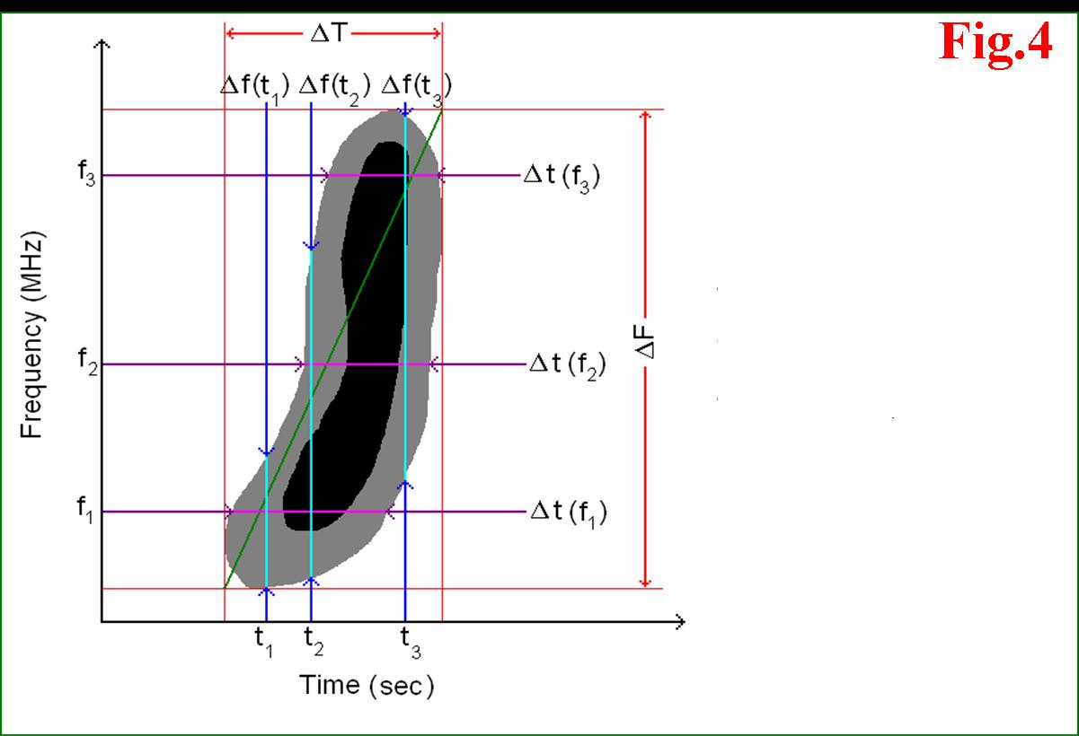
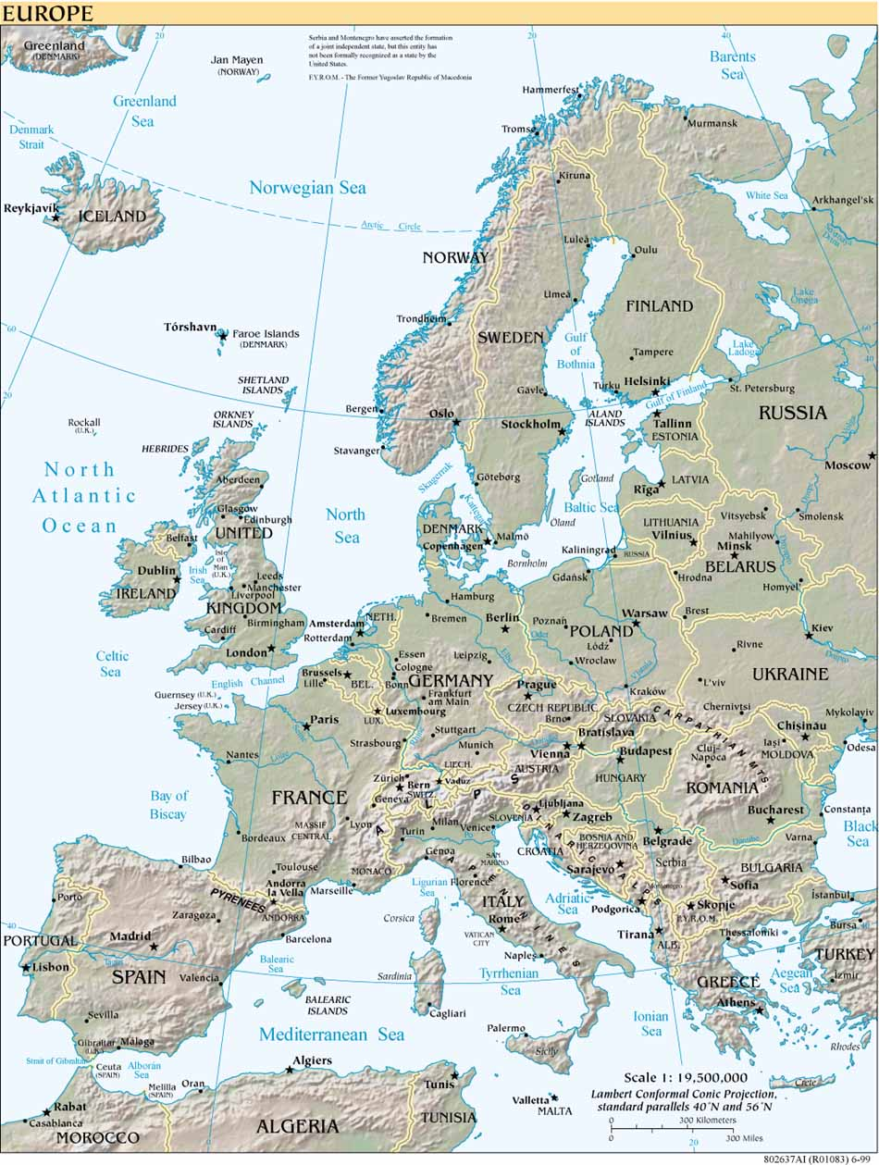
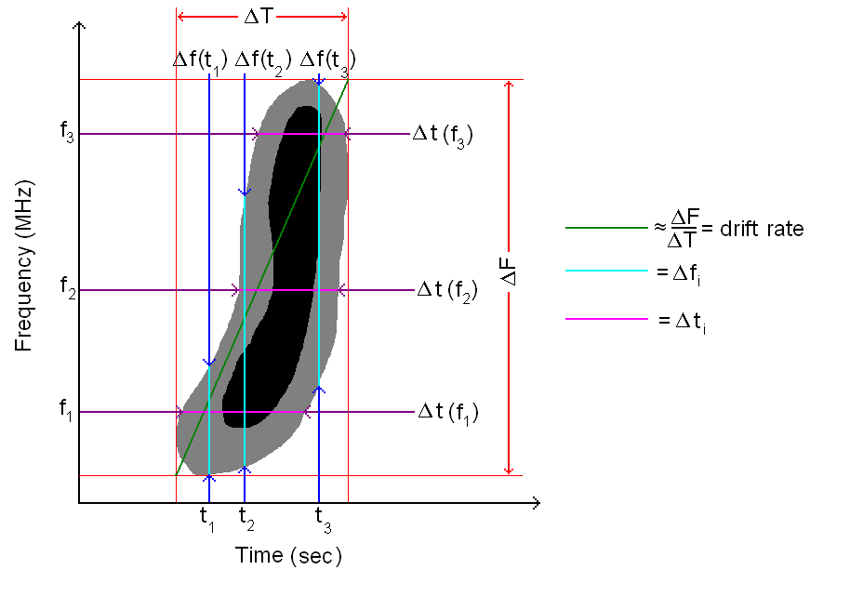
Spectral method
ΔT is the time duration (sec)
    ΔF is the frequency bandwidth (MHz)
    ΔF / ΔT is the drift rate (MHz/sec)
    Δti is the fixed frequency duration (sec)
    Δfi is the instantaneous bandwidth (MHz)
Fig.1
Fig.1
Fig.1
Fig.1
Fig.1
•
•
•
•
•
•
•
•
•
•
•
Nançay Decameter Array (France)
47° N, 2° E
Right- and left-hand circular
polarisations
Frequency range: 10 MHz – 80 MHz
•
•
•
Nançay Decameter Array (France)
47° N, 2° E
Right- and left-hand circular
polarisations
Frequency range: 10 MHz – 80 MHz
•
•
Nançay Decameter Array (France)
47° N, 2° E
Right- and left-hand circular
polarisations
Frequency range: 10 MHz – 80 MHz
•
•
Nançay Decameter Array (France)
47° N, 2° E
Right- and left-hand circular
polarisations
Frequency range: 10 MHz – 80 MHz
•
•
Nançay Decameter Array (France)
47° N, 2° E
Right- and left-hand circular
polarisations
Frequency range: 10 MHz – 80 MHz
Fig.4
Fig.4
Fig.4
Fig.4

Slide 4
Spectral method
Type III burst
5 MHz
25 kHz
0.3 sec
5 ms
Classic Method
Spectral Method

Slide 5
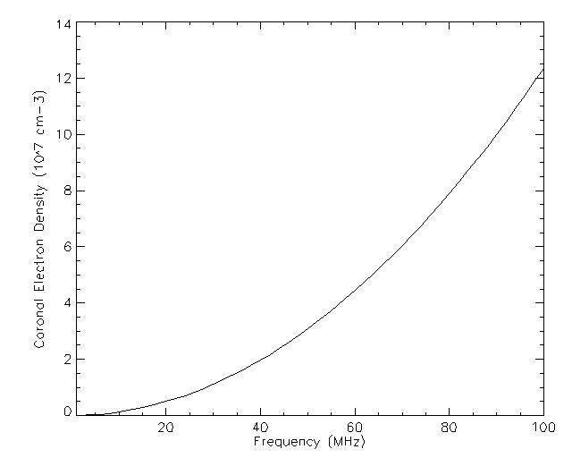
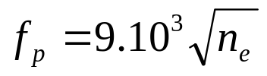
Solar Type III frequency drift rates
Spectral method
a) Decametric frequency range:
+ the electron density
b) Observations of Solar Type III bursts at Lustbühel radio station in the end of year 2000.
c) Digital Spectro-Polarimeter:
+ 12.5 kHz and 50 ms
+ Freq. Bandwidth: 32 – 45 MHz
Decametric frequency range (DAM)

Slide 6
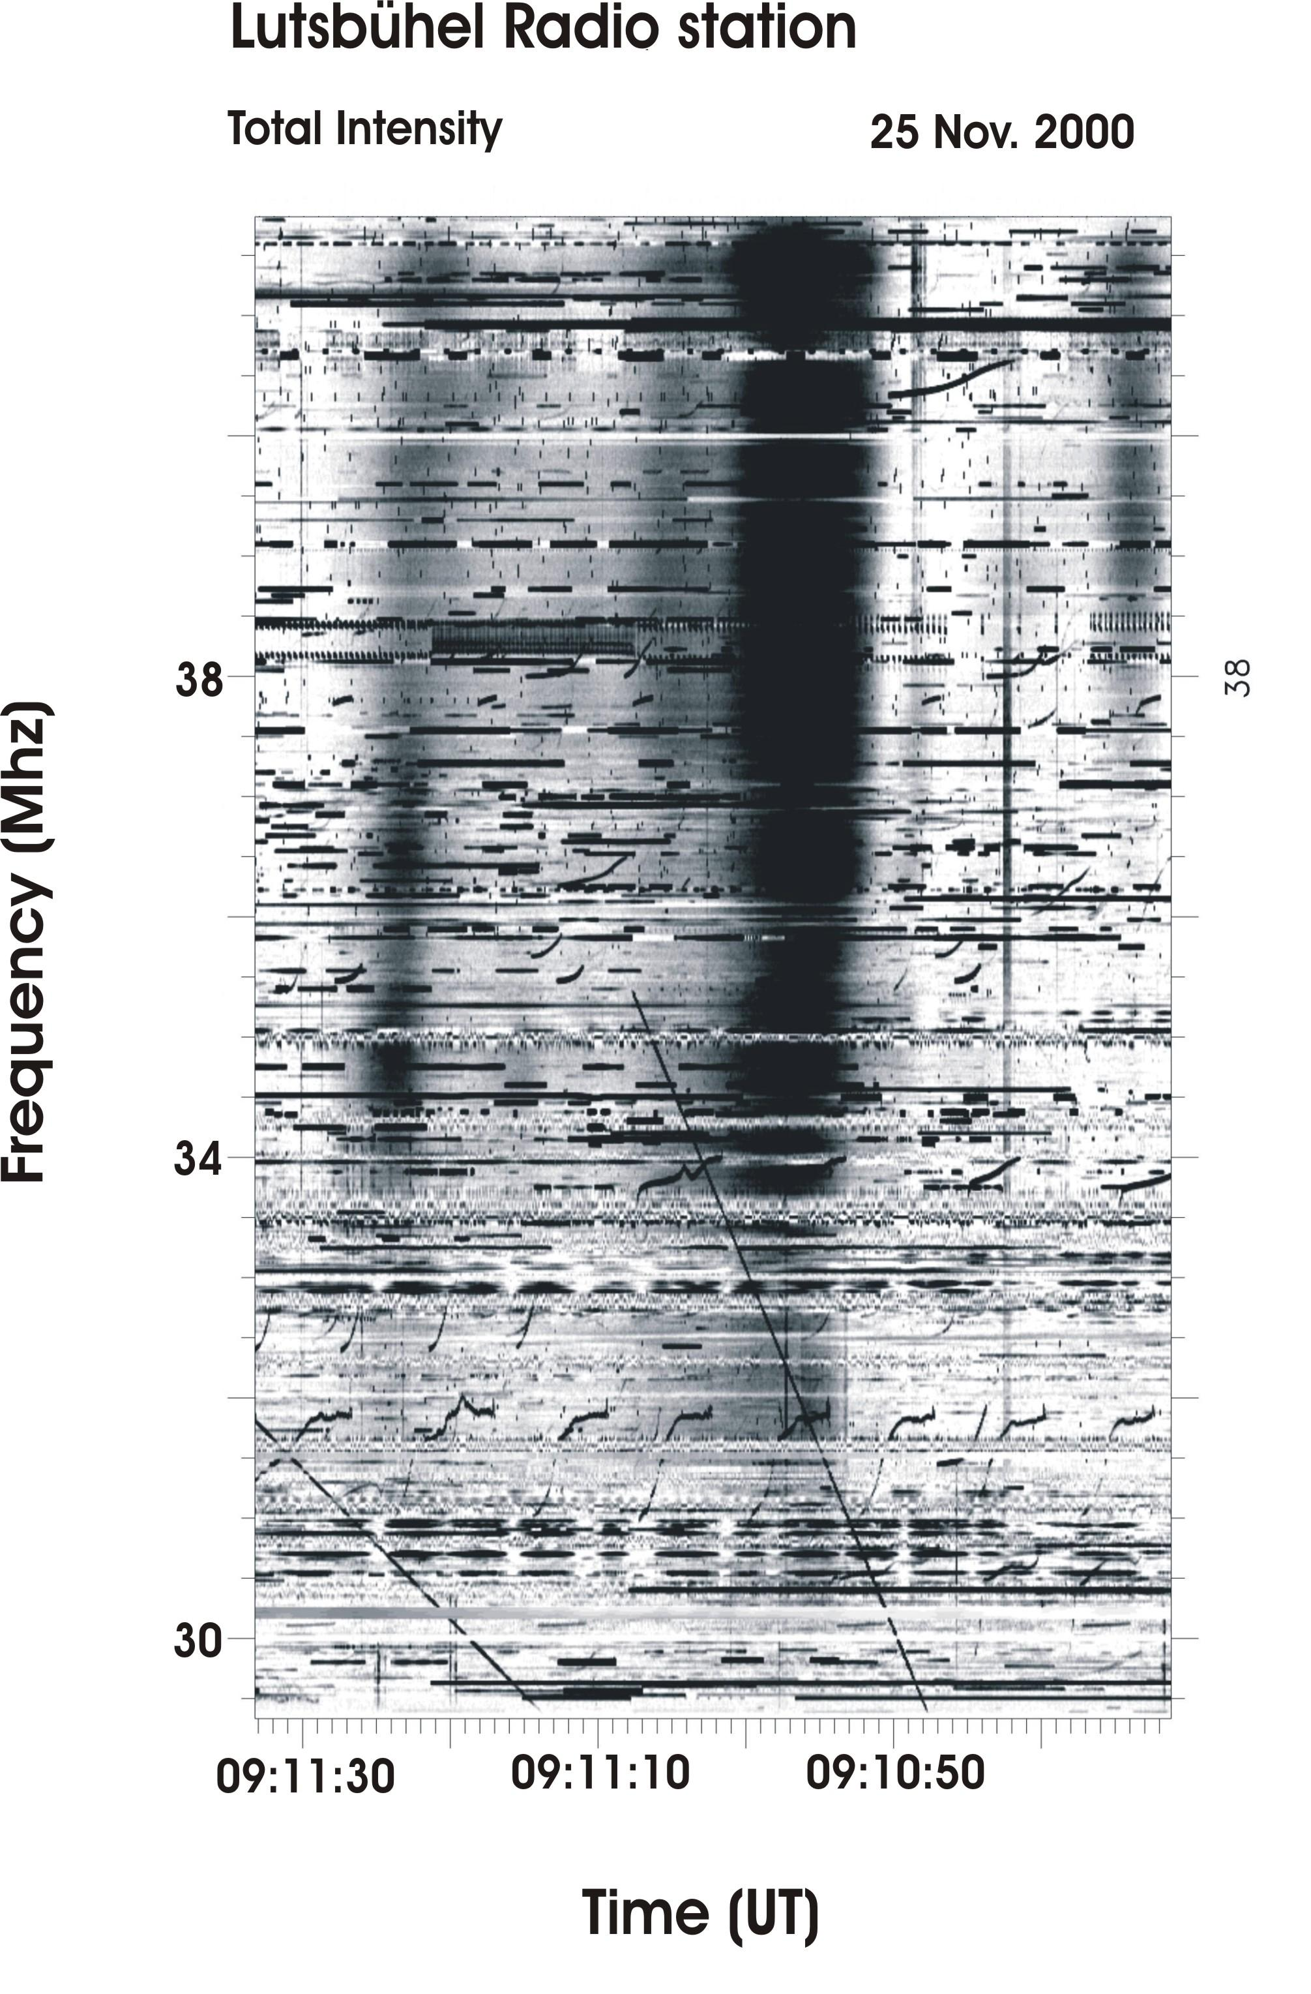
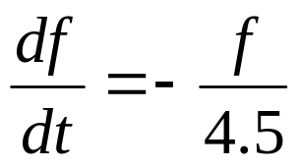
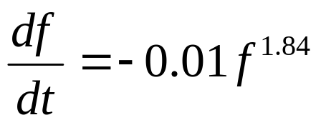
Solar Type III frequency drift rates
a) On the dynamic spectrum:
+ intense band of emission
+ frequency drift rate of about ~ 100 MHz/s
b) Model of drift rates versus frequency:
+ Wild (1950)
+ Alvarez & Haddock (1973)

Slide 7
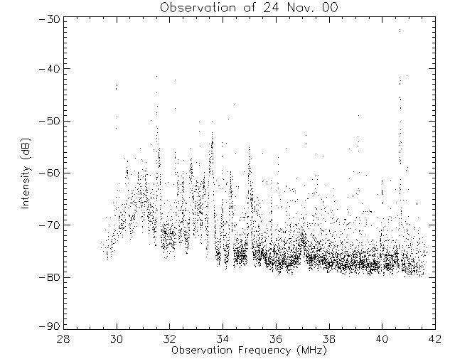
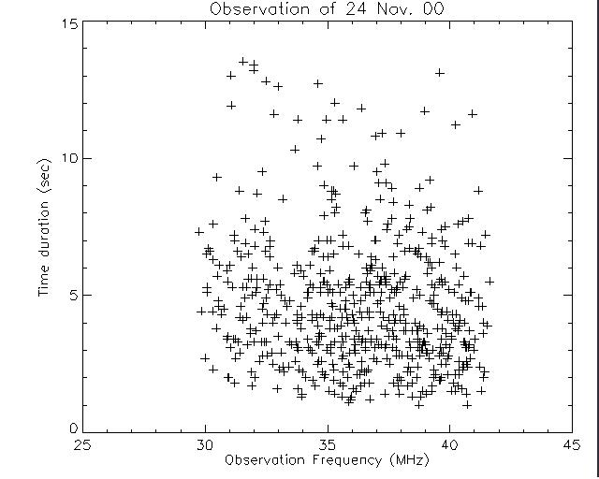
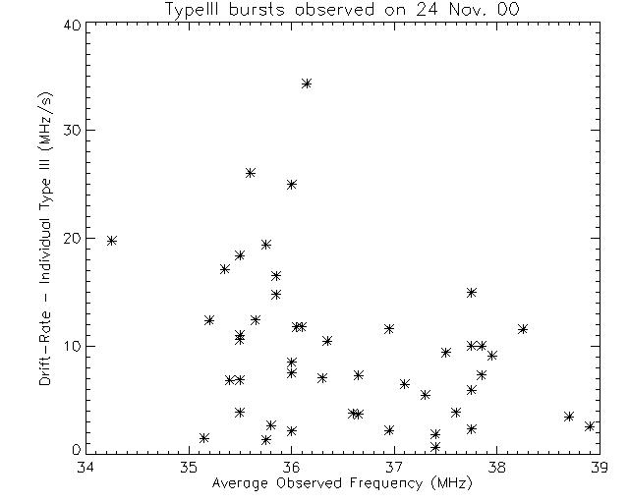
Statistical studies
Flux density
Time duration
Frequency drift rate
Energy distribution function
Time travel of electrons through the
Solar corona layers
Electron density in the upper part
of the Solar corona

Slide 8
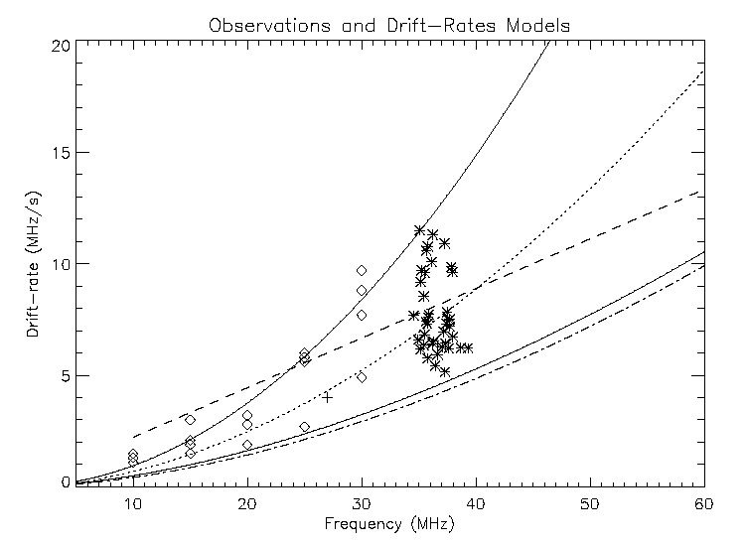
Type III frequency drift rate
Empirical models
1. Model of Wild - 1950 (dashed line)
2. Model of Alvarez&Haddock - 1973
(dotted line)
3. Model of Man - 1996
(dotted-dashed line)
Decametric observations
1. Boischot – 1967 (symbol ◊)
2. Riihimaa – 1967 (symbol +)
2. Boudjada et al. – 2004 (symbol *)

Slide 9
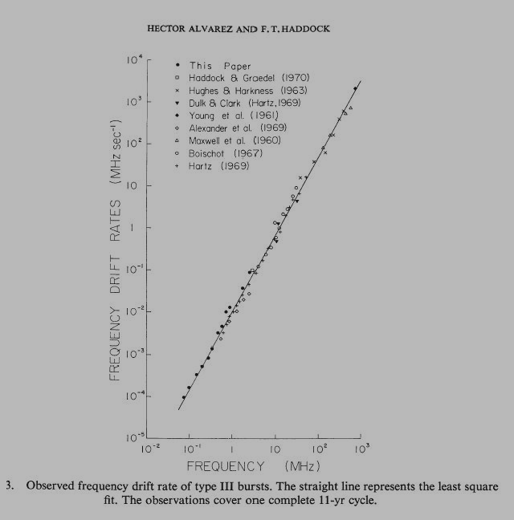
Type III frequency drift rate
Alvarez&Haddock model (1973)

Slide 10
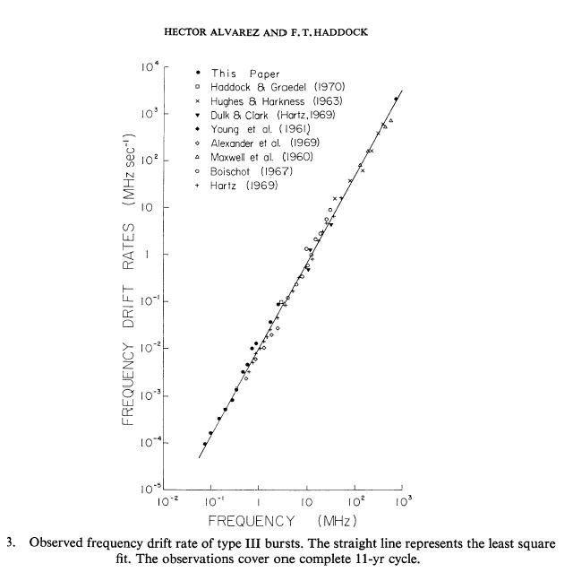
Type III frequency drift rate
Macro-scale
Micro-scale

Slide 11
Remote sensing of the Solar Corona
Decametric observations
Wavelengths
hectometric – kilometric
Wavelengths
metric – dm – cm - mm
Interplanetary Medium
Lower Solar Corona
Solar Wind
Chromosphere
Photosphere

