Slide 1


Review of Solar decametric studies in the frame of the Solar Orbiter mission
M.Y. Boudjada, G. Fischer, H.O. Rucker
Space Research Institute, Austrian Academy of Sciences, Graz, Austria

Slide 2
Solar decametric (DAM) emissions
Solar DAM emissions are part of the large radio
spectrum of the Sun
Covers the frequency range from 80 MHz down to 3 MHz
(wavelength from 3 meters to about 100 meters)
Solar DAM emissions are generated at radial height of about
2.2 to 12.5 Solar radius which corresponds to the frequency
from ~ 43 MHz to 0.9 MHz

Slide 3
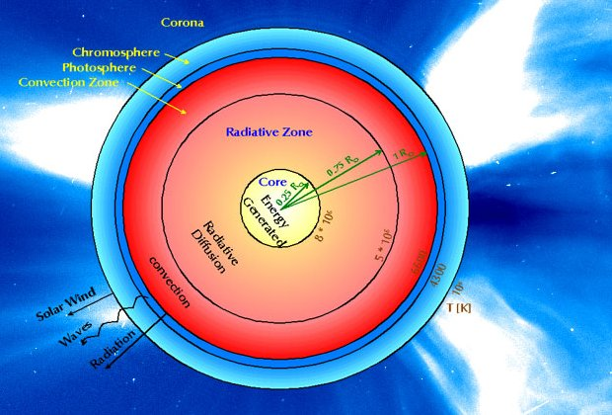
Solar DAM emissions

Slide 4
Solar DAM emissions
DAM main radiotelescopes
Southern Hemisphere
Culgoora radioheliograph (1950 - 1982):
  Discover the main Solar bursts: Type I, Type II,
  TypeIII (40 MHz – 70 MHz)
  Systematic observations in 1967
  Different types of receiver: radiometer,
  spectro-polarimeter, and acousto-optic radiospectrograph
  Frequency/time resolution of 2 kHz/20 ms
  Analog observations and fixed frequency
  Famous scientist: Wild, Dulk, Suzuki, Melrose

Slide 5
Solar DAM emissions
Northern Hemisphere
Oulu Radio observatory (1965 - 1970):
  Type III observed during the night period
  Different types of receiver: spectro-polarimeter, and
  acousto-optic radiospectrograph (6 MHz – 30 MHz)
  Analog observations and fixed frequency
  Famous scientist: Riihimaa
Potsdam Radio telescope (1966 - ):
  Different types of receiver: spectro-polarimeter
  (40 MHz ~ more than 200 MHz)
  Famous scientist: Aurass, Krüger, Mann

Slide 6
Solar DAM emissions
Northern Hemisphere
Kharkov Radiotelescope (1970 - ):
  Largest decametric radiotelescope (150 000 m²)
  Multi-channel receivers
  Famous scientist: Abranin, Bazelyan, Mel’nik
Nançay Decametric Array (1970 - ):
  Polarisation studies of the Solar bursts
  Large frequency bandwidth: 10 – 70 MHz
  Famous scientist: Boischot, Leblanc, Aubier

Slide 7
Solar DAM emissions
Actual decametric observations
Coverage of the lower frequency:
  Potsdam: minimum frequency over 40 MHz
  Kharkov radiotelescope: 8 – 10 MHz
  Nancay Decametric Array: 20 MHz
Main limitations at low frequency are due to:
  Artificial man-made interferences
  Ionospheric cutoff

Slide 8
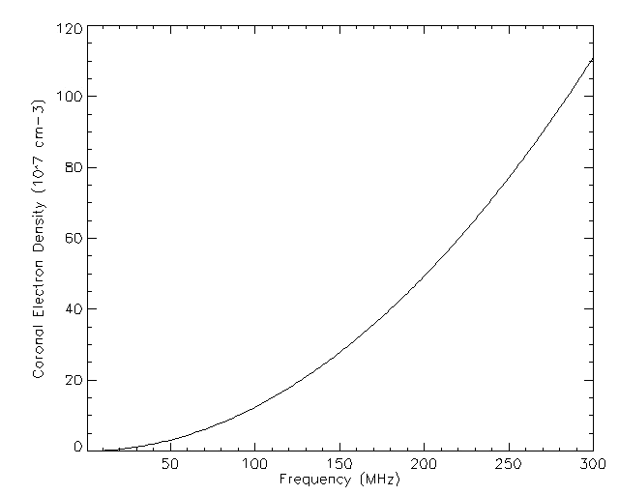
Solar DAM emissions
Metric (MET)
Decametric (DAM)
Hectometric (HOM)

Slide 9




Solar Orbiter Experiments
In Situ Instruments
Remote sensing Instruments

Slide 10
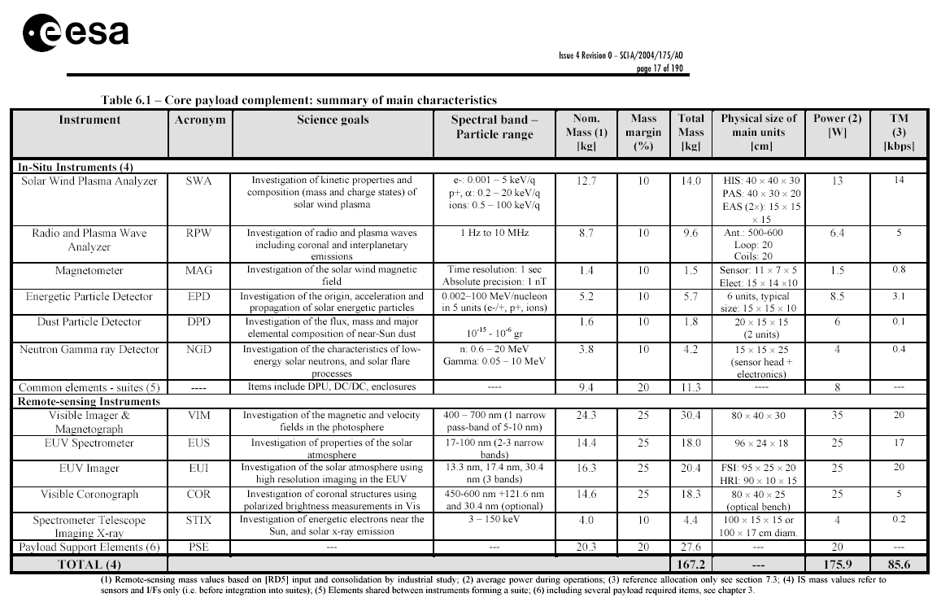

Slide 11
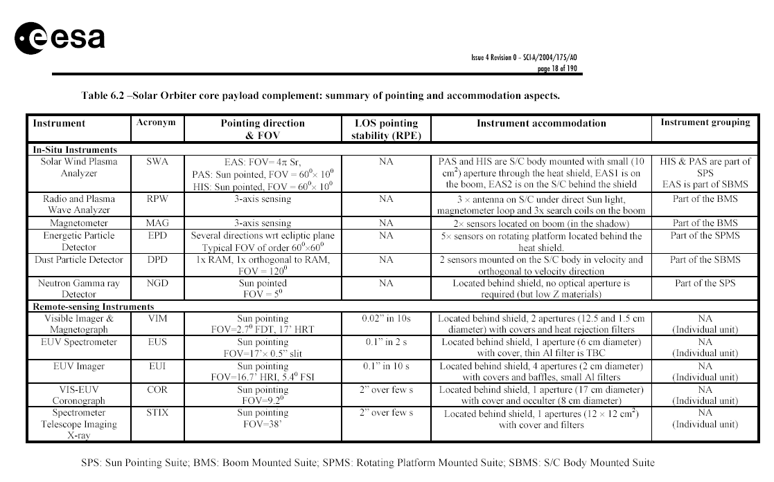

Slide 12
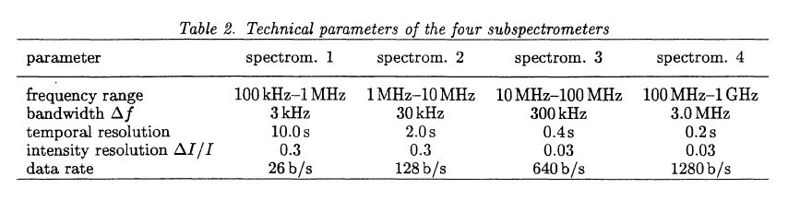
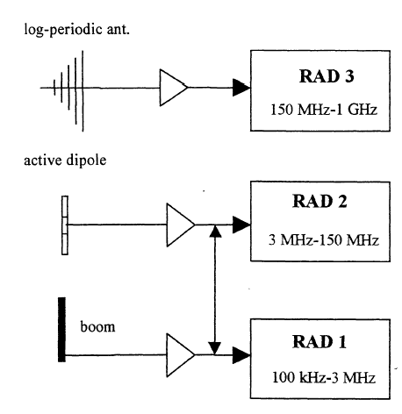
Mann et al., 2001
Rucker et al., 2001

Slide 13
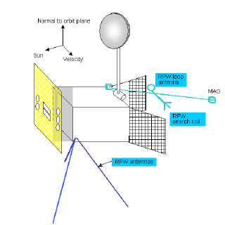
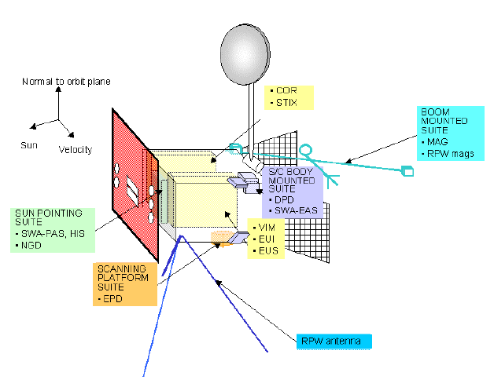

Slide 14
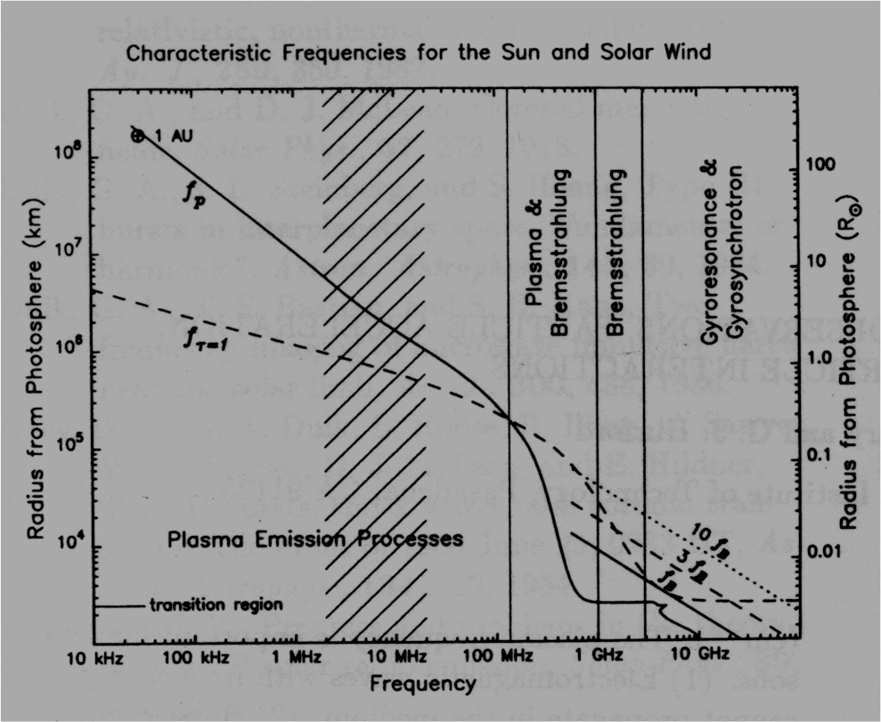
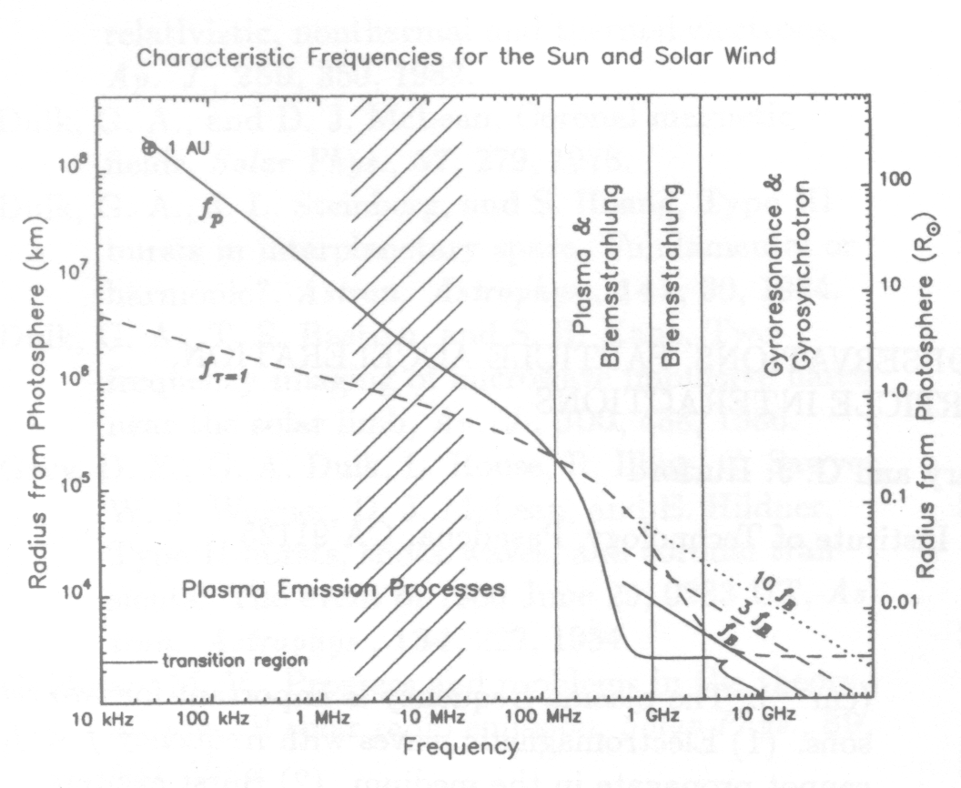
Solar DAM emissions
Hatching area from 2 to 22 MHz marks an observational gap. This gap is covering the height range of few solar radii
(Gary and Hurford, 1989).

Slide 15
Solar DAM emissions
Solar Orbiter mission should feel the gap due to
Observation conditions on the Earth
Decametric observations (10 – 40 MHz):
  Study of the Solar corona
  Key region between the interplanetary medium and the
  deeper dense area of the Solar corona
  Relationship between the Solar Wind and Solar corona

Slide 16
Solar DAM emissions
Adaptation of the frequency bands of the receiver to the
physical requirements
Position and orientation of the antennas to optimize scientific
gain with regard to:
    Direction finding
    Polarization and spectral observation
Application of methods for the determination of antenna
properties: accurate evaluation of observational data

