Slide 1
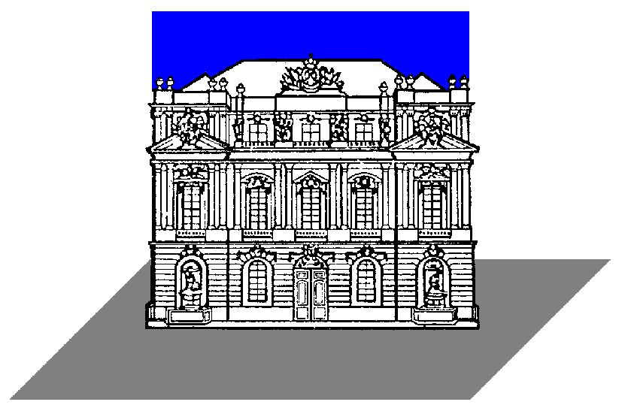

The STEREO/WAVES antenna calibration
Results, comparison and discussion of the numerical and experimental method
Oswald, T.H. (1), W. Macher (1), G. Fischer (1), H.O. Rucker (1), A. Lecacheux (2), J.L. Bougeret (2), M.L. Kaiser (3), K. Goetz (4)
IWF/OEAW thomas.oswald@oeaw.ac.at
Observatoire de Paris-Meudon, France
NASA/GSFC Greenbelt, MD, USA
University of Minnesota, USA

Slide 2
The STEREO mission
Two spacecraft, one ahead and one behind earth,slowly drifting apart at a rate of 22 degrees by year
To extend our knowledge about the physics of the solar system
Research on space weather, CMEs and sun-earth-connection (SEC)
For the first time stereoscopic methods are used which include remote and insitu measurements of the same events

Slide 3
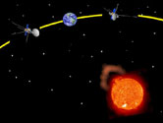
The STEREO mission

Slide 4
SWAVES
Measures electric fields
Frequency 40kHz-16MHz
Measures electron density and temperature with quasi thermal noise analysis
3 orthogonal monopole-stacer-antennas, directed away from the sun, 6m length
“Direction Finding” (DF) mode provides all auto- and cross correlation parameters
2 spacecraft render it possible to pinpoint the source of the EM radiation via triangulation
The equipment on the 2 s/c will track those radio sources from less than 2 R_{S} to 1AU and beyond

Slide 5
Why is antenna calibration necessary ?
To perform “Direction Finding”(DF), antenna properties must be known to a high degree of accuracy
The receiving properties can be quantified by the effective length vector
The effective length vector represents the antenna as it behaves electrically
It is influenced by the geometry of the spacecraft
Depends, in general, upon frequency and direction of incidence and is a complex vector, but at low frequency it can be treated as a constant real vector
In this quasistatic range, DF is possible

Slide 6
Methods to determine the effective length vector
Numerical electromagnetic code
Rheometry
The electromagnetic chamber
In-flight Calibration

Slide 7
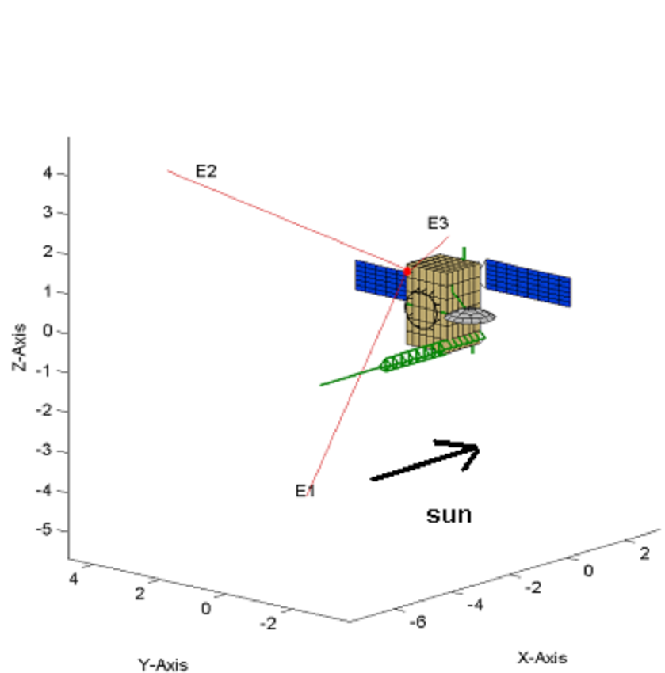
The numerical method

Slide 8
The numerical method
The spacecraft is modelled as a grid of wires
Then the currents along these wires are computed
On base of the current distribution, all other antenna properties (effective length vectors, impedances) can be calculated

Slide 9
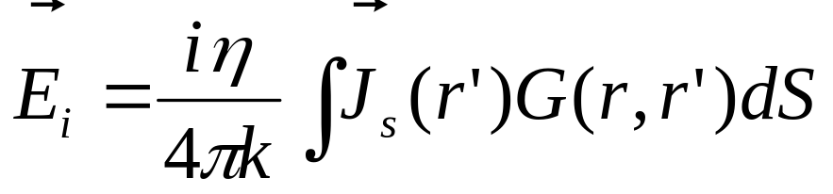
Computation of the current distribution
The equation governing the current distribution is the electric field integral equation (EFIE)
Simplifications:
  Thin currents along the center of the wires
  No transverse currents

Slide 10
The Method of Moments
The Method of Moments (MoM) can be used to solve integral equations
A modified version of the antenna scatterers analysis program (ASAP) is used to calculate the currents

Slide 11
The Matlab toolbox
The effective length vectors and impedances are calculated by the Matlab toolbox created in the space research institute
Calculations were performed for open feeds and capacitances of 90pF

Slide 12
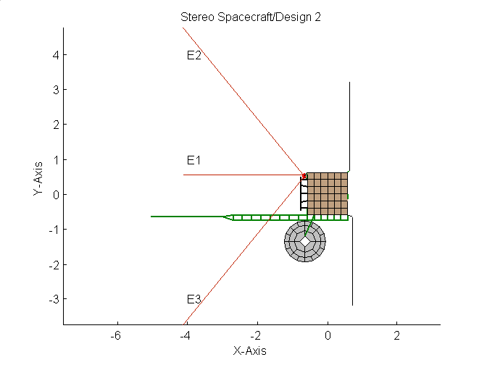
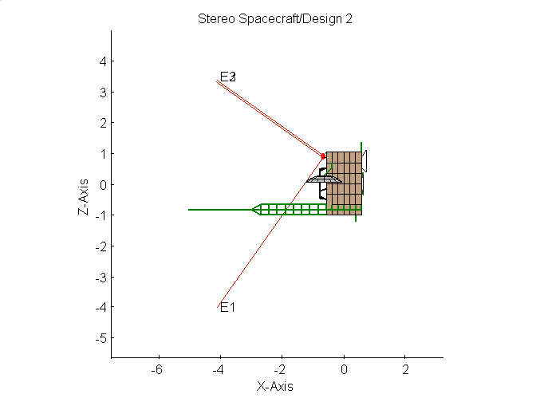
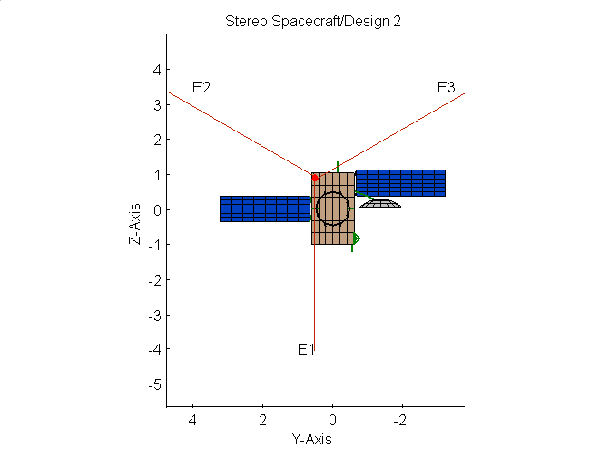
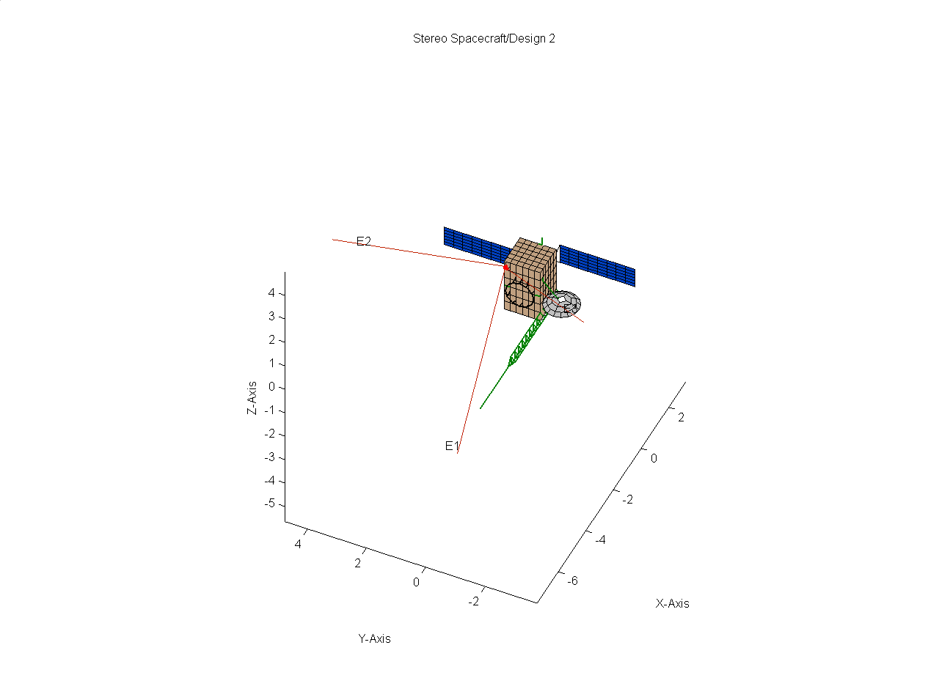
The model
RING

Slide 13
The model
RING
BOOM

Slide 14
The model
RING
BOOM
HGA DISH

Slide 15
The model
RING
BOOM
HGA DISH
SOLAR PANELS

Slide 16
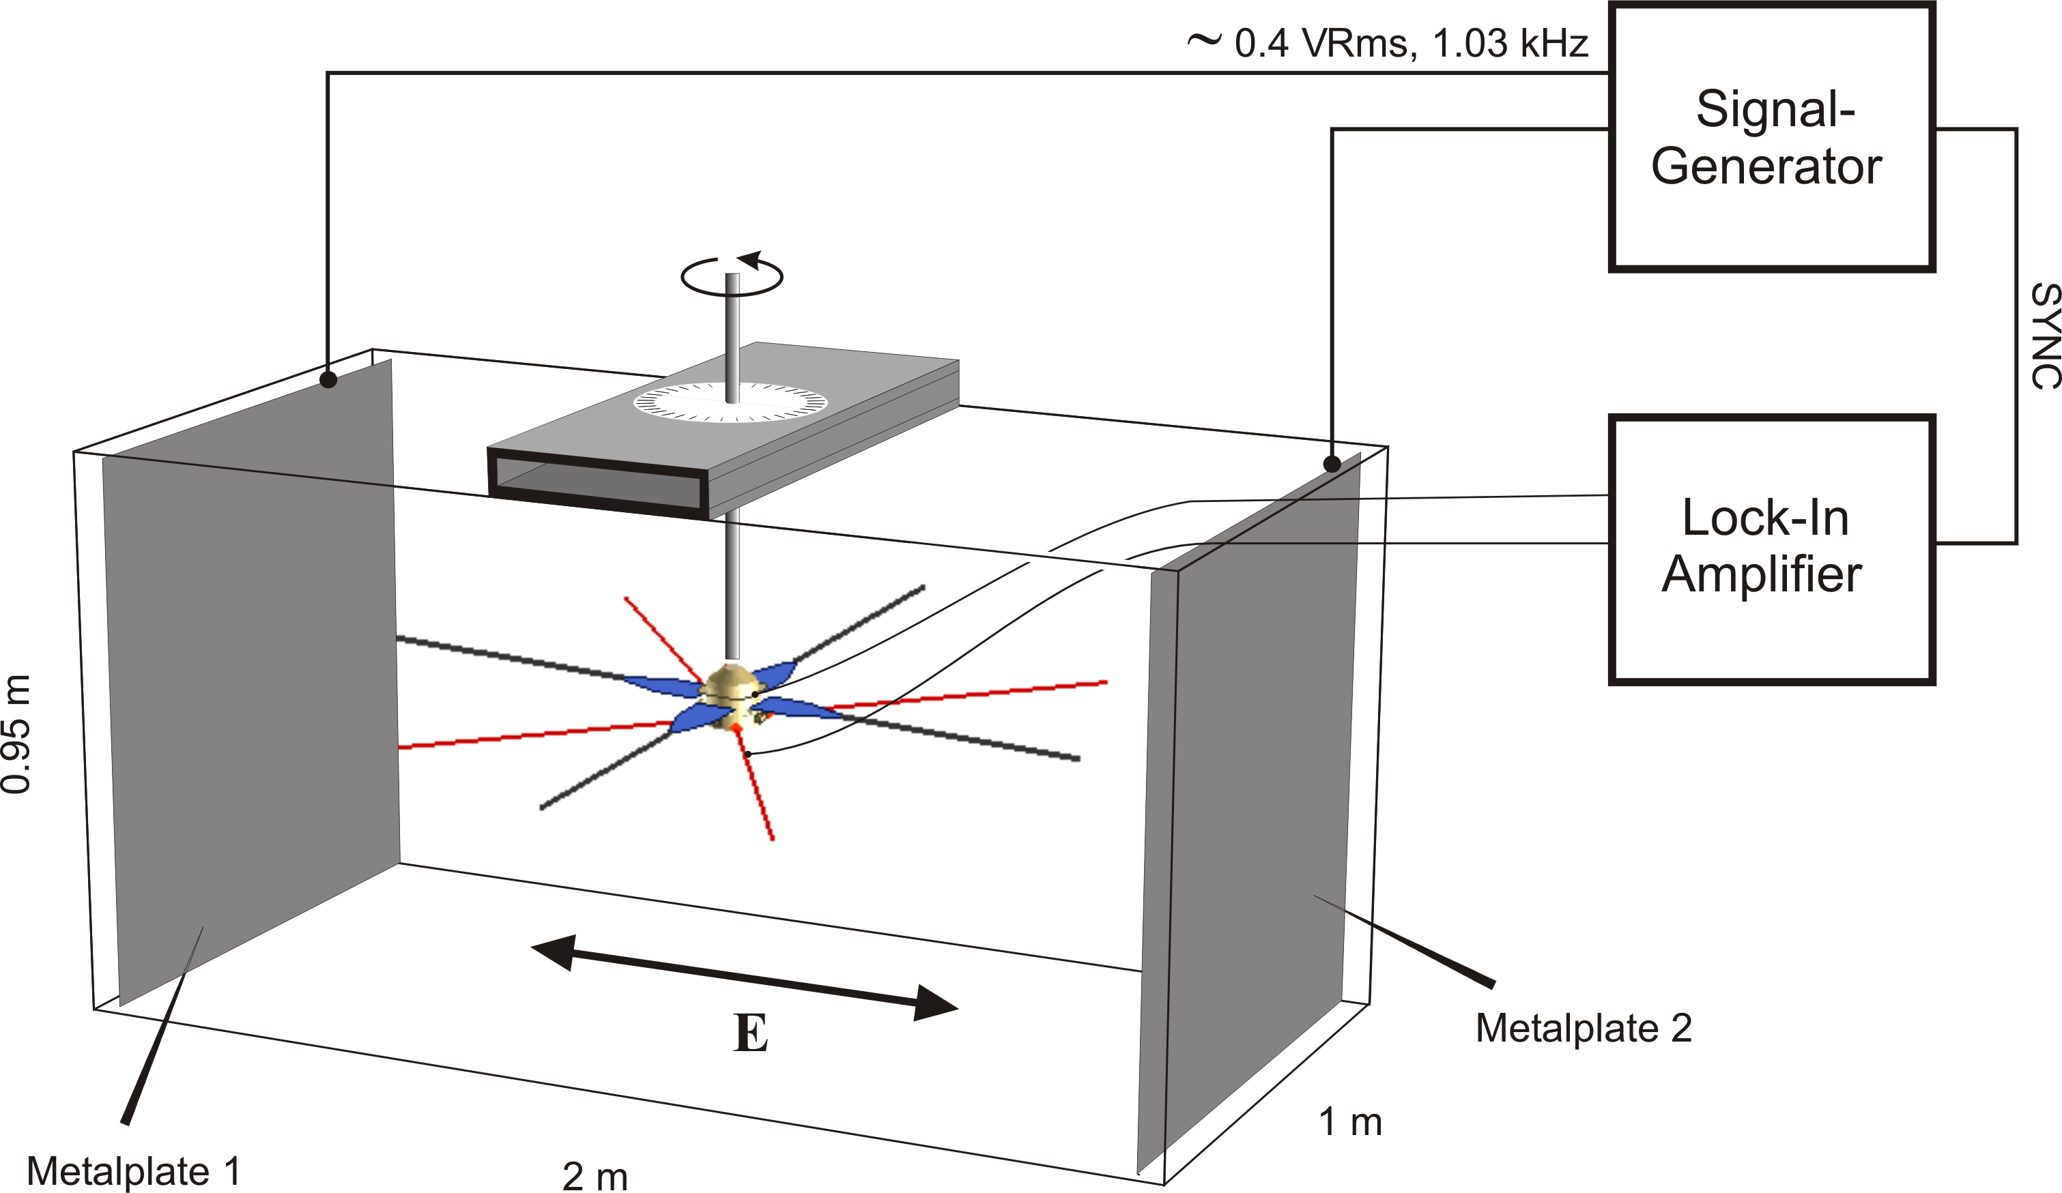
Rheometry

Slide 17
Rheometry
A gold-plated model of the spacecraft is submerged into a water tank
A low-frequency electric field is applied
The response (induced voltage) of the antennas is measured as a function of spacecraft orientation
The effective length vectors and the antenna impedances can be computed from the data
Open feeds are intrinsically included in the method

Slide 18
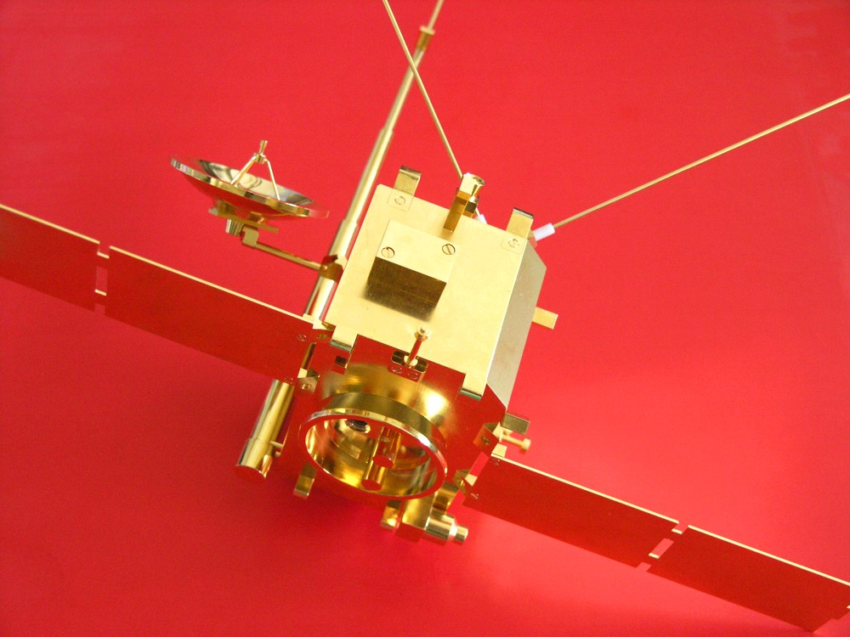
Our model

Slide 19
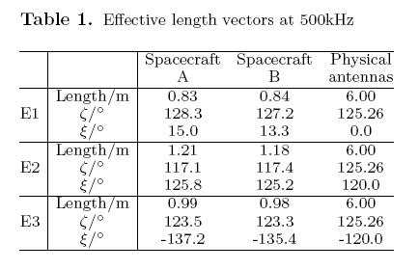
The results

Slide 20
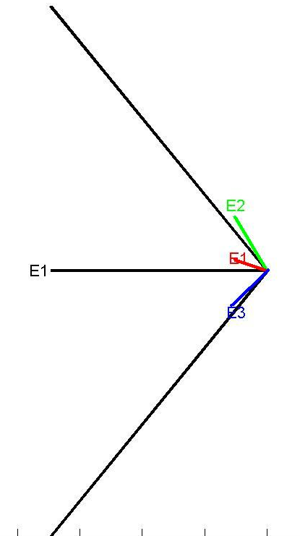
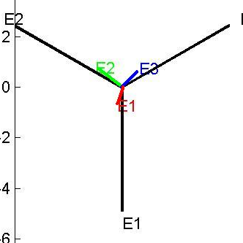
Quasi-static effective length vectors
A
B
S/C A at 500 kHz

Slide 21
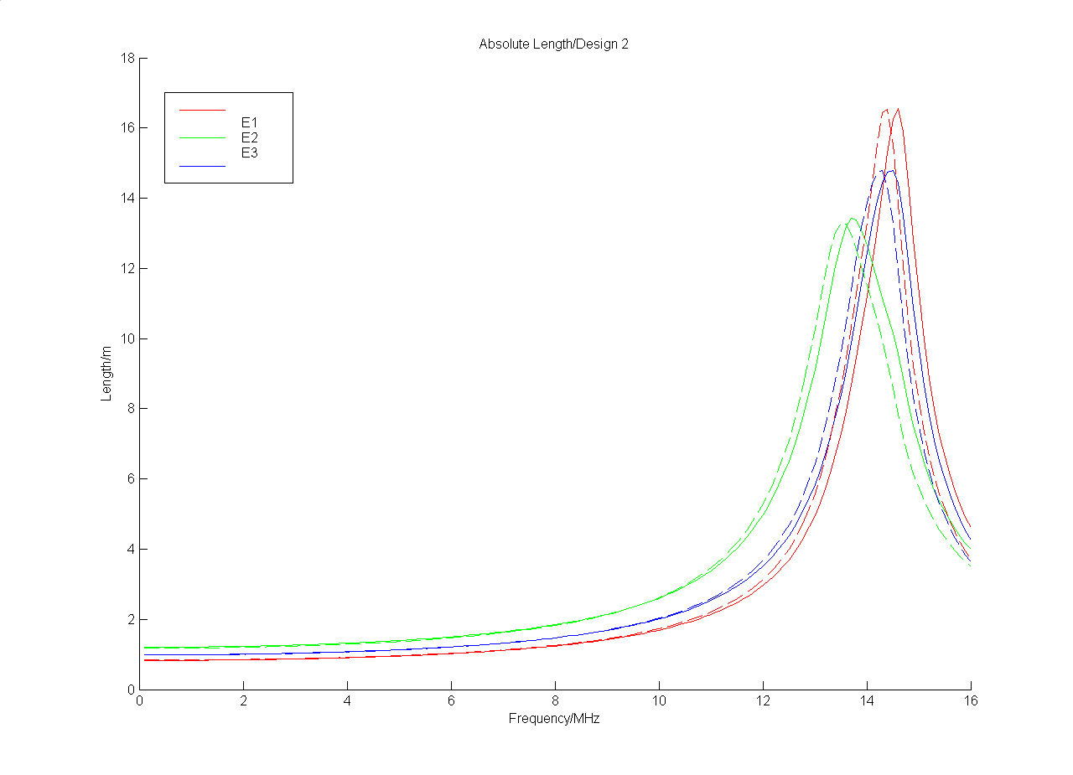
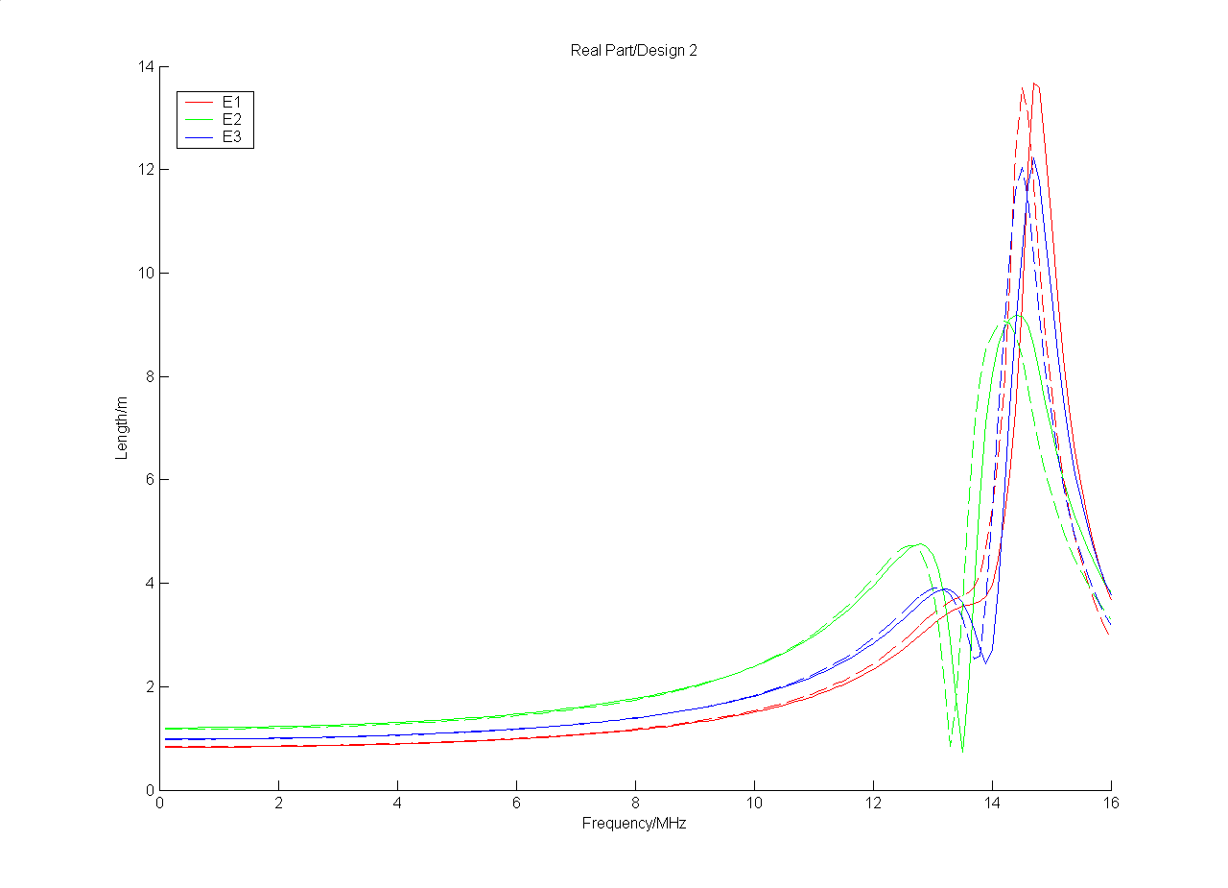
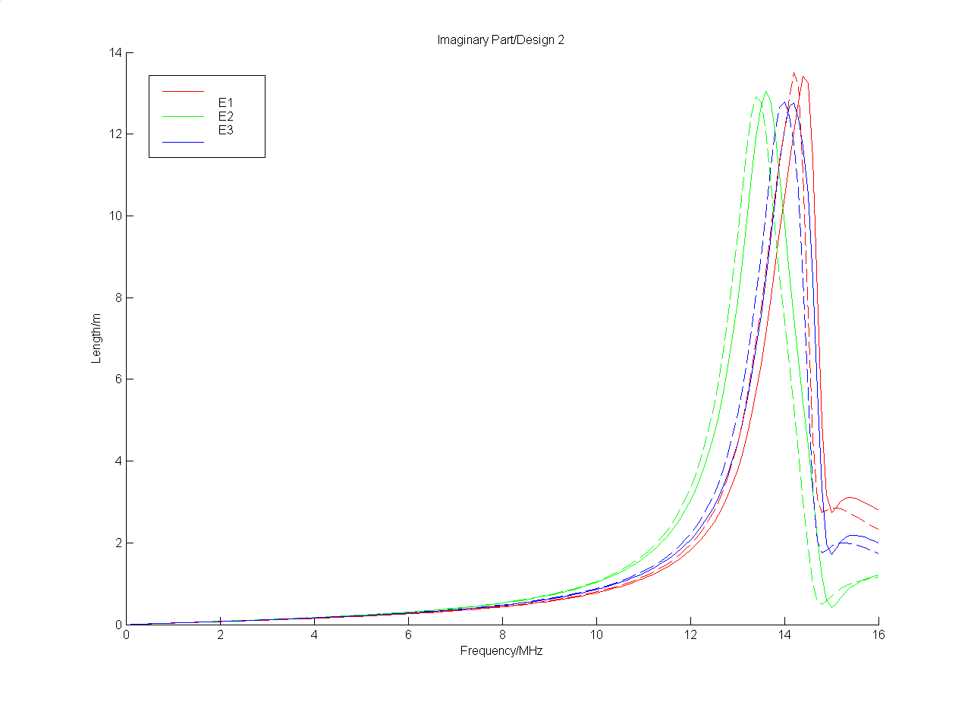
The effective length vector as function of frequency
|h_{eff}|
Frequency/0-16 MHz
Re(h_{eff})
Im(h_{eff})
1. Resonance at 14 MHz
Frequency/0-16 MHz
Frequency/0-16 MHz

Slide 22
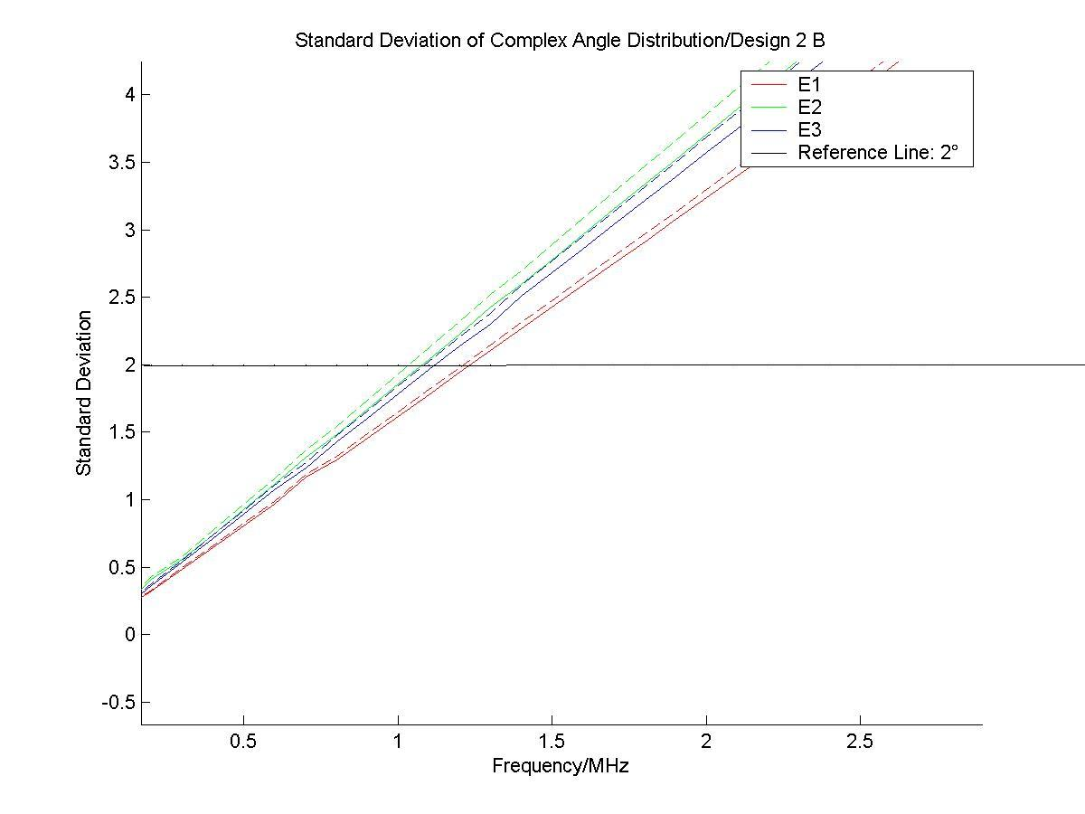
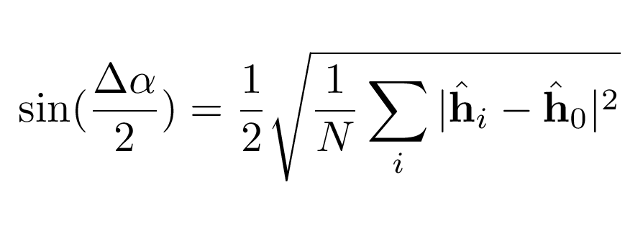
Variation of the direction with frequency
Standard Deviation of Direction angle/°
2 degree reference line
Frequency/MHz

Slide 23
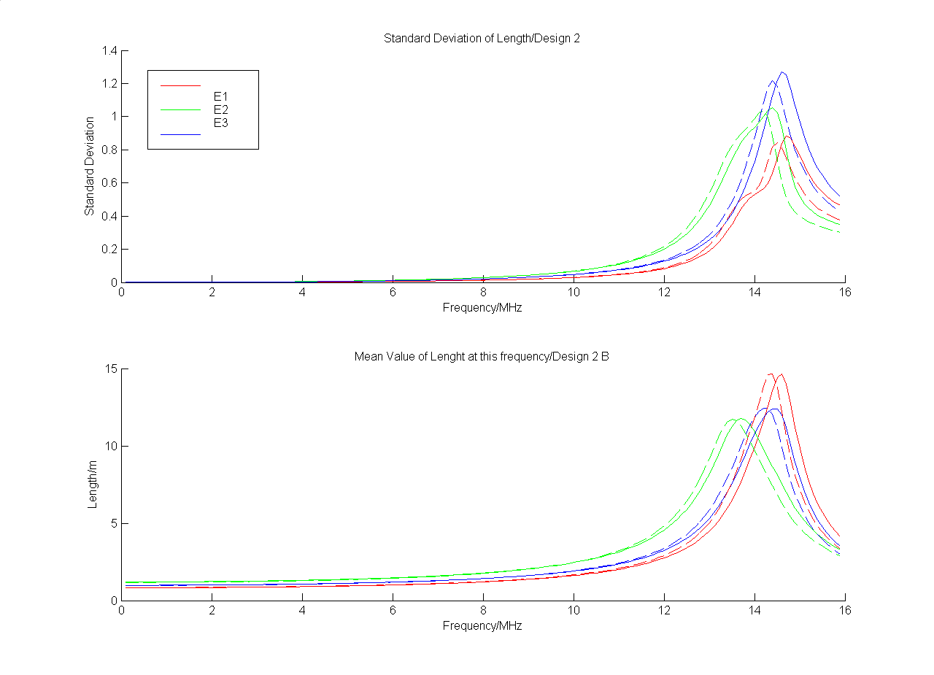
Variation of the length with frequency
Standard Deviation of Magnitude/m
Mean Magnitude/m
Frequency/MHz

Slide 24
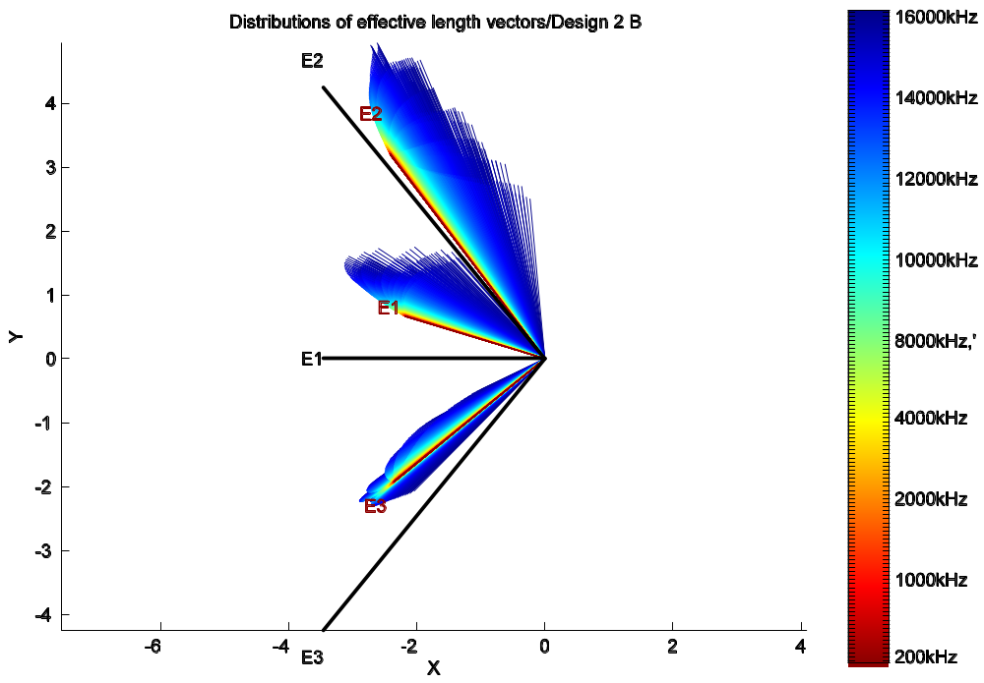
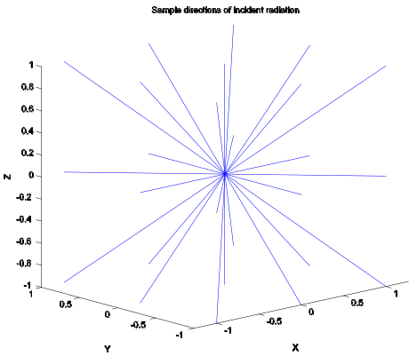
Variation of the length with frequency

Slide 25
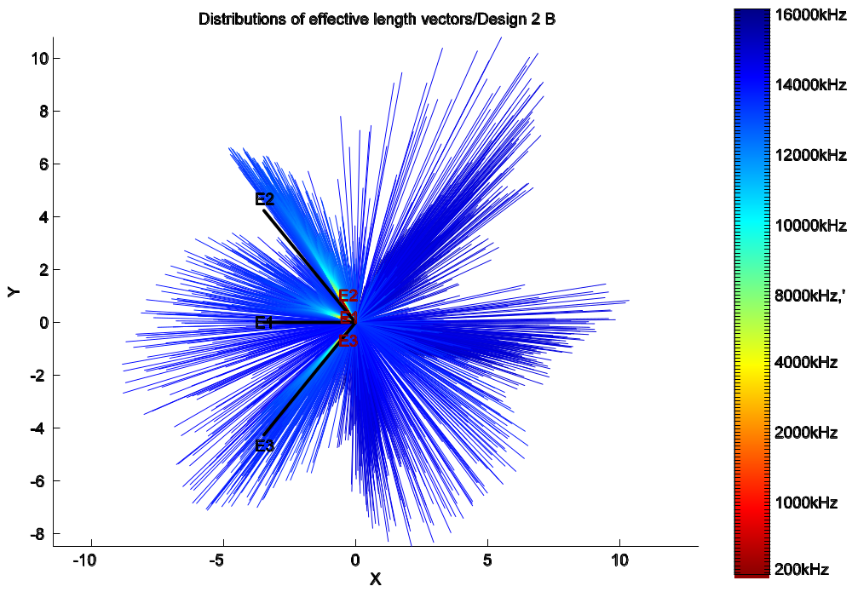
Variation of the length with frequency

Slide 26
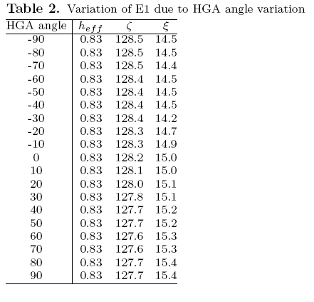
Variation due to the HGA orientation

Slide 27
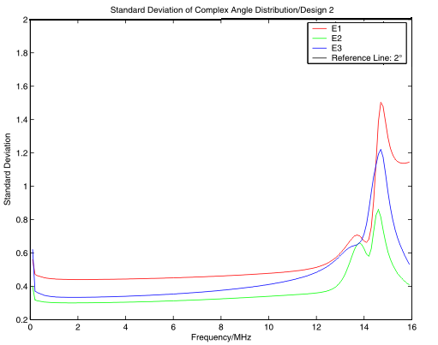
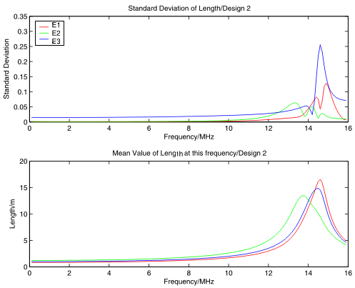
Variation due to the HGA orientation

Slide 28
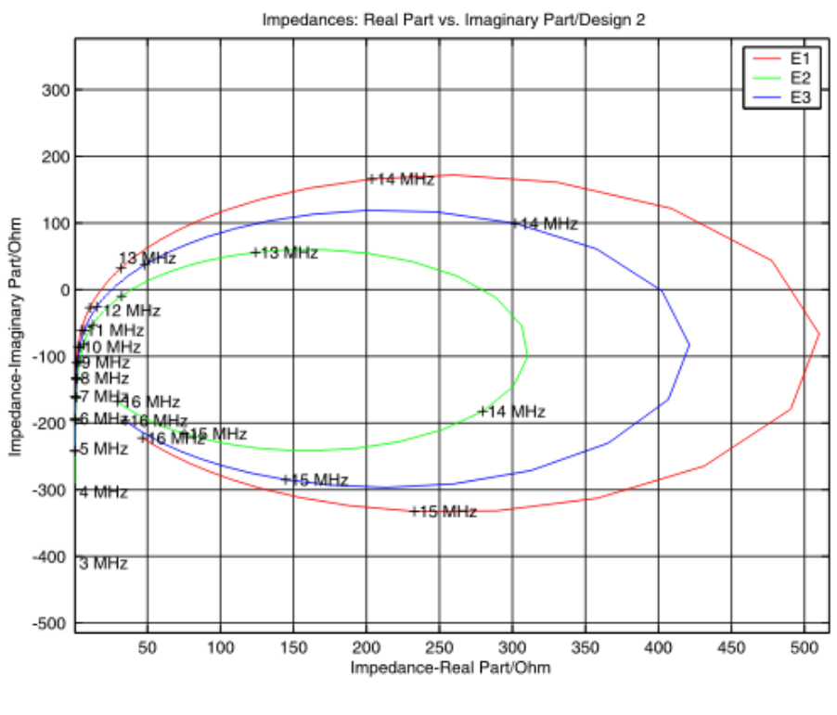
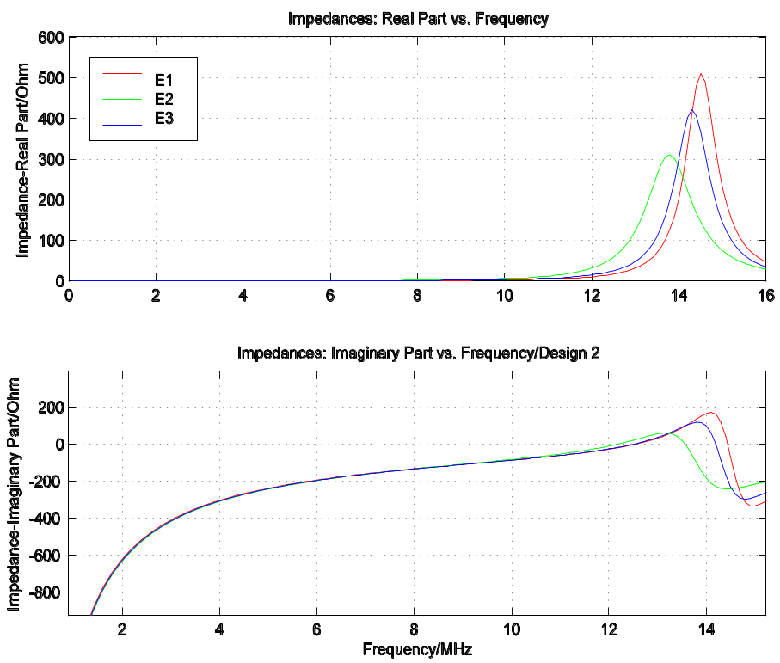
The impedances: Spacecraft A
Re vs. Im
Real part
Imaginary part

Slide 29
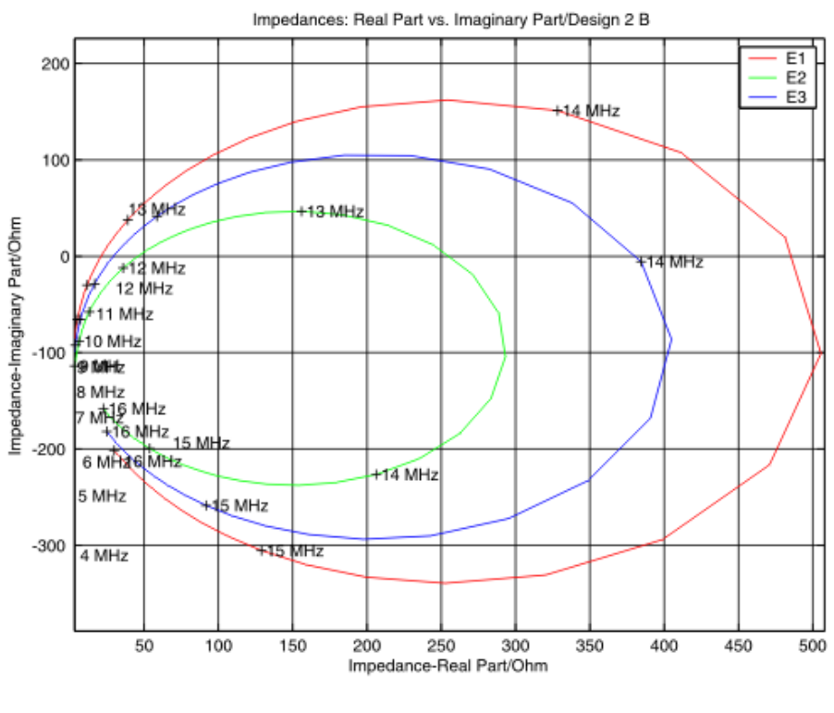
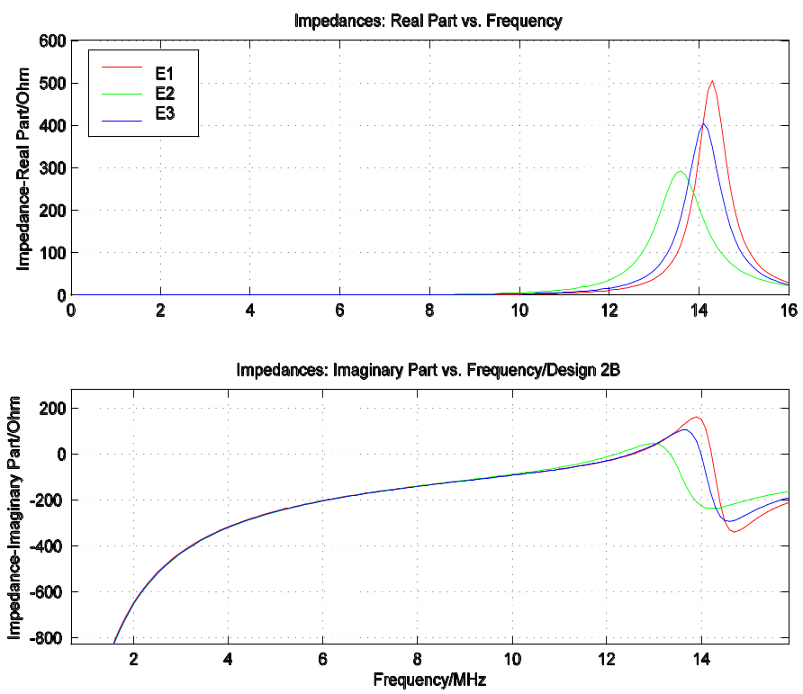
The impedances: Spacecraft B
Re vs. Im
Real part
Imaginary part

Slide 30
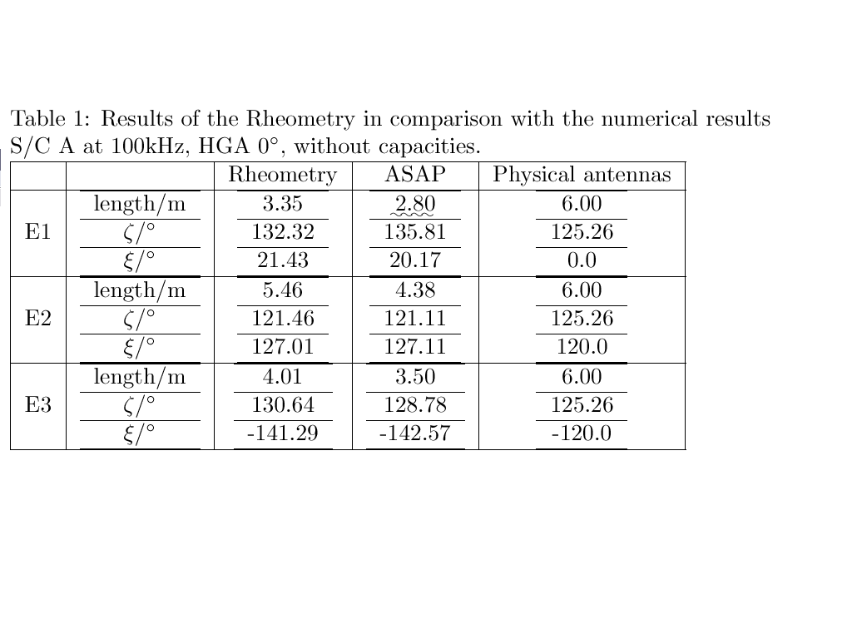
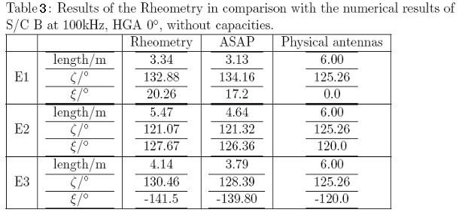
Numerical vs. Experimental approach

Slide 31
Next activities
Compute the impedances from the rheometry data
Use a new electromagnetic code to calculate the current distribution
Use a model made of patches in combination with the MFIE
Include some aspects of the influence of the magnetized plasma

