Slide 1


The STEREO/WAVES antenna calibration
Final Results
Oswald, T.H. (1), W. Macher (1), H.O. Rucker (1), and the SWAVES team
Space Research Institute Graz/Austrian Academy of Sciences thomas.oswald@oeaw.ac.at

Slide 2
STATUS QUO
We finished the ASAP project for the determination of the reception properties of the WAVES antennas on-board the two STEREO spacecraft.
The numerical and experimental procedures are completed
The interpretation of the results and the publication is not yet complete

Slide 3
SWAVES antennas
The Goal: Correct data interpretation
Influence of the spacecraft body
Effective length vectors and impedance- or capacitance matrices
These quantities were determined and analyzed numerically and experimentally
Notes:
Due to the Due to the influence of the spacecraft body, the properties of the antennas are different than those of stand-alone monopoles which point in the same direction
In particular the effective length vectors and impedance- or capacitance matrices are valuable parameters
These quantities were determined and analyzed numerically and experimentally

Slide 4
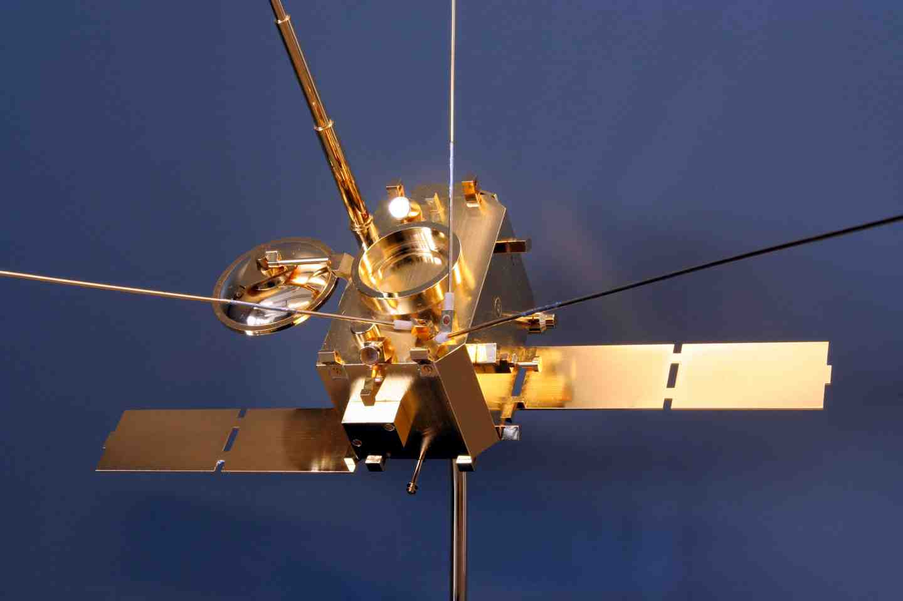
The experimental method :
Rheometry
A gold-plated model of the spacecraft is submerged into a water tank
A low-frequency electric field is applied
The response (induced voltage) of the antennas is measured as a function of spacecraft orientation
The effective length vectors and the antenna impedances can be computed from the data
Rheometry is only applicable to the quasi-static limit

Slide 5
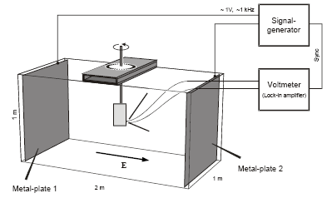
Rheometry

Slide 6
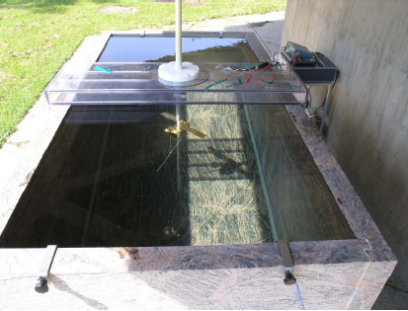
Rheometry

Slide 7
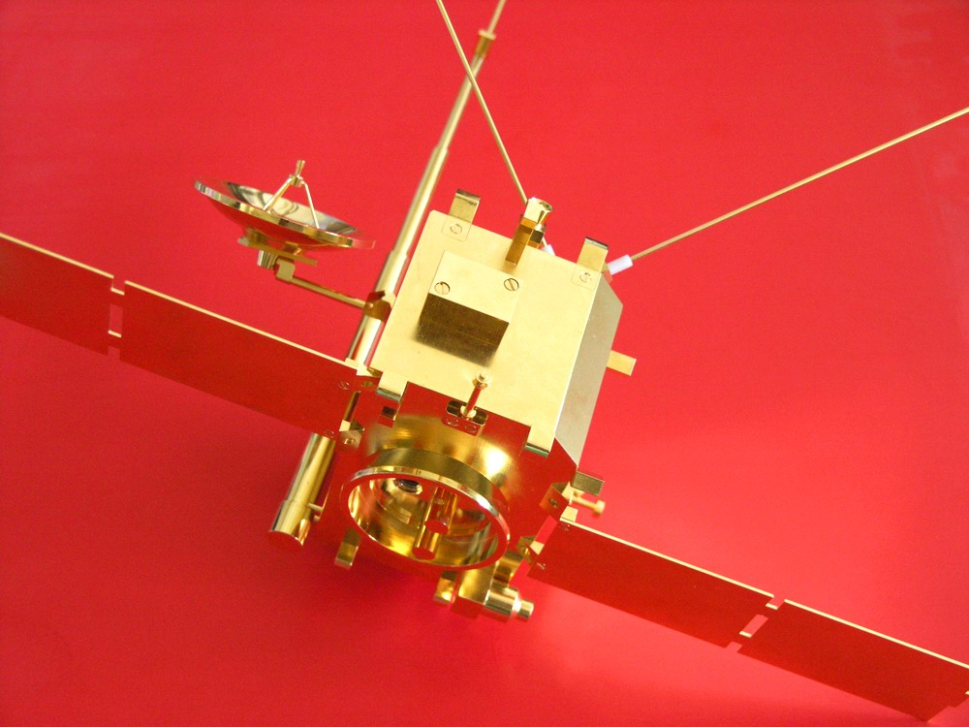
Our model

Slide 8
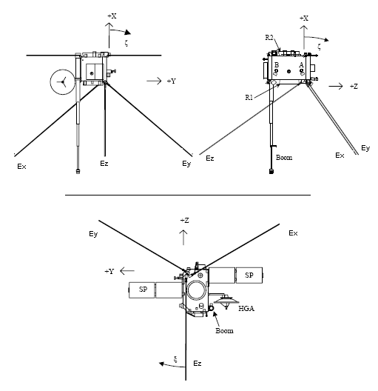

The coordinate system

Slide 9
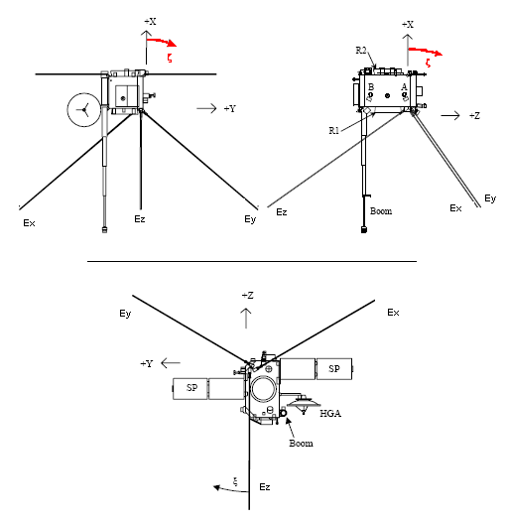
The coordinate system

Slide 10
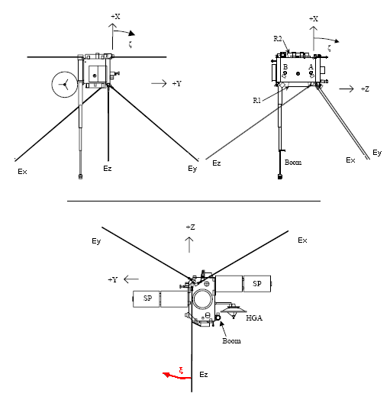
The coordinate system

Slide 11
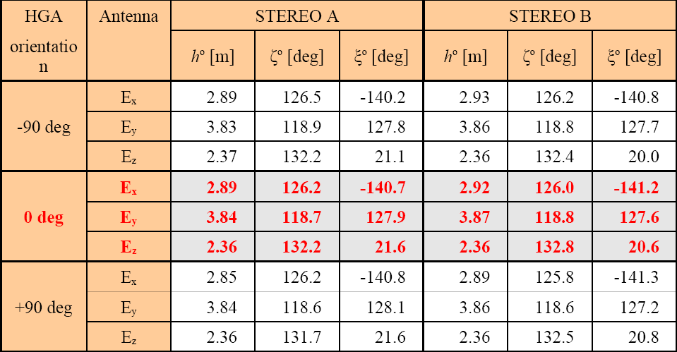
Rheometry results

Slide 12
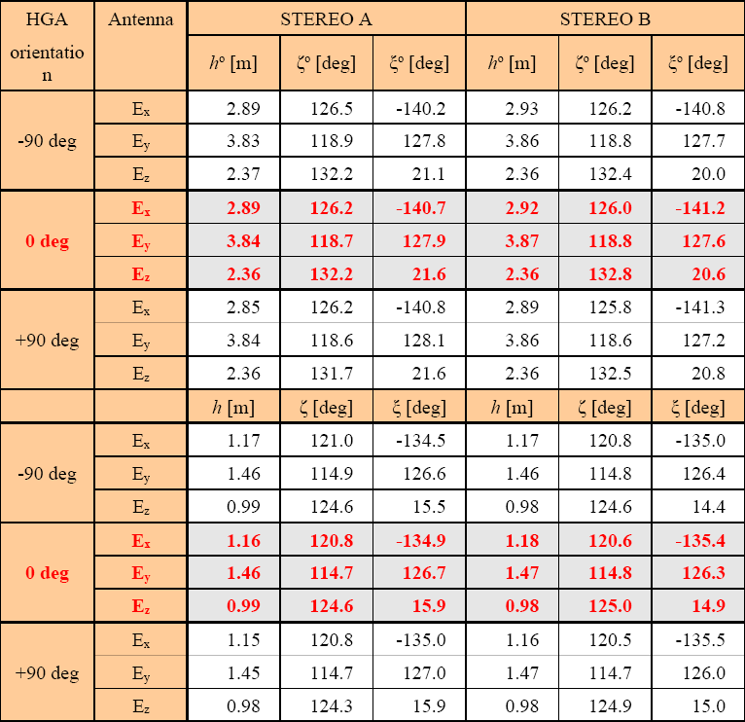
Rheometry results
open feeds
loaded feeds

Slide 13
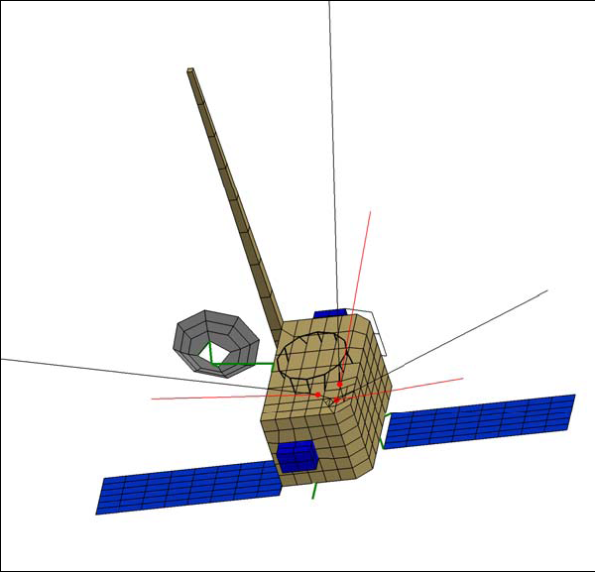
The numerical method

Slide 14
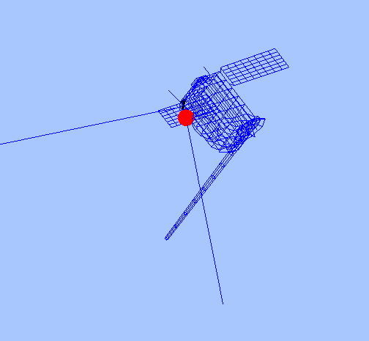
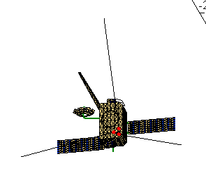
The numerical method

Slide 15
The numerical method
The spacecraft is modeled as a grid of wires or patches
Then the currents along these wires/patches are computed
This calculation is done with ASAP (wires) and CONCEPT II (wires and patches)
On base of the current distribution, all other antenna properties (effective length vectors, impedances) can be calculated with MATLAB routines

Slide 16
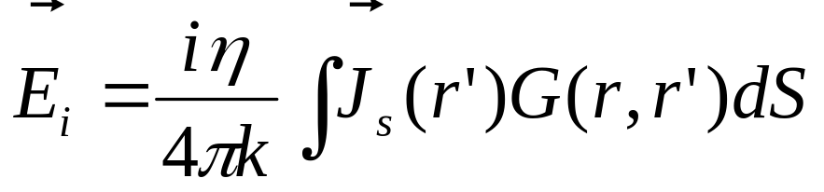
Computation of the current distribution
The equation governing the current distribution is the electric field integral equation (EFIE. CONCEPT), or the reaction integral equation (RIE, ASAP)
For patches, the magnetic field integral equation (MFIE, CONCEPT) is used
The antenna is excited at the feed
Due to reciprocity, the receiving antenna results in the same current distribution as the transmitting

Slide 17
Computation of the antenna properties
Calculations were performed for open feeds and base capacitances of 90pF
A correction for the real antenna diameters has to be applied on the ASAP results. CONCEPT can deal with real antenna diameters.

Slide 18
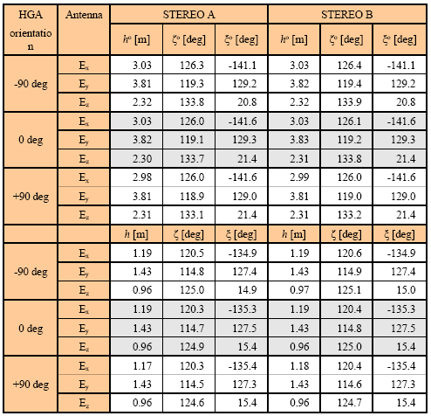
Numerical Results:
The quasi-static limit (ASAP)

Slide 19
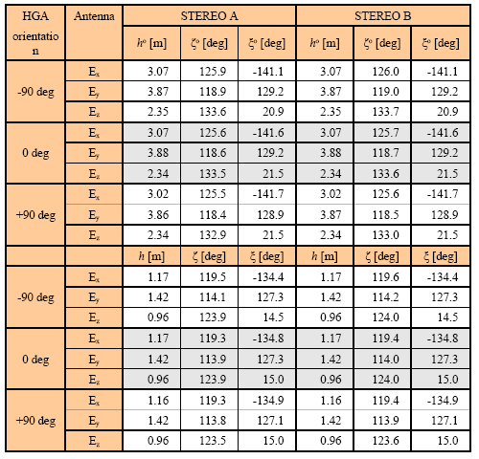
Numerical Results:
The quasi-static limit (CONCEPT)

Slide 20
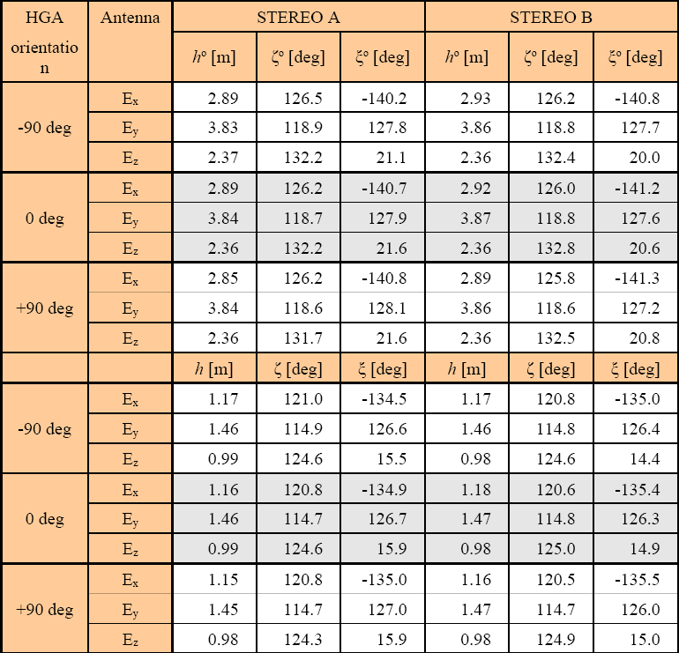
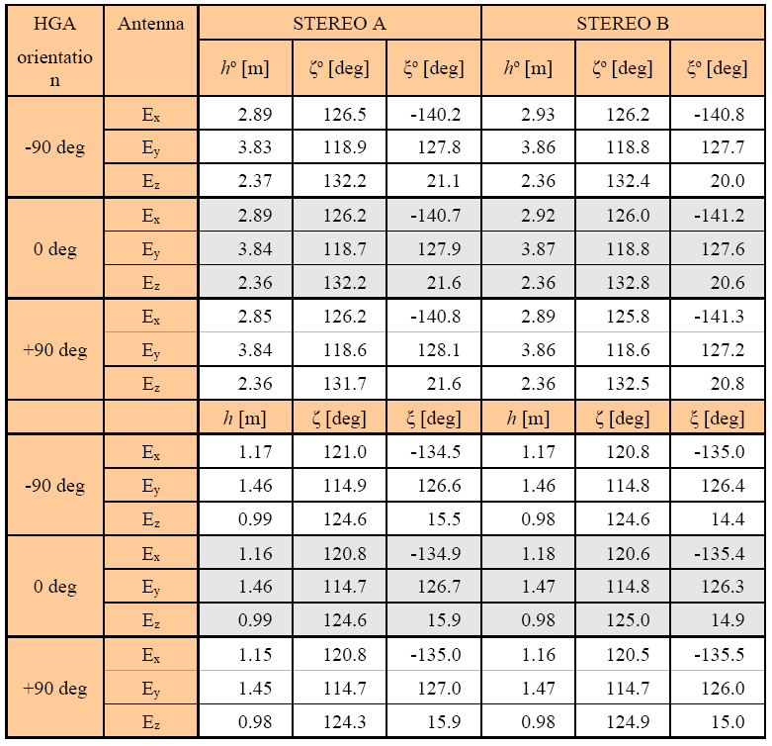
Experimental Results

Slide 21
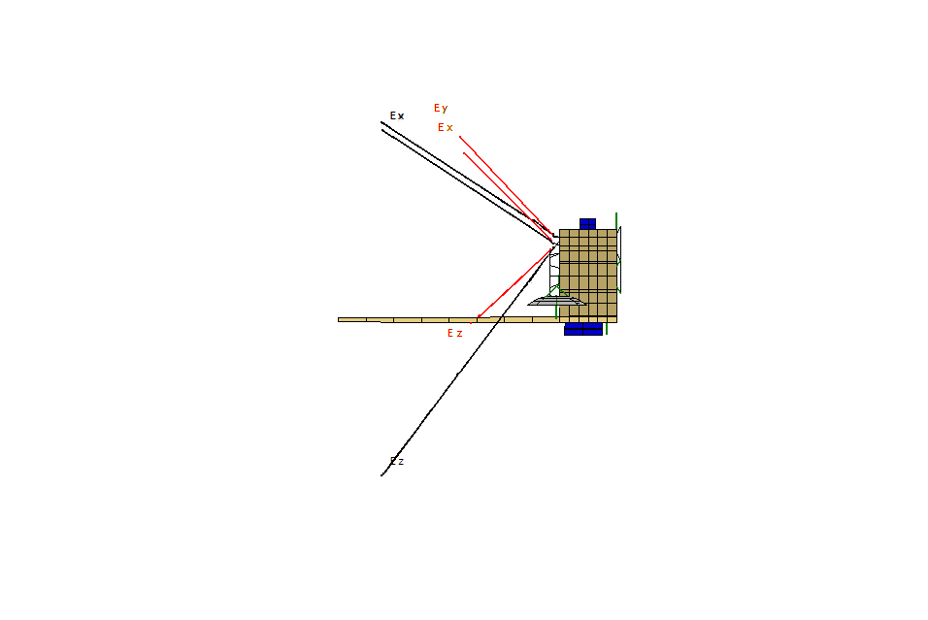
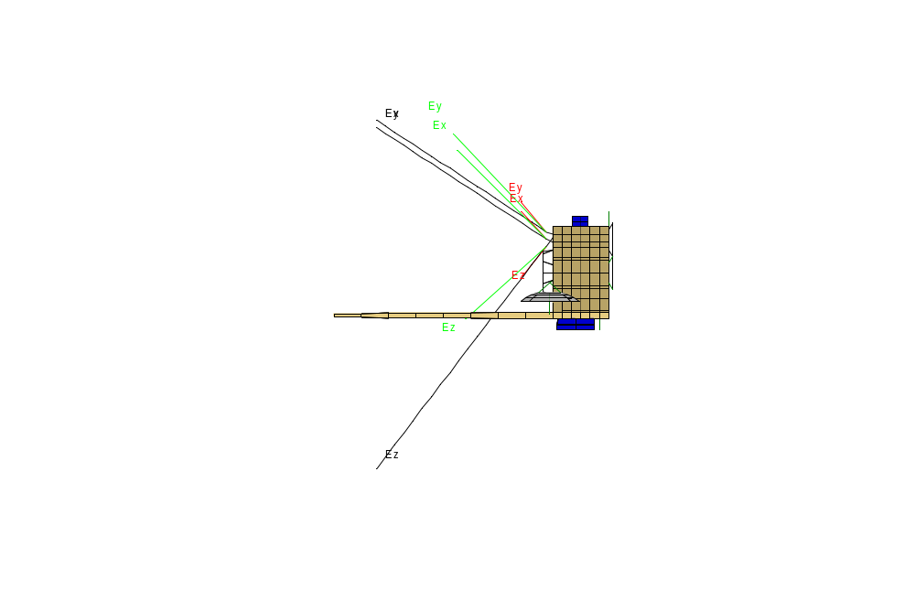
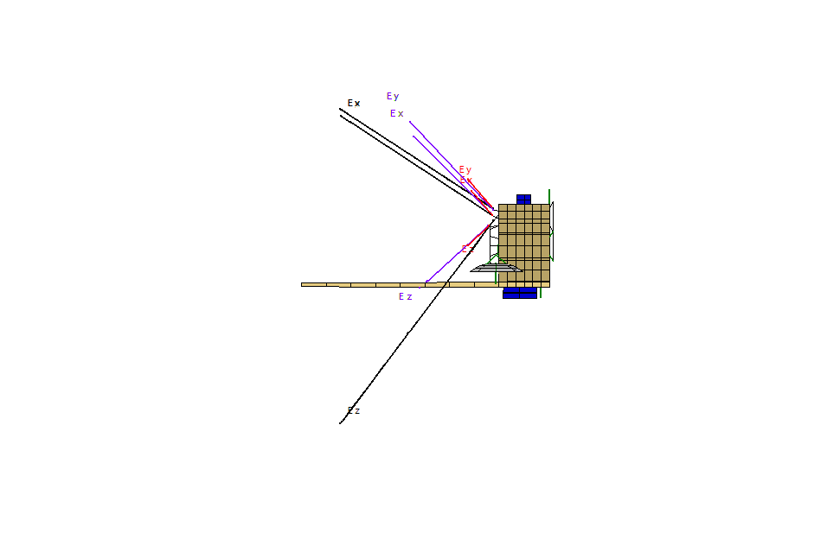
Numerical Results:
The quasi-static limit

Slide 22
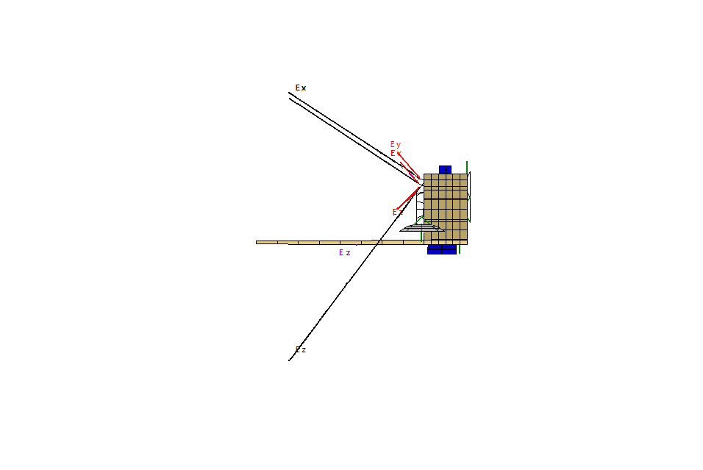
Numerical Results:
The quasi-static limit

Slide 23
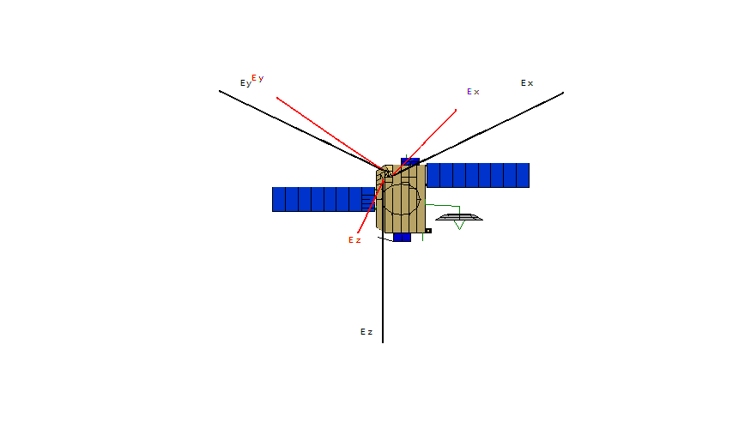
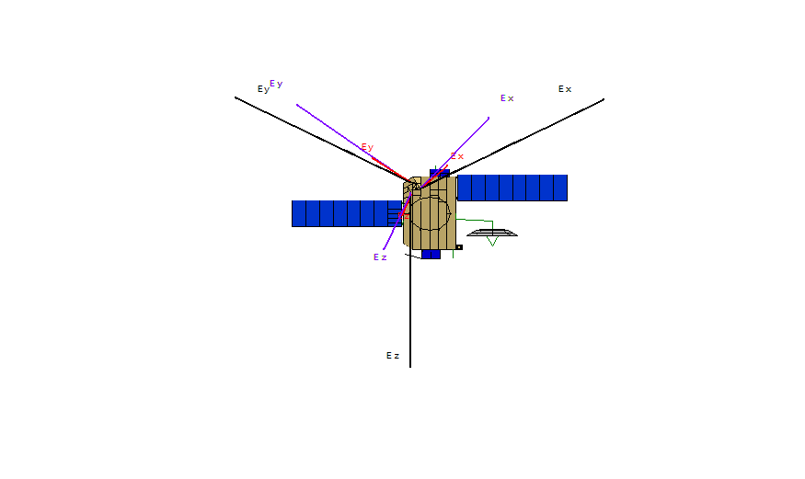
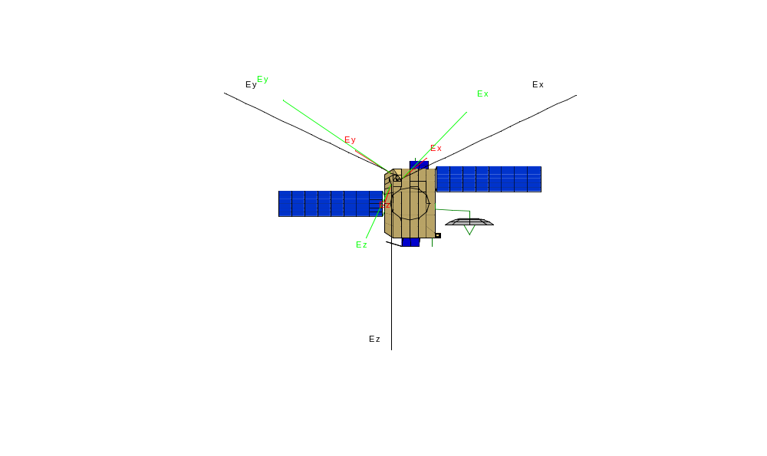
Numerical Results:
The quasi-static limit

Slide 24

Numerical Results:
The quasi-static limit

Slide 25
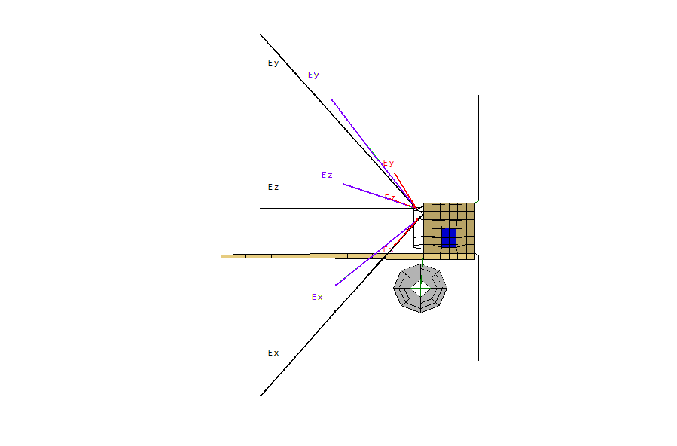
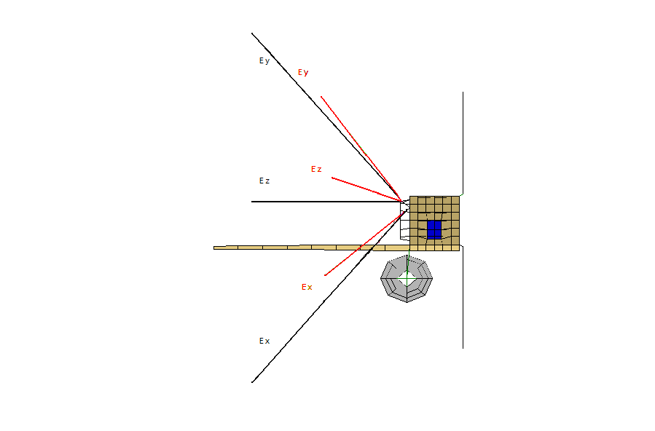
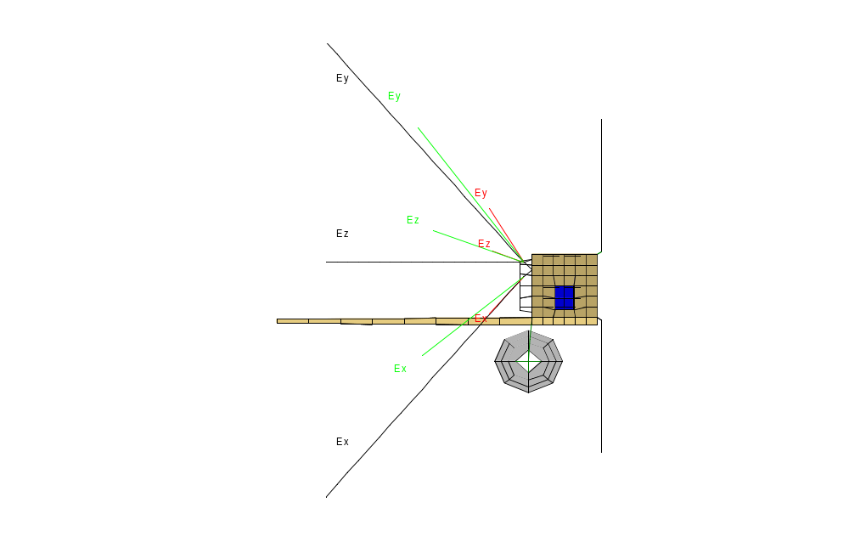
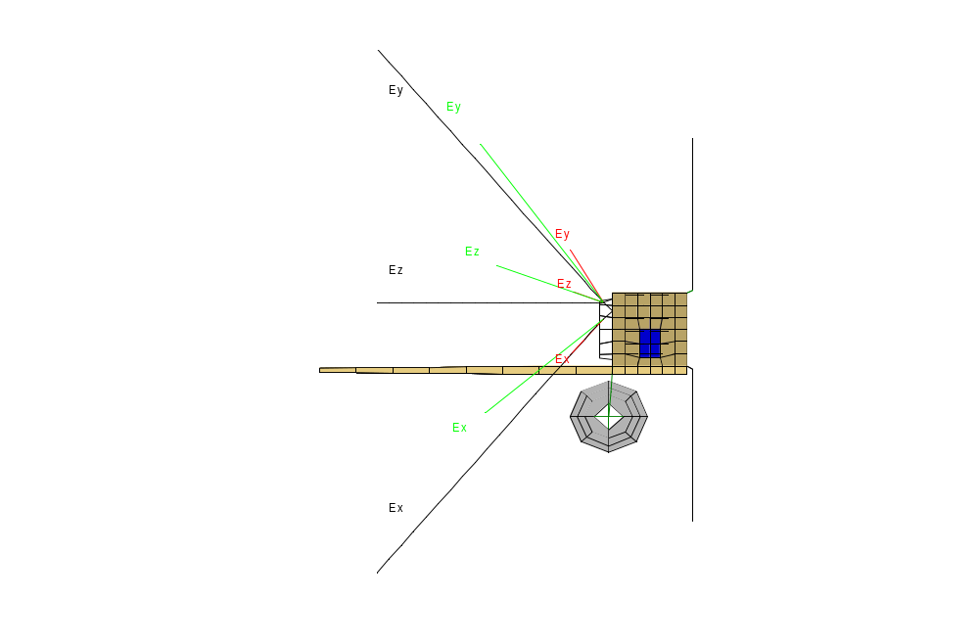
Numerical Results:
The quasi-static limit

Slide 26
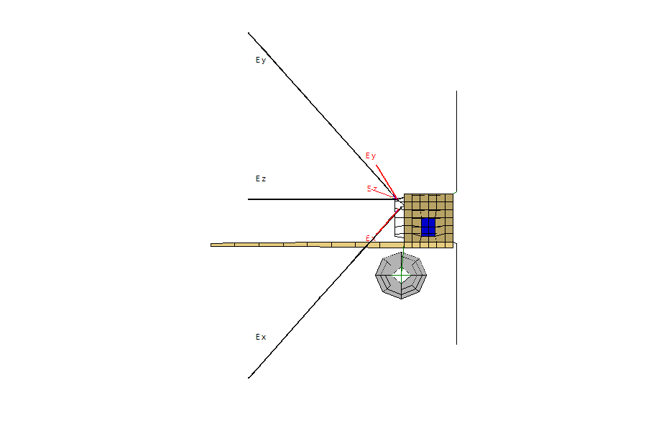
Numerical Results:
The quasi-static limit

Slide 27
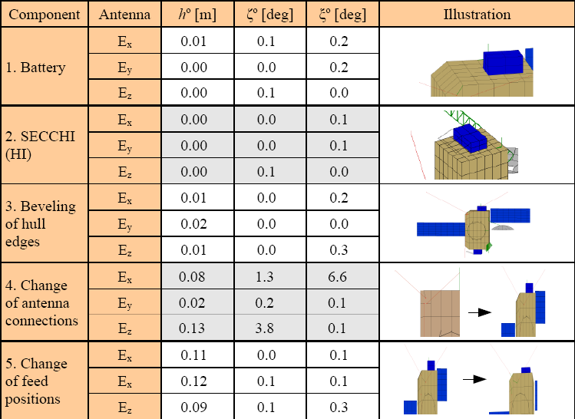
Numerical Results:
The Effect of changing the model 1

Slide 28
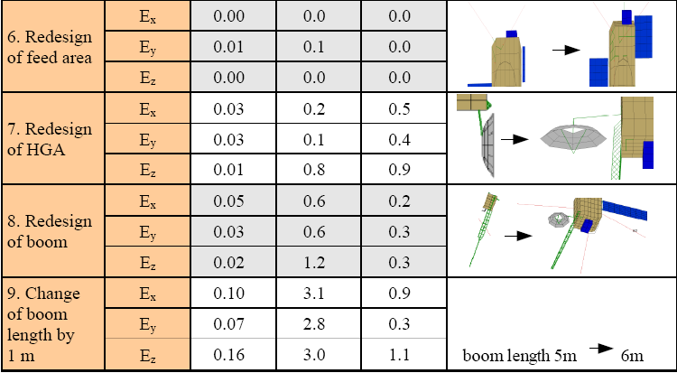
Numerical Results:
The Effect of changing the model 2

Slide 29
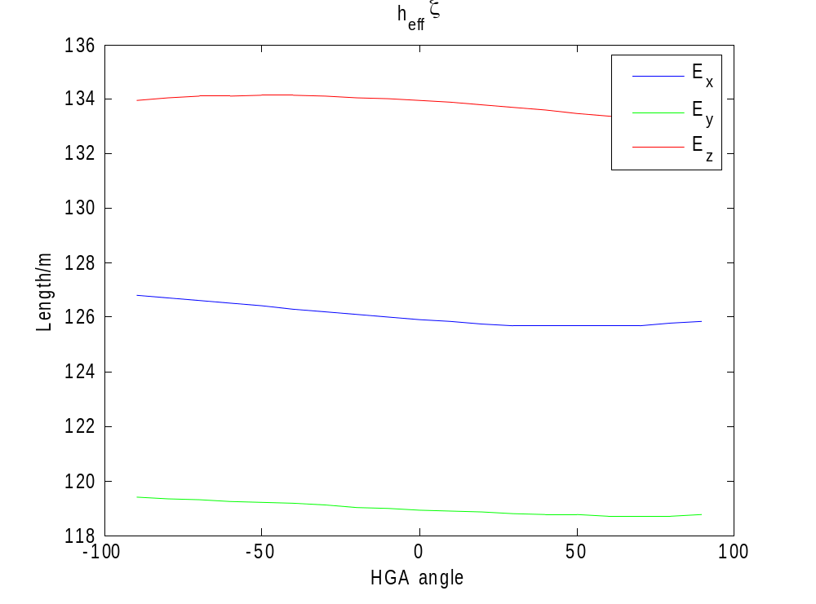
Variation due to the HGA orientation

Slide 30
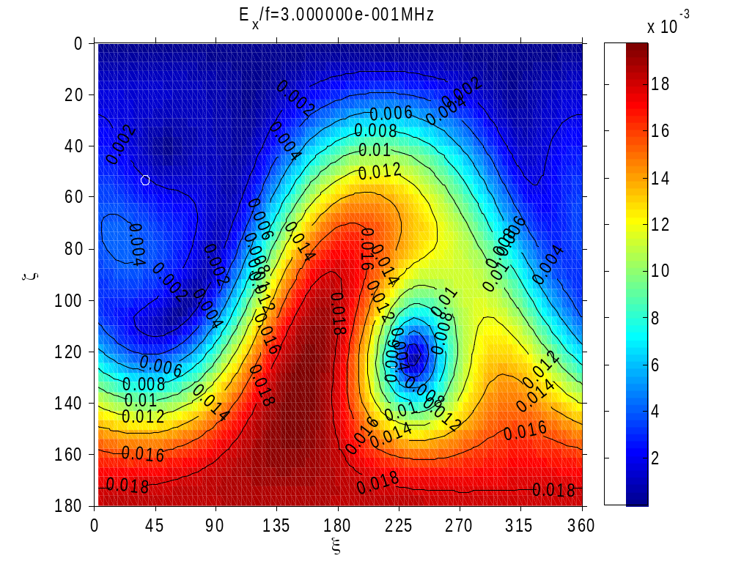

Relative deviation of the perpendicular component of the effective length vector

Slide 31

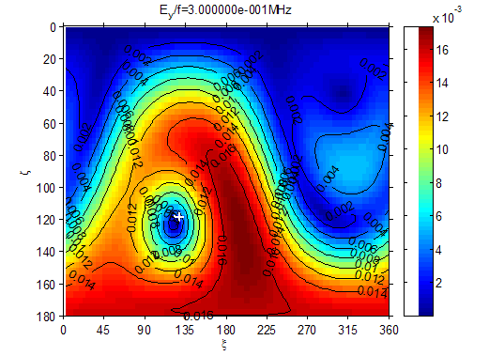
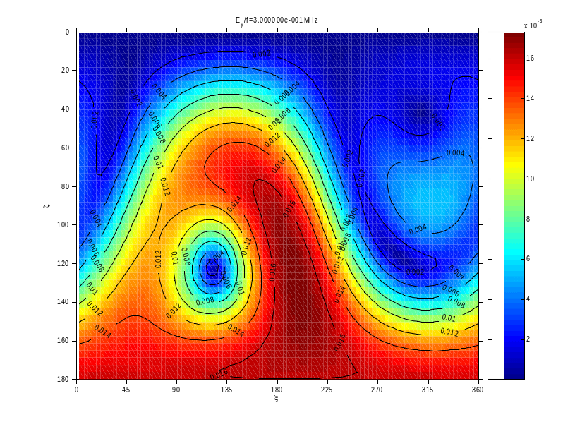
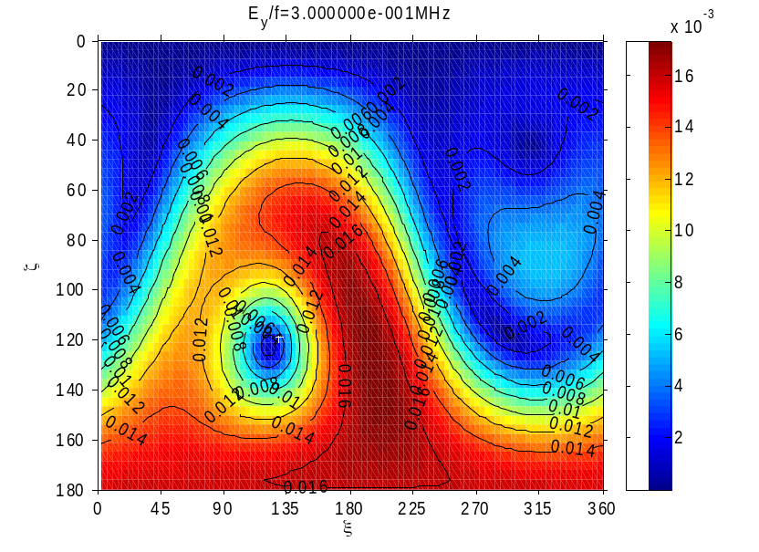
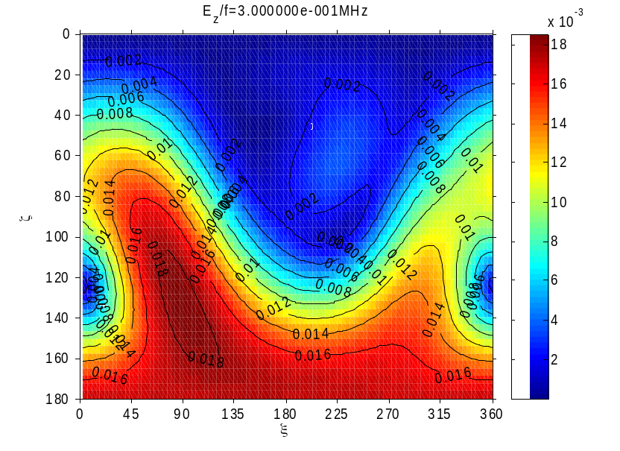

Relative deviation of the perpendicular component of the effective length vector

Slide 32
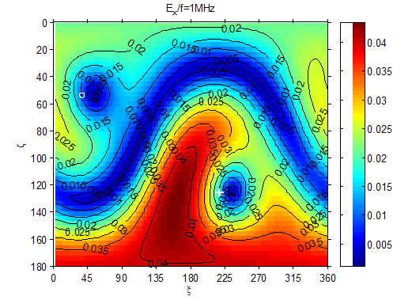
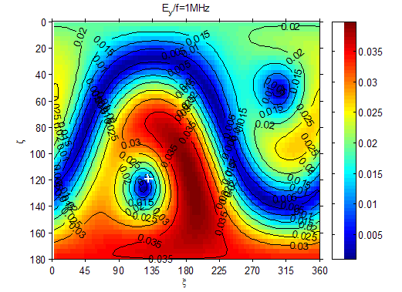
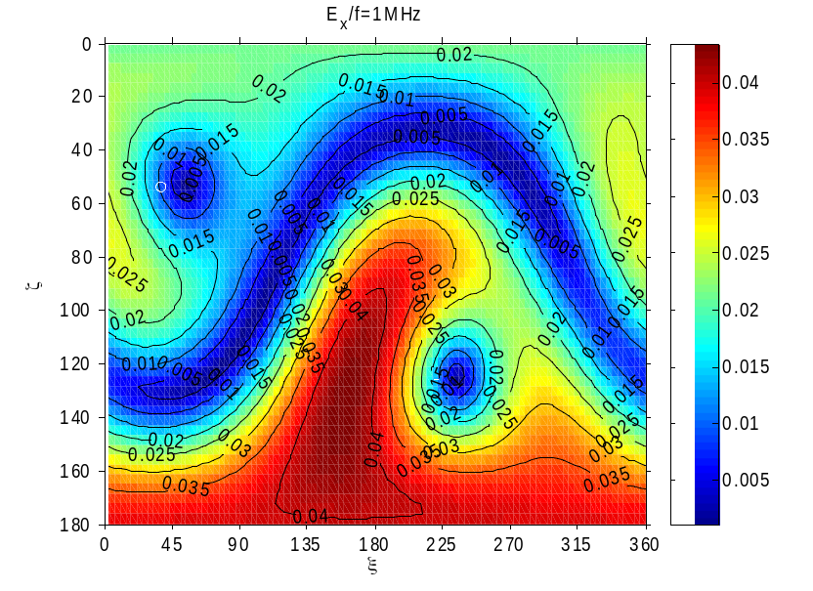
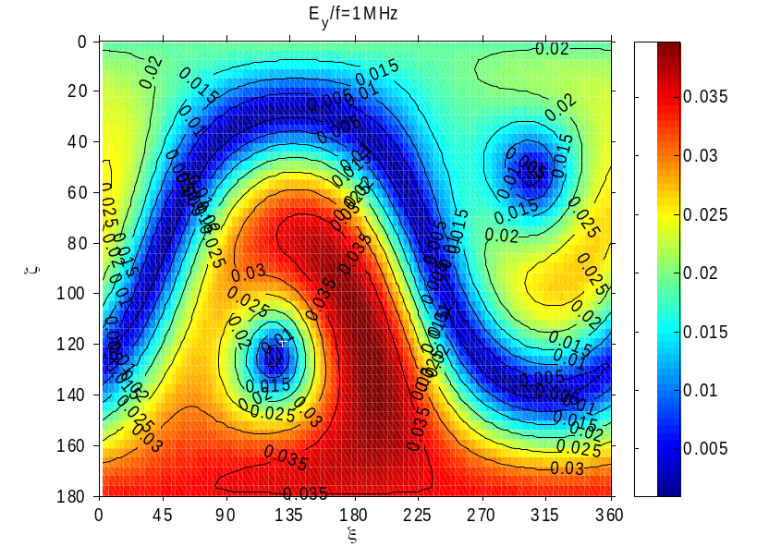
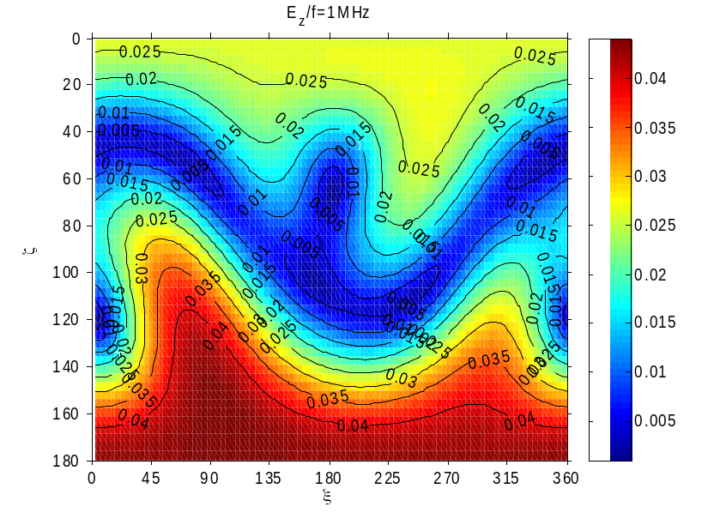
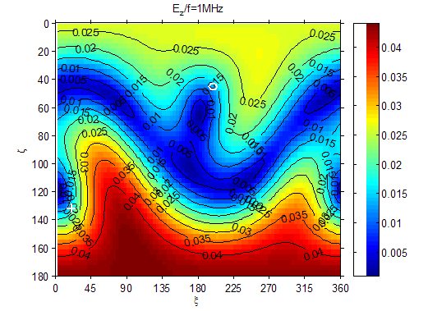
Relative deviation of the perpendicular component of the effective length vector

Slide 33
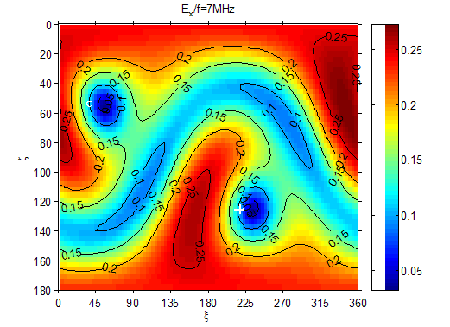
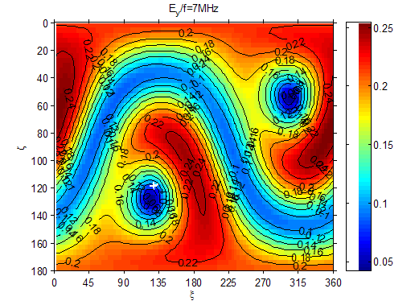
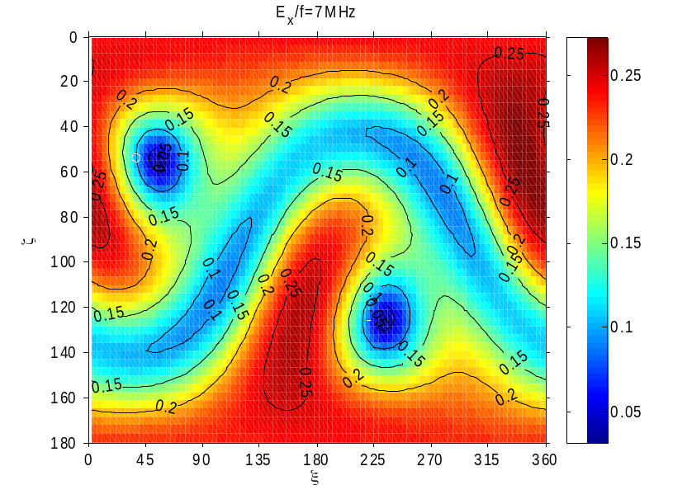
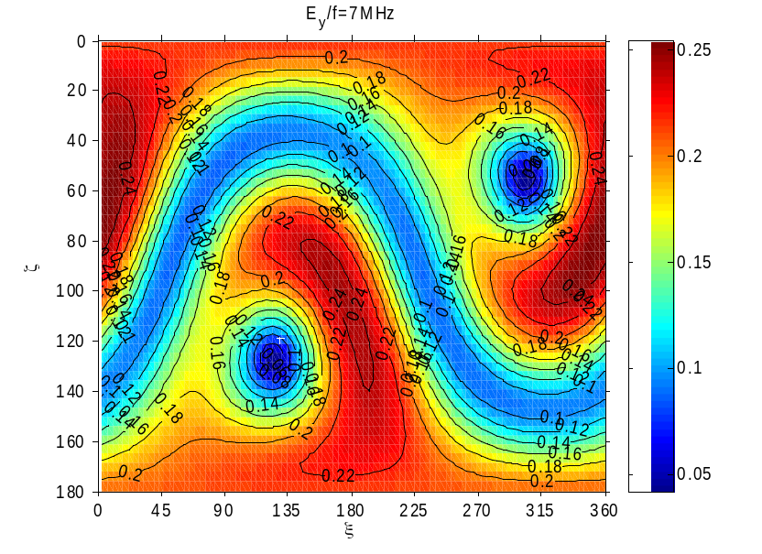
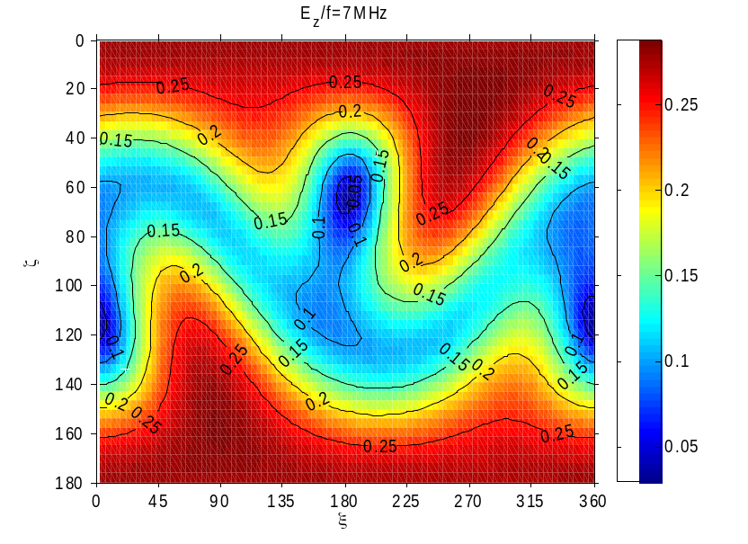
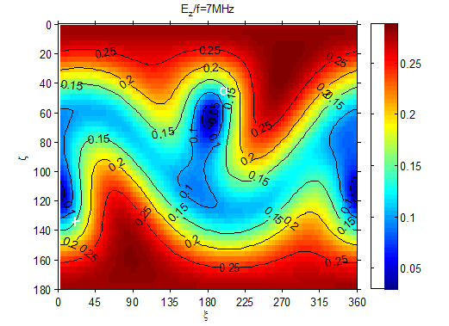
Relative deviation of the perpendicular component of the effective length vector

Slide 34
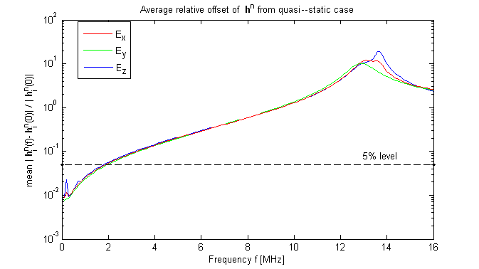

Relative offset from the quasi-static case
average
maximum

Slide 35

The self-impedances(open)

Slide 36

The self-impedances(loaded)

Slide 37

Relative Gain Patterns

Slide 38
Summary
The following parameters have been determined and investigated:
Open port transfer matrices
Antenna capacitances
Transfer matrices of the loaded antennas
The change of the results due to variation of the spacecraft structure
The effect of the orientation of the HGA
An estimation of the upper frequency limit below which the quasi-static result can be used
A new technique of correcting for inexact modeling of the antenna radii.
An estimation of the surface impedance of the rheometry model
The reception patterns at the FFR frequencies
Notes:
Experimental method and 2 numerical methods
merits: rheometry : more details
numerical method: variation of model
patches: longer computing time but higher accuracy

