Slide 1
Electromagnetic waves in space and the STEREO/WAVES experiment
Thomas Oswald

Slide 2
Overview
Propagation of EM waves in vacuum and plasma
Antennas
Direction Finding
Antenna calibration of the STEREO/WAVES antennas

Slide 3
EM waves in space science
Transmit energy
Transmit information
Remote sensing

Slide 4
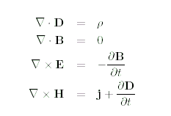

EM waves in space
The basic equations are the Maxwell equations in compination with the constitutive equations

Slide 5
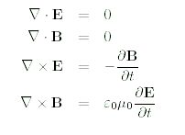
EM waves in vacuum 1
In vacuum there are no source terms
Maxwell equations can be simplified

Slide 6
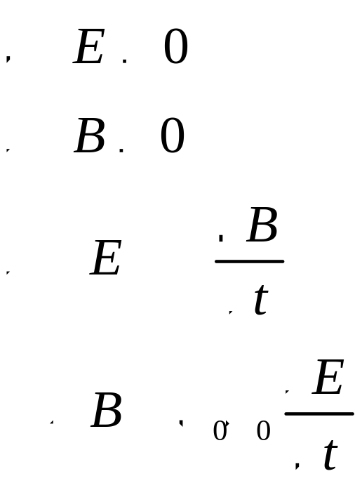
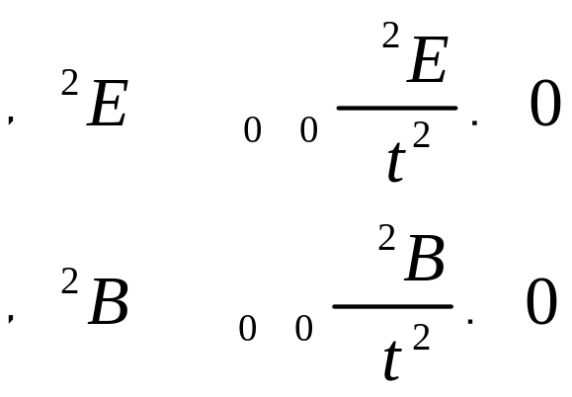
EM waves in vacuum 2
Equations can be combined to give a wave equation

Slide 7
EM waves in vacuum 3
And be solved by postulating a time harmonic wave
And using a Fourier transform
The result is the dispersion relation

Slide 8
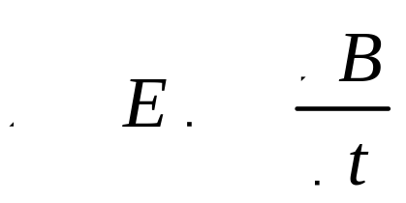
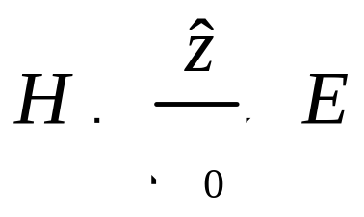
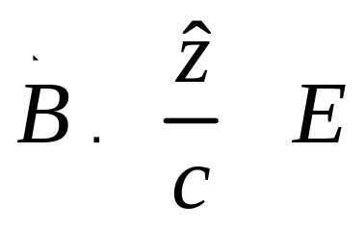
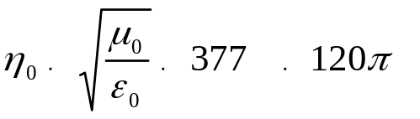
EM waves in vacuum 4
By substituting in the Maxwell equation the B field can be found to be

Slide 9
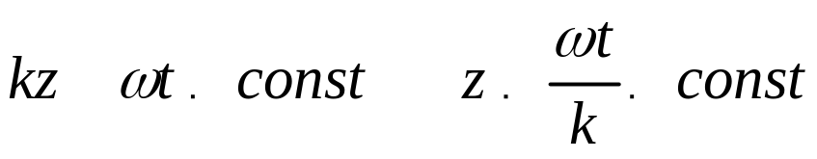
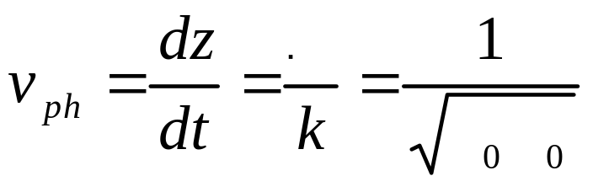
The phase velocity
When riding on a wave, the phase must be constant

Slide 10

The principle of superposition
Maxwell equations are linear, so the principle of superposition applies
Any waveform can be sythesized by superposition of monochromatic waves

Slide 11
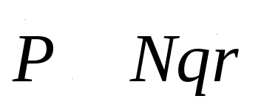
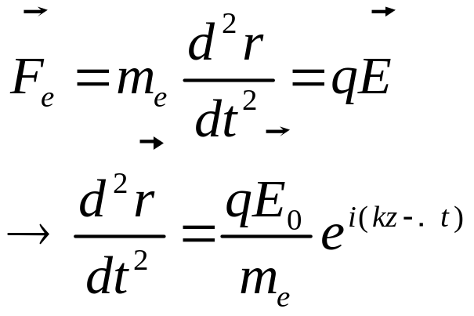
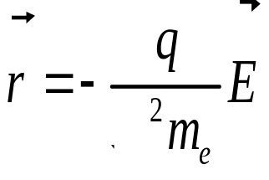
Wave propagation in an isotrope plasma 1
Polarization
Force on an electron

Slide 12
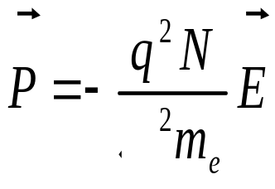
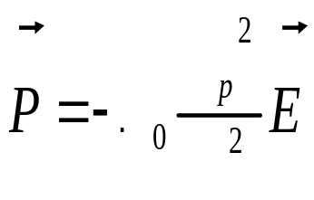
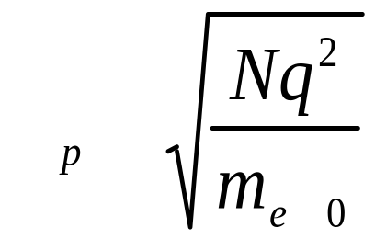
Wave propagation in an isotrope plasma 2

Slide 13
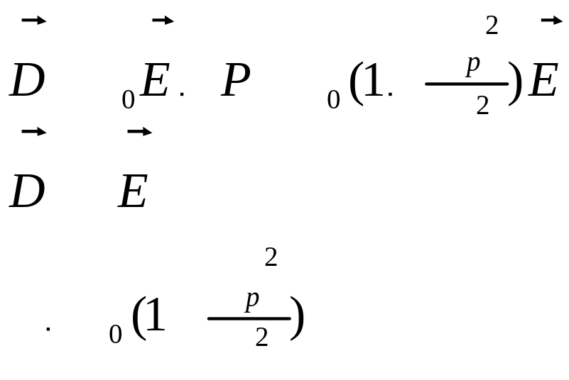
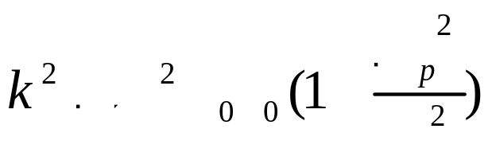
Wave propagation in an isotrope plasma 3
Dispersion relation

Slide 14
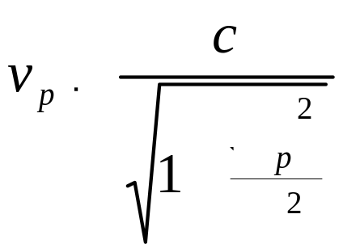
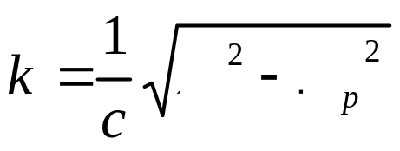
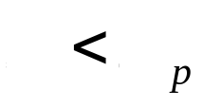
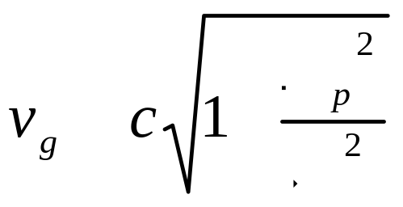
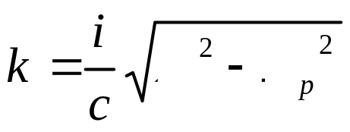
Wave propagation in an isotropic plasma 4

Slide 15

Wave propagation in an isotropic plasma 5

Slide 16
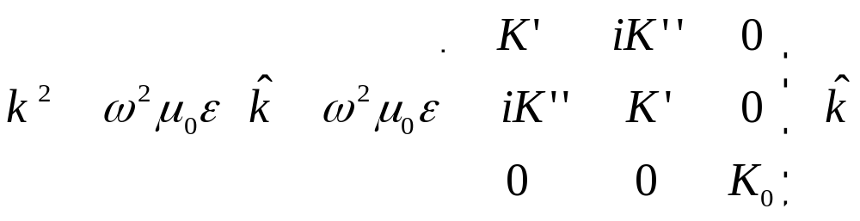
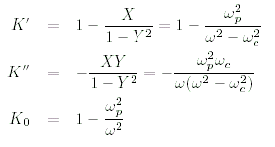
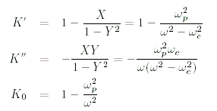

Wave propagation in magnetized, collisionless plasma
Dispersion relation

Slide 17
Antennas in space
An antenna can be used to transmit and receive EM and other plasma waves
Free wave propagation <--> Guided wave propagation

Slide 18
Some basics
EM fields are produced by accelerating charges
I case of antennas oscillating electrons
The radiated field can be divided into a near field and a far field
The nearfield pard is only storing energy. No transmittion

Slide 19
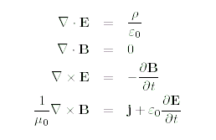

Retarding potentials 1
It is useful to introduce the potential fields

Slide 20
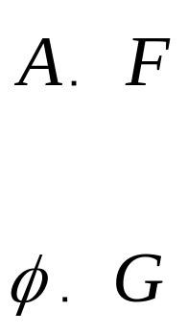
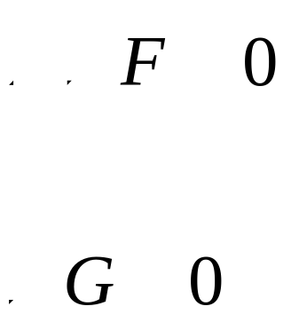
Retarding potentials 2
The potentials are not unique
Does not change the physical fields if

Slide 21

Lorenz gauge
...so we can define the Lorenz gauge
Makes the system symmetrical and compatible with special relativity

Slide 22


The Helmholtz equations
The potential field equation can be manipulated to result in wave equations
These are called Helmholtz equations

Slide 23
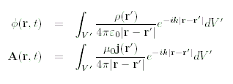
The solutions
By postulating time harmonic behavior and Fourier transform they can be solved

Slide 24
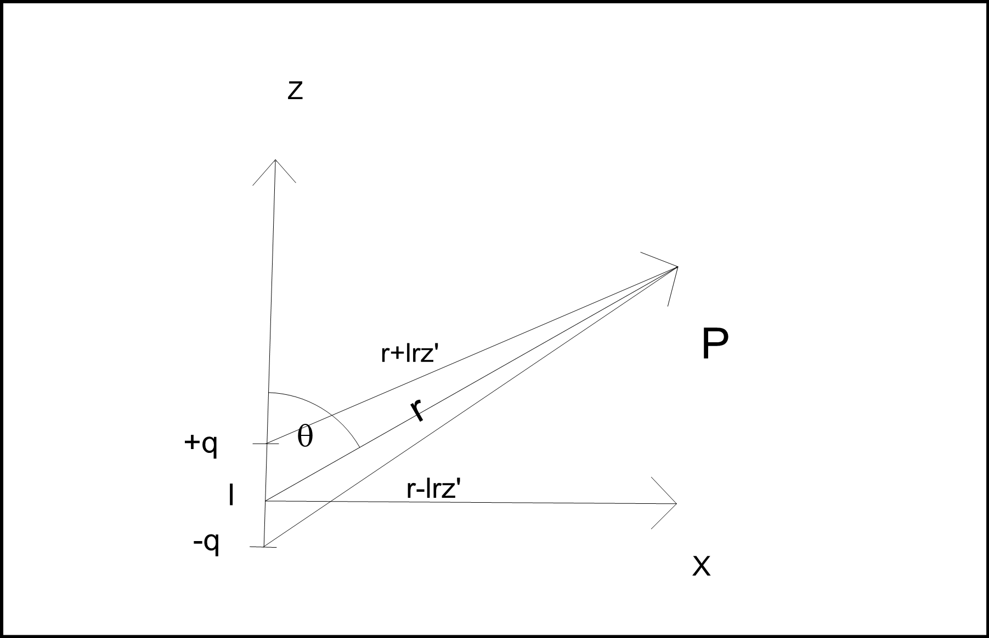
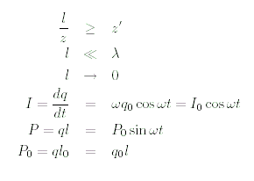
Hertzian dipole 1

Slide 25



Hertzian dipole 2
Farfield:

Slide 26
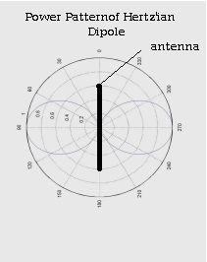
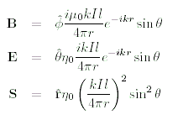
Hertzian dipole 3
The physical (far) fields and the Poynting vector

Slide 27
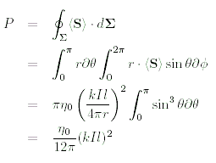






Hertzian dipole 4
Other properties

Slide 28
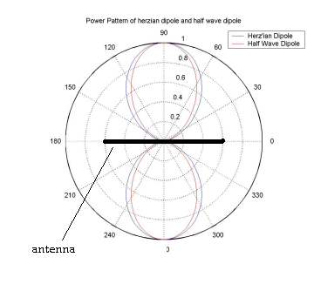
Real antennas
Real antennas show a slightly different behavior

Slide 29
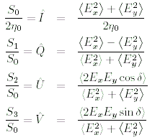
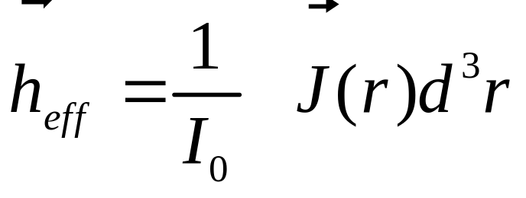
Direction Finding 1
Direction finding (DF) is the procedure to find the direction of incidence and the polarization of the incident wave
The polarization can be represented by the normalized Stokes parameters

Slide 30


Direction Finding 2
The basic equation:
Where h_{eff} is the effective length vector

Slide 31
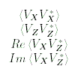

The observables
The auto and cross correlation parameters

Slide 32
The coordinate frame

Slide 33
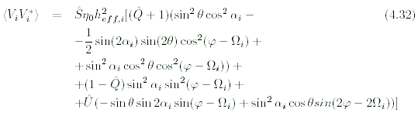
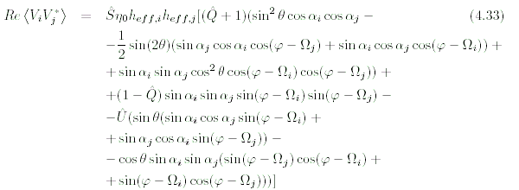
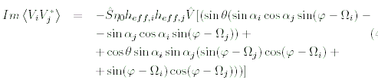
Observables-parameter

Slide 34
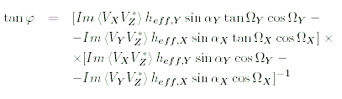
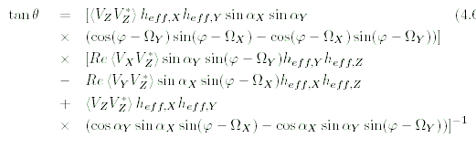
Analyticle solution for the direction
Attention: Phi is not unique

Slide 35

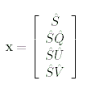
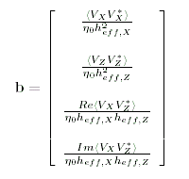

The matrix equation for the Stokes parameters

Slide 36
The STEREO mission
Two spacecraft, one ahead and one behind earth,slowly drifting apart at a rate of 22 degrees by year
To extend our knowledge about the physics of the solar system
Research on space weather, CMEs and sun-earth-connection (SEC)
For the first time stereoscopic methods are used which include remote and insitu measurements of the same events

Slide 37
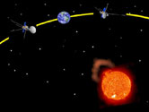
The STEREO mission

Slide 38
SWAVES
Measures electric fields
Frequency 40kHz-16MHz
Measures electron density and temperature with quasi thermal noise analysis
3 orthogonal monopole-stacer-antennas, directed away from the sun, 6m length
“Direction Finding” (DF) mode provides all auto- and cross correlation parameters
2 spacecraft render it possible to pinpoint the source of the EM radiation via triangulation
The equipment on the 2 s/c will track those radio sources from less than 2 R_{S} to 1AU and beyond

Slide 39
Why is antenna calibration necessary ?
To perform “Direction Finding”(DF), antenna properties must be known to a high degree of accuracy
The receiving properties can be quantified by the effective length vector
The effective length vector represents the antenna as it behaves electrically
It is influenced by the geometry of the spacecraft
Depends, in general, upon frequency and direction of incidence and is a complex vector, but at low frequency it can be treated as a constant real vector
In this quasistatic range, DF is possible

Slide 40
Methods to determine the effective length vector
Numerical electromagnetic code
Rheometry
EMC chamber
In-flight Calibration

Slide 41
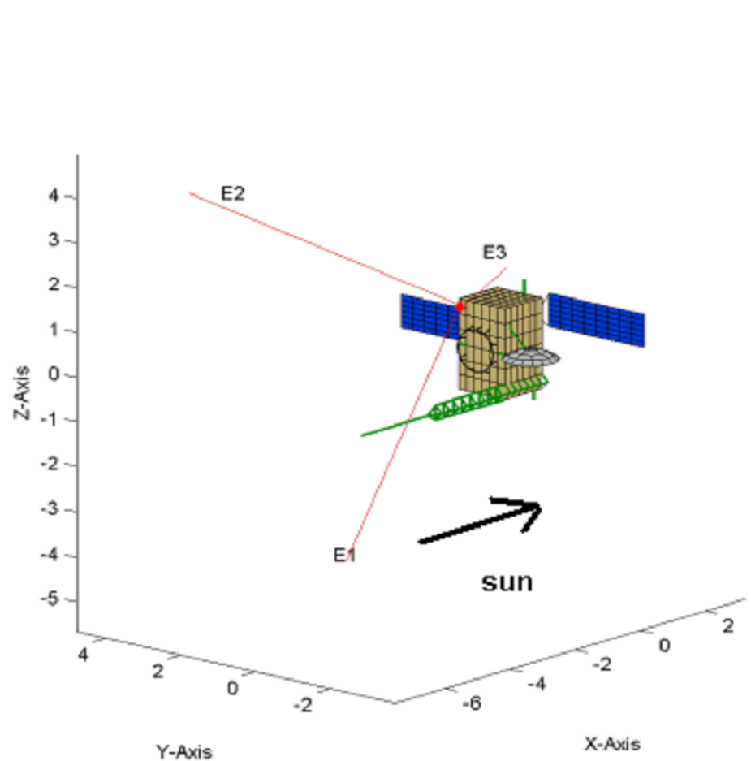
The numerical method

Slide 42
The numerical method
The spacecraft is modelled as a grid of wires
Then the currents along these wires are computed
On base of the current distribution, all other antenna properties (effective length vectors, impedances) can be calculated

Slide 43
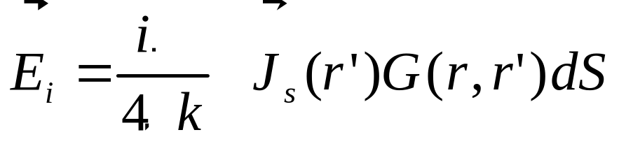
Computation of the current distribution
The equation governing the current distribution is the electric field integral equation (EFIE)
Simplifications:
  Thin currents along the center of the wires
  No transverse currents

Slide 44

The Method of Moments
The Method of Moments (MoM) can be used to solve integral equations
A modified version of the antenna scatterers analysis program (ASAP) is used to calculate the currents

Slide 45
The Matlab toolbox
The effective length vectors and impedances are calculated by the Matlab toolbox created in the space research institute
Calculations were performed for open feeds and capacitances of 90pF

Slide 46
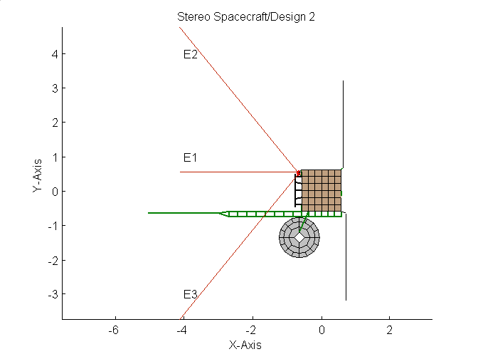



The model
RING

Slide 47
The model
RING
BOOM

Slide 48
The model
RING
BOOM
HGA DISH

Slide 49
The model
RING
BOOM
HGA DISH
SOLAR PANELS

Slide 50

The results

Slide 51


Quasi-static effective length vectors
A
B
S/C A at 500 kHz

Slide 52



The effective length vector as function of frequency
|h_{eff}|
Frequency/0-16 MHz
Re(h_{eff})
Im(h_{eff})
1. Resonance at 14 MHz
Frequency/0-16 MHz
Frequency/0-16 MHz

Slide 53


Variation of the length with direction

Slide 54

Variation of the length with direction

Slide 55


Variation of the length with frequency
500kHz
13.5MHz

Slide 56

Variation due to the HGA orientation

Slide 57


The impedances: Spacecraft A
Re vs. Im
Real part
Imaginary part

Slide 58


The impedances: Spacecraft B
Re vs. Im
Real part
Imaginary part

Slide 59
Thank You for Your attention !

