Slide 1
Antennas in plasma: Numerical calculation
Presentation of the PhD Thesis by Thomas Oswald
At Karl-Franzens-Universität Graz, supervised by Prof. H.O. Rucker

Slide 2
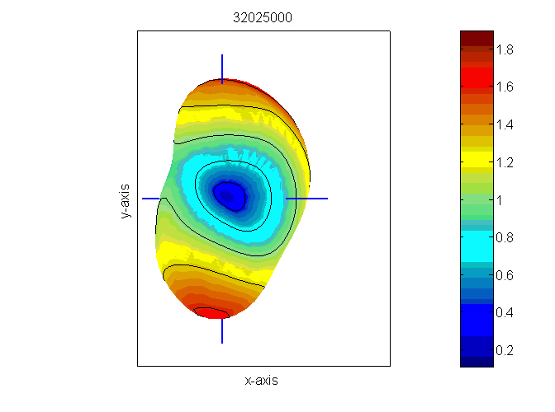
Content
Introduction
The method of moments (MoM)
Theory (Plasma-Electrodynamics)
Theory (Antenna Theory)
Analysis of a dipole radiation
Application on STEREO antennas
Modeling the plasma sheath
Conclusion + Outlook

Slide 3
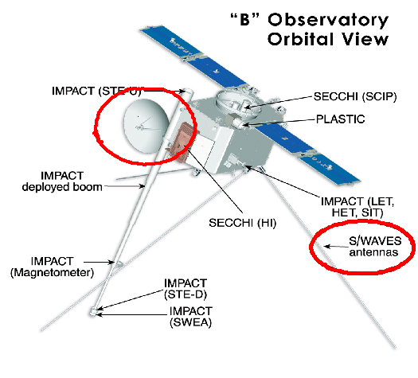
Introduction: Radio Experiments
Radio experiments are one of the most important experiments on spacecraft
By receiving and analyzing radio and plasma waves created by natural phenomena, the physics of the creation process can be studied.
Radio and plasma waves are received by antennas which are the interface between free wave propagation and guided wave propagation
My thesis deals with the radio frequency range (kHz-MHz)

Slide 4
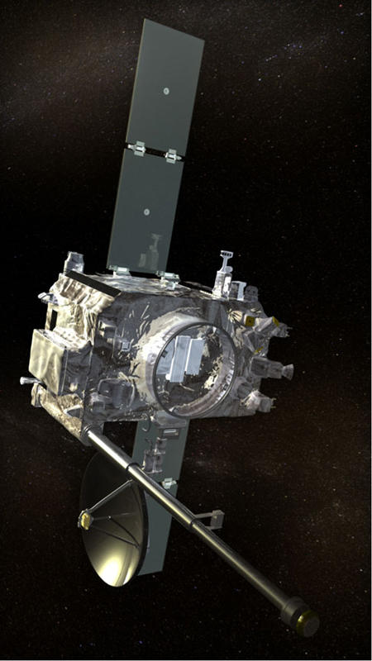
Introduction: Antennas
Scientific antennas are monopoles which are either driven against another monopole to for a dipole, or against the spacecraft body.
For the correct interpretation of the received data, the antenna properties must be known accurately
Those are influenced by the spacecraft body and the surrounding plasma
The influence is highest near the plasma resonance frequencies but also noticeable at the higher parts of the typical radio experiment frequency range.

Slide 5

Introduction: Properties
The most important properties are:
  Power patterns
  Impedances
  Admittances
  Effective length vectors
Usually a vacuum is postulated

Slide 6

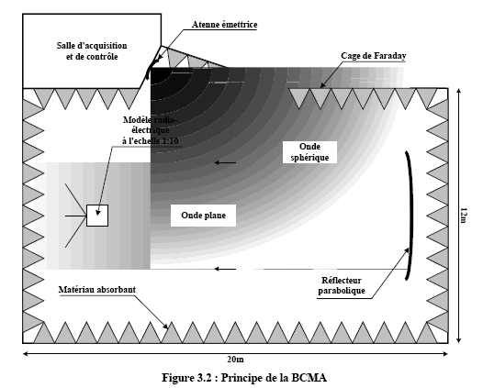
Introduction: Calibration methods
Numerical calculation
Rheometry
Anechoic chamber
Inflight calibration

Slide 7

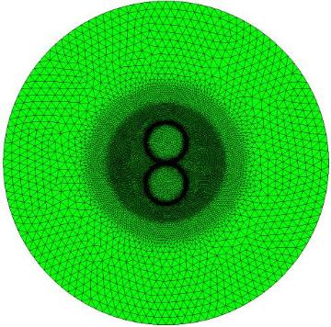
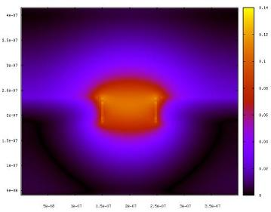
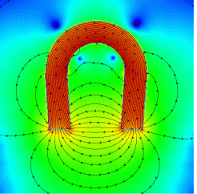
Introduction: Numerical methods
Method of Moments(MoM)
Finite difference, time domain (FDTD)
Finite element (FEM)
www.thecomputationalphysicist.com

Slide 8

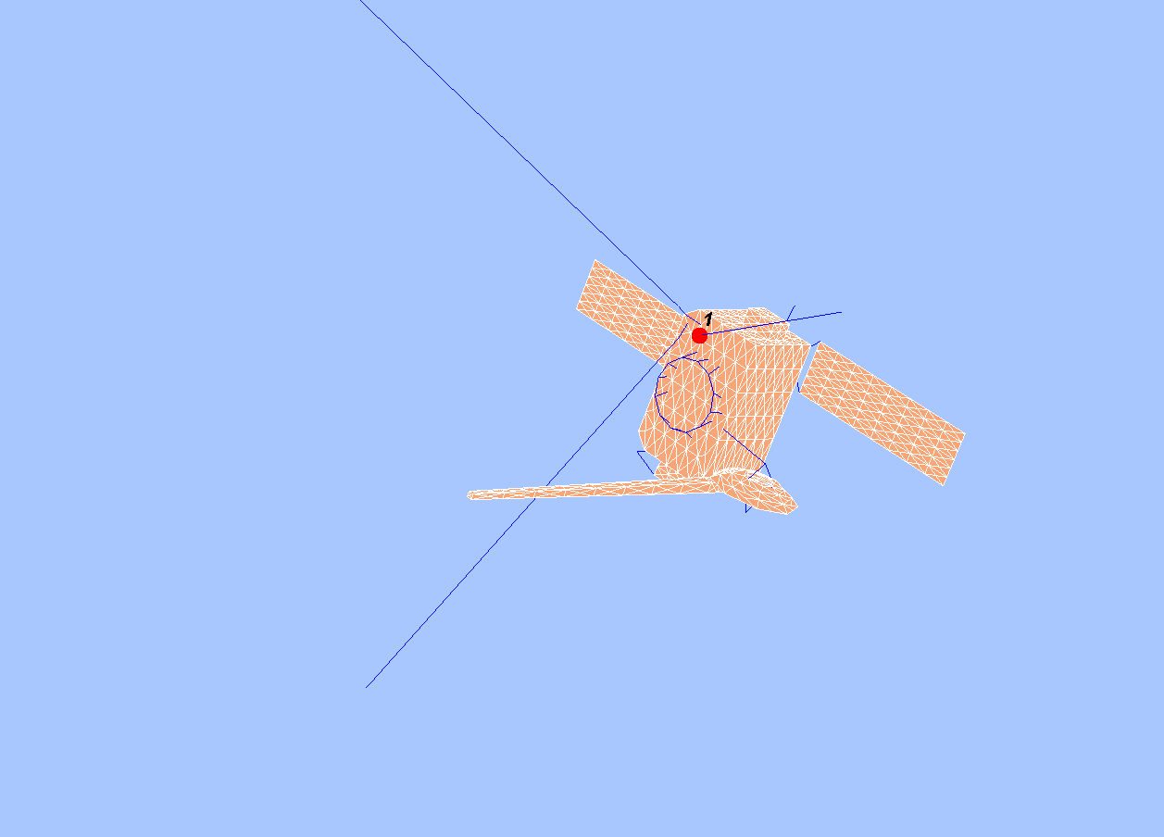
Introduction: MoM
The MoM is a boundary value method
The spacecraft is modeled as a grid of wires or patches
Then the currents as a response of a 1V excitation along these wires/patches are computed
This calculation is performed with an appropriate solver
On basis of the current distribution, all other antenna properties (effective length vectors, impedances) can be calculated with MATLAB routines

Slide 9

Introduction: Putting plasma into the MoM
The effect of surrounding plasma is small but measurable at radio frequencies.
Two Methods:
  The dielectric plasma mode: plasma physics in is the equivalent dielectric tensor.
  Modeling the plasma sheath: The plasma effect manifests itself in a capacity and resistivity which can be included easily in the calculation.

Slide 10
Content
Introduction
The method of moments (MoM)
Theory (Plasma-Electrodynamics)
Theory (Antenna Theory)
Analysis of a dipole radiation
Application on STEREO antennas
Modeling the plasma sheath
Conclusion + Outlook

Slide 11
Method of Moments
MoM is a method to solve field problems which can be described with the theory of linear spaces.
L(j)=g
  L...operator, functional
  j...response function to be determined
  g...excitation
In the MoM this equation is converted to matrix form and solved numerically
To solve electromagnetic scattering problems:
  g...excitation voltage
  j...the surface current system
L must have certain properties which are governed by the theory of linear operators (e.g. self-adjointness,...)

Slide 12


Method of Moments
A suitable inner product has to be defined
The inner product has to have certain properties:
A suitable inner product for our purpose is
The function to be determined has to be expanded:
Jn forms a set of independent basis functions
Cn are coefficients to be determined
Substituting for j in the linear equation gives

Slide 13


Method of Moments
The inner product with a weighting or testing function is formed:
This can be written as matrix equation:
The solution can be found my standard methods of linear algebra.
Then the currents can be reconstructed.
For electromagnetic theory the equation can be written as
When the antenna is excitec by a unit voltage, V or g is a vector with zeros and a single entry which is 1 at the feed.
When the excitation is by an incoming wave, the vector is

Slide 14
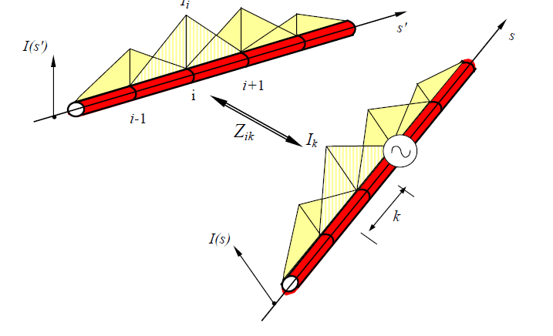
MoM: Basis and Testing functions
In infinite set of combinations of basis and testing functions lead to success
They differ in accuracy and convergence.
For basis functions, constant functions (MEC), linear function (Concept II) and sinusoidal functions (ASAP, NEC, MEC) are common.
For patches, spacial functions have to be used.

Slide 15
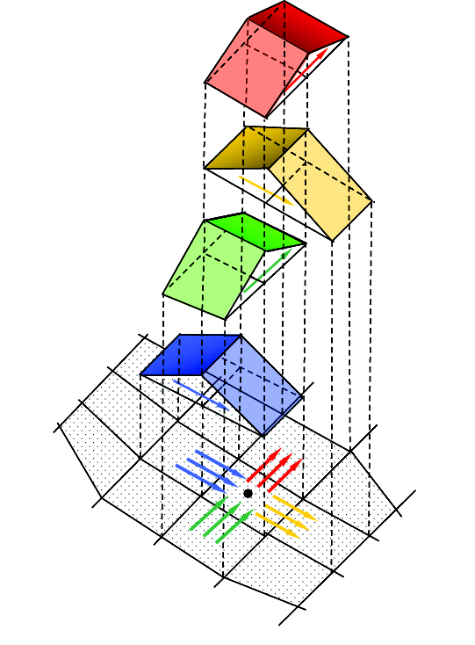
MoM: Basis and Testing functions
For testing functions it is common to use the same functions as basis functions (Galerkin method).
An other method is to use Dirac delta functions (collocation method).
The collocation method facilitates the integration to get the matrix elements.
This way the function is forced to fit at a single point.

Slide 16
Content
Introduction
The method of moments (MoM)
Theory (Plasma-Electrodynamics)
Theory (Antenna Theory)
Analysis of a dipole radiation
Application on STEREO antennas
Conclusion + Outlook

Slide 17
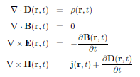
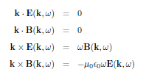



Theory: Electrodynamics
Starting point: Maxwell
And Constitutive equations
A similar equation would exist for the magnetic field but is not necessary, because all the physics can be included in the equivalent dielectric tensor.
If the material is linear and space and time are homogeneous, the equations can be Fourier transformed. When external sources are not present:
and
where

Slide 18




Theory: Electrodynamics
Often potential fields are used to facilitate finding solutions:
They are not unique, so gauge conditions are used:
Lorenz gauge, Coloumb gauge, temporal (Weyl) gauge
In plasma it is often better to use the fields directly, since there is no gain in solving for A instead of E.
Maxwell's equation can be manipulated to form a wave equation:
Or: using the
diffraction index
Since

Slide 19


Theory: Electrodynamics

Slide 20




Theory: The equivalent dielectric tensor
Includes all plasma physics in the dielectric model.
Describes the linear response of a medium to electromagnetic disturbances.
Is a tensor in general.
Can be complex. The imaginary part can be interpreted as a damping effect.
Ohm's law

Slide 21






Theory: Cold isotropic plasma
The cold isotropic dielectric function is a scalar function of the frequency.
It is real valued.
Can easily be derived by using the Polarization:
And solving Newton's equation.
For r. One gets:
Using
One gets
Hence
The isotropic dielectric tensor can be inserted to all MoM solvers, so this result can be used immediately

Slide 22


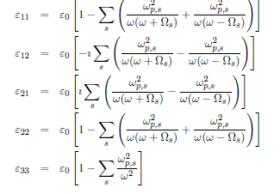
Theory: Cold magnetized plasma
The dielectric tensor of magnetized cold plasma is well known.
It can be derived by using Newton's equation with the magnetic field.
The subscript is to show that it is an external static field.
The result:
Or when factorizing for lh and rh polarization:

Slide 23




Theory: Kinetic isotropic plasma...electrostatic approximation 1
Kinetic theory finds many wave-modes.
Above characteristic frequencies and without magnetic field, 2 types are important:
  Langmuir waves
  EM waves
Basis: Vlasov equation
And perturbation theory.
E-field || k
After Fourier transform one gets:
one can use scalar potential and Poisson eq. as second function:
Results in:

Slide 24

Theory: Kinetic isotropic plasma...electrostatic approximation 2
Can be identified as dispersion relation. Hence:
The integral can not be evaluated since it contains a pole.
Landau found a solution by making the frequency complex:
Integrated along a contour around.
This leads to the famous collision-less Landau-Damping.
...which means the Langmuir waves are so heavily damped that we will never receive such waves from a distant source in the RF-range.
But these waves are important for quasi-static thermal noise analysis.

Slide 25






Theory: Kinetic isotropic plasma...EM waves
Using the same procedure but retaining the vector form, one gets:
Substituting this into the equation for current density:
The electric field is independent of v, so can be pulled out of the integral:
Finally:
The integration over the longitudinal part is difficult. But at high frequencies:
The the integrand can be approximated:
At T=10⁵K and 100kHz:
So for this subject no kinetic treatment is necessary !

Slide 26

Theory: Other dielectric tensors
There is a complicated dielectric tensor for magnetized kinetic plasmas. This tensor is not relevant due to the result of the last slide.
At high temperatures the kinetic model would be necessary. Then also the relativistic effects and the radiation would have to be taken into account.
Quantum mechanical model necessary ? The criterion is
For electrons:
Which is always true in the scope of this subject.

Slide 27
Content
Introduction
The method of moments (MoM)
Theory (Plasma-Electrodynamics)
Theory (Antenna Theory)
Analysis of a dipole radiation
Application on STEREO antennas
Modeling the plasma sheath
Conclusion + Outlook

Slide 28


Antenna Theory: Green's function
In this context Green's function is a dyadic function.
It maps an infinitesimal source to the responding field.
The wave equation for the electric field :
It can be solved when the Green's function is found:
This equation is independent of the medium. The whole plasma physics is insider Green's function.
Combining the two equations gives:
Fourier transforming and manipulating gives:
And finally
To use, a FT to real space has to be performed.

Slide 29




Antenna theory: Cold isotropic Green's function
For the isotropic cold plasma the solution turns out to be:
Where g is the Green's function in vacuum:
So the electric field equation is:
And the electric field integral equation, EFIE would be
This equation is the boundary condition of an electric field on a conducting surface. It says, that the tangential field of the incident field is equal to the tangential component of the scattered field.
This equation is used in NEC to compute the mutual impedances between the segments to create the matrix.
Certain assumptions are made for facilitation: thin wires, where only axial currents are used.

Slide 30


Antenna theory: cold magnetized plasma
Using a special form of the radiation tensor:
Green's function can be written as
To my knowledge the integral can not be solved analytically.
It would have to be solved together with:
Numerically as the inner integral in a system of 2 nested integrals.

Slide 31
Content
Introduction
The method of moments (MoM)
Theory (Plasma-Electrodynamics)
Theory (Antenna Theory)
Analysis of a dipole radiation
Application on STEREO antennas
Modeling the plasma sheath
Conclusion + Outlook

Slide 32
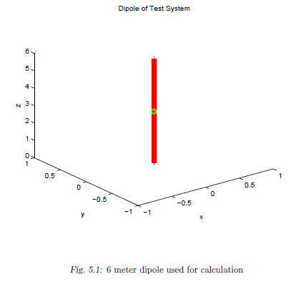
Dipole Radiation
A 1D MoM solver was written and calculations where performed with a 6m dipole.
The MoM code uses pulse functions.
A second solver, using sinusoidal functions, was written and produces the same results.
The feed is across a segment.
The isotropic cold plasma model was implemented.

Slide 33
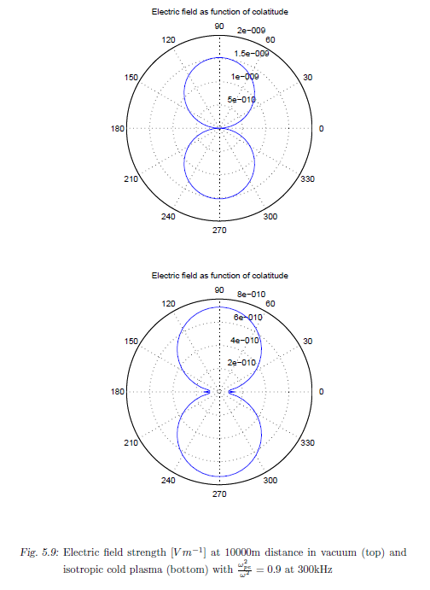

Dipole Radiation
After many test-calculations in vacuum, field calculations where performed, using currents computed with vacuum conditions.
In this simple model, the main difference is an elongation of wavelength.
This corresponds to a smaller effective length vector.
A lower field intensity is expected because energy is stored in the oscillation of the plasma particles: ordered kinetic energy.

Slide 34
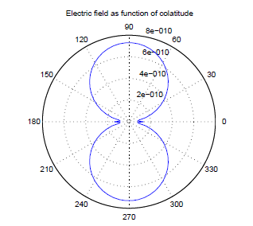
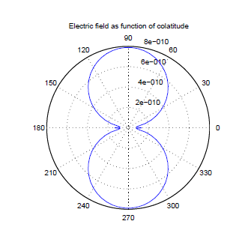
Dipole Radiation
Including the effect of the ions is of magnitude due to the mass relation of the particles.

Slide 35
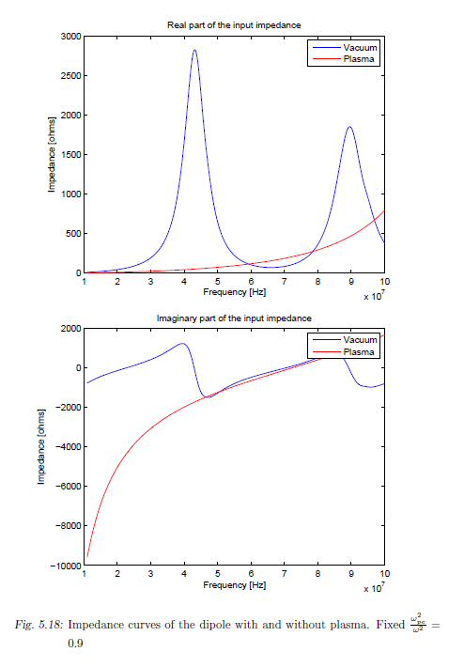
Dipole Radiation
Investigating the currents and Impedances, it can be seen that the net effect is a reduction of the lengths of the effective length vectors.
This is the unrealistic situation where the relation of plasma frequency to frequency is constant over the whole frequency range.

Slide 36
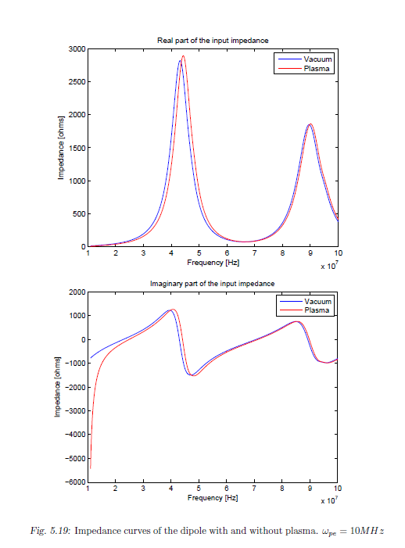
Dipole Radiation
Here a realistic case.
ωpe = 10MHz
This result suggests that a vacuum approximation is valid for many situations.

Slide 37
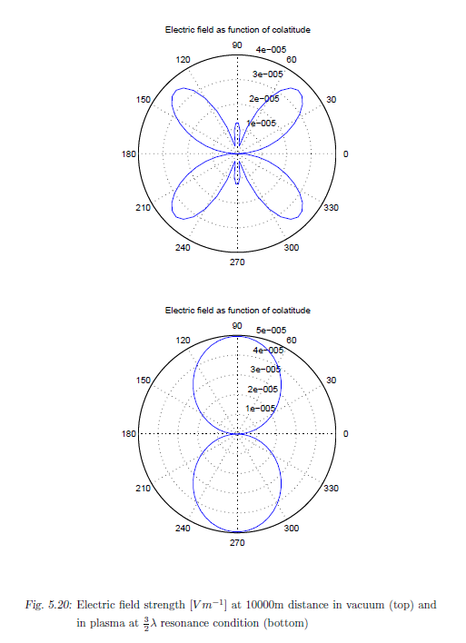
Dipole Radiation
But near resonances the situation can be different.

Slide 38
Content
Introduction
The method of moments (MoM)
Theory (Plasma-Electrodynamics)
Theory (Antenna Theory)
Analysis of a dipole radiation
Application on STEREO antennas
Modeling the plasma sheath
Conclusion + Outlook

Slide 39

STEREO Antennas
Calculations of the S-WAVES antennas where performed.
The Stereo mission comprises 2 spacecraft.
Both are nearly at earth orbit around the sun, one ahead of earth, one behind.
They drift apart to get a stereographic view with different angles.
Solar radiation is received with the antennas.

Slide 40
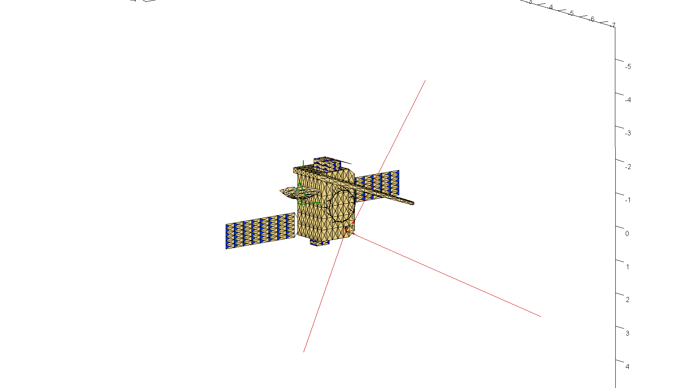
STEREO Antennas
The calculations where performed with Concept II.
In Concept the real and imaginary part of the permittivity can be altered.
By setting the real part, a simple cold isotropic plasma can be simulated.

Slide 41
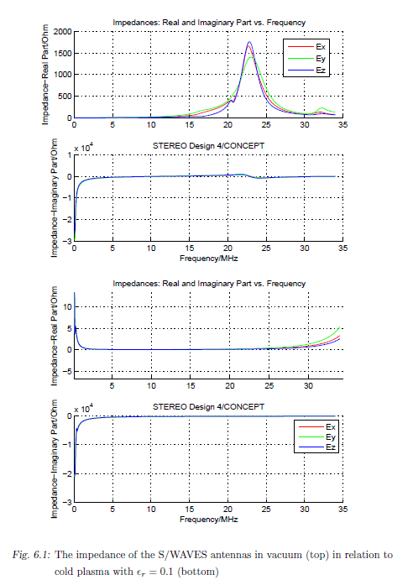
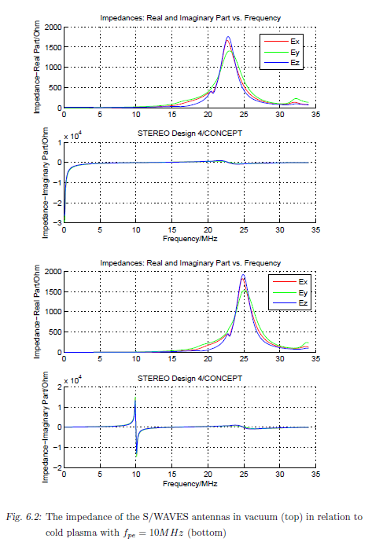
STEREO Antennas: Impedances

Slide 42
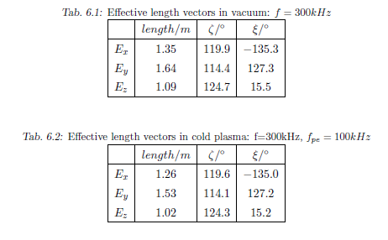
STEREO Antennas: Effective length vectors

Slide 43
Content
Introduction
The method of moments (MoM)
Theory (Plasma-Electrodynamics)
Theory (Antenna Theory)
Analysis of a dipole radiation
Application on STEREO antennas
Modeling the plasma sheath
Conclusion + Outlook

Slide 44

Plasma sheath
Conductive surfaces interact with surrounding plasma.
Around the immersed object a plasma sheath forms.
This sheath can vary, depending on the charge of the object (positive or negative).
The sheath can be modeled as capacity which is easily included in the antenna calculation.
[Bale et. al. 2007]

Slide 45
Plasma sheath
2 or three currents flow between S/C and plasma.
In equilibrium the sum of the currents is zero.
Depending on the photoelectron current the S/C is charged positively or negatively.
Different physical effects.
+
-
-
Ion current
Photoelectron
current
Electron
current

Slide 46
Plasma sheath, negative charge
No solar radiation → S/C negatively charged.
If electrons and ions are in thermal equilibrium, mean electron speed is higher.
→ more electrons hit the surface.
→ negative charge builds up.
→ thermal electrons are pushed away by charge.
→ Ions are attracted.
→ electrons depletion sheath forms.
→ the thickness of the sheath regulates itself in a way that the sum of the currents are equal.

Slide 47






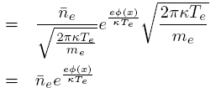
Plasma sheath, negative charge
Thermal electrons are postulated to be Maxwell distributed.
Conservation of energy:
Particle density: zero^{th} moment.
Current: first moment x charge

Slide 48





Plasma sheath, negative charge
All ions reach the surface.
They fall into a potential well.
→ acceleration
→ density decreases due to mass conservation.
Energy conservation.
Combining the conservation laws yields equation for particle density.
From this the ion current can be derived.

Slide 49

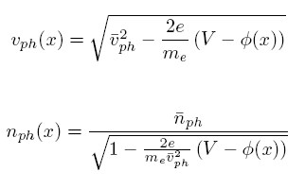
Plasma sheath, negative charge
Photoelectrons are created by the photoelectric effect.
Usually solar radiation.
All photoelectrons reach the plasma.
i_{ph} depends on energy distribution of the photons and on geometry and material of the S/C.
A_{Φ}...illuminated cross section.
Speed and density as for ions..

Slide 50



Plasma sheath, negative charge
Boundary conditions:
The currents are summed to zero.
Quasi neutrality postulated.
Influence of ions small.
Sheath thickness can be estimated as the Debye length or one calculates the potential and density distribution across the sheath.

Slide 51
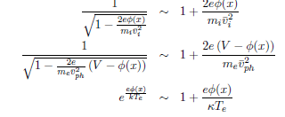






Plasma sheath, negative charge
To calculate the potential distribution, Poisson's equation has to be solved:
This equation is non-linear and can not be solved analytically. But it can be linearized if
Then a Taylor approximation can be used:
Neglecting the photoelectrons and assuming quasi-neutrality, the result is
The solution:

Slide 52



Plasma sheath, negative charge
Sheath resistance is the gradient of the V-I curve.
Explicit expression by [Gurnett 2000]
At high frequencies the resistance can be neglected.
For the capacity I use the formula of a cylindrical capacitor.

Slide 53
Plasma sheath, positive charge
Photo-electrons dominate.
Again, the currents sum up to zero.
→S/C is charged positively. Number of photoelectrons reaching the plasma (only a few %) == number of thermal electron reaching the surface.
Most photoelectrons have too low energy and fall back to the surface from which they are attracted.
They form an electron-sheath.
They are not part of the photo-electron current.

Slide 54





Plasma sheath, positive charge
All thermal electrons reach the surface → no Boltzmann
Only photoelectrons which are energetic enough reach the plasma.
Photo-electrons nearly Maxwell-distributed [Grard et. al].
Photo-electron backflow:
Photo-electron current == thermal electron-current.
→ total backflow:
Potential:

Slide 55




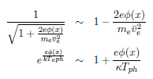
Plasma sheath, positive charge
Poisson equation, 1D over flat surface:
Or
Linearizion:
With assumed quasi-neutrality:
Which gives:

Slide 56



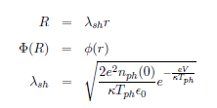


Plasma sheath, positive charge
In cylindrical coordinates:
Linearized:
Can be brought into the form of a Sturm Luiville problem:
With the solution:
and

Slide 57






Plasma sheath, positive charge
The sheath resistivity:
Using just the photoelectrons, one can write:
Then
As before
But now using the mean permittivity:

Slide 58



Plasma sheath, STEREO
Using the equations presented before:
the S/C is positively charged and 5.5V is in accordance with experience of similar missions.
The Debye length of the photoelectrons:
Using the derived formula:
This gives:
Bale gives a capacity of 40pF

Slide 59
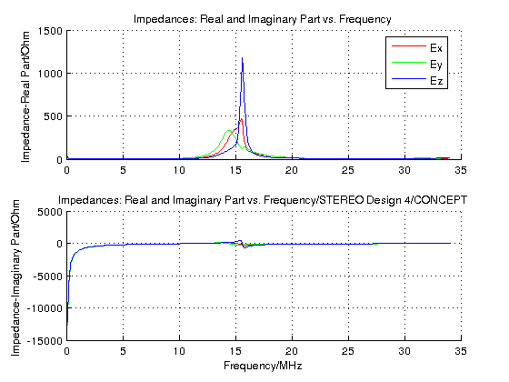
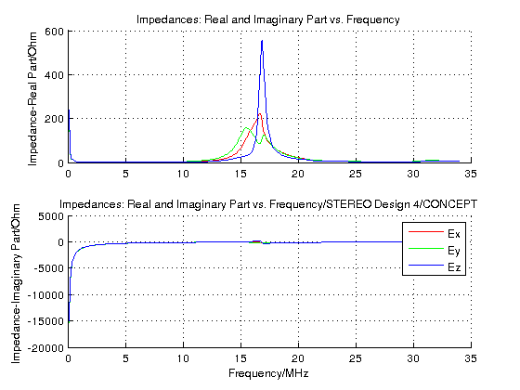
Plasma sheath, STEREO

Slide 60
Content
Introduction
The method of moments (MoM)
Theory (Plasma-Electrodynamics)
Theory (Antenna Theory)
Analysis of a dipole radiation
Application on STEREO antennas
Modeling the plasma sheath
Conclusion + Outlook

Slide 61
Outlook
Only the most simple situation has been treated, cold isotropic plasma.
It has been shown that kinetic treatment is not necessary.
Including the effect of magnetized plasma would be interesting, because S/C typically operate in such an environment.
Using the FDTD method, it would be easier to implement anisotropy.
Also isotropic results could be verified.
But there is probably another way to implement anisotropic plasma in MoM simulations without having to use the dielectric tensor.
In this simple dielectric plasma model, plasma manifests itself as a change in wavelength and therefore phase speed.
By scaling the model, the same results can be achieved.

Slide 62
Outlook
Calculation | Impedance
Dipole, 6m, ε=1, r=2mm | 6.882736497964838e-03 - 7.112228243779676e+04i
Dipole, 6m, ε=0.5, r=2mm | 3.441273366066885e-03 - 1.005881770038659e+05i
Dipole, 6m *sqrt(ε), ε=1, r=2mm*sqrt(ε) | 3.441273374398452e-03 - 1.005881770038794e+05i

Slide 63
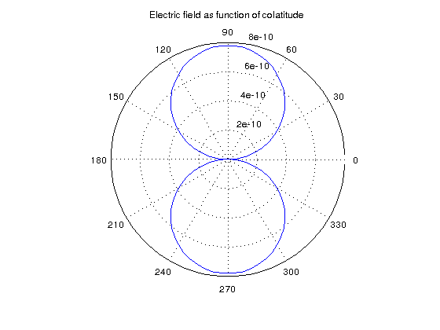
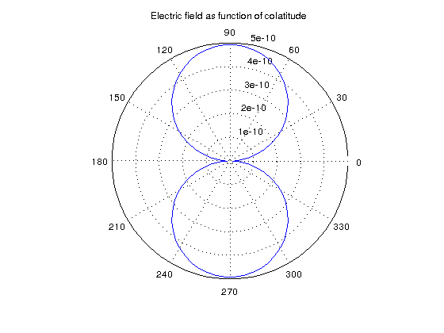
Outlook

Slide 64
Outlook
Unfortunately this does not work with all solvers. But it is easier to write a solver which adheres to the invariance of Maxwell's equations at scaling, than to write one which can cope with dielectric tensors.
Magnetized plasma could be modeled by scaling the model an-isotropically
It remains to analyze how the imaginary tensor elements are to be dealt with.
The plasma sheath theory should be refined and synchronized with existing results and ongoing research.
It is possible to simulate the sheath realistically by using particle simulations or particle-in-cell simulations.

Slide 65
Thank you for your attention !

