Slide 1
Voice-Controlled Smart Home System
An Embedded Systems Project Pitch
Your Name – Aaradhya gupta

Slide 2
Problem Domain
Controlling home appliances (lights, fans) is often manual.
Many existing smart home systems are expensive.
Lack of low-cost, voice-controlled systems that integrate with IoT.
Need for an affordable, user-friendly smart home solution.

Slide 3
Proposed Solution
Use Raspberry Pi + microphone for voice recognition.
Use Arduino Nano 33 IoT for controlling devices.
Use Relay Module to control real 230V appliances (light/fan) safely.
Voice commands like:
“Turn on light → Relay ON → Light ON”
“Turn off fan → Relay OFF → Fan OFF”
“What’s the temperature?” → Arduino sends readingLow-cost, scalable, and easy to expand.

Slide 4
Main Components
Raspberry Pi (brain, voice processing)
Arduino Nano 33 IoT (executor, device control)
USB Microphone (voice input)
Relay Module – Acts like an electronic switch to control real appliances
LEDs (simulate bulb + fan)
Optional Sensors:
DHT22 (temperature & humidity)
LDR + resistor (light intensity)

Slide 5
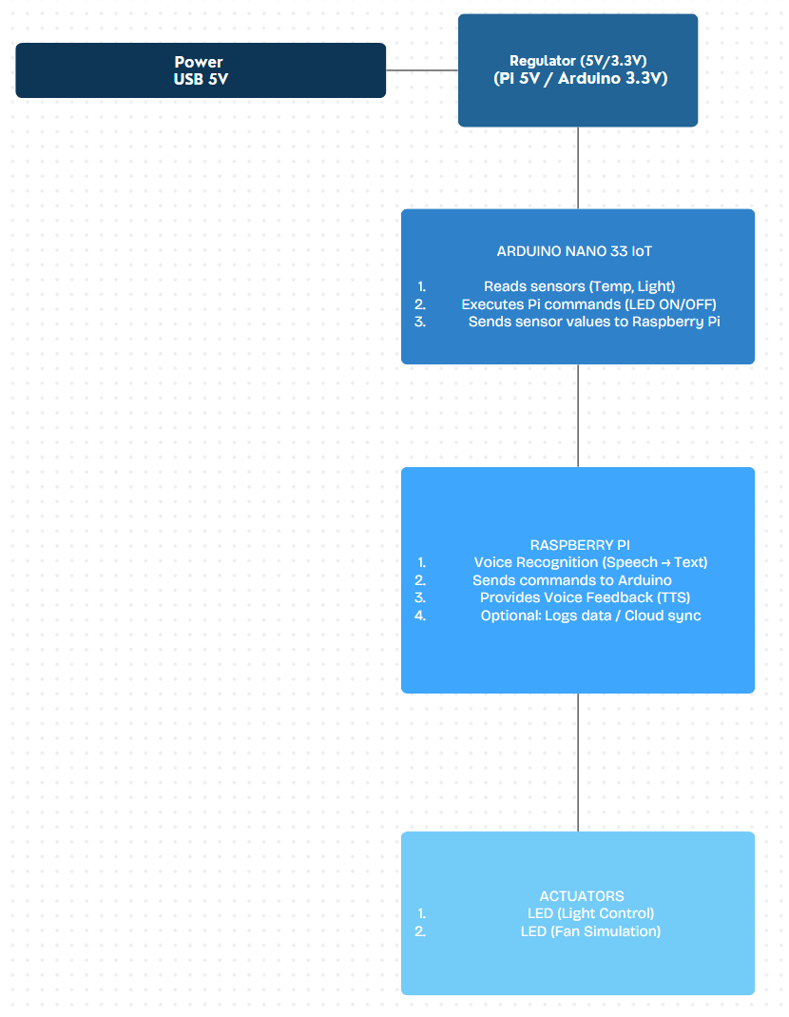
Block Diagram

Slide 6
Communication Protocols
Raspberry Pi ↔ Arduino → Serial (USB UART).
Arduino ↔ LED/Fan → Digital I/O.
Arduino ↔ Sensors (optional) → Analog/Digital pins.
Pi ↔ User → Voice recognition + text-to-speech feedback.

Slide 7
User Interface
Voice commands via Pi microphone.
Arduino responds with LED actions (light/fan simulation).
Raspberry Pi can display or speak sensor values.
Example:
User: “What’s the temperature?”
Pi: “The temperature is 28 degrees.”

Slide 8
Flow Diagram
User gives voice command.
Pi converts speech → text.
Pi sends command to Arduino.
User → Pi → Arduino → Relay Module → Appliance (Light/Fan)
Pi responds to user (LED feedback or spoken message).

Slide 9
Benefits
Affordable smart home system.
Hands-free control with voice.
Real-time monitoring of environment.
Easily expandable (more appliances, cloud, mobile app).
Can control real high-voltage appliances using relay module

Slide 10
Conclusion
Integrates Raspberry Pi, Arduino Nano 33 IoT, and a Relay Module to control real appliances.
Provides voice-controlled automation.
Scalable: add relays for real appliances, sensors for richer data.
Future scope: cloud sync, smartphone app, AI-based automation.

