Slide 1
Data Mining and Machine Learning
Lecture 3: Data Preprocessing
Dr. Edgar Acuna
Department of Mathematical Sciences
Universidad de Puerto Rico- Mayaguez website: academic.uprm.edu/eacuna

Slide 2
Data Preparation-1
Data Preparation= Data Cleansing+ Feature Engineering
Data cleansing converts the raw data into one of good quaity and ready for analysis. It includes the following tasks:
Select, Filter and removal of duplicates
Sampling
Data Partitioning: Creation of the training, the validation and the test sets.
Data Normalizacion.
Data Reduction
Data Integration.
Discretization (Binning)
Imputation of missing values

Slide 3
Data Preparation-2
Feature Engineering:
It selects the right attributes to be used in the Machine Learning Algorithm.
It involves
The use of domain knowledge of the data to select or create attributes.
Feature selection.
Validation of how the features work with your model
Feature Extraction: Principal component Analysis(PCA)

Slide 4
Data Preparation-3
Data Preparation: Data Preprocessing + Data Wrangling (Data Munging)
Data preparation can be classified in two, according to the moment of the analytic process when it is performed:
Data Preprocessing: Preparation of data directly after accessing it from a data source. Typically realized by a data scientist for initial transformations, aggregations and data cleansing. This step is done before the interactive analysis of data begins. It is executed once.
Data Wrangling: Preparation of data during the interactive data analysis and model building. Typically done by a data scientist to change views on a dataset and for features engineering. This step iteratively changes the shape of a dataset until it works well for finding insights or building a good analytic model.

Slide 5
Why Preprocess the Data?
Data in the Real World Is Dirty: Lots of potentially incorrect data, e.g., instrument faulty, human or computer error, transmission error
incomplete: lacking attribute values, lacking certain attributes of interest, or containing only aggregate data
e.g., Occupation=“ ” (missing data)
noisy: containing noise, errors, or outliers
e.g., Salary=“−10” (an error)
inconsistent: containing discrepancies in codes or names, e.g.,
Age=“42”, Birthday=“03/07/2010”
Was rating “1, 2, 3”, now rating “A, B, C”
discrepancy between duplicate records

Slide 6
Why Preprocess the Data?
Intentional (e.g., disguised missing data)
Jan. 1 as everyone’s birthday?
It data does not have quality then results Machine Learning algorithms do not have quality! (GIGO Principle)
The quality of decisions is based on data quality.
A good Data Warehouse is built on integration of data having high quality.

Slide 7
Noisy Data
Noise: random error or variance in a measured variable
Incorrect attribute values (Noise) may be due to
faulty data collection instruments
data entry problems
data transmission problems
technology limitation
inconsistency in naming convention.
Two Sine Waves
Two Sine Waves + Noise

Slide 8
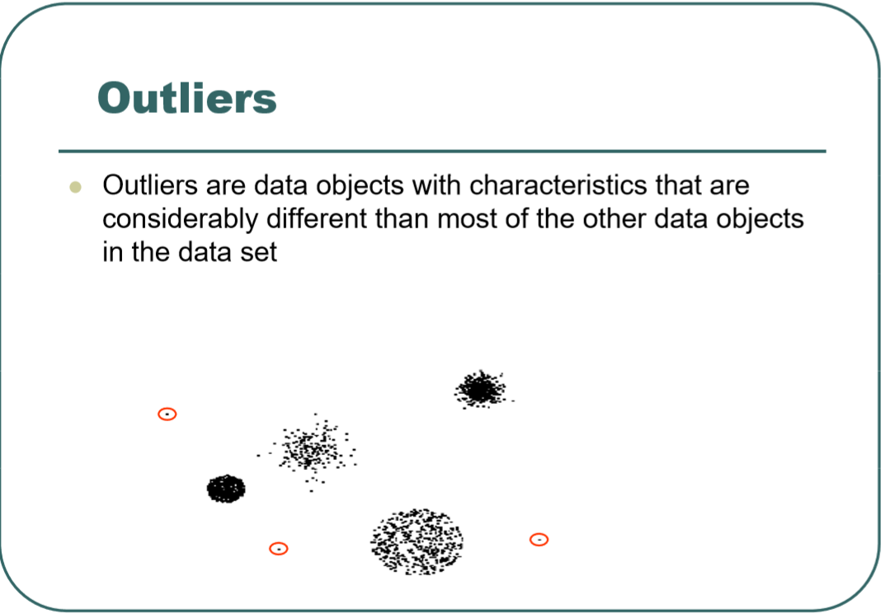

Slide 9
Major Tasks in Data Preprocessing
Data cleaning
Fill in missing values, smooth noisy data, identify or remove outliers, and resolve inconsistencies
Data integration
Integration of multiple databases, data cubes, or files
Data reduction
Obtain a reduced representation of the data set that is much smaller in volume but yet produces the same (or almost the same) analytical results. It includes Dimensionality reduction, Numerosity reduction, Data compression
Data transformation
Normalization
Data discretization(binning)

Slide 10
Data Cleaning
Tasks:
Fill in missing values valores.
Outlier Detection
Smoothing of noisy data.
Fixing inconsistences.

Slide 11
Handling of Missing Values
Data is not always available
E.g., many tuples have no recorded value for several attributes, such as customer income in sales data
Missing data may be due to
equipment malfunction
inconsistent with other recorded data and thus deleted
data not entered due to misunderstanding
certain data may not be considered important at the time of entry
not register history or changes of the data
Missing data may need to be inferred.

Slide 12
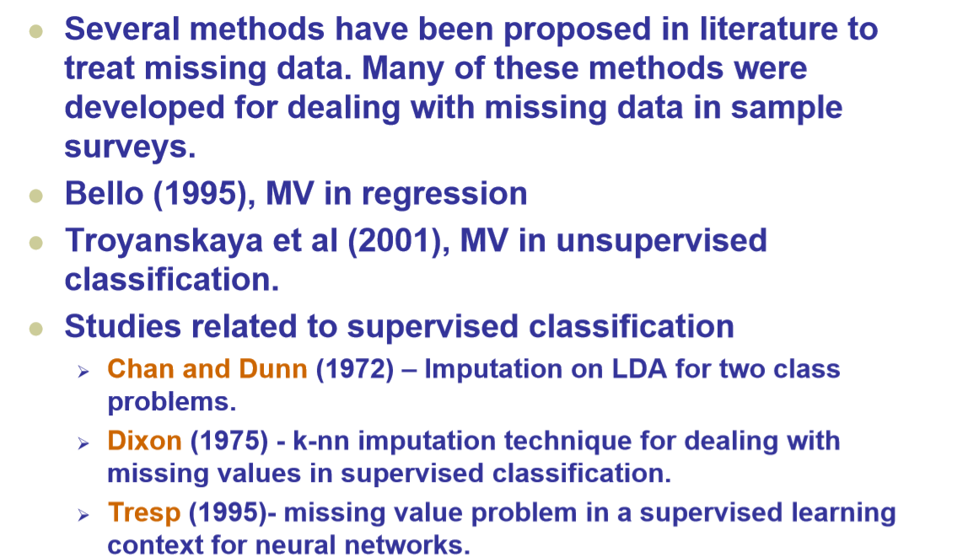
Handling of Missing Values (cont)

Slide 13
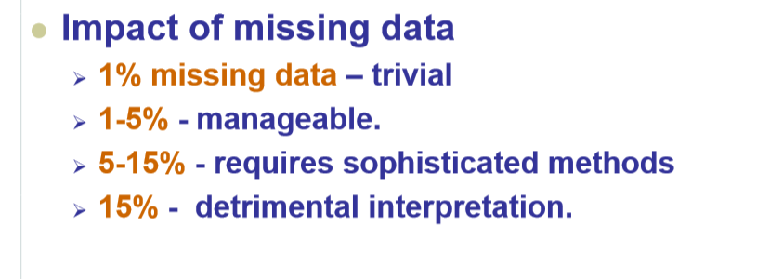
Handling of Missing Values (cont)

Slide 14
Example: The Census dataset
Also it is known as Adult.
48842 instances, it contains continuous, ordinals and nominal features (training set =32561 , test set=16281).
Remain 45222 instances after deleting instances containing at least one missing value. (Training set=30162, test=15060).
Size in Bytes=Training set 3.8M, Test set 1.9MB.
Available at: http://archive.ics.uci.edu/ml/
Donors: Ronny Kohavi y Barry Becker (1996).

Slide 15
Features in Census
1- age: continuous.
2- workclass: Private, Self-emp-not-inc, Self-emp-inc, Federal-gov, Local-gov, State-gov, Without-pay, Never-worked. Nominal
3- fnlwgt (final weight) : Continuous.
4- education: Bachelors, Some-college, 11th, HS-grad, Prof-school, Assoc-acdm, Assoc-voc, 9th, 7th-8th, 12th, Masters, 1st-4th, 10th, Doctorate, 5th-6th, Preschool. Ordinal.
5- education-num: continous.
6- marital-status: Married-civ-spouse, Divorced, Never-married, Separated, Widowed, Married-spouse-absent, Married-AF-spouse. Nominal
7- occupation: Nominal

Slide 16
Features in Census
8-relationship: Wife, Own-child, Husband, Not-in-family, Other-relative, Unmarried. Nominal
9-race: White, Asian-Pac-Islander, Amer-Indian-Eskimo, Other, Black. Nominal
10-sex: Female[0], Male[1]. Nominal-Binary.
11-capital-gain: continuous.
12-capital-loss: continuous.
13-hours-per-week: continuous.
14-native-country: nominal
15 Salary: >50K [2], <=50K [1].

Slide 17
The census dataset

Slide 18
Reading the data file using Python
import pandas as pd
df = pd.read_csv('https://archive.ics.uci.edu/ml/machine-learning-databases/adult/adult.data', header=None, sep=',‘,na_values=“ ?”)
df.columns=['v1', 'v2', 'v3', 'v4',v5','v6','v7','v8','v9','v10','v11','v12','v13','v14','class’]
Another way:
import pandas
names=['v1','v2','v3','v4','v5','v6','v7','v8','v9','v10','v11','v12','v13','v14','clase']
data=pandas.read_csv('c://PW-PR/census.csv',names=names)
print(data.shape)
(32562, 15)
data.describe()

Slide 19
Pyhton functions dealing with missing values
Asssuning that df is a Pandas dataframe
To find out columns containing missing values
colmiss=df.columns[df.isnull().any()].tolist()
To find out columns containing missing values
rowmiss=df.index[df.isnull().T.any()].tolist()
To find out the percentage of rows with missing values
df.isnull().T.any().sum()*100/float(len(df))
To find out the percentage of missing values per column
df[colmiss].isnull().sum()*100/float(len(df))
Deleting all the rows conatining missing values
dfclean=df.dropna()
print dfclean.shape
(30162, 15)

Slide 20
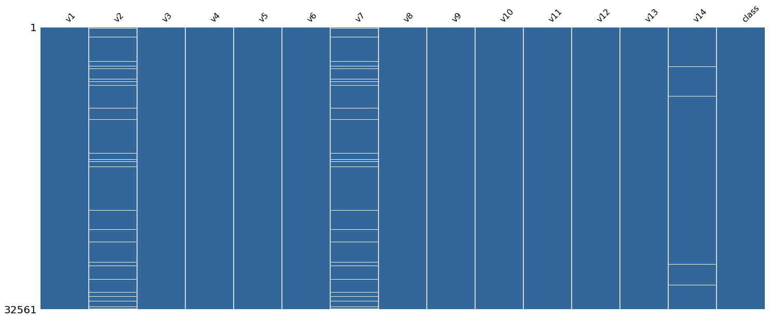
Visualizing the missing values

Slide 21
A “clean” function
Build a function for deleting columns and rows with a large amount of missing values. Something like:
clean(df,tol.col=.5,tol.row=.3)
In here, from the dataframe df we are deleting columns with more than 50 % of missing vaues and rows with more than 30% of missings

Slide 22
Modules in Python to impute missing values
The module scikit-learn has a class named imputer to carry out inputation.
The function fill.na in pandas does imputation.
Also, there are two other module for imputation
Fancyimpute
impyte
Both of them run only in Python 3.

Slide 23
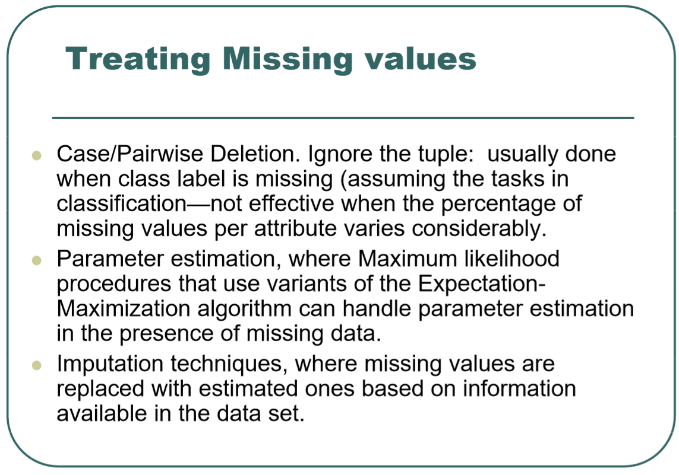

Slide 24
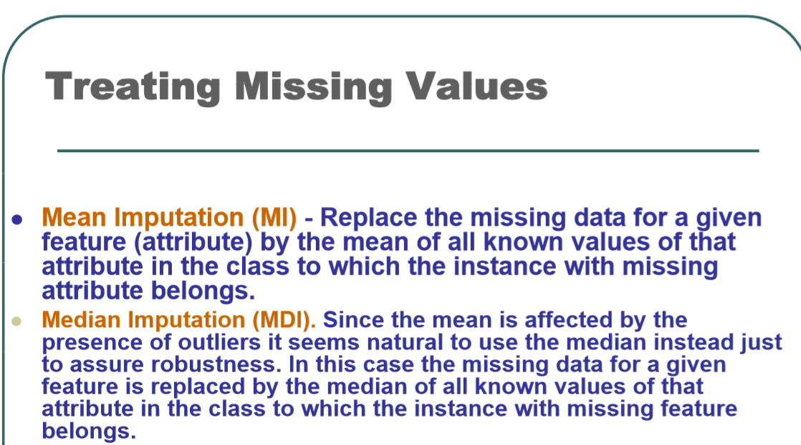
Mean Imputation using Pandas:
df.fillna(df.mean())
df.apply(lambda x: x.fillna(x.mean()),axis=0)

Slide 25
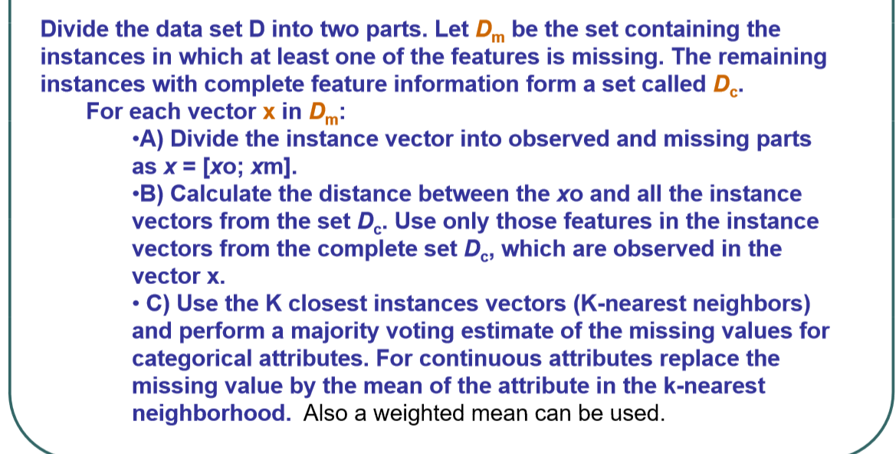
K-Nearest Neighbors Imputation

Slide 26
K-nn Imputation
A1 | A2 | A3 | A4 | Clase
4 | 5 | 6 | NA | 1
5 | 1 | 1 | 4 | 1
7 | 9 | 2 | 5 | 1
8 | 2 | 8 | 5 | 1
6 | 4 | 2 | 6 | 1
There is a missing value in record 1. We will predict this NA value using knn. Dist(r1,r2)= sqrt[(4-5)²+(5-1)²+(6-1)²]= 6.48, Dist (r1,r3)=6.40, Dist(r1,r4)=5.38, Dist(r1,r5)= 4.58. There is a function distance in the module scipy.spatial. Also numpy.linalg,norm compute the Euclidean distance between to arrays. Using k=1 nearest neighbor, this is record r5, NA would be replaced by 6, using k=3 nearest neighbors: r3,r4 y r5, NA would be replaced by the average value of 5, 5 and 6 that is 5.33

Slide 27
K-nn Imputation (cont)
The method can not be applied if all the rows have at least a missing value.
Usually, k is taken equals to 10. The k value is at most equals to the number of complete rows.Usualmente, se toma k igual a 10.
If the dataset contains numerical and categorical atributes the the euclidean distance can be replaced by the Gower distance.
.

Slide 28
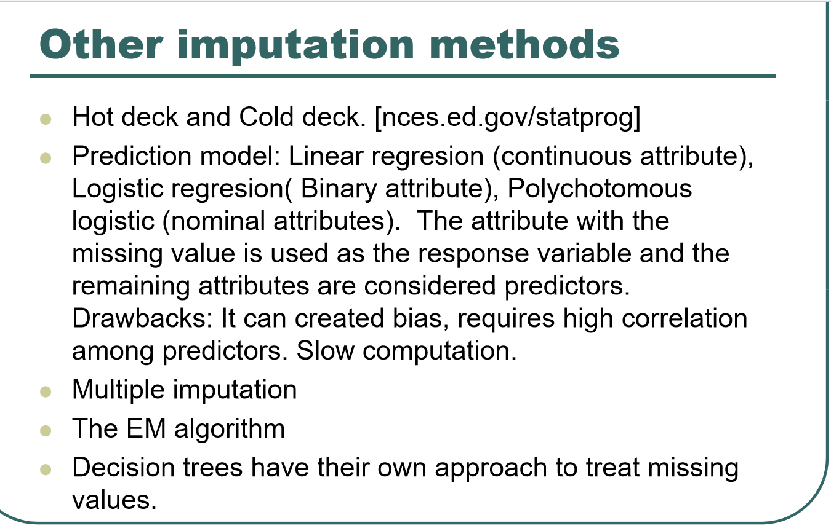

Slide 29
Other imputation methods (cont)
Multiple Imputation. The missing values are imputed several times by choosing randomly from the observed values. The final prediction is obtained by combining the individual predictions.
The SVD method (X=UΣV’). It is iterative. Initially missing values are replaced by the mean of the corresponding column and in each iteration these values are updated until the norm of the matrix converges.
The above approaches are too expensive.

Slide 30
Effect of the treatment of Missing values
For datasets with an small amount of missing values, say less than 1 percent, deleting the cases containing missing values does not have much affect on the performance of the machine learning algorithm. However the variability of the estimated error increases.
There is not much difference between mean imputation and median imputation.
The effect of the missing values depends on the way that they are distributed on the table and its location with respect to the most important features.
The percentage of instances containing missing values has more effect than the percentage o table cells containing missing values on the performance of the algorithm.

Slide 31
Preprocessing-Normalization
Data normalization consists in scaling the attribute values of the data into an small specified range, such as -1 to 1 or 0 to 1.
Also, it is known as range normalization.
There is also variance normalization but mostly is used in bioinformatics

Slide 32
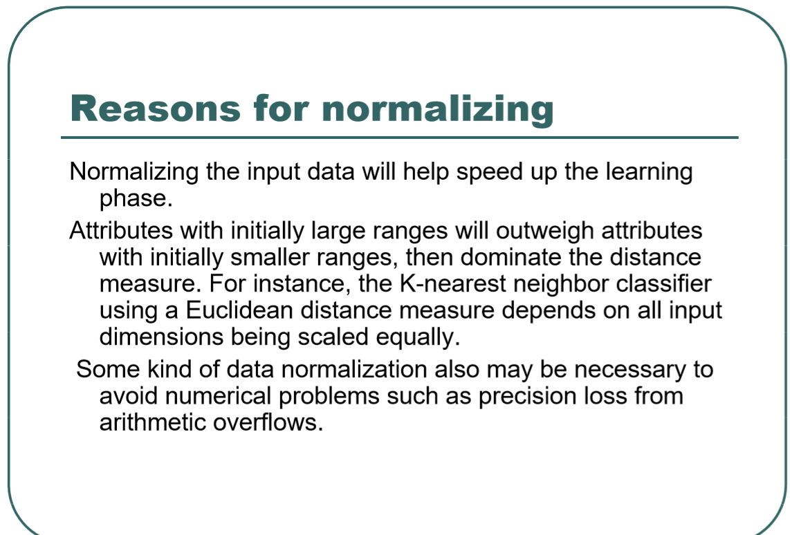

Slide 33
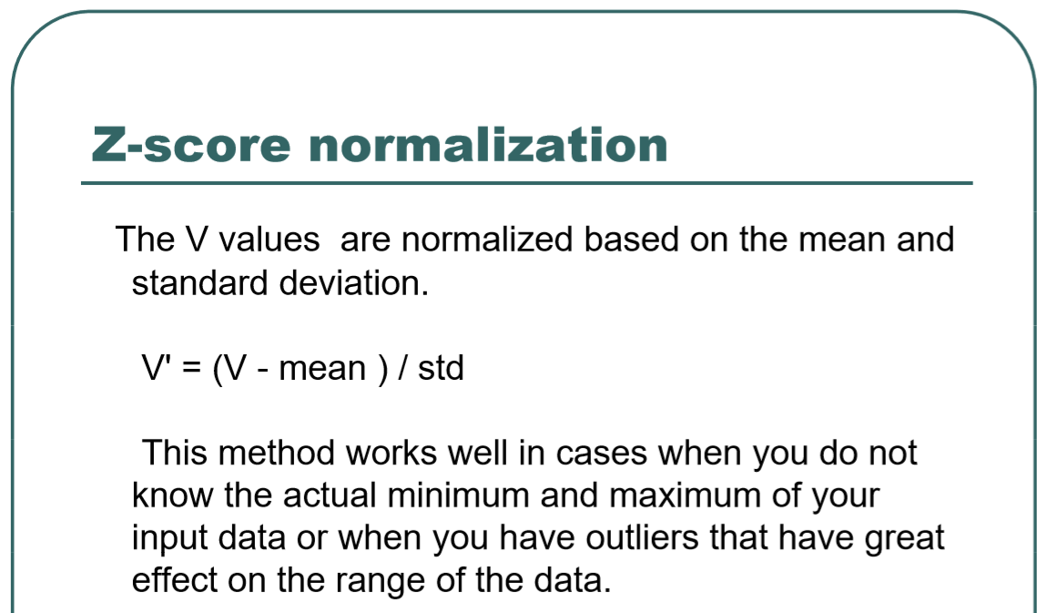
It can be done with pandas or with the class StandardScaler from scikit-learn

Slide 34
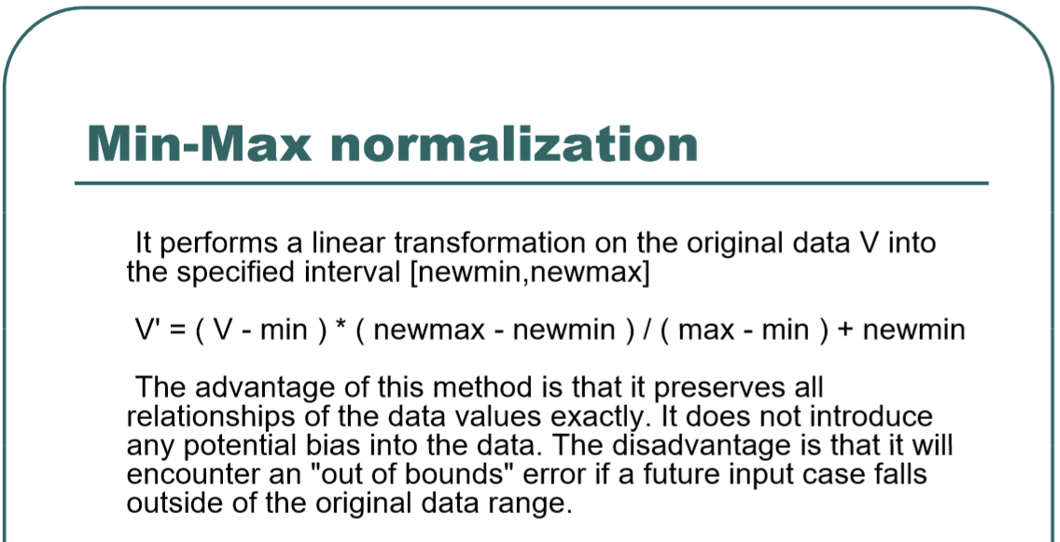
It can be done with Pandas or with the class MinMaxScaler from scikit-learn

Slide 35
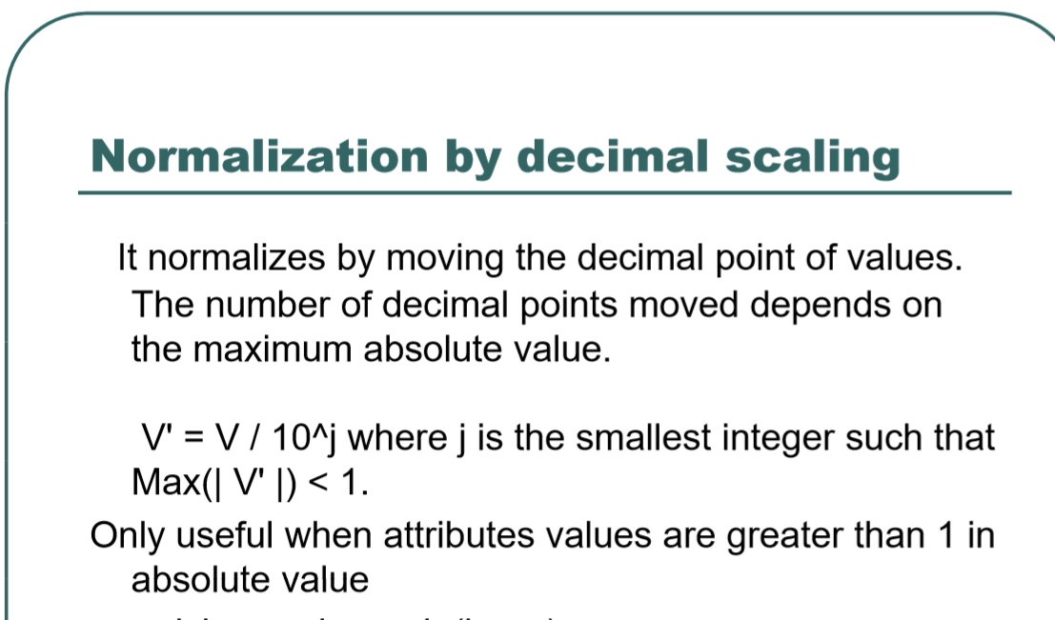

Slide 36
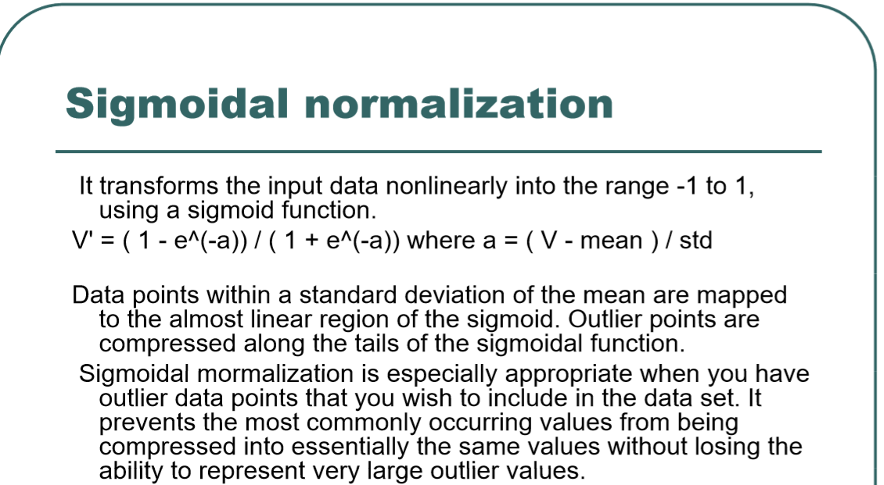

Slide 37
