Slide 1
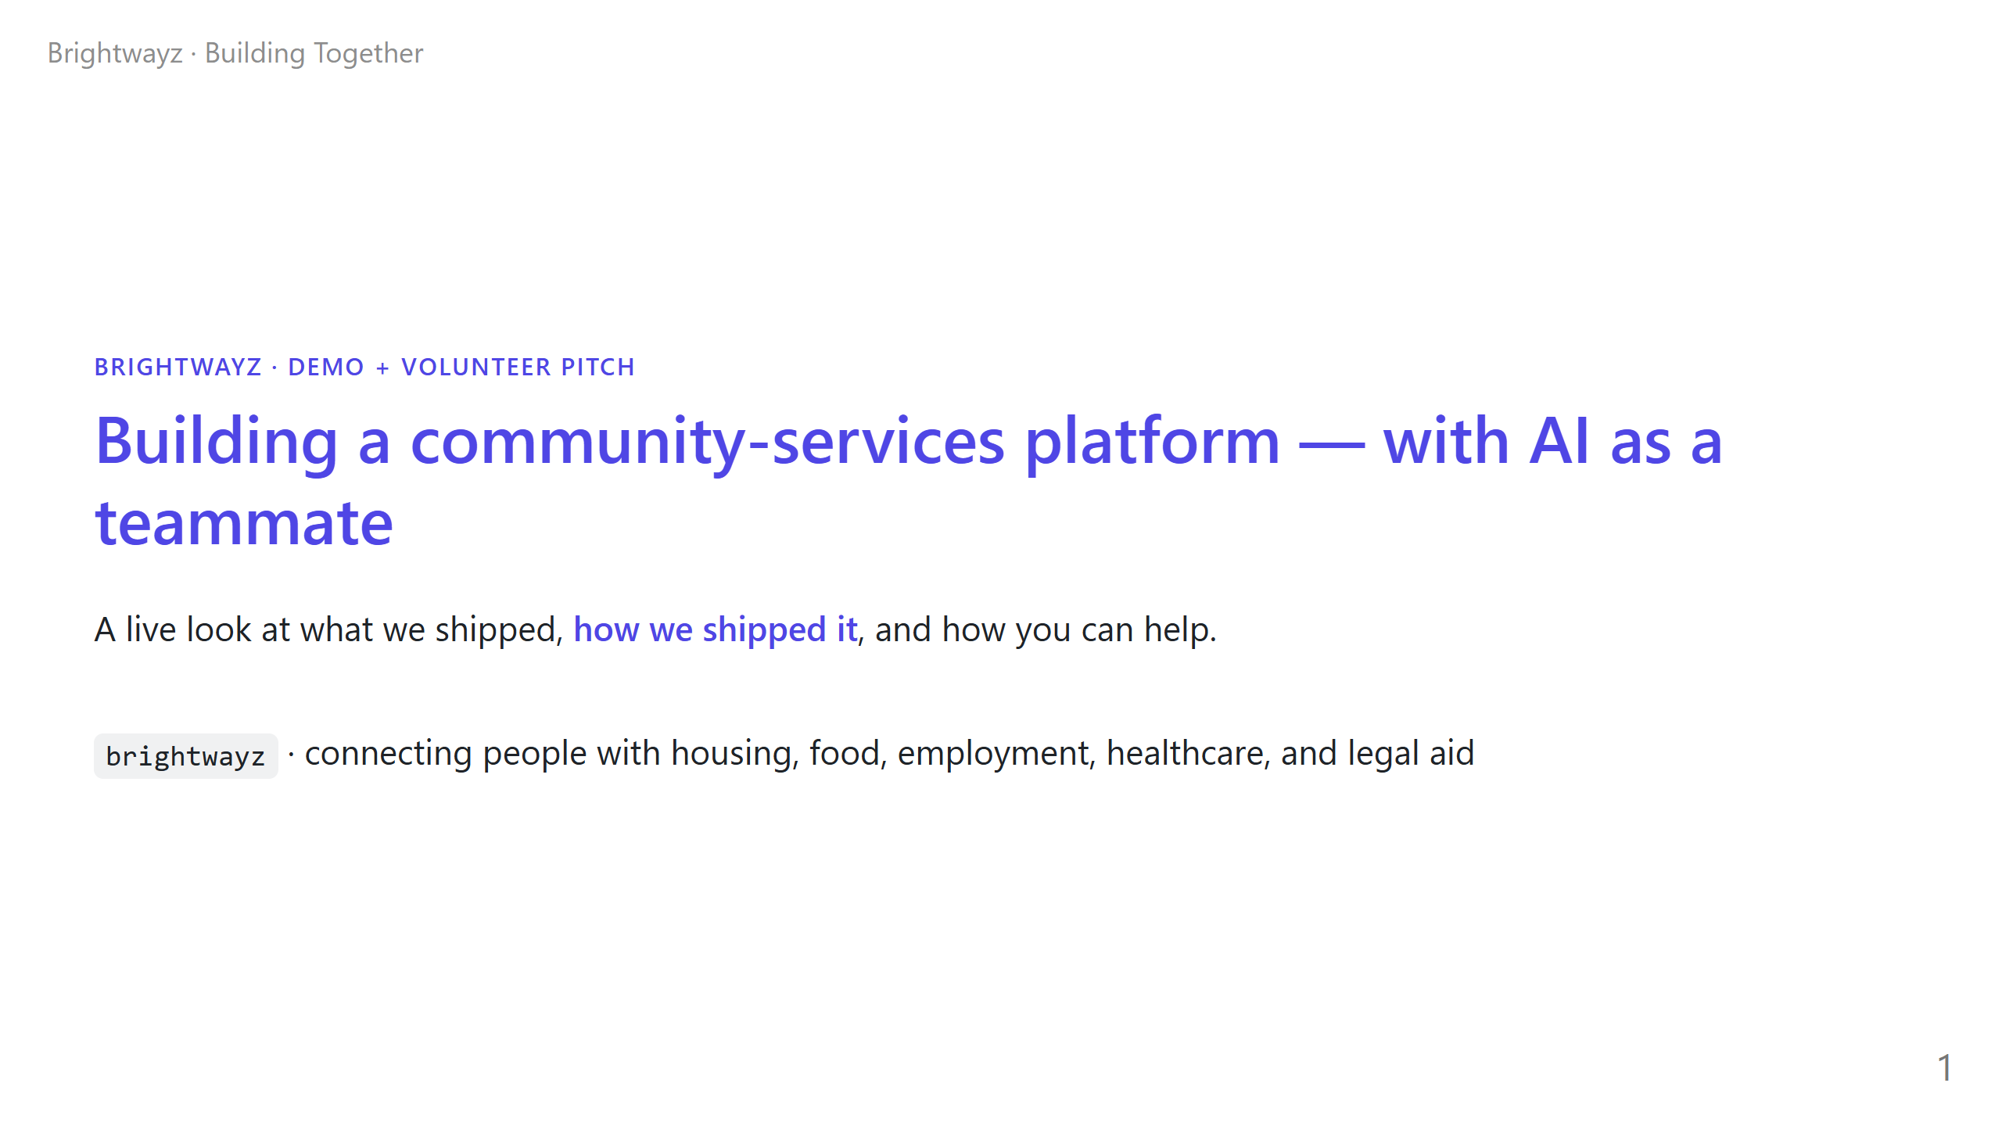
Notes:
==================================================================== TIMING: 60 sec OPENING (warm + confident): "Thanks for being here. This is a 15-minute walk through a project that proves a small group of people — many of them non-coders — can ship real production software now, with AI as a teammate. I'm going to show you what we built, how, and where you fit in." NOTES: - Don't say "vibe coding" yet — let it land in slide 4 - Mix of technical + non-technical in the room: keep eye contact split - If the demo URL is live, mention "you can pull this up on your phone right now"

Slide 2
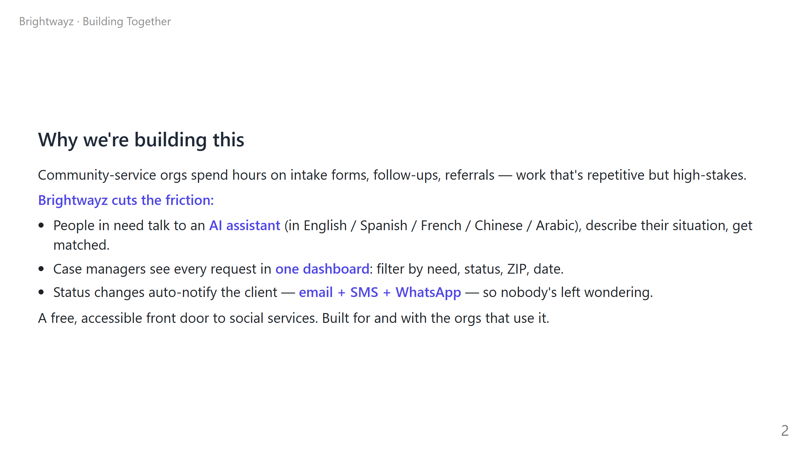
Notes:
TIMING: 90 sec KEY POINTS: 1. Frame the pain first — "intake hell" resonates with anyone who's ever volunteered at a food bank, free clinic, or housing nonprofit. 2. Three concrete benefits, one per audience role. 3. Land on "built for and with" — this signals that we want their input, which is the recruiting hook. ANALOGY (if non-tech audience): "Think of it like the difference between filling out 8 PDFs and texting a friend who already knows what to ask." DO NOT: - List every feature here. That's the next slide. - Mention competitors. Stay focused on the work.

Slide 3
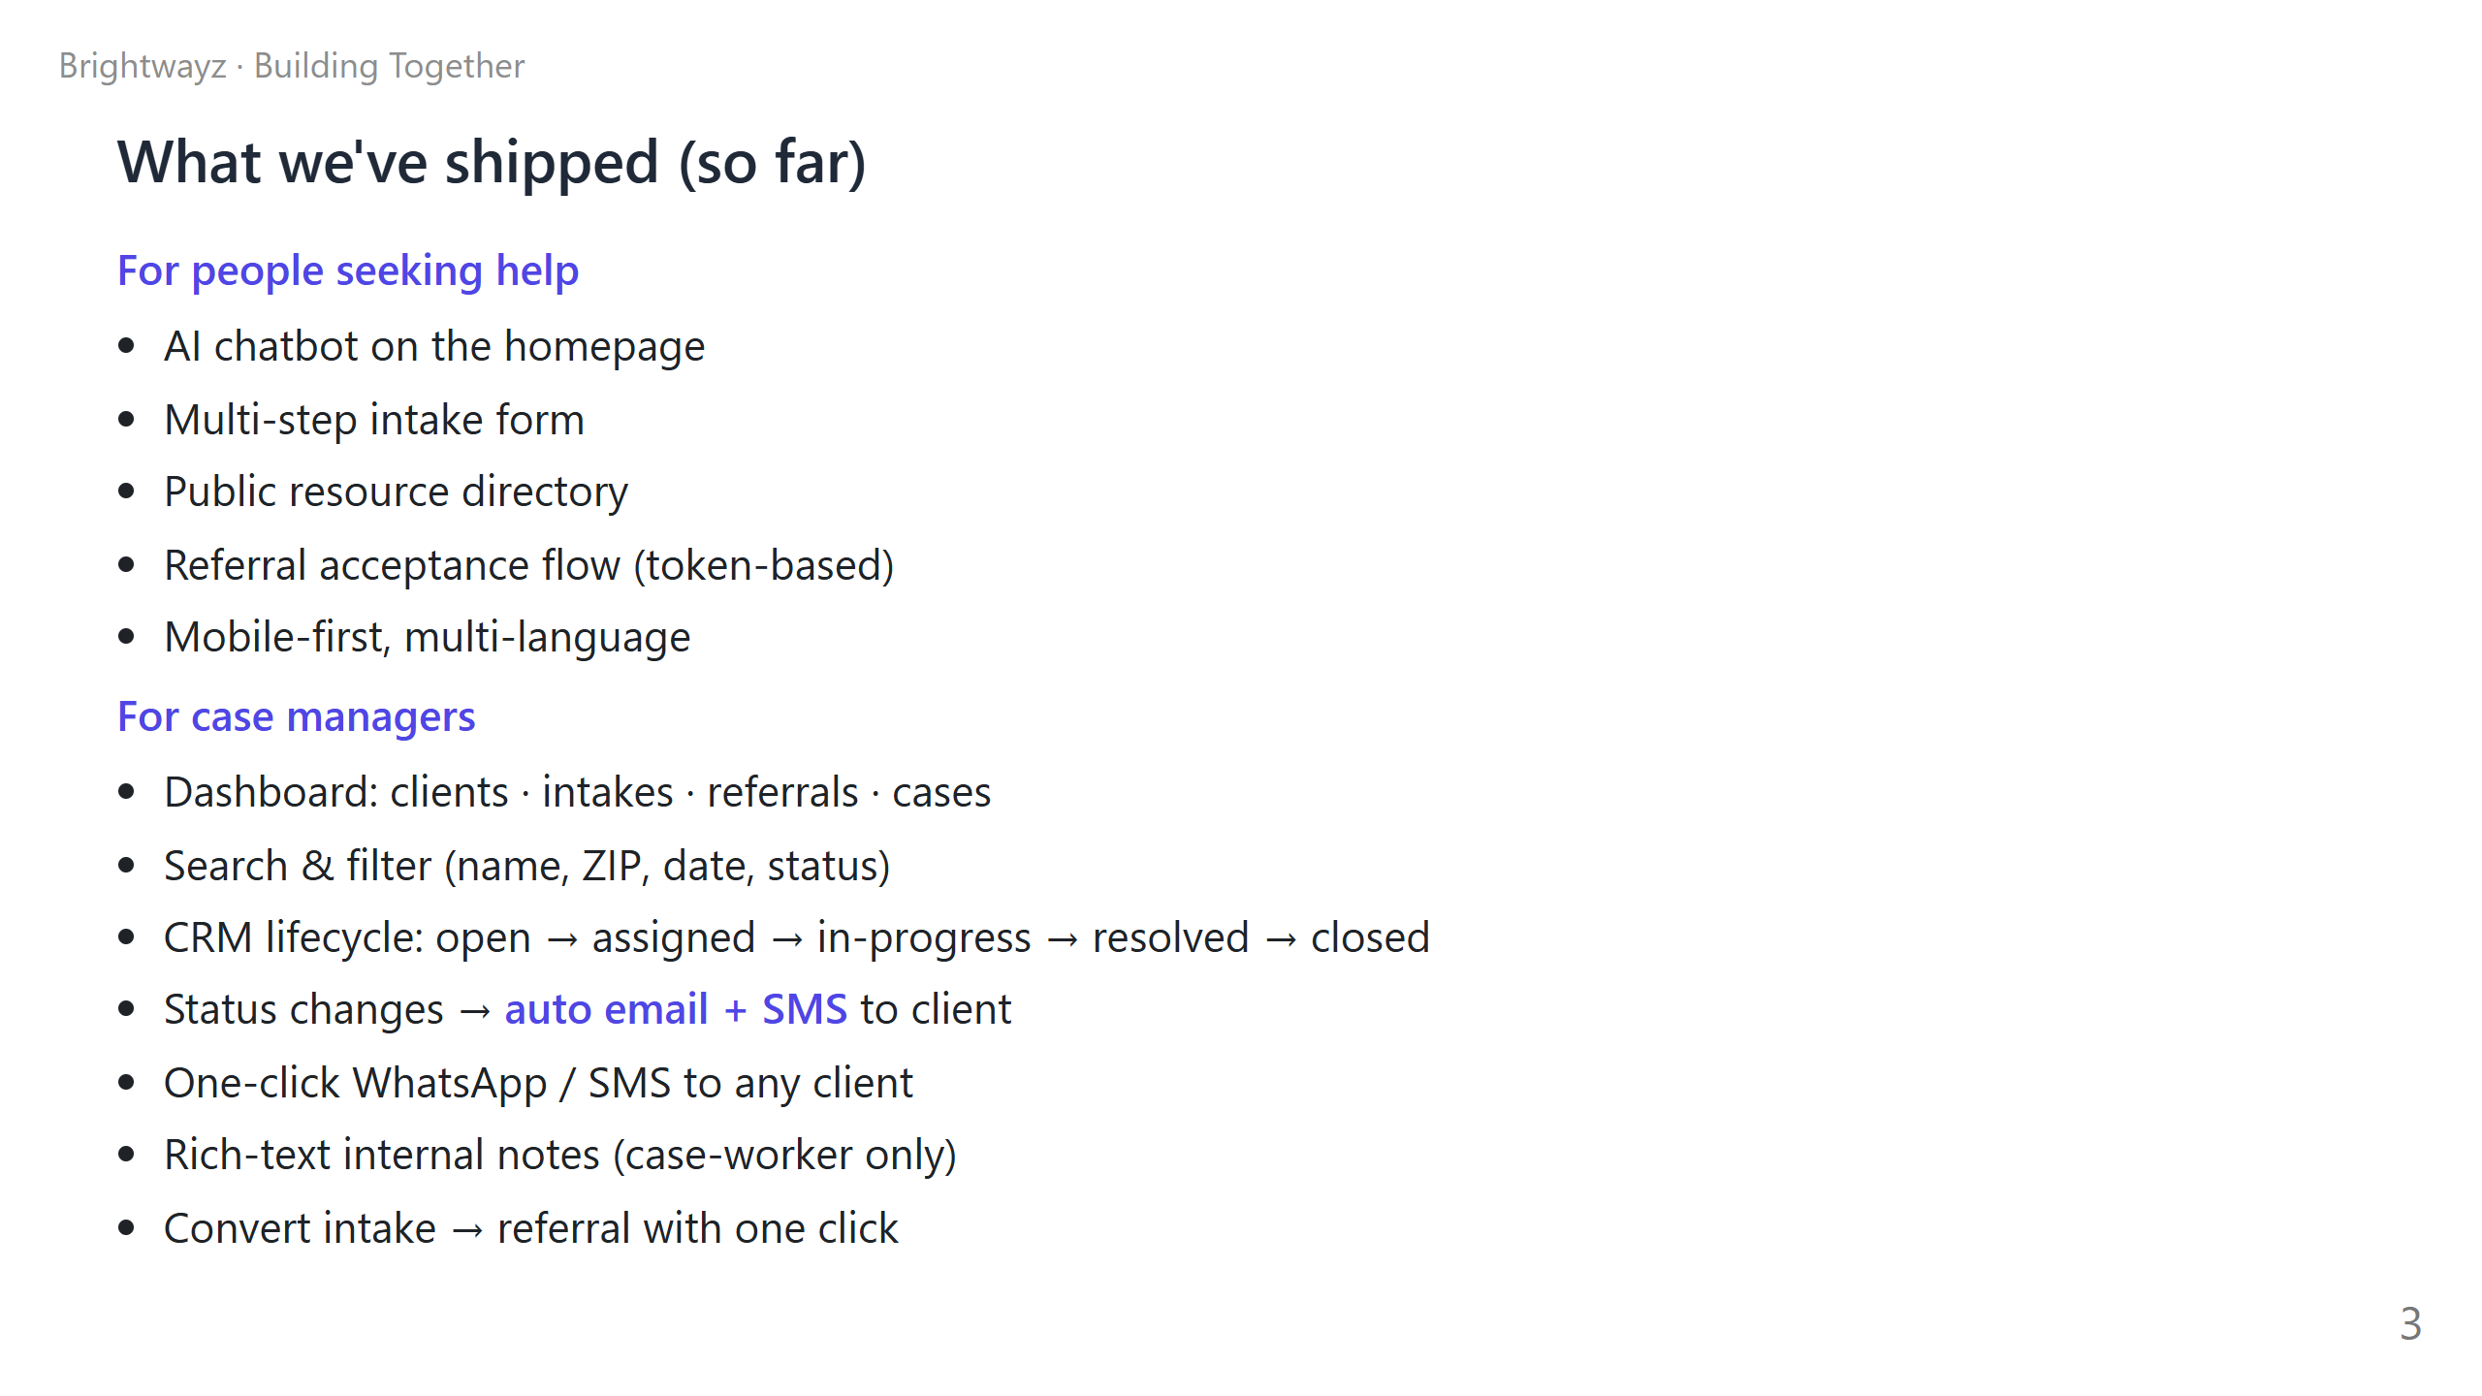
Notes:
TIMING: 2 min (this is where the live demo happens) LIVE DEMO: Open two browser windows on the projector: 1. Phone or laptop on the public landing page (the AI chatbot) 2. Dashboard logged in as a case worker WALK THROUGH: - "I'm a person needing housing help" → say one sentence to the AI chatbot. Watch it ask for the right follow-up info. - Switch to dashboard → "and here it is, in real time." - Click into the new intake → show the case status dropdown → flip it to 'assigned' → "watch — the client just got an email saying a case manager is on it. And an SMS, and a WhatsApp." IF DEMO BREAKS: - That's fine — say "this is software, software breaks." - Pivot to screenshots if you've got them prepped. - Don't try to debug live; it eats time and audience attention. IF DEMO GOES LONG: - Cut the SMS / WhatsApp demo (the email one alone makes the point).

Slide 4
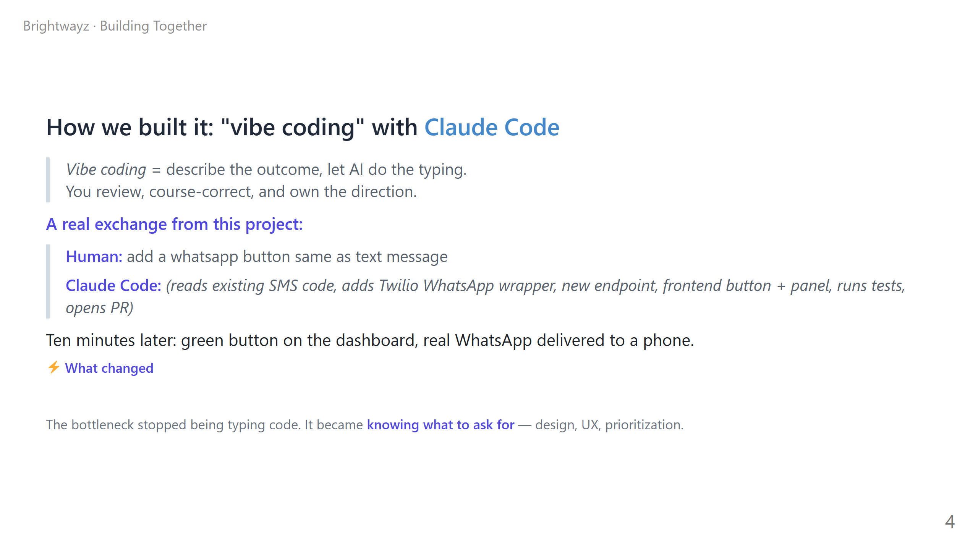
Notes:
TIMING: 2 min DEFINE FIRST: pause and say the term out loud. "Vibe coding is a term coined by Andrej Karpathy earlier this year. The idea is: you describe the vibe of what you want, and the AI handles the typing. Your job becomes *direction*, not *production*." THEN: the WhatsApp story. - Six words → working feature, end to end. - Mention this is REAL — not staged, not a demo project. Real Twilio account, real WhatsApp message, real production deploy at the time. PUNCHLINE — say it slowly: "The bottleneck stopped being typing code. It became knowing what to ask for." TIE TO AUDIENCE: - Tech folks: "Your code-review skills matter more than ever." - Non-tech: "If you can describe what you want clearly, you can ship." OPTIONAL LIVE BIT: If you have a laptop with Claude Code running, open a new terminal and run a tiny request live. Example: ask it to add a confirmation modal to one button. Watch it write the code in front of the audience. RISKY but high impact if it works.

Slide 5
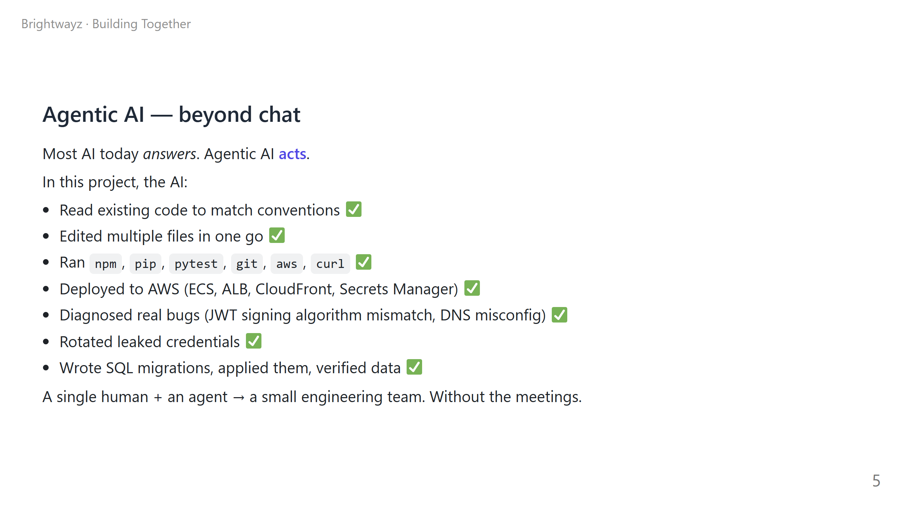
Notes:
TIMING: 2 min CONTRAST CLEARLY: "ChatGPT answers questions. An agent does the work." POINT TO THE LIST: "Every check mark here is a real thing that happened on this project. Not in a sandbox — on actual AWS infrastructure with real credentials." WAR STORY (pick one): 1. JWT mismatch — Supabase migrated to ES256 partway through, every login broke, agent diagnosed and fixed it in 10 minutes. 2. Leaked AWS keys — agent spotted them in a config file, rotated them, and updated GitHub secrets and the live ECS task — without downtime. 3. DNS — agent traced why www.wedkai.com worked but apex didn't, all the way to GoDaddy forwarding settings. These are the kinds of multi-step incidents that used to need an on-call engineer + a meeting. Now: one prompt, one human watching. DON'T: - Oversell. The human still needed to confirm sensitive steps. - The point is "force multiplier," not "replaces humans."

Slide 6
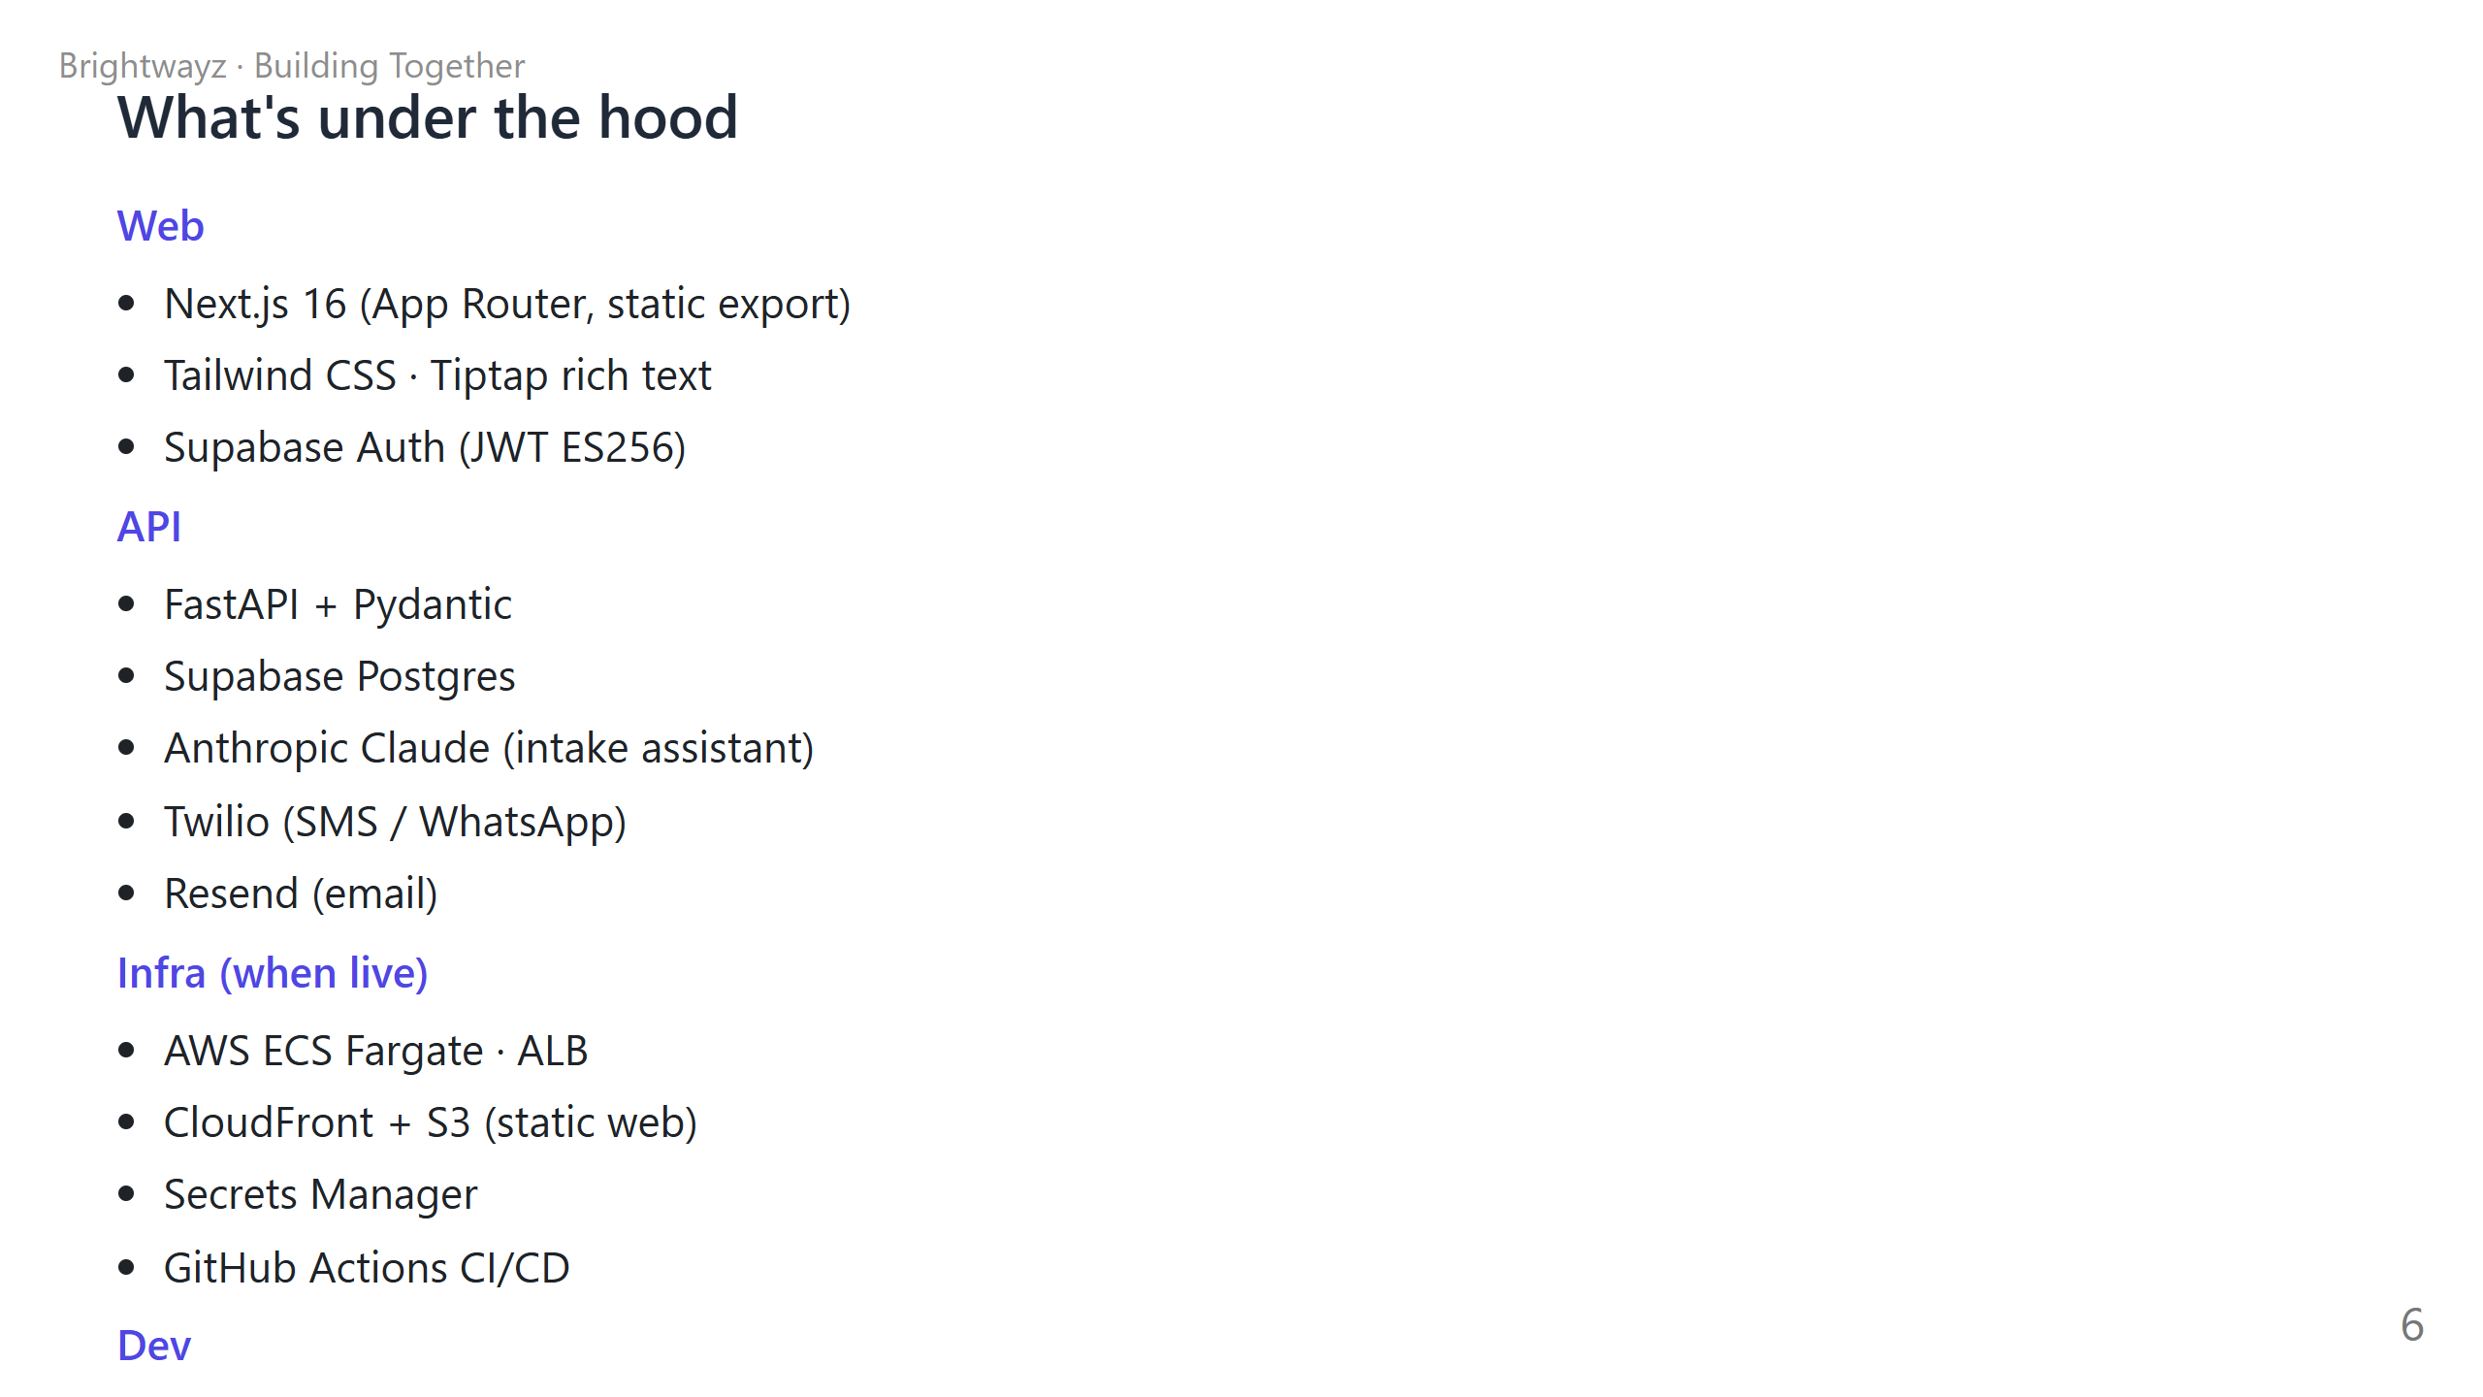
Notes:
TIMING: 60 sec — this is a "skim" slide ASK FIRST: "Quick show of hands — who's a developer?" IF MOSTLY DEVS: Spend more time. Mention you can swap any layer (e.g. Resend → SES, Supabase → self-hosted Postgres) and the AI handles the refactor. IF MOSTLY NON-DEVS: "You don't need to know any of these names. I'm showing you the stack just so you know there's nothing exotic here — these are standard tools. Anyone with a few months of practice could maintain this." PUNCH: "What's interesting isn't the stack. It's that we shipped this whole stack with the AI as the integration engineer."

Slide 7
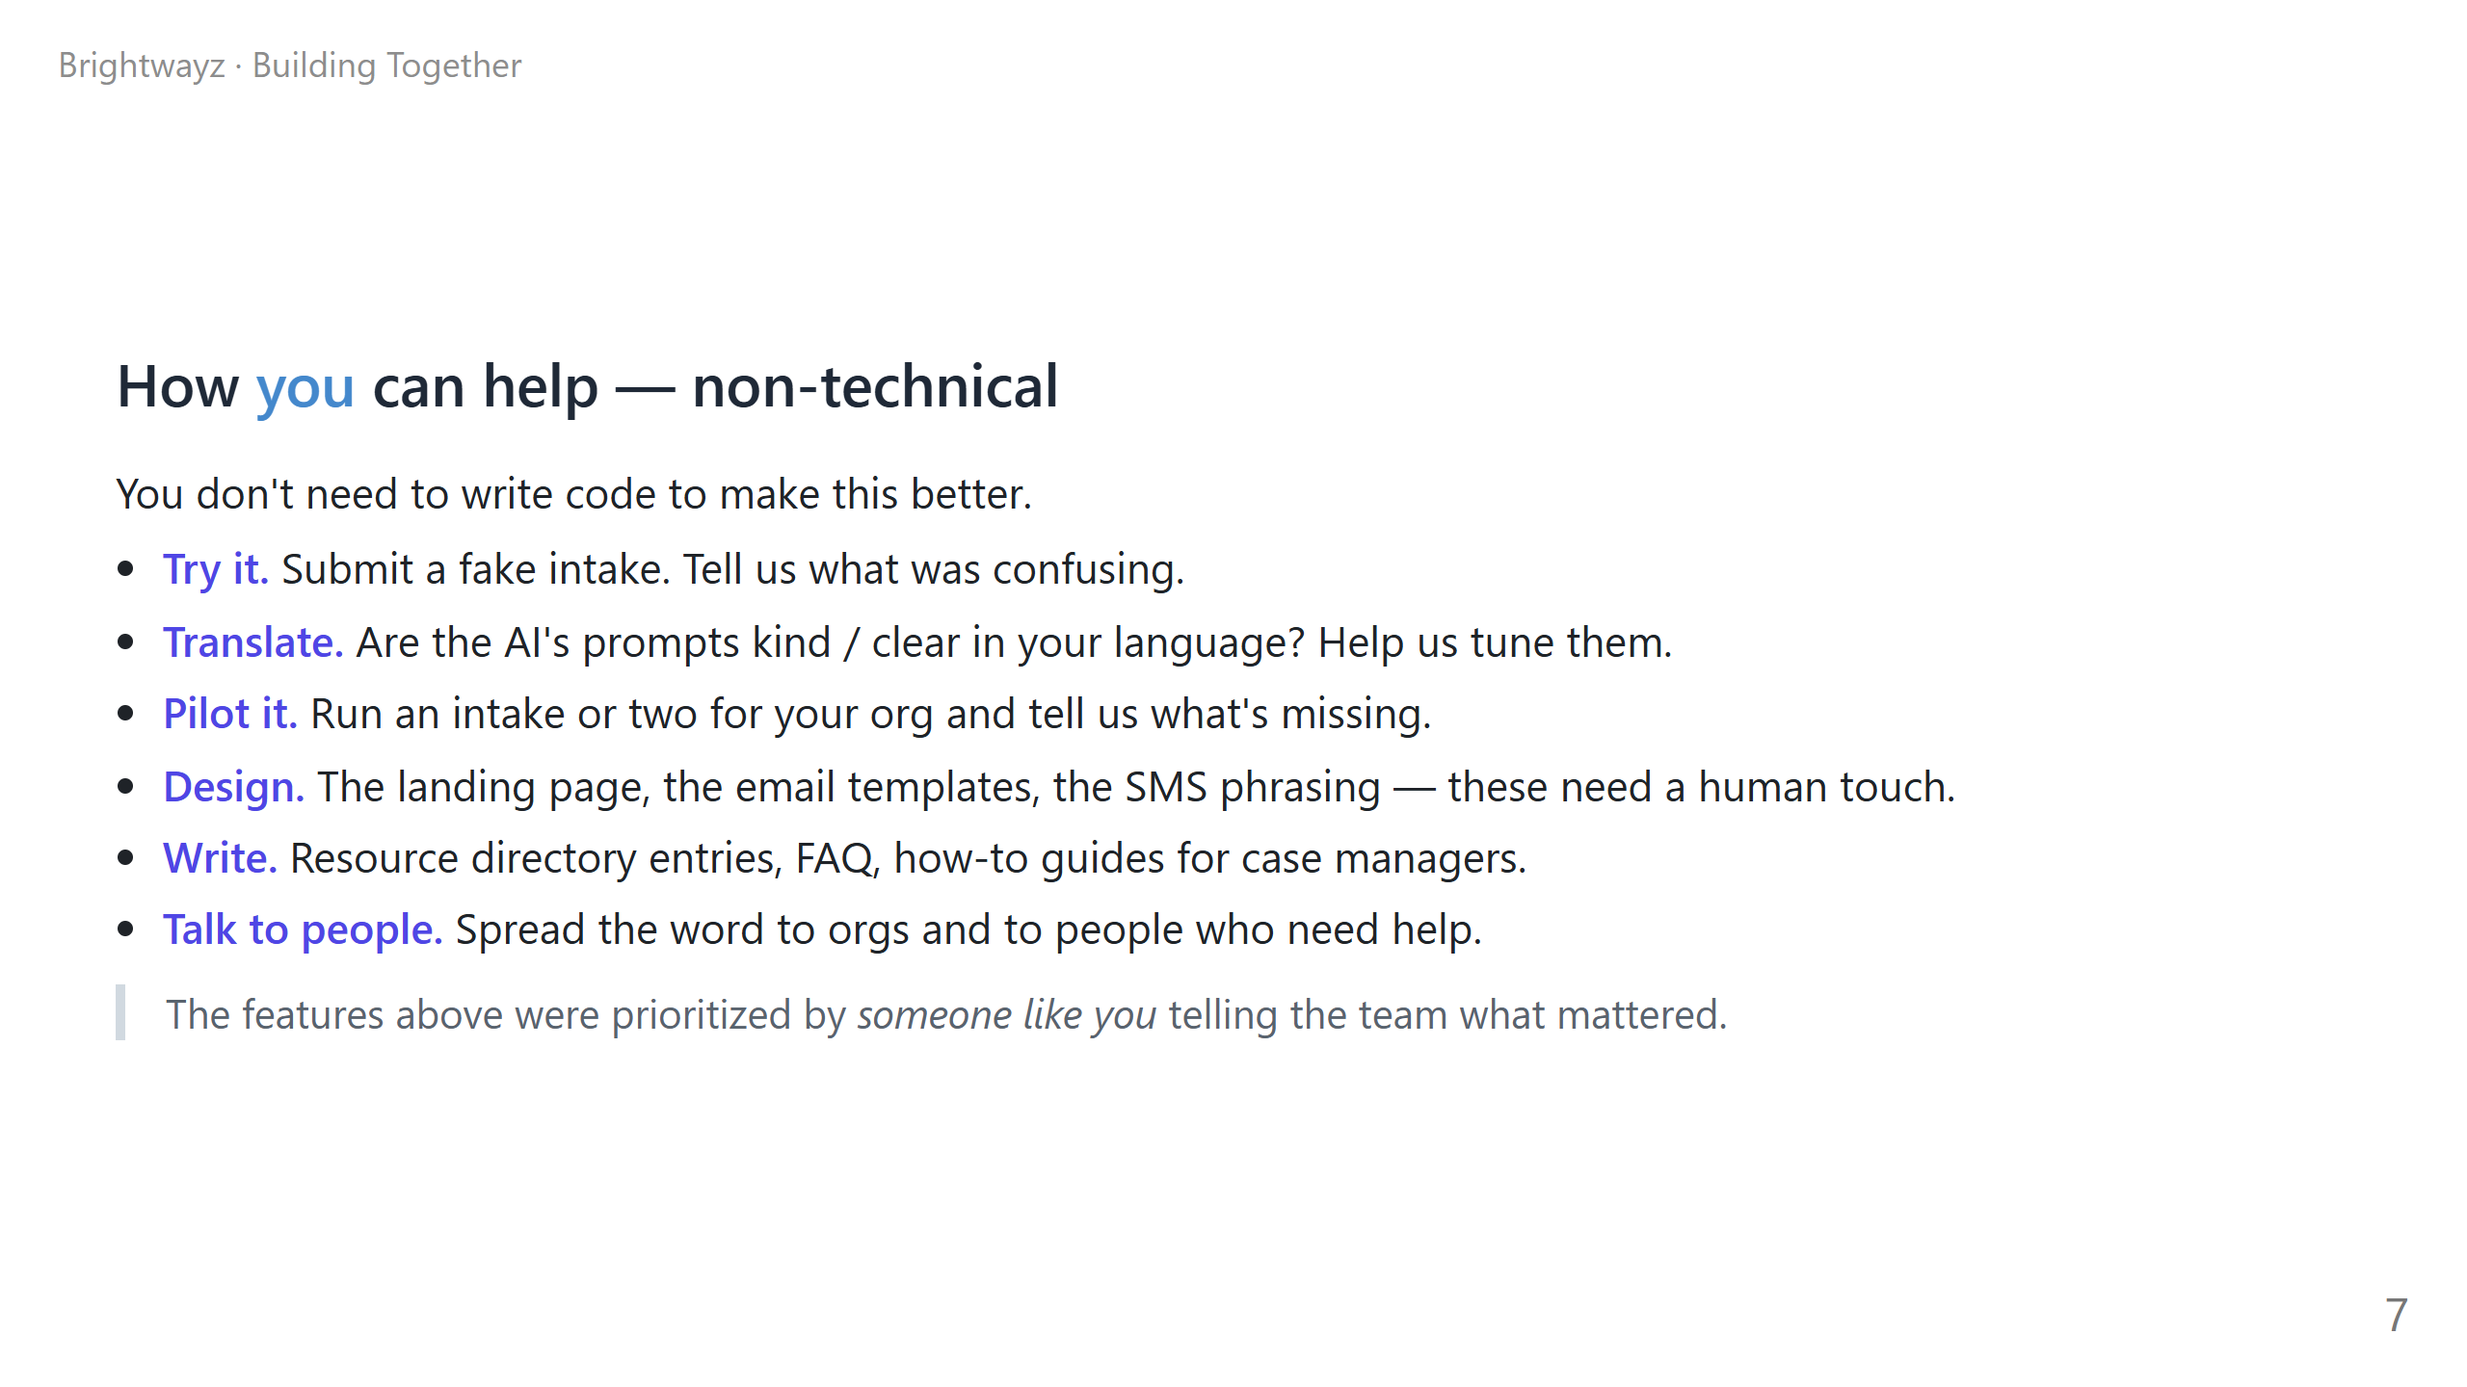
Notes:
TIMING: 90 sec POSTURE: lean in. This is the recruiting moment for half your audience. EMPHASIZE: "You don't need to write code." Repeat it. Many people in the room will be quietly thinking they're not technical enough to contribute. CONCRETE ASKS: Pick ONE bullet and go deep, rather than skimming all six. The "translate" bullet is great if the room is diverse linguistically. The "pilot it" bullet is great if there are nonprofit folks present. CALL OUT NAMES IF YOU CAN: "Sara, you mentioned you run intake at [Org] — that 'pilot it' bullet is literally aimed at you." THE LAST LINE IS THE PUNCHLINE: "The features above were prioritized by someone like you telling the team what mattered." Pause. Let it sit.

Slide 8
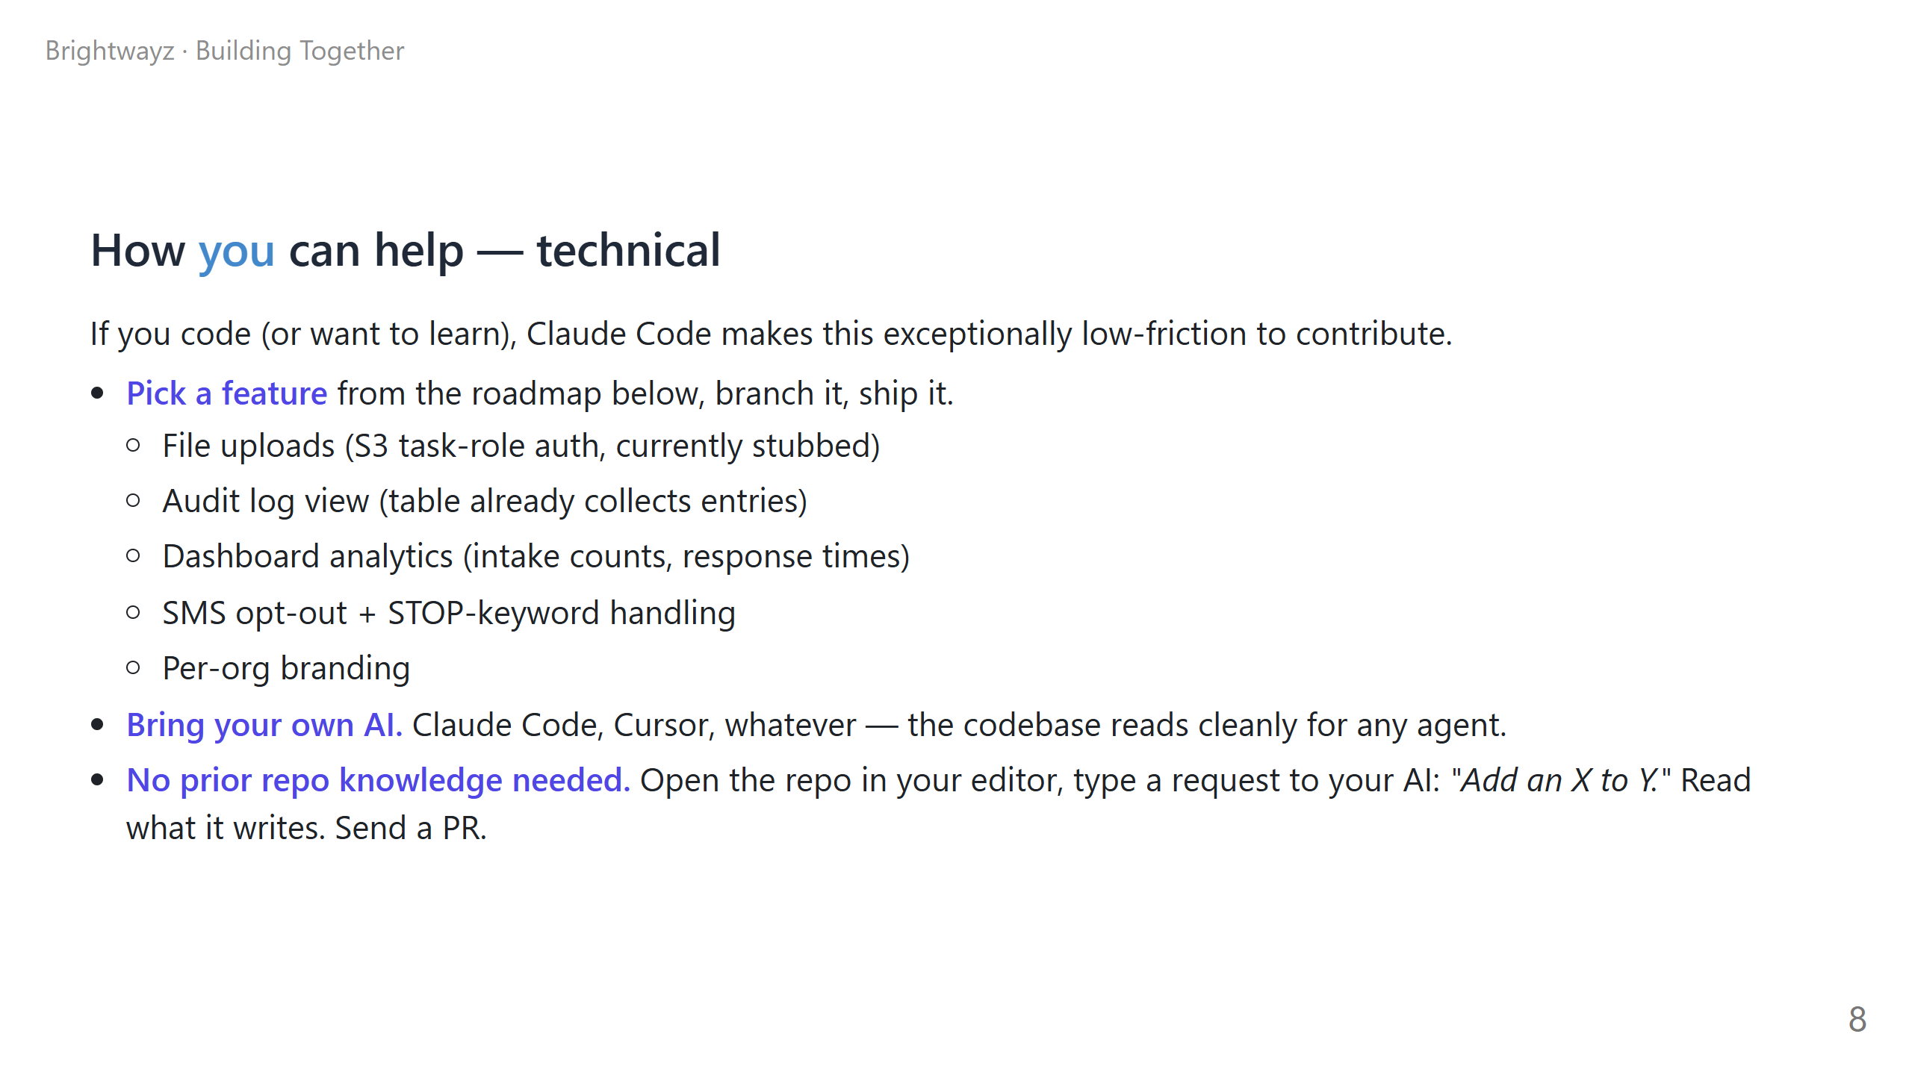
Notes:
TIMING: 90 sec POSTURE: this is the recruiting moment for the OTHER half of the audience. THE 5 ROADMAP ITEMS: Don't read them all out. Mention 2-3 you find most interesting. The bullets are there for the slide deck PDF that lives on after. REASSURE NEW CONTRIBUTORS: "If you've never contributed to an open-source project, this is a gentle entry point. Pick a small thing. Type one sentence to your AI. Read what it produces. Send a PR. We'll review it kindly." REASSURE EXPERIENCED ENGINEERS: "If you're a senior eng wondering 'is this codebase a mess' — the quality bar in here is set by Pydantic + TypeScript types + pytest + ESLint. You'll feel at home." OFFER PAIR PROGRAMMING: "If you want to ship something together, I'll pair with you live for an hour. Just DM me."

Slide 9
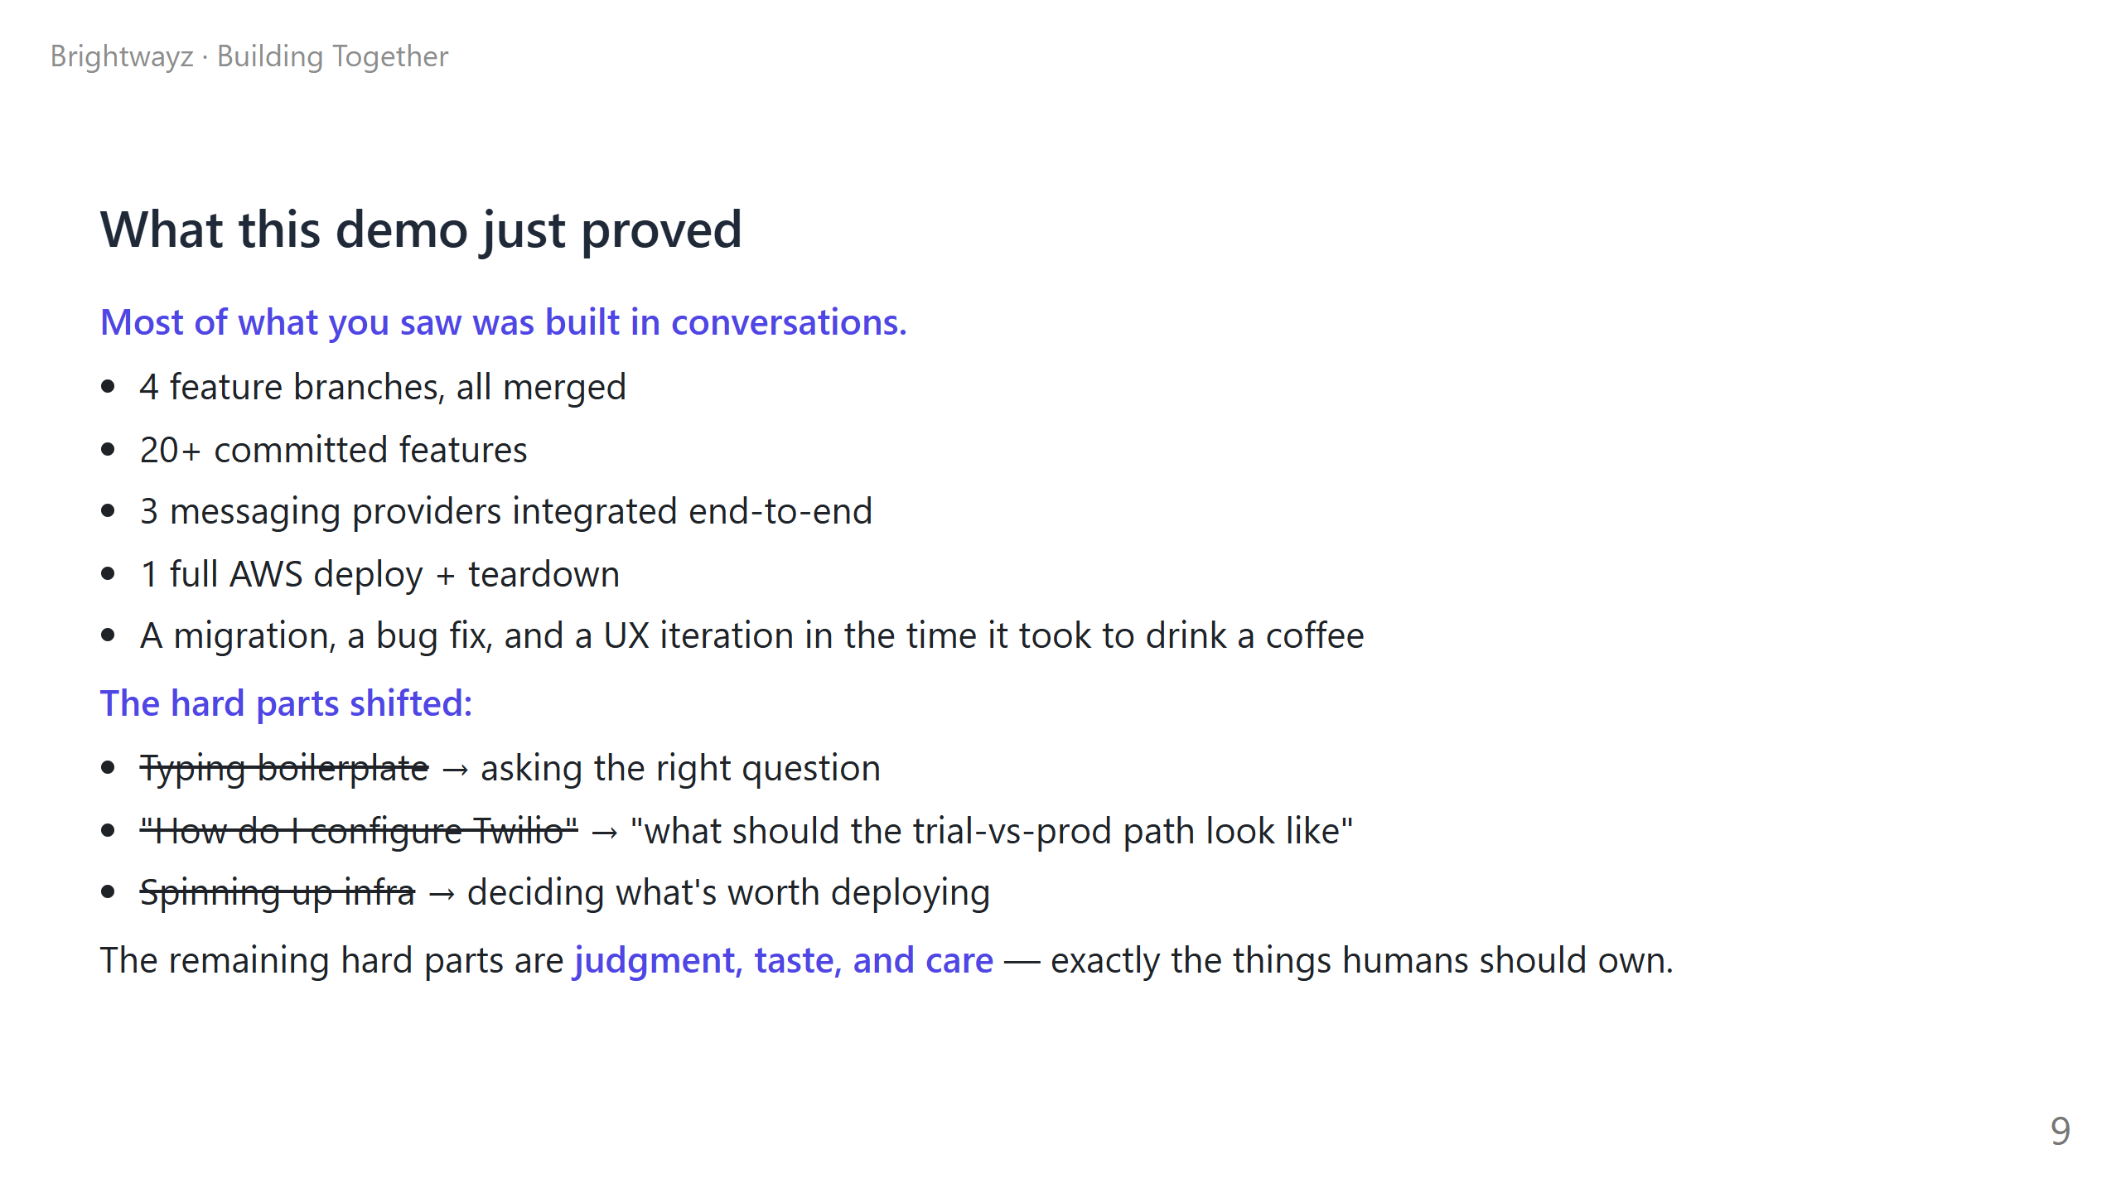
Notes:
TIMING: 60 sec POSTURE: this is the takeaway slide. Slow down. NUMBERS LAND BETTER WHEN SPOKEN, NOT READ: Don't say "twenty plus committed features." Say "we shipped more than twenty features. And that's just what's on this branch." THE STRIKETHROUGH LIST: Read each item aloud. The "before → after" cadence is the rhetorical trick that makes the point stick. LAST LINE — say slowly, look up from notes: "The remaining hard parts are judgment, taste, and care — exactly the things humans should own." This is your money line. Pause. Move on.

Slide 10
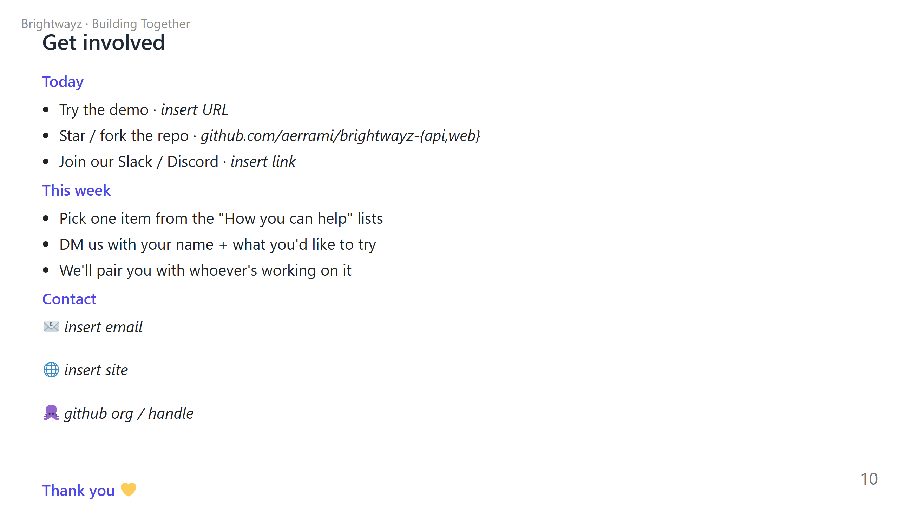
Notes:
TIMING: 90 sec + Q&A LEAVE THIS SLIDE UP through Q&A — people will photograph it. OFFER TO LINGER: "I'll be in the [room / corner / coffee area] for the next 20 minutes. Come find me if you want to chat about anything you saw today." ASK A QUESTION BACK: "Before we close — what's one feature you'd add tomorrow if you had the time and tools? Just shout it out." This often surfaces your next 2-3 best contributors. PRACTICAL NEXT STEPS: - If you're collecting signups, have a QR code or Google Form ready. - Print 5-10 paper copies of the contact info for people who don't photograph slides. - Mention any in-person follow-up: "I'm hosting an intro-to-Claude-Code workshop next Saturday."

