Slide 1

AGM 2015 29th November 2016
Financial Report

Slide 2
FUNDING SOURCES
Income | 2015 € ,000 | 2014 €,000
Dublin and Dun Laoghaire EBT-Dept of Education and Skills | 170 | 170
Dublin and Dun Laoghaire ETB-Tusla | 91 | 115
Dublin and Dun Laoghaire ETB-Drugs Task Force | 33 | 33,
Department of Education and Skills | 160 | 159
Other Income | 55 | 6
TOTAL | 509 | 482
Notes:
Other Income includes -2015 €45,000 from fundraising and €10,000 from insurance claim.
2014 €2,500 fundraising

Slide 3
INCOME AND EXPENDITURE
 | 2015 | 2014
Income(funding/Fundraising) | 499 | 482
Other Income | 10 | -
Total Income | 509 | 482
Administrative Expenses | 553 | 501
Exceptional Item | 161 | -
Other | - | 2
Total Expenditure | 714 | 503
Deficit | 204 | 21
Notes:
Total Ex penditure increase due to exceptional item. It is really a loss of Income. Admin expenses increase largely down to Legal Fees and fund raising expenses.

Slide 4
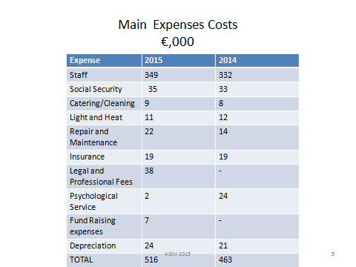
Main Expenses Costs
Notes:
from Schedule of Admin expenses-Annual Report- Art teaching cost added to Wages and Salaries figure

