Slide 1

SMART INDIA HACKATHON 2026
TITLE PAGE
Problem Statement ID - SIH26038
Problem Statement Title - Explainable AI for Diabetic Retinopathy Screening in Rural India
Theme - MedTech / BioTech / HealthTech
PS Category - Software
Team ID - 148873
Team Name - MMC
Institute - Motihari College of Engineering

Slide 2
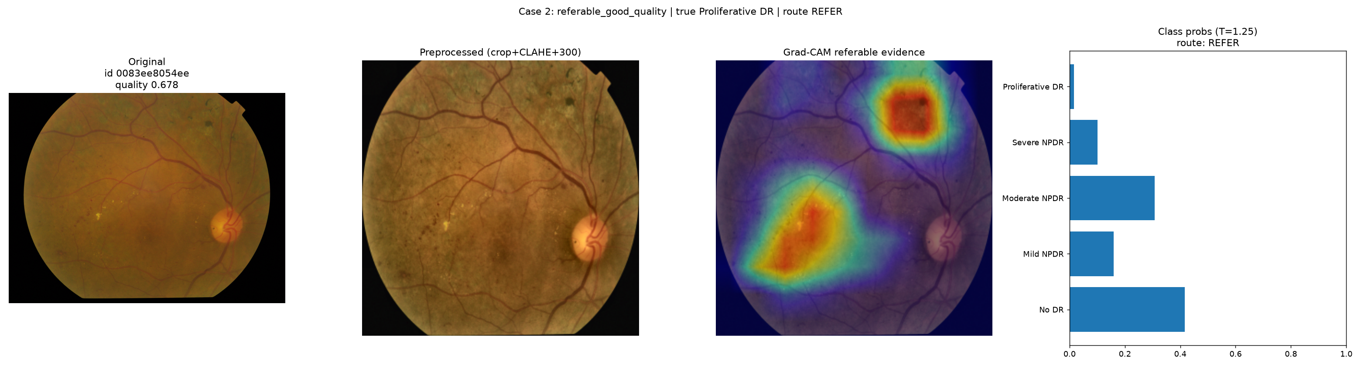
IDEA TITLE
MMC
An explainable, quality-aware AI workflow that grades diabetic retinopathy, surfaces retinal evidence, generates an AI-assisted screening report, and routes each case to screening output, human review, or referral.
Fundus Image
Quality Check
Retinal Evidence
DR Grading
ICDR 0-4
Explainability
Screening
Output / Recapture
Human Review / Referral
(1) Quality-aware screening
(2) Evidence-aware explainability
(3) MATLAB + Simulink workflow integration
Real explainability hero case - referable DR (Grad-CAM + AI report snippet)
AI-ASSISTED SCREENING ≠ AUTONOMOUS DIAGNOSIS
Clinician oversight + further clinical validation remain required.

Slide 3
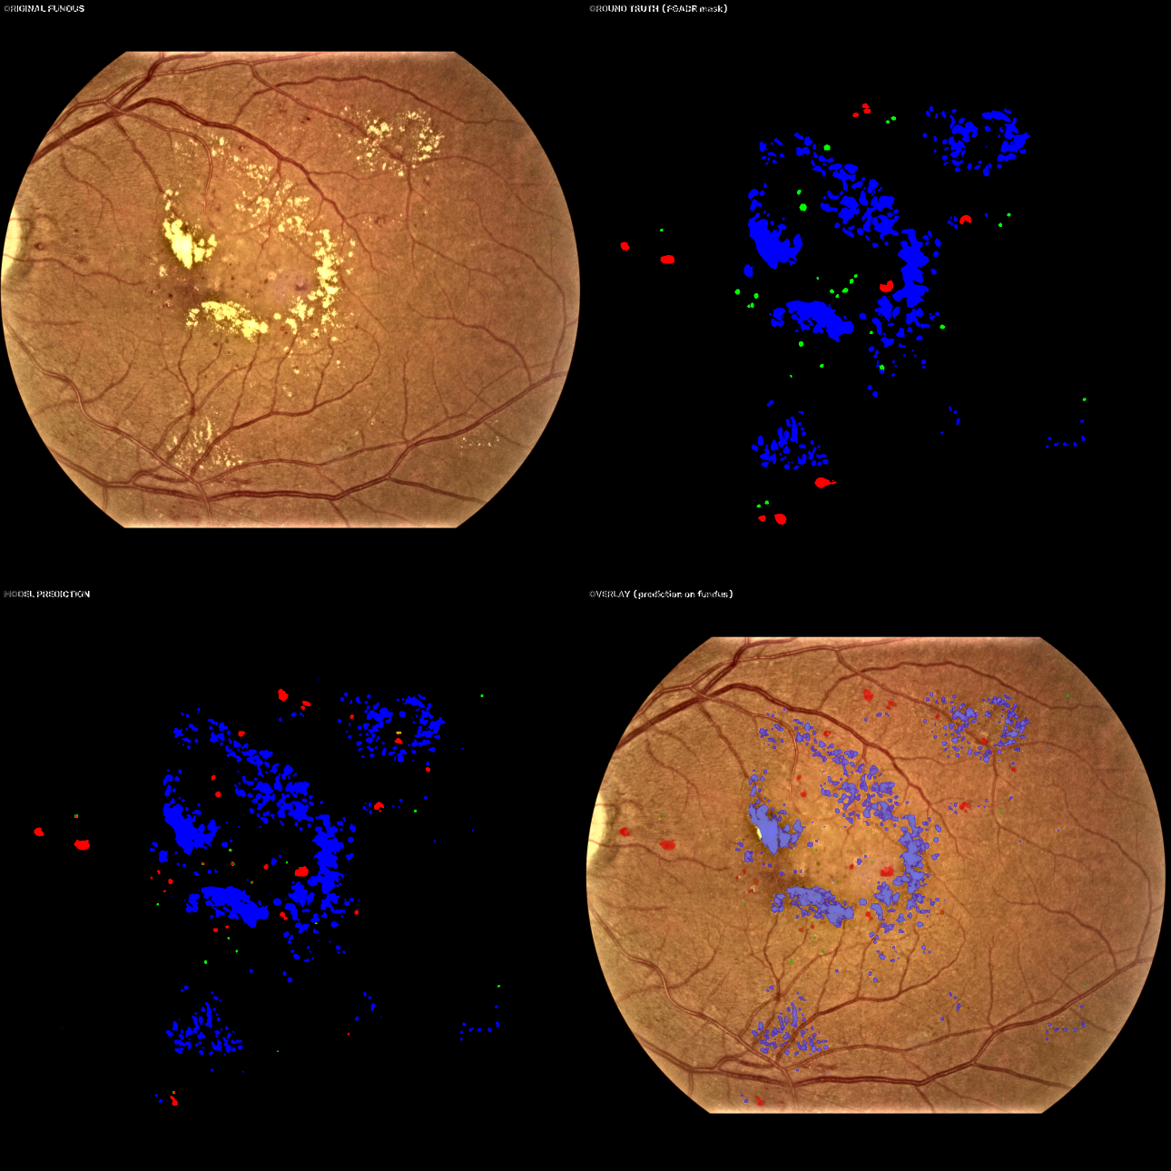
TECHNICAL APPROACH
MMC
METRICS - ONE-SHOT LOCKED TEST · APTOS 2019 · n = 732
0.9027
Quadratic Weighted Kappa
91.92%
Referable Sensitivity
93.33%
Specificity
0.9792
ROC AUC
IMAGE QUALITY
RETINAL STRUCTURES
LESION EVIDENCE
Heuristic quality index
gate → accept / review
OD Dice 0.897 - STRUCTURAL EVIDENCE
fovea 273 px · vessels - PROTOTYPE
MA · HE · EX · SE
mean Dice 0.409 - PROTOTYPE
DR GRADING
EXPLAINABILITY
MATLAB / SIMULINK
ICDR 0-4 · QWK 0.9027
T=1.25 temp. scaling + argmax
Grad-CAM attention evidence
AI-assisted screening report
ONNX export · parity 6.7e-6
queue / workflow simulation
FGADR prototype - EX case 1091_2
Dice 0.871 (PROTOTYPE)
MATLAB / ONNX parity max ≈ 6.7e-6 · Python → ONNX ≈ 8.1e-6 · MATLAB reproduced all 4 routing cases
Lesion / fovea / vessel components are labelled PROTOTYPE. Optic-disc Dice 0.897 is STRUCTURAL EVIDENCE, not lesion evidence.

Slide 4
FEASIBILITY AND VIABILITY
MMC
VALIDATED NOW
PROTOTYPE EVIDENCE
REMAINING VALIDATION
• Locked APTOS test n=732: QWK 0.9027 · Sens 91.92% · Spec 93.33%
• MATLAB / ONNX parity ≈ 6.7e-6 · 4/4 routing cases reproduced
• 0 missed referable cases (evaluated workflow)
• Simulink LOW / BASE / HIGH queue scenarios drained
• Optic-disc structural Dice 0.897
• Fovea prototype: median 273 px · 32% within 200 px
• FGADR lesion evidence: mean Dice 0.409
• Real AI-assisted reports · Grad-CAM + lesion overlays
• Clinician reviewer study (pending)
• Prospective clinical validation (pending)
• NV - insufficient data (experimental-only)
• Broader external-domain validation
• Field deployment / offline hardware validation
NEXT VALIDATION: blinded clinician review of AI report + routing + evidence overlays (pending - not yet executed)

Slide 5
IMPACT AND BENEFITS
MMC
PHC / EYE CAMP
91.92%
referable sensitivity
93.33%
specificity
161
human-review cases
302
referral cases
↓
LOCAL AI SCREENING
(AI-assisted prototype)
≈ 346,000 screenings / year - MODELED CAPACITY
↓
Simulink queue/workflow simulation only - not deployed or clinically validated capacity.
AI EVIDENCE + REPORT
Technician
Clinician
District system
↓
Instant quality check + evidence pack at PHC / camps
AI-assisted report with explainable overlays, remote review
Standardized routing + referral queue, reduced specialist load
CLINICIAN REVIEW
↓
DISTRICT REFERRAL
HUMAN-IN-THE-LOOP: AI screens and routes; clinician reviews; referral is clinician-driven.
AI-assisted screening report ≠ autonomous diagnosis

Slide 6
RESEARCH AND REFERENCES
MMC
A. RESEARCH / EVIDENCE
B. LIMITATIONS / NEXT STEP
APTOS 2019 -
Kaggle blindness challenge - locked test n = 732
FGADR -
arXiv:2008.09772 - lesion prototype (non-commercial use)
IDRiD -
IEEE JBHI 2020 - external OD / fovea + lesion reference
DRIVE -
vessel prototype (dev split only; not official test)
ICDR 5-point scale -
Wilkinson et al., Diabetes Care 2003
Grad-CAM -
Selvaraju et al., CVPR - classifier attention evidence
ONNX → MATLAB -
parity ≈ 6.7e-6 - PyTorch model exported via ONNX
Simulink -
queue / workflow simulation (modeled capacity)
• Clinician reviewer validation - pending
• NV evidence - insufficient data (experimental-only)
• Lesion segmentation - research prototype (MA 0.256 weakest)
• External / domain-shift risk - broader validation required
• Prospective clinical validation - required before deployment

