Slide 1

General Recommendations
OOP 1973 SW

Slide 2
OOP RULES
Education
Escuela Politécnica Nacional. 1998
San José State University, (USA), Master of Science in Software Engineering, 2009
Utah State University (USA), PhD in Computer Science, 2017
Ing. Jorge Edison Lascano, PhD, MSc
EDISON
ENGLISH (practice your English)
NO FOOD, NO DRINKS, (WATER is OK)
SCREENS OFF, NO CLICKS, NO KEYBOARD KEY PRESS, COMPLETE SILENCE while receiving theory
NO CELLPHONES or WHATSAPP use in the classroom, you will get zero (0) in the day activities.
HOMEWORK, WORKSHOPS (ON TIME) Before MIDNIGHT (7:00 a.m.), 15 minutes to 11:00 p.m.
COFFEE BREAK (11:55: or 12:05)
CLASSES start at 11:05 a.m. (if you or I are late, we will wait, and please knock the door, ask for permission and enter)
Have your own Handouts/notes, they will be reviewed every unit or every friday.
No ChatGTP or AI tools for full assignments
No plagiarism

Slide 3
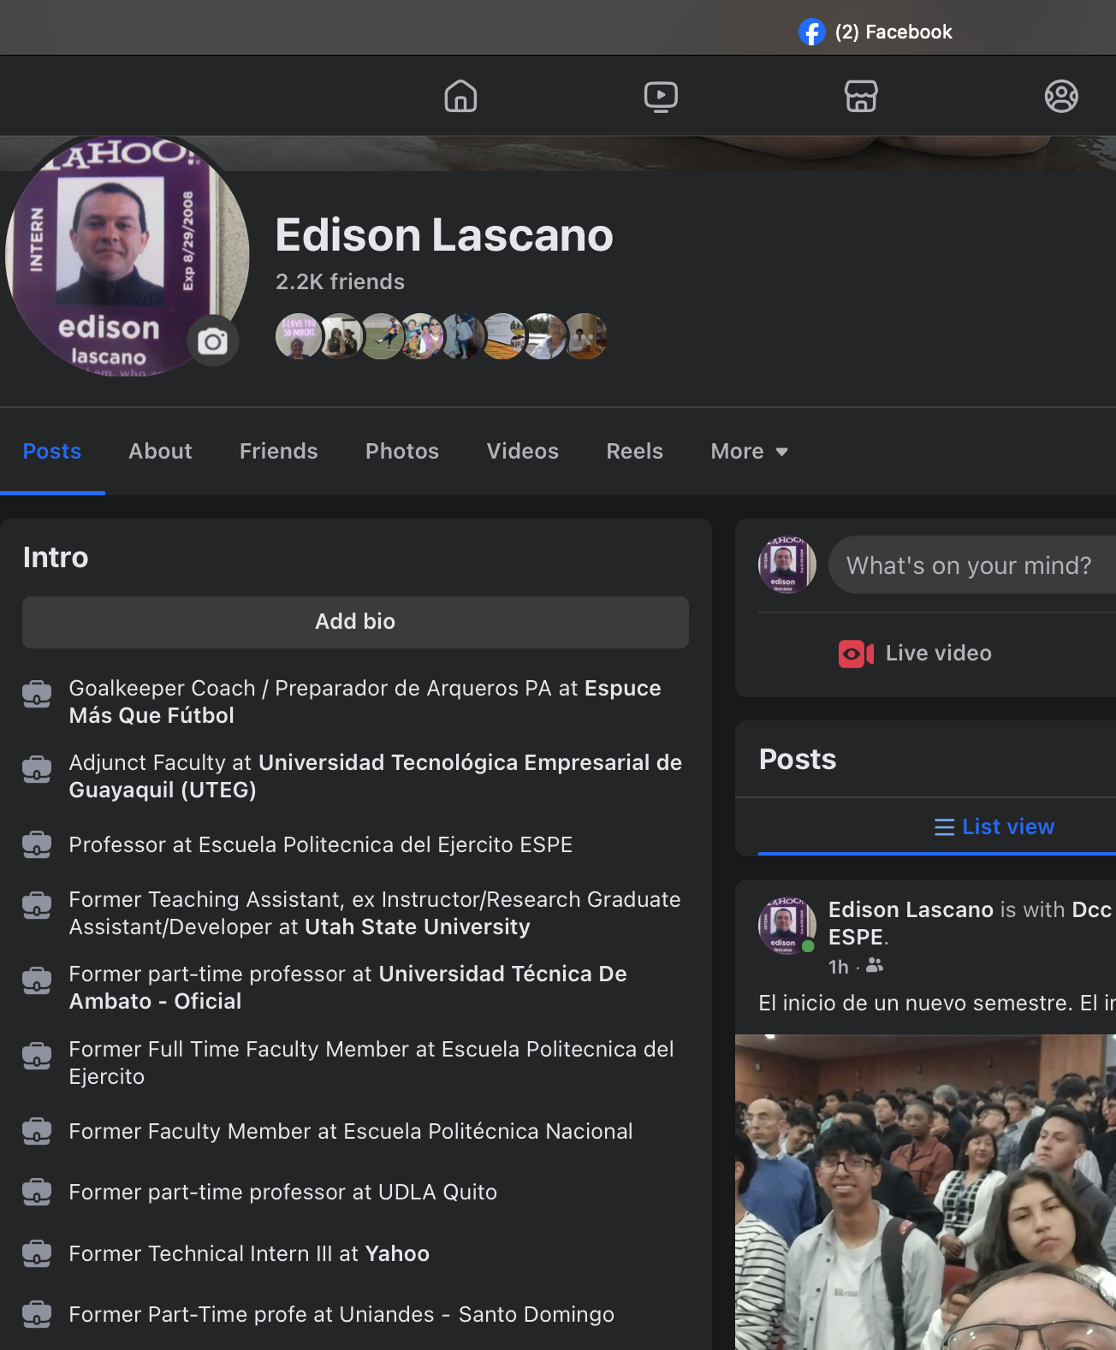
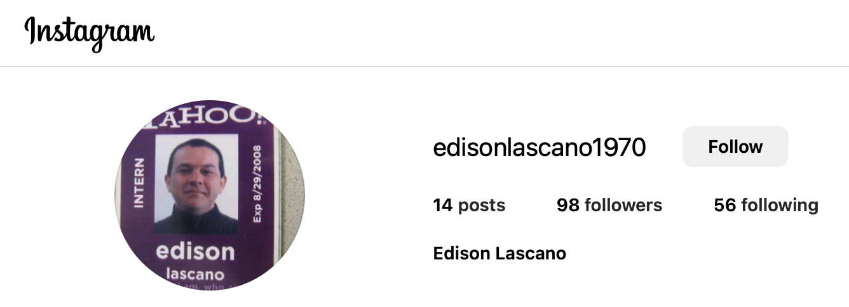
CONTACTS
0961195050 (WhatsApp)
Edison Lascano (Facebook)
edisonlascano1970 (Instagram)
edison_lascano@yahoo.com
jelascano@espe.edu.ec

Slide 4
ETHICS

Slide 5
IT Tools
Google classroom —> Moodle
Homework, workshops, quiz, exam
Google docs
Google forms
Code → Git Hub → Moodle
Kahoot!
Google Doc (WhiteBoard)
Microsoft Teams / Google Meet / Zoom
WhatsApp 0961195050, edison_lascano@yahoo.com,
Facebook: edison lascano

Slide 6
EVALUATION
WORKSHOPS 4.0
HOMEWORK 4.0
QUIZZES 4.0
PARTICIPATIONS 1.0
EXAM. 7.0
PROJECT. 3.0
WRITTEN+EXERCISE 4.0

Slide 7
DATES
Unit 1
Project Wednesday 4, December
Exam Monday 9, December
Unit 2
Project Wednesday 22, January
Exam Monday 27, January
Unit 3
Project Wednesday 5, March
Exam Thursday 10, March

Slide 8
Pre requisites
Programming languages
IDE : Code blocks, Visual studio code, Netbeans
Files (File System)
Structured programming
Variables
if, for, while, switch-case, etc.
functions
GitHub
English

Slide 9
Content
Theory about the topics
Code snippets
Video Tutorial
Students: RESTful, Front-End, Web Applications,
Implement the example of the video tutorial
Apply what you learn in your project
Project teams are formed by 4 students in alphabetical order.
Publish your application in the cloud, it may be VM or Dockers
Exams are individual, theory + exercise

