Slide 1

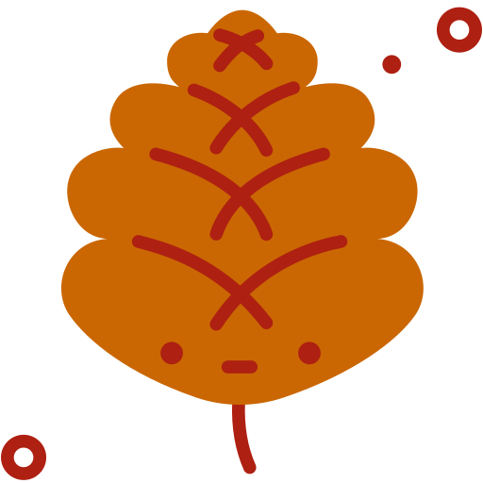
CompSci club
Decorators
Going beyond what you need to really know

Slide 2
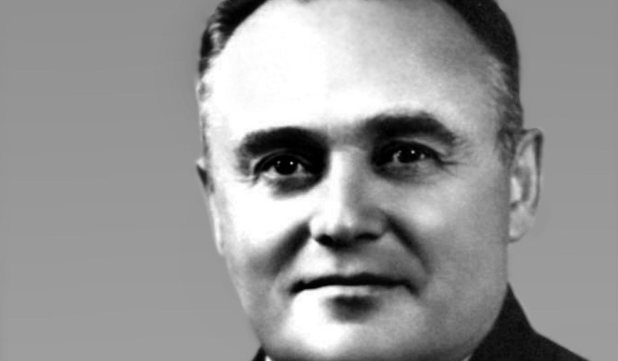
Our person of the day!
Sergei Korolev
With Russians being very dear to our hearts here at CompSci Club (birthday, fyi!), we honor Soviet rocket engineer Sergei Korolev, who was an architect of the Space Race between the U.S. and the USSR
One of Korolev’s biggest contributions is the development of Sputnik 1, which launched on this day in 1957
Sergei would be responsible for pitching the idea of an artificial satellite in 1954
The sputnik (Russian for satellite) travelled at 18,000 mi/hr and reported data for 21 days before burning up in January 1958
Before it did burn up, it rotated the Earth 1,440 times and travelled 43,000,000 mi
Ever wondered for the growth of calculus and science in our schools? You can partially thank (or blame) Sergei!
Rocket Engineer

Slide 3
Let's make it pretty
Introduction
decorators

Slide 4
What are Decorators?
In Python, a decorator is a design pattern that we can use to add new functionality to an already existing object without the need to modify its structure

Slide 5
Lets try something new
Let's get a function, and make functions inside that first parent function
Now try to call on the parent function
Then try to call on a function that you defined in the parent function
Notes:
def parent():
print("Printing from the parent() function")
def first_child():
print("Printing from the first_child() function")
def second_child():
print("Printing from the second_child() function")
second_child()
first_child()

Slide 6
Let’s Move to Decorators
Copy an example of a decorator from down below
Guess what will happen if you call on say_whee — meaning you put in say_whee()
Don’t run it yet, we will go through the code line by line
Notes:
def my_decorator(func):
def wrapper():
print("Something is happening before the function is called.")
func()
print("Something is happening after the function is called.")
return wrapper
def say_whee():
print("Whee!")
say_whee = my_decorator(say_whee)

Slide 7
So what is actually going on
The decoration itself is happening at the line say_whee = my_decorator(say_whee)
This say_whee becomes a function
Try to just put in say_whee without the parentheses. What do you think will happen? What actually happens?
Notes:
def my_decorator(func):
def wrapper():
print("Something is happening before the function is called.")
func()
print("Something is happening after the function is called.")
return wrapper
def say_whee():
print("Whee!")
say_whee = my_decorator(say_whee)

Slide 8
Let’s look at a simpler way to decorate
It is very tedious to write say_whee = my_decorator(say_whee) or something similar to that every single time
So, there is a way to decorate much easier
That is with the symbol @
When making a function say_whee, right before you define it, write @my_decorator
Try to call the function after that!
Notes:
def my_decorator(func):
def wrapper():
print("Something is happening before the function is called.")
func()
print("Something is happening after the function is called.")
return wrapper
def say_whee():
print("Whee!")
say_whee = my_decorator(say_whee)

Slide 9
Now you kind of try!
Make a separate file called decorators.py and make some decorators
Make a decorator that makes the function run twice even when it is prompted once (so essentially somewhere in the child function there will be func() func())
Import the decorators from the file into your main, just like with classes
Decorate some function
Notes:
def my_decorator(func):
def wrapper():
print("Something is happening before the function is called.")
func()
print("Something is happening after the function is called.")
return wrapper
def say_whee():
print("Whee!")
say_whee = my_decorator(say_whee)

Slide 10
If you have any questions at all, please don’t hesitate to stay back or email one of us!
Thank you!
That is all we have for today!

