Slide 1
Power BI Dashboard Overview & Interview Q&A
Understanding Dashboards, KPIs, Slicers, and More

Slide 2
Key Elements of a Dashboard
Visualizations: Charts, graphs, cards, KPIs
Slicers/Filters: Allow interactive data exploration
KPIs: Show key performance indicators (Net Profit, Sales Amount, etc.)
Tables & Maps: Show detailed and geographical data
Interactivity: Tooltips, drilldowns, slicers

Slide 3
What is a KPI?
Definition: A Key Performance Indicator (KPI) is a measurable value that shows how effectively a company is achieving business objectives.
Examples from Dashboard:
Net Profit: $1.778bn
Sales Quantity: 13.642M
Return Amount: $41.241M
Use: To monitor business health and performance.

Slide 4
What are Slicers in Power BI?
Definition: Slicers are visual filters that allow users to segment and analyze data dynamically.
Types of Slicers Used in Dashboard:
Year, Channel, City, Region, Store, Category
Purpose: Enhances interactivity and custom views for users.

Slide 5
Power BI vs. Tableau
Feature | Power BI | Tableau
Ease of Use | More beginner-friendly | Requires some learning curve
Integration | Strong Microsoft integration | Good with multiple data sources
Cost | More affordable | Higher cost
Data Modeling | Strong DAX & Power Query | Better visual analytics tools

Slide 6
Making Dashboards Interactive
Use Slicers: Allow filtering by date, region, category
Drillthrough/Drilldowns: Enable deeper data insights
Bookmarks: Save and share personalized views
Tooltips: Provide extra info on hover
Dynamic Titles/Values: Reflect selected filters

Slide 7
Large Datasets & Trend Analysis
Handling Large Datasets:-
Use DirectQuery or Aggregated Tables
Optimize DAX queries
Apply Row-level Security (RLS)
Trend Analysis Charts:-
Line Charts (e.g., Net Profit Trend)
Bar/Column Charts (Year Over Year comparison)
Area Charts
Combo Charts (Bar + Line)

Slide 8
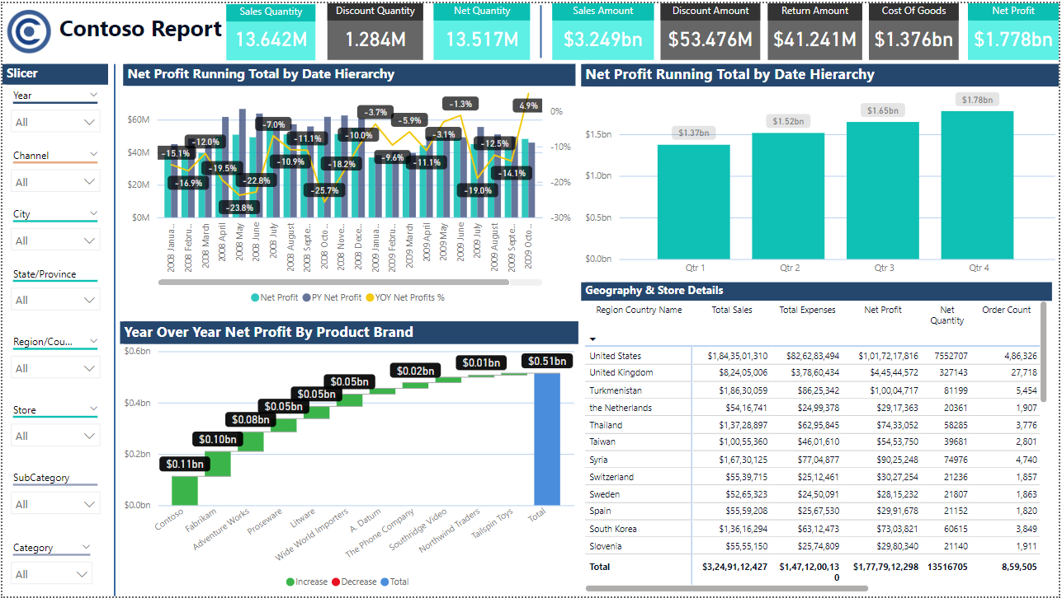
Dashboard Snapshot

Slide 9
Conclusion
Power BI is a powerful tool for data analysis and visualization that enables businesses to make informed, data-driven decisions.
By leveraging KPIs, slicers, interactive dashboards, and a variety of visualizations, we can gain deep insights from even the largest datasets.

