Slide 1



MysteryBox
Interactive Detective Game
Python Mini Project
Presented by:
Name:Megha Suthar
Enro.no.:12402080601082
Class:IT-B
Name:Vira Patel
Enro.no.:12402080601151
Notes:
Good morning everyone. Today I will present my Python mini project called MysteryBox. It is an interactive detective game with four different cases, three difficulty levels and a hint system. The player investigates, collects clues, questions suspects and names the culprit. It is built with Python and the tkinter library.

Slide 2
About
1
2
3
4
Introduction
Cases and Levels
Gameplay
Code Design
What the project is, its goals and tools
Four mysteries and three difficulty levels
Game flow and the clue unlock system
Program structure and key functions
5
6
7
8
Scoring and Testing
How to Run
Future Scope
Conclusion
Points, ranks, screenshots and tests
Step-by-step commands and fixes
Ideas to make the game even better
What we built and what we learned
Notes:
This is the plan of my presentation: the introduction, the cases and difficulty levels, how the game works, the code design, scoring and testing, how to run the game, future scope and the conclusion.

Slide 3
What is MysteryBox?
MysteryBox is a desktop detective game made in Python. The player becomes Detective Sam, chooses one of four cases, searches places, questions suspects, collects clues and names the culprit.
4
3
Mystery cases
Difficulty levels
Why this project?
Makes learning Python fun and practical
Uses dictionaries, functions, loops and conditions together
Has a real window (GUI), so it feels like a real game
48
20
Clues in total
Actions per game
Notes:
MysteryBox is a mystery-solving game. There are four different cases, three difficulty levels, 48 clues in total across all cases, and the player gets 20 actions per game. I chose this project because it lets me use many core Python concepts together in a fun way.

Slide 4



Project objectives
Present a mystery
Collect clues and question suspects
A crime case with a story and several suspects, each with something to say.
Players search places and talk to suspects. Everything is saved in a notebook.
Unlock new clues
Score correct deductions
Choices matter. Some clues appear only after earlier clues or statements are found.
Points for clues, the right culprit and quiz answers. A wrong accusation costs points.
Extra features: 4 different cases | Easy, Medium and Hard levels | Hint system
Notes:
These are the four objectives from the project topic: present a mystery with suspects, let players collect clues and question suspects, use their choices to unlock new clues, and calculate a score based on correct deductions. I added extra features: four cases, three difficulty levels and a hint system.

Slide 5



Tools and Python concepts
Python 3
tkinter
random module
The main language. Easy to read and perfect for logic-based games.
Built-in GUI library. Makes windows, buttons, menus, text boxes and pop-ups.
Picks random questions, shuffles answers and chooses hints.
Python concepts used
Dictionaries
Lists
Functions
Loops
Conditions
Score tracking
Notes:
I used Python 3 as the language. For the window I used tkinter, which comes built into Python so nothing extra is needed. The random module is used to pick random questions and hints. The concepts from the topic are dictionaries, functions, loops, conditions and score tracking, and I also use lists.

Slide 6




Four mystery cases
The Missing Blue Diamond
The Stolen Painting
The Leaked Exam Paper
The Night Train Necklace
A dinner party at Rose House
A night exhibition at the City Art Museum
Final exam night at Sunrise College
A theft on the Night Express
4 suspects
5 suspects
5 suspects
5 suspects
5 places
5 places
5 places
5 places
11 clues
13 clues
12 clues
12 clues
Pick a case from the menu. Each case has its own story, suspects, clues and final questions.
Notes:
The game has four complete cases: the Missing Blue Diamond, the Stolen Painting, the Leaked Exam Paper and the Night Train Necklace. The player picks a case from a menu. Each case has its own story, 4 or 5 suspects, 5 places to search, 11 to 13 clues and a pool of final questions. All the case data is stored in dictionaries.

Slide 7
Example: The Missing Blue Diamond
The story
T
Tom
A
Anna
Butler
Niece
Works for the family for 30 years.
Lord Brown's niece. She looks scared.
Rose House, 9:00 PM. Lord Brown is having a dinner party. Suddenly, his Blue Diamond is gone from the safe in his study!
You are Detective Sam. Find the thief before time runs out.
L
Leo
R
Dr. Ray
Chef
Family Doctor
Angry chef. Lord Brown shouted at him last week.
Calm and well dressed.
Notes:
Here is one case as an example. During a dinner party at Rose House, the Blue Diamond is stolen from the safe in the study. The player is Detective Sam. There are four suspects: Tom the butler, Anna the niece, Leo the chef and Dr. Ray the family doctor. Only one is the real thief.

Slide 8








How the game works
STEP 1
STEP 2
STEP 3
STEP 4
STEP 5
STEP 6
Choose case and level
Search places
Question suspects
Notebook and hints
Accuse
Quiz and rank
Pick a mystery and Easy, Medium or Hard
Find clues in five locations
Hear statements that unlock clues
Every clue is saved. A hint costs 5 points
Name the culprit
Answer questions, get a rank
20 actions
Wrong accusation
Out of actions
Every search or question uses one action.
The game ends and 10, 25 or 40 points are lost.
The player must name the culprit now.
Notes:
This is the game flow. The player first chooses a case and a difficulty level. Then they search places, question suspects and check the notebook. A hint can be used but costs 5 points. When ready, they make an accusation. If the culprit is correct, the player answers final questions and gets a rank. The player has 20 actions. A wrong accusation ends the game, and when actions run out the player must accuse.

Slide 9

Three difficulty levels
Setting | Easy | Medium | Hard
Actions | 20 | 20 | 20
Hints (5 points each) | 3 | 1 | 0
Final questions | 3 | 5 | 7
Wrong accusation | -10 | -25 | -40
Speed bonus per unused action | +1 | +2 | +3
Wasted move (nothing found) | Free | Free | Costs 1 extra action
A hint tells the player one move that will find something new. It costs 5 points, so use it wisely.
Notes:
The player can choose Easy, Medium or Hard. All levels give 20 actions. Easy gives 3 hints, 3 final questions and a small penalty of 10 for a wrong accusation. Medium gives 1 hint, 5 questions and a penalty of 25. Hard gives no hints, 7 questions, a penalty of 40, and every wasted move costs one extra action. The speed bonus per unused action also grows with difficulty. All these numbers are stored in a DIFFICULTY dictionary, so changing a level only means editing numbers.

Slide 10




How clues unlock each other
Study and Tom
Safe was opened with the right code
Torn rubber glove in the bin
Tom: only Dr. Ray uses gloves
Tom: Dr. Ray needs money
Library
Gambling papers with Dr. Ray's name
Jeweler letter about the blue stone
Dr. Ray: Call my lawyer!
Garden and Leo
Shoe prints to the gate
Anna tells what she saw
Gate book: Dr. Ray's car, 9:10 PM
Leo saw the car lights
Dining Room
Seating chart: Dr. Ray's chair was empty
Dr. Ray admits he left the table
Search a location
Question a suspect
Arrow = the next step needs the one before it
Notes:
This is the heart of the game, shown for the Diamond case. Clues are not all available at the start. For example, you must first find the safe clue, then the glove. After that Tom talks about gloves, and then tells you that Dr. Ray needs money. Only then does the library desk reveal the gambling papers. Each clue has a requires list that controls this order. I tested that every clue in all four cases can be reached.

Slide 11
Program structure: 5 simple parts
1
Game data
CASES and DIFFICULTY dictionaries hold the 4 cases, 3 levels, suspects, clues and questions.
Dictionaries
2
Game state
One dictionary remembers case, level, score, actions, hints, clues found and notes.
Score tracking
3
Functions
Each action has its own function: search, question, hint, accuse, end game.
Functions
4
Window (GUI)
tkinter builds the menu, level buttons and text boxes. Loops create the buttons.
Loops
5
Start
start_game() resets everything, then mainloop() waits for clicks.
Event loop
Notes:
The code is divided into five simple parts, all in one file. First the game data in dictionaries: all cases and the difficulty levels. Second the game state dictionary which tracks the score, actions and hints. Third the functions with the game logic. Fourth the window built with tkinter. And fifth the start of the game with the main loop.

Slide 12
Key functions
Function | What it does
requirements_met() | Checks if the player already knows what a clue needs
search_location() | Searches a place and finds the next available clue
question_suspect() | Plays the next statement from a suspect
use_hint() | Suggests a move that will find something new (-5 points)
build_buttons() | Creates the place and suspect buttons for the chosen case
on_setting_change() | Starts a new game when the case or level is changed
check_accusation() | Checks the culprit, asks questions, calculates the score
get_rank() | Turns the final score into a rank (depends on the level)
start_game() | Resets the game and picks random questions
Notes:
These are the main functions. requirements_met checks whether a clue can be unlocked. search_location and question_suspect are the two main player actions. use_hint helps the player. build_buttons and on_setting_change make the game switch between cases and levels. check_accusation handles the final accusation and scoring. start_game resets everything for a new game.

Slide 13






Python concepts in the code
Dictionaries
Functions
Loops
Store cases, suspects, clues and the game state.
Every game action is a small function.
Search clues, build buttons, find hints.
game["score"] += 10
def search_location(place):
for place in case["locations"]:
Conditions
Lists and random
Score tracking
Decide if a clue unlocks or the answer is right.
Hold found clues and pick random hints.
Points go up and down as the player plays.
if key != case["culprit"]:
random.choice(ideas)
game["score"] -= HINT_COST
Notes:
Here is each Python concept with a real line from my code. Dictionaries store the data and the score. Functions break the game into small parts. Loops search through clues and create buttons. Conditions decide what happens. Lists and the random module pick hints and questions. And the score changes with every action.

Slide 14
Core logic: unlocking a clue
mysterybox.py
1
Every clue has a requires list, for example the ledger needs Tom's tip.
def requirements_met(requires):
known = game["clues"] + game["heard"]
for item in requires:
if item not in known:
return False
return True
# inside search_location()
for clue_id in case["clues"]:
clue = case["clues"][clue_id]
if (clue["place"] == place
and clue_id not in game["clues"]
and requirements_met(clue["requires"])):
add_clue(clue_id)
return
2
requirements_met() loops through that list and checks what the player already knows.
3
If everything is known and the clue is new, it is added to the notebook for +10.
Notes:
This is the most important code. requirements_met loops through the list of required clues and returns False if any is missing. In search_location, we loop through all clues of the chosen case and pick the first one that is in this place, not yet found, and whose requirements are met. That is how the unlock system works with only simple loops and conditions. The same check is also used by the hint function.

Slide 15
Scoring system and ranks
Final ranks (score needed)
Rank | Easy | Medium | Hard
Legendary Detective | 200+ | 230+ | 260+
Senior Inspector | 150+ | 180+ | 200+
Junior Detective | 100+ | 120+ | 140+
Rookie | below 100 | below 120 | below 140
Speed bonus: +1, +2 or +3 points for every unused action (Easy, Medium, Hard).
Notes:
The score is tracked in one variable. A new clue gives 10 points and a new statement 5. A correct culprit gives 50 and each correct quiz answer 10. A hint costs 5 points. A wrong accusation costs 10, 25 or 40 points depending on the level. Unused actions give a speed bonus. At the end the score becomes a rank from Rookie to Legendary Detective, and the score needed is higher on harder levels.

Slide 16
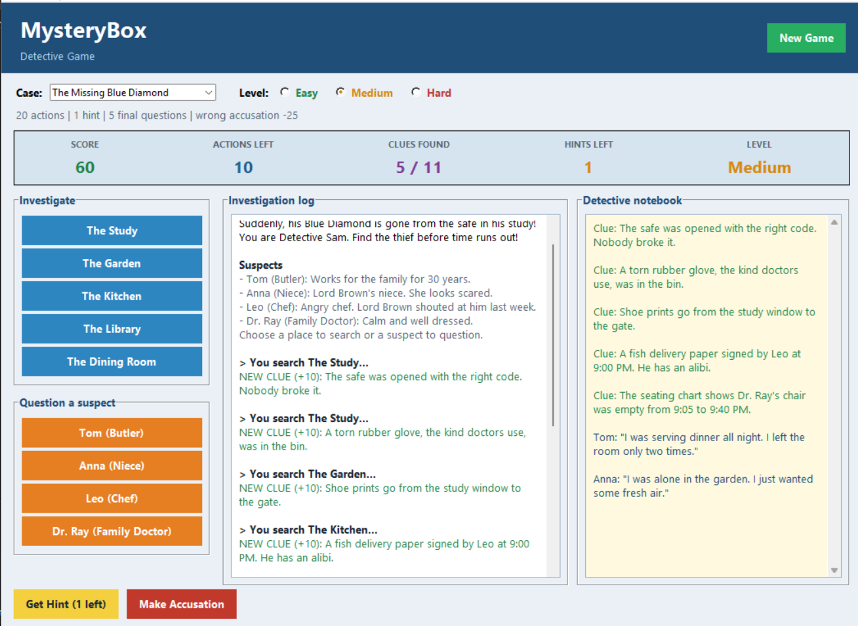
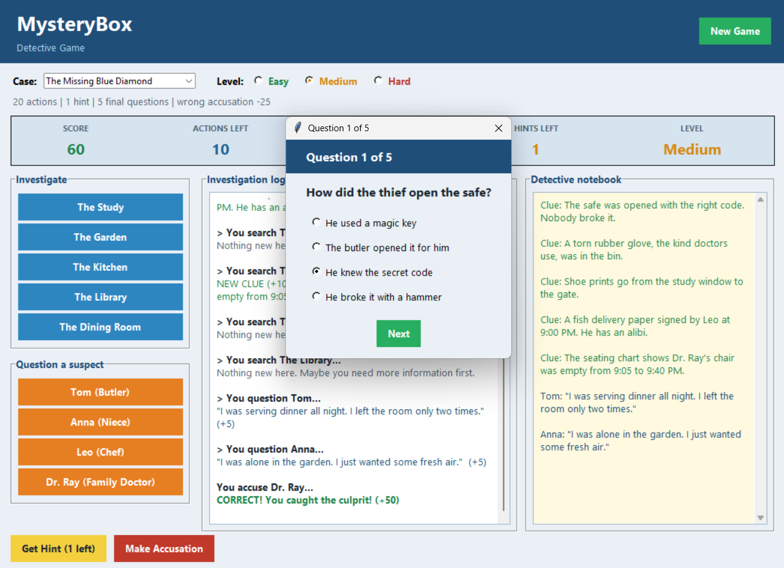
Game screenshots
Main screen (Diamond case, Medium)
Final question
Case menu, level buttons, hint button, live score, case feed and notebook.
After a correct accusation, questions appear with shuffled answers.
Notes:
These are real screenshots of the game. On the left the Diamond case on Medium level, with the case menu, difficulty buttons, hint button, live score, the case feed and the detective's notebook. On the right one of the final questions with shuffled answers. The other cases, like the Night Train case, use the same screen.

Slide 17

Testing the game
Test case | Action | Expected result | Status
Locked clue | Search the Library at the start | Nothing found, no clue added | Passed
Clue chain | Search the Study twice | Safe clue, then glove clue unlocks | Passed
Hard wasted move | Search with nothing to find on Hard | 1 extra action is lost | Passed
Hint | Use a hint on Easy | Hints left 2, score drops by 5 | Passed
Wrong accusation | Accuse Leo on each level | Score drops by 10, 25 and 40 | Passed
Correct accusation | Accuse Dr. Ray, answer all questions | 50 + 10 per answer + speed bonus | Passed
Switch case | Pick The Stolen Painting | New game starts with new buttons | Passed
Out of actions | Use all 20 actions | Accusation window opens by itself | Passed
Random questions | Start several new games | Different question sets appear | Passed
9 of 9 tests passed. Every clue in all 4 cases can be reached.
Notes:
I tested the main situations: locked clues, clue chains, the extra penalty on Hard, hints, wrong and correct accusations on all levels, switching cases, running out of actions and random questions. I also checked with a small program that every clue and statement in all four cases can be reached. All tests passed.

Slide 18





Future scope
High scores
Pictures and sound
Cases in files
Save the best scores in a text file.
Add suspect photos and background music.
Load new cases from a JSON file without changing the code.
Timer mode
Two-player mode
Random culprit
Add a real countdown clock for extra pressure.
Two detectives compete on the same case.
A different thief in every new game.
Notes:
The project can be improved in many ways: saving high scores, adding pictures and sound, loading cases from files, a real timer, a two-player mode and a random culprit each game. More cases and difficulty levels are already done.

Slide 19

Conclusion
What we built
What we learned
Result
A complete detective game in one Python file
4 cases, 3 levels and a hint system
Clean window with notebook and live score
Dictionaries, lists, functions and loops
Building a GUI with tkinter
Testing and fixing a real program
All 4 project objectives achieved
9 of 9 test cases passed
Easy to extend with new cases
MysteryBox turns basic Python concepts into a game people enjoy playing.
Notes:
To conclude: I built a complete detective game in one Python file with a clean window, four cases, three difficulty levels and a hint system. I practised dictionaries, lists, functions, loops, conditions and score tracking, and learned to build a GUI and test a program. All four objectives are achieved and all test cases passed.

Slide 20
Thank You
Any questions?
MysteryBox | Python Mini Project
Notes:
Thank you for listening. I am happy to answer any questions or show a live demo of the game.

