Slide 1
Data Visualization of Top 5 Cryptocurrencies
Agustin Espinoza

Slide 2
Reserach Question and Background
How volatile are the top 5 cryptocurrencies on the market?
Crypto is still fairly new
Much ongoing research
This is important to investors who want to make profit and minimize loss

Slide 3
What is Crypto?
Digital currency
Decentralized software system
Cryptography encrypted
Mostly Blockchain technology (improving, and better tech emerging)
Distributed ledger

Slide 4
Datasets
Yahoo Finance datasets
Use CoinMarketCap API to get real time price data
# read csv data btc_data <- read.csv("BTC-USD-MAX.csv") eth_data <- read.csv("ETH-USD-MAX.csv") usdt_data <- read.csv("USDT-USD-MAX.csv") bnb_data <- read.csv("BNB-USD-MAX.csv") usdc_data <- read.csv("USDC-USD-MAX.csv")

Slide 5
Hypothesis
5 different crypto datasets
7 variables per dataset
60-100 observations per dataset
Hyposthesis: Volatility is inversely proportional to market cap

Slide 6
Methods
Error when importing raw CSV files into RStudio
Solved problem with as.Date() function in R
# reformat dates btc <- btc_data %>% mutate(date = ymd(as.Date(Date)))
Data is already reproducible
Libraries: ggplot2, dplyr, lubridate, scales

Slide 7
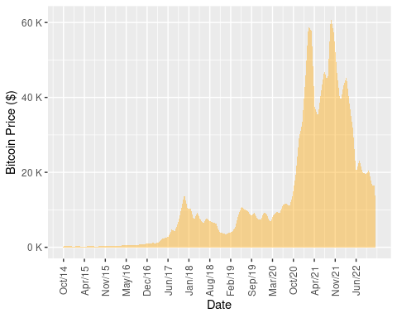
Bitcoin
Market Cap = $325 B
Sept 2014 - Nov 2022
# BTC Max Price Plot ggplot(btc, aes(x=as.Date(Date), y=Close, group=1)) + geom_area(fill="orange", alpha=.4) + scale_x_date(date_labels = "%b/%y", breaks = seq.Date(from = as.Date("2014-10-01"), to = as.Date("2022-11-29"), by = 200)) + scale_y_continuous(labels = label_number(suffix = " K", scale = 1e-3)) + theme(axis.text.x = element_text(angle = 90, vjust = 0.5, hjust = 0.5)) + labs(y= "Bitcoin Price ($)", x = "Date")

Slide 8
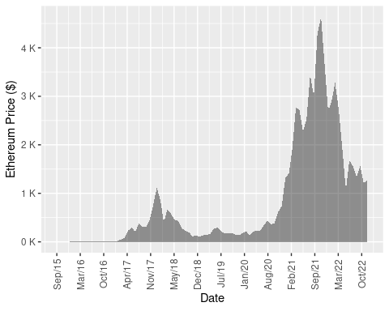
Ethereum
$156 B
Sept 2015 - Nov 2022
# ETH Max Price Plot ggplot(eth, aes(x=as.Date(Date), y=Close, group=1)) + geom_area(fill="black", alpha=.4) + scale_x_date(date_labels = "%b/%y", breaks = seq.Date(from = as.Date("2015-09-01"), to = as.Date("2022-11-30"), by = 200)) + scale_y_continuous(labels = label_number(suffix = " K", scale = 1e-3)) + theme(axis.text.x = element_text(angle = 90, vjust = 0.5, hjust = 0.5)) + labs(y= "Ethereum Price ($)", x = "Date")

Slide 9
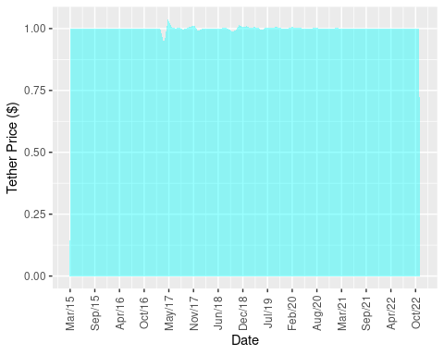
Tether
$65 B
Mar 2015 - Nov 2022
# USDT Max Price Plot ggplot(usdt, aes(x=as.Date(Date), y=Close, group=1)) + geom_area(fill="cyan", alpha=.4) + scale_x_date(date_labels = "%b/%y", breaks = seq.Date(from = as.Date("2015-03-01"), to = as.Date("2022-11-30"), by = 200)) + theme(axis.text.x = element_text(angle = 90, vjust = 0.5, hjust = 0.5)) + labs(y= "Tether Price ($)", x = "Date")

Slide 10
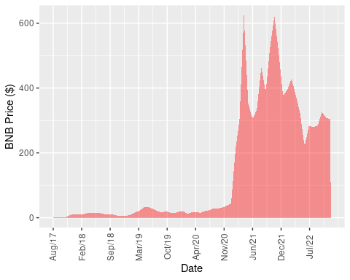
BNB
$47 B
Aug 2017 - Nov 2022
# BNB Max Price Plot ggplot(bnb, aes(x=as.Date(Date), y=Close, group=1)) + geom_area(fill="red", alpha=.4) + scale_x_date(date_labels = "%b/%y", breaks = seq.Date(from = as.Date("2017-08-01"), to = as.Date("2022-11-30"), by = 200)) + theme(axis.text.x = element_text(angle = 90, vjust = 0.5, hjust = 0.5)) + labs(y= "BNB Price ($)", x = "Date")

Slide 11
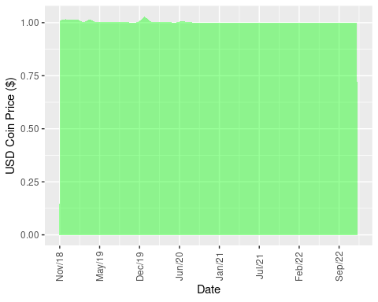
USD Coin
$43 B
Nov 2018 - Nov 2022
# USDC Max Price Plot ggplot(usdc, aes(x=as.Date(Date), y=Close, group=1)) + geom_area(fill="green", alpha=.4) + scale_x_date(date_labels = "%b/%y", breaks = seq.Date(from = as.Date("2018-11-01"), to = as.Date("2022-11-30"), by = 200)) + theme(axis.text.x = element_text(angle = 90, vjust = 0.5, hjust = 0.5)) + labs(y= "USD Coin Price ($)", x = "Date")

Slide 12
What Did I Learn?
How to download raw crypto data from reliable sources and APIs
Visualize data using ggplot2
Create powerpoint presentations using R Markdown
More about cryptocurrencies

Slide 13
Conclusion
Overall, project was a success
Did not fully satisfy initial project vision
However, I still learned a great deal about R and crypto
Future projects, volatility analysis and crypto trading bot

Slide 14
References
Crypto real time prices & latest news Yahoo! Finance. Available at: https://finance.yahoo.com/crypto/ [Accessed December 1, 2022].
Hayes A (2022) Volatility: Meaning in finance and how it works with stocks. Investopedia. Available at: https://www.investopedia.com/terms/v/volatility.asp#:~:text=Volatility%20is%20a%20statistical%20measure%20of%20the%20dispersion%20of%20data,prices%2C%20on%20an%20annualized%20basis. [Accessed December 1, 2022].
Documentation R. Available at: https://www.r-project.org/other-docs.html [Accessed December 1, 2022].

