Slide 1
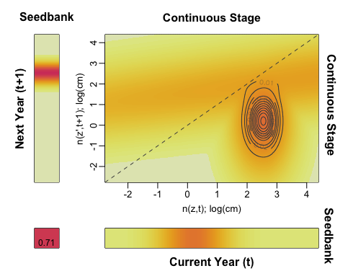
A IPM kernel
B sensitivity kernel
C elasticity kernel

