Slide 1

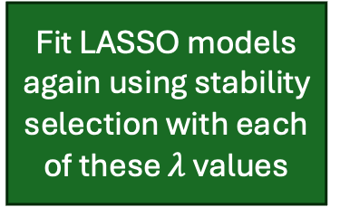
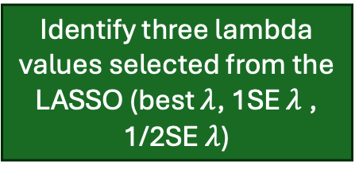
Vegetation response data: functional-group absolute cover
LANDFIRE reference database
USFS Forest Inventory and Analysis (FIA) data
BLM Assessment, Inventory, and Monitoring data (AIM)
Rangeland Analysis Platform (RAP)
“Level 1” cover variables
Meteorological data from dayMet
“Level 2” cover variables
Climate variables (summary values across previous 20 to 30 years)
Weather variables (Anomaly of summary value over previous 3 years relative to climate value)
Then, for each cover response variable…
Spatial averaging of response variable
Soils information modified from SOLUS100
Add climate, weather, and soils predictors to each vegetation response observation
Ecoregion classification
Remove predictors that are correlated (r ≤ 0.7)
Center and scale all potential predictor variables
Add climate and soils predictors to ecoregion classification observations
If applicable, subset the response variable data by ecoregion (forest vs. non-forest)
Assign response variable observations to groups with similar abiotic conditions based on the EPA Level II Ecoregions.
Create the final list of potential predictors which includes interactions, transformations, and main effects. From this final list, only retain those where r ≤0.7.
Remove predictors that are correlated (r ≤ 0.7)
Repeat for each response variable and ecoregion combination
Fit a Gamma LASSO model with internal cross-validation to tune $λ$.
Fit a a series of binomial glms that predict ecoregion classification with different combinations of predictors.
Identify three lambda values selected from the LASSO (best $λ$, 1SE $λ$, 1/2SE $λ$)
Fit LASSO models again using stability selection with each of these $λ$ values
Generate diagnostic information for these models
For each of the three resulting models, remove weather anomaly variables if their corresponding climate variable is not also included
Select a best model to use in subsequent steps
Using each of these predictor sets, fit a regular glm (Gamma with a log link)
Final model formula
P(forest) ~ selected climate and soils predictors
Generate diagnostic figures and tests for each of these models
Select a model to use in subsequent steps
Final model formula
Vegetation response variable ~ selected climate, weather and soils predictors
contemporary climate, weather, and soils data
Use the final model formulas to predict vegetation cover across CONUS for each cover variable
Use the final model formula to predict the probability of forest vs. non forest across CONUS
Modeled future climate and weather data and contemporary soils data
Scale predictions of level 2 cover variables so those that break down the same level 1 cover variable sum to 1.
Warmer and drier model (IPSL-CM5A-MR (France))
Cooler and wetter model (BNU-ESM)
Curtail predictions of level 1 cover variables values so the maximum is 100%
For ecoregion-level models, relativize the cover predictions according to the predicted ecoregion classification probability
Scale all predictions of level 1 cover variables to sum to 100 to acquire final predictions of level 1 cover variables
Create CONUS-wide maps of all predictions
Acquire final predictions of level 2 cover variables by multiplying final predictions of a level 1 cover variable by scaled and relativized predictions of the relevant level 2 cover variables

