Slide 1
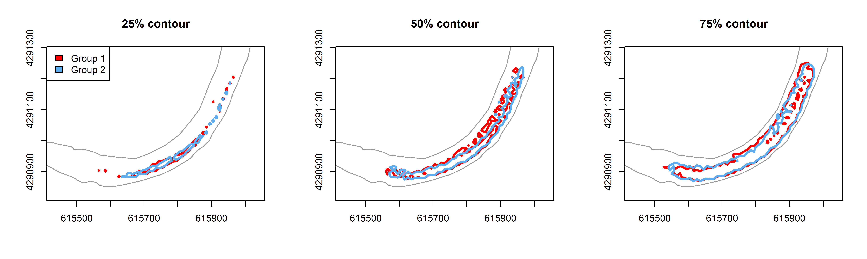
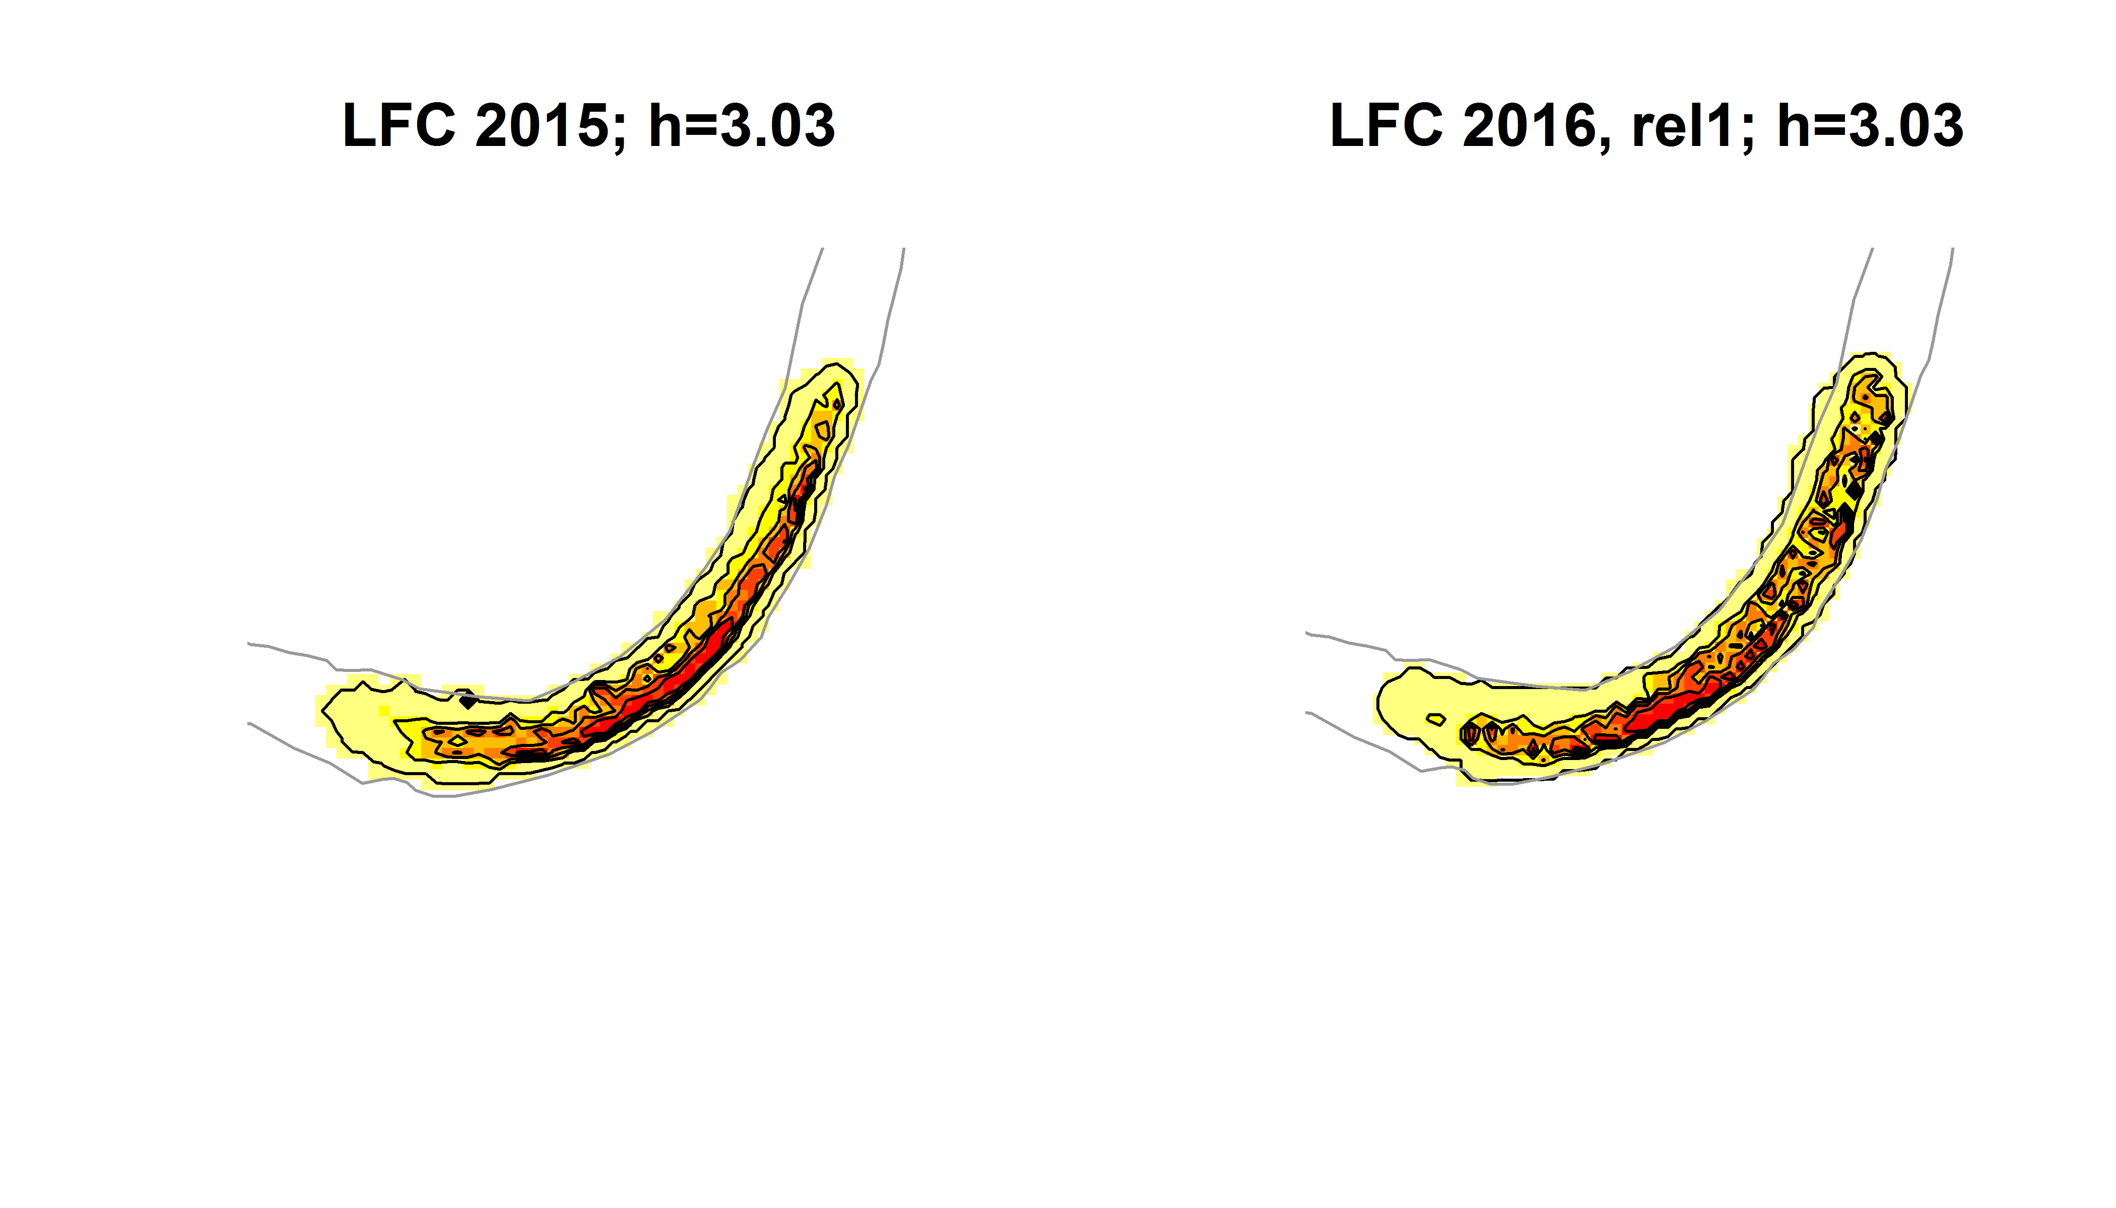
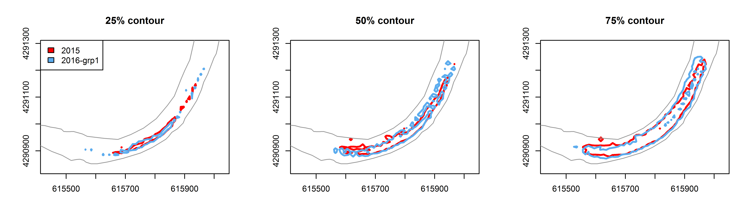
Compare years during most similar flows
A
2015 LFC only
2016
Group 1
B

Slide 2
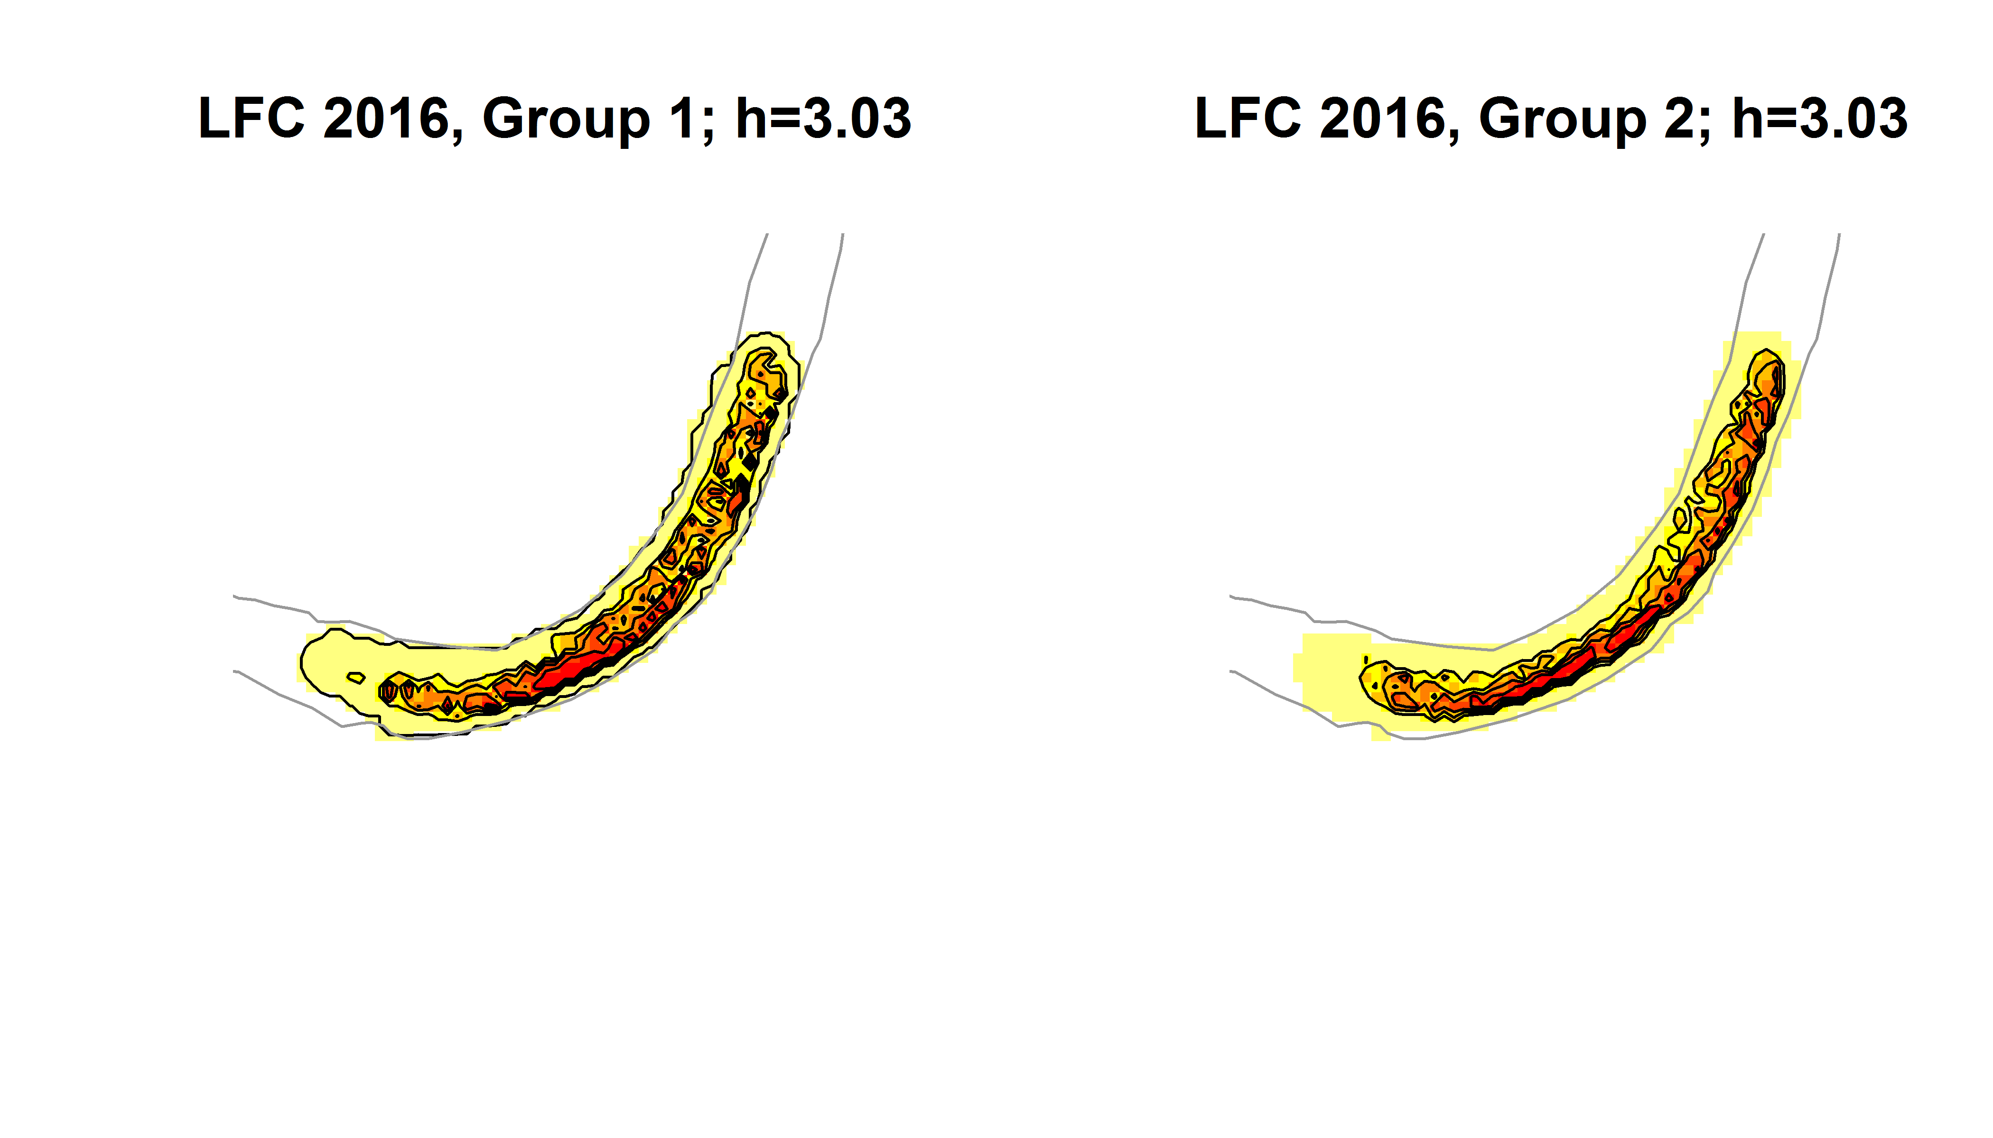
Compare two flows within 2016
A
2016 Group 1
2016 Group 2
B

Slide 3
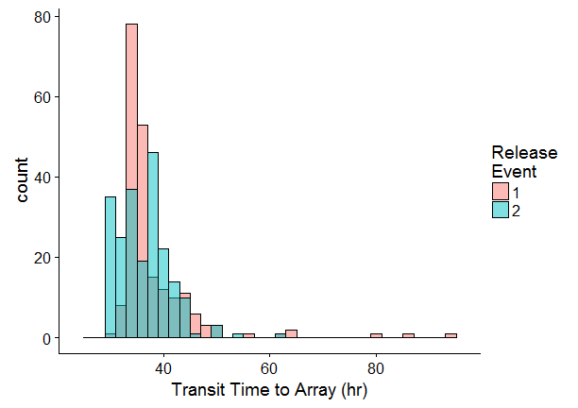
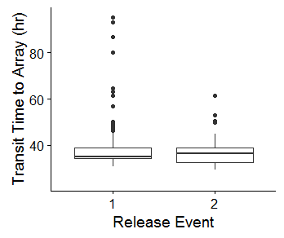

Slide 4
Old Table of Figures
Figure 1. Map of receiver array 3
Figure 2. Photograph of receiver mounts 5
Figure 3. Map of 2D receiver array 5
Figure 4. Bathymetry of study area 6
Figure 5. Map of ADCP survey transects 7
Figure 6. Size of tagged fish 9
Figure 7. River stage during study 11
Figure 8. Number of positions recorded per fish 12
Figure 9. Positional error estimates 13
Figure 10. Dataset filtering 15
Figure 12. Rose diagrams of arrival times to array 19
Figure 13. Boxplots of initial movement time by size?? 22
Figure 14. Boxplots of initial movement time by release hour 22
Figure 15. Boxplots of speed over ground by size?? 2015 v 2016?? 25
Figure 16. Boxplots of speed over ground by river stage 25
Figure 17. Boxplots of turning angles by run and size 28
Figure 18. Boxplots of turning angles by release hour 28
Figure 19. Histograms of cross-channel distribution 30
Figure 20. Longitudinal cross-channel distribution 31
Figure 21. Utilization distributions 2015 v 2016 33
Figure 22. Overlap of utilization distributions 2015 v 2016 34
Tables
Table 1. Release events and river conditions 11
Table 2. Linear model predictions of initial movements 21
Table 3. Linear model predictions of speed over ground 24
Table 4. Linear model predictions of turning angles 27
Table 5. Overlap between spatial distribution of runs 32

