Slide 1
GFP_1 Final Poster
HIV Intervention Receipt and Care Access Among MSM, Female Sex Workers, and Transgender Women in Ecuador, 2020–2022
Group Members: Yuyan Chen, Aidan Estes, Daniel Herrera

Slide 2

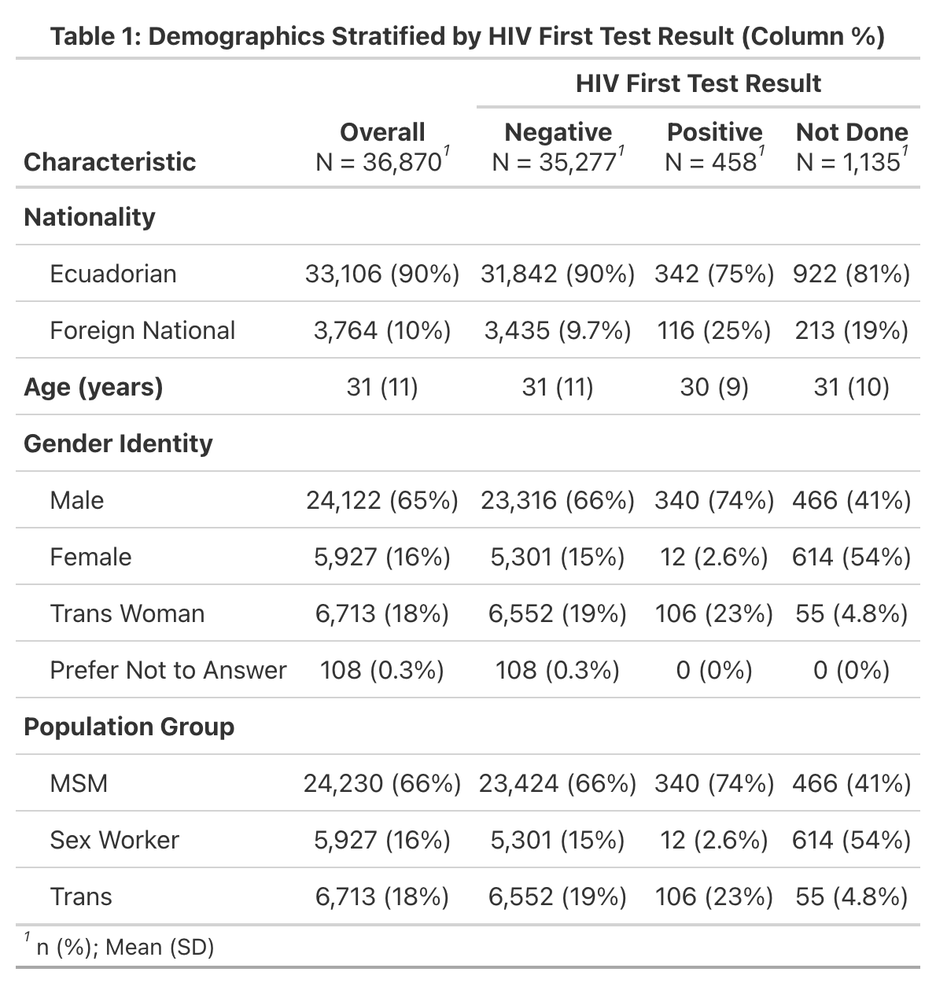
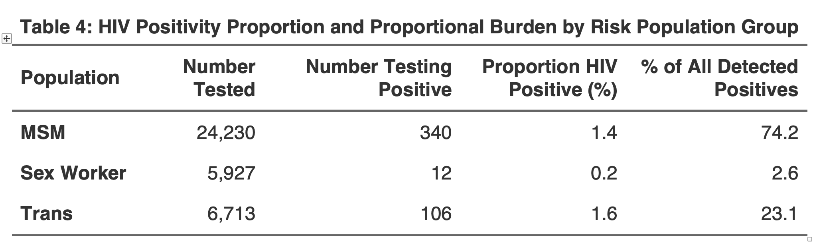
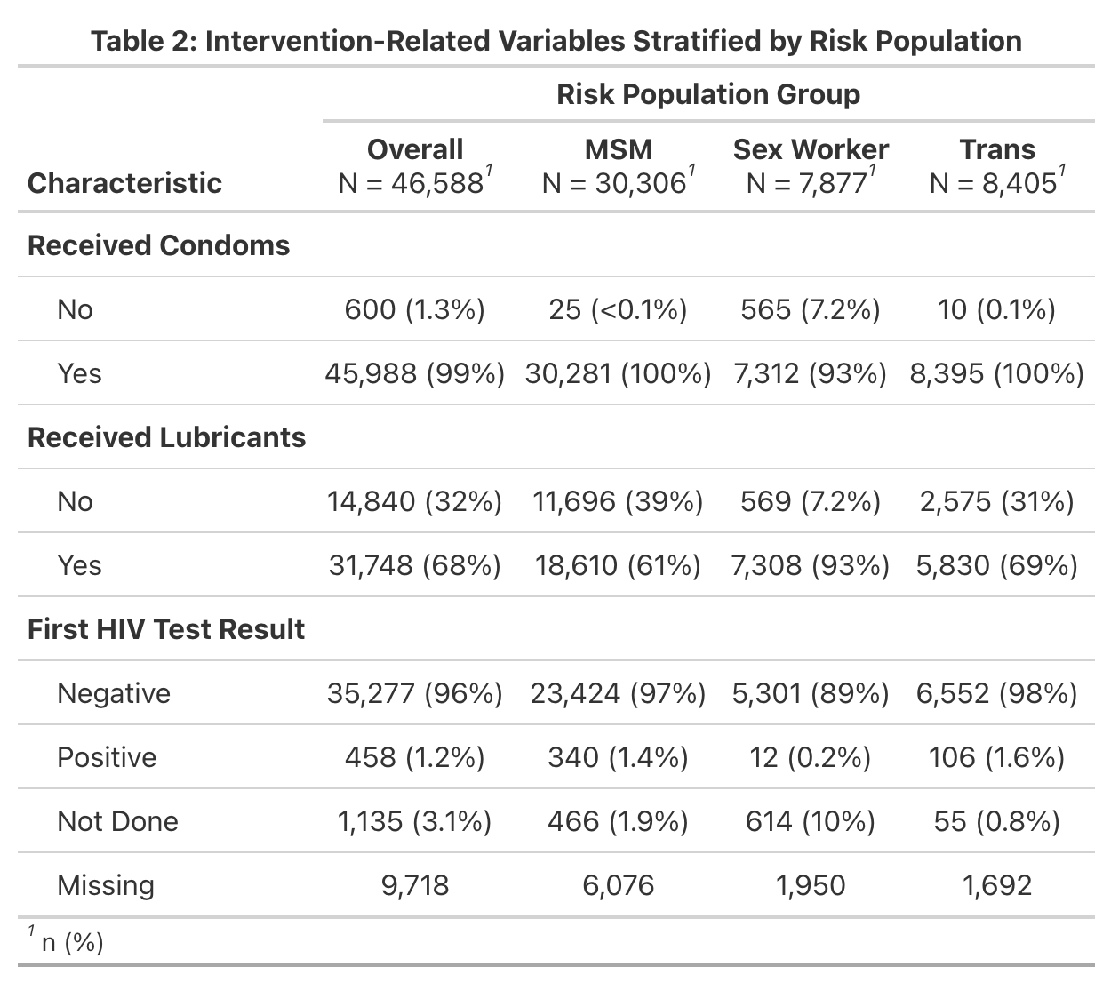
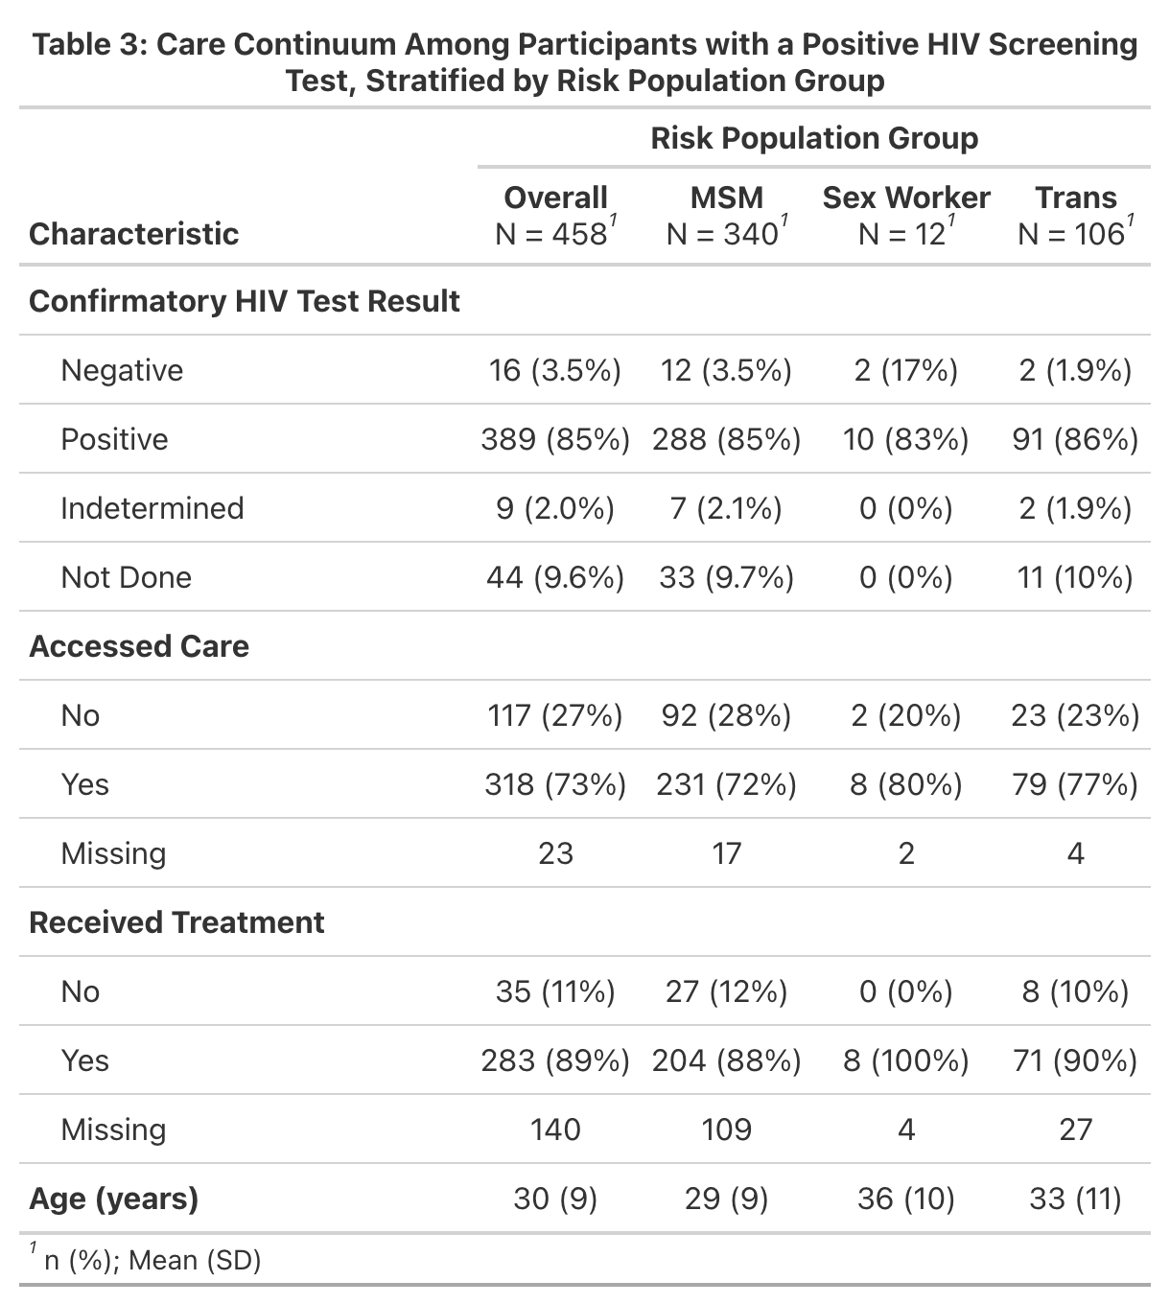

HIV Intervention Receipt and Care Access Among MSM, Female Sex Workers, and Transgender Women in Ecuador, 2020–2022
Yuyan Chen, Aidan Estes, Daniel Herrera
Department of Epidemiology, Emory University, Atlanta, GA
RESEARCH QUESTION
BACKGROUND
RESULTS
RESULTS (CONT’D)
DISCUSSIONS
What is the relationship between demographic factors and the receipt of the HIV intervention – condom and lubricant distribution, and screening – and subsequent access to care among high-risk populations in the 17 Ecuadorian cantons covered between 2020 and 2022?
National HIV prevalence is 0.4%, with MSM (10.2%) and transgender women (18.2%) experiencing the highest burden³.
31% of new diagnoses occur at an advanced stage, delaying treatment and worsening health outcomes².
Stigma, discrimination, and structural challenges prevent key populations from accessing timely testing and treatment, contributing to ongoing transmission^{1,2}.
Addressing healthcare disparities and expanding prevention programs is critical to reducing new infections and improving HIV outcomes in Ecuador.
This analysis assesses the effectiveness of the Global Fund Program at improving intervention kit delivery, screening, and care for HIV.
Age was not significantly associated with receipt of condoms or lubricants (IRR = 1).
Gender identity was associated with differential receipt of intervention kit components.
Females were less likely than males to receive condoms (IRR = 0.93) but more likely to receive lubricants (IRR = 1.81).
Transgender females showed no significant difference in condom receipt (IRR = 1.00) but were more likely to receive lubricants (IRR = 1.14).
Nationality and sexual orientation had little to no impact on condom receipt but were associated with differences in lubricant receipt.
Age and gender identity were not significantly associated with access to HIV care among individuals who screened positive.
Nationality slightly influenced care access, with foreign-born individuals being marginally more likely to access care than Ecuadorians (IRR = 1.07).
Sexual orientation was the strongest risk factor for access to HIV care.
Individuals identifying as straight or "other" were less likely to access care (IRR = 0.89), possibly due to stigma or social barriers.
Low observed prevalence remains unexplained.
High HIV prevalence among foreign nationals suggests added vulnerabilities.
Female sex workers have the lowest screening prevalence but high reported intervention receipt and treatment access.
Targeted interventions may benefit trans women, foreign nationals, and heterosexual-identifying individuals.
Table 5: Regression Indicator Variables for Receiving Intervention (N= 46,588)
 |  | Condoms Received |  |  |  | Lubricant Received
Characteristic |  | IRR |  | 95% CI |  | IRR |  | 95% CI
Age |  | 1 |  | 1.00, 1.00 |  | 1 |  | 1.00, 1.00
Gender Identity
Female (vs. Male) |  | 0.93 |  | 0.89, 0.97 |  | 1.81 |  | 1.71, 1.91
Trans Female (vs. Male) |  | 1 |  | 0.98,1.02 |  | 1.14 |  | 1.11, 1.17
Nationality (Foreign (vs. Ecuadorian) |  | 0.98 |  | 0.95, 1.01 |  | 0.93 |  | 0.89, 0.96
Sexual Orientation (Other (vs. Heterosexual) |  | 1 |  | 0.96, 1.04 |  | 1.21 |  | 1.15, 1.27
PROJECT AIM
This project aims to examine how demographic factors influence the receipt of HIV interventions (condom/lubricant distribution, and HIV screening) and subsequent access to care among high-risk populations across 17 cantons in Ecuador (2020–2022)
LIMITATIONS/
RECOMMENDATIONS
METHODS
LIMITATIONS
Project inactivity for two years limited intervention details.
Poisson regression was used instead of logistic regression; IRRs approximate prevalence ratios, possibly affecting interpretation.
Inconsistent data collection and supply issues affected lubricant data quality.
Some participants not receiving lubricant may have been miscoded as not receiving condoms.
Self-reports may introduce bias.
Small HIV-positive subset sample limits power and generalizability of care access analysis.
RECOMMENDATIONS
Strengthen supply chains to prevent material shortages.
Implement longitudinal follow-up to assess long-term outcomes.
Develop a monitoring and evaluation framework with clear standards and indicators.
CONTRIBUTIONS
We worked together on
Literature Review
Analysis Plan and Data Dictionary
REFERENCES
Balogun K, Slev PR. Clinical Biochemistry.
Luz PM, Veloso VG, Grinsztejn B. Current Opinion in HIV and AIDS.
Ecuador [Internet]. USAIDS.
ACKNOWLEDGEMENTS: CARE (Hannah Anolik, David Sánchez, and Caitlin Shannon) and Emory (Dr. Julie Gazmararian, and Matheus Gyorfy)
Cross-sectional study conducted across 17 Ecuadorian cantons from 2020–2022. Data from CARE Ecuador provided demographic information (date of birth, nationality, sex assigned at birth, gender identity, among others), receipt of HIV intervention kits, HIV screening and confirmatory tests and results, and care access from 2020 to 2022.
STUDY POPULATION
46,593 participants.
Individuals who self-identified as one or more of the following high-risk populations (MSM, transgender females, and female sex workers).
ANALYTICAL APPROACHES
Exposure Variables
Demographic factors included age, gender identity, nationality, and sexual orientation.
Receipt of each HIV intervention component (condom, lubricant, HIV screening)
Outcome Variables
Access to HIV care was coded as a binary variable among individuals with a positive screening result.
Descriptive tables summarized demographic characteristics (Table 1).
Poisson regression models were used to estimate prevalence ratios using the incidence rate ratio (IRR).
Poisson regression models assessed associations between demographic variables and
Receipt of each intervention component
Access to HIV care among individuals who screened positive
Statistical analyses were conducted using R (RStudio), with statistical significance defined as p < 0.05.
Table 6: Care Access among HIV+ only (N = 435)
Characteristic | IRR | 95% CI
Age | 1.00 | 0.99, 1.02
Gender Identity
Female (vs. Males) | 1.00 | 0.41, 2.21
Trans Female (vs. Males) | 1.07 | 0.82, 1.38
Nationality Foreign (vs. Ecuadorian) | 1.07 | 0.83, 1.36
Sexual Orientation Other (vs. Heterosexual) | 0.89 | 0.56, 1.52

