Slide 1
Mortality Rates Across Shelby County 2015-2019
Aidan Estes

Slide 2

Descriptive Statistics

Slide 3
Shelby County Mortality Rates by Year

Slide 4
Tennessee State Mortality Rates by Year

Slide 5
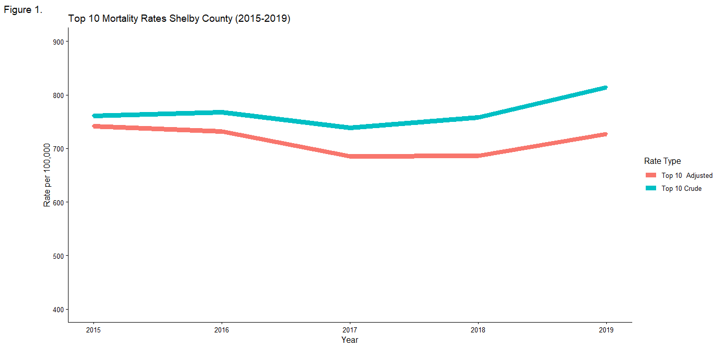
Crude Vs. Age Adjusted Mortality Rates (Shelby County)
Combined mortality rates of top 10 causes of death

Slide 6
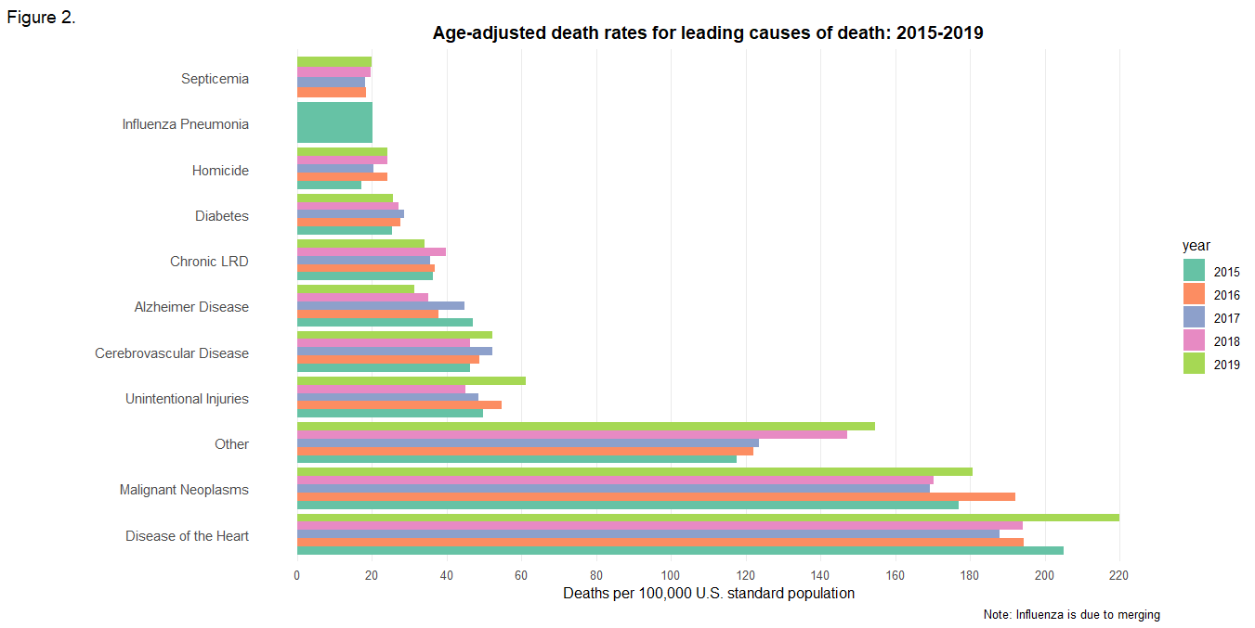
Top 10 Causes of Death in Shelby County 2015-2019
All trends for Shelby county

Slide 7
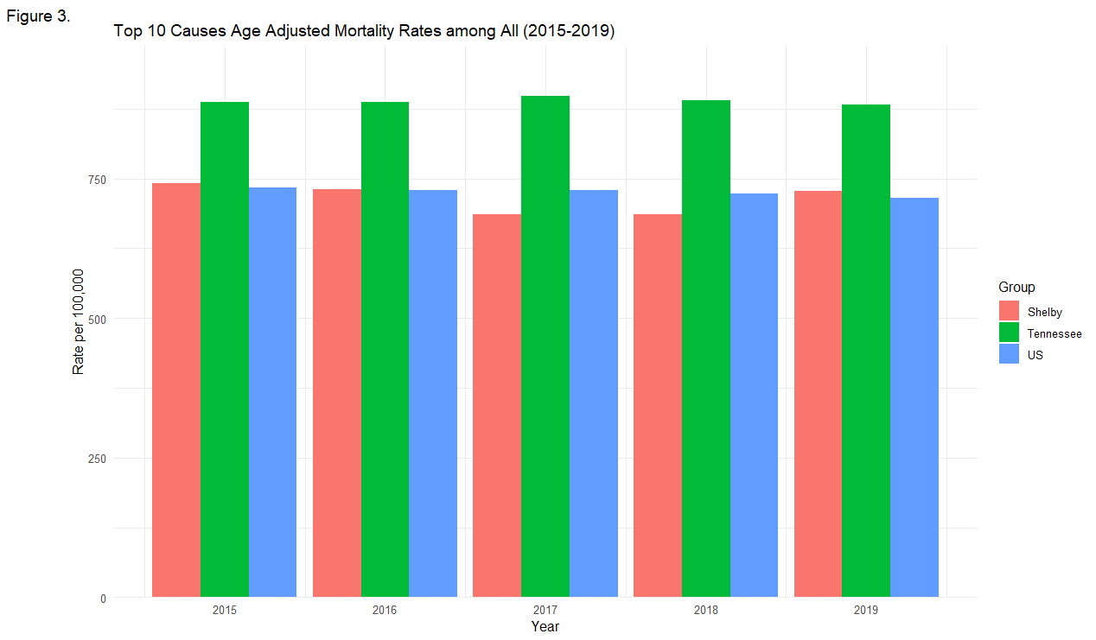
Overall Age-adjusted Mortality Comparison 2015-2019
Shelby is closer to US in overall mortality than Tennessee

Slide 8
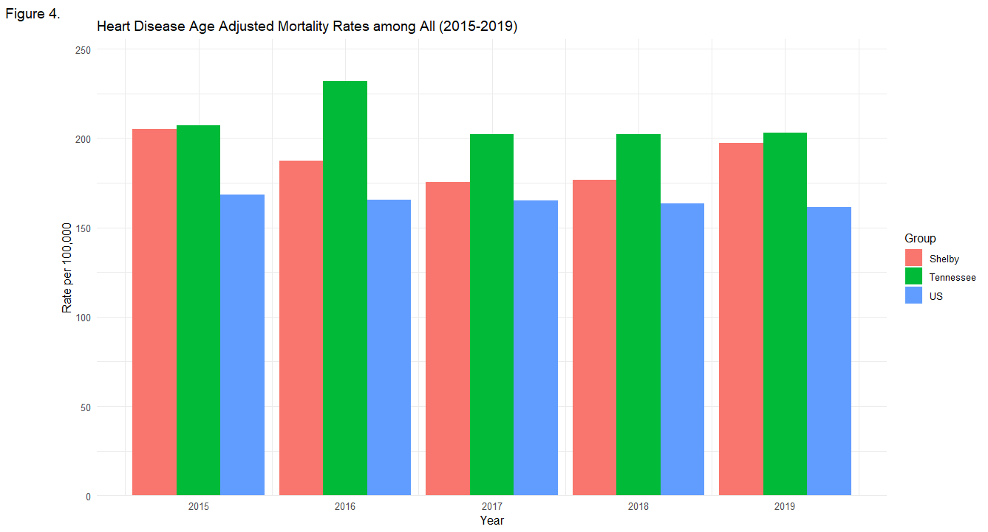
Overall Age-adjusted Comparison of Heart Disease
Shelby County is closer to Tennessee for heart disease

Slide 9
Strengths
Excel format is widely used and able to be adopted in several different software
Can be directly imported into R for coding and direct analysis
Includes relevant variables for mortality analysis and descriptive statistics
Large amount of data to work with; Good for statistical tests and analyses
Data dictionary was helpful and is always important to have for large datasets
Multiple variables with different names can lead to confusion without proper definitions

Slide 10
Shortcomings
Most analyses will require modifying variables into either vectors or other types for more efficient data analysis
Missing/ incomplete data
Lack of income data for demographic information
Income data is often used as a proxy for other variables like insurance status
Incomplete definition of “Other” in cause of death
Data dictionary does not give enough detail and leaves a leading cause of death vague
Age is not categorical, allows for typos and other errors to go unnoticed
Ex: Max age of death is 200 years old

Slide 11
Supportive Data Requests
More detail in Data Dictionary for DRace_Ethnicity valid values and how it was categorized
Datasets for Mortality for Tennessee 2015-2019 and US
Total Shelby county population for each year
Total US population demographic information

Slide 12
Additional Sources Used
1. Dunn J. Death statistics. Death Statistics. 2019. Accessed September 22, 2025. https://www.tn.gov/health/health-program-areas/statistics/health-data/death-statistics.html.
2. Dunn J. Population Statistics. tn.gov. 2019. Accessed September 22, 2025. https://www.tn.gov/health/health-program-areas/statistics/health-data/population.html.
3. CDC. Multiple cause of death 1999-2020. Centers for Disease Control and Prevention. September 17, 2025. Accessed September 22, 2025. https://wonder.cdc.gov/wonder/help/mcd.html.
4. CDC. Products - National Vital Statistics Reports - Homepage. Centers for Disease Control and Prevention. April 8, 2025. Accessed September 22, 2025. https://www.cdc.gov/nchs/products/nvsr.htm.
5. CDC. National Center for Health Statistics. Centers for Disease Control and Prevention. September 8, 2025. Accessed September 22, 2025. https://www.cdc.gov/nchs/index.html?CDC_AA_refVal=https%3A%2F%2Fwww.cdc.gov%2Fnchs%2Findex.htm.

Slide 13

Questions?
Want further details? Check out my GitHub

