Slide 1
Chapter 5, Analysis:
Dynamic Modeling

Slide 2
An overview of OOSE development activities and their products
Problem Statement
Requirements Elicitation
Use Case Diagrams
Non-functional Req.
Functional Model
Sequence Diagrams
Analysis
Class Diagrams
State Diagrams
Analysis Object Model
Dynamic Model
System Design
Activity Diagrams

Slide 3
Outline of the Lecture
Dynamic modeling
  Interaction Diagrams
    Sequence diagrams
    Collaboration diagrams
  State diagrams
  Activity diagrams (UD: interestingly, our book continues to ignore their significance; considers as a special case of State diagrams!)
Requirements analysis model validation

Slide 4
How do you find classes?
We have already established several sources for class identification:
  Application domain analysis: We find classes by talking to the client and identify abstractions by observing the end user
  General world knowledge and intuition
  Textual analysis of event flow in use cases (Abbot)
Today we identify classes from dynamic models
Two good heuristics:
  Life lines and messages in sequence diagrams are candidates for objects and operations, resp.
  Actions and activities in state and activity diagrams are candidates for public operations in classes

Slide 5
Dynamic Modeling
Describe components of the system that have interesting dynamic behavior, using
  State diagrams: One state diagram per class with interesting dynamic behavior
  Sequence diagrams: For interaction between classes
  Activity diagrams: Model (complex) logic (business rules) captured by a use case
Purpose:
  Detect and supply operations for the object model.

Slide 6
How do we detect Operations?
Look for interacting objects and extract their “protocol”
Look for objects with interesting behavior on their own
Good starting point: Flow of events in a use case description
From flow of events, proceed to the sequence diagram to find participating objects.

Slide 7
What is an Event?
Something that happens at a point in time
An event sends information from one object to another
Events can have associations with each other:
  Causally related:
    An event happens always before another event
    An event happens always after another event
  Causally unrelated:
    Events that happen concurrently
Events can also be grouped in event classes with a hierarchical structure => Event taxonomy

Slide 8
Sequence Diagram
A graphical description of objects participating in a use case using a DAG notation
Heuristic for finding participating objects:
  An event always has a sender and a receiver
  Find them for each event => These are the objects participating in the use case.

Slide 9
An Example
Flow of events in “Get SeatPosition” use case :
  1. Establish connection between smart card and onboard computer
  2. Establish connection between onboard computer and sensor for seat
  3. Get current seat position and store on smart card
Where are the objects?

Slide 10

Sequence Diagram for “Get SeatPosition”
:Smart Card
:Onboard Computer
:Seat
  1. Establish connection between smart card and onboard computer
  2. Establish connection between onboard computer and seat (actually seat sensor)
  3. Get current seat position and store on smart card.
Establish connection
Establish connection
Accept connection
Accept connection
Get SeatPosition
time

Slide 11
Heuristics for Sequence Diagrams
Layout:
  1st column: actor of use case
  2nd column: a boundary object
  3rd column: control object managing rest of use case
Creation of objects:
  Create control objects at beginning of event flow
  Control objects create boundary and entity objects
Access of objects:
  Entity objects can be accessed by control (and boundary?) objects
  Entity objects should not access boundary or control objects.
Notes:
Access of objects
Entity objects are accessed by control and boundary (UD: not ideal!) objects
Entity objects should never access boundary or control objects:
This makes it easier to share entity objects across use cases and makes entity objects resilient against technology-induced changes in boundary objects.

Slide 12
ARENA Sequence Diagram: Create Tournament
:Tournament
Boundary
:Arena
:League
League
Owner
newTournament
(league)
:Announce
«new»
Tournament
Control
checkMax
Tournament()
setName(name)
setMaxPlayers
(maxp)
commit()
createTournament
(name, maxp)
create
Tournament
(name, maxp)
«new»
:Tournament

Slide 13
Impact on ARENA’s Object Model
Let’s assume ARENA’s object model contains - at this modeling stage - the objects
  League Owner, Arena, League, Tournament, Match and Player
The Sequence Diagram identifies 2 new Classes
  Tournament Boundary, Announce_Tournament_Control

Slide 14
League
Owner
1
*
League
Attributes
Attributes
Operations
Operations
Tournament
Attributes
Operations
Player
*
*
Match
Attributes
Attributes
Operations
Operations

Slide 15
League
Owner
1
*
League
Attributes
Attributes
Operations
Operations
Tournament_
Boundary
Attributes
Operations
Tournament
Announce_
Tournament_
Control
Attributes
Operations
Attributes
Operations
Player
*
*
Match
Attributes
Attributes
Operations
Operations

Slide 16
Impact on ARENA’s Object Model (2)
The sequence diagram also supplies us with many new events
  newTournament(league)
  setName(name)
  setMaxPlayers(max)
  commit
  checkMaxTournament()
  createTournament
Question:
  Who owns these events?
Answer:
  For each object that receives an event there is a public operation in its associated class
  Name of operation is usually the name of event

Slide 17
Example from Sequence Diagram
:Tournament
Boundary
:Arena
:League
League
Owner
newTournament
(league)
:Announce
«new»
Tournament
Control
checkMax
Tournament()
setName(name)
setMaxPlayers
(maxp)
commit()
createTournament
(name, maxp)
create
Tournament
(name, maxp)
«new»
:Tournament
Notes:
createTournament is a public operation offered by Announce_Tournament_Control

Slide 18
League
Owner
1
*
League
Attributes
Attributes
Operations
Operations
Tournament_
Boundary
Attributes
Operations
Tournament
Announce_
Tournament_
Control
Attributes
Operations
Attributes
createTournament
(name, maxp)
Player
*
*
Match
Attributes
Attributes
Operations
Operations
Notes:
This is the corresponding view in the UML class diagram:
createTournament is a public operation offered by Announce_Tournament_Control

Slide 19
Dynamic Modeling
We distinguish between two types of operations:
  Activity: Operation that takes time to complete
    associated with states
  Action: Instantaneous operation
    associated with events
A state diagram relates events and states for one class

Slide 20
UML Statechart Diagram Notation
Action
Name of
State
Event with parameters attr
State1
Event
Event(attr) [condition]/action
State2
do/Activity
entry /action
Guard
condition
exit/action
Actions and Activities in State
Note:
  Events are italics
  Conditions are enclosed with brackets: []
  Actions and activities are prefixed with a slash /
Notation is based on work by Harel; added are a few object-oriented modifications.

Slide 21
Example of a StateChart Diagram
coins_in(amount) / set balance
Collect Money
Idle
coins_in(amount) / add to balance
cancel / refund coins
[item empty]
[select(item)]
[change<0]
do/Test item and compute change
[change=0]
[change>0]
do/Dispense item
do/Make change

Slide 22
State
An abstraction of attributes of a class
  State is aggregation of several attributes a class has
A state is an equivalence class of all those attribute values and links that do no need to be distinguished
  Example: State of a course section
State has duration
States should not overlap; an object should be in exactly one state from its creation until its destruction

Slide 23

Activity Diagrams
An activity diagram is useful to depict the workflow in a system

Slide 24
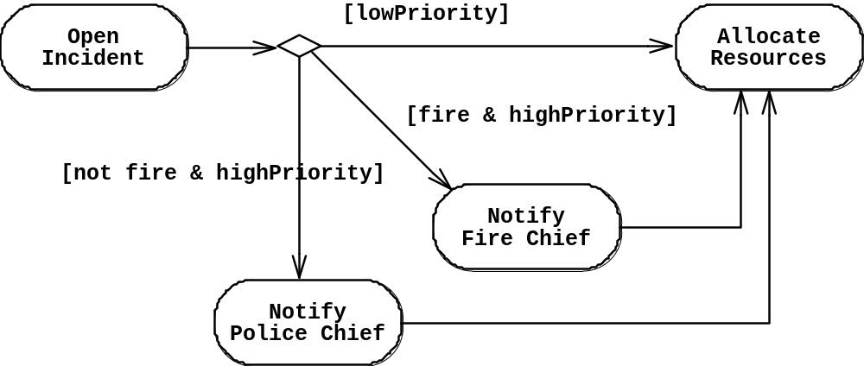
Activity Diagrams allow to model Decisions
Decision

Slide 25
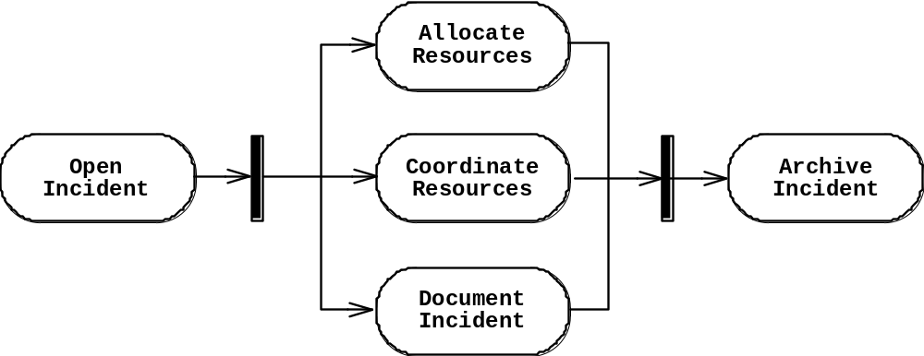
Activity Diagrams can model Concurrency
Synchronization of multiple activities
Splitting flow of control into multiple threads
Splitting
Synchronization

Slide 26
Activity Diagrams: Grouping of Activities
Activities may be grouped into swimlanes to denote the object or subsystem that implements the activities.
Allocate
Dispatcher
Resources
Open
Coordinate
Archive
Incident
Resources
Incident
FieldOfficer
Document
Incident

Slide 27
Practical Tips for Dynamic Modeling
  Construct dynamic models only for (avoid “analysis paralysis”):
  Classes with significant dynamic behavior and
  Use cases that are non-trivial
Consider only relevant attributes
  Use abstraction if necessary
Look at granularity of application when deciding on actions and activities
Reduce notational clutter
  Try to put actions into super-state boxes (look for identical actions on events leading to the same state).

Slide 28
Model Validation and Verification
Verification: an equivalence check between transformation of two models
  Objects in sequence diagrams vs classes in class diagrams
Validation: comparison of model with reality
  A critical step in development process
  Requirements should be validated with client & user
  Techniques: Formal and informal reviews (meetings, requirements review)
Involves several types of checks
  Correctness, Completeness, Ambiguity, Realistic

Slide 29
Checklist for a Requirements Review
Is the model correct?
  Represents client’s view of the system?
Is the model complete?
  Every scenario described?
Is the model consistent?
  Has components that contradict?
Is the model unambiguous?
  Describes one system, not many?
Is the model realistic?
  Can be implemented?

Slide 30
Examples for syntactical Problems
Different spellings in different UML diagrams
Omissions in diagrams

Slide 31
Different spellings in different UML diagrams
UML Sequence Diagram
UML Class Diagram
League
Owner
1
*
League
createTournament
(name, maxp)
Attributes
Attributes
Operations
Operations
Tournament_
Boundary
Attributes
Operations
Announce_
Tournament_
Control
Tournament
Attributes
Operations
Attributes
Different spellings
in different models
for the same operation
makeTournament
(name, maxp)
Player
*
*
Match
Attributes
Attributes
Operations
Operations

Slide 32
Checklist for a Requirements Review (2)
Syntactical check of models
  Consistent naming of classes, attributes, methods in different subsystems
  Dangling associations (“pointing to nowhere”)
  Doubly-defined classes
  Missing classes (mentioned in one model but not defined anywhere)
  Classes with same name but different meanings

Slide 33
When is a Model Dominant?
Object model:
  Contains classes with nontrivial states and many relationships between classes
Dynamic model:
  Has many different types of events: input, output, exceptions, errors, etc.
Functional model:
  Performs complicated transformations (e.g. computations consisting of many steps)

Slide 34
Examples of Dominant Models
Compiler:
  Functional model is most important
  Dynamic model is trivial since there is only one type of input and only a few outputs
    Is that true for IDEs?
Database systems:
  Object model is most important
  Functional model is trivial, because purpose of functions is to store, organize and retrieve data
Spreadsheet program:
  Functional model is most important
  Dynamic model is interesting if program allows computations on a cell
  Object model is trivial

Slide 35
Requirements Analysis Document Template
1. Introduction
2. Current system
3. Proposed system
3.1 Overview
3.2 Functional requirements
3.3 Nonfunctional requirements
3.4 Constraints (“Pseudo requirements”)
3.5 System models
3.5.1 Scenarios
3.5.2 Use case model
3.5.3 Object model
3.5.3.1 Data dictionary
3.5.3.2 Class diagrams
3.5.4 Dynamic models
3.5.5 User interfae
4. Glossary

Slide 36
Section 3.5 System Model
3.5.1 Scenarios
- As-is scenarios, visionary scenarios
3.5.2 Use case model
  - Actors and use cases
3.5.3 Object model
  - Data dictionary
  - Class diagrams (classes, associations, attributes and operations)
3.5.4 Dynamic model
  - State diagrams for classes with significant dynamic behavior
  Sequence diagrams for collaborating objects (protocol)
  Activity diagrams for complex business rules/logic
3.5.5 User Interface
  - Navigational Paths, Screen mockups

Slide 37
Requirements Analysis Questions
1. What are the transformations?
  Create scenarios and use case diagrams
    Talk to client, observe, get historical records
2. What is the structure of the system?
  Create class diagrams
    Identify objects. Associations between them? Their multiplicity?
    What are the attributes of objects? Operations on objects?
3. What is its behavior?
  Create sequence diagrams
    Identify senders and receivers
    Show sequence of events exchanged between objects
    Identify event dependencies and event concurrency
  Create state diagrams
    Only for the dynamically interesting objects
  Create activity diagrams
Functional Modeling
Object Modeling
Dynamic Modeling

Slide 38
Summary
In this lecture, we reviewed construction of the dynamic model from use case and object models. In particular, we described:
  Sequence and state diagrams for identifying new classes and operations
  Activity diagrams for describing complex business rules/logic inside operations
In addition, we described requirements analysis document and its components.

